Slide 1
What I heard from you
✓
Right now everything runs through your phone and a Google Sheet
✓
You want a simple site: a home page, a page to meet the tutors, and a way to book
✓
Each tutor should show their photo, subjects, grade levels, rate, and real availability
✓
Booking should just ask for the parent's name and email, and the student's name, grade, and subject
✓
The calendar has to show each tutor's actual free times — not a generic 9-to-5
✓
It needs to feel clean and friendly on a phone — not dark, not corporate, not a big test-prep chain
Notes:
A listening check, not a status report — pause here and let Dana confirm each line matches what she asked for before moving on.

Slide 2
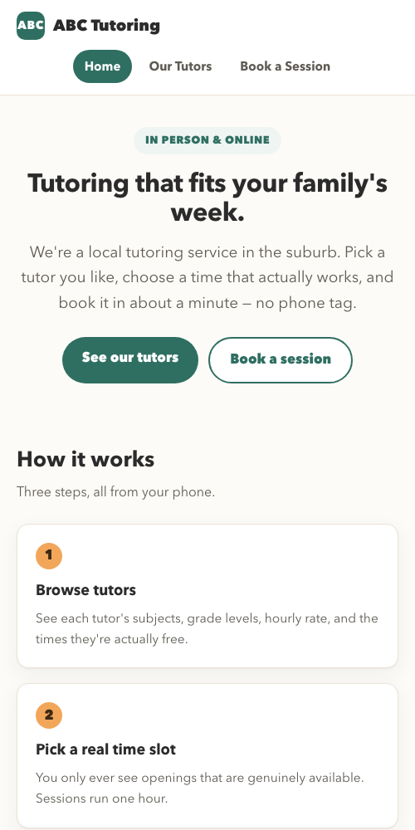
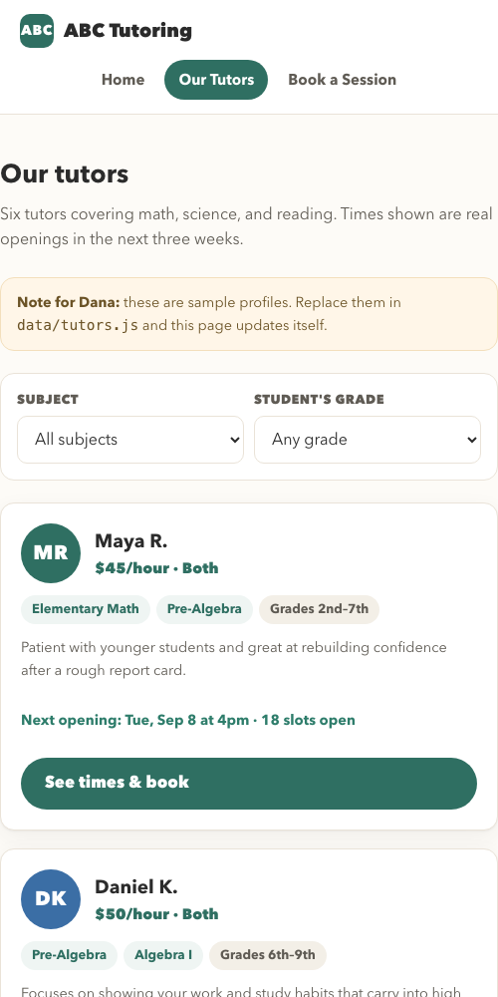
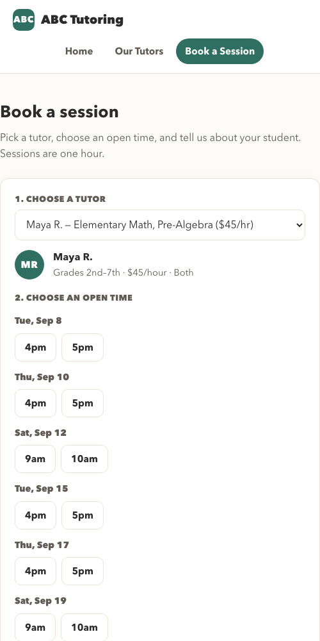
Your website
Home — a warm welcome and a clear next step
Meet the tutors — photo, subjects, rate, and open times
Book a session — one short form, done in about a minute
Notes:
Live screenshots from the real site at https://ct-upskilling-2026.github.io, shown at phone width because that is how most parents will actually see it.

Slide 3
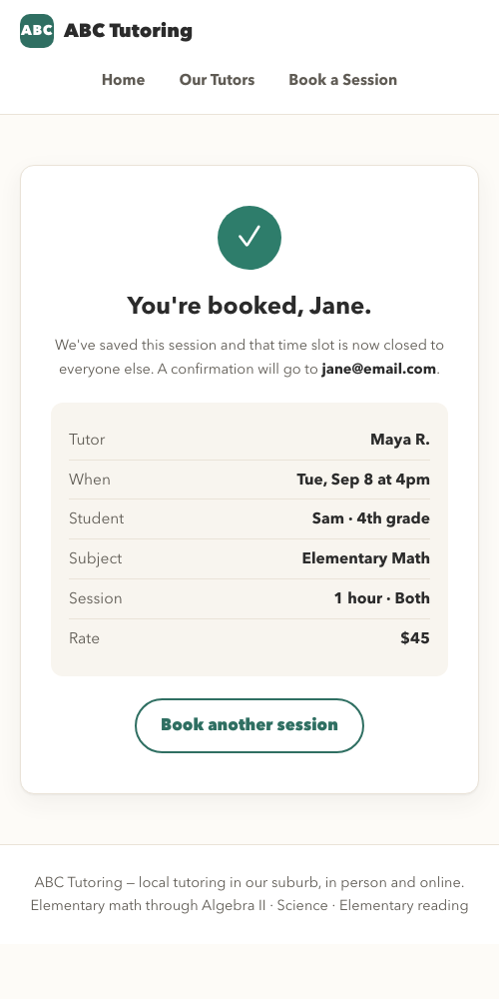
How a parent books
1
Pick a tutor
See their subjects, rate, and photo
2
Pick an open time slot
Only real, available times are ever shown
3
Fill in one short form
Parent and student details — nothing more
4
Get an instant confirmation
That slot closes automatically, so nobody double-books it
Start to finish: about a minute. No phone tag.
Notes:
Emphasize 'the slot closes automatically' — that single behavior is what eliminates the double-booking risk she has today with the Google Sheet and her phone.

Slide 4
What you can now see about your visitors
A suggestion from me: here are the four things I'd watch, and what each one is worth to you.
44 parents came looking for Algebra II help. Only 4 could book. 10 found no open times.
One tutor covers Algebra II with 2 hours a week. Compare Elementary Reading, which books at 41% because that tutor has hours to spare.
Looked vs. booked, by subject
From visit to booking
How parents found you
69% of parents visited on a phone (233 of 340)
Notes:
These are simulated demo numbers from two weeks of test traffic (340 visitors), not real customers — the measurement is proven and ready to read real traffic once the site is promoted. Reiterate verbally that this is a recommendation: Dana was asked twice what she wanted to know about visitors and both times described booking-form fields instead, which is exactly why this slide is framed as 'here is what I'd suggest'.

Slide 5
What I need from you
To replace the sample tutors
Coming next (not built yet)
Real names, photos, subjects, and grade levels for your 6 tutors
A simple screen where you can add or remove tutors yourself
Each tutor's hourly rate
A shared calendar so bookings stay in sync across every device
Automatic email confirmations to parents
Each tutor's real weekly availability (the times shown now are placeholders)
Invoicing
All of this lives in a single file — once you send it over, it's a quick swap. No rebuilding the site.
Notes:
Be explicit and warm that sample tutors were used because real tutor details were never provided — this is not a gap in the work, it is the one open input still needed. Frame phase 2 as sequenced, not forgotten.

