Slide 1



Instructional Design + Knowledge Components: A Systematic Method for Refining Instruction
Computer Science: Luke Gusukuma, Austin Cory Bart, Dennis Kafura
Education: Jeremy Ernst, Katherine Cennamo
Notes:
As you can guess from the title, I’m going to be talking about how to combine Instructional Design and Knowledge Components together, which I call ID + KC for short

Slide 2


Cliff Notes
Concrete
Theoretical
Knowledge
Component
Instructional Design
Notes:
So, the cliff notes of the ID + KC process is that it combines various instructional design methodologies, concrete processes, driven by a cognitivist theory model of Knowledge Components.
Additionally, it’s an effort conscious and approachable methodology to improve targeted units of instruction in a systematic, quantitative way.
So if you’re interested in a systematic way of improving your instruction, stick around

Slide 3
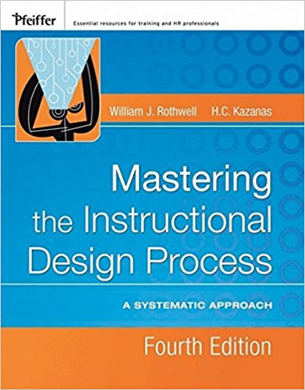

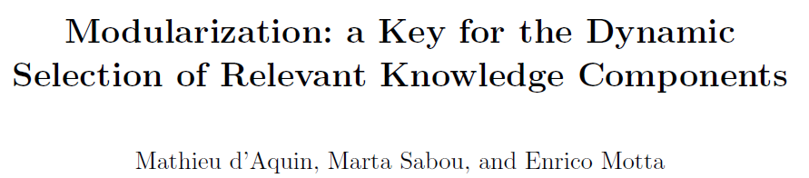





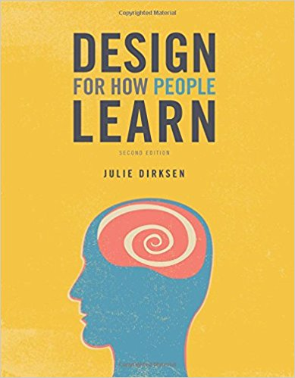
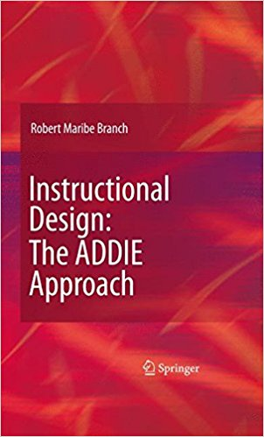

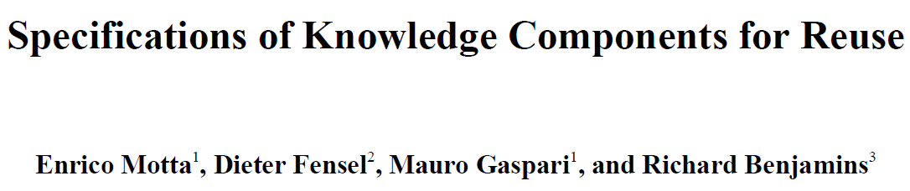

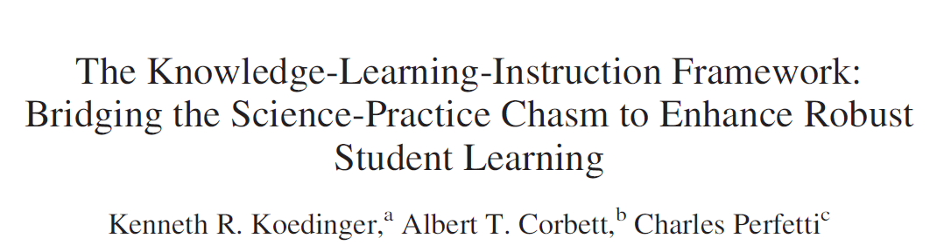
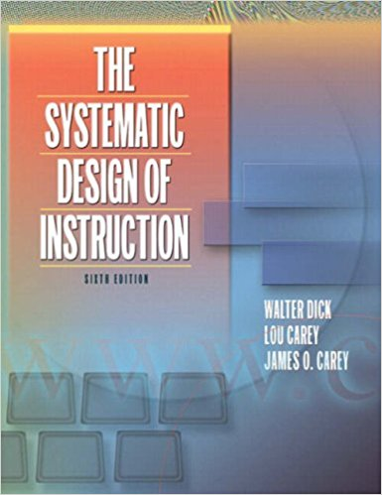
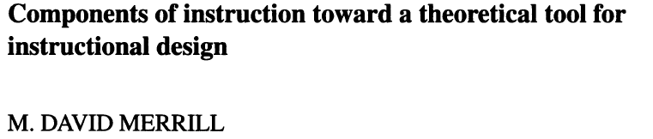
Prior Work
Notes:
For prior work, read the paper and/or look up instructional design and knowledge components. I’m not going to dwell on that because

Slide 4
Systematically Improving Instruction
Instruction revision is crucial to course design
Instruction needs to evolve with time
Don’t typically need to revise an entire course
Don’t have a formalized process
Notes:
…what we’re really here for is to find a way to systematically improve our instruction because we realize that revising a course is crucial to course design.
After all, we find/learn new things, information changes, we want to have our course evolve with time.
And while we want to revise, we also realize that we don’t need to revise an entire course and/or don’t have a formalized process with which to do it.
So we’ve read up on some education literature and worked with an Instructional Design Researcher and developed a formalized, systematic methodology for improving targeted units of instruction. The…

Slide 5
What is ID + KC
Teacher's Process
Instructional Design
Analyze Student Learning
Instructional Analyses
Create Assessments
Evaluate Assessment Instruments
Knowledge Components
misconceptions
Student's Knowledge
Notes:
…ID + KC process, a relatively simple process to get the most bang for your buck in course revision in a targeted way.
ID + KC uses Instructional Design, education’s equivalent to the software engineering process, much akin to software engineering models like Waterfall and Agile, except with instruction….
And augments it with the cognitivist theory construct called Knowledge Components.
While Instructional Design itself is a concrete mechanical process, the theoretical model that you use throughout changes. You can imagine Instructional Design being a car that can be switched out with different engines, in our case, Knowledge Components.
The rest of this talk is about presenting the ID + KC process, how it works, how to use it, as well as our experience with it in our redesign of our Computational Thinking class for non-majors.

Slide 6
Knowledge Component
“…an acquired unit of cognitive function or structure that can be inferred [observed] from performance…”
Notes:
So before going on, one term I want to define, that we’ll use a lot, knowledge components.
In our process we use Kenneth Koedinger definition of a knowledge component: an acquired unit of cognitive function or structure that can be inferred from performance.
The important parts of this definition are that they are =cognitive functions=, and that they are =inferred=.
They can be correct, or incorrect, but they are a function, that gives an output, e.g. a mistake or a correct answer, and are thus, debuggable. That being said, more often than not, we’ll encounter Knowledge Components as misconceptions. One such example might be….

Slide 7
Knowledge Component - Example
You can add together a number and a list
You can’t add together a number and a list
Notes:
“you can add together a number and a list”, a misconception, or an incorrect knowledge component. Likewise, you can have knowledge components that are desirable, such =as= “you can’t add together a number and a list”, a desirable knowledge component rather than an undesirable knowledge component

Slide 8
ID + KC: The steps
Teacher's Process
Instructional Design
Analyze Student Learning
Instructional Analyses
Create Assessments
Evaluate Assessment Instruments
Knowledge Components
misconceptions
Student's Knowledge
Notes:
Alright, so with the technical educational jargon out of the way, let’s dig into the guts of the ID + KC process.

Slide 9
ID + KC: The steps
Teacher's Process
Instructional Design
Analyze Student Learning
Instructional Analyses
Create Assessments
Evaluate Assessment Instruments
Identify Instructional Goals
Identify Performance Tasks
Knowledge Components
misconceptions
Student's Knowledge
Notes:
The first part of the ID + KC Process is the Instructional Analyses, which has two major =parts=
Identifying instructional goals, and Identifying performance tasks

Slide 10

Identify Instructional Goals
Instructional Design
Analyze Student Learning
Instructional Analyses
Create Assessments
Evaluate Assessment Instruments
Knowledge Components
misconceptions
Construct an algorithm that outputs a quantitative measure of the values in a given list
Instructional Goal
Observable
Notes:
Identifying your instructional goals is about finding a =target= to aim for, to keep you focused
you want them to be =observable= and you want them to be defined enough such that you can always go back and ask, “does this further my instruction goal?”
An example of an instructional goal for our non-computing major students =is= Construct an algorithm that outputs a quantitative measure of the values in given list. In our case, we’re talking about sums, counts, and averages.

Slide 11






Identify Performance Tasks
Instructional Design
Analyze Student Learning
Instructional Analyses
Create Assessments
Evaluate Assessment Instruments
Knowledge Components
misconceptions
Instructional Goal
Why?
Helps create assessments
Groups misconceptions together
Performance
Task
Performance
Task
Notes:
Identifying performance tasks, the second major part of the instructional analysis…
Is about breaking down your instructional goal into bite size chunks. What tasks do students need to be able to perform to fulfil your instructional goal.
These performance tasks of course will be composed of smaller performance tasks. Many of these performance tasks will also end up becoming assessment questions.
Additionally, this step ties KCs to ID because misconceptions, your incorrect knowledge components, will become distractors, your multiple choice options.
This allows us to concretely relate inferred student knowledge, knowledge components, to one or more performance tasks.
And just as a sample, breaking down your instructional goal into performance tasks might look like….

Slide 12
Identify Performance Tasks
Instructional Design
Analyze Student Learning
Instructional Analyses
Create Assessments
Evaluate Assessment Instruments
Knowledge Components
misconceptions
Construct an algorithm that outputs a quantitative measure of the values in a given list
1.0 Construct an iteration that computes the accumulated properties from the list
2.0 Compute the quantitative measure using the accumulated properties
3.0 Output the quantitative measure
1.1 Construct an iteration using an iteration property and the given list
1.2 Initialize the new properties to accumulate the value(s)
1.3 Construct the body of the iteration using the iteration property and the properties accumulating values
1.1.1 Identify the type of the iteration property
1.1.2 Select a syntactically correct iteration
Are all list elements included?
1.2.1 Choose appropriate initial value(s)
yes
1.3.3 Select appropriate operations to update the accumulation properties using the iteration property
Identify the components of iteration
no
Identify the type of a list
Define iteration
1.2.2 Place initialization(s) correctly
1.3.2 Choose a decision to select included values
Define a list
1.3.1 Explain that the iteration property takes on every value of the list
Notes:
…this. The text on this diagram is specific to our case, no need to read it, but this diagram maps out the prerequisite tasks to accomplish our instructional goal. In our case, one of our performance tasks =was= “Construct the body of the iteration using the iteration property and the properties accumulating values”.
While our diagram might look a little complex, the complexity of your performance task diagram will largely depend on how fine-grained you want to trace your instruction. In our case, this diagram represents about 2.5 days of instruction on for-loops. We made it this complex in part because it was worth the effort as iteration was one of our students’ trouble areas, but also because iteration is difficult for non-computing, liberal arts majors.

Slide 13
ID + KC: The steps
Teacher's Process
Instructional Design
Analyze Student Learning
Instructional Analyses
Create Assessments
Evaluate Assessment Instruments
Knowledge Components
misconceptions
Identify Student Misconceptions
Student's Knowledge
Notes:
The second part step of the ID + KC process, which while I say second step, is actually done in parallel with Instructional Analyses, but it’s identifying your knowledge components! This mainly consists =of= identifying student misconceptions.

Slide 14



Identify Student Misconceptions
Instructional Design
Analyze Student Learning
Instructional Analyses
Create Assessments
Evaluate Assessment Instruments
Knowledge Components
misconceptions
Identifying Misconceptions
Classroom Observations
Personal Experience
Manual Inspection student work
Automated Code Analysis
Body
Assign
Assign
For
Name
Num
Name
Call
Target
Iter
Body
Assign
total
BinOp: +
total
total
0
prices
Name
Name
price
prices
Name
Call
print
inventory
Name
Price
Body
Assign
Assign
For
Name
Num
Name
Call
Target
Iter
Body
Assign
Name
BinOp: +
Name
total
0
prices
Name
Name
price
prices
Num
Call
print
inventory
total
total
1
Notes:
Identifying your misconceptions is the step where you leverage all of your available resources, whatever you have at hand, such as =classroom= observations, =personal= experience, =manual= inspection of student work, =Automated= code analysis. We actually used all of these.

Slide 15


Identify Student Misconceptions
Instructional Design
Analyze Student Learning
Instructional Analyses
Create Assessments
Evaluate Assessment Instruments
Knowledge Components
misconceptions
Identifying Misconceptions
Classroom Observations
Personal Experience
Manual Inspection student work
Clustering Algorithms
Why?
Pervades everything
Polish instructional goal
Helps create assessments
Student driven – KNOWLEDGE COMPONENTS
?
?
?
?
Notes:
This step is where you REALLY build up your resource of instructional guidance.
Misconceptions help identify missing performance tasks, they help create assessments. These knowledge components, these misconceptions, are vital tools for hammering out kinks in our instruction, as well as making sure we stayed anchored in STUDENT data.

Slide 16
ID + KC: The steps
Teacher's Process
Instructional Design
Analyze Student Learning
Instructional Analyses
Create Assessments
Evaluate Assessment Instruments
Generating Questions
Timing Assessments
Knowledge Components
misconceptions
Student's Knowledge
Notes:
So you’ve done instructional Analyses, you’ve gathered your knowledge components, so the next step is creating tools to collect more data, which is the third step in the ID + KC process, creating assessments, which consists of two parts, =Generating= Questions, and timing your assessments

Slide 17
Generating Questions
Instructional Design
Analyze Student Learning
Instructional Analyses
Create Assessments
Evaluate Assessment Instruments
Knowledge Components
misconceptions
Why?
Systematically ties student data to Instructional Goals
Question: PERFORMANCE TASK
Mistake a
Mistake b
Mistake c
KC
KC
infer
Observable
infer
infer
KC
Notes:
So Generating Questions is essentially the creation of our tests, and depending on your methodology, your exercises as well.
This is important for making sure that linking step between our cognitive model, connects to our instructional design. So questions should be constructed to line up to a =performance task= in your hierarchy of performance tasks, and the =distractors= should be mistakes you’ve seen in student data that correlate to the misconceptions you gathered in the Identifying Knowledge Components Step.

Slide 18
Generating Questions
Instructional Design
Analyze Student Learning
Instructional Analyses
Create Assessments
Evaluate Assessment Instruments
Knowledge Components
misconceptions
Mistake a
Mistake b
Mistake c
1.3 Construct the body of the iteration using the iteration property and the properties accumulating values
Question: PERFORMANCE TASK
Notes:
One example, take our task for constructing the body of a loop to sum values in a list.

Slide 19
Generating Questions
Instructional Design
Analyze Student Learning
Instructional Analyses
Create Assessments
Evaluate Assessment Instruments
Knowledge Components
misconceptions
Mistake a
Mistake b
Mistake c
1.3 Construct the body of the iteration using the iteration property and the properties accumulating values
When using the iteration shown below to compute the sum of the numbers in the distance_list, which of the following is the correct statement to be in the body of the iteration?
distance_sum = 0
for distance in distance_list:
_______
distance_sum = distance_list + distance
distance = distance_sum + distance
distance_sum = distance_sum + distance_list
distance_sum = distance_sum + distance
distance_list = distance
distance_sum = distance_sum + 1
distance_sum = distance_list
Question: PERFORMANCE TASK
Instructional Goal
Construct an algorithm that outputs a quantitative measure of the values in a given list
The data block in the BlockPy canvas below provides a list of the number of students taking the 2015 SAT test in each state. Write an algorithm to compute and print the total number of students taking the SAT test in 2015.
Notes:
It can become a multiple choice question like this, where we ask the students to select a correct body in a loop, and the answer choices are some common mistakes we see in student code. Or, we can even take our =instructional goal=, and turn it into an =open= programming question where they have a prompt and have to write code directly.
Once you’ve established creation of your assessments….

Slide 20
Timing Assessments
Instructional Design
Analyze Student Learning
Instructional Analyses
Create Assessments
Evaluate Assessment Instruments
Knowledge Components
misconceptions
Pre-test
Baseline knowledge
Embedded post-test
Improvement over time
Speed of acquisition
Final post-test
Learning Results
Far transfer post-test
Retention
Beginning of Day 3
Beginning of Day 20
Before Instruction
Beginning of Day 4
Notes:
…we go into timing your assessments. At what point do you want to deliver your assessments. And this entirely depends on what kind of data you want to collect, which depends on what kind of information you want. In our case, we wanted to determine how our feedback systems affected the entire learning experience for our liberal arts majors, so we administered many tests.
The pre-test is a test designed to get baseline data. This was necessary to measure learning gains throughout the entire experience.
Embedded post-test is a term for a test that’s delivered in the middle of the instruction. This is used to measure improvement over time as well as the speed of acquisition of the material
The Final post-test is a term for a test that’s delivered immediately after they complete the intended instruction. This is generally where we see our overall outcomes.
The Far-transfer post-test is a term for a test that’s delivered after an extended period of time since the instructional material was delivered. In our case, since our students start their coding in blocks, we wanted to see how well the material transferred to text based python.

Slide 21
ID + KC: The steps
Teacher's Process
Instructional Design
Analyze Student Learning
Instructional Analyses
Create Assessments
Evaluate Assessment Instruments
Knowledge Components
misconceptions
Student's Knowledge
Notes:
The last part of the ID + KC process is Analyzing Student Learning and Evaluating Assessment Instruments. While one aspect of this last part was covered implicitly when we were identifying knowledge components using data, my explanation of this step focuses on the analysis of student learning we can do with assessments created from the ID + KC process

Slide 22
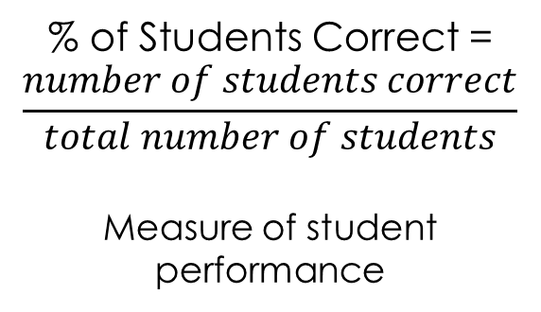


Metrics Analysis
Instructional Design
Analyze Student Learning
Instructional Analyses
Create Assessments
Evaluate Assessment Instruments
Knowledge Components
misconceptions
 | Percent of Students Correct |  |  |  | Learning Gains |  |  | Discrimination
 | pre | post1 | post2 | post3 | post1 | post2 | post3 | Average
Question 1
Question 2
Question 3
Question 4
Question 5
Question 6
Question 7
Question 8
Question 9
$$Learning Gain=$$
$$\left\{\begin{matrix}\frac{post−pre}{1−pre} & if pre<1 \\ 1 & pre=1\end{matrix}\right.$$
Measure of Learning gain relative to pre-test
Pearson Correlation
$poor<0.10≤$
$fair≤0.3≤$
$good$
Measure of question
quality
% of Students Correct =
$$\frac{number of students correct}{total number of students}$$
Measure of student performance
Notes:
So for this part, we worked with an Educational Statistician who gave us these three, easy to use metrics for our use case.
The first metric is simply Percent of students correct, this is a measure of student performance, which is what percentage of students got a particular question correct.
The second metric is learning gains. This is a measure of what percentage of potential improvement from the pretest students were able to accomplish, which is simply student performance on the post test minus student performance on the pre-test divided by potential improvement available from the pretest.
The third metric is discrimination. This is a Pearson correlation of question responses to performance on the overall test. This measures question quality in the sense that good students should consistently get a question correct.

Slide 23
Metrics Analysis
Instructional Design
Analyze Student Learning
Instructional Analyses
Create Assessments
Evaluate Assessment Instruments
Knowledge Components
misconceptions
 | Percent of Students Correct |  |  |  | Learning Gains |  |  | Discrimination
 | pre | post1 | post2 | post3 | post1 | post2 | post3 | Average
Question 1 | 0.65 | 0.55 | 0.71 | 0.59 | -0.3 | 0.18 | -0.2 | 0.59
Question 2 | 0.63 | 0.95 | 1 | 1 | 0.86 | 1 | 1 | 0
Question 3 | 0.33 | 0.95 | 0.93 | 0.94 | 0.92 | 0.9 | 0.91 | 0.22
Question 4 | 0.24 | 0.69 | 0.71 | 0.8 | 0.6 | 0.62 | 0.73 | 0.6
Question 5 | 0.71 | 1 | 1 | 1 | 1 | 1 | 1 | 0
Question 6 | 0.52 | 0.91 | 0.88 | 0.9 | 0.81 | 0.74 | 0.79 | 0.55
Question 7 | 0.33 | 0.47 | 0.89 | 0.94 | 0.21 | 0.83 | 0.91 | 0.4
Question 8 | 0.37 | 0.51 | 0.82 | 0.73 | 0.22 | 0.72 | 0.57 | 0.66
Question 9 | 0.44 | 0.77 | 0.93 | 0.81 | 0.59 | 0.88 | 0.66 | 0.36
Notes:
When you fill in the numbers, it’ll look something like this. For ease of convenience, I’ve color coded performance based on an 80% threshold, learning gains based on a 60% threshold, and discrimination on 0.1 and 0.3 threshold. This particular table shows that overall, our students are actually doing pretty well, They show greater than 80% mastery in most of the areas that we assess them on. But that being said, we can easily identify a few items for improvement

Slide 24
Analysis – Q1
Instructional Design
Analyze Student Learning
Instructional Analyses
Create Assessments
Evaluate Assessment Instruments
Knowledge Components
misconceptions
 | Percent of Students Correct |  |  |  | Learning Gains |  |  | Discrimination
 | pre | post1 | post2 | post3 | post1 | post2 | post3 | Average
Question 1 | 0.65 | 0.55 | 0.71 | 0.59 | -0.3 | 0.18 | -0.2 | 0.59
Question 2 | 0.63 | 0.95 | 1 | 1 | 0.86 | 1 | 1 | 0
Question 3 | 0.33 | 0.95 | 0.93 | 0.94 | 0.92 | 0.9 | 0.91 | 0.22
Question 4 | 0.24 | 0.69 | 0.71 | 0.8 | 0.6 | 0.62 | 0.73 | 0.6
Question 5 | 0.71 | 1 | 1 | 1 | 1 | 1 | 1 | 0
Question 6 | 0.52 | 0.91 | 0.88 | 0.9 | 0.81 | 0.74 | 0.79 | 0.55
Question 7 | 0.33 | 0.47 | 0.89 | 0.94 | 0.21 | 0.83 | 0.91 | 0.4
Question 8 | 0.37 | 0.51 | 0.82 | 0.73 | 0.22 | 0.72 | 0.57 | 0.66
Question 9 | 0.44 | 0.77 | 0.93 | 0.81 | 0.59 | 0.88 | 0.66 | 0.36
Notes:
For example, on question 1, we ask student’s to determine the type of a list. =Student’s= aren’t doing particularly well, and =the= overall learning gains are inconsistent and with no trend. This means that NOT only are our students performing poorly on this question, but they ALSO aren’t learning anything about this question! Now maybe it’s just the question. this could be because of it’s placement in the test, could be because it was hard to make this question in parallel structure, could be because we don’t cover types very well. But we can verify this using the other statistic, =discrimination=.
In this case, we can see that question 1 actually has a high correlation to test score. Students who get this question right GENERALLY do better on the test as a whole, suggesting that it is indeed the content of the question, and not the wording, design, or circumstances of the question itself that is the issue.
Since we know that the question itself is a good question, we look =back= at the learning gains. Since the learning gains suggest there’s no improvement, it means that our instruction for this content is terrible, and we just need strategic level fixes for this content, a brand new way to approach teaching the content this question covers.
But okay, that’s a question student’s are doing terribly on, so let’s try a more nuanced question.

Slide 25
Analysis – Q4
Instructional Design
Analyze Student Learning
Instructional Analyses
Create Assessments
Evaluate Assessment Instruments
Knowledge Components
misconceptions
 | Percent of Students Correct |  |  |  | Learning Gains |  |  | Discrimination
 | pre | post1 | post2 | post3 | post1 | post2 | post3 | Average
Question 1 | 0.65 | 0.55 | 0.71 | 0.59 | -0.3 | 0.18 | -0.2 | 0.59
Question 2 | 0.63 | 0.95 | 1 | 1 | 0.86 | 1 | 1 | 0
Question 3 | 0.33 | 0.95 | 0.93 | 0.94 | 0.92 | 0.9 | 0.91 | 0.22
Question 4 | 0.24 | 0.69 | 0.71 | 0.8 | 0.6 | 0.62 | 0.73 | 0.6
Question 5 | 0.71 | 1 | 1 | 1 | 1 | 1 | 1 | 0
Question 6 | 0.52 | 0.91 | 0.88 | 0.9 | 0.81 | 0.74 | 0.79 | 0.55
Question 7 | 0.33 | 0.47 | 0.89 | 0.94 | 0.21 | 0.83 | 0.91 | 0.4
Question 8 | 0.37 | 0.51 | 0.82 | 0.73 | 0.22 | 0.72 | 0.57 | 0.66
Question 9 | 0.44 | 0.77 | 0.93 | 0.81 | 0.59 | 0.88 | 0.66 | 0.36
Notes:
For example. question 4. =Question 4= has a strong correlation to student performance, students who do well on this question generally do well on the entire test. This means that it’s good for assessing our student’s knowledge, its successfully discriminating students
=However=, the student performance on the question isn’t quite where we’d like it to be, especially so because question 4 assesses one of the more important aspects of our unit on iteration. =But=, the fact that there is a high amount of learning gain, and that the learning gain progressively improves, we know that our instruction is on the right track, but we need to make small improvements to our instruction. In cases like this, ID + KC really shines

Slide 26
Analysis – Q4
Instructional Design
Analyze Student Learning
Instructional Analyses
Create Assessments
Evaluate Assessment Instruments
Knowledge Components
misconceptions
When using the iteration shown below to compute the sum of the numbers in the distance_list, which of the following is the correct statement to be in the body of the iteration?
distance_sum = 0
for distance in distance_list:
_______
distance_sum = distance_list + distance
distance = distance_sum + distance
distance_sum = distance_sum + distance_list
distance_sum = distance_sum + distance
distance_list = distance
distance_sum = distance_sum + 1
distance_sum = distance_list
Notes:
So taking a closer look at Question 4: This is about creating an update statement in a for loop. Can students successfully write the body for a loop to sum elements in a list. A novice question, but tricky for our novice, computing phobic, non computing major students.

Slide 27
Question Design
Instructional Design
Analyze Student Learning
Instructional Analyses
Create Assessments
Evaluate Assessment Instruments
Knowledge Components
misconceptions
Question: PERFORMANCE TASK
Mistake a
Mistake b
Mistake c
KC
KC
infer
Observable
infer
infer
KC
Notes:
So if you recall, the questions we put on our assessment are directly related to the performance tasks, and our distractors are mistakes, which are representative of misconceptions and one or more knowledge components.
While question 1, the question on types, needed instructional revision on the =performance= task level, question 4 has pretty good instruction and needs revision at the =knowledge= component level.

Slide 28
Question 4
Instructional Design
Analyze Student Learning
Instructional Analyses
Create Assessments
Evaluate Assessment Instruments
Knowledge Components
misconceptions
When using the iteration shown below to compute the sum of the numbers in the distance_list, which of the following is the correct statement to be in the body of the iteration?
distance_sum = 0
for distance in distance_list:
_______
distance_sum = distance_list + distance
distance = distance_sum + distance
distance_sum = distance_sum + distance_list
distance_sum = distance_sum + distance
distance_list = distance
distance_sum = distance_sum + 1
distance_sum = distance_list
Notes:
So from question 4, let’s =take= option a as an example

Slide 29
Take Action
Instructional Design
Analyze Student Learning
Instructional Analyses
Create Assessments
Evaluate Assessment Instruments
Knowledge Components
misconceptions
distance_sum = distance_list + distance
Student Knows
Student Doesn’t know
KC 09: The iteration variable and the list are two different items
KC 18-1: Need an accumulator variable on the left side
KC 18-2: Need iteration variable on the right side
…
KC 08: The list is multiple items
KC 20: You can’t add a list to a number
KC 13: The sum and the list are two different items
…
Notes:
This is a misconception that we the authors are intimately familiar with because in the first open ended coding problem students do in our class, we could have given feedback regarding this misconception on 30% of the submissions. And, for the second post test, this misconception was 38% of the wrong answers.
As I said, for question 4, however, only smaller revision to the instruction are necessary, and, with the knowledge components we’ve associated with this question, we can tackle it from multiple angles, such as the fact that the list is multiple items because student’s see a single block for the lists they, we can tackle it from the fact that you can’t add a list to a number because some students think of the list holistically, or we can tackle it by differentiating the sum and the list, as some students mistake the quantitative measure of a list for the list itself. An example of how we might change our instruction might be by refocusing pieces of our instruction, or perhaps creating new feedback for a students when we see this issue in student code.

Slide 30

Summary
Instructional Design
Analyze Student Learning
Instructional Analyses
Create Assessments
Evaluate Assessment Instruments
Knowledge Components
misconceptions
Decompose a well defined instructional goal into tasks
Collect Misconceptions
Create assessments systematically using misconceptions and tasks
Analyze student learning and assessment instruments using 3 easy to understand metrics
Questions?
Contacts:
Luke Gusukuma: lukesg08@vt.edu
Dennis Kafura: kafura@cs.vt.edu
Austin Cory Bart: acbart@vt.edu
NSF:DUE 1624320
Notes:
So in Summary, I introduced a Systematic methodology for improving instruction, the ID + KC process, which consisted of four major parts.
How to decompose a well definined instructional goal into tasks
How to collect misconceptions
How to create assessments systematically using misconceptions and tasks,
And finally, go over how to analyze assessments using ID + KC using 3 easy to understand metrics.

Slide 31
Future Work
Looking at specific KCs across questions
Incorporation of the ID + KC process into automated systems
Misconceptions as assessment tools in open programming problems

Slide 32
Improvement – Question 4: The Knowledge Components
KC006: The iteration property takes on each value of the list
KC007: The iteration property is a single item
KC008: The list is multiple items
KC009: The iteration property and the list should be different
KC012: The sum and the list are two different items
KC013: The accumulator and the list are two different items
KC018: Update for sum is accumulator = accumulator + iteration property
Contains 6 subcomponents
KC019: Update for accumulation is accumulator = accumulator + X
KC020: You can't add the list to a number
KC022: The list is not used in accumulation
KC023: The list is not used as an accumulator
KC024: The iteration property is not an accumulator
KC025: for each loop is for iter_prop in list

Slide 33
Appendix – Discrimination P-Values
 | P-values for discrimination
 | post1 | post2 | post3
q1 | 1.05E-07 | 6.20429E-11 | 7.78E-09
q2 | 0.005955 | #DIV/0! | #DIV/0!
q3 | 0.234948 | 0.023552222 | 0.008578
q4 | 6.69E-06 | 4.66073E-15 | 2.33E-09
q5 | #DIV/0! | #DIV/0! | #DIV/0!
q6 | 1.91E-07 | 5.28738E-13 | 8.74E-05
q7 | 1.25E-08 | 0.009457884 | 0.001904
q8 | 8E-07 | 9.9301E-19 | 1.3E-12
q9 | 0.002875 | 0.002527445 | 8.49E-05

Slide 34
Item Analysis
Classical Test Theory
Item Response Theory
Pros
Easy to understand
Easy to use
Looser Assumptions
Cons
Less flexible
Doesn’t allow for inter-test comparisons
Pros
More Versatile
More Flexible
More possible Analyses
Allows inter-test comparisons
Handles larger populations
More information
Cons
Difficult to understand
Stricter Assumptions

