Slide 2
Abstraction
layers
list
visualize
Social Impacts
ethics
stake-
holders
model
use
blocks
text
Algorithms
nano
micro
2 weeks
5 weeks
mini
8 weeks
Project

Slide 3
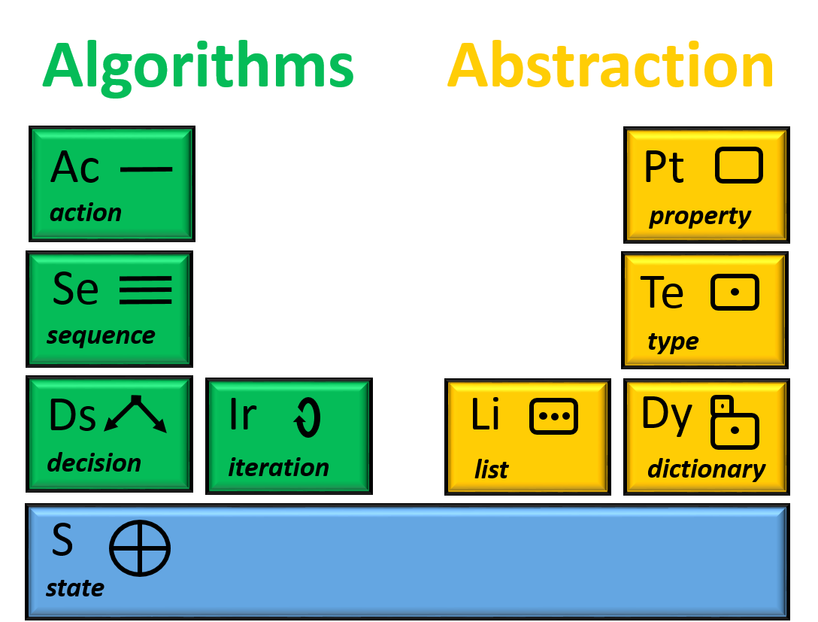
Building Blocks
Learn incrementally – create anything!

