Slide 1
Final Project Title: Obesity Prediction based on Eating Habits and Physical Activities Group 9 CSCE 5380 Section 002 – Data Mining (Spring 2023)
Team Members:
Nikhil Makkena(11435993)
Manish Reddy Radha Reddy(11518946)
Chathurya Thimmapuram(11479590)
Vaishnavi Choppalli(11545194)

Slide 2
Table of Contents
Introduction
Objectives
Experimental Methodology
Results
Conclusions
Limitations
Future Scope
References

Slide 3
Introduction
Obesity is a complex health issue characterized by an excessive amount of body fat, which can have serious consequences for an individual's physical and mental health.
Obesity is a growing global problem, affecting people of all ages and socioeconomic backgrounds.
Predicting obesity based on eating habits and physical activities is important because it can help individuals and healthcare professionals identify individuals who are at risk of developing obesity.
This information can be used to develop targeted interventions aimed at preventing or treating obesity.

Slide 4
Objectives
The objectives of the project on obesity prediction based on eating habits and physical activities may include:
To develop a predictive model that can accurately predict obesity based on a person's eating habits and physical activities.
To determine the relative importance of different eating and physical activity habits in predicting obesity.
To compare the performance of different predictive algorithms in accurately predicting obesity based on eating habits and physical activities.
To provide insights that can inform public health policies aimed at preventing and managing obesity at a population level.

Slide 5
Experimental Methodology
Data Collection and Exploration: We obtained the data from the "UCI Machine Learning Repository", which has 2111 records and 17 attributes of various sorts, including ordinal, categorical, and ratio. Gender, Age, Height, Weight, FAVC, FCVC, SCC, CALC, and others are some of the characteristics.
Data Preprocessing and Cleaning: The data was preprocessed to eliminate any missing values or outliers and to standardize it so that each feature would be given equal significance during training.
Data Intuition & Further Exploration: In order to fully comprehend the data, we will conduct analysis on visualizations of categorical variables and also perform the correlation prediction on number of records and obesity levels in this stage.
Feature Selection: The essential features for predicting obesity were determined using feature selection approaches. The predictive algorithms received their input from the chosen features. Adding dummy variables for features like gender, family history of obesity, NObeyesdad, FAVC, CALC, smoking, SCC, etc., and dividing the data into features and target variables

Slide 6
To be continued….
Model Training: On the training dataset, we trained various predictive algorithms, such as random forest, logistic regression, KNN, and decision tree. Accuracy criteria including the confusion matrix and F1 score were used to evaluate the performance of each model. We have train and test data sets 70% and 30% respectively. The training data and target data are assigned respectively. We have trained each model with three different parameters and compared the best model based on accuracy.
Model Evaluation: The most accurate models were tested against the testing dataset to determine how well they predicted obesity. To find the most precise forecasting algorithm, the performance of each model was compared. We performed hyperparameter tuning on the top three models KNN, Decision tree, and random forest method based on scalar data and min-max data.
Result Analysis: In order to determine the characteristics that are most crucial for predicting obesity and to learn more about the connections between physical activity, eating habits, and obesity, we studied the results. According to the results, the random forest model is the most accurate with a score of 0.821, followed by decision trees and KNN, and logistic regression model has the lowest accuracy.

Slide 7
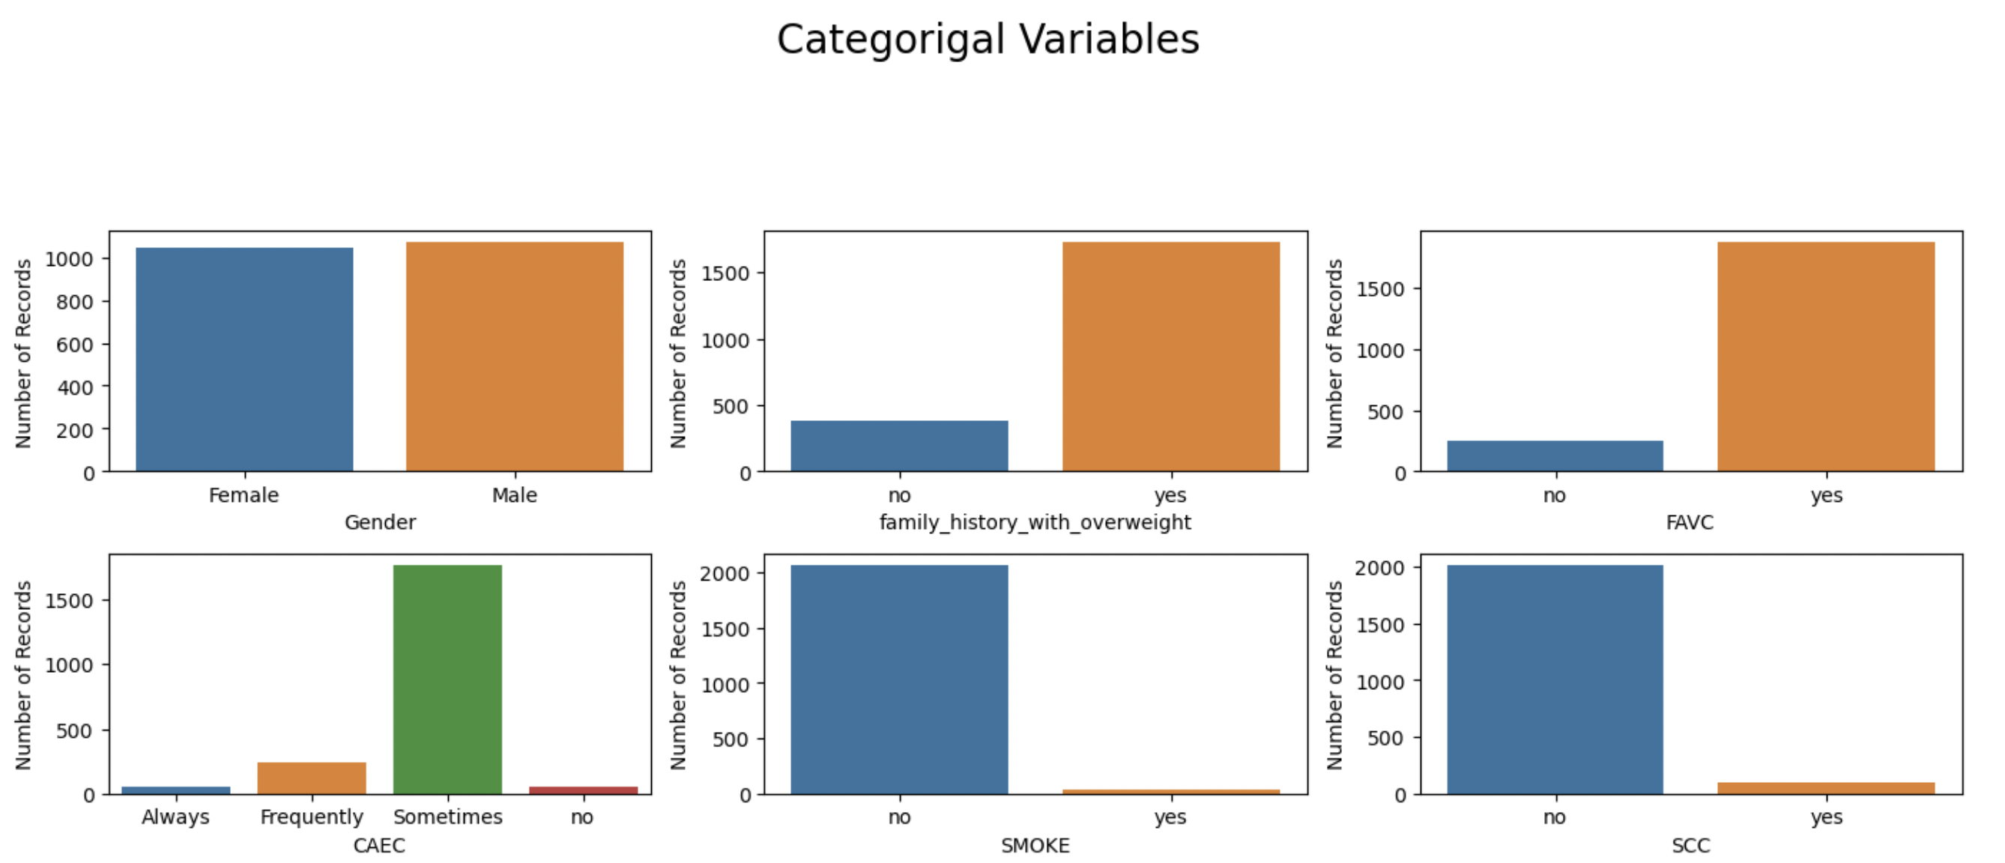
Results
Analysis on categorical variables: We are studying the various variables using a graphical representation of the data.

Slide 8
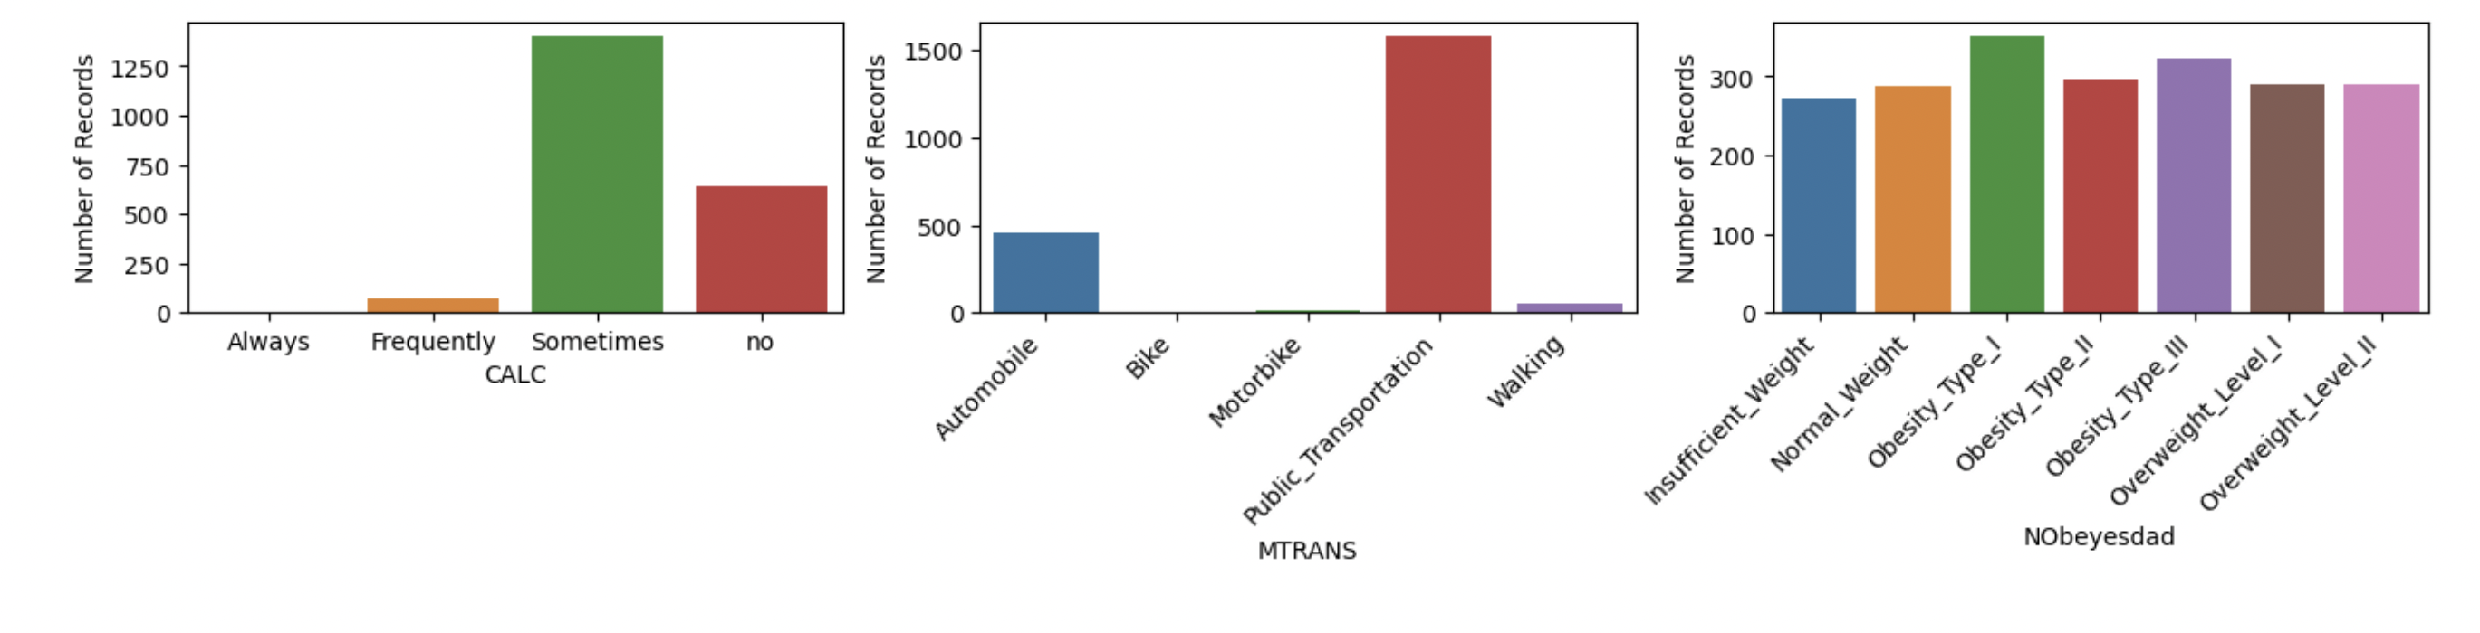
To be continued….

Slide 9
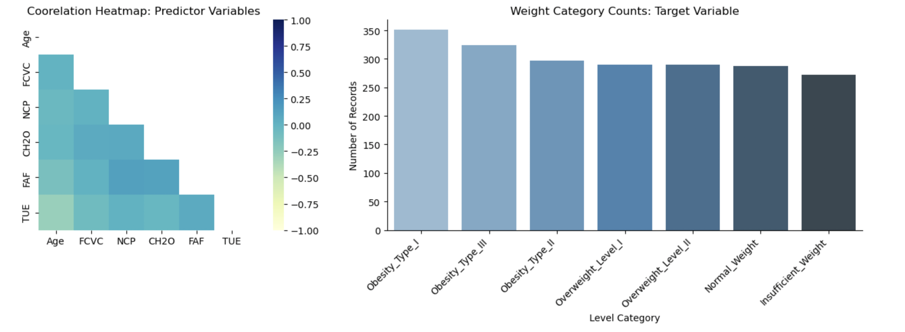
To be continued…

Slide 10
To be continued…
Table: Performance metrics of each algorithm
Table shows the accuracy, precision, recall, and F1-score of each algorithm. We can see that Random Forest outperformed all the other algorithms with an accuracy of 0.821, precision of 0.82, recall of 0.82, and F1-score of 0.82.
Algorithm | Accuracy | Precision | Recall | F1-Score
Random Forest | 0.821 | 0.82 | 0.82 | 0.82
Decision Tree | 0.761 | 0.76 | 0.76 | 0.76
KNN | 0.766 | 0.76 | 0.76 | 0.75
Logistic Regression | 0.577 | 0.60 | 0.61 | 0.59

Slide 11
To be continued….
Based on the results, we can conclude that Random Forest is the most accurate algorithm for predicting obesity based on eating habits and physical activities. It outperformed all the other algorithms in terms of accuracy, precision, recall, and F1-score. Next best algorithm is the Decision Tree Model.
Table : KNN algorithm accuracy of different n neighbors
n_neighbors | Accuracy
1 | 0.772
3 | 0.731
5 | 0.735

Slide 12
To be continued….
For a particular machine learning algorithm, we choose the best collection of hyperparameters; these parameters are modified to enhance model performance. The number of nearest neighbors (n) in KNN algorithm, the maximum depth of the tree in decision trees, and the maximum depth of the tree in random forests are among the hyperparameters that can be tweaked.
In KNN algorithm, we are considering the hyperparameters of nearest neighbors(n) of 1, 3, 5 to enhance the model in which the nearest neighbor of 1 is having the highest accuracy of 0.772
In Decision Tree algorithm, we will consider the maximum depth of 20, 40, 80 from which the maximum depth of 40 is having the highest accuracy of 0.76
In Random Forest algorithm, the hyperparameters taking into consideration are maximum depth of 20, 40, 80 these three depth are having almost same accuracy however, the maximum depth of 40 is having high accuracy of 0.818
We can compare the overall hyperparameter tuning between KNN, Decision Tree and Random Forest

Slide 13
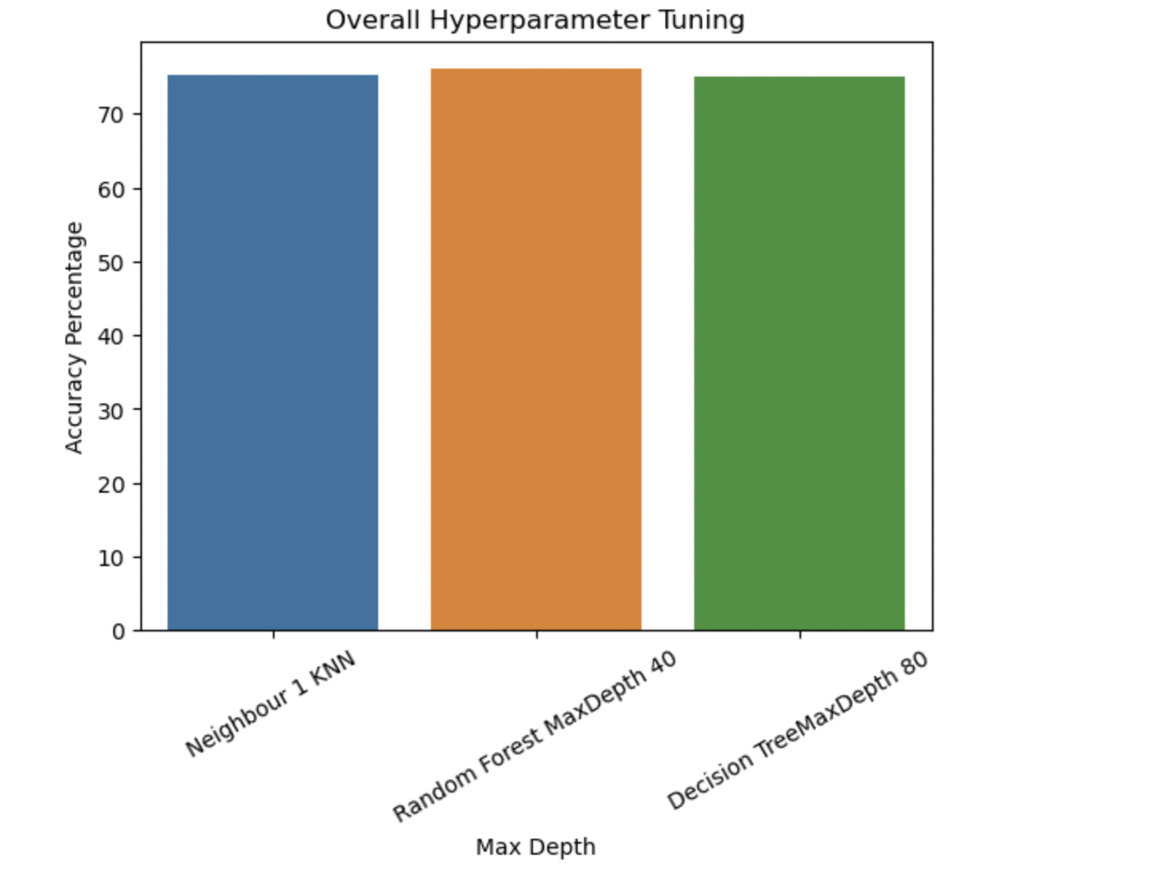
Overall best model after hyperparameter tuning is Random Forest Model with maximum depth of 40

Slide 14
Conclusion
It is clear from the study on Obesity Prediction based on Eating Habits and Physical Activity utilizing the prediction algorithms Logistic regression, KNN, Linear regression, Decision Tree, and Random Forest that the performance of the models differed greatly.
The Random Forest model performed the best, followed by the Decision Tree model, while the Logistic regression performed the worst. KNN also performed relatively well but was outperformed by the tree-based models.
Physical activity, age, and caloric intake were discovered to be the three most crucial indicators of obesity. This shows that programs to increase physical activity and cut calories may be useful in preventing and treating obesity.

Slide 15
Limitations
The accuracy of the predictive models is heavily dependent on the quality of the dataset used. If the dataset is not representative of the population being studied, or if it contains incomplete or inaccurate data, the results of the analysis may be compromised.
The predictive models used in the project are based only on eating habits and physical activities, which are just two of many factors that contribute to obesity. Other important factors such as genetics, socioeconomic status, and cultural influences are not considered in the analysis.
The study was also conducted on a particular demographics, therefore it might not be generalizable to other populations.

Slide 16
Future Scope
We will focus on incorporating additional data sources such as genetics, social determinants of health, and environmental factors to improve the accuracy and predictive power of the models.
The project can explore new predictive algorithms such as neural networks or support vector machines to improve the accuracy and robustness of the models.
Improving the quality of the data collection to predict the high accuracy.

Slide 17
References
https://archive.ics.uci.edu/ml/datasets/Estimation+of+obesity+levels+based+on+eating+habits+and+physical+condition+
https://www.geeksforgeeks.org/ml-logistic-regression-using-python/?ref=lbp
https://machinelearningmastery.com/logistic-regression-for-machine-learning/
https://www.quanthub.com/how-to-read-a-correlation-heatmap/

Slide 18
Thank you….

