Slide 1


Innovations in Food Security Training and Research
Milla McLachlan
Stellenbosch University
Synthesis workshop on Mainstreaming Tertiary Education in ARD Policy Processes, Wageningen, 25-27 September 2013

Slide 2
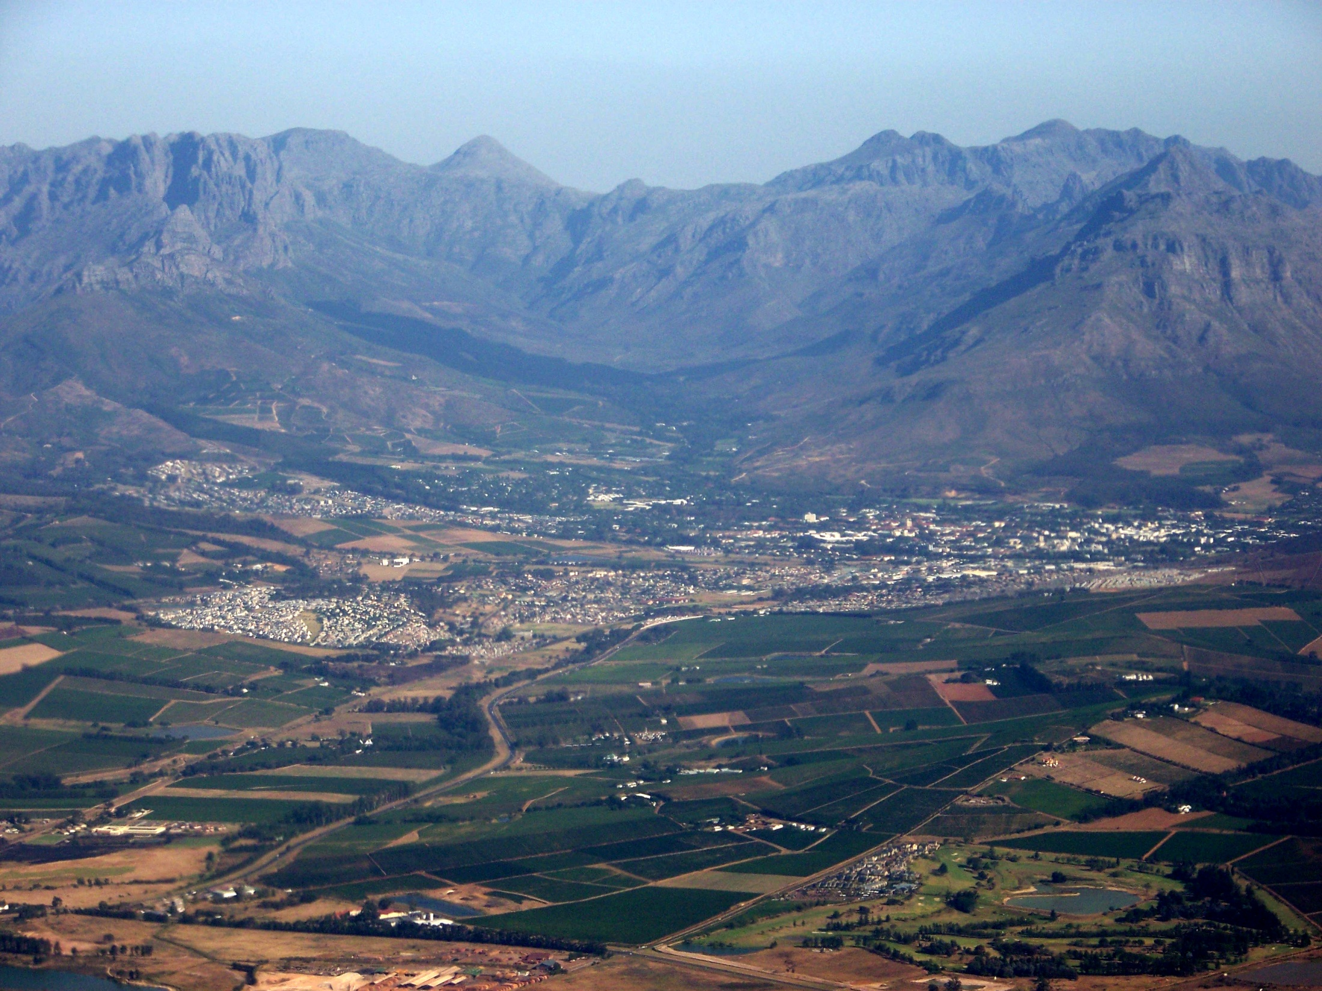
Stellenbosch University
Research-focused
28000 students
9853 postgraduate students
Hope Project: Renewal

Slide 3

FSI Vision statement - March 2009
“The Food Security Initiative contributes to the
emergence of a resilient, sustainable food system
for Southern Africa, by
reconceptualising the food security challenge, and
creating new models of practice in the food system, through
integration of findings from in-depth research on key issues in the food value chain,
collaboration across disciplinary boundaries,
capacity building, and
systematic impact assessment.”
Notes:
Hope project funds – R26 m; by 2013, external funding about R24 m

Slide 4
FSI focus areas
Transdisciplinary approach with
Social learning
Sustainable Production of safe and nutritious food
Post Harvest optimization
Utilization of safe and nutritious food

Slide 5
HOW?
The FSI is not (only) about finding technical solutions, but about contributing to an engaged society with the capacity to address food security challenges as they emerge
Collaboration: on campus, and with communities, other research groups, in South Africa, Africa and internationally
Policy dialogue: Local, Provincial, National,
The FSI itself is evolving……..
Notes:
2011 CHEC symposium on food security
2011-2012 - inputs to National Planning Commission on NDP
2011-2013 – input to Western Cape Provincial government food security task force, City of CT deliberations on food security strategy for the city.
2012 hosted first TAE partnership initiative meeting in Africa
2012-collaboration with PLAAS, through SAFL on Project on supporting smallholders into commercial agriculture

Slide 6
Outputs
51 Masters and 5 PhDs awarded since 2010
82 Masters and 24 PhDs currently enrolled
50 publications including 5 papers in a Special section of the journal Food Security http://link.springer.com/journal/12571/5/2/page/1
Notes:
NRF/DST funded project running 2012-2014

Slide 7
Social Learning for Sustainable Food systems
Failure of existing strategies to deal adequately with complex challenges facing the food system
  Disciplinary research
  Incremental, piecemeal change strategies.
Multi-stakeholder, systemic initiatives such as the SA Food Lab seek to facilitate shifts in the system
SLSFS a transdisciplinary research strategy:
  Aims to increase understanding of the role and functioning of multi-stakeholder change processes
  Document challenges at the ‘science-society interface’
  Explore alternative mechanisms to facilitate mutual learning among scientists and other stakeholders in the food system.
4 PhD students, 3 Masters currently enrolled
Notes:
NRF/DST funded project running 2012-2014

Slide 8

The Southern Africa Food Lab
A response to the complex challenges of food insecurity:
  A space for learning how to shift dominant patterns and trends in a stuck complex system
  Involving teams created out of diverse stakeholders through ongoing joint learning and action
  Using experience-based and experimental approaches to innovate solutions,
  Guided by an intention to create fundamental shifts in the system
Notes:
Complex social-economic-ecological problems, too complex to be handled by the state, or NGO’s or private sector, acting alone.
Needs social innovation – innovation in the ways people interact to deal with the problem; and adopting a whole-system view of the problem and finding new ways to address it.
Increasingly recognized that such complex problems require novel structures and processes, inter-organizational collaboration involving different sectors, different disciplines, and linking researchers and practitioners, and addressing gender, race and other social divides.
The Southern African food lab is a social innovation effort to address food security

Slide 9
Supporting Smallholders into Commercial Agriculture: A social dialogue and learning project
Supporting Smallholders into Commercial
Agriculture
Social dialogue, policy debate, institutional learning
and media dissemination component
Learning
Innovation
journeys
Consult
workshps
meetings
Supporting Smallholders into Commercial
Agriculture
Research component
Designed to galvanise action and innovation on collaborative change
Notes:
Within the Food lab, we have followed this U process a number of times and allowed a number of innovations or innovative projects to surface and find traction.
I will now shift to discussing one of these innovations which is a collaborative Supporting Smallholders into Commercial Agriculture: A social dialogue and learning project. This unique project is based on a collaboration between the Food Lab (SAFL) and the Institute for Poverty, Land and Agrarian Studies at the University of the Western Cape (PLAAS). This project has been specifically designed to ensure strong linkages between academic research and processes of social dialogue, policy debate, media dissemination and institutional learning among stakeholders involved in the development of smallholder agriculture.
These components are linked through a number of learning journeys, consultative meetings and innovation workshops
The whole process (again based on the U process) is designed to galvanising action, especially collaborative action for change.

Slide 10
Lessons and next steps
Changing the discourse on Food security takes time and effort
Starting with conventional discipline-based research had advantages and disadvantages
Creating different opportunities for researchers from different disciplines to meet formally and informally generates trust and understanding
Academic research enriched through engagement with communities, NGOs, government structures and private sector through the SAFL and other forums
FSI research activities are now leading to the development of new post-graduate courses - sustainable agriculture (2014), public health nutrition (2015), agriculture for nutrition and health (2016)
Notes:
Hope project funds – R26 m; by 2013, external funding about R24 m

Slide 11
THANK YOU

Slide 12
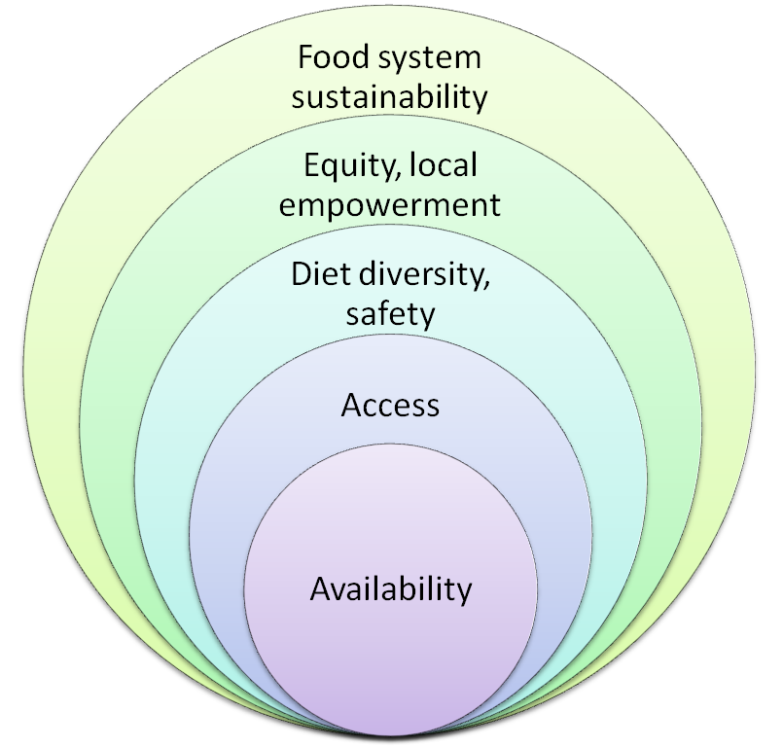
Food Security: Multiple Perspectives
Global
Regional
National
Local
Household
Individual
Notes:
Scale is al

Slide 13
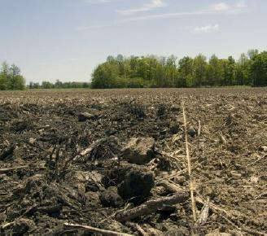
Biochar and food?
Alien and waste wood from timber industry is burned with minimal oxygen to retain much of the carbon
Could provide a sustainable means for growing food by the urban and rural food insecure
Pioneering work for SA, setting up protocol for analysis and practice
Potential usefulness for farmers to obtain personal food production, sequester carbon and provide ‘access’ to others
Adding this high C product to different soils of the W. Cape to study the following effects on the soil/plant
    Chemical
    Physical
    Biological
    Microbiological

Slide 14
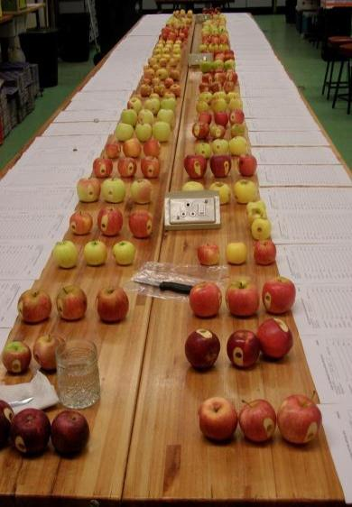
Horticultural Science
Improve cultivars & packaging to reduce waste and losses
Working with small-scale farmers on a mobile cooling unit
Training locally and within Southern Africa on post-harvest technology & physiology
Notes:
Training is with producers to share knowledge on both reducing losses and market requirements (both of which can increase income and food security amongst these communities
Mobile cooling unit is so that their produce gets to market, reducing losses but also increasing income and food security amongst these communities
FSI Goal
2 Promote the utilization of safe and nutritious food
3 Empower small-scale farmers through appropriate new technologies
4 Reduce losses & waste in the farm to fork chain

Slide 15
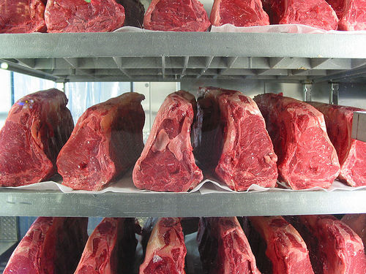
Meat – the science we all need to know
Is our meat safe to eat?
What about melamine and the food chain? Dairy?
Are cheaper meat products possible?
What about meat ‘waste’ products, could we use these?
Is free-range meat actually better for us?
Notes:
How can we ensure adequate protein for the under- and malnourished?
FSI GOALS:
2 Promote the utilization of safe and nutritious food
3 Empower small-scale farmers through appropriate new technologies
4 Reduce losses & waste in the farm to fork chain

Slide 16
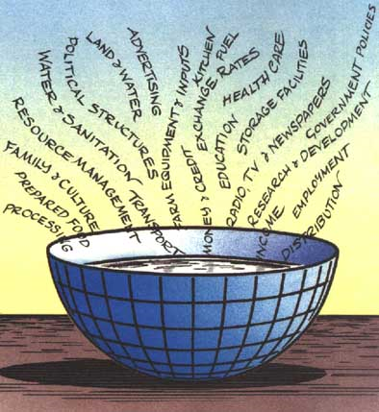
Understanding the social dynamics of food insecurity
What are the ‘drivers’ of household food insecurity?
How do different households and communities experience food insecurity?
Studies on the social dynamics relating to food insecurity in two West Coast fishing communities and locally at Lynedoch.
In the Breede Valley, the focus is on measuring levels of malnutrition and exploring immediate and underlying causes.
Notes:
shaped by a complex intersection of social forces, including those of race, class and gender, and is not simply the consequence of technical factors related to the production and distribution of food
Want to contribute to understanding some of the access elements of food security and how the social, economic and political elements are complex and intrinsically linked

