Slide 1



CTA/WUR Synthesis Workshop on
“Mainstreaming Tertiary Education in ACP ARD Policy Processes: Increasing Food Supply and Reducing Hunger
Programme Overview, Introductions & Expectations
By Judith Ann Francis,
Senior Programme Coordinator, Science &Technology Policy
CTA, The Netherlands

Slide 2
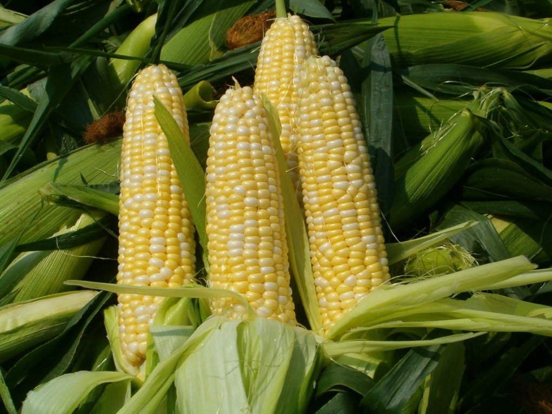
Status quo – Food Insecurity
870 million People chronically undernourished in 2010–12
One-third of food produced for human consumption is lost or wasted globally - 1.3 billion tons per year
Population growth is faster than the rate of poverty reduction (0.84% over 1990–2008) – Reducing Food Access
Ecological and Biodiversity challenges – Soil, Water & Energy

Slide 3
Status quo – Food Insecurity
A multi dimensional approach is needed:
  Policy harmonization
  Political will
  Multidisciplinary research
  Technological and social innovation
  International cooperation and collaboration,
  Local and national ownership
  Capacity building and development
  Gender equality and women empowerment

Slide 4
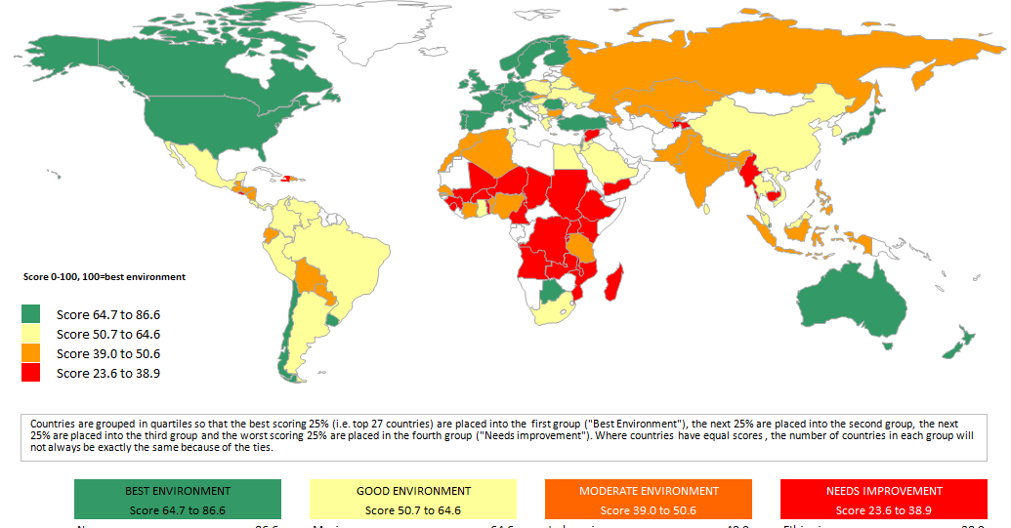



Food availability
Most African countries = 23.6 to 38.8.
Caribbean & Pacific =32.9 to 50.6
Most EU countries = 64.7 and 86.6.
Figure Global Food Availability. Source: GFSI, July 2013
Score 0 -100, 100 = Best environment

Slide 5
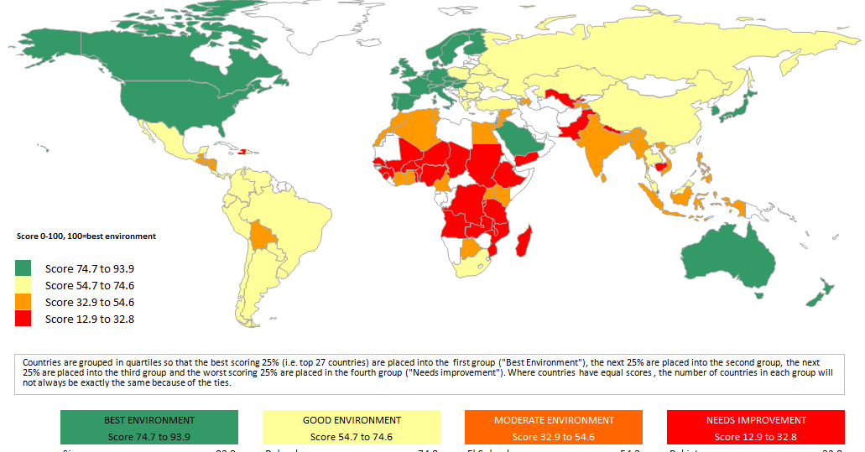
Food affordability
Most African countries = between 12.9 and 32.6
Caribbean & Pacific =32.9 to 54.6
EU countries = 74.7 and 93.9.
Figure Global food affordability. Source: GFSI, July 2013
Score 0 -100, 100 = Best environment

Slide 6
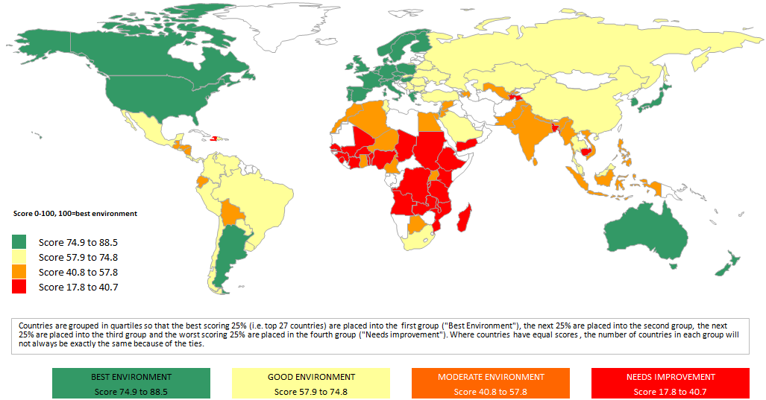
Food utilization
Most of Africa = 17.8 to 40.7
Caribbean & Pacific =40.8 to 57.8
EU Countries = 74.9 to 88.5
Figure Global food safety and quality in July 2013. Source: GFSI, July 2013
Score 0 -100, 100 = Best environment

Slide 7
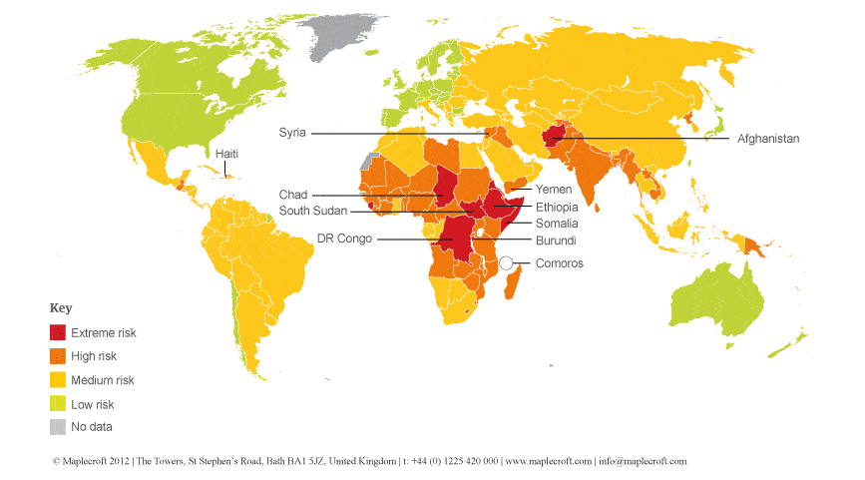
Food stability
African countries fall under the worst category and need improvement.
Figure the food security risk index. Source: Maple croft , October 2012

Slide 8
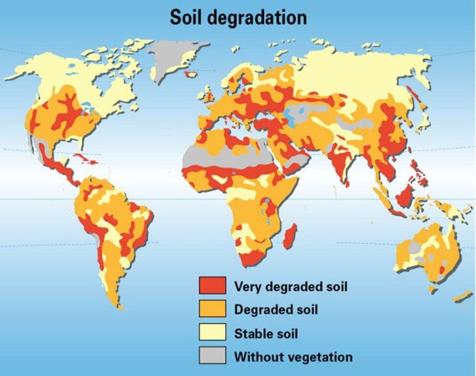
Global soil degradation
Adverse effect on the structure and diversity of ecosystems is usually associated with nitrogen and phosphorous from agricultural runoff (Ross, 2010).
Figure State of global soil degradation in the world (Rekacewicz, 2005)

Slide 9
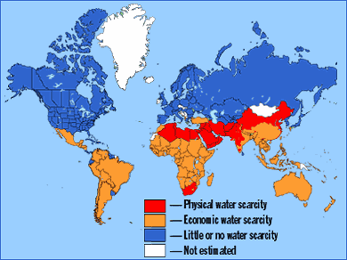
Water as a key limiting factor
ACP countries = Economic Water Scarcity
Fig 6: Global water availability (Source: Scenariothinking.org)

Slide 10
Activities Undertaken
Quick Scan of the university programmes
Inception workshop at CTA – 18 to 21 September, 2012
Audit/Evaluation using the AIFSHE tool
Policy Quick Scan
Mapping
Internal academic consultation to validate results with peers
National consultations & preparation of reports leading up to the Synthesis workshop

Slide 11
Objective of Synthesis Workshop
To present the results of case studies;
To further refine the Auditing Instrument for Food Security in Higher Education (AIFSHE)tool;
To determine the strategies to be piloted/implemented for improving teaching, research and outreach on food and nutrition security;
To develop plans for scaling out to other universities;
To reflect on whether the universality representatives see themselves as having improved their capacity to become centers of excellence on food and nutrition security in the future.

Slide 12
Output
The lessons learnt from the pilots will be documented and shared.
Questions to be answered
What are appropriate methodological frameworks for re-orienting Higher Agricultural Education Institutions towards the ARD policy priorities and the needs of society and the world of work?
What are key capacities needed to address the ARD policy priority areas especially as they relate to food and nutrition security and how do they translate to concrete learning outcomes and competences to be developed in students and faculty for greater impact?

Slide 13
Output con’t
Questions to be answered con’t
What are current gaps in resources, curriculum, teaching and research in addressing these priority areas and building the needed capacities?
What are appropriate pathways for bridging these gaps?
What mechanisms can be put in place to make Higher Agricultural Education and Research more responsive to changes in science and society (institutionalization)?
To what extent is the process used suitable for initiating similar reflections on curriculum and research re-orientation processes in other universities and for other development priorities? (transferability & up-scaling)

Slide 14
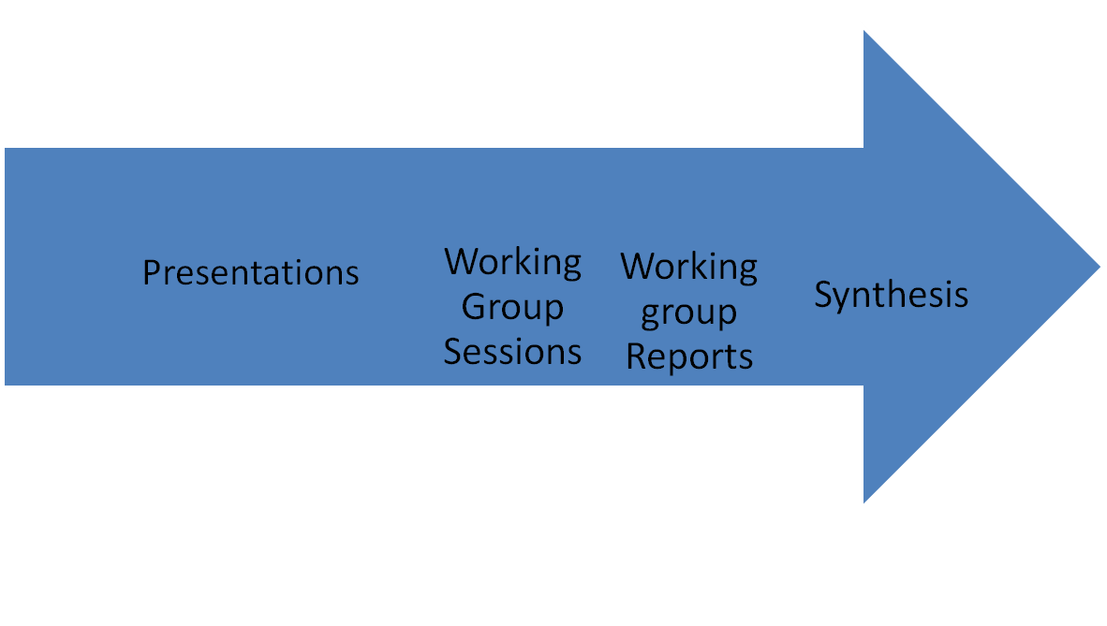
How to get there!

Slide 15


