Slide 1
PROJECT PRESENTATION
OneTownCity
A Hyperlocal Community Platform for Kuppam
Prepared for: Client Review
Prepared by: CraftLanee · September 2026

Slide 2
AGENDA
What we'll cover
01
Project overview & who it serves
05
NEW — category request workflow & admin notifications
02
The public experience — home, discovery & search
06
Super Admin dashboard, roles & permissions
03
All six listing types (Business, Property, Jobs, Events, News, Projects)
07
Community engagement & trust/safety features
04
Content submission & multi-level approval workflow
08
Technology stack & deployment readiness
OneTownCity · Powered by CraftLanee

Slide 3
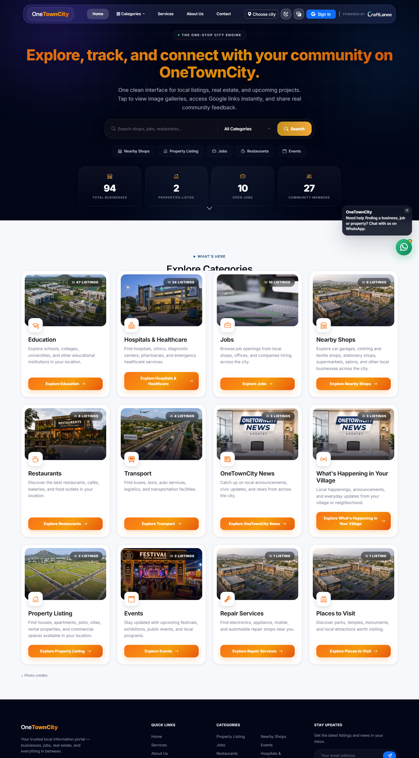
PROJECT OVERVIEW
One platform for everything local
OneTownCity is a hyperlocal community platform built for the town of Kuppam. It brings local businesses, real estate, jobs, events, news, and civic/infrastructure projects together in one place — giving residents a single trusted destination to discover what's happening locally, and giving local businesses and organizations a simple way to list themselves and reach the community.
The platform combines a public-facing directory and discovery experience with a self-service content submission system. Local businesses and residents submit their own listings, while a structured admin and moderation team reviews and approves everything before it goes live — keeping information accurate and trustworthy.
6
5
4
100%
Listing types
User roles
Languages
Moderated content
OneTownCity · Powered by CraftLanee

Slide 4
ROLES & ACCESS
Five roles, one clear chain of trust
Super Admin
City Admin
Sub Admin
Unrestricted, platform-wide access — oversees the entire system across all cities.
Full authority over their assigned city. Publishes instantly, manages Sub Admins & Content Providers.
A scoped set of responsibilities delegated by a City Admin — e.g. only Events or only Businesses.
Content Provider
Public Visitor
A business owner or resident approved to manage listings in the categories they applied for.
Browses and searches; can like, comment, review, favorite, share — and apply to become a Content Provider.
OneTownCity · Powered by CraftLanee

Slide 5
CONTENT TYPES
Six listing types, tailored to what matters
Business
Property
Job
19 categories — restaurants, pharmacies, hospitals, schools, tourism & more; GPS + working hours.
Sale, rent, apartment, villa, plot, commercial, PG — price, location, contact, Maps link.
Company, title, regular or hourly type, salary, location, GPS, shift date/time for gigs.
Event
News
Civic Project
Title, date & time, venue, description, contact & Maps link.
Article content, publish date, source, and photo.
Status (planned/ongoing/completed), location, completion date, executing department.
Every listing supports multi-image photo galleries, a “featured” flag, and active/inactive visibility control.
OneTownCity · Powered by CraftLanee

Slide 6
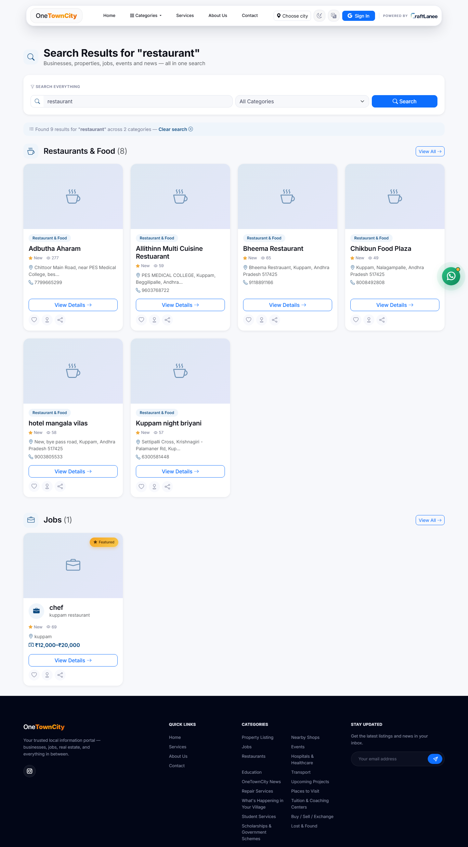
DISCOVERY & SEARCH
Finding anything in seconds
› Site-wide search — filter by category and listing type from one search bar.
› “Near me” GPS search — surfaces nearby shops and repair services based on live location.
› Precise location pinning — every listing carries a Google Maps link, auto-derived from GPS or entered manually.
› Structured working hours — auto-formatted business hours, day-by-day.
› Category browsing — 12+ curated categories on the homepage, each with live listing counts.
OneTownCity · Powered by CraftLanee

Slide 7
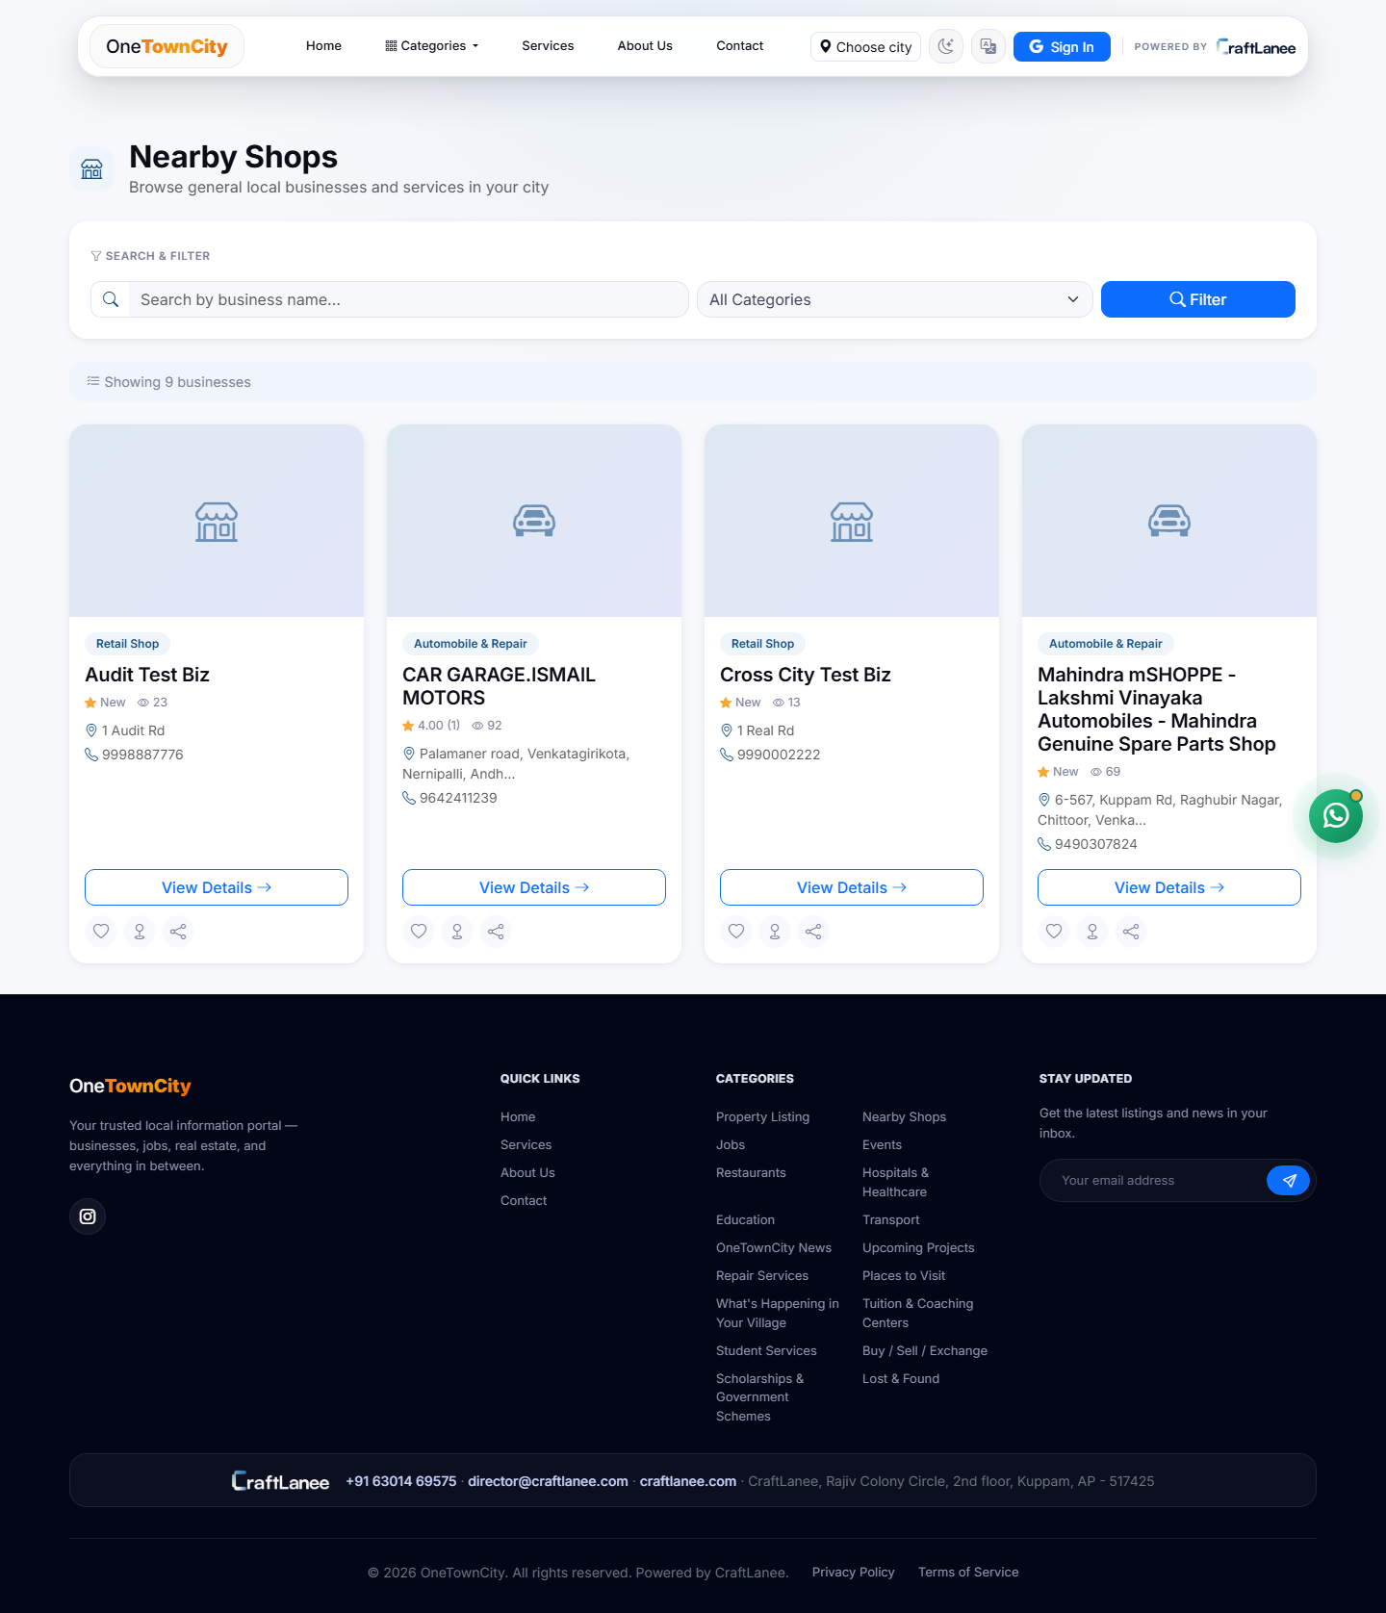
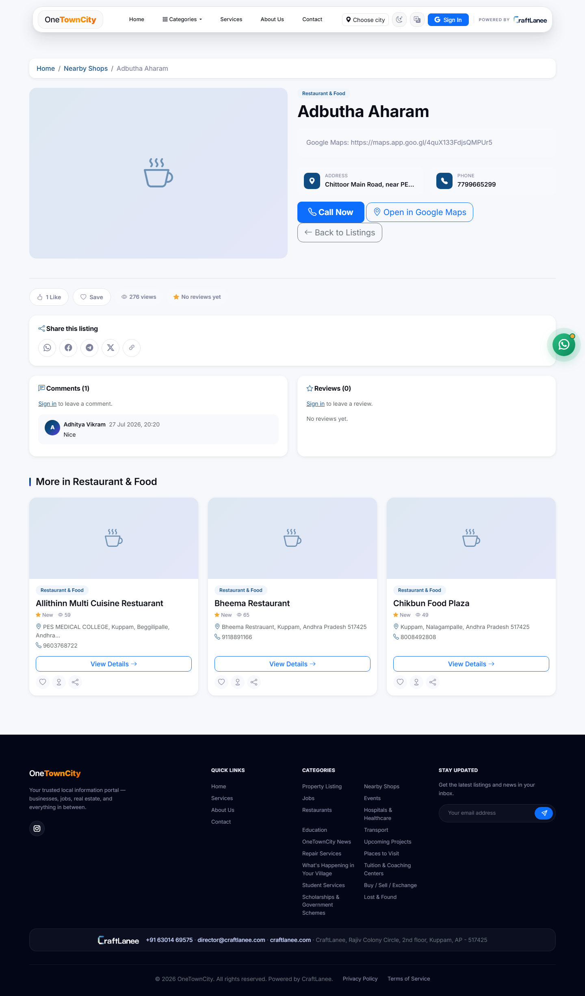
BUSINESS DIRECTORY
Every local business, one searchable directory
The largest and most active listing type — 19 categories from restaurants to hospitals, each with contact details, hours, and photos.
Business directory — filterable grid
Business detail — contact, map & reviews

Slide 8
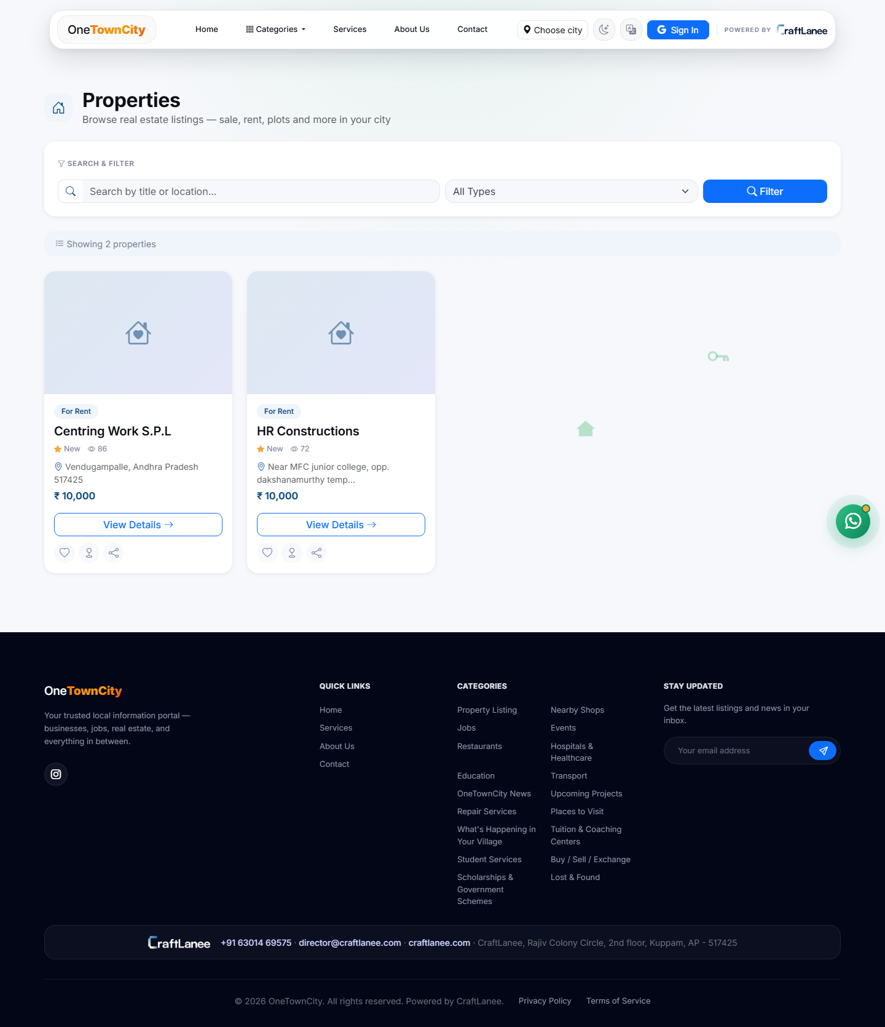
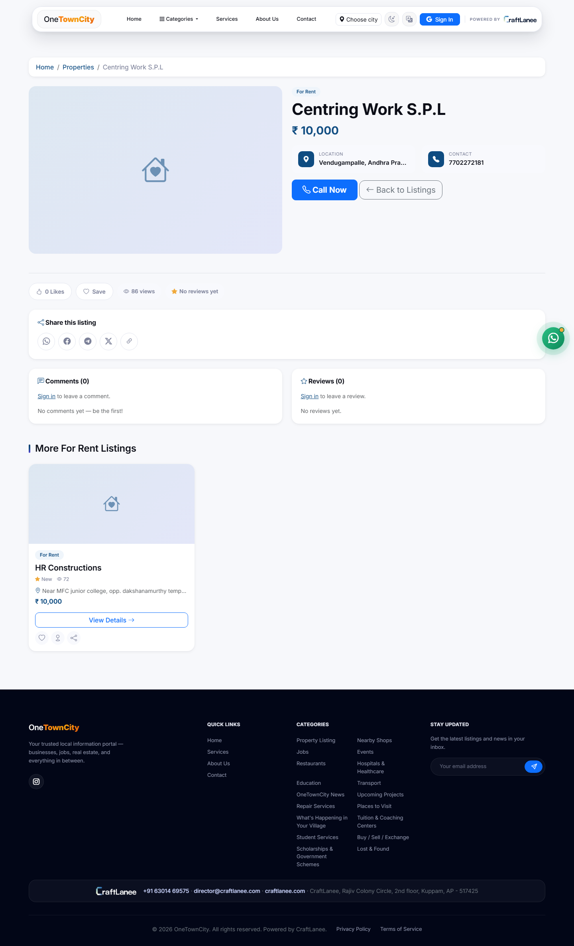
REAL ESTATE
Property listings for sale, rent & more
Apartments, villas, plots, commercial spaces and PGs — each with price, location, photos and a direct Maps link.
Property listing grid
Property detail page

Slide 9
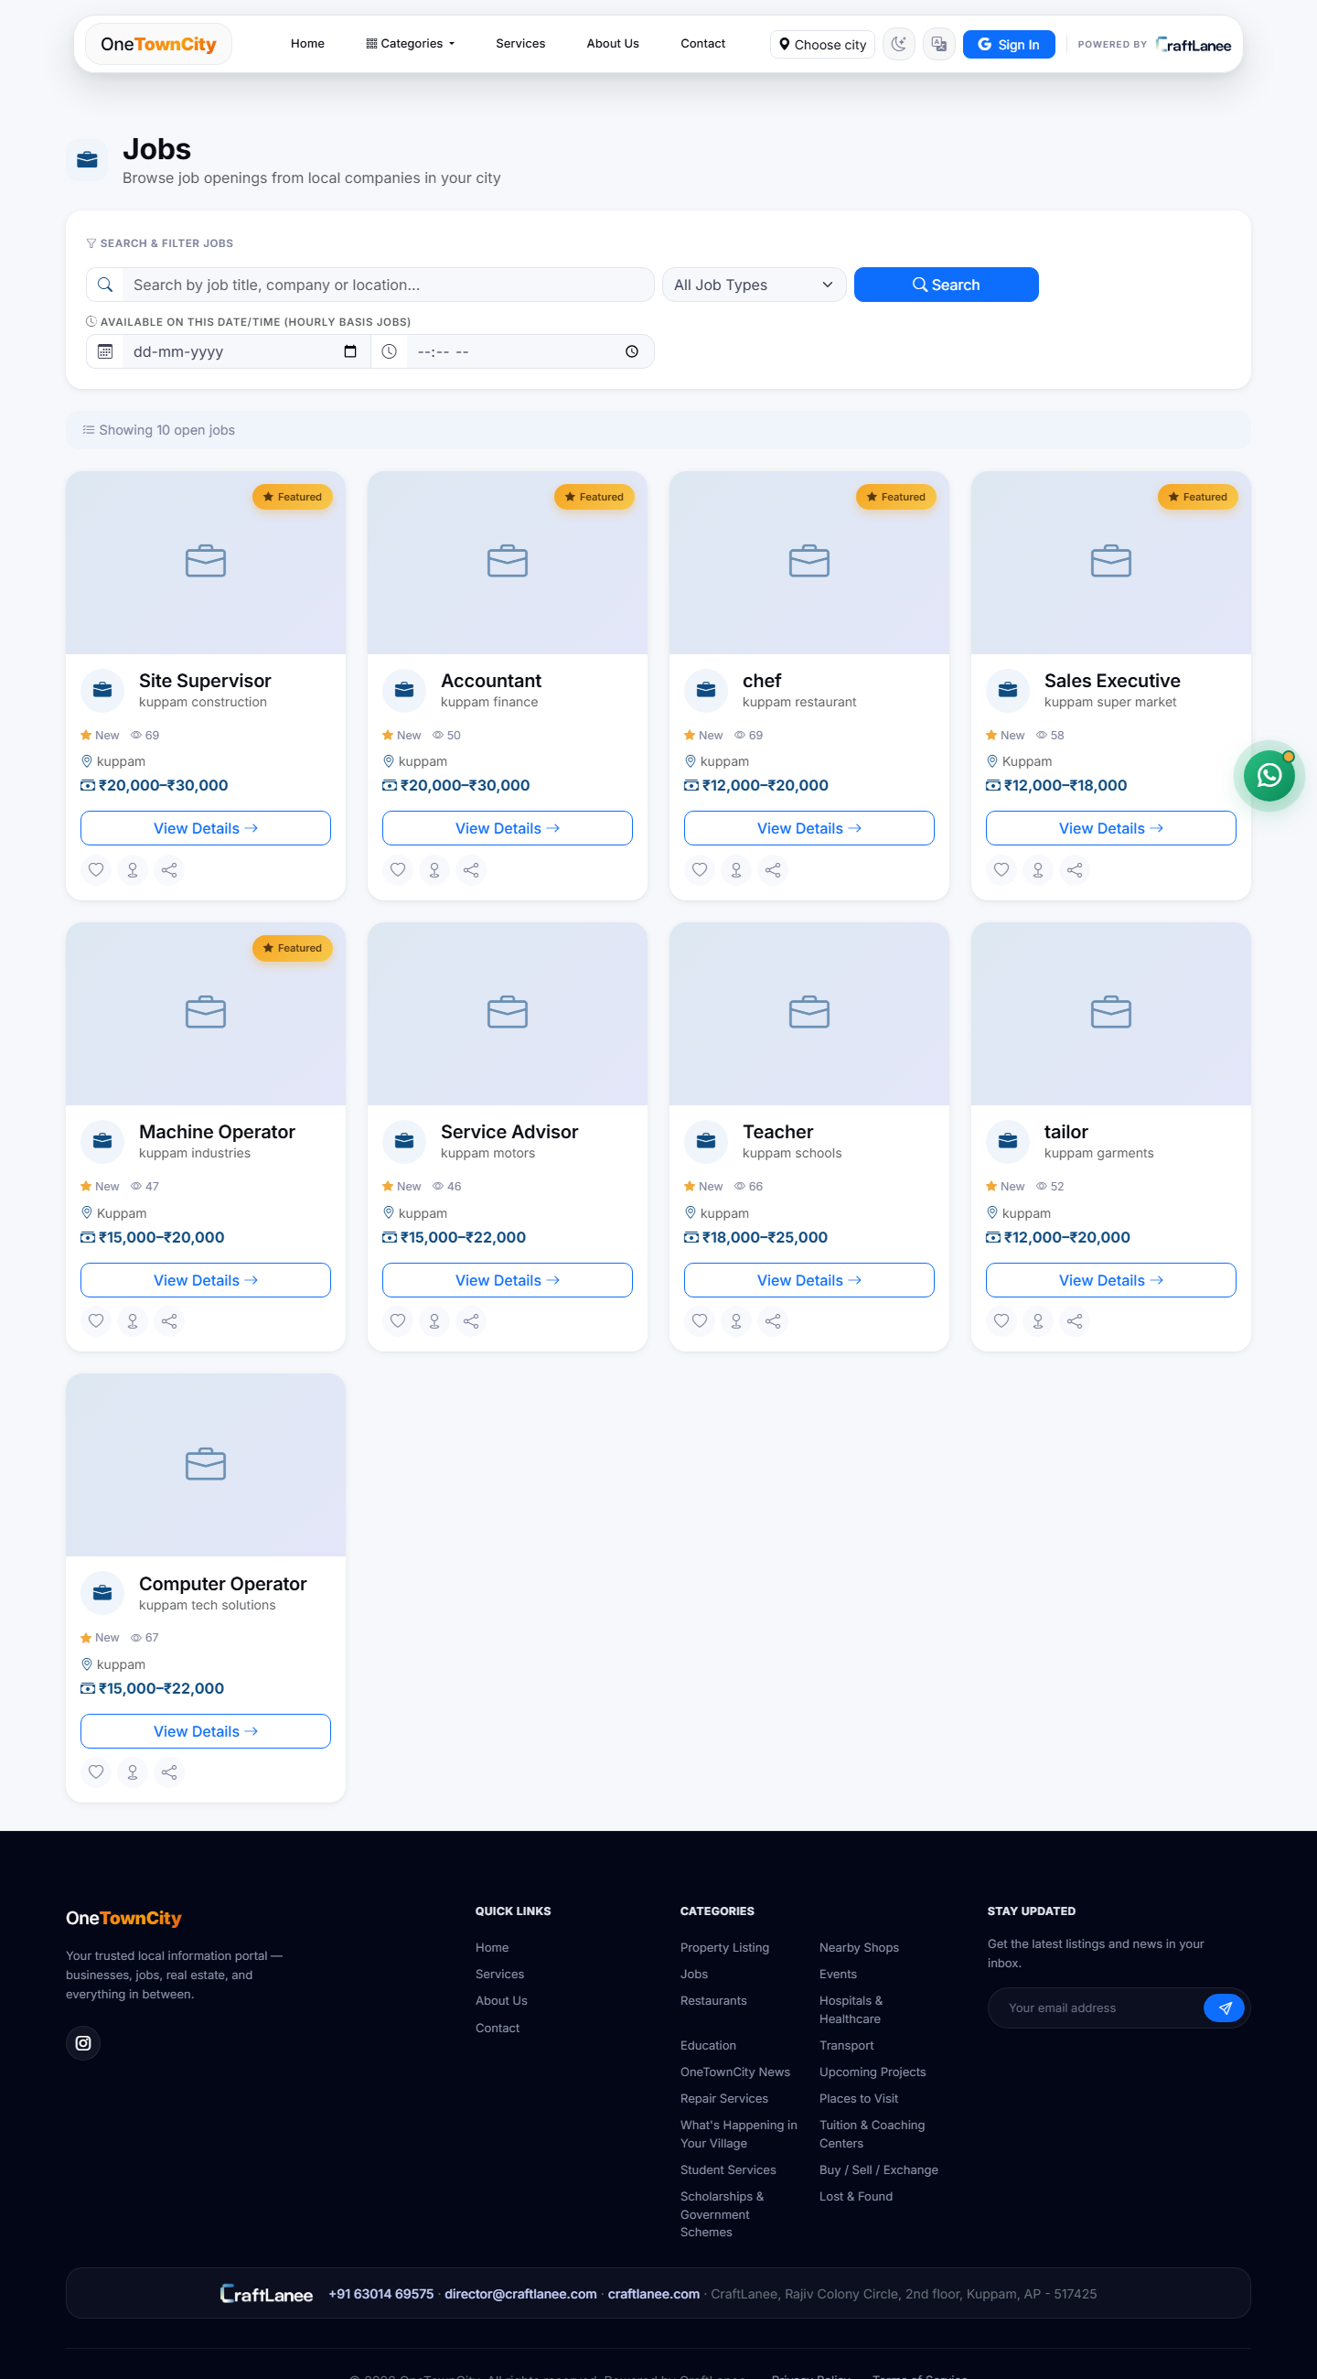
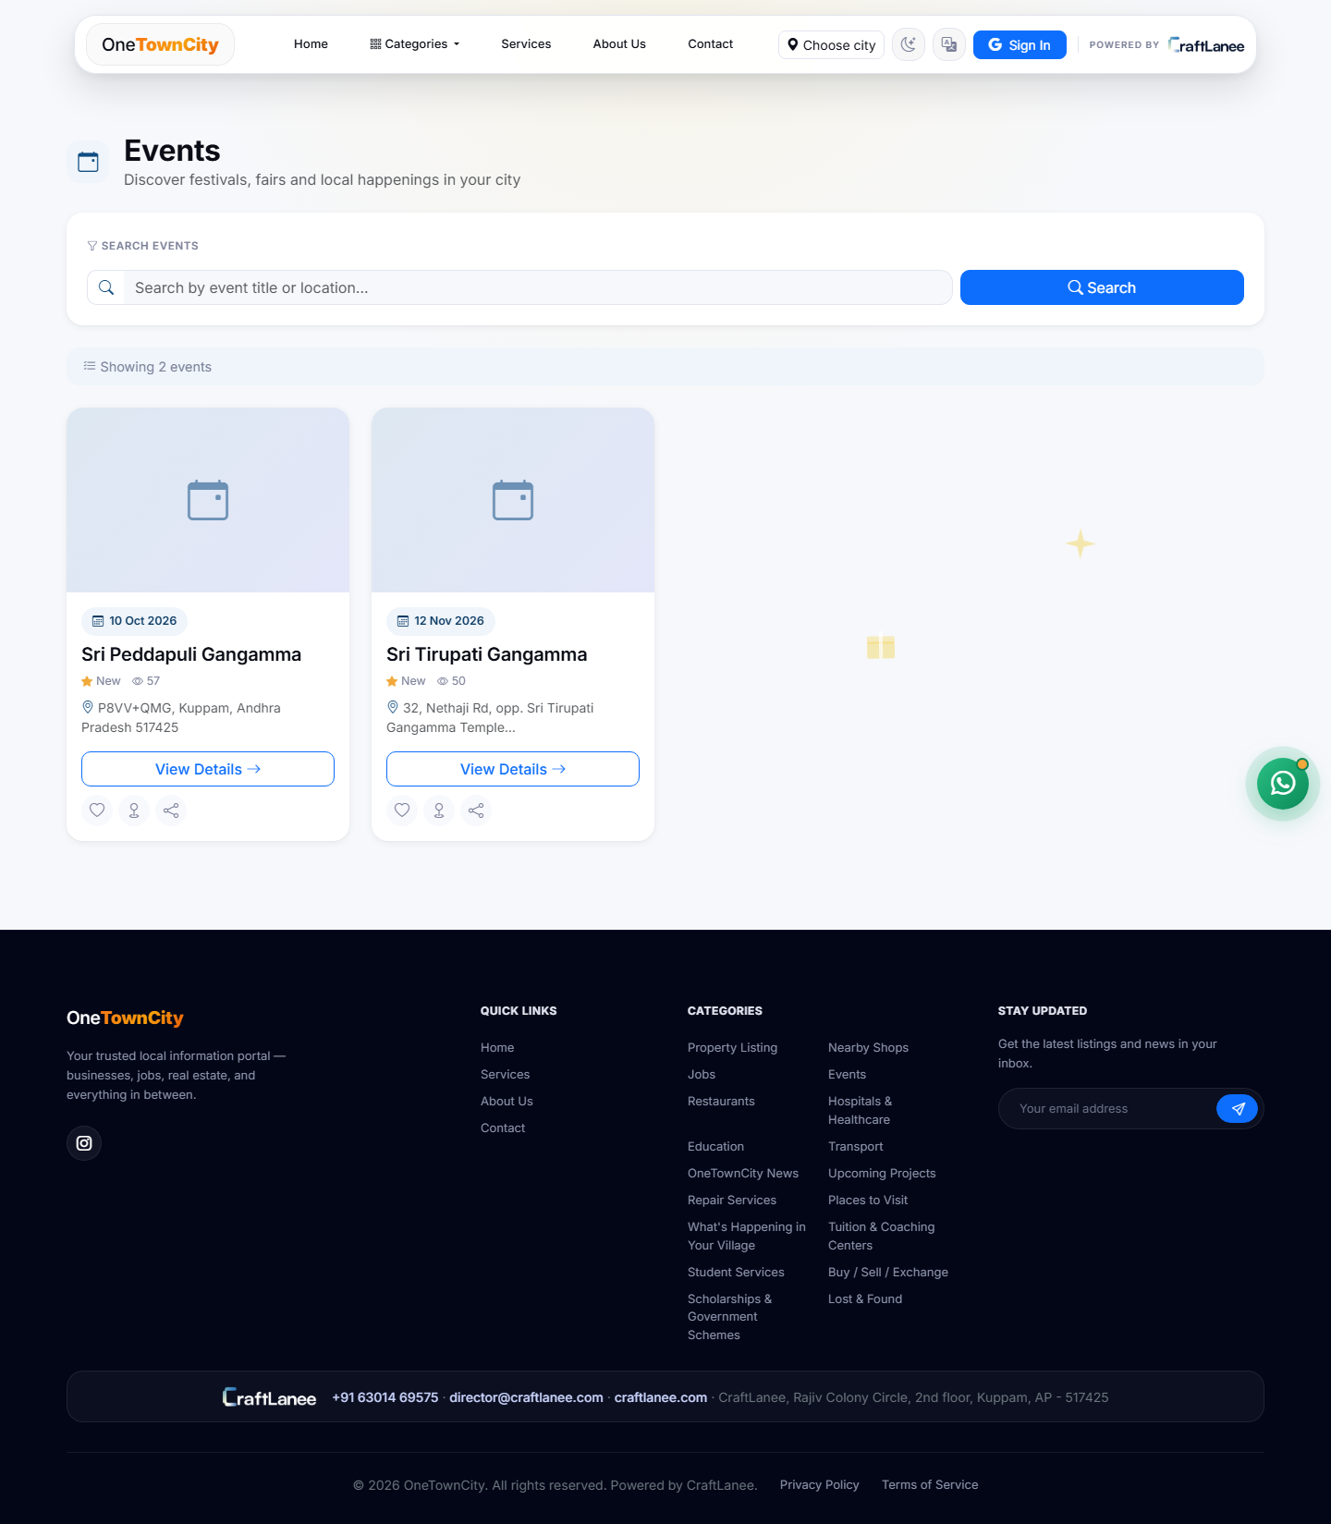
JOBS & EVENTS
Local opportunities and happenings
Regular and hourly-gig job postings with salary & shift details, alongside a live calendar of community events.
Job board
Events listing

Slide 10
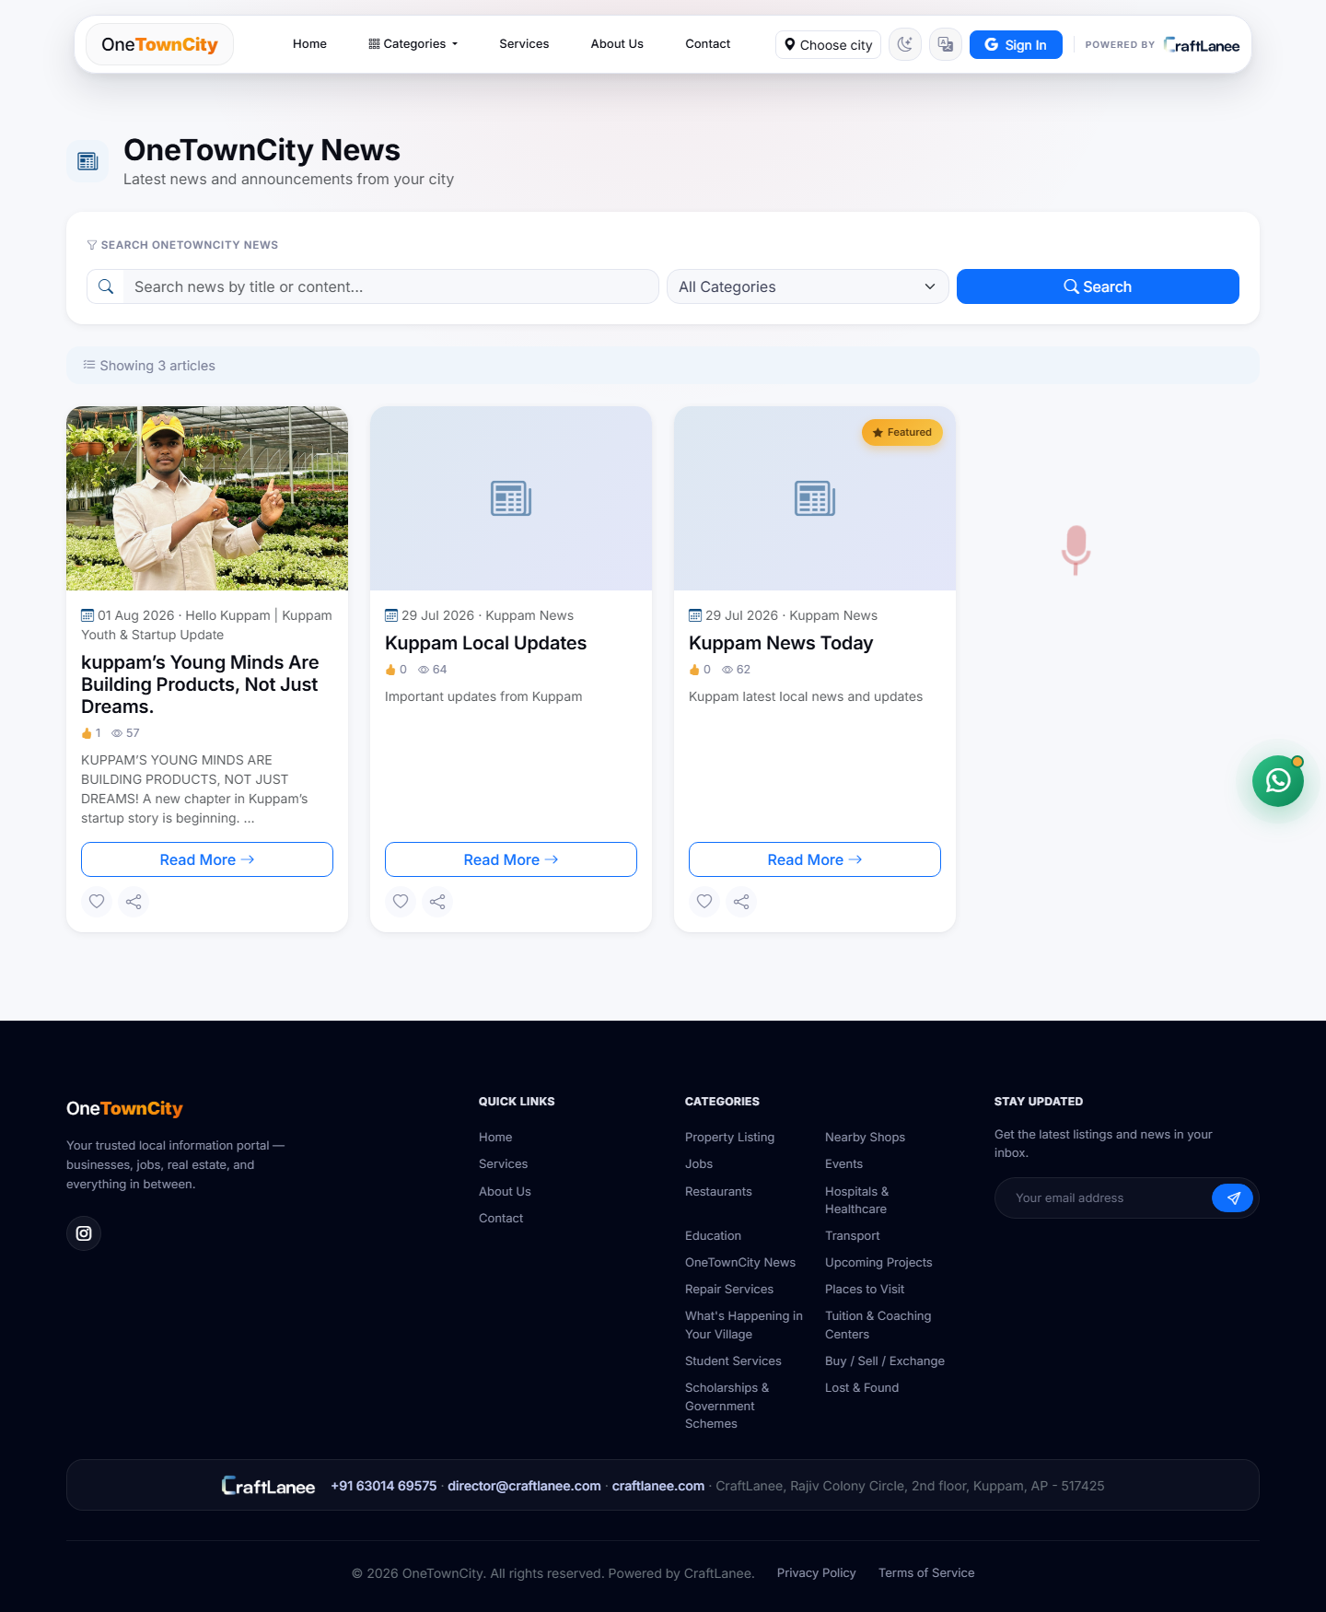
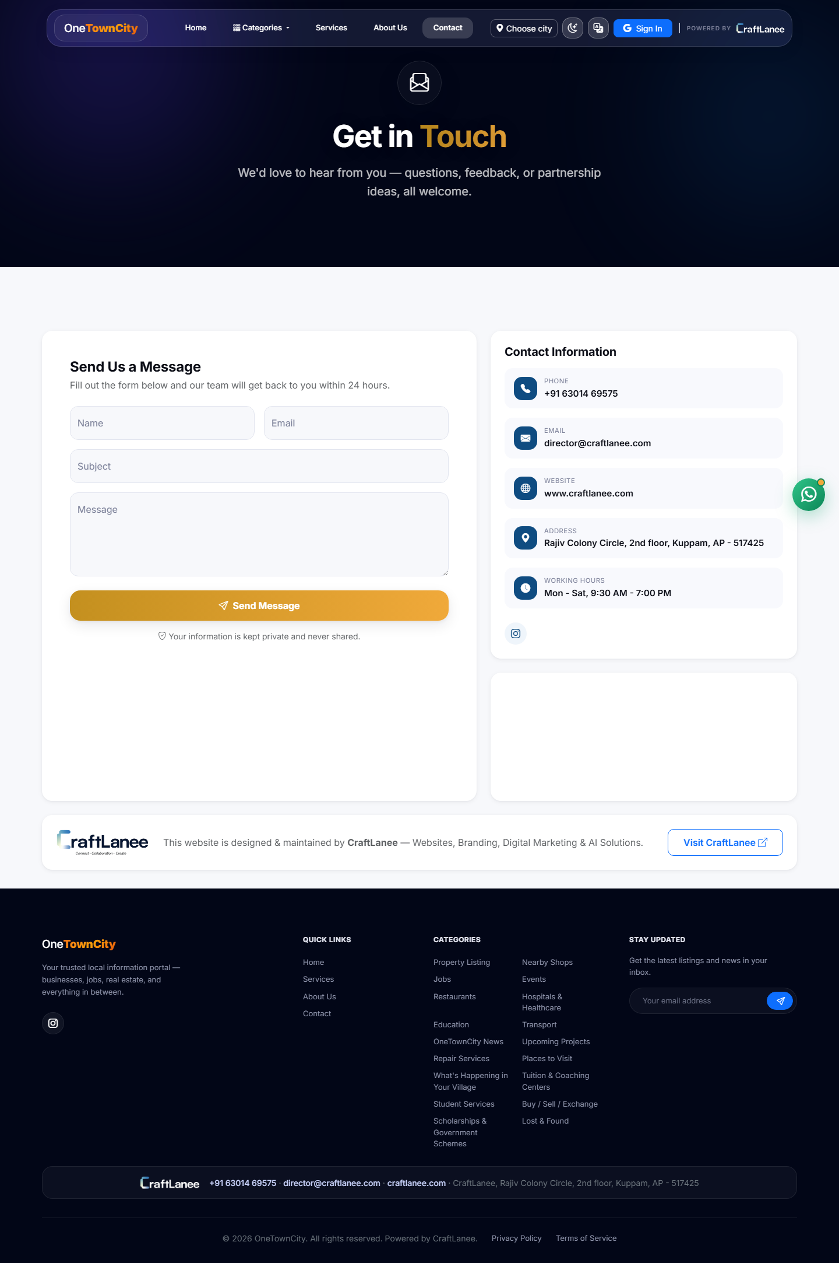
NEWS & COMMUNITY
Keeping residents in the loop
Local announcements and civic news, plus a always-available contact form for resident enquiries.
OneTownCity News
Contact page

Slide 11
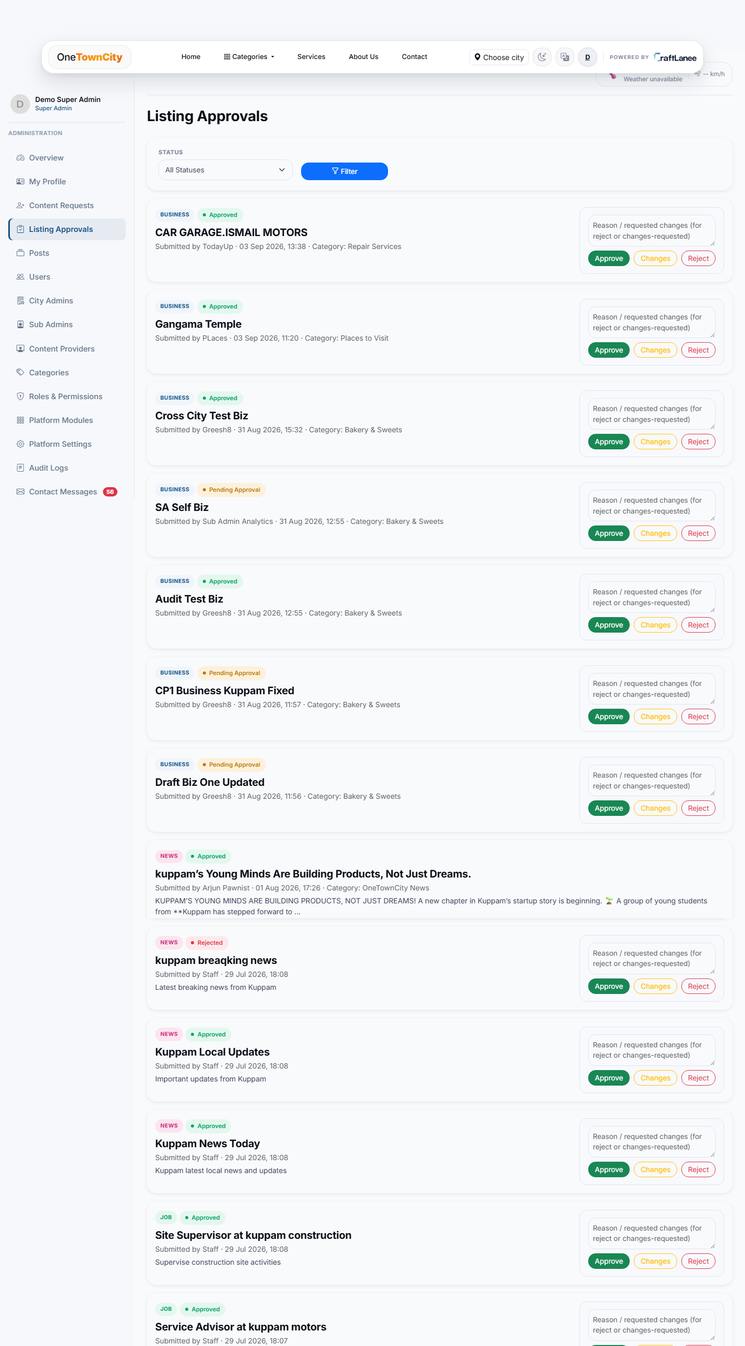
TRUST & MODERATION
Every listing is reviewed before it goes live
Draft
→
Pending Approval
→
Approved / Rejected
→
Changes Requested
› Instant publish — City Admin submissions go live immediately, since they carry full authority.
› Review queue — Sub Admin and Content Provider submissions wait for the responsible admin.
› Full control — reviewers can approve, reject with a reason, or request changes before resubmission.
› Accountability — every listing keeps a record of who reviewed it and when.
OneTownCity · Powered by CraftLanee

Slide 12
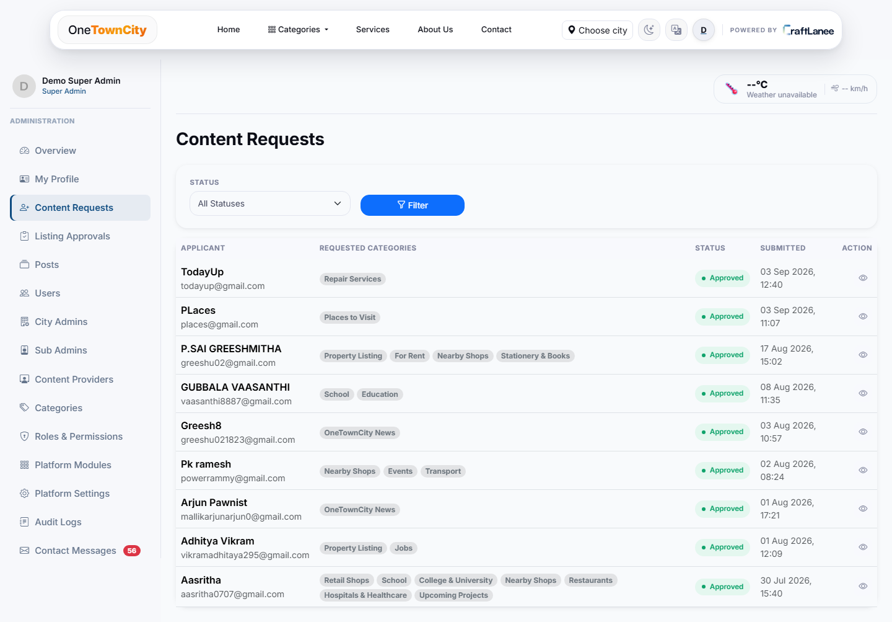
NEW
NEW FEATURE
Category request & access workflow
› Self-service applications — residents/businesses apply to list content in one or more categories.
› Reviewed, not automatic — every request is approved or rejected by an admin, with an optional note.
› Scoped access — approval grants access limited to exactly the categories requested.
› Existing providers can expand — approved Content Providers can request additional categories later, from their own dashboard.
› New: “What's Happening in Your Village” category, with its own request/approval flow.
OneTownCity · Powered by CraftLanee

Slide 13
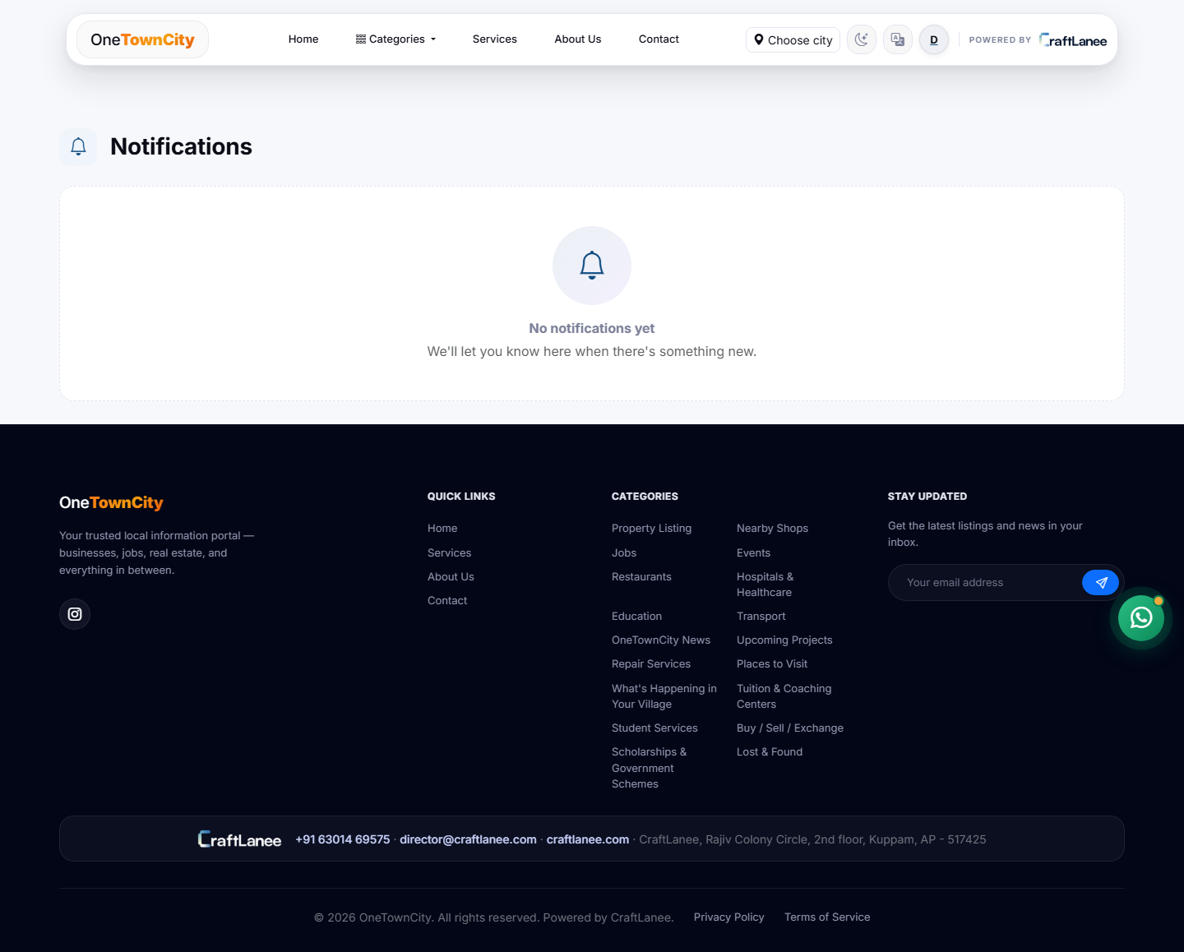
NEW
NEW FEATURE
Notifications keep everyone in sync
› In-app notification bell — for every signed-in user, with unread counts.
› Admin dashboard alerts — City Admins are notified the moment a new category request or listing needs review.
› Browser/OS push — Web Push notifications reach users even when the site isn't open.
› Mark-as-read controls — individually or all at once.
› Faster turnaround — requests no longer sit unnoticed in a queue.
OneTownCity · Powered by CraftLanee

Slide 14
COMMUNITY ENGAGEMENT
Built to feel like a community, not a directory
Likes & Comments
Ratings & Reviews
Favorites
Residents react and discuss on any listing.
Star ratings build trust in local businesses.
Save listings to revisit later, from “My Favorites”.
Social Sharing
Content Reporting
Newsletter & Contact
One-tap share to WhatsApp, Facebook, Telegram, X.
Flag inappropriate listings for moderator review.
Stay subscribed, or reach the team directly.
OneTownCity · Powered by CraftLanee

Slide 15
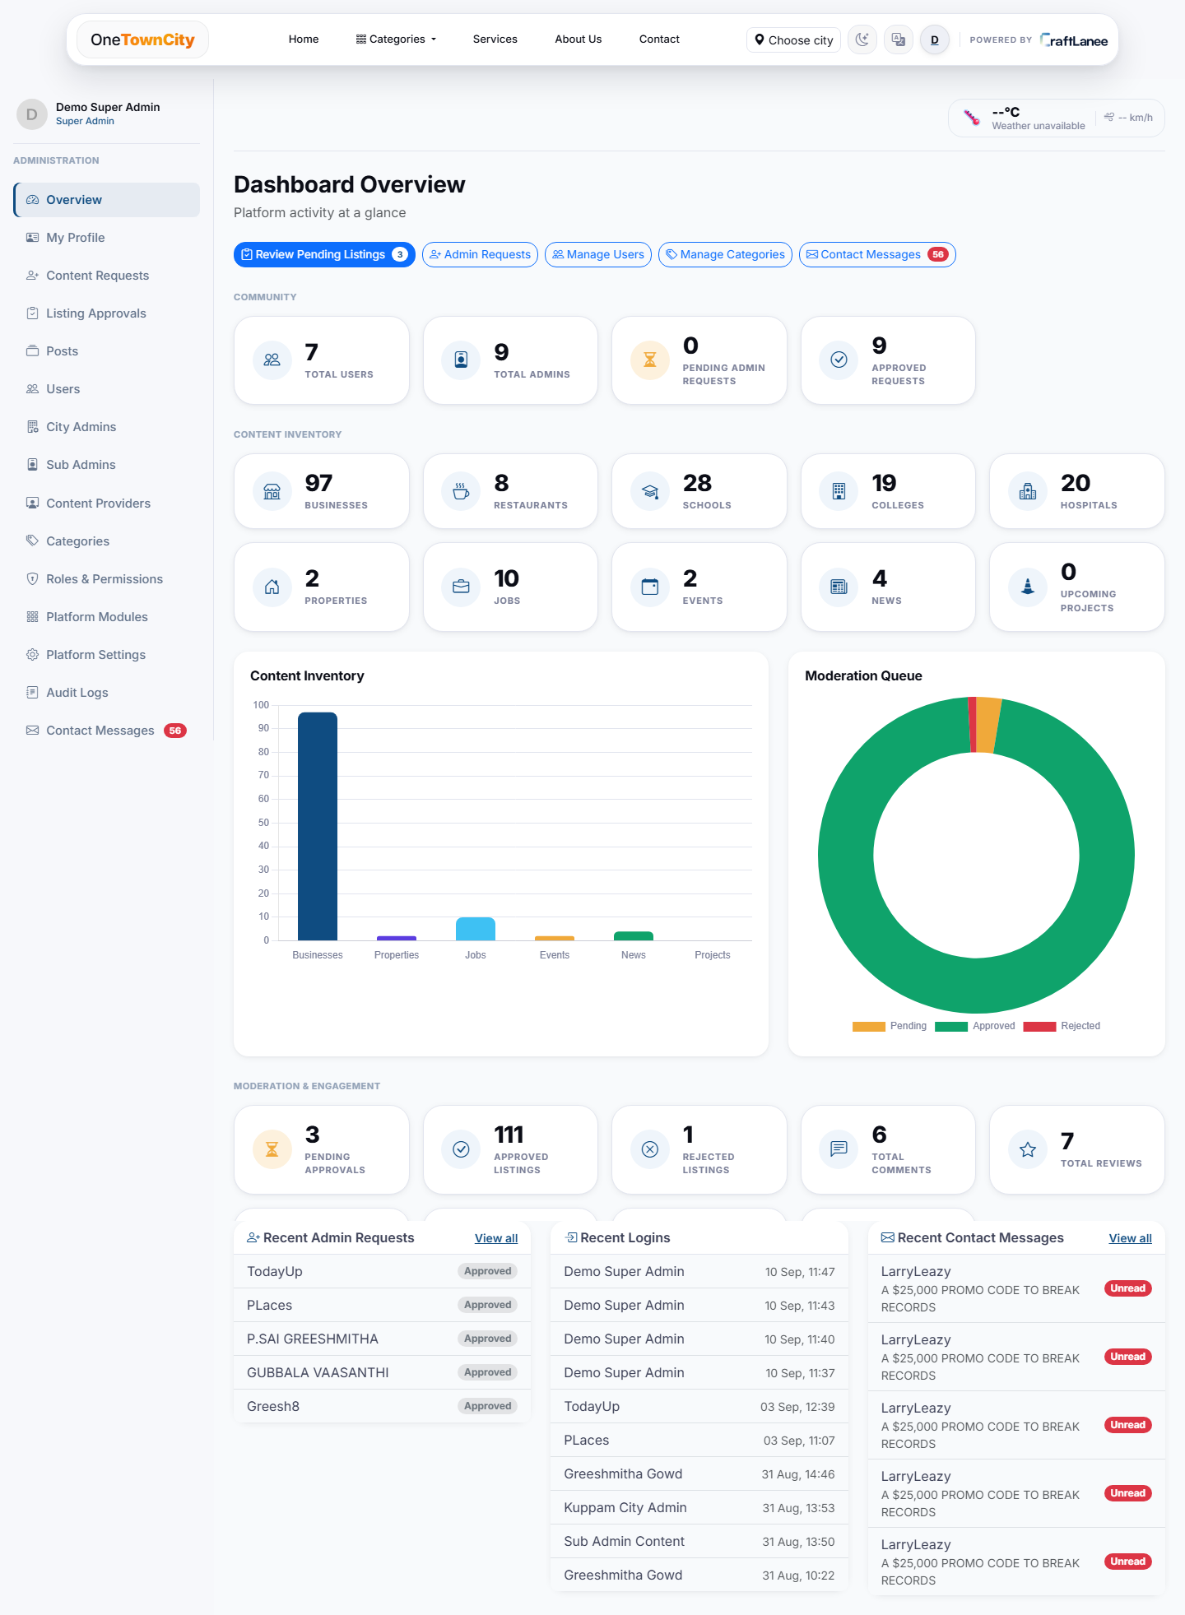
COMMAND CENTER
A real-time Super Admin dashboard
› At-a-glance metrics — total listings, users, pending approvals and activity, live.
› Role-aware views — Super Admin, City Admin, Sub Admin and Content Provider each see a dashboard scoped to their authority.
› Engagement analytics — views, likes, comments and shares per listing, over time — built from real event logs, not estimates.
› City-ready — scoping is built in, so onboarding additional towns is structural, not a rewrite.
OneTownCity · Powered by CraftLanee

Slide 16
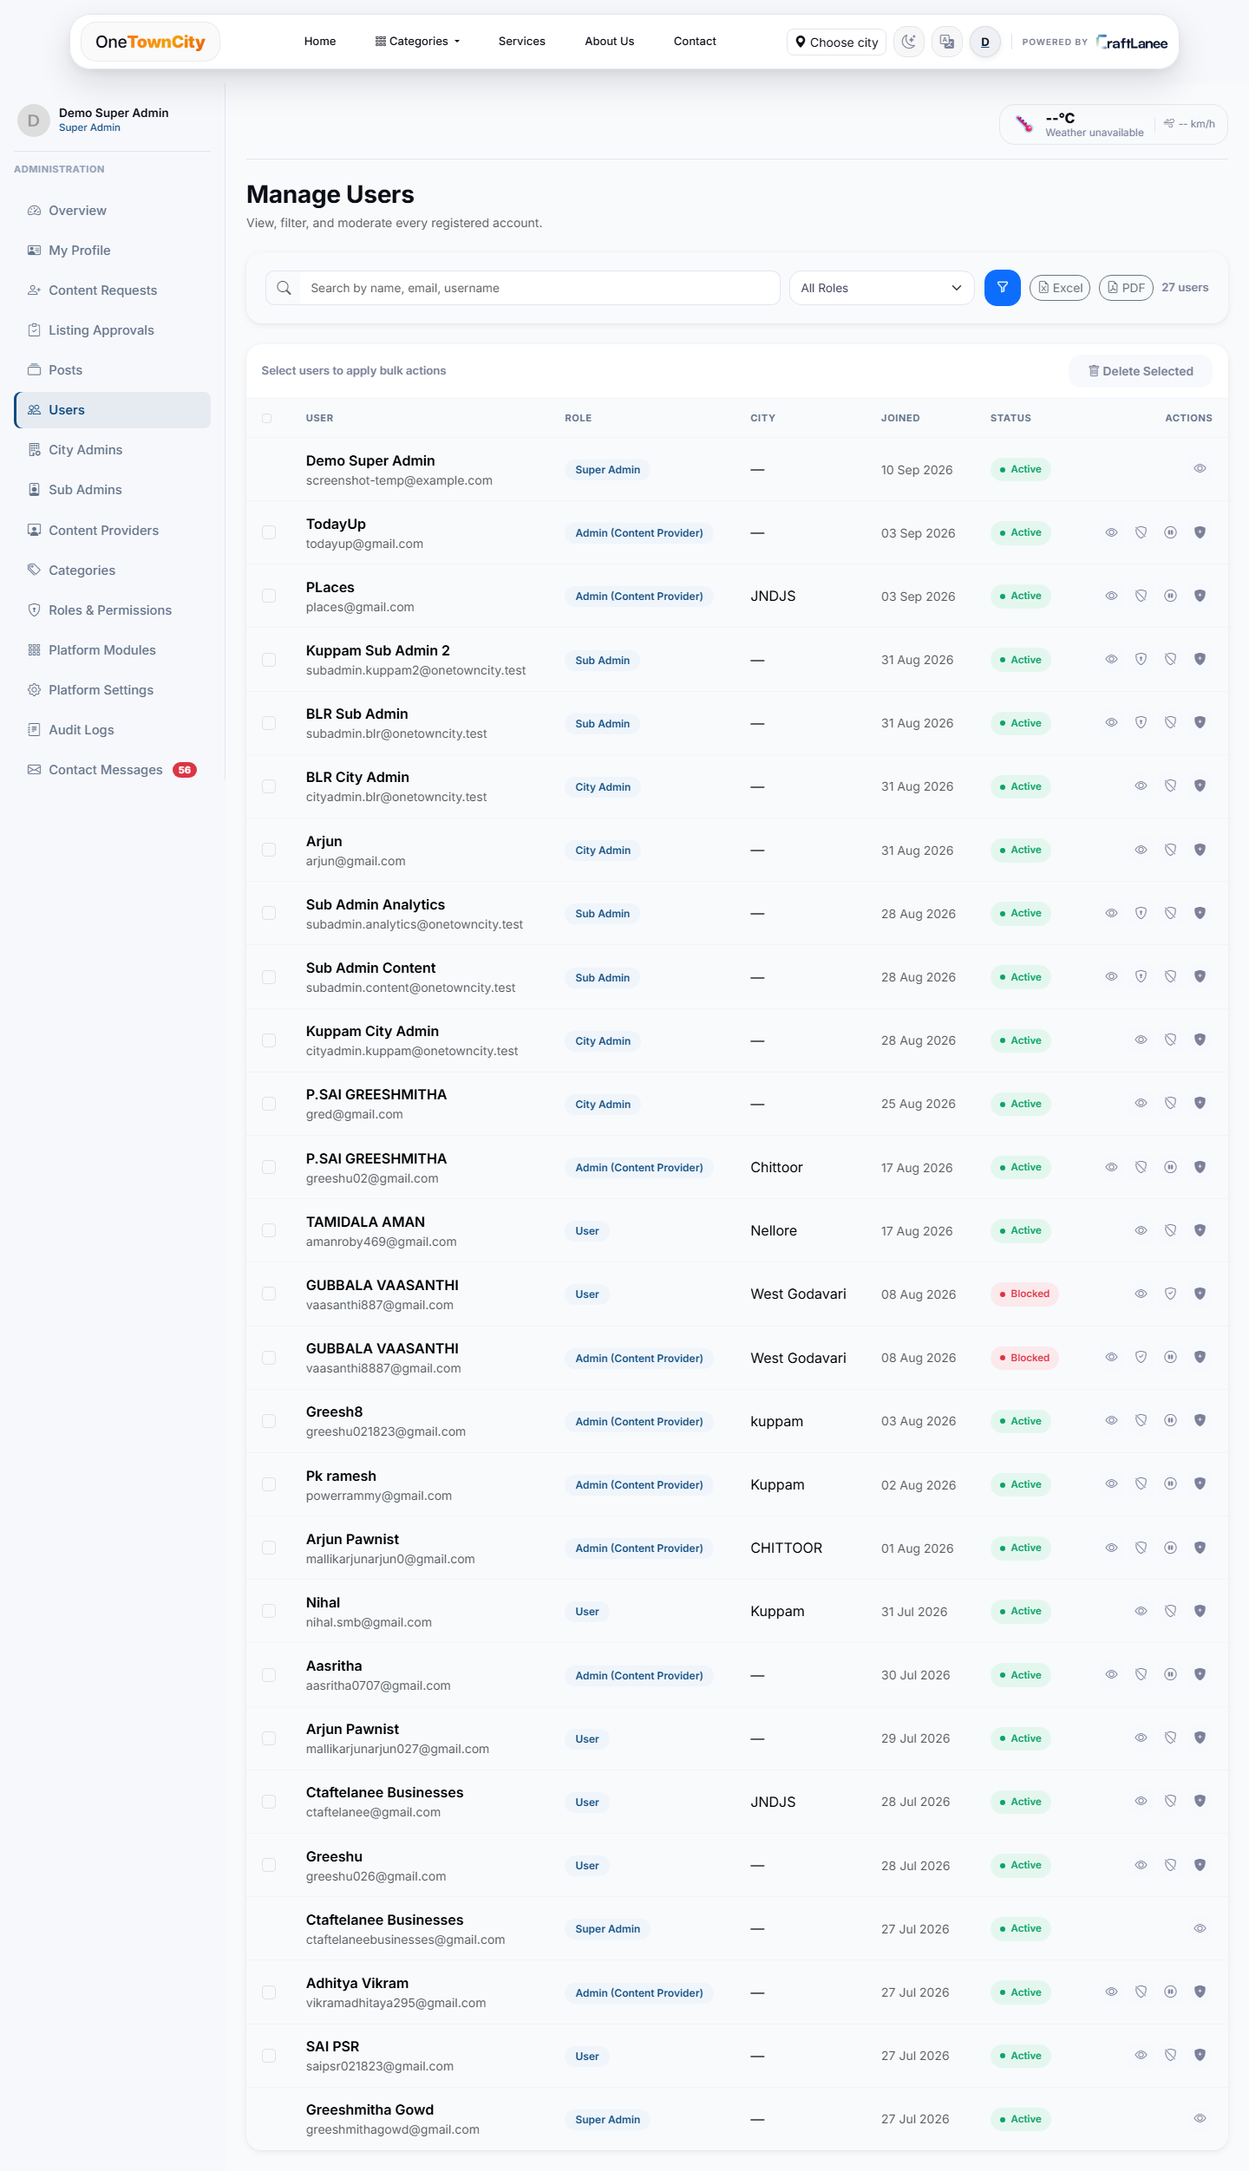
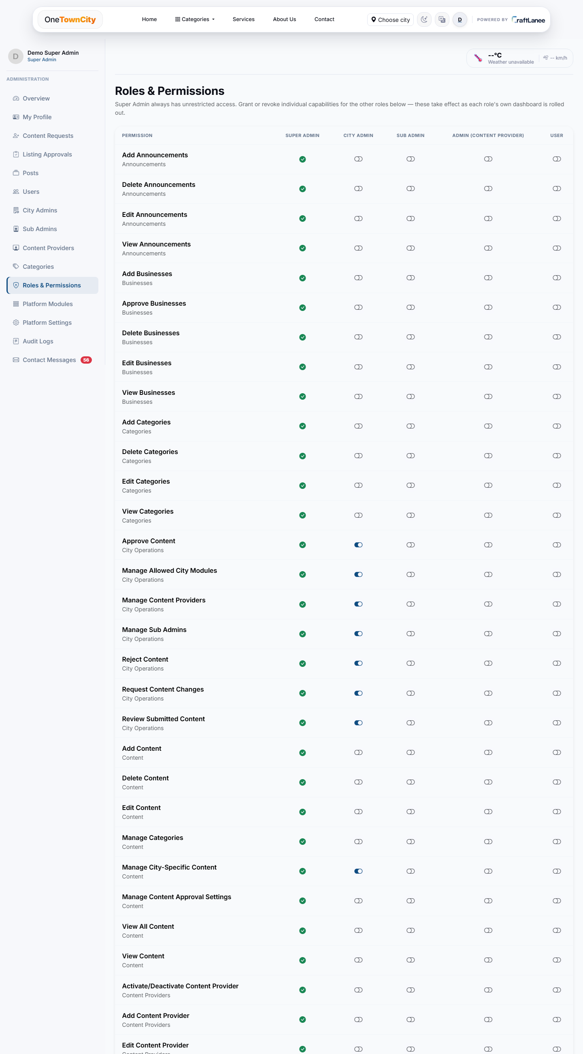
ADMINISTRATION
Fine-grained user & role management
Every account, role and permission lives in one place — with a full capability matrix per role.
Manage Users — search, filter, export, moderate
Roles & Permissions matrix

Slide 17
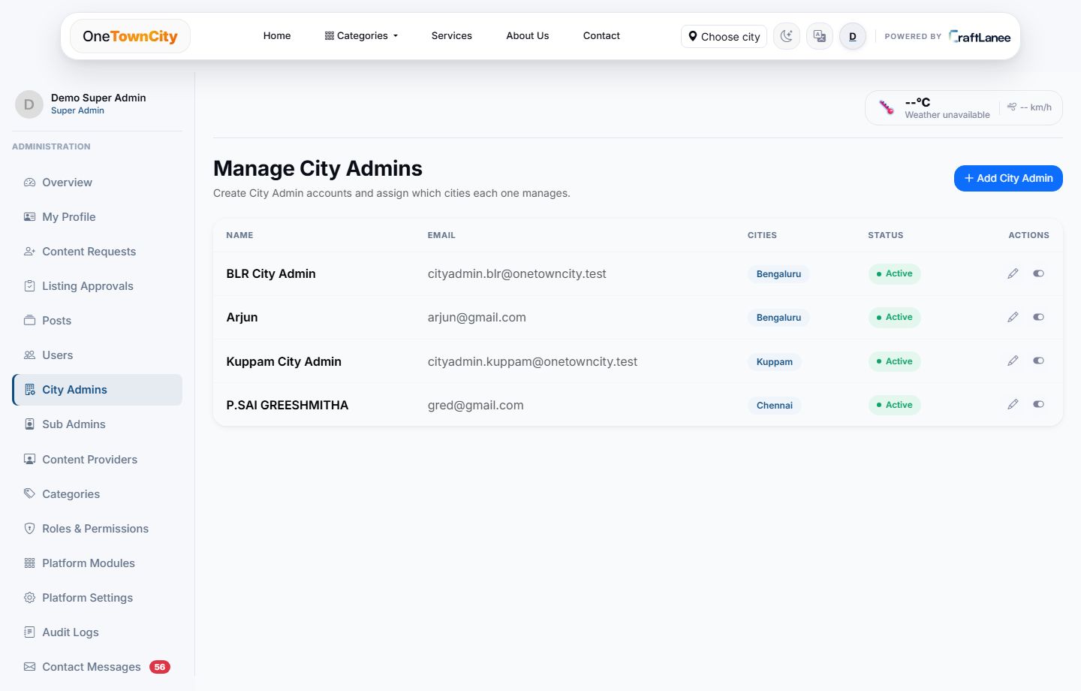
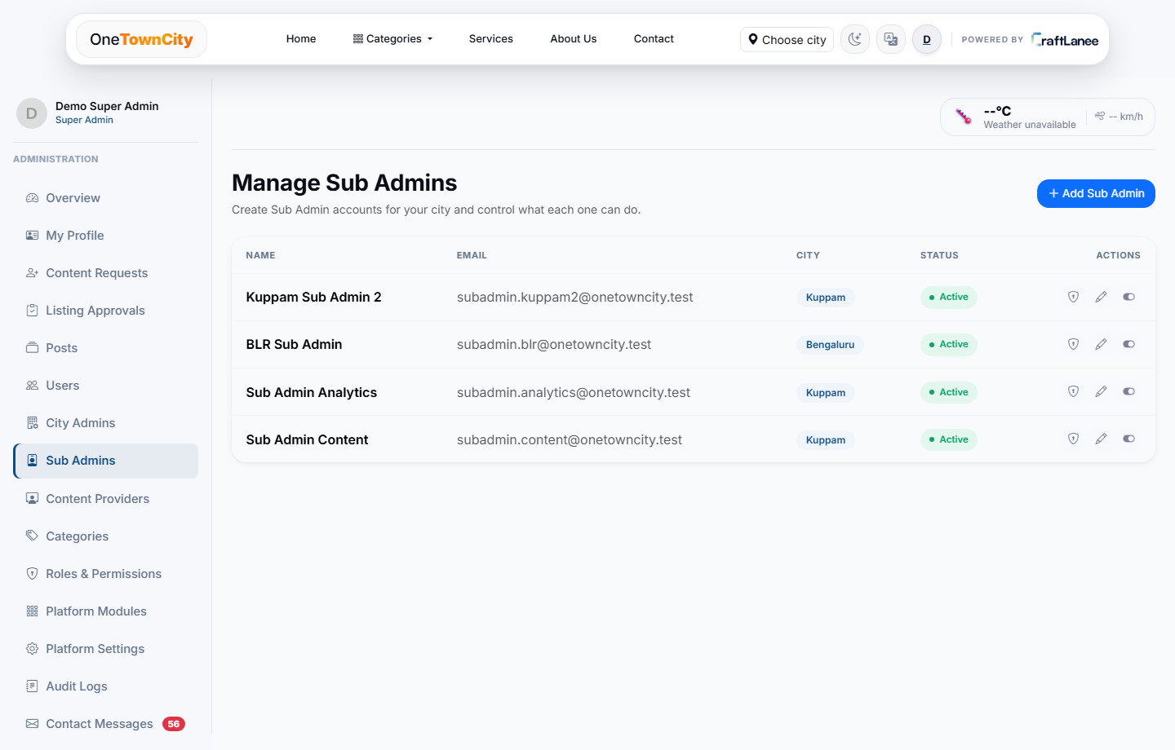
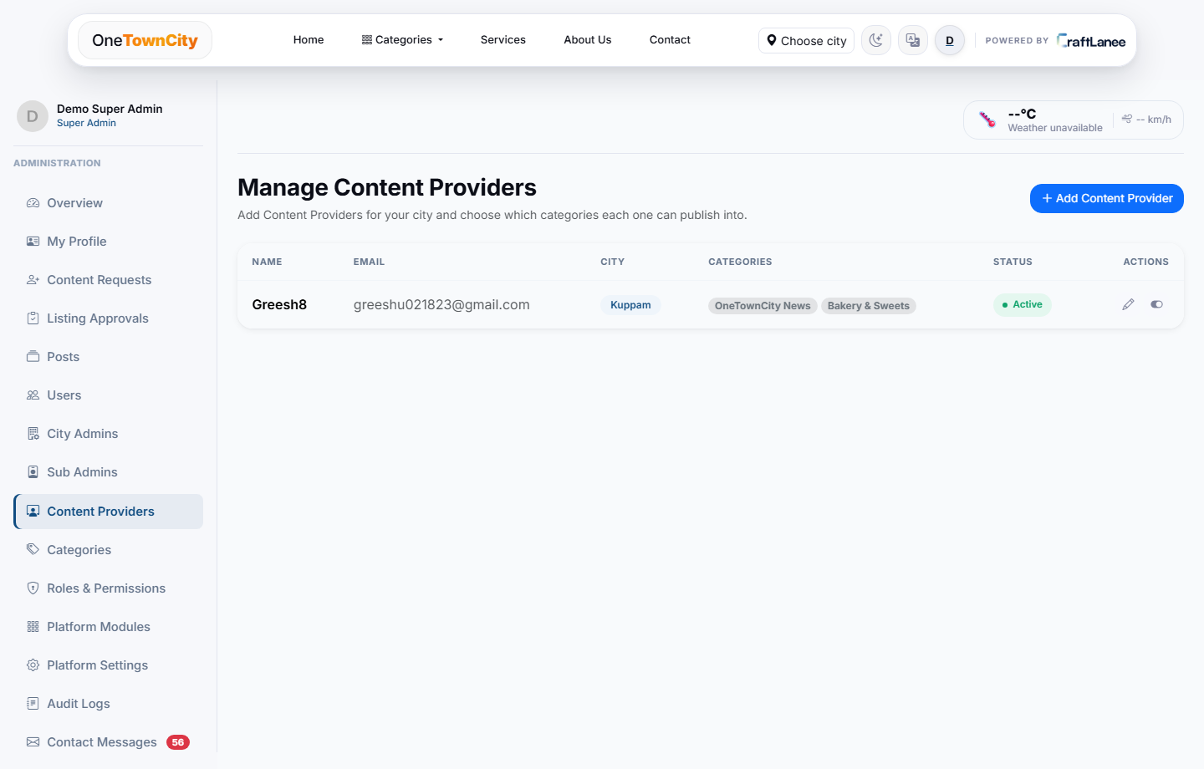
DELEGATED ADMINISTRATION
Authority that scales down cleanly
City Admins delegate exactly what's needed — a category, a listing type, or a permission — to the people who need it.
City Admins
Sub Admins
Content Providers
Full authority over one city.
Scoped rights per listing type, via a permission matrix.
Businesses/residents approved for specific categories.
OneTownCity · Powered by CraftLanee

Slide 18
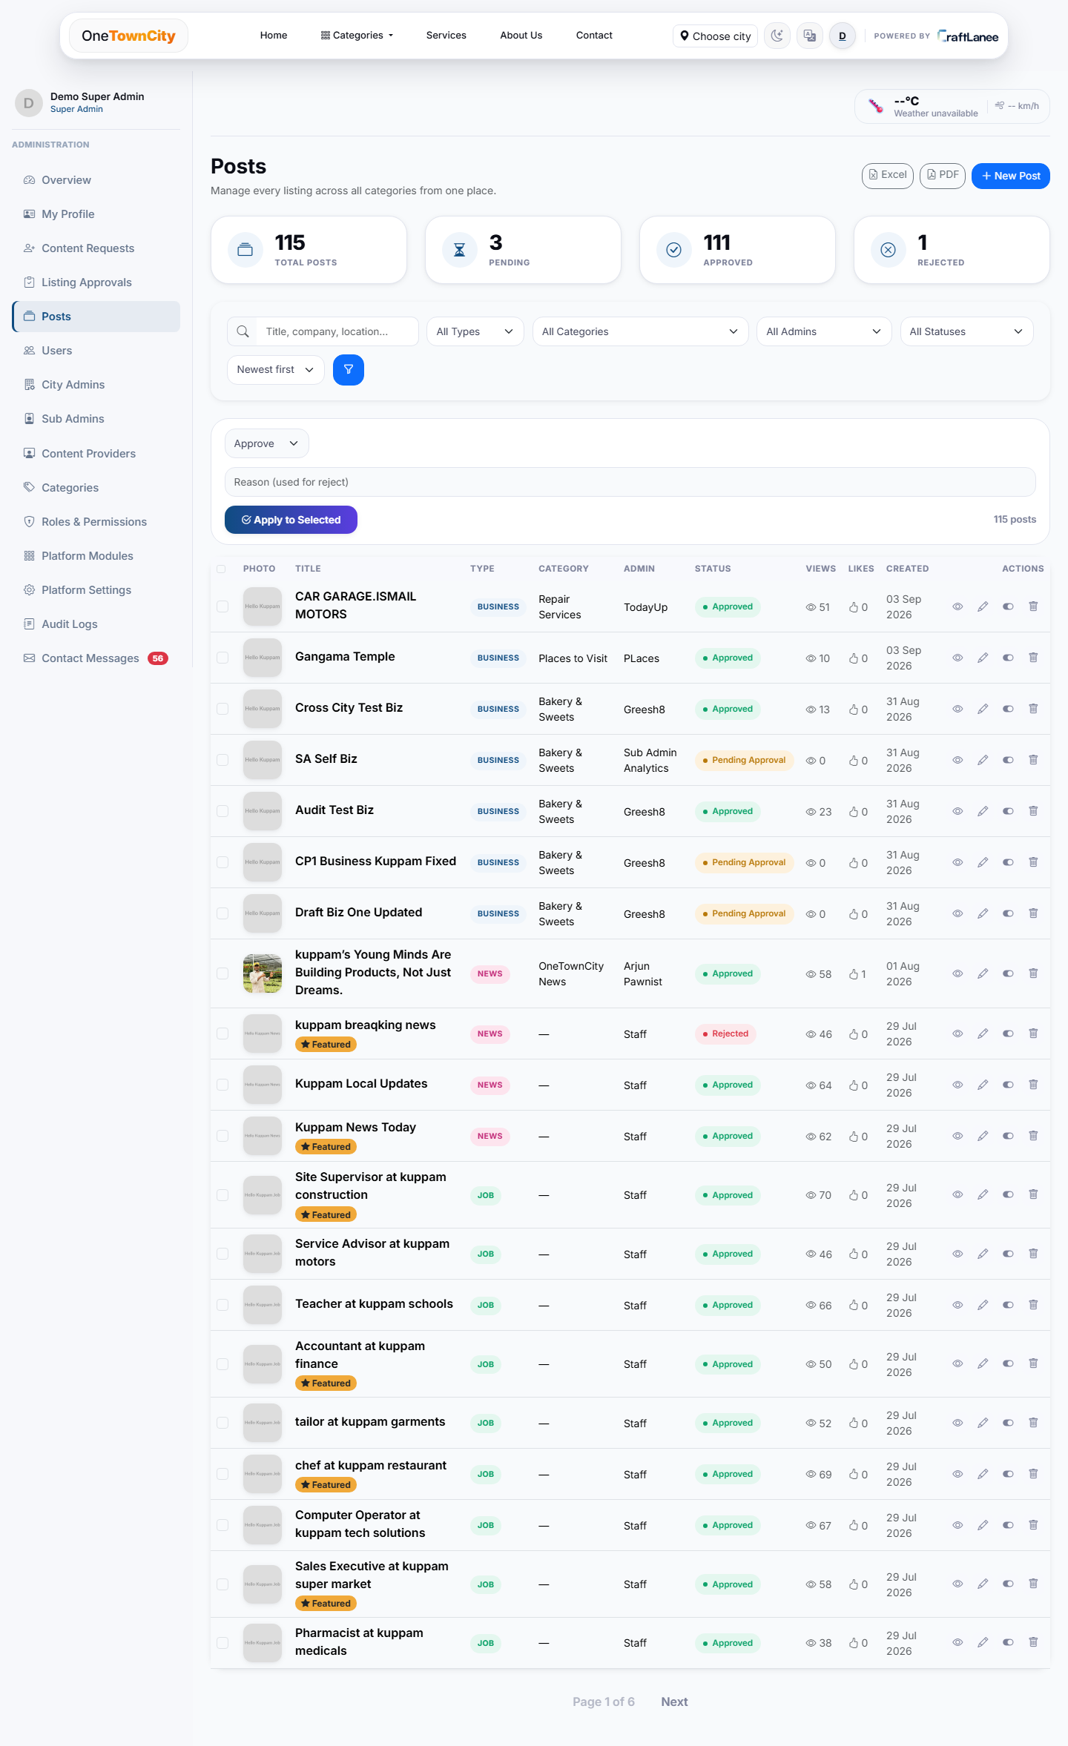
CONTENT OPERATIONS
One screen to manage every listing type
› Cross-model management — Business, Property, Job, Event, News and Project listings, unified in one table.
› Bulk actions — activate, feature, or remove listings in bulk.
› Media control — add/remove images and videos, set a cover image, per listing.
› Export — download the full listing set to Excel or PDF for offline reporting.
OneTownCity · Powered by CraftLanee

Slide 19
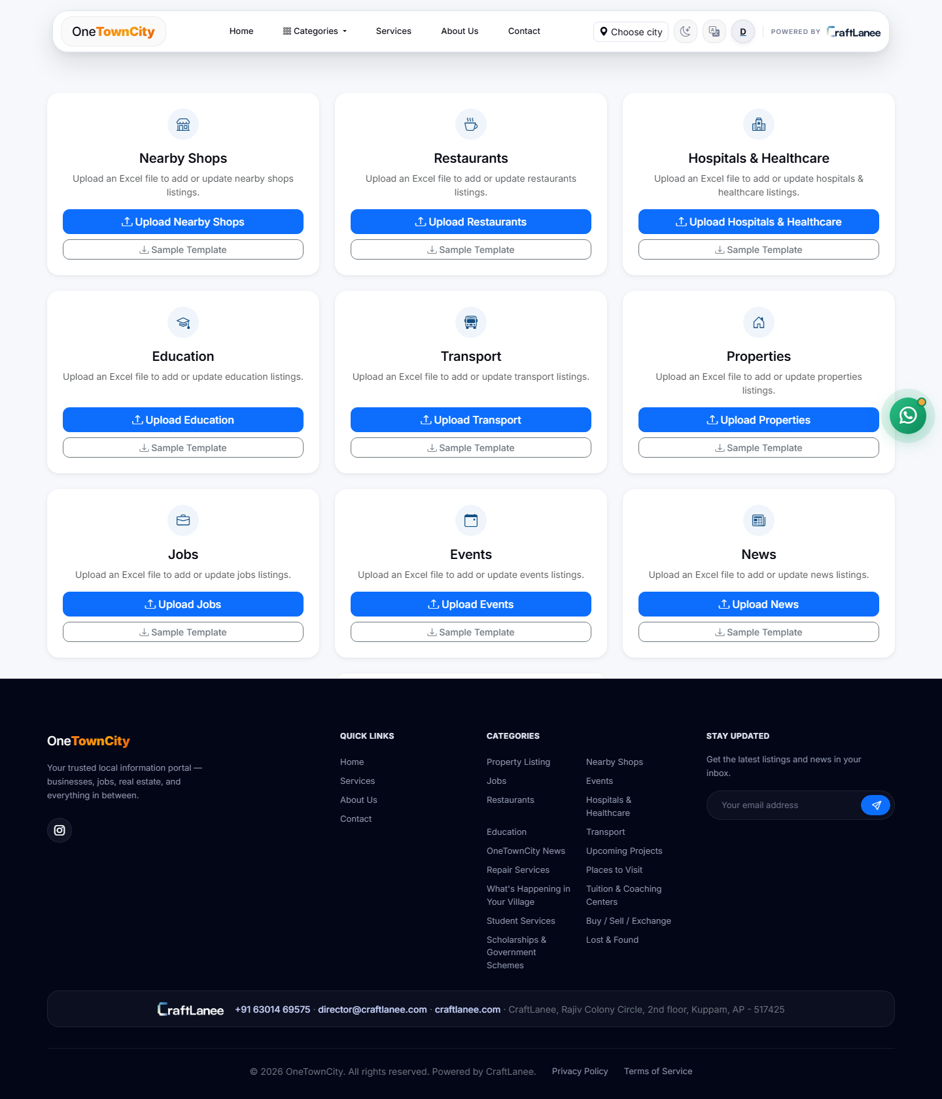
ADMIN TOOLS
Bulk content seeding via Excel
› Fast onboarding — seed dozens of listings at once from a spreadsheet, per listing type.
› Sample templates — downloadable sample files show the exact expected column format.
› Ownership-aware — Content Provider uploads are attributed and enter the approval queue; staff uploads publish directly.
› Built on pandas/openpyxl — reliable parsing with clear per-row error feedback.
OneTownCity · Powered by CraftLanee

Slide 20
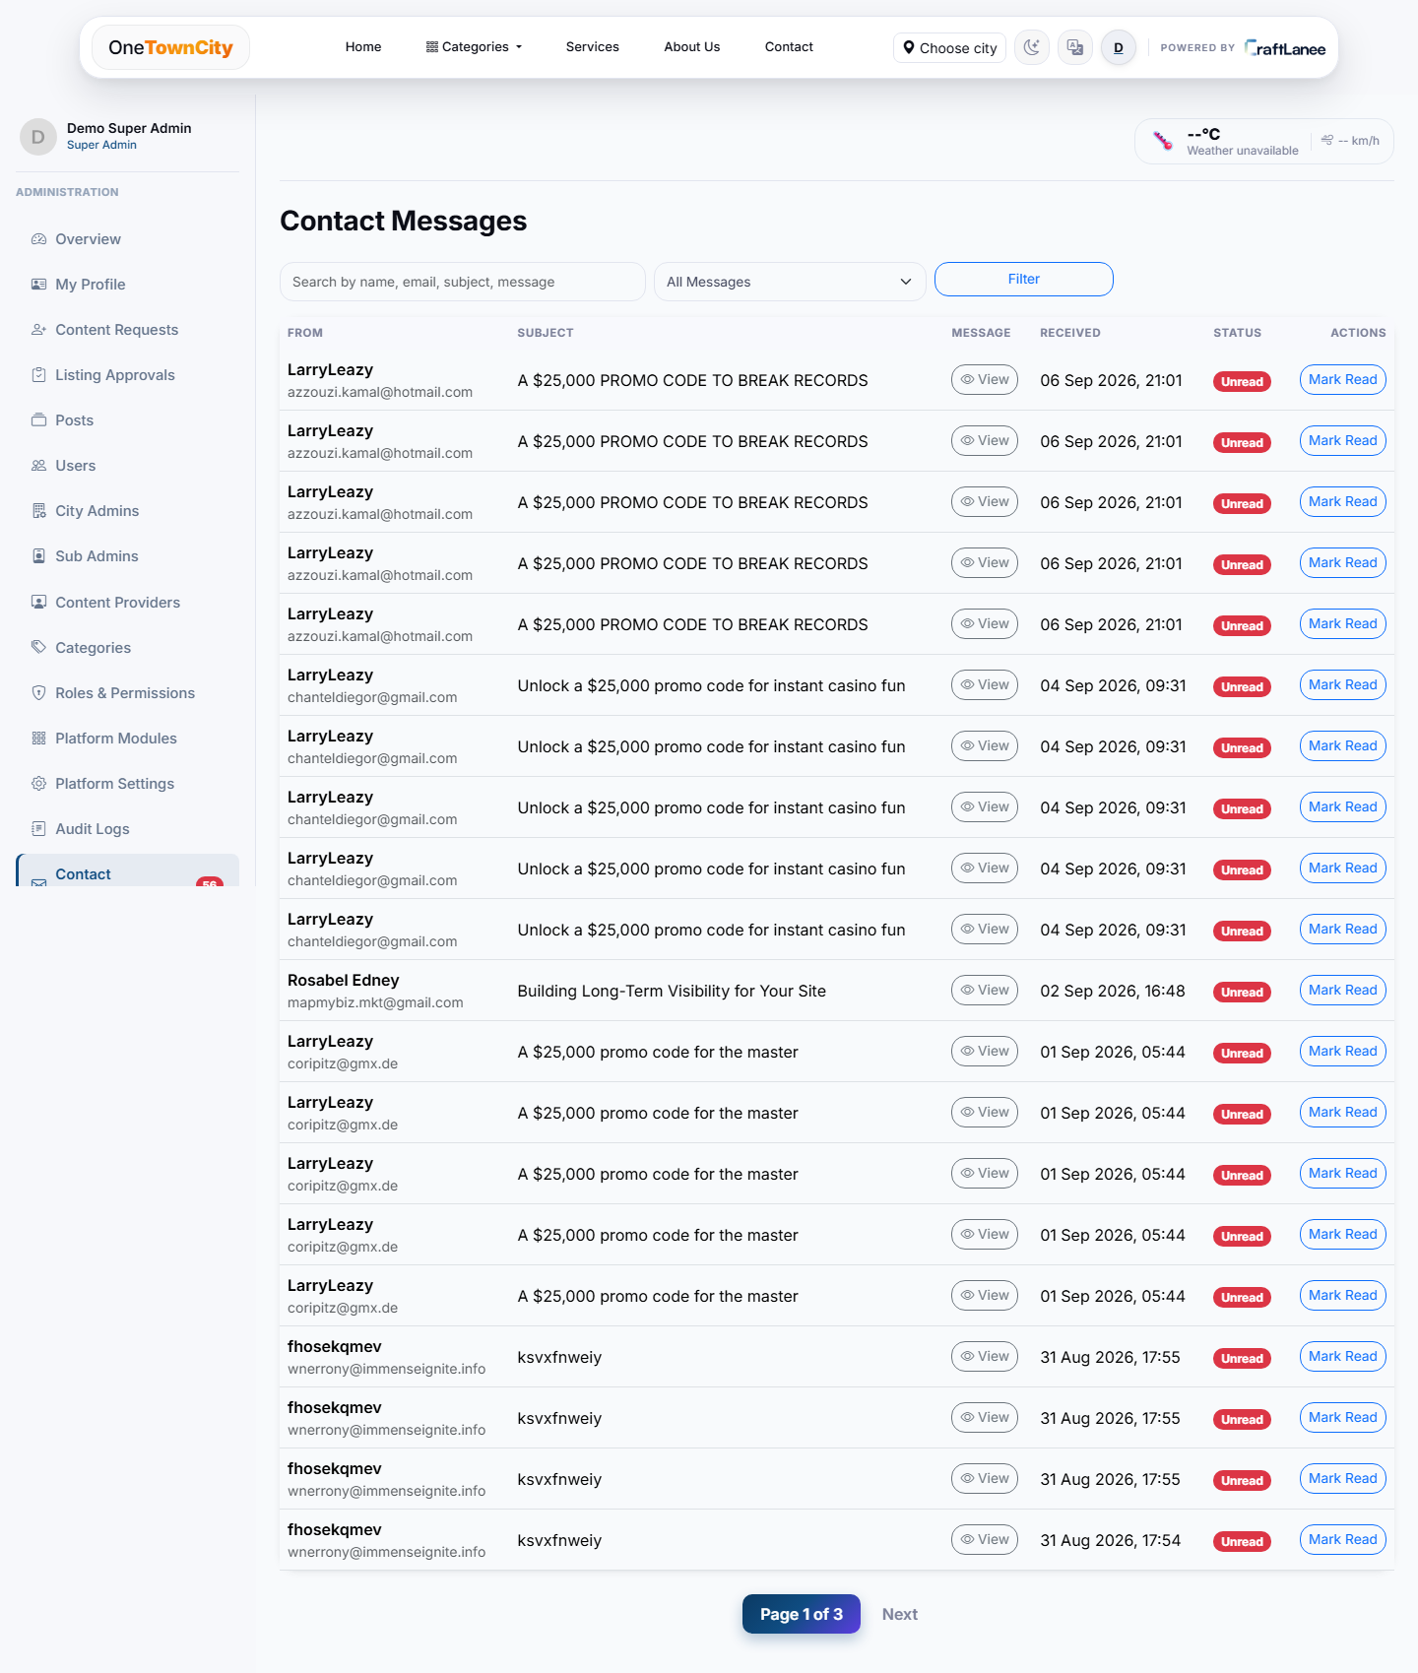
REACH & ACCESSIBILITY
Built for every resident
› Multi-language interface — Hindi, Tamil, Telugu and Kannada, alongside English.
› Google Sign-In — quick, secure access with no password to remember.
› Mobile-first, responsive — designed for the phone-first way most residents will use it.
› Centralized inbox — every contact-form submission lands in one filterable admin view.
OneTownCity · Powered by CraftLanee

Slide 21
TECHNOLOGY
A modern, reliable, widely-supported stack
Django 5.1
PostgreSQL
Supabase Storage
Supabase Auth
Python web framework
via Supabase
cloud media hosting
Google Sign-In
Bootstrap 5.3
Web Push
pandas + openpyxl
Gunicorn
responsive frontend
browser notifications
Excel import/export
production WSGI server
Deployment-ready for standard cloud hosting (Render, Railway) with static files served by WhiteNoise and configuration kept out of the codebase for secure deployment anywhere.
OneTownCity · Powered by CraftLanee

Slide 22
Thank you
Ready for review, feedback, and next steps.
CraftLanee
director@craftlanee.com · +91 63014 69575 · craftlanee.com

