Slide 1
Adaptive H.I.D.
Viability Review of Low Cost, Libre
Adaptive Human Interface Devices
to Modern Computers
CPE 495-01
Michael Baldwin
Christopher Bero
Bryant Johnson
John Gould

Slide 2
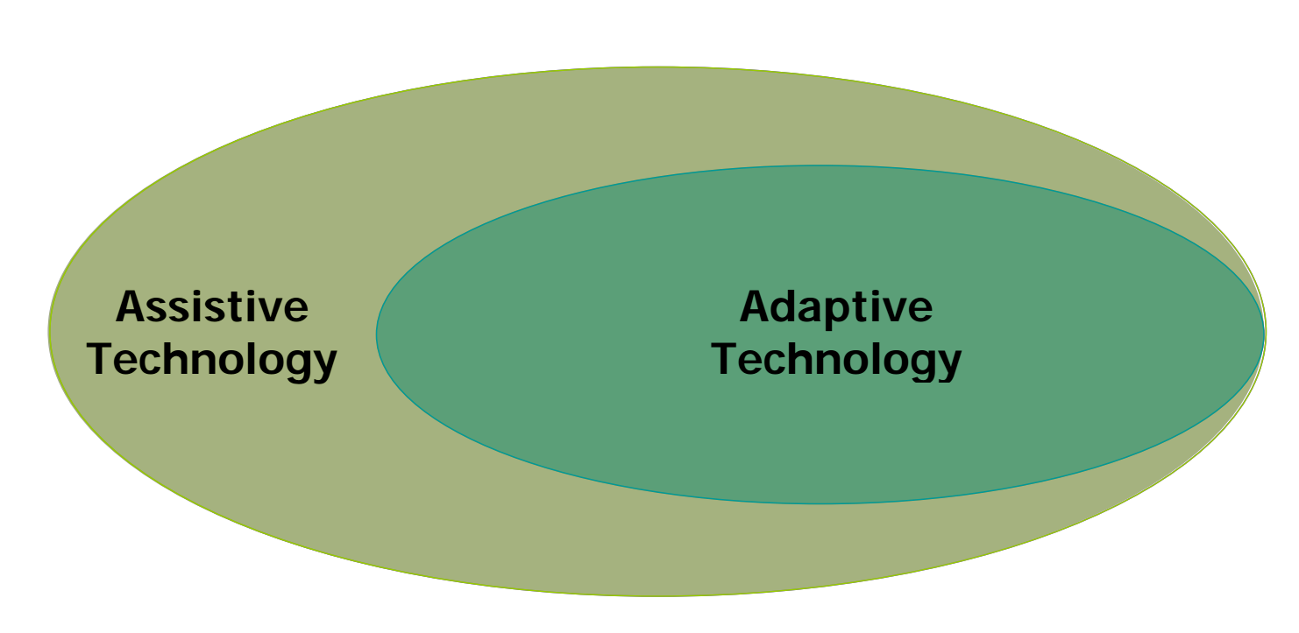
Vocabulary
[1]
Assistive Technology
Any item, equipment, or product that can be used to increase functional capabilities of persons with disabilities.
Adaptive Technology/Systems (A.T.)
A device or component which is specifically design for persons with disabilities.
Notes:
[1] PDF
http://glencoe.mheducation.com/sites/dl/free/0078901359/594902/AAT_v4.pdf

Slide 3
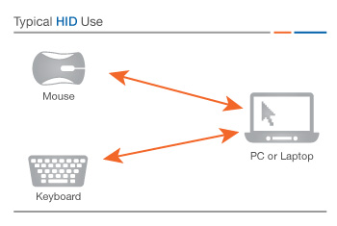
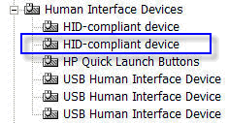
Vocabulary
Human Interface Device (H.I.D.)
A method by which a human interacts with an electronic information system either by input or output [1].
That thing that Windows XP could never recognize.
Notes:
[1]
https://www.techopedia.com/definition/19781/human-interface-device-hid

Slide 4
Team Members
Christopher Bero
Interested in Environmental Conservation
Bryant Johnson
Interested in Cybersecurity
Mike Baldwin
Interested in Software Development
John Gould
Interested in Micro-controllers and Software Development

Slide 5
Team Members
Christopher Bero
Hardware Lead, Community Outreach
Bryant Johnson
Testing Lead, Technical Writer
Mike Baldwin
Software Lead, Systems Interface
John Gould
Systems Lead, Microcontrollers

Slide 6
Existing A.T. Shortfalls
Why Computers
In the United States alone:
12 million visually impaired persons
11.7 million physically disabled persons
These people perceive the format of books and paper as an obstruction to information access [1].
Computers offer access to this information and have allowances to implement highly customized interfaces.
Our generation consists of a voice that Internet access is a human right [2]. Unless it extends to all people, such discussions are farcical.
Notes:
“The Need”
[1]
http://www.independentliving.org/docs6/mates2000.html#chapter1
[2]
http://foreignpolicy.com/2015/02/02/unrestricted-internet-access-human-rights-technology-constitution/

Slide 7
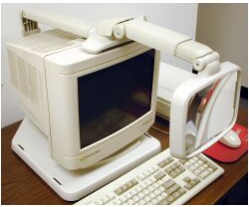
Existing A.T. Shortfalls
Adaptability and Improvement
Due to high development costs and low volume market, adaptive technology tends to be less than.. adaptive.
Systems developed a decade ago were not targeted toward efficient flat panel monitors or high speed USB connections.
But they are still in use today, and either have no replacement or are prohibitively expensive to exchange.

Slide 8
Existing A.T. Shortfalls
Expense
A.T. is currently prohibitively costly to obtain.
This is often attributed to the “niche market” and left to government programs and health insurance to offset [1].
Such reasoning leaves out persons without insurance and developers who wish to create software for these systems.
In order for A.T. to reach as many people as effectively as possible, the cost must be brought down.
Notes:
[1]
http://www.atia.org/i4a/pages/index.cfm?pageid=3859

Slide 9
Move A.T. Forward
The maker / hacker movement has brought widespread adoption of:
Capable, easy to use prototyping tools
Access to low volume manufacturing
There should no longer be a barrier to providing modern, affordable interface systems to persons living with disabilities.

Slide 10
Marketing Requirements
Open Source Design
Require only items available to common makerspaces
Easy to iterate and customize
Low cost requirements for parts and machinery
Easy to Operate
Must provide as good or better functionality than existing solutions
Reliable
Must accept improper input and have a robust mechanical design

Slide 11
Engineering Requirements
Hardware bounce time during activation < 6ms
10 Million Cycle Lifetime
Operation [1]
30 Words Per Minute
90% Typing Accuracy
Operating Temperature: -10C – 70C
Materials
Thermoplastics – Case, Mounts
Stainless Steel – Springs, Case
Gold Alloy – Switch Contacts
Notes:
[1] Braille App
http://www.cnn.com/2012/02/20/tech/can-braille-be-faster-than-qwerty-app-developer-thinks-so/index.html

Slide 12
Existing Systems
Large Switch Keyboards
Head/Mouth Stick Keyboards [1]
Braille Embossed Keyboards [1]
Keyless (orb) Keyboards [2]
Notes:
[1] Maltron
http://www.maltron.com/shop/category/142-usa
[2] Orbitouch
http://orbitouch.com/products/#

Slide 13
Alternatives
MSP430 USB or Kiibohd KLL
Paddle Input Keyboard
Braille Input Keyboard
Refreshable Braille Display

Slide 14
Proposed Approach
Contact customer ☑
Triage Systems
Design iteration w/ customer
Milestone 1: Primary system hardware and software prototype
Integration testing with customer
Metrics for study collected
Deliverbables brought to cutomer

Slide 15
Project Summary
Design a set of adaptive interface devices for modern computers with readily available consumer machinery and products. The product will have a focus on affordability, iterative design, and easy operation. Construct and test the devices for viability in general use; then generate a case study on the effectiveness of this approach to bringing adaptive technology to a larger audience.

Slide 16

System Design Description

Slide 17

System Design Description

Slide 18
Testing
Primary testing will be dependent on the cooperation of outside organizations. We have already reached out to several organizations and are waiting on feedback.
Optimally we would like to allow several people from our target audience to try several of our prototypes so we can determine values such as words per minute and get feedback on the system for improvements.

Slide 19
Testing
Testing will consist of qualitative and quantitative feedback from the user.
Qualitative:
Ease of use, time required to learn.
Ergonomics, comfortable use.
Quantitative:
Setup time for a new user.
Words per minute.
Daily use setup/boot time

Slide 20
Timeline

Slide 21
Individual Responsibility

Slide 22
Cost Estimate
Supplies Cost
Microcontrollers (2) $37.94 - $200
Switches (25) $37.50
Case (4) $50.00 - $150
PCB (10) $31.00 - $200
Total cost $156.44 - $587.50

Slide 23
Course Deliverables
Detailed feedback on what approaches worked well and would be worth further investigation in future projects as well as what approaches were less than successful.
Working prototypes of four different input or output devices for the handicapped.
A collection of software enhancing the prototypes from a simple I/O peripheral to a more useful tool.

