Slide 1
Adaptive H.I.D.
Viability Review of Low Cost, Libre
Adaptive Human Interface Devices
to Modern Computers
CPE 495-01
Michael Baldwin
Christopher Bero
Bryant Johnson
Trey Gould

Slide 2
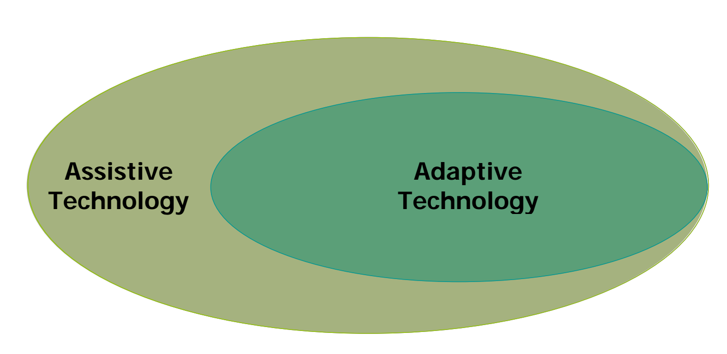
Vocabulary
[1]
Assistive Technology
  Any item, equipment, or product that can be used to increase functional capabilities of persons with disabilities.
Adaptive Technology/Systems (A.T.)
  A device or component which is specifically design for persons with disabilities.
Notes:
[1] PDF
http://glencoe.mheducation.com/sites/dl/free/0078901359/594902/AAT_v4.pdf

Slide 3
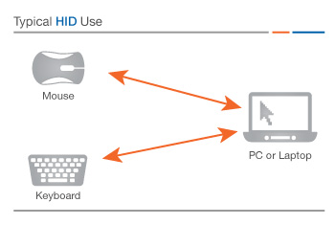
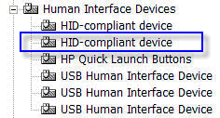
Vocabulary
Human Interface Device (H.I.D.)
  A method by which a human interacts with an electronic information system either by input or output [1].
  That thing that Windows XP could never recognize.
Notes:
[1]
https://www.techopedia.com/definition/19781/human-interface-device-hid

Slide 4
Team Members
Christopher Bero
  Interested in environment conservation
Bryant Johnson
  Interested in Cybersecurity

Slide 5
Team Members
Christopher Bero
  Hardware Lead, Microcontrollers
Bryant Johnson
  Testing Lead, systems engineering

Slide 6
Existing A.T. Shortfalls
Why Computers
  In the United States alone:
    12 million visually impaired persons
    11.7 million physically disabled persons
  These people perceive the format of books and paper as an obstruction to information access [1].
  Computers offer access to this information and have allowances to implement highly customized interfaces.
  Our generation consists of a voice that Internet access is a human right [2]. Unless it extends to all people, such discussions are farcical.
Notes:
“The Need”
[1]
http://www.independentliving.org/docs6/mates2000.html#chapter1
[2]
http://foreignpolicy.com/2015/02/02/unrestricted-internet-access-human-rights-technology-constitution/

Slide 7
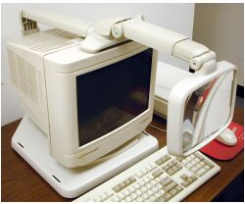
Existing A.T. Shortfalls
Adaptability and Improvement
  Due to high development costs and low volume market, adaptive technology tends to be less than.. adaptive.
  Systems developed a decade ago were not targeted toward efficient flat panel monitors or high speed USB connections.
  But they are still in use today, and either have no replacement or are prohibitively expensive to exchange.

Slide 8
Existing A.T. Shortfalls
Expense
  A.T. is currently prohibitively costly to obtain.
  This is often attributed to the “niche market” and left to government programs and health insurance to offset [1].
  Such reasoning leaves out persons without insurance and developers who wish to create software for these systems.
In order for A.T. to reach as many people as effectively as possible, the cost must be brought down.
Notes:
[1]
http://www.atia.org/i4a/pages/index.cfm?pageid=3859

Slide 9
Move A.T. Forward
The maker / hacker movement has brought widespread adoption of:
  Capable, easy to use prototyping tools
  Access to low volume manufacturing
There should no longer be a barrier to providing modern, affordable interface systems to persons living with disabilities.

Slide 10
Marketing Requirements
Open Source Design
  Require only items available to common makerspaces
  Easy to iterate and customize
  Low cost requirements for parts and machinery
Easy to Operate
  Must provide as good or better function than existing solutions
Reliable
  Must accept improper input and have a robust mechanical design

Slide 11
Engineering Requirements
Hardware bounce time during activation < 6ms
10 Million Cycle Lifetime
Operation [1]
  30 Words Per Minute
  90% Typing Accuracy
Operating Temperature: -10C – 70C
Materials
  Thermoplastics – Case, Mounts
  Stainless Steel – Springs, Case
  Gold Alloy – Switch Contacts
Notes:
[1] Braille App
http://www.cnn.com/2012/02/20/tech/can-braille-be-faster-than-qwerty-app-developer-thinks-so/index.html

Slide 12
Existing Systems
Large Switch Keyboards
Head/Mouth Stick Keyboards [1]
Braille Embossed Keyboards [1]
Keyless (orb) Keyboards [2]
Notes:
[1] Maltron
http://www.maltron.com/shop/category/142-usa
[2] Orbitouch
http://orbitouch.com/products/#

Slide 13
Alternatives
MSP430 USB or Kiibohd KLL
Paddle Input Keyboard
Braille Input Keyboard
Refreshable Braille Display

Slide 14
Proposed Approach
Contact customer
Triage Systems
Design iteration w/ customer
Milestone 1: Primary system hardware and software prototype
Integration testing with customer
Deliverbables brought to cutomer

Slide 15
Project Summary
Design a set of adaptive interface devices for modern computers with readily available consumer machinery and products. The product will have a focus on affordability, iterative design, and easy operation. Construct and test the devices for viability in general use; then generate a case study on the effectiveness of this approach to bringing adaptive technology to a larger audience.

Slide 16

System Design Description

Slide 17
Testing

Slide 18
Timeline

Slide 19
Individual Responsibility

Slide 20
Cost Estimate

Slide 21
Course Deliverables

