Slide 1
February 2016
Serialized Additive Manufacturing
CPE 496
Adaptive H.I.D.
Notes:
Oh no, I hope nobody reads my notes because LibreOffice can't decide what screen to display on! D:

Slide 2
Review – Terminology
Additive Manufacturing – Generally the process by which a component is built up layer by layer by depositing material.
Sometimes explained as a compliment to subtractive manufacturing – typical CNC routers and mills.
Also called “3D Printing” by many.
Additive manufacturing sounds more smarter-er.
http://www.eos.info/additive_manufacturing/for_technology_interested

Slide 3
Review – Terminology
FDM – Fused Deposition Modeling, what we're interested in. Operates by laying a molten bead (of plastic) to create discrete layers of an item.
SLA – Stereolithography. Uses a laser to cure liquid resin into discrete layers of an item.
SLS – Selective Laser Sintering. Cures layers of powder with lasers to form discrete layers of an item.
http://3dprintingfromscratch.com/common/types-of-3d-printers-or-3d-printing-technologies-overview/

Slide 4
Review – Beginnings
Originally designated as “Rapid Prototyping” methods, 3D printers first appeared in the 1980s.
Charles Hull invented the first SLA system in 1983; patented it in 1986.
In 1989 Scott Crump filed a patent for FDM technology.
Many derivative and bespoke processes followed throughout the 90's and early 2000's.
http://3dprintingindustry.com/3d-printing-basics-free-beginners-guide/history/
Notes:
Charles Hull later co-founded 3D Systems Corporation, one of the larger companies around.
Scott Crump is co-founder of Statasys Inc.

Slide 5

Review - Community Base
“Humanity's first general-purpose self-replicating manufacturing machine.”
Objectives:
1. RepRaps create more RapRaps
2. …
3. The world, Mr. Bond. The world.
Because RepRaps tend to include electronics, they aren't inherently a typical FDM 3D printer. Except they are.
http://reprap.org/wiki/Main_Page
Notes:
Right now repraps are almost exclusively FDM systems. But they don't have to be, and future systems will likely be multipurpose routers/mills as well.

Slide 6
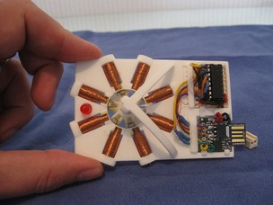
Review – Community Base
http://hackaday.com/2013/04/13/working-3d-printed-stepper-motor/
But really, objectives:
1. Print structure ()
2. Create circuits (may omit ICs)
3. Create motors
4. Create hotends (?!)
5. Still needs things like wire,
microcontroller, PSU.
But the base case is there.
Notes:
The idea of Repraps is to create a manufacturing machine from the most basic elements with the most basic skill.
Right now: human + reprap + dept. store + raw material + internet
Eventually: human + raprap + raw material

Slide 7
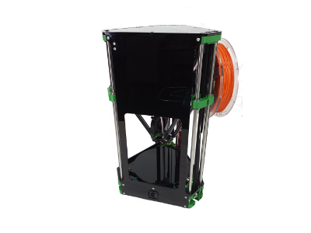
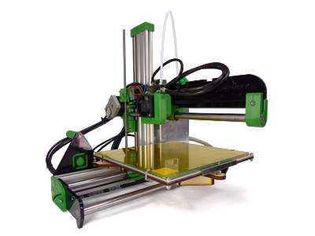
Educate – Community Base
The RepRap scene currently focuses more on “general-purpose manufacturing machines” than on “self-replicating future overlords”
https://reprappro.com/shop/
Notes:
Things have cooled down while an industry of the reprap pioneers spearhead mainstream acception of 3d printers. This isn't a bad thing.

Slide 8
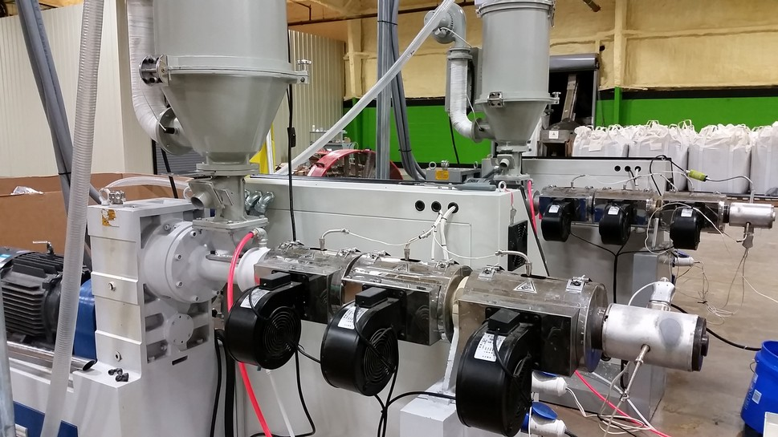
Educate – Community Base
There are great advancements in the design's durability, reliability, cost, along with an expanding of the material science behind filaments.
I believe this is a result of commercialization.
https://3dfuel.com/image-gallery/
Notes:
Image is of an industrial filament extruder from 3D-Fuel.

Slide 9
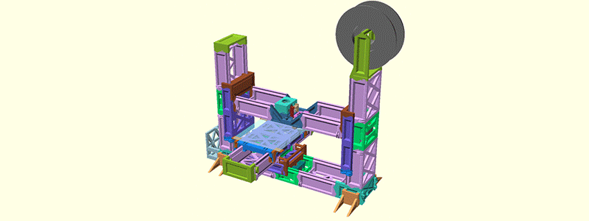
Review – Community Base
There are fewer great advancements in self-replication and community manufacturing.
I believe this will pick back up after
commercialization / adoption.
RepRap “Snappy”
75% of frame printable
https://hackaday.com/2015/09/12/the-most-self-replicating-reprap-yet/
Notes:
[Revar] is setting a new tack in the problem of printer self-replication and is joining parts together with snap fit connectors. The entire frame of the Snappy printer is built out of small parts that interlock to form larger units.
Another of the tricks up [Revar]’s scheme is reducing the number of ‘vitamins’ or parts that cannot be 3D printed. This includes belts, motors, screws, and electronics. You can’t really print machine screws yet, but [Revar] did manage to eliminate some belts and bearings. He’s using a rack and pinion system, all made with printed parts. It’s a technique that hasn’t been seen before, but it does seem to work rather well.
[Revar] has made all the files for the printed parts available in his repository. If you have enough filament, these files are enough to print 73% of the RepRap Snappy.

Slide 10
Review – Community Base
To be clear, I hate the idea of printers being pushbutton (Like, say, new cars or laundrymachines).
Instead, FDM machines need to be more robust, and the science of creating good parts should be integrated into the design. This is tricky in several ways.
Serialization “just happens”
The whole robot overlord thing, except it'll be awesome
Science
Happening
Printers no longer require attention level of small child
Today
Super compelling timeline
The future
Notes:
With software like OctoPrint, the digital realm is ready for serialization. The hardware side has catching up to do.
This is tricky because, like the community which built the Internet, the changes appear to include a locking down of printers. Imagine like an email provider.

Slide 11
Educate – 3D Printing Arena
Okay, so why serialization now?
Because it's needed:
- Colleges wasting tuition ☑
Okie dokie
- Public schools wasting taxes ☒
We need that for .. bombs and stuff
Notes:
Teachers are being taken in by people selling FDM printers without explaining the time sink involved.
Local schools can't even high full time IT staff, much less someone to babysit a printer.

Slide 12
Educate – 3D Printing Arena
But really, serialization is the jumping off point to providing printers to soldiers and other people in remote support situations (expeditions, space).
Notes:
Teachers are being taken in by people selling FDM printers without explaining the time sink involved.
Local schools can't even high full time IT staff, much less someone to babysit a printer.

Slide 13
Challenges – Material Defects
There are currently very few standards for FDM filament. Quality control problems reign supreme.
Our very first reel of filament had such issues. The plastic had a synthetic polyester-like filler in the core which ruined an ubis hotend.
Notes:
Garbage in → Garbage out

Slide 14
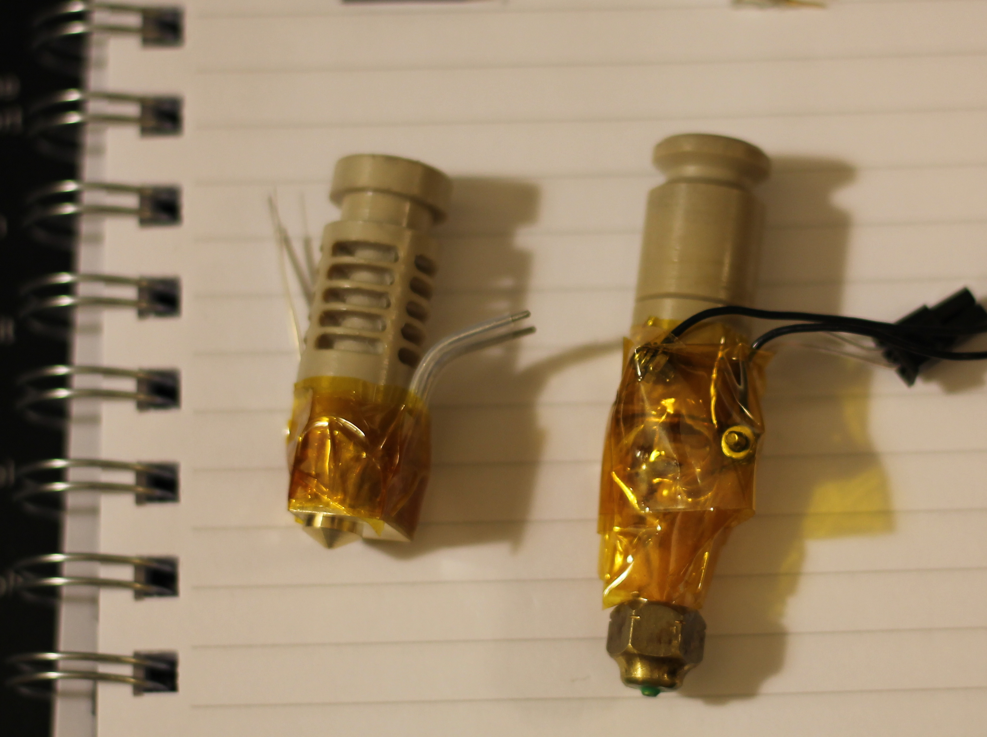
Challenges – Material Defects
We did try repairing it :(
Notes:
Re-wrapped the steel core with new nichrome wire. Accidentally ruined the PTFE liner.

Slide 15
Challenges – Mechanical Defects
This is a huge area.
The science of printing is still very basic and loose. Speed, temperature, nozzle diameter, material, and many more factors play into creating a 'good' versus 'bad' print.
When these parameters don't align, nothing else matters. The print will fail.
Notes:
Also includes the printer environment (temp, humidity).

Slide 16
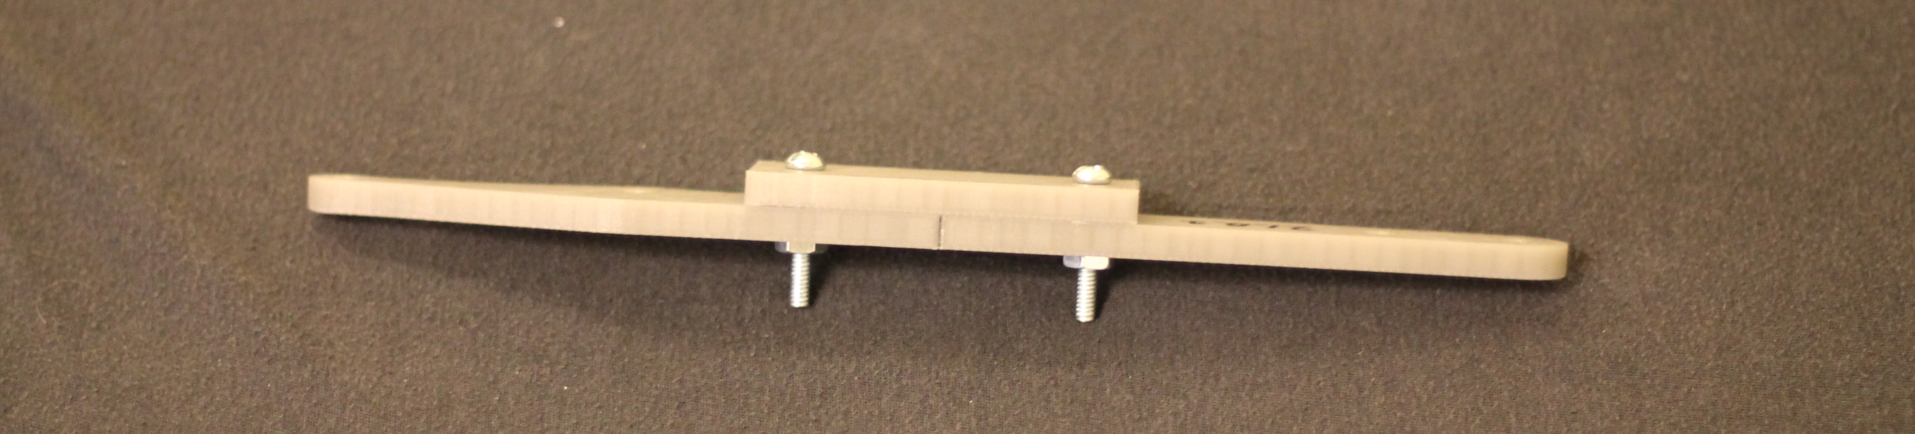
Challenges – Mechanical Defects
Strong part adhesion.
Base of part is flat, no warping or curling of edges.
Notes:
Many factors play into getting consecutive good prints. Finding the rules and formulas that govern these relationships is key.

Slide 17
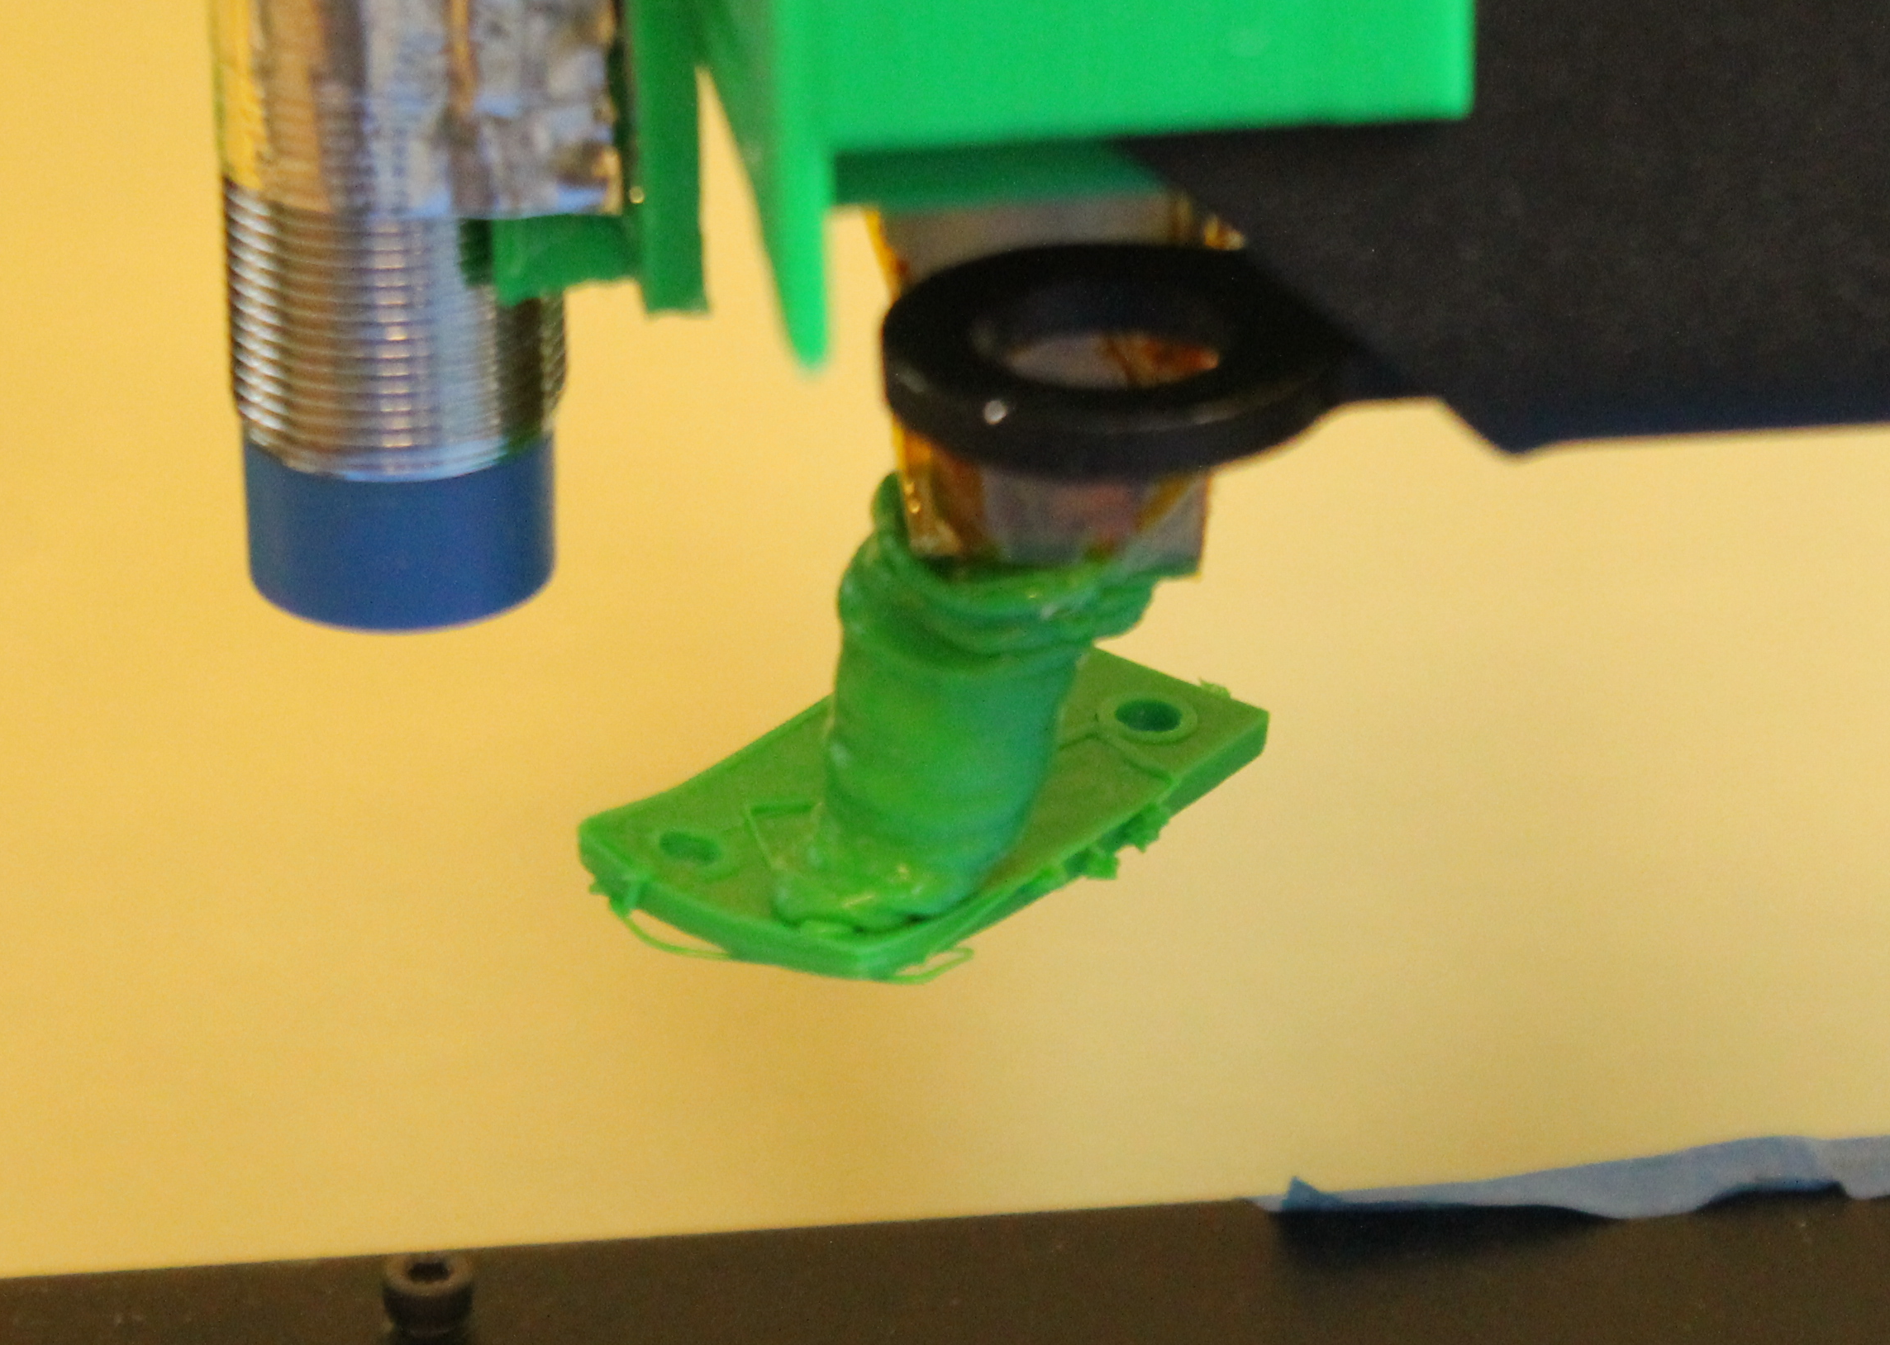
Challenges – Mechanical Defects
No part adhesion to the build surface.
Systems to detect this failure mode are required for serialization.
Notes:
A lot of work in this space goes into trying to find balance for part adhesion.
Too much adhesion, and the part will break before coming loose.
Too little adhesion and this happens.

Slide 18
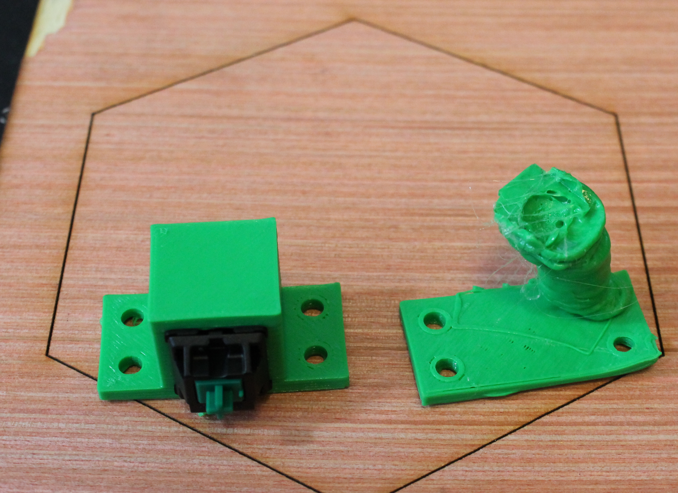
Challenges – Mechanical Defects
Notes:
Notice the curling edges on the failed print. Even before coming unattached, the sharp corners pulled away from the build plate.

Slide 19
Challenges – Operator Overhead
Printing with most consumer grade FDM systems entails babysitting the printer while it is powered on and operating.
Imagine: If you had to sit there and watch every load of laundry and be ready to jump up and catch it when it starts spewing molten clothes around.
You now understand how consuming this task is.
Notes:
This is complicated.
Both material and mechanical defects factor into operator overhead.
But even when a printer is perfectly calibrated and prints consecutively without fail, operator overhead still exists. Someone must remove finished parts from the build plate.

Slide 20
Serialize
We want to investigate serialization for the purpose of maximizing output. More things printed -> more keyboards and tools for those who need them.
Our focus: automated build plate prep.
But really, serialization is the jumping off point to providing printers to soldiers and others in remote support situations (expeditions, space).

Slide 21
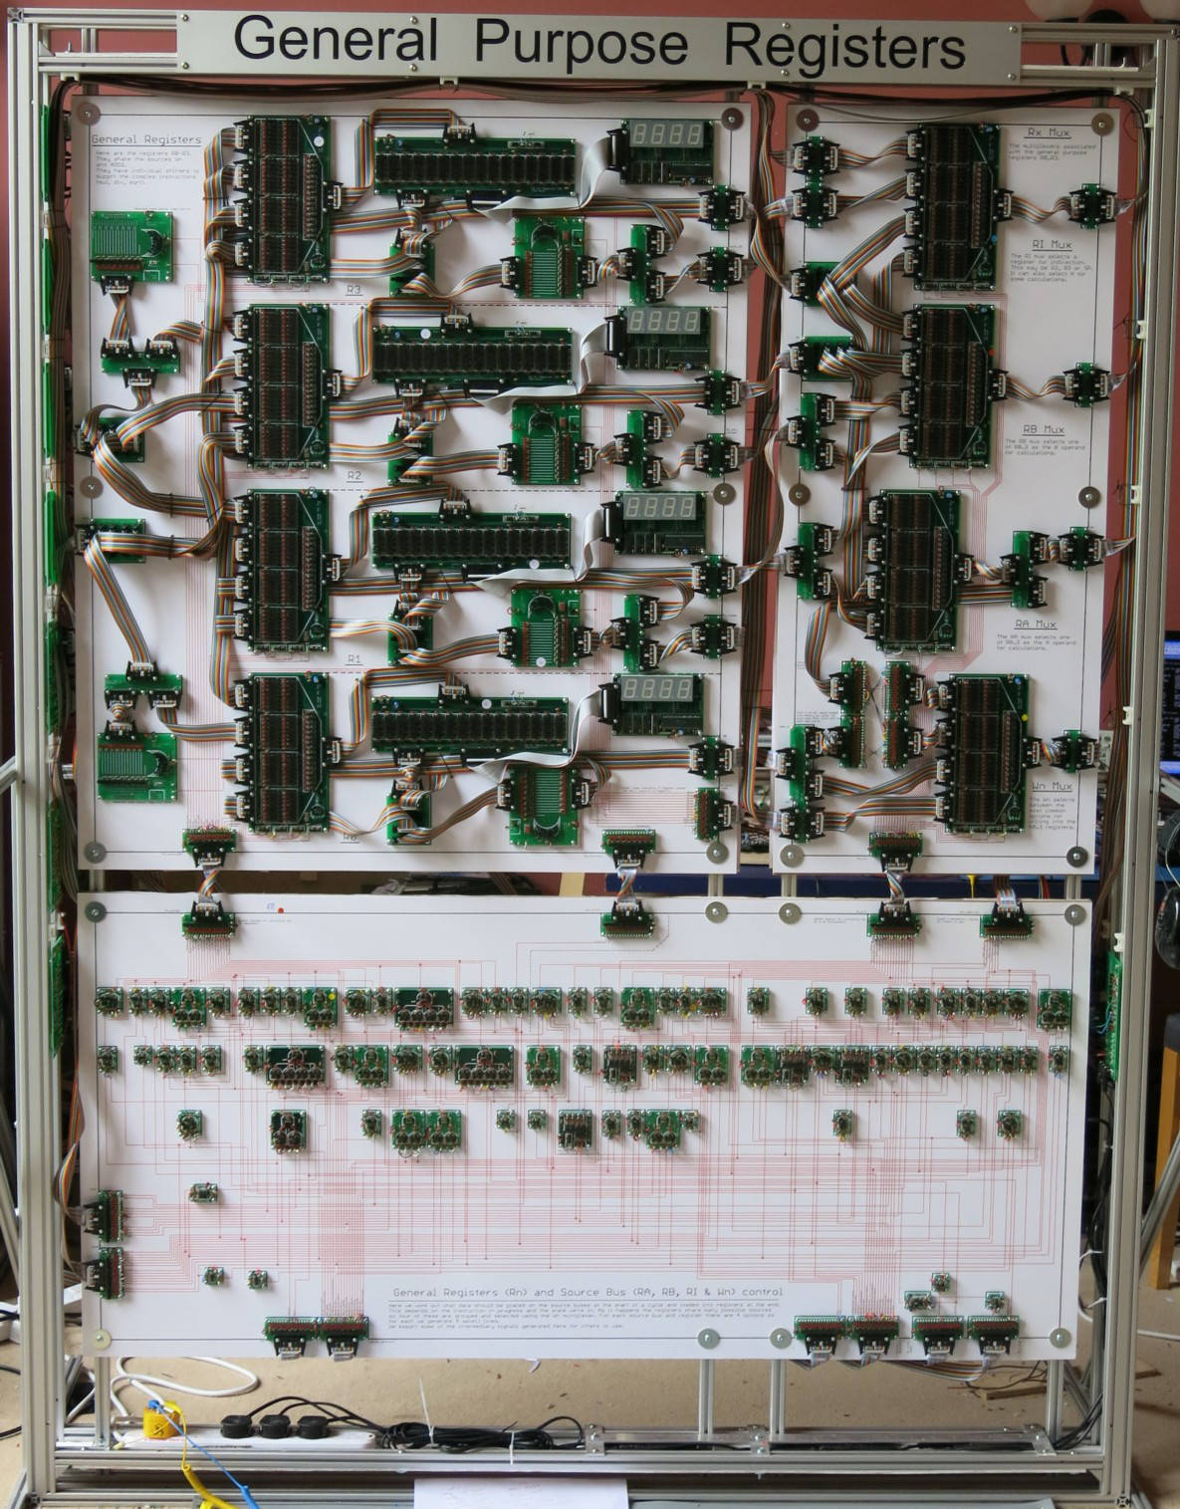
Educate – 3D Printing Arena
For comparison, to the right is the register component of a hand made 16-bit processor.
It stands about 2 meters tall.
http://www.theregister.co.uk/2015/06/23/brit_mega_processor/
Notes:
Teachers are being taken in by people selling FDM printers without explaining the time sink involved.
Local schools can't even high full time IT staff, much less someone to babysit a printer.

Slide 22
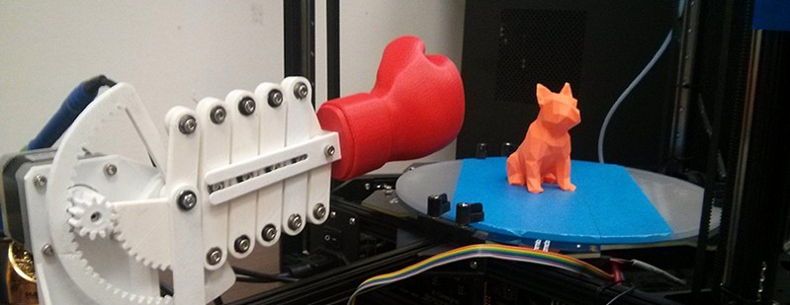
Serialize – Existing Systems
A recent video from online.
Scissor mechanisms: We want to increase robustness, not eliminate it!
http://hackaday.com/2015/06/06/automatic-print-ejector-for-all-3d-printers/
Notes:
Teachers are being taken in by people selling FDM printers without explaining the time sink involved.
Local schools can't even high full time IT staff, much less someone to babysit a printer.

Slide 23
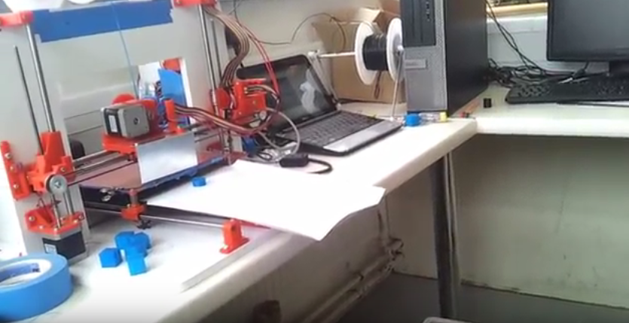
Serialize – Existing Systems
Existing RepRap work:
Pretty much all one person.
SanjayM's part ejection system
http://forums.reprap.org/read.php?1,216570
Notes:
Username: SanjayM
“Automatically clearing the bed and starting the next print”

Slide 24
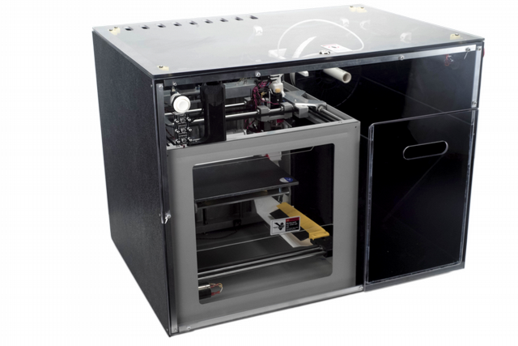
Serialize – Existing Systems
Existing commercial work:
Pretty much all one company.
The NVPro
http://makezine.com/2013/09/26/worlds-first-fully-automated-3d-printer-for-schools/
Notes:
NVPro
Works similarly to SanjayM's setup, metal plat collides with parts to break them free and push them into a bin.

Slide 25
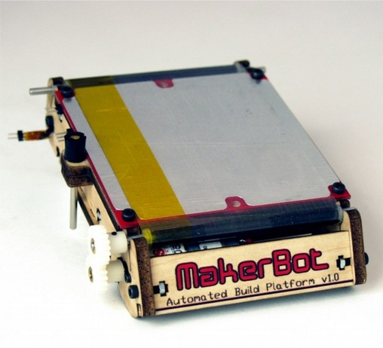
Serialize – Existing Systems
There's also this black sheep.
MakerBot touted this Automated Build Platform around 2010, and then immediately discontinued it.
http://www.makerbot.com/blog/2010/09/13/makerbot-automated-build-platform
Notes:
Pitfalls with this design include a material problem where most plastic sheets that will work as a print surface also warp when put on rollers.
Oh, and the patents too.

Slide 26
Serialize – Our Work
OK, we want to make printers automatically eject finished prints.
Let's dive right in!
We're going to need a printer...

Slide 27
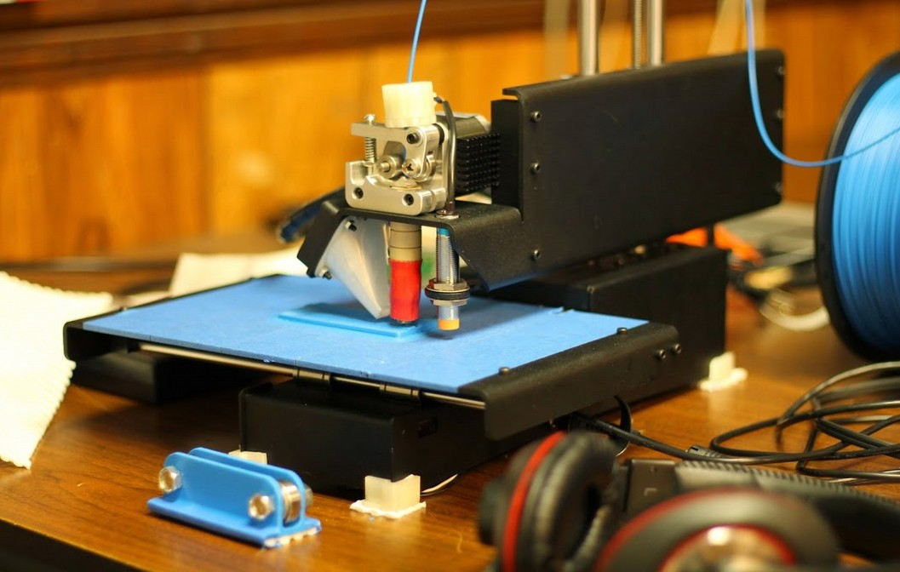
Serialize – Our Work
Notes:
Username: SanjayM
“Automatically clearing the bed and starting the next print”

Slide 28
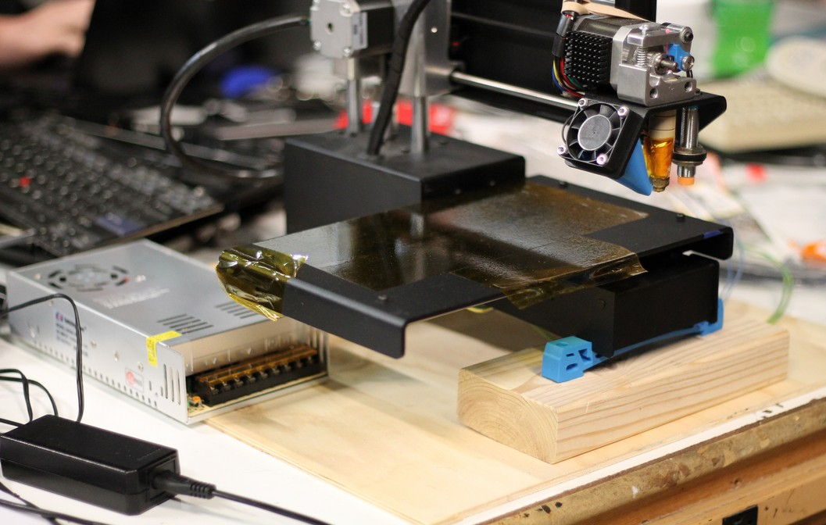
Serialize – Our Work

Slide 29
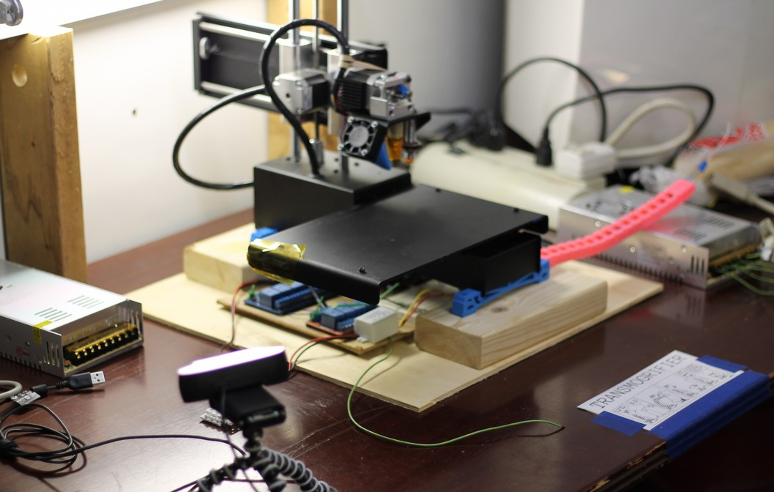
Serialize – Our Work

Slide 30
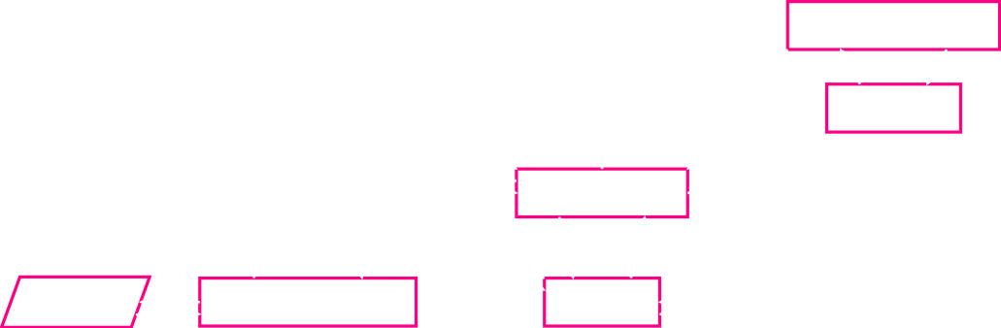
Serialize – Our Work
Cool. Now we need software.
https://github.com/ctag/cerealbot
Notes:
Custom PlatformIO environment to flash firmware to the Atmega. Reused the SPI header pins on the raspberry pi.
Typo: RedQueen256 communication is also via Resty.

Slide 31

Serialize – PopBar
What about a bed-of-nails approach?
Reducing the mechanical complexity leaves us with a lever embedded in the build platform.
https://256.makerslocal.org/wiki/Cerealbot/Hardware
Notes:
Once a printed part has cooled, it is quite rigid, and if we can manipulate the print bed a little, it should break free.

Slide 32
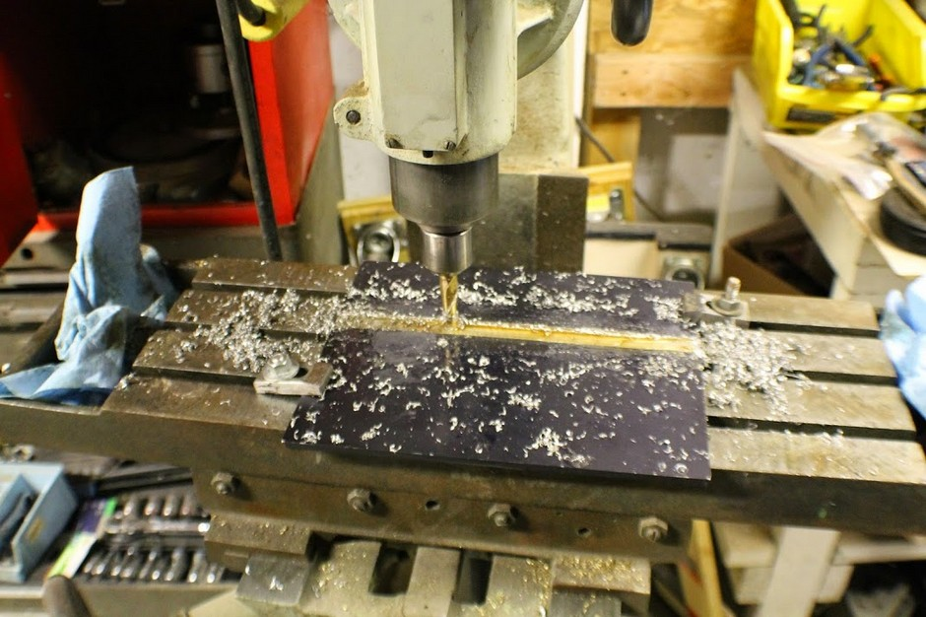
Serialize – PopBar

Slide 33
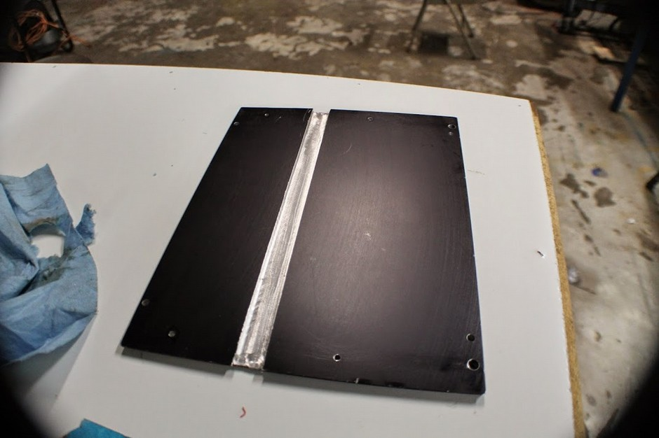
Serialize – PopBar

Slide 34
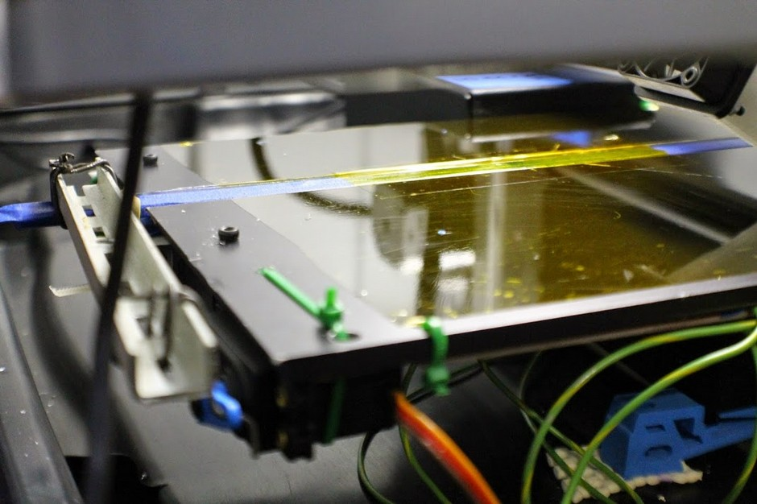
Serialize – PopBar

Slide 35
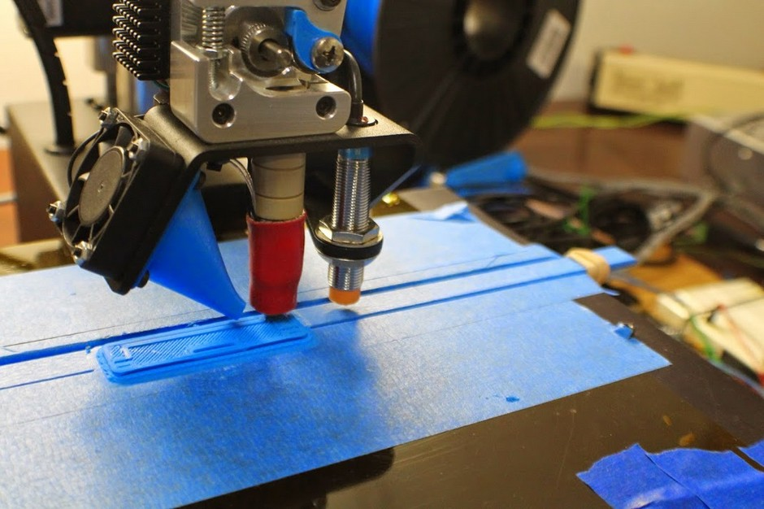
Serialize – PopBar

Slide 36
Serialize – PopBar
Build Plate Pop-Bar:
- Much more robust than expected, inconclusive since this is a draft.
- If mis-configured will destroy a hotend.
- Won't work with a heated bed, due to warping
- Didn't work with an inductive probe due to differences in metals.

Slide 37

Serialize – Hinge
Pop-Bar is out, what if the mechanism was larger?
We never got around to building this.
https://256.makerslocal.org/wiki/Cerealbot/Hardware
Notes:
Username: SanjayM
“Automatically clearing the bed and starting the next print”

Slide 38
Serialize – Bulldozer
Extruder mounted bulldozer:
- possibly too weak, esp if quieter
steppers are used.
- Same destructive capabilities as the
punching glove.
- Decreases robustness of system. Keeping
the extruder calibrated becomes a larger challenge.
Notes:
Username: SanjayM
“Automatically clearing the bed and starting the next print”

Slide 39
Serialize – Bulldozer
https://256.makerslocal.org/wiki/Cerealbot

Slide 40
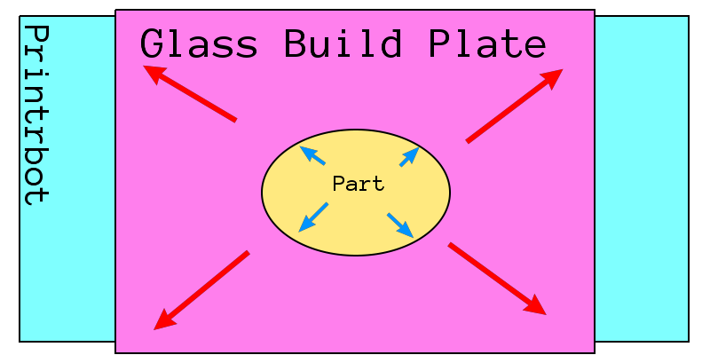
Serialize – HGBP
The ultimate frustration in FDM land:
What material to make the build plate from?
Well, on forums some people discuss how nice glass is because parts will separate more easily after cooling..
https://256.makerslocal.org/wiki/Cerealbot/Hardware

Slide 41
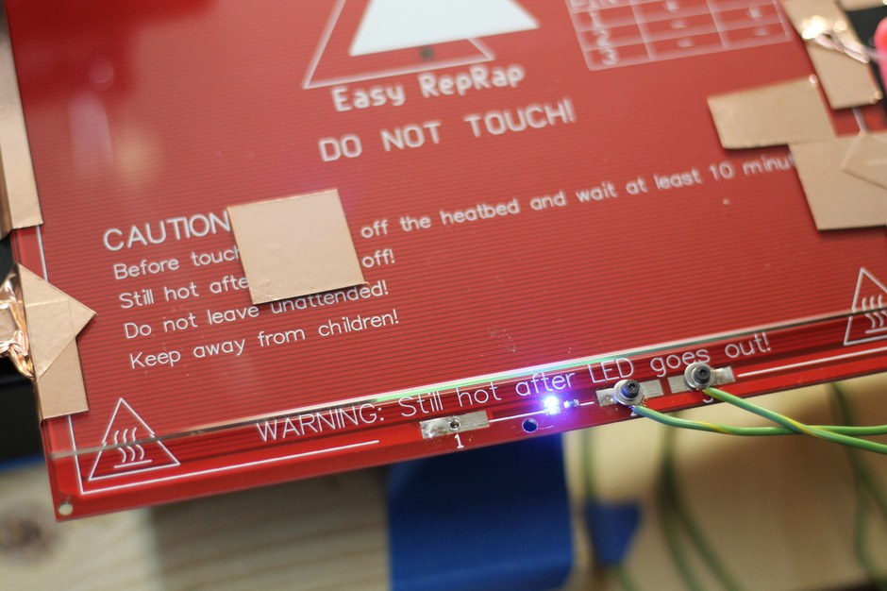
Serialize – HGBP

Slide 42
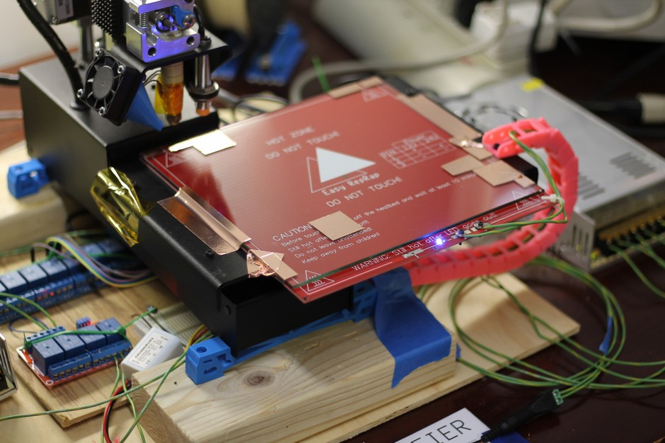
Serialize – HGBP

Slide 43
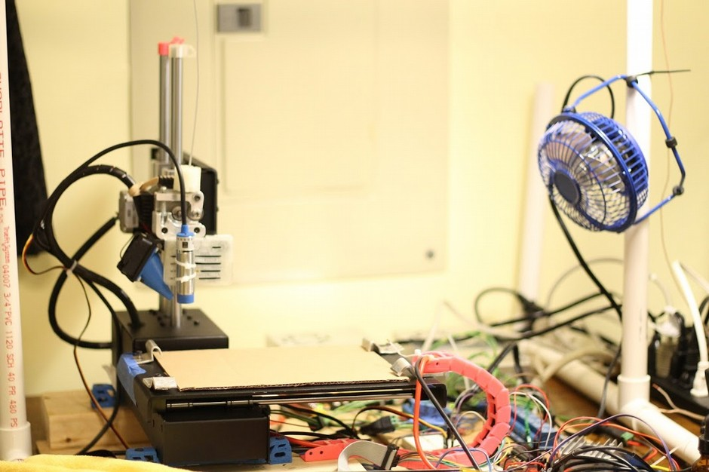
Serialize – HGBP (v3)

Slide 44
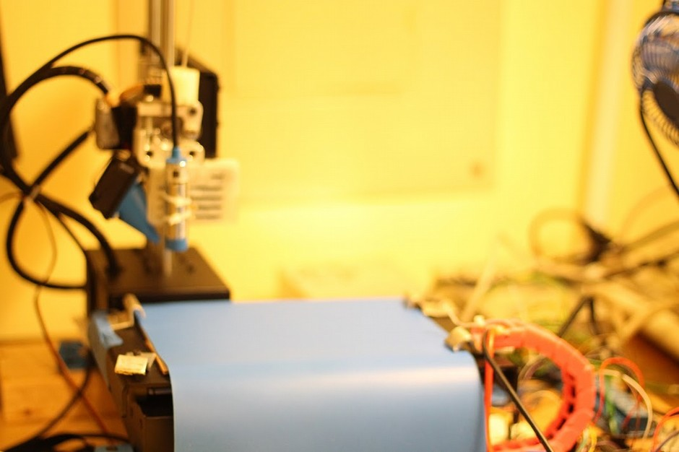
Serialize – HGBP

Slide 45
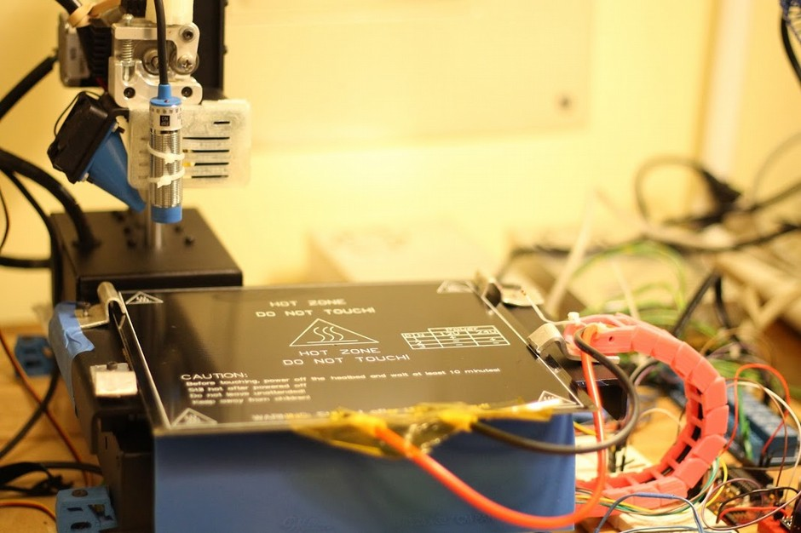
Serialize – HGBP

Slide 46
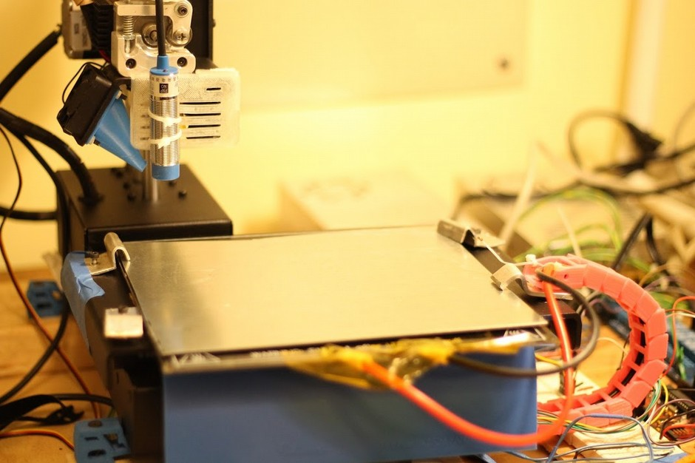
Serialize – HGBP

Slide 47
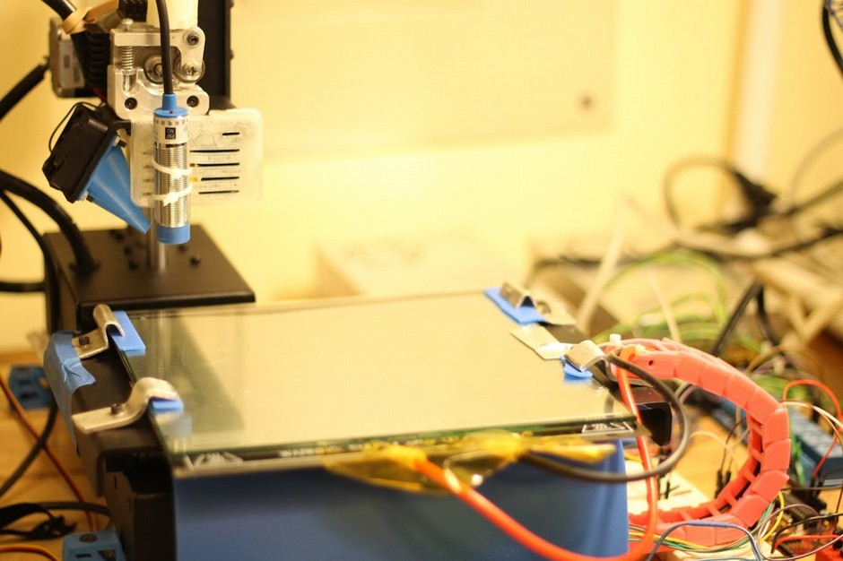
Serialize – HGBP

Slide 48
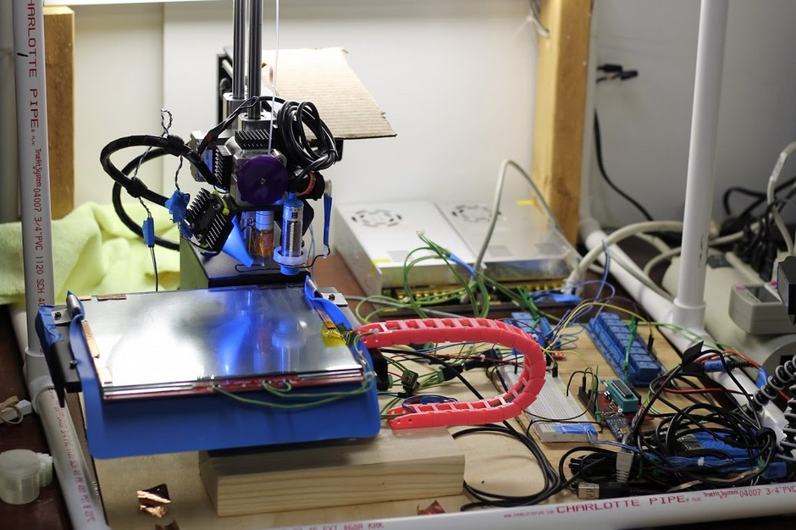
Serialize – HGBP

Slide 49
Serialize – HGBP
Glass Build Platform Pitfalls:
- The borosilicate glass plate isn't perfectly flat. Easily fixed with proper sourcing.
- Had to retrofit the new induction sensor.
- Parts now come free perfectly. Sometimes even before the print is done.

Slide 50
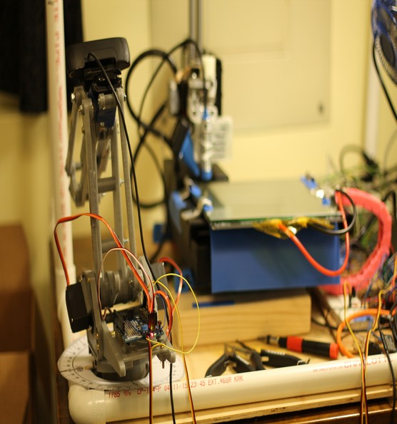
FIN
Sources are linked at the bottom of each page.
That's all folks!

