Slide 1
CPE 323 Introduction to Embedded Computer Systems: The MSP430 System Architecture Introduction
Instructor: Dr Aleksandar Milenkovic
Lecture Notes
Notes:
Alex Milenkovich

Slide 2
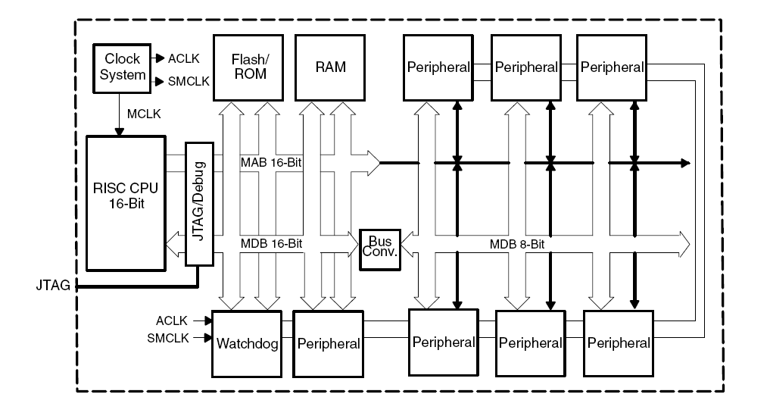
MSP 430 System Architecture:
A Closer Look
CPE 323
Notes:
Alex Milenkovich

Slide 3
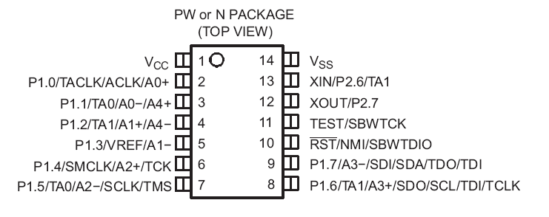
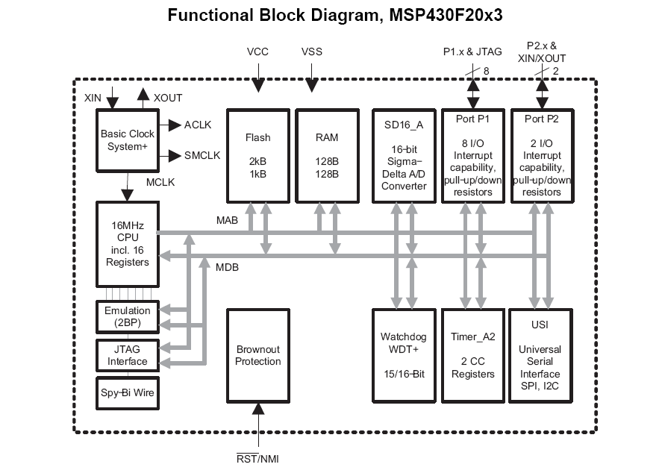
MSPx430F2013 Microcontroller
CPE 323
Notes:
Alex Milenkovich

Slide 4
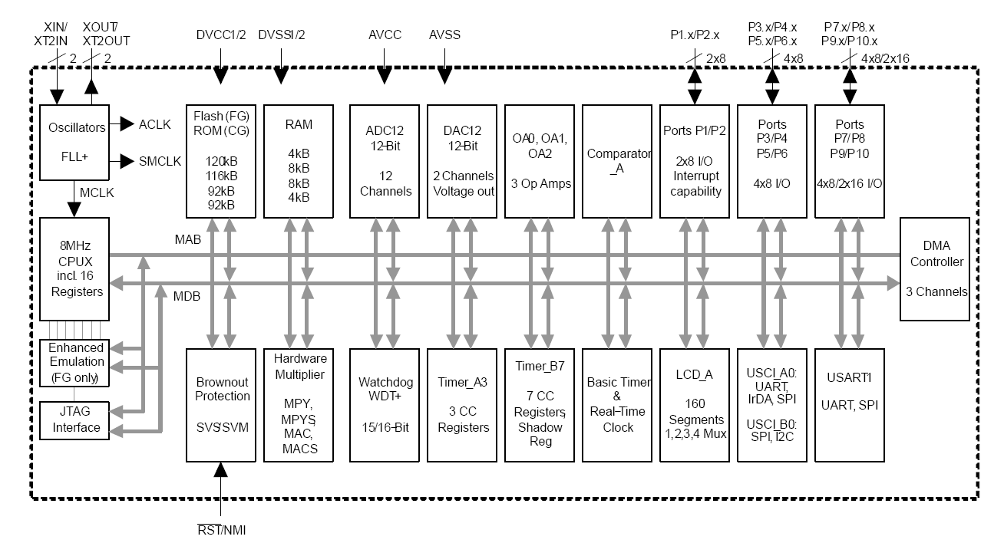
MSP430xG461x Microcontroller
CPE 323

Slide 5
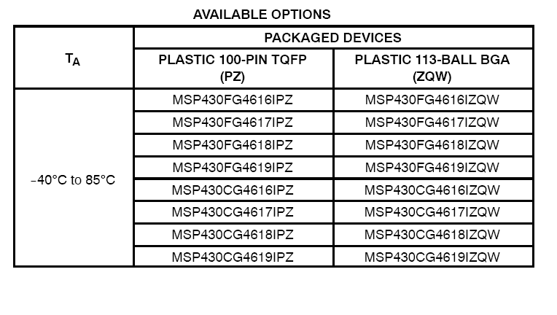
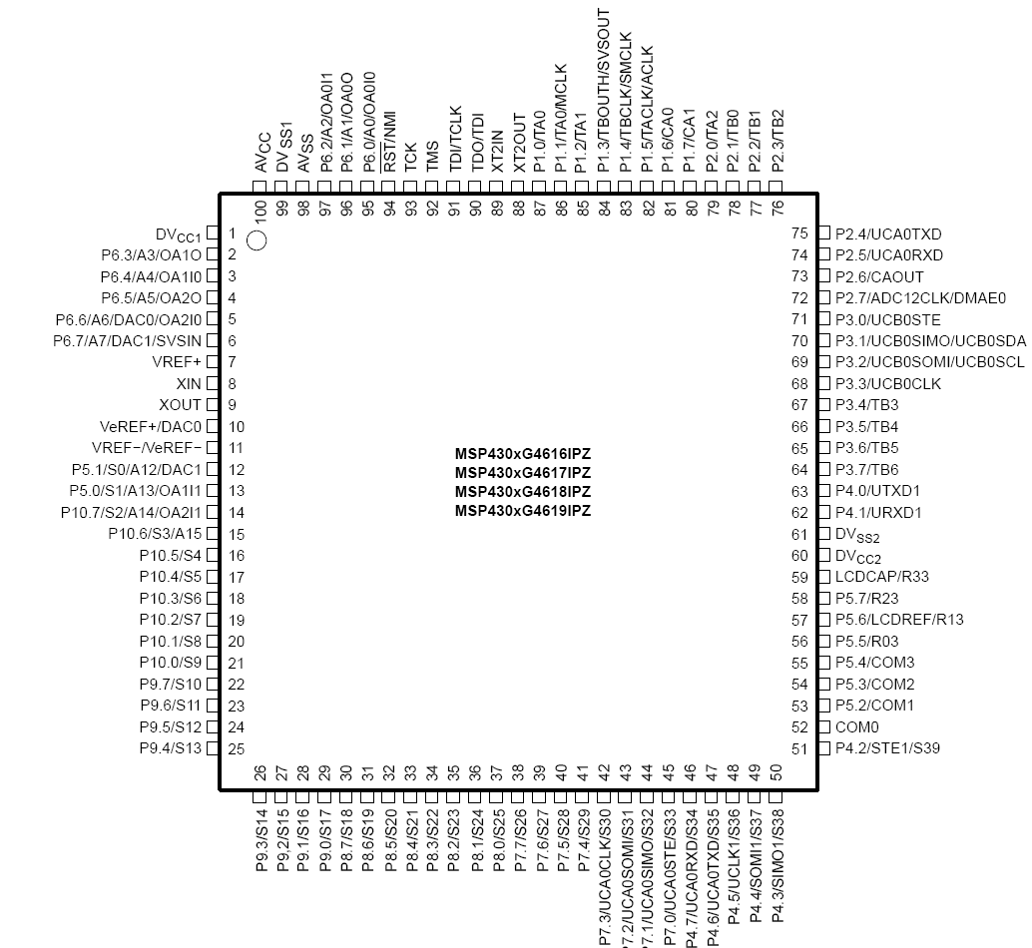
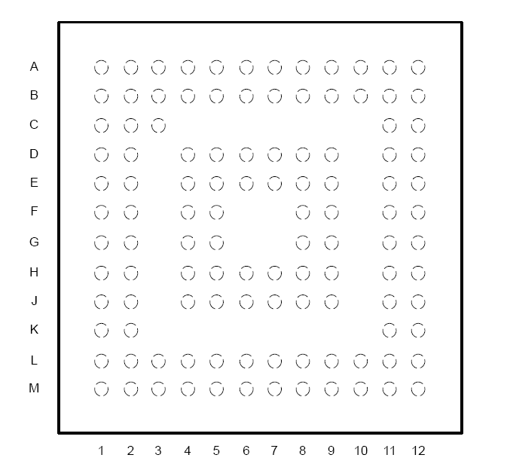
MSP430xG461x Microcontroller
CPE 323

Slide 6
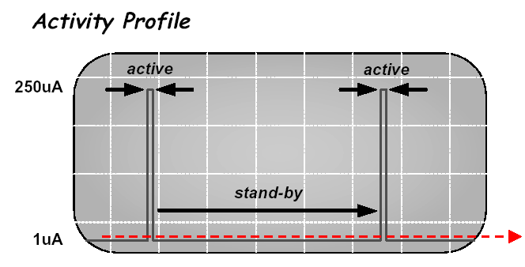
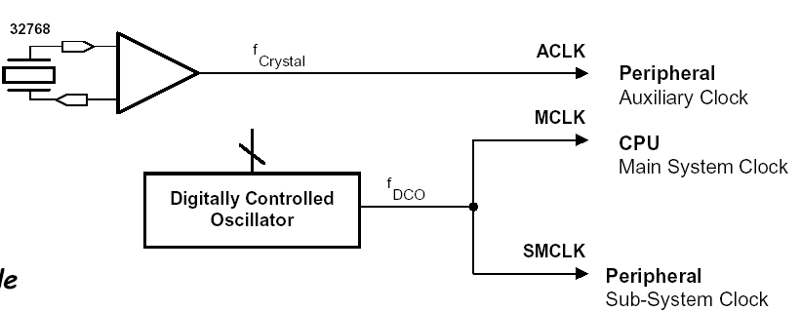
Basic Clock System
Basic Clock Module
provides the clocks for the MSP430 processor and peripherals
CPE 323
Notes:
Alex Milenkovich

Slide 7
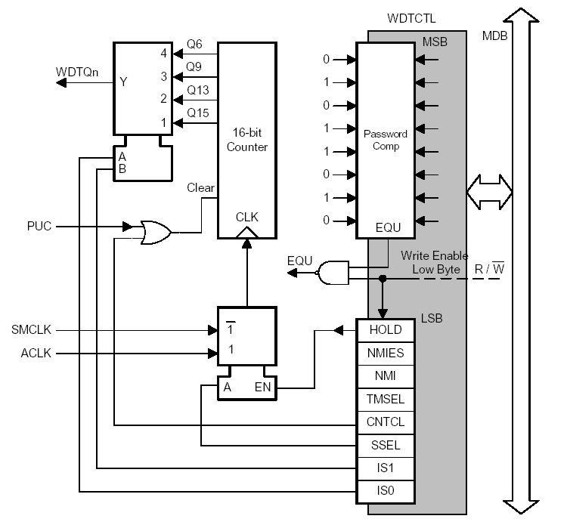
Watchdog Timer
WDT module performs a controlled system restart after a software problem occurs
Can serve as an interval timer (generates interrupts)
WDT Control register is password protected
Note: Powers-up active
CPE 323
Notes:
Alex Milenkovich

Slide 8
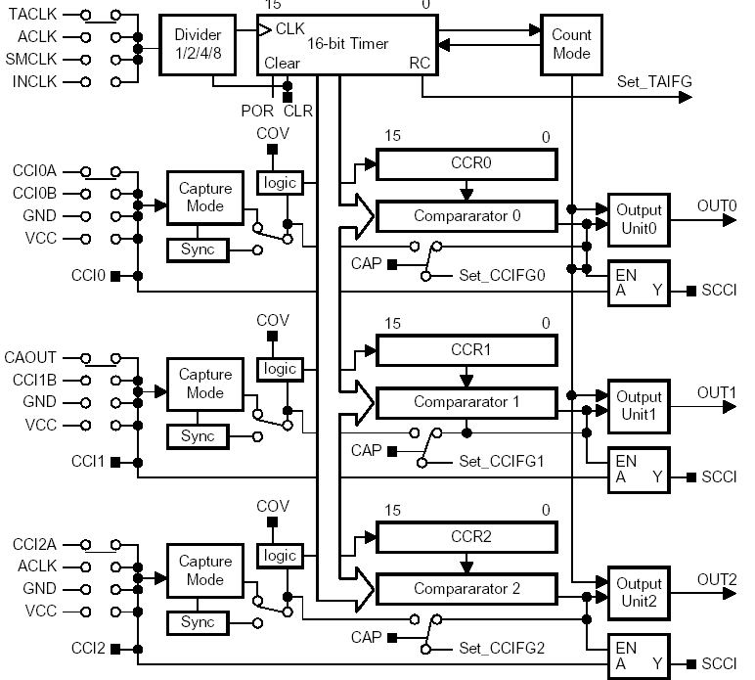
Timer_A
Timer_A is a 16-bit timer/counter with three capture/compare registers
Capture external signals
Compare PWM mode
SCCI latch for asynchronous communication
CPE 323
Notes:
Alex Milenkovich

Slide 9
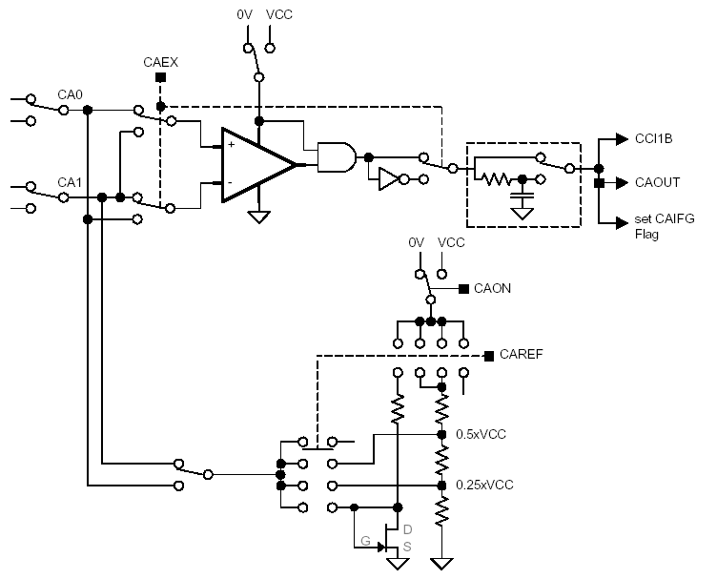
Comparator_A
Comparator_A is an analog voltage comparator
Supports precision slope analog-to-digital conversions
Supply voltage supervision, and
Monitoring of external analog signals.
CPE 323
Notes:
Alex Milenkovich

Slide 10
Digital I/O
Independently programmable individual I/Os
Port1
Port3
Port2
…
Port6
Function Select Register PxSEL
yes
yes
Interrupt Edge Select Register PxIES
yes
no
Up to 6 ports (P1 – P6)
Each has 8 I/O pins
Each pin can be configured as input or output
P1 and P2 pins can be configured to assert an interrupt request
Interrupt Enable Register PxIE
yes
no
Interrupt Flag Register PxIFG
yes
no
Direction Register PxDIR
yes
yes
Output Register PxOUT
yes
yes
Input Register PxIN
yes
yes
P1.
P2.
P3.
7
6
5
4
3
2
1
0
P4.
P5.
P6.
CPE 323
Notes:
Alex Milenkovich

Slide 11
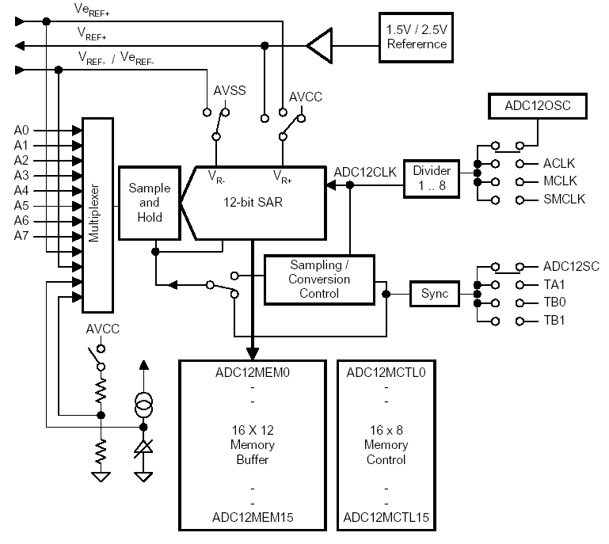
ADC12
High-performance 12-bit analog-to-digital converter
More than 200 Ksamples/sec
Programmable sample&
hold
8 external input channels
Internal storage
CPE 323
Notes:
Alex Milenkovich

Slide 12
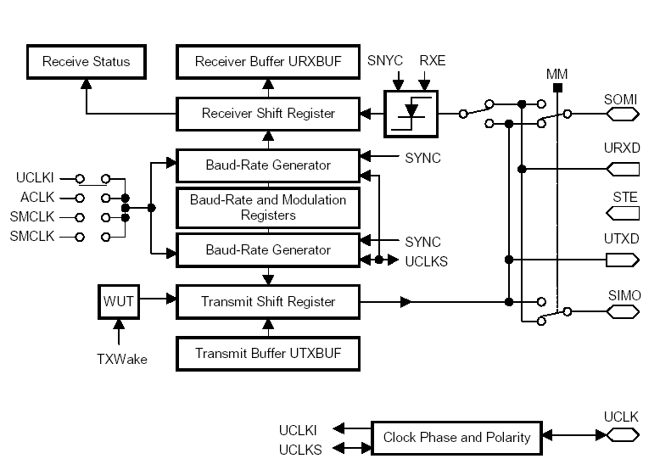
USART Serial Port
The universal synchronous/ asynchronous receive/transmit (USART) peripheral interface supports two serial modes with
one hardware module
UART or SPI (Synchronous Peripheral Interface) modes
Double-buffered
Baud-rate generator
CPE 323
Notes:
Alex Milenkovich

Slide 13
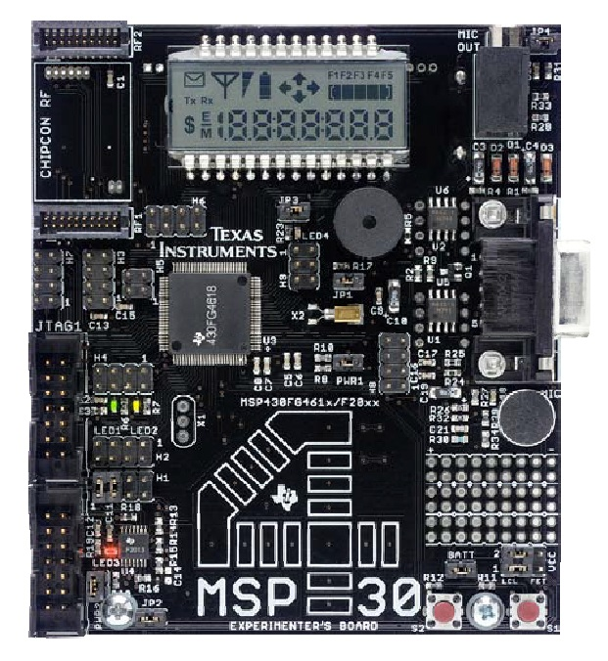
TI Experimenter Board
Two on-board CPUs
  MSP430FG4618
  MSP430F2013
The Softbaugh SBLCDA4 LCD display
  4-MUX operation and is interfaced to the MSP430FG4618 LCD driver peripheral
Momentary Push-ON Buttons
  S1 and S2 are connected to pins on
  Port 1 (P1) of the MSP430FG4618
Light Emitting Diodes (LEDs)
  Four LEDs, three of which are connected to the MSP430FG4618, and one connected to the F2013.
Buzzer
  Connected to one of the MSP430FG4618 port pins and can be disabled using jumper JP1
CPE 323

Slide 14
TI Experimenter Board
Single-Touch Capacitive Sensing Interface
  A 16-segment touch pad in the shape of a “4” is connected to the data pins of the MSP430F2013, which then relays the data to the MSP430FG4618 using the inter-processor communications peripherals on each CPU
RS232 Serial Communication Port
  A standard 9-pin serial communications port is connected to the MSP430FG4618 USCI peripheral and can be used when the USCI is configured in UART mode
Microphone & Analog Out
  A microphone is connected to a port pin of the MSP430FG4618, and the input to the 3.5mm analog out can be connected to the output from the MSP430FG4618’s 12-bit digital to and analog (DAC12) convertor
Radio
  Wireless Communication Module Interface
CPE 323

Slide 15
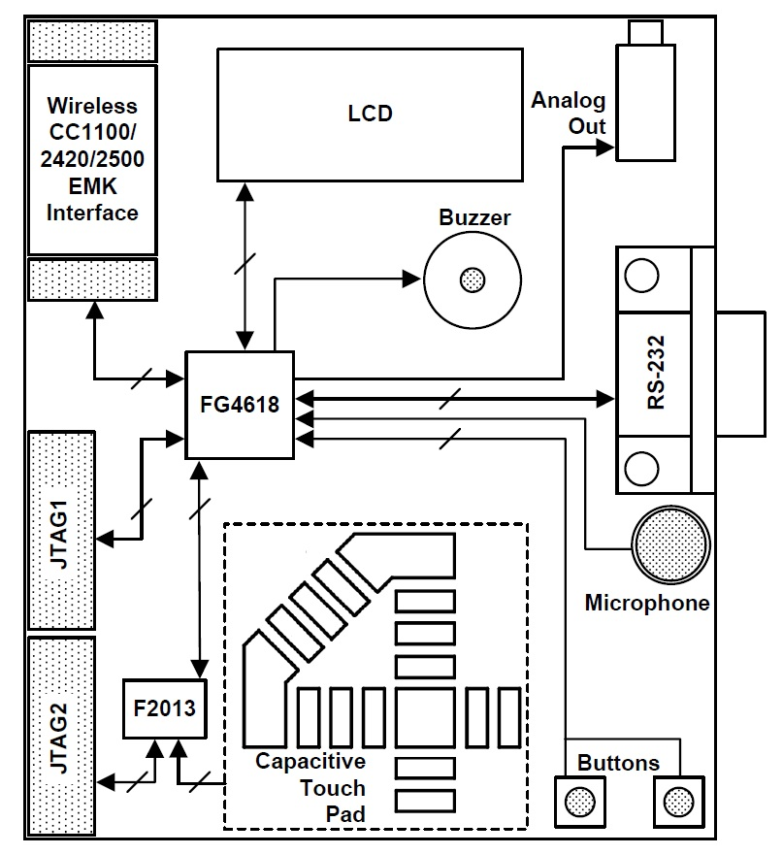
TI Experimenter Board: Block Diagram
CPE 323

Slide 16
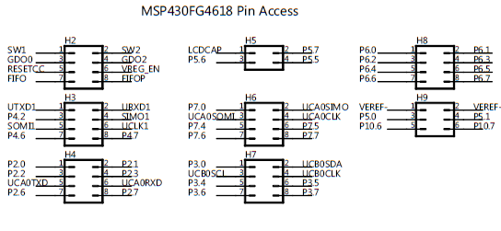
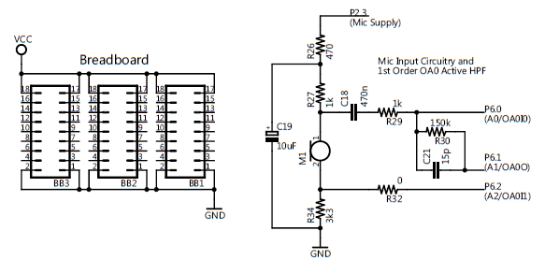
TI Experimenter Board: Headers
CPE 323

Slide 17
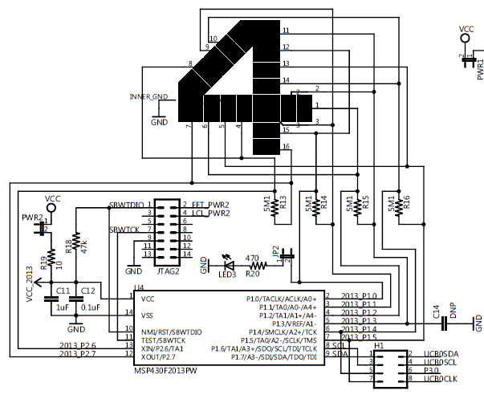
TI Experimenter Board: Capacitive Touch Pad + MSP430 F2013
CPE 323

Slide 18

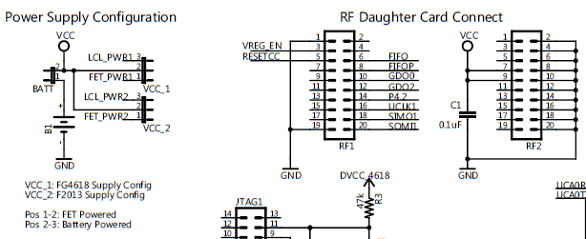
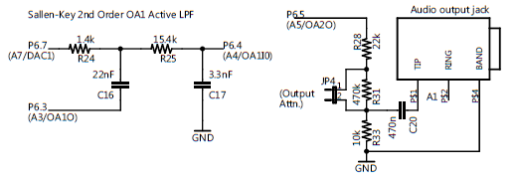
TI Experimenter Board: Power Supply Configuration, RF Daughter Card Connect, Audio Output
CPE 323

Slide 19
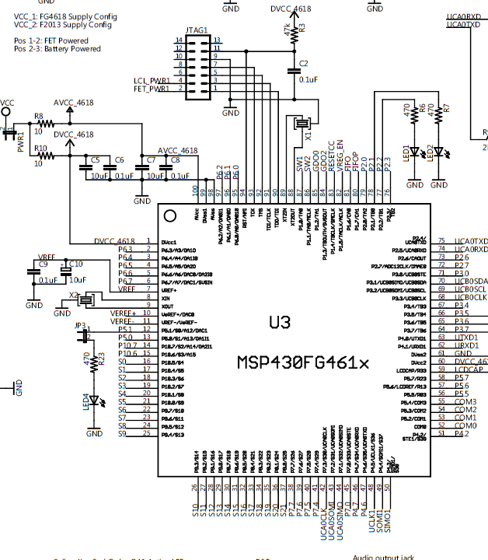
TI Experimenter Board: FG461x
CPE 323

Slide 20
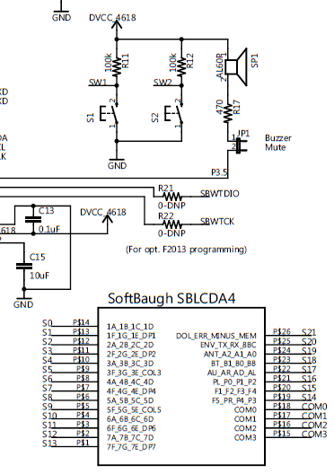
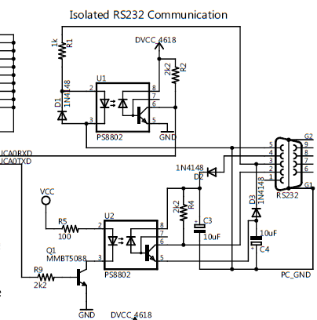
TI Experimenter Board: RS232, Display
CPE 323

Slide 21
Blink a LED – Demo Program
/****************************************************************************
; TI Experimenter board demo, blinking leds LED1 and LED2 (msp430FG4618)
; Description: Toggle P2.1 and P2.2 by xoring P2.1 and P2.2 inside a loop.
; The leds are connected to P2.1 and P2.2 and are on when
; P2.1=1 and P2.2=1;
; The LEDs are initalized P2.1 to be off, and P2.2 to be on;
; ACLK = 32.768kHz, MCLK = SMCLK = default DCO
; MSP430xG461x
; -----------------
; /|\| |
; | | |
; --|RST |
; | P2.2|-->LED1(GREEN)
; | P2.1|-->LED2(YELLOW)
; Alex Milenkovich, milenkovic@computer.org
;****************************************************************************/
#include "msp430xG46x.h"
void main(void)
{
WDTCTL = WDTPW + WDTHOLD;// Stop watchdog timer
P2DIR |= 0x06; // Set P2.1&P2.2 to output direction (0000_0110)
P2OUT = 0x02; // Set P2OUT to 0x0000_0010 (LED2 is on, LED1 is off)
for (;;) {
unsigned int i;
P2OUT ^= 0x06; // Toggle P2.1 using exclusive-OR
i = 50000; // Delay
do (i--);
while (i != 0);
}
}
CPE 323

