Slide 1
Performance Metrics and Time Complexity Considerations in
Message-Passing Computing
1.<number>

Slide 2
Sequential execution time, t(1) or t_{s} : Estimated by counting computational steps of best sequential algorithm.
Parallel execution time, t(p) or t_{p}:
  Estimated by counting the computational steps of the “busiest” processing core at any given point in time, t_{comp}, and the effective communication overhead, t_{comm}:
t(p) = t_{comp} + t_{comm}
Common assumptions:
  No overlap between computation and communication
  All processing cores are identical
1.<number>

Slide 3
Computational Time
Computation Time usually proportional to communication time
  Normalize by counting the number of computational steps.
When more than one process is executed simultaneously, count computational steps of most complex process.
Generally, function of problem size, n and number of processes p, i.e.
t_{comp} = f (n, p)
Computation is usually broken down into stages. Total computation is the sum.
t_{comp} = t_{comp1} + t_{comp2} + t_{comp3} + …
.
1.<number>

Slide 4
Communication Time
Many factors, including network structure and network contention.
As a first approximation it is common to use
t_{comm} = t_{startup} + W t_{data}
t_{startup} is startup time, essentially time to send a message with no data. Assumed to be constant.
t_{data} is transmission time to send one data word, also assumed constant, and there are W data words.
1.<number>

Slide 5
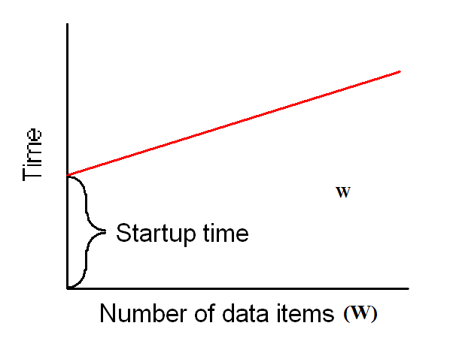
Idealized Communication Time
1.<number>

Slide 6
Communication Time
Final communication time, t_{comm}, the summation of communication times of all sequential messages from a process, i.e.
t_{comm} = t_{comm1} + t_{comm2} + t_{comm3} + …
Assumptions:
  Communication patterns of all processes are the same and take place together so that only one process need be considered.
  Both startup and data transmission times, t_{startup} and t_{data}, are normalized in terms of a single computational step
    i.e. one can add t_{comp} and t_{comm} together to obtain parallel execution time, t(p).
1.<number>

Slide 7


Speedup Factor
where t(1) is execution time on a single processor and t(p) is execution time on a multiprocessor.
Use best sequential algorithm with single processor system. Underlying algorithm for parallel implementation might be (and is usually) different.
1.<number>

Slide 8

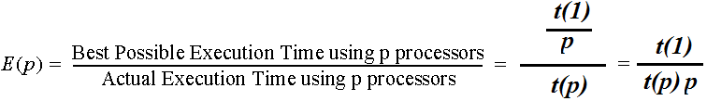
Efficiency
where t(1) is execution time on a single processor and t(p) is execution time on a multiprocessor.
Again use best sequential algorithm with single processor system. Underlying algorithm for parallel implementation might be (and is usually) different.
1.<number>

Slide 9




Performance Metrics
With t(1), t_{comp}, and t_{comm}, can establish for a particular algorithm/implementation the Speedup factor
and Computation/Communication ratio
Both functions of number of processors, p, and number of data elements, n.
  Will give indication of scalability of parallel solution with increasing number of processors and problem size.
  Computation/communication ratio highlights the effect of communication with increasing problem size and system size.
1.<number>

Slide 10
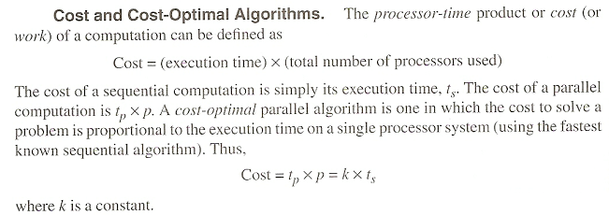
Benchmark Factors (cost)
1.<number>

Slide 11
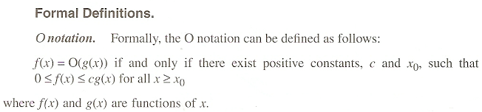


Time Complexity (general)
1.<number>

Slide 12
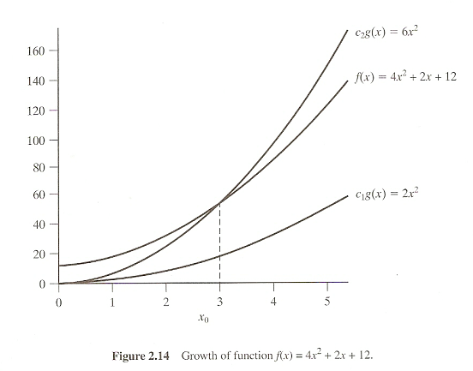
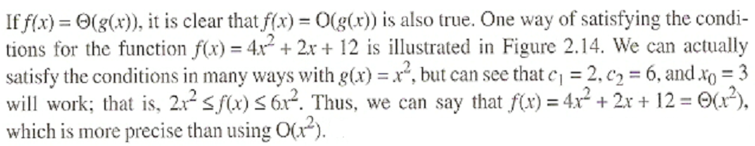
Time Complexity (general)
1.<number>

Slide 13
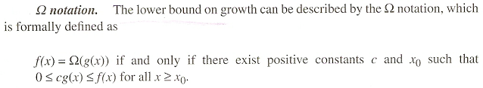

Time Complexity (general)
1.<number>

Slide 14
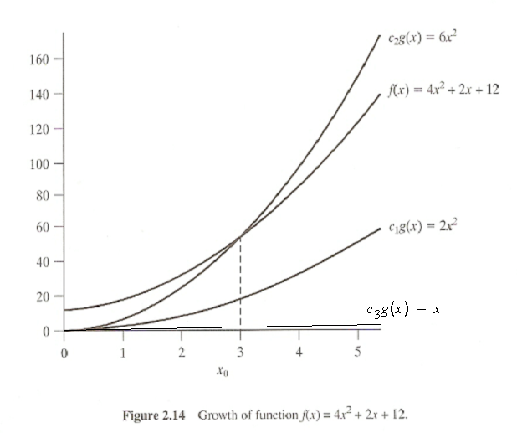
Time Complexity (general)
1.<number>

Slide 15

Time Complexity (general)
1.<number>

Slide 16
Time Complexity (general)
1.<number>

Slide 17

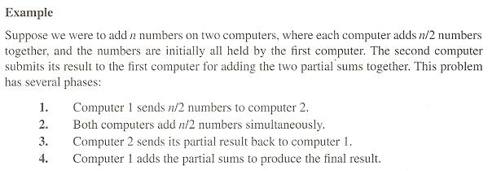
Time Complexity (parallel)
1.<number>

Slide 18
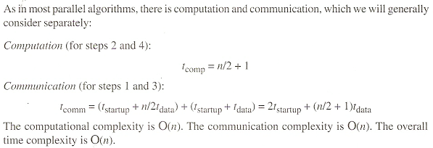
Time Complexity (parallel)
1.<number>

Slide 19
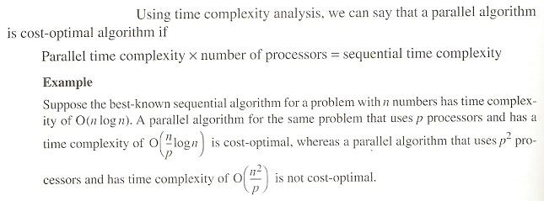
Time Complexity (parallel)
1.<number>

Slide 20
Message Passing
Pros
  Flexible
    Can do almost any other “paradigm” with this as a layer
    Used by many of the other paradigms and layers underneath
    Can implement very efficient load balancing and domain decomposition
  Efficient
    Ultimately, this is what the machine does over its network anyway
    Often the network hardware API is simply a MP library
  Implementations Solid
    There are several widely know implementations
      MPI
      Portals
      Remote Memory Access/Shmem
  Algorithmic Support
    Much research has been done in solving problems using MP
  Debugging Support
    Both debuggers and techniques have been developed
Cons
  Lower level means more detail for the coder
  Debugging requires more attention to detail
  Development usually requires a “start from scratch” approach
  Domain decomposition and memory management must be explicit
1.<number>

Slide 21
Problem: given the engineering constraint of a machine made up of a large collection of multi-core processors, how do we use message passing at the wide level while still taking advantage of the local shared memory?
Solution: Hybrid Coding.
As the most useful MP library is MPI, and the most useful Shared Memory library is OpenMP, the obvious mix is MPI and OpenMP.
But, one must design the MPI layer first, and them apply the OpenMP code at the node level. The reverse is rarely a viable option.
1.<number>

