Slide 1
Distributed-Memory Programming with MPI
Chapter 3
1.<number>

Slide 2
Networked Computers as a Computing Platform
A network of computers became a very attractive alternative to expensive supercomputers and parallel computer systems for high-performance computing in early 1990’s.
Several early projects. Notable:
  Berkeley NOW (network of workstations) project.
  NASA Beowulf project.
1.<number>

Slide 3
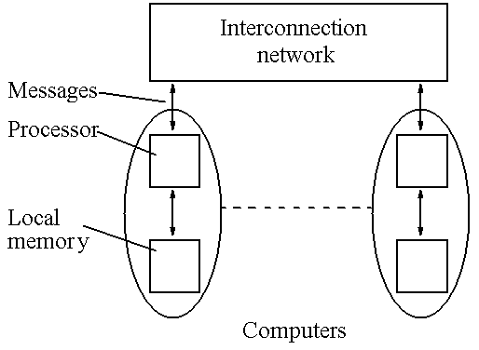
Message-Passing Multicomputer
Complete computers connected through an interconnection network:
1.<number>

Slide 4
Beowulf Clusters*
A group of interconnected “commodity” computers achieving high performance with low cost.
Typically using commodity interconnects - high speed Ethernet, and Linux OS.
* Beowulf comes from name given by NASA Goddard Space Flight Center cluster project.
1.<number>

Slide 5
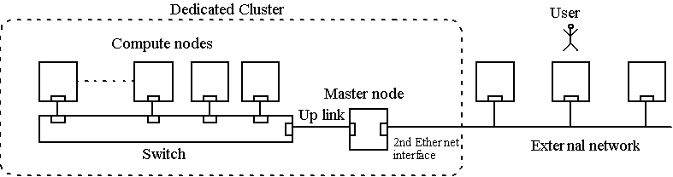
Dedicated cluster with a master node
1.<number>

Slide 6
Key advantages:
Very high performance workstations and PCs readily available at low cost.
The latest processors can easily be incorporated into the system as they become available.
Existing software can be used or modified.
1.<number>

Slide 7
Software Tools for Clusters
Based upon Message Passing Parallel Programming:
Parallel Virtual Machine (PVM) - developed in late 1980’s. Became very popular.
Message-Passing Interface (MPI) - standard defined in 1990s.
Both provide a set of user-level libraries for message passing. Use with regular programming languages (C, C++, ...).
1.<number>

Slide 8
Message-Passing Programming using User-level Message Passing Libraries
Two primary mechanisms needed:
1. A method of creating separate processes for execution on different computers
2. A method of sending and receiving messages
1.<number>

Slide 9
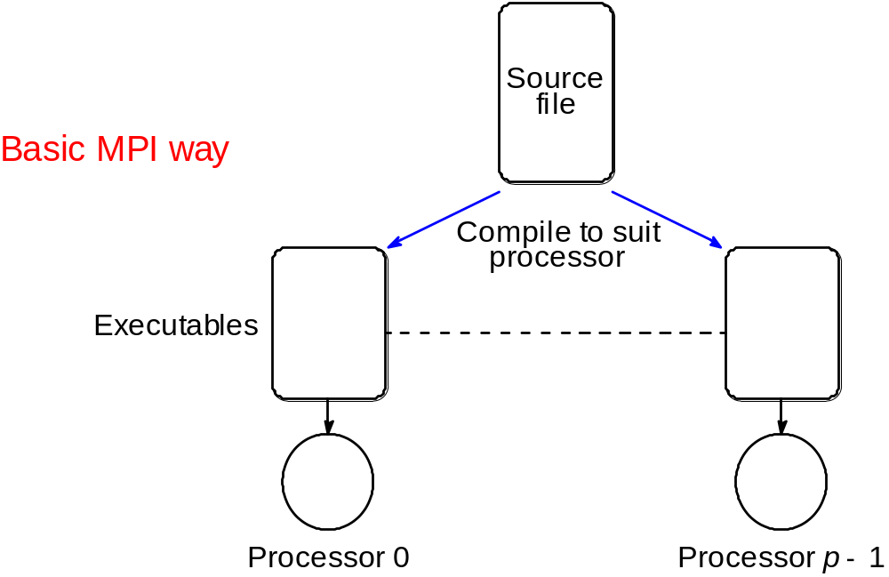
Single Program Multiple Data (SPMD) model
.
Different processes merged into one program. Control statements select different parts for each processor to execute. All executables started together - static process creation
1.<number>

Slide 10
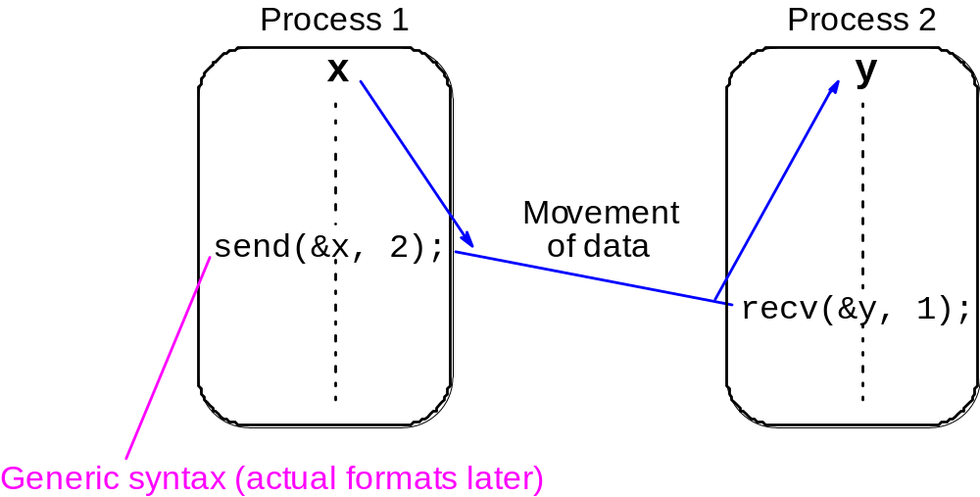
Basic “point-to-point” Send and Receive Routines
Passing a message between processes using send() and recv() library calls:
1.<number>

Slide 11
Synchronous Message Passing
Routines that actually return when message transfer completed.
Synchronous send routine
Waits until complete message can be accepted by the receiving process before sending the message.
Synchronous receive routine
Waits until the message it is expecting arrives.
Synchronous routines intrinsically perform two actions: They transfer data and they synchronize processes.
1.<number>

Slide 12
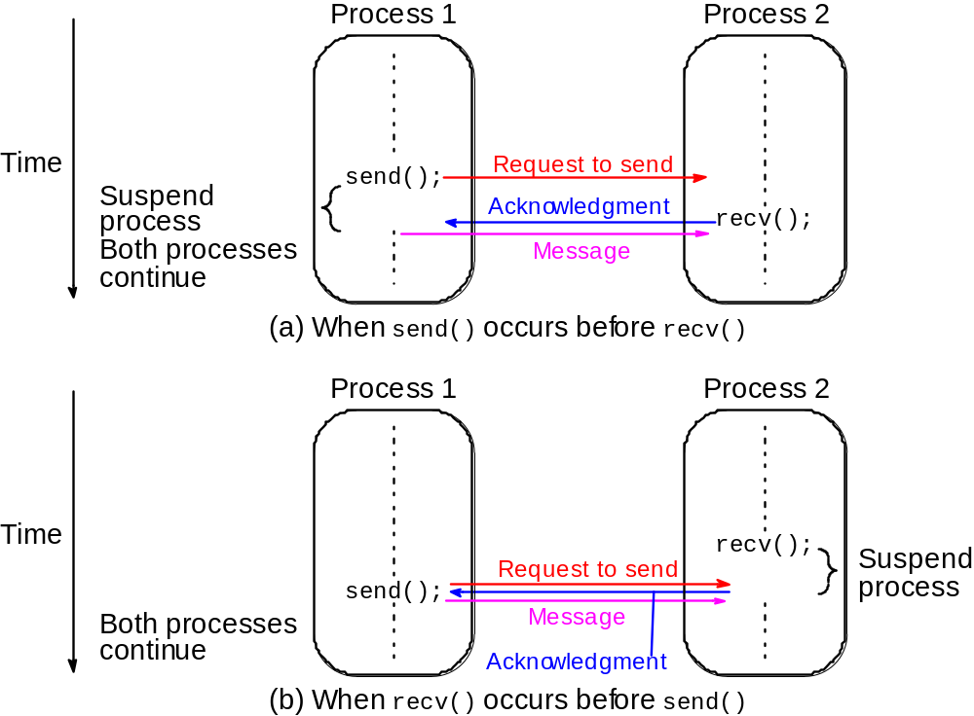
Synchronous send() and recv() using 3-way protocol
1.<number>

Slide 13
Asynchronous Message Passing
Routines that do not wait for actions to complete before returning. Usually require local storage for messages.
More than one version depending upon the actual semantics for returning.
In general, they do not synchronize processes but allow processes to move forward sooner. Must be used with care.
1.<number>

Slide 14
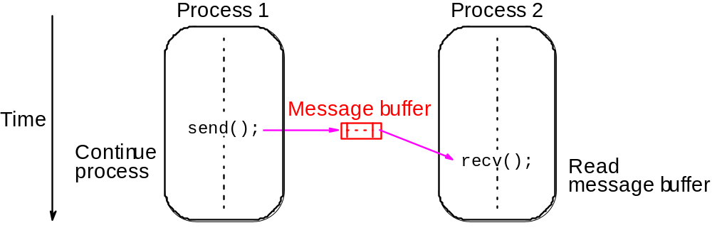
How message-passing routines return before message transfer completed
Message buffer needed between source and destination to hold message:
1.<number>

Slide 15
Blocking routines -- can act asynchronously and synchronously
Once local actions completed and message is safely on its way, sending process can continue with subsequent work.
But buffers only are of finite length and a point could be reached when send routine is held up because all available buffer space is exhausted.
Then, send routine will wait until storage becomes re-available - i.e then routine behaves as a synchronous routine.
1.<number>

Slide 16
Message Tag
Used to differentiate between different types of messages being sent.
Message tag is carried within message.
If special type matching is not required, a wild card message tag is used, so that the recv() will match with any send().
1.<number>

Slide 17
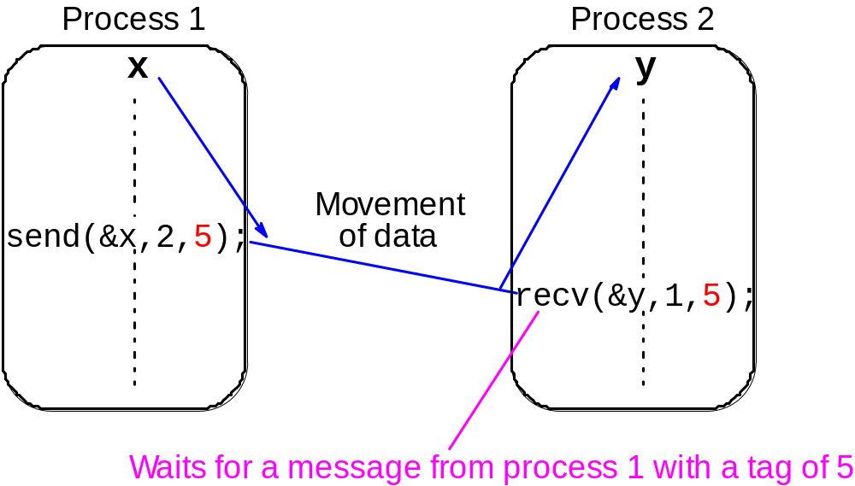
Message Tag Example
To send a message, x, with message tag 5 from a source process, 1, to a destination process, 2, and assign to y:
1.<number>

Slide 18
Collective or “Group” message passing routines
Have routines that send message(s) to a group of processes or receive message(s) from a group of processes
Higher efficiency than separate point-to-point routines although not absolutely necessary.
1.<number>

Slide 19
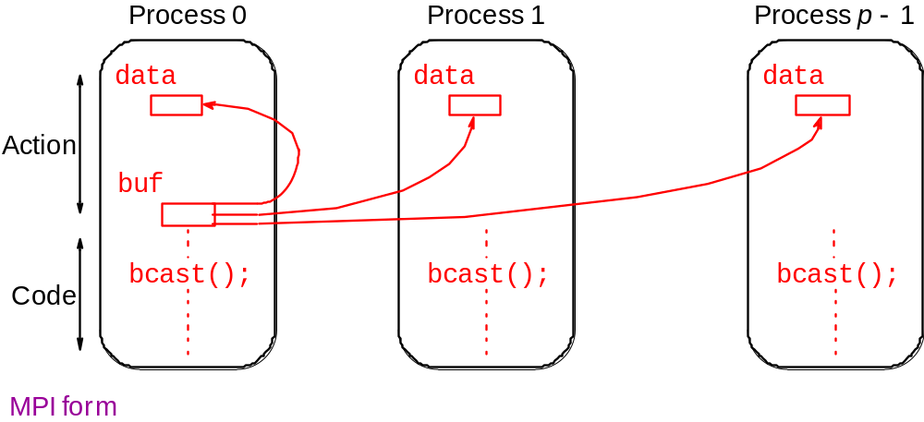
Broadcast
Sending same message to all processes concerned with problem.
Multicast - sending same message to defined group of processes.
1.<number>

Slide 20
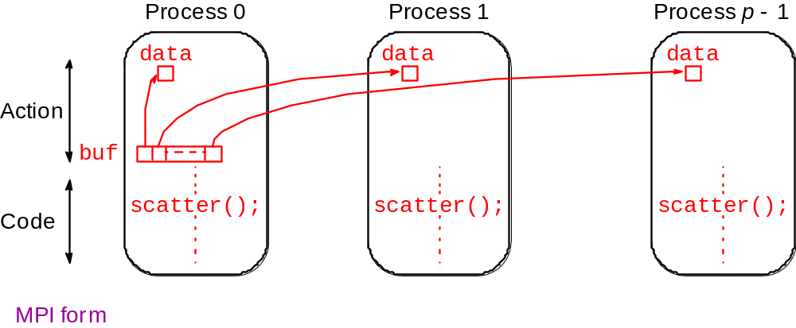
Scatter
Sending each element of an array in root process to a separate process. Contents of ith location of array sent to ith process.
1.<number>

Slide 21
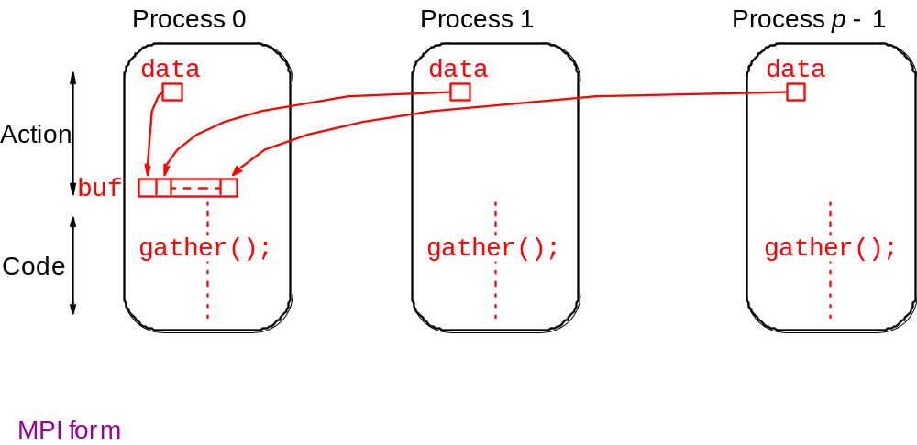
Gather
Having one process collect individual values from set of processes.
1.<number>

Slide 22
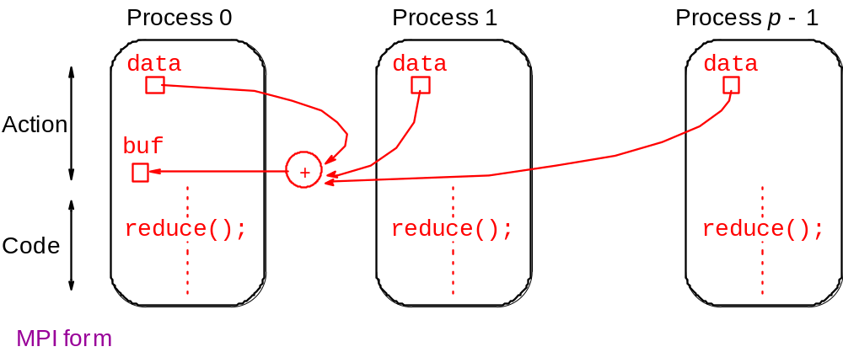
Reduce
Gather operation combined with specified arithmetic/logical operation.
Example: Values could be gathered and then added together by root:
1.<number>

Slide 23
MPI
(Message Passing Interface)
Message passing library standard developed by group of academics and industrial partners to foster more widespread use and portability.
Defines routines, not implementation.
Several free implementations exist.
1.<number>

Slide 24
MPI Definitions of Blocking and Non-Blocking
Blocking - return after their local actions complete, though the message transfer may not have been completed.
Non-blocking - return immediately.
Assumes that data storage used for transfer not modified by subsequent statements prior to being used for transfer, and it is left to the programmer to ensure this.
These terms may have different interpretations in other systems.
1.<number>

Slide 25
MPI
Process Creation and Execution
Purposely not defined - Will depend upon implementation.
Only static process creation supported in MPI version 1. All processes must be defined prior to execution and started together.
Originally SPMD model of computation.
MPMD also possible with static creation - each program to be started together specified.
1.<number>

Slide 26
Using SPMD Computational Model
main (int argc, char *argv[])
{
MPI_Init(&argc, &argv);
.
.
MPI_Comm_rank(MPI_COMM_WORLD, &myrank); /*find process rank */
if (myrank == 0)
master();
else
slave();
.
.
MPI_Finalize();
}
where master() and slave() are to be executed by master process and slave process, respectively.
1.<number>

Slide 27
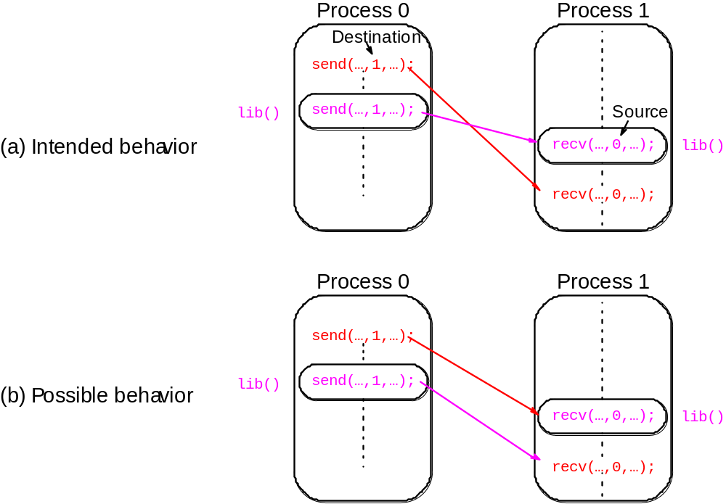
Unsafe message passing
Example
1.<number>

Slide 28
MPI Solution
“Communicators”
Defines a communication domain - a set of processes that are allowed to communicate between themselves.
Communication domains of libraries can be separated from that of a user program.
Used in all point-to-point and collective MPI message-passing communications.
1.<number>

Slide 29
Communicators
Defines scope of a communication operation.
Processes have ranks associated with communicator.
Initially, all processes enrolled in a “universe” called MPI_COMM_WORLD, and each process is given a unique rank, a number from 0 to p - 1, with p processes.
Other communicators can be established for groups of processes.
1.<number>

Slide 30
Default Communicator MPI_COMM_WORLD
Exists as first communicator for all processes existing in the application.
A set of MPI routines exists for forming communicators.
Processes have a “rank” in a communicator.
1.<number>

Slide 31
MPI Point-to-Point Communication
Uses send and receive routines with message tags (and communicator).
Wild card message tags available
1.<number>

Slide 32
MPI Blocking Routines
Return when “locally complete” - when location used to hold message can be used again or altered without affecting message being sent.
Blocking send will send message and return - does not mean that message has been received, just that process free to move on without adversely affecting message.
1.<number>

Slide 33
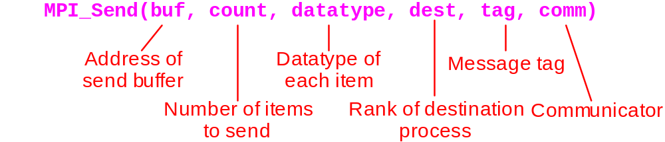
Parameters of blocking send
1.<number>

Slide 34
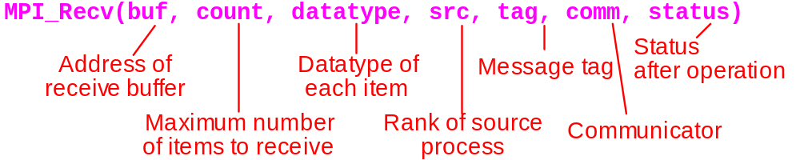
Parameters of blocking receive
1.<number>

Slide 35
Example
To send an integer x from process 0 to process 1,
MPI_Comm_rank(MPI_COMM_WORLD,&myrank); /* find rank */
if (myrank == 0) {
int x;
MPI_Send(&x, 1, MPI_INT, 1, msgtag, MPI_COMM_WORLD);
} else if (myrank == 1) {
int x;
MPI_Recv(&x, 1, MPI_INT, 0,msgtag,MPI_COMM_WORLD,status);
}
1.<number>

Slide 36
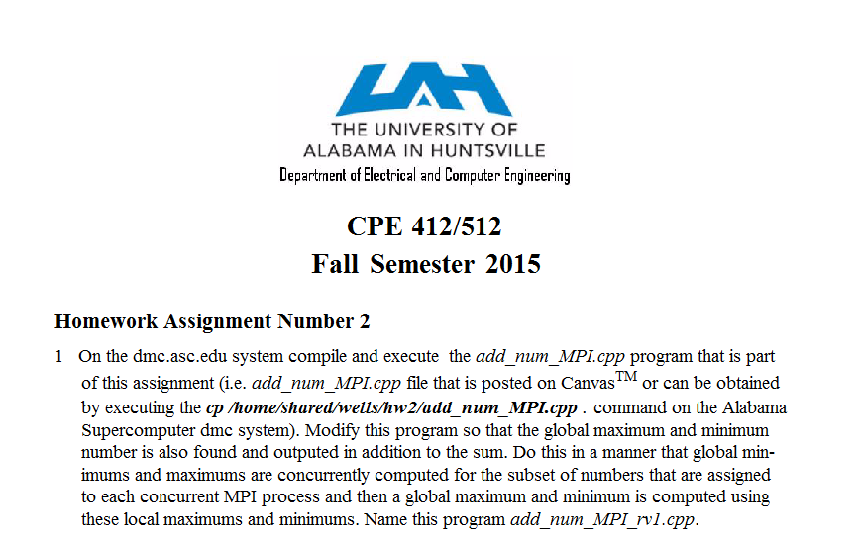
1.<number>

Slide 37
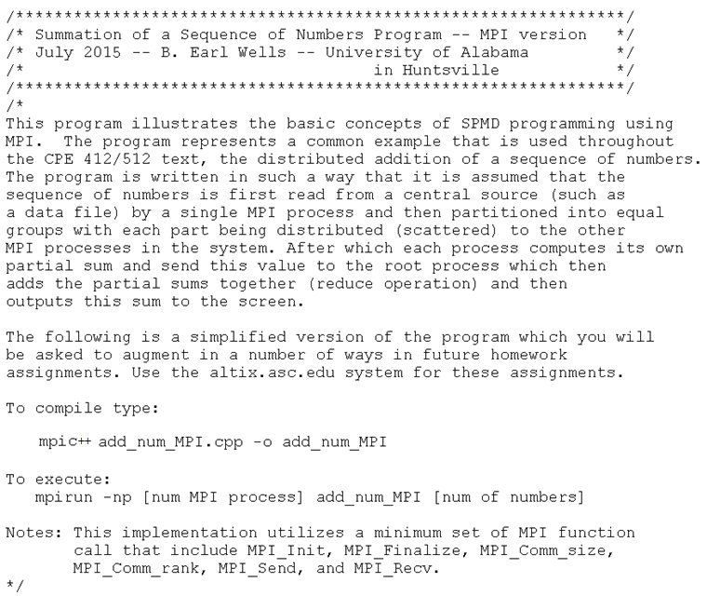
1.<number>

Slide 38
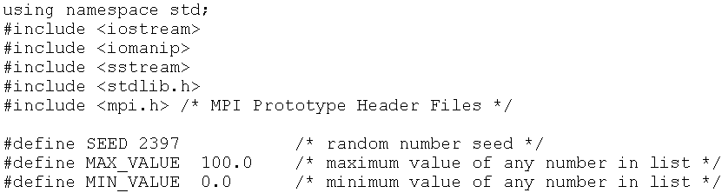
1.<number>

Slide 39
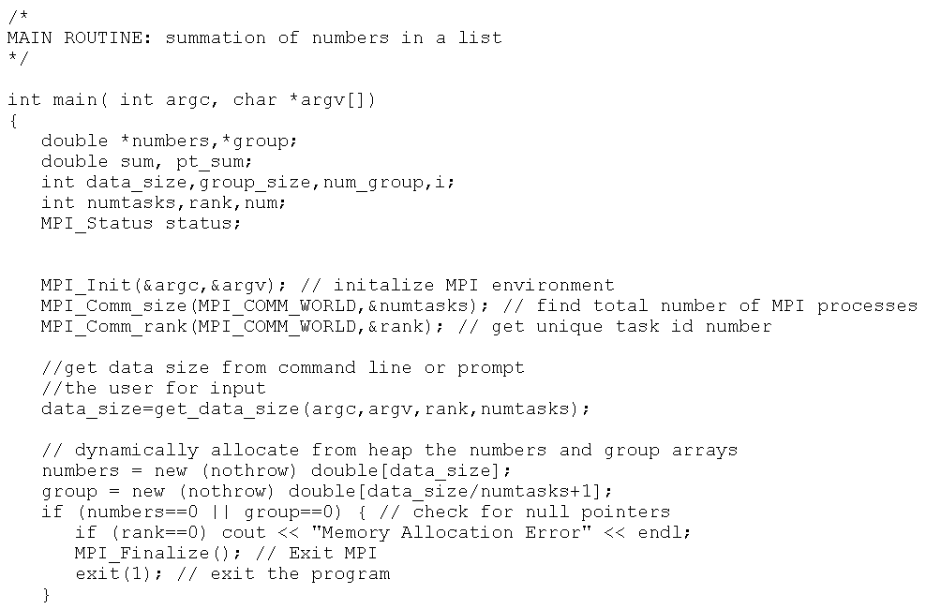
1.<number>

Slide 40
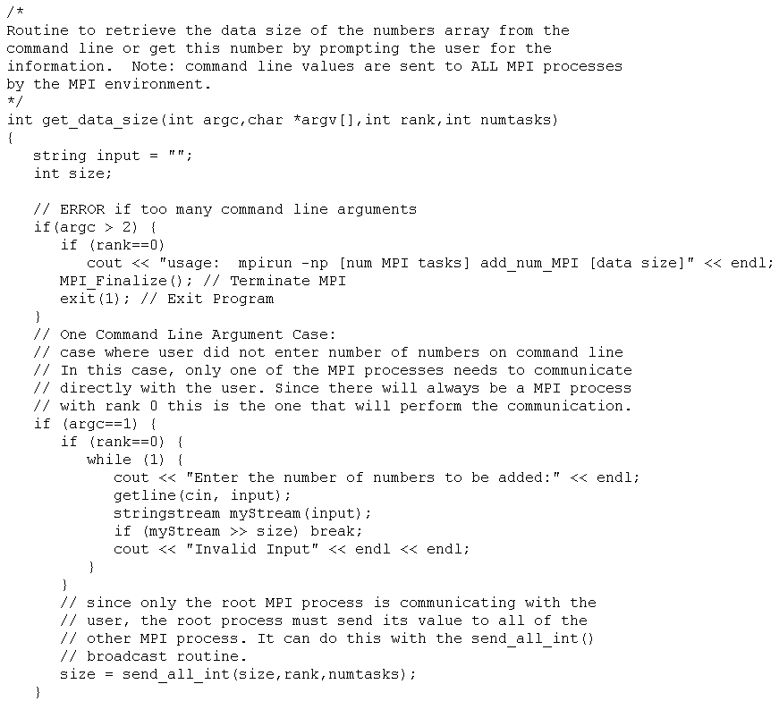
1.<number>

Slide 41
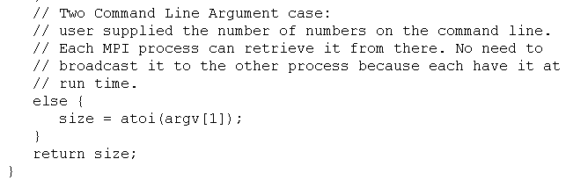
1.<number>

Slide 42
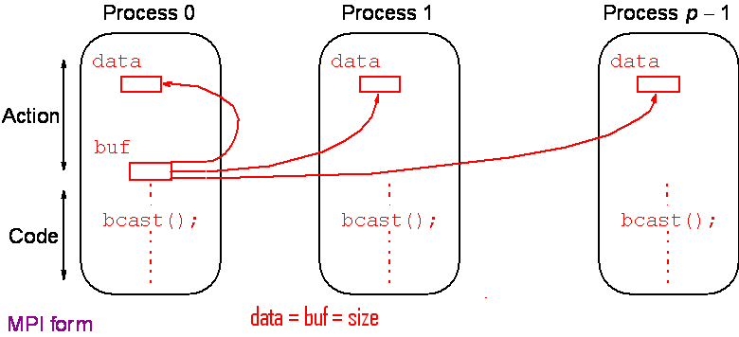
Broadcast
Sending same message to all processes concerned with problem.
Multicast - sending same message to defined group of processes.
1.<number>

Slide 43
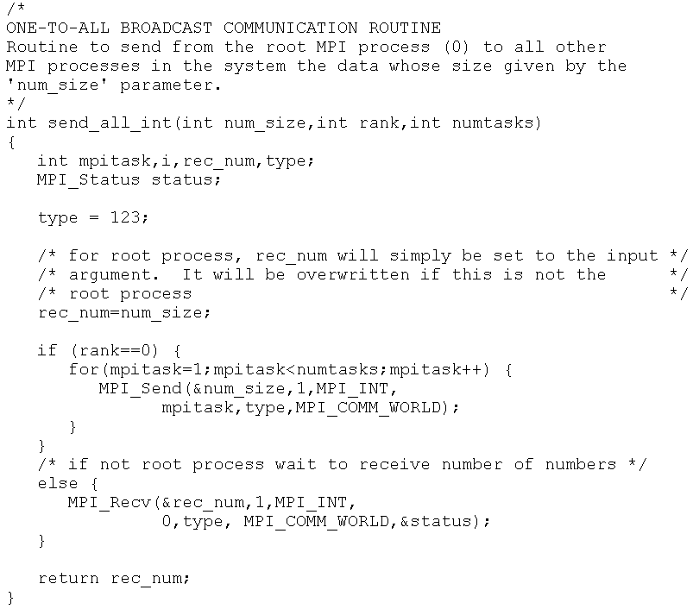
1.<number>

Slide 44
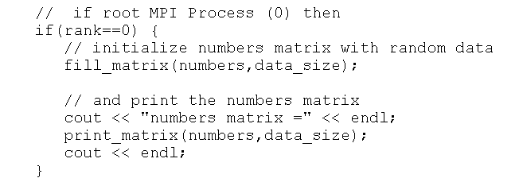
1.<number>

Slide 45
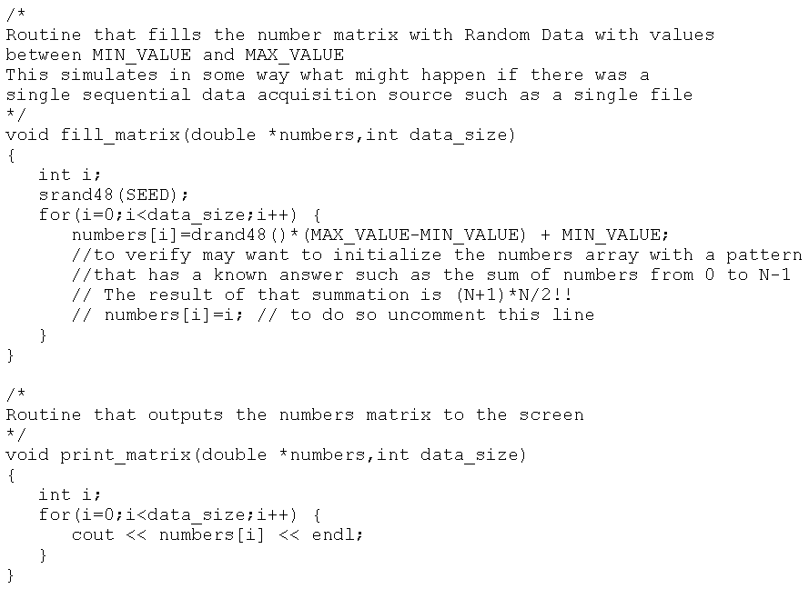
1.<number>

Slide 46
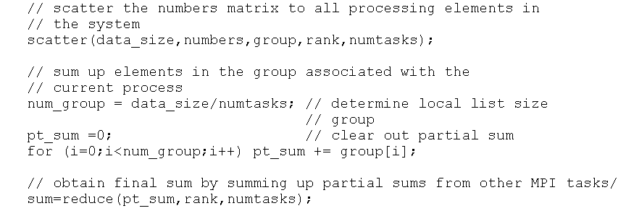
1.<number>

Slide 47
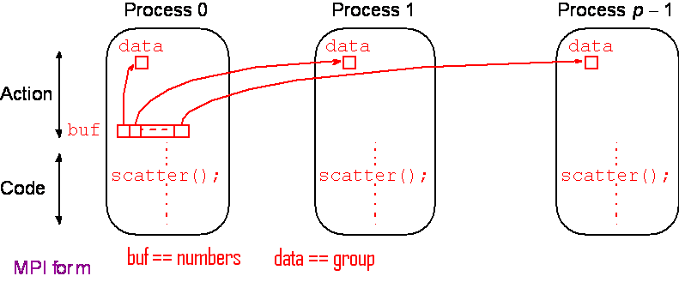
Scatter
Sending each element of an array in root process to a separate process. Contents of ith location of array sent to ith process.
1.<number>

Slide 48
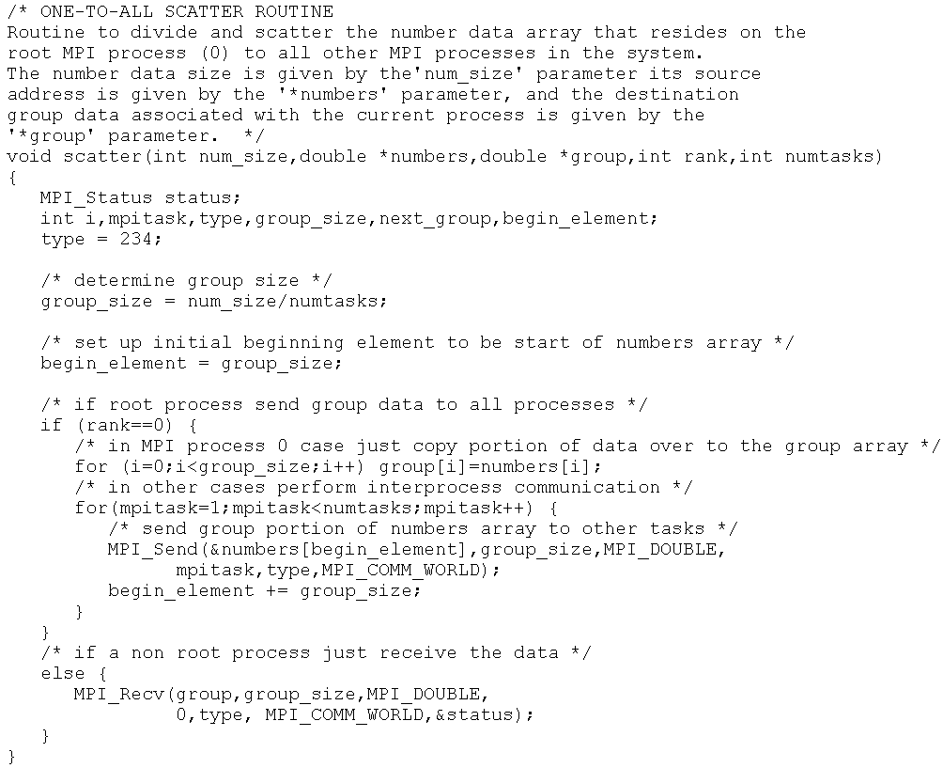
1.<number>

Slide 49
1.<number>

Slide 50
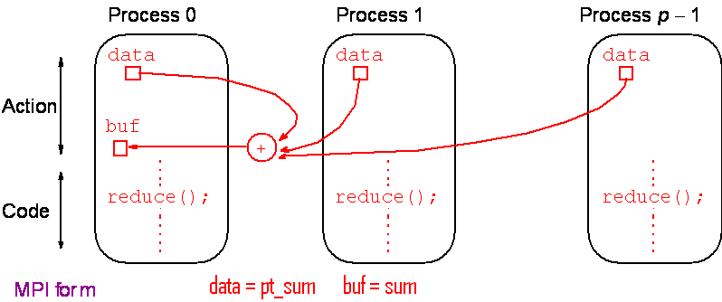
Reduce
Gather operation combined with specified arithmetic/logical operation.
Example: Values could be gathered and then added together by root:
1.<number>

Slide 51
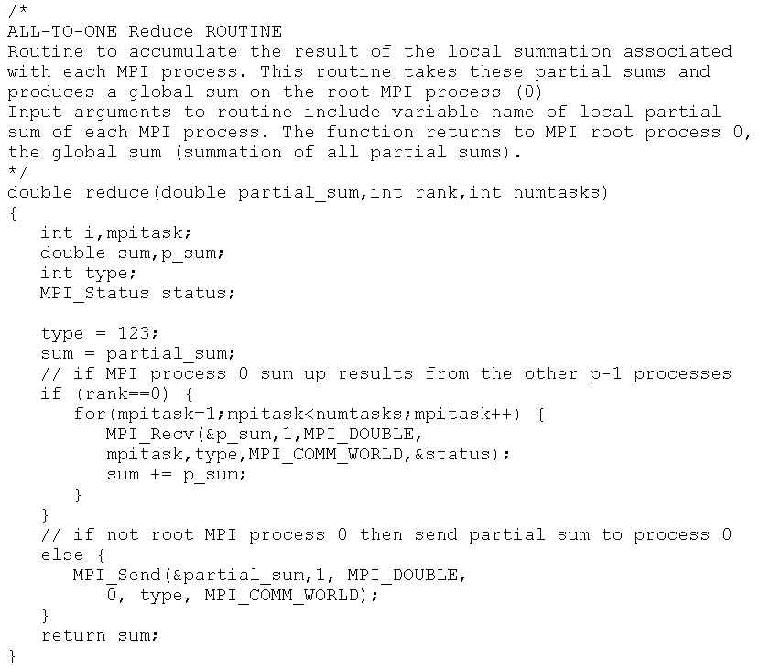
1.<number>

Slide 52
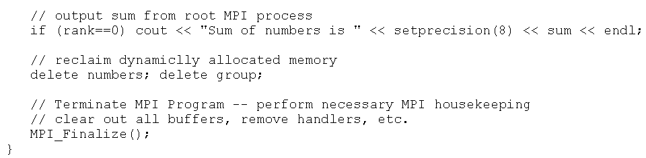
1.<number>

Slide 53
Evaluating the add_num_MPI.cpp
Program Runtime Behavior
1.<number>

Slide 54
Data Parallelism
(Spatial Parallelism)
Data Parallelism may be possible when there are independent tasks that apply the same operation to different data items
1.<number>

Slide 55
Communication Time
Communication time is affected by factors, including network structure and network contention. As a first approximation, use
  tcomm = tstartup + ntdata
tstartup is startup time, essentially time to send a message with no data. Assumed to be constant.
tdata is transmission time to send one data word, also assumed constant, and there are n data words.
1.<number>

Slide 56
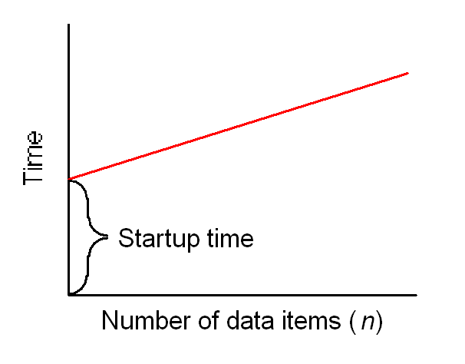
Idealized Communication Time
1.<number>

Slide 57
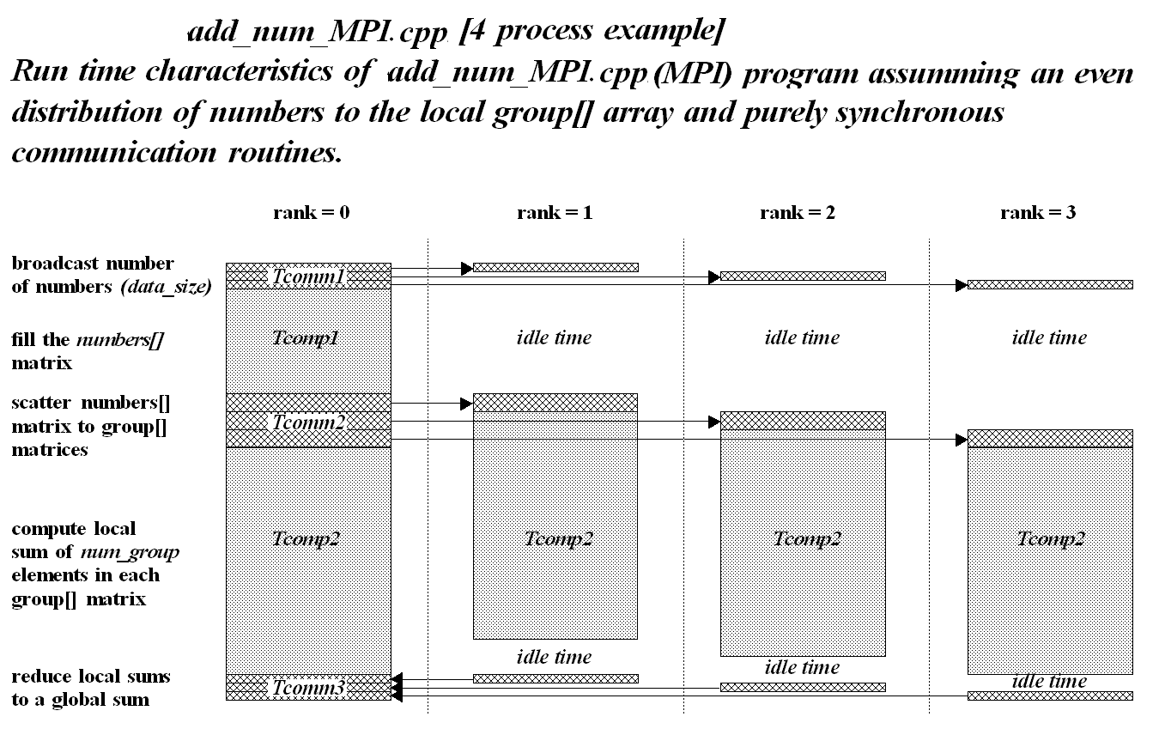
1.<number>

Slide 58
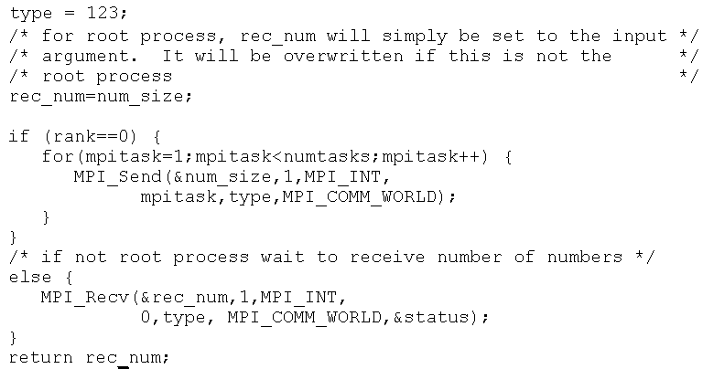
1.<number>

Slide 59
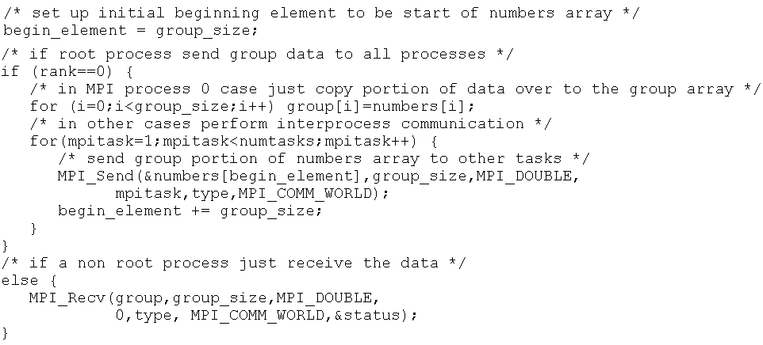
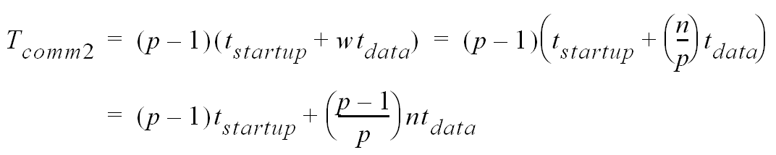
1.<number>

Slide 60
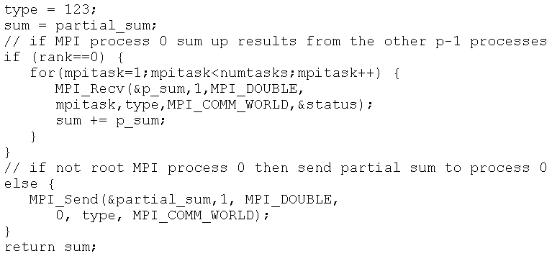
1.<number>

Slide 61
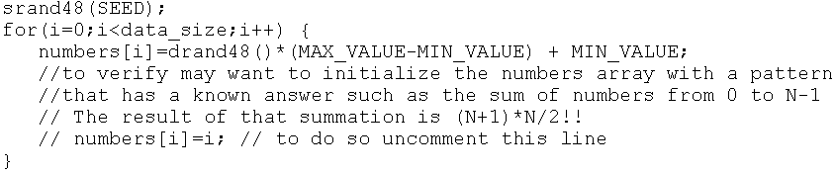
1.<number>

Slide 62
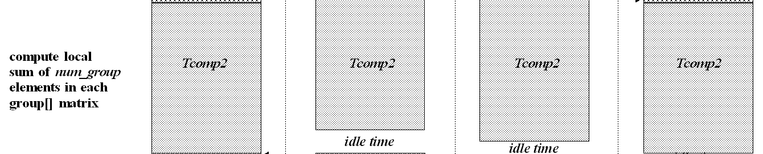
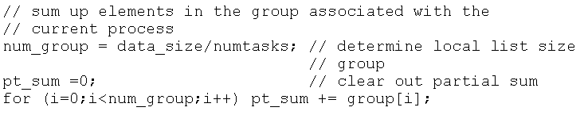
1.<number>

Slide 63
1.<number>

Slide 64
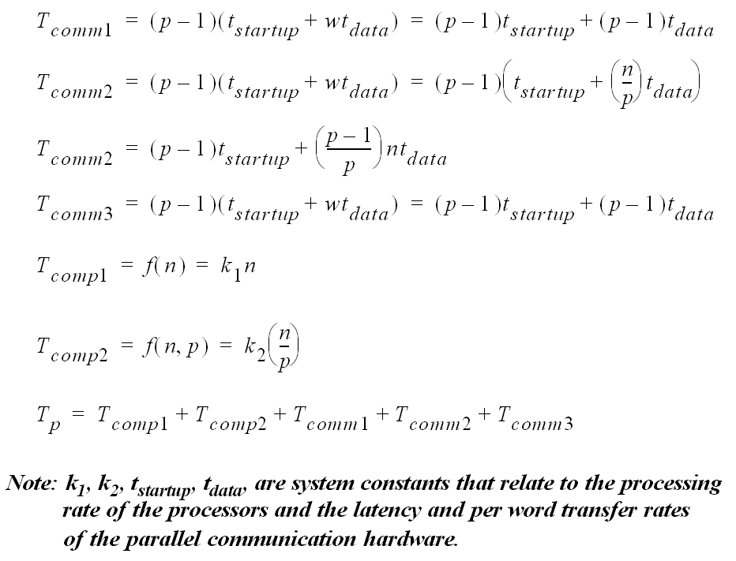
1.<number>

Slide 65



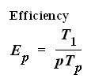

Performance Metrics
1.<number>

