Slide 1
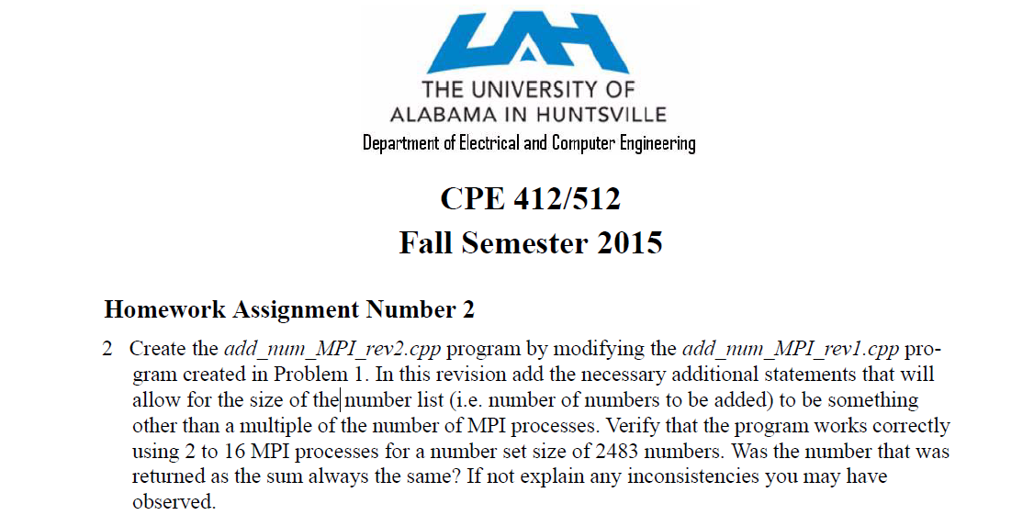
1.<number>

Slide 2
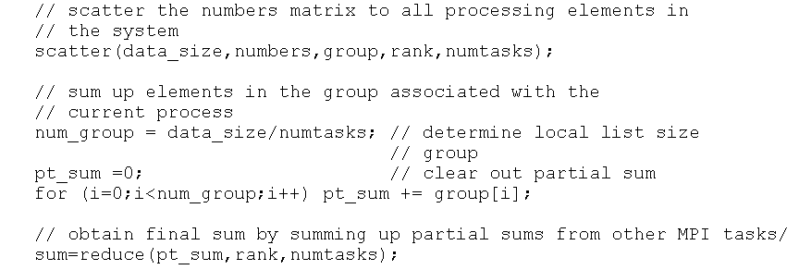
1.<number>

Slide 3
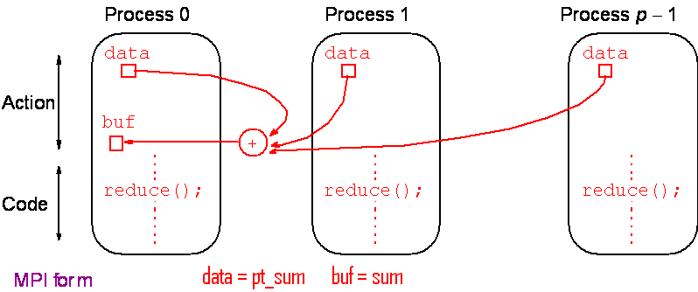
Reduce
Gather operation combined with specified arithmetic/logical operation.
Example: Values could be gathered and then added together by root:
1.<number>

Slide 4
Performance Metrics
Execution time is not always the most convenient metric by which to evaluate parallel algorithm performance.
But execution time tends to vary with problem size
  execution times must be normalized when comparing algorithm performance at different problem sizes.
1.<number>

Slide 5
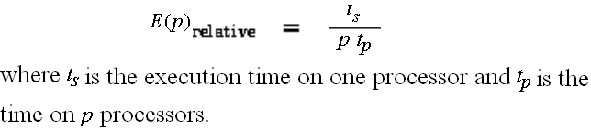
Relative Efficiency
Efficiency -- the fraction of time that processors spend doing useful work.
  It characterizes the effectiveness with which an algorithm uses the computational resources of a parallel computer in a way that is independent of problem size
Relative Efficiency is defined
1.<number>

Slide 6
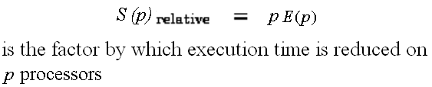
Relative Speedup
Relative Speedup is defined
1.<number>

Slide 7
Relative versus Absolute Speedups and Efficiencies
These metrics are relative because they are defined with respect to the parallel algorithm executing on a single processor.
They are useful when exploring the scalability of an algorithm but do not constitute an absolute figure of merit.
  Absolute efficiencies and speedups are used in these cases.
1.<number>

Slide 8
Absolute Speedup
where t_{s} is execution time on a single processor and t_{p} is execution time on a multiprocessor.
S(p) gives increase in speed by using more than one processing core element.
Use best sequential algorithm with single processor system. Underlying algorithm for parallel implementation might be (and is usually) different.
1.<number>

Slide 9

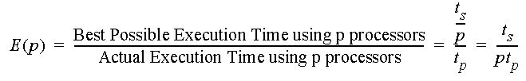
Absolute Efficiency
where t_{s} is execution time on a single processor and t_{p} is execution time on a multiprocessor.
Again use best sequential algorithm with single processor system. Underlying algorithm for parallel implementation might be (and is usually) different.
1.<number>

Slide 10
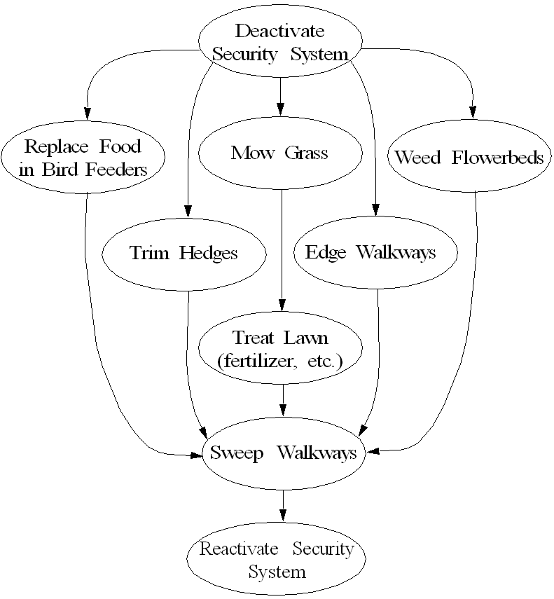
Landscape Management
Example
1.<number>

Slide 11
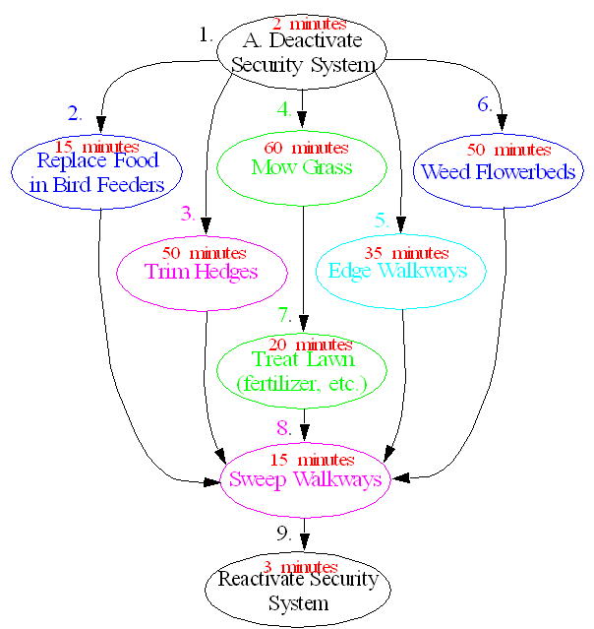
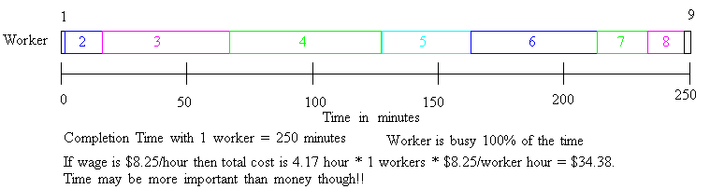
1.<number>

Slide 12
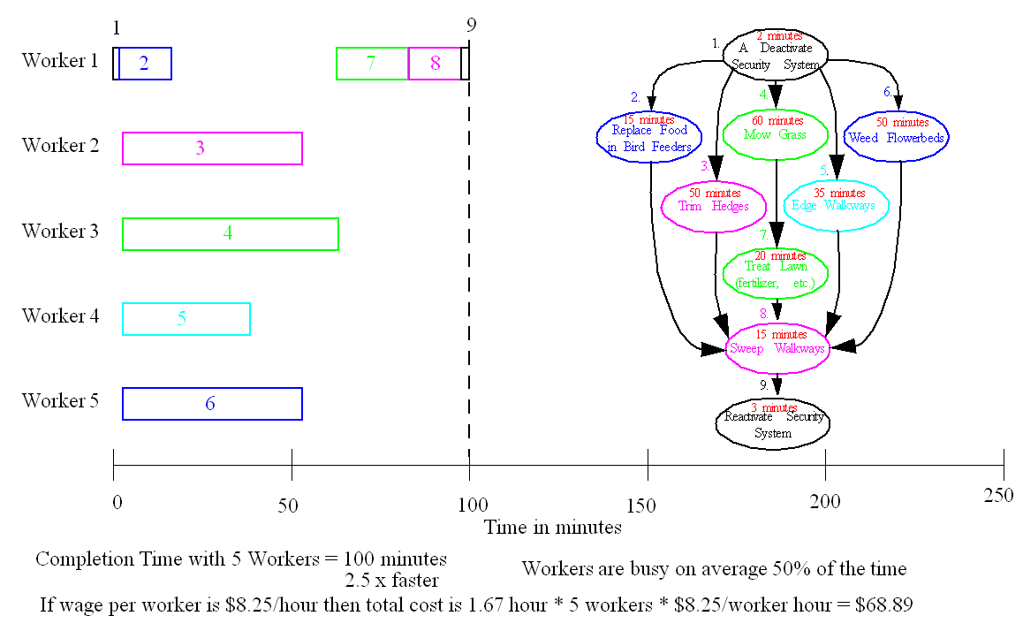
1.<number>

Slide 13
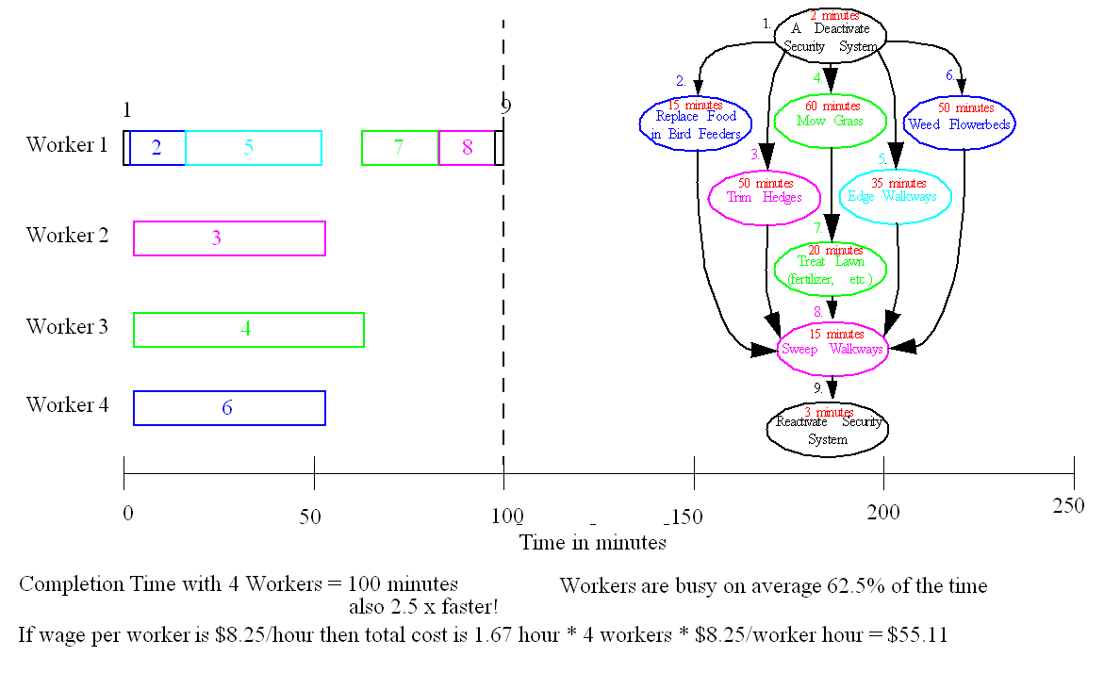
1.<number>

Slide 14
Absolute Speedup
where t_{s} is execution time on a single processor and t_{p} is execution time on a multiprocessor.
S(p) gives increase in speed by using more than one processing core element.
Use best sequential algorithm with single processor system. Underlying algorithm for parallel implementation might be (and is usually) different.
1.<number>

Slide 15
1.<number>

Slide 16
Absolute Speedup can also be cast in terms of computational steps:
Can also extend time complexity to parallel computations.
1.<number>

Slide 17
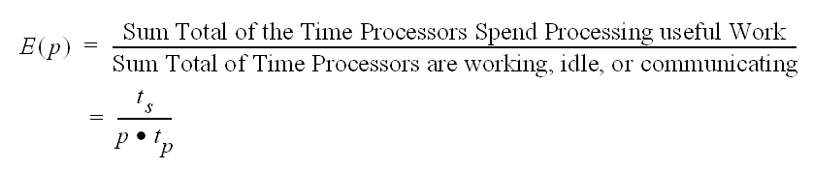
Absolute Efficiency
where t_{s} is execution time on a single processor and t_{p} is execution time on a multiprocessor.
1.<number>

Slide 18
1.<number>

Slide 19
Efficiency
where t_{s} is execution time on a single processor and t_{p} is execution time on a multiprocessor.
Again use best sequential algorithm with single processor system. Underlying algorithm for parallel implementation might be (and is usually) different.
1.<number>

Slide 20

Cost
1.<number>

Slide 21
1.<number>

Slide 22
1.<number>

Slide 23

Speedup Factor
where t_{s} is execution time on a single processor and t_{p} is execution time on a multiprocessor.
Use best sequential algorithm with single processor system. Underlying algorithm for parallel implementation might be (and is usually) different.
1.<number>

Slide 24
Maximum Speedup
Maximum speedup is usually p with p processors (linear speedup).
Possible to get superlinear speedup (greater than p) but usually a specific reason such as:
Extra memory in multiprocessor system
Nondeterministic algorithm
1.<number>

Slide 25
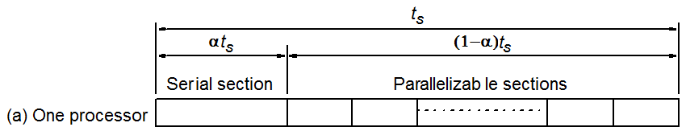
Maximum Speedup
Amdahl’s law
1.<number>

Slide 26
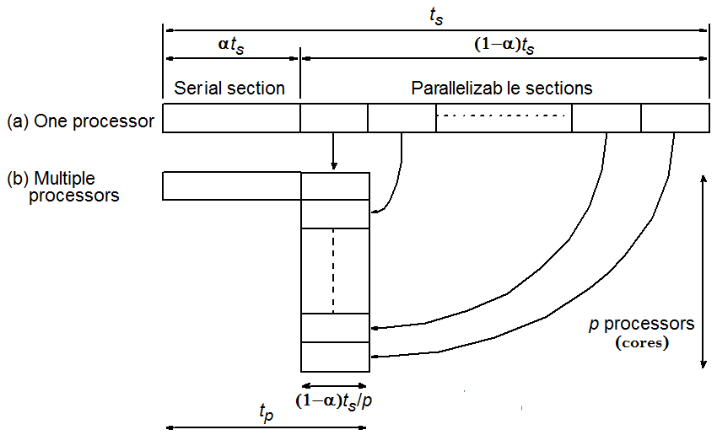

Maximum Speedup
Amdahl’s law
1.<number>

Slide 27


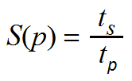
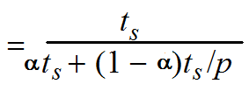

Maximum Speedup
Amdahl’s law
1.<number>

Slide 28
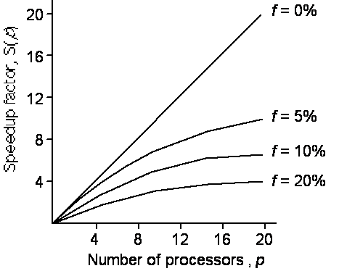
Speedup against number of processors
Even with infinite number of processors, maximum speedup limited to 1/f .
Example: With only 5% of computation being serial, maximum speedup is 20, irrespective of number of processors.
1.<number>

Slide 29
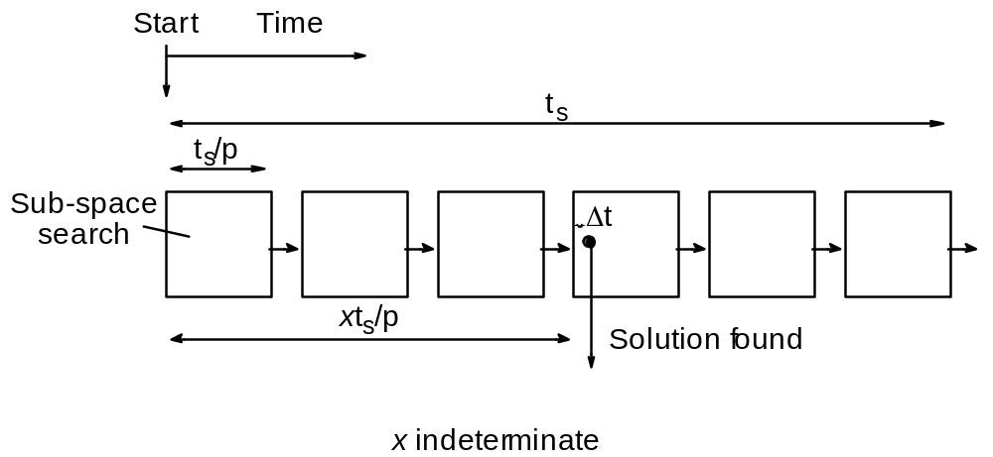
Superlinear Speedup example - Searching
(a) Searching each sub-space sequentially
1.<number>

Slide 30
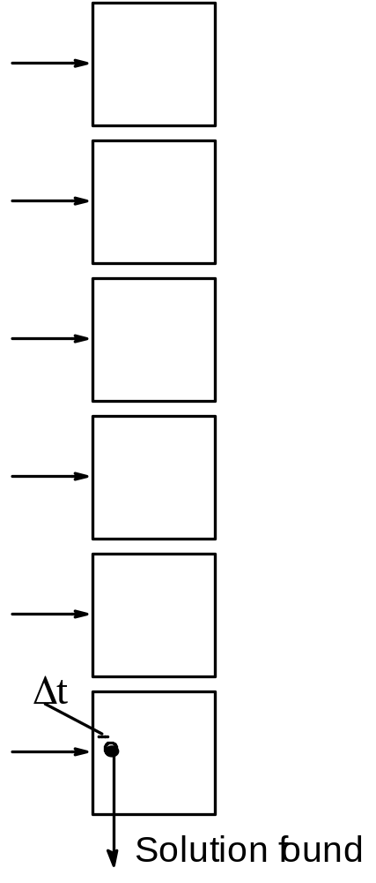
(b) Searching each sub-space in parallel
1.<number>

Slide 31
Speed-up then given by
t
x
×
-
s
-
-
-
+
Δ
t
()
p
Sp
=
-
-
-
-
-
-
-
-
-
-
-
-
-
-
-
-
-
-
-
-
-
-
-
-
-
-
-
-
-
-
Δ
t
1.<number>

Slide 32
Worst case for sequential search when solution found in last sub-space search. Then parallel version offers greatest benefit, i.e.
p
–
1
×
Δ
-
-
-
-
-
-
-
-
-
-
-
-
t
+
t
s
p
()
-
→
∞
-
-
-
-
-
-
-
-
-
-
-
-
-
-
-
-
-
-
-
-
-
-
-
-
-
-
-
-
-
-
-
-
-
-
-
-
-
-
Sp
=
-
Δ
t
as
Δ
t tends to zero
1.<number>

Slide 33
Least advantage for parallel version when solution found in first sub-space search of the sequential search, i.e.
Actual speed-up depends upon which subspace holds solution but could be extremely large.
()
Δ
t
Sp
-
-
-
=
-
=
1
Δ
t
1.<number>

Slide 34


Computation Rates
1.<number>

Slide 35

Computation Rate Example
1.<number>

Slide 36


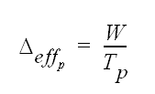
Effective Computation Rates of a p cpu/core System
1.<number>

Slide 37
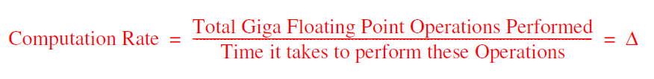



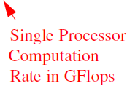

Effective Computation Rates of a p cpu/core System
1.<number>

Slide 38
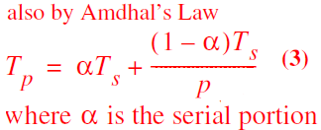
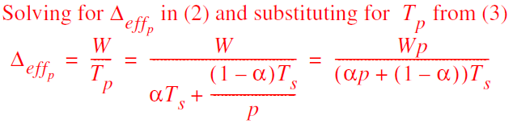
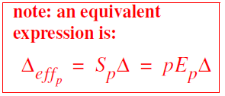
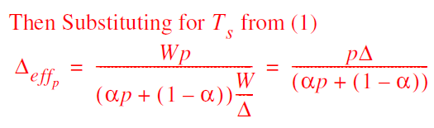
Effective Computation Rates of a p cpu/core System
1.<number>

Slide 39


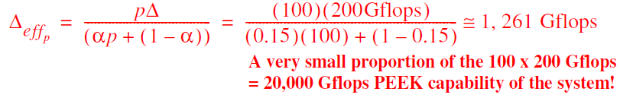
Effective Computation Rates of a p cpu/core System
1.<number>

Slide 40
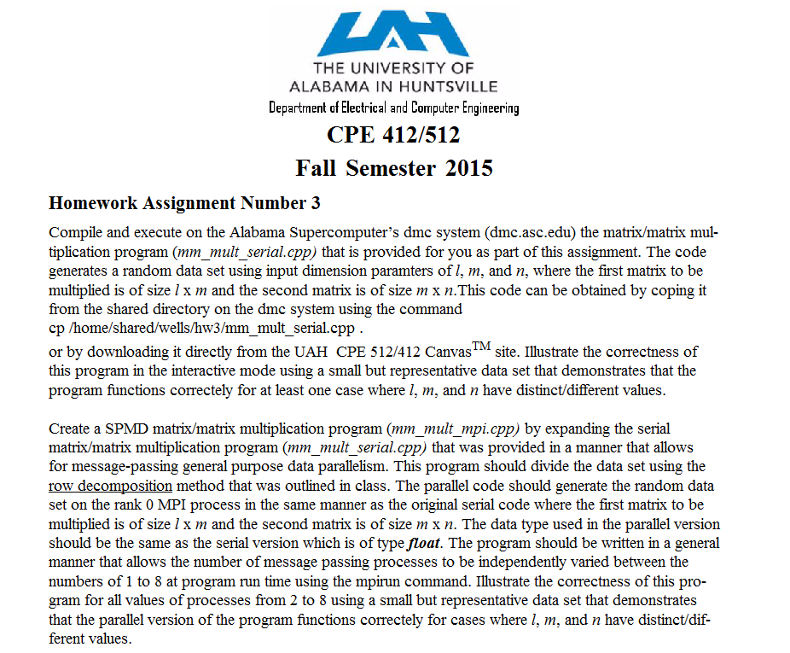
1.<number>

Slide 41
Matrix Multiplication
1.<number>

Slide 42
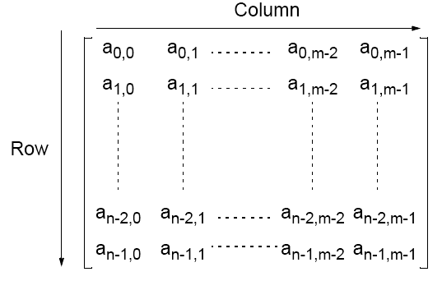
Matrices — A Review
An n x m matrix
1.<number>

Slide 43
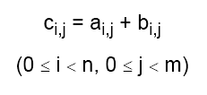
Matrix Addition
Involves adding corresponding elements of each matrix to form the result matrix.
Given the elements of A as ai,j and the elements of B as bi,j, each element of C is computed as
1.<number>

Slide 44

Matrix Multiplication
Multiplication of two matrices, A and B, produces the matrix C
whose elements, ci,j (0 <= i < n, 0 <= j < m), are computed as follows:
where A is an n x l matrix and B is an l x m matrix.
1.<number>

Slide 45
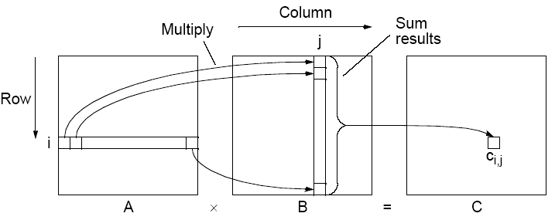
Matrix multiplication, C = A x B
1.<number>

Slide 46
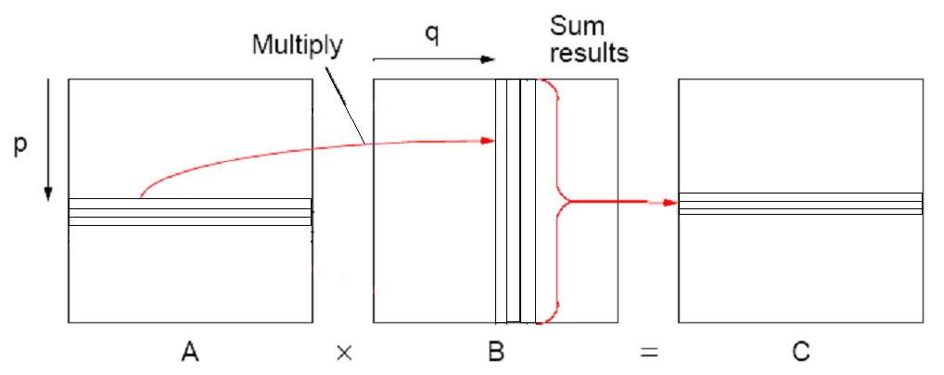
Row Matrix Multiplication
1.<number>

Slide 47
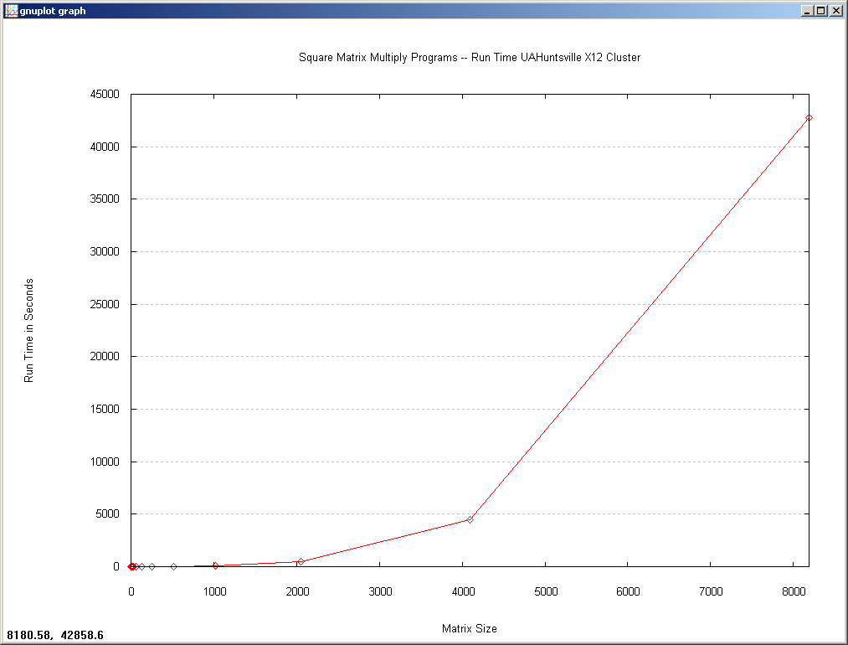
1.<number>

Slide 48
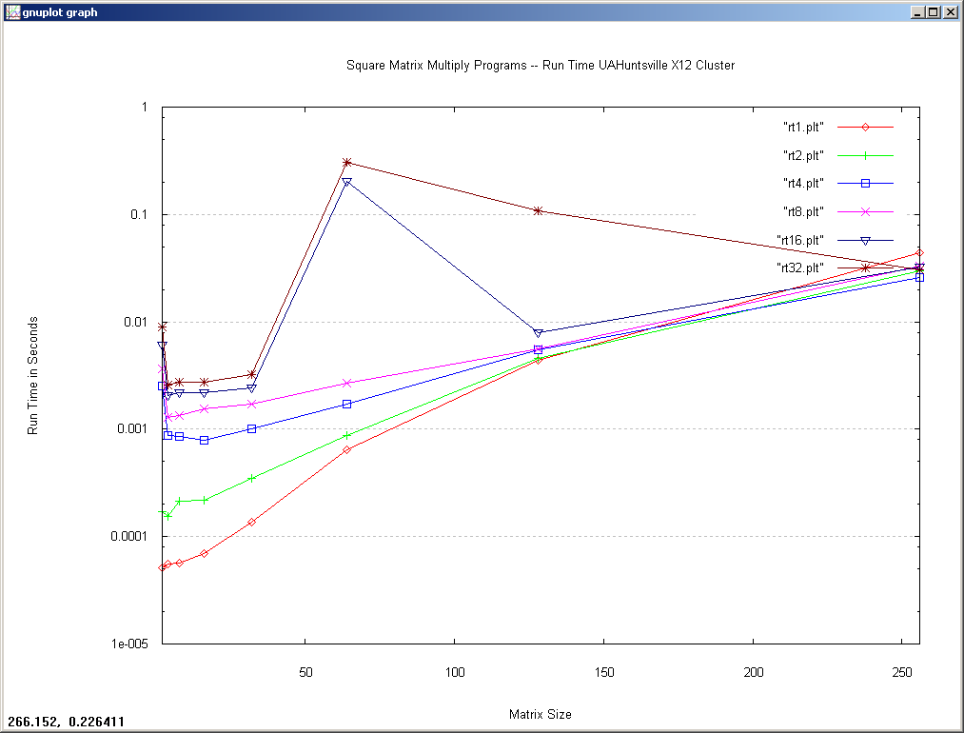
1.<number>

Slide 49
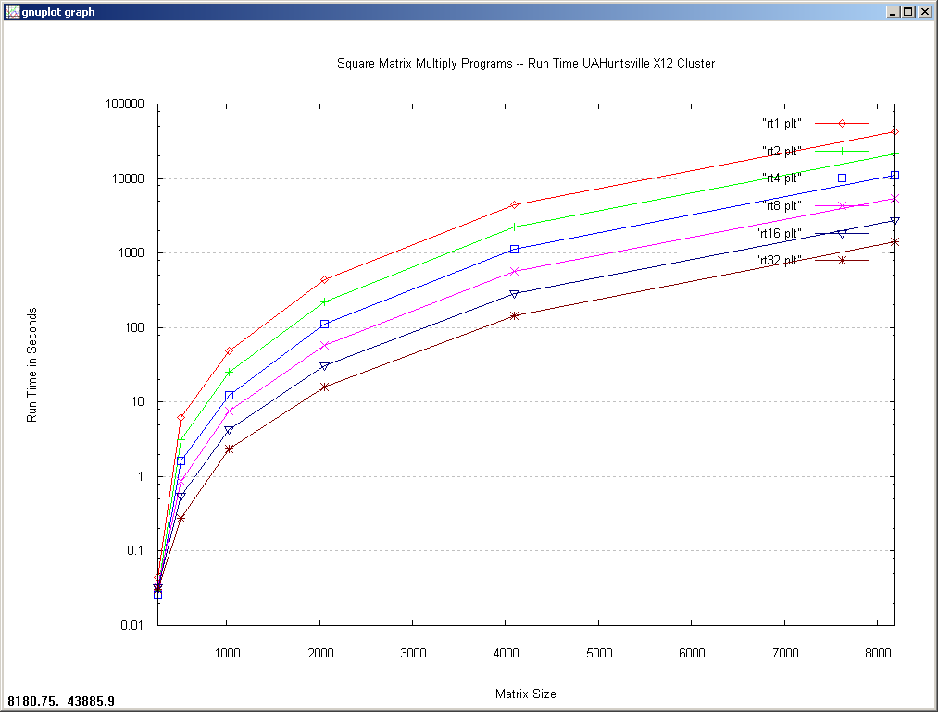
1.<number>

Slide 50
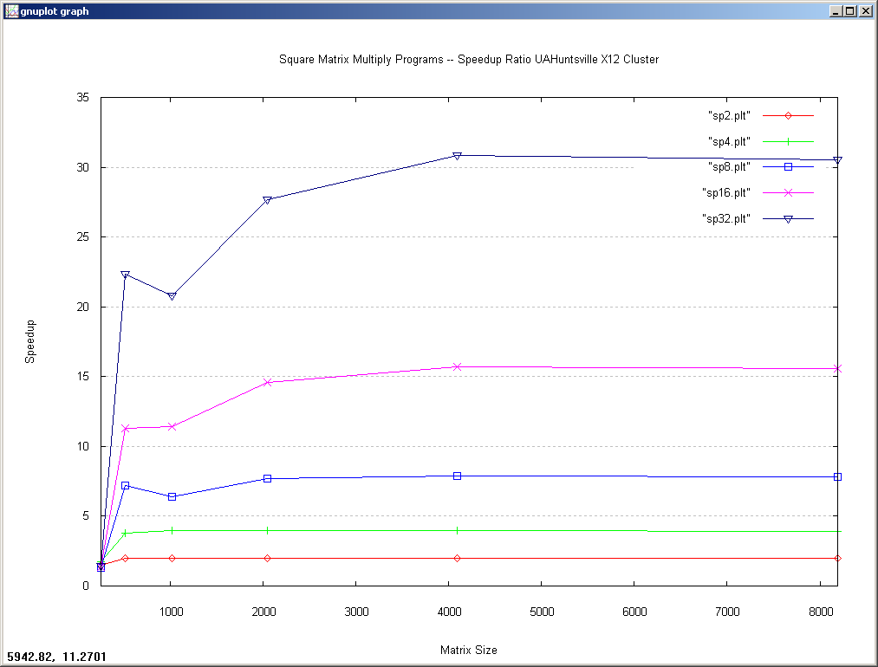
1.<number>

Slide 51
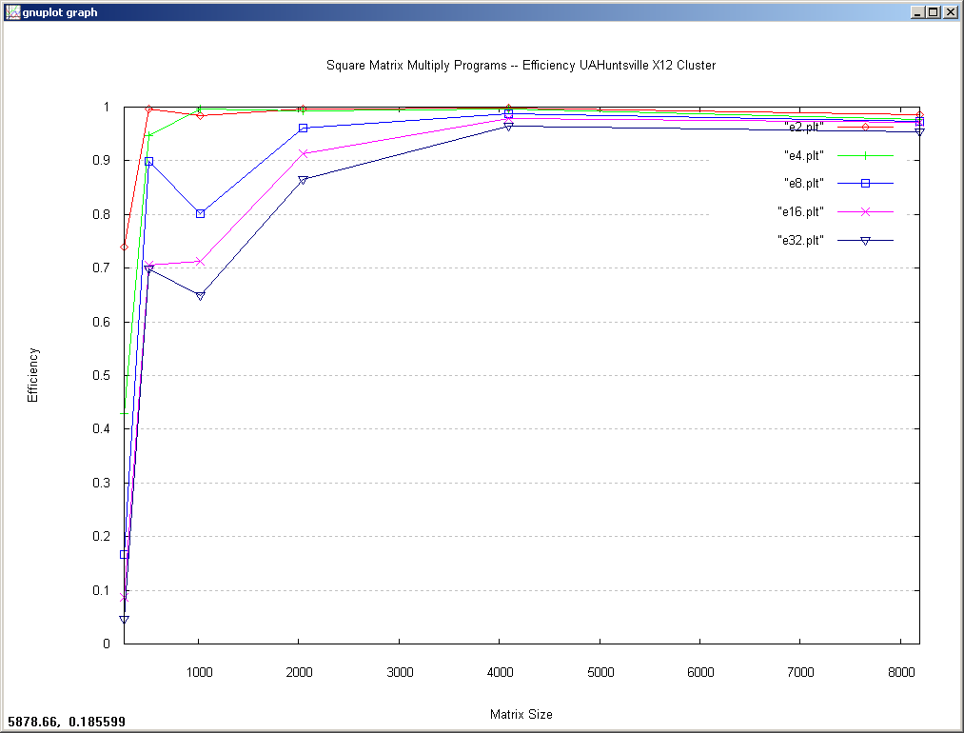
1.<number>

Slide 52
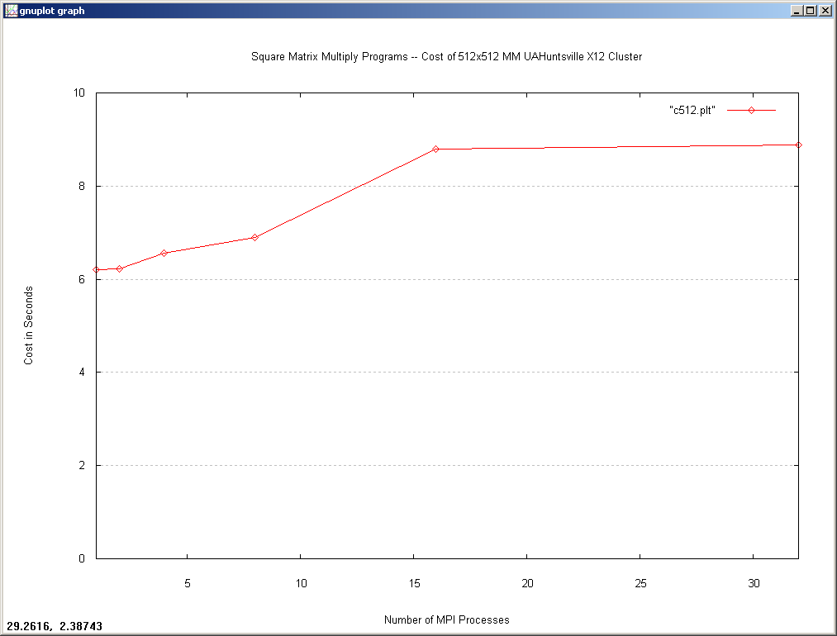
1.<number>

Slide 53
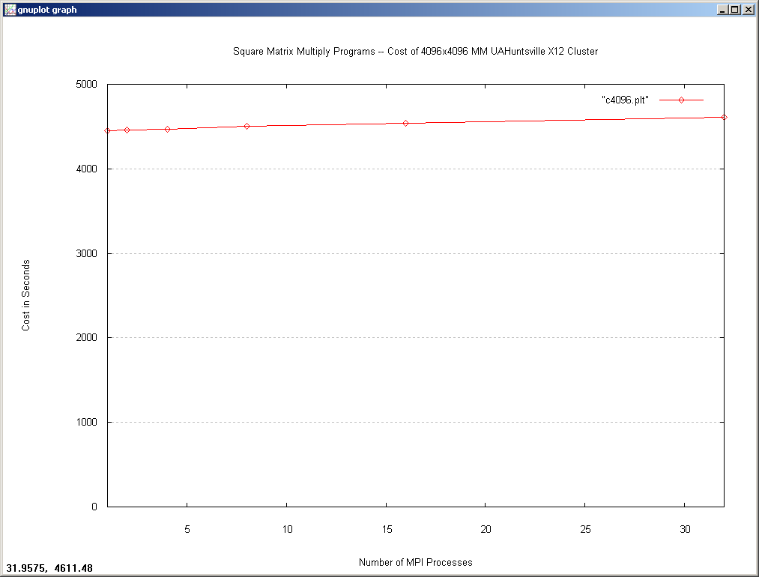
1.<number>

