Slide 1
CPE 412/512 Introduction to Parallel Programming
Scope of Course
Introduction to software development methodologies for multi-core, distributed, and general purpose GPU computing environments. Exploration of parallel machine models, performance evaluation, process and thread creation, mutual exclusion, synchronization, and message passing communication mechanisms.
1.<number>

Slide 2
CPE 412/512 Introduction to Parallel Programming
Course Focus
Focus of course is the effective implementation of concurrent programs that are written in MPI, Pthreads, and OpenMP as well as hybrid implementations that can take full advantage of clustered/multi-threaded computing environments. Introduction to GPU programming paradigm and concepts and programming in OpenACC.
1.<number>

Slide 3
Concurrent Programming
Traditional programming courses focus on writing program code in a high-level language such as C++ where processing is to always occur sequentially from the programmers point of view.
This course introduces the basic concept of concurrent programming where programs are written in a manner so they can execute using multiple interacting processes, theads, fibers, and/or tasks.
1.<number>

Slide 4
Reasons for Concurrent Programming
It is more convenient to write code in this manner.
  The concurrent model is closer in nature to the actual application problem being solved.
  It better supports the concepts of encapsulation and varied disjoint activity of multiple functions and applications.
    OS, GUI, OLTP, server, event driven code
1.<number>

Slide 5
Reasons for Concurrent Programming
It provides more flexibility, reactability and expandability
  Functionality can be more easily added and removed
The code is to execute on a geographically distributed system
  Web based code, cloud computing
To improve responsiveness or fault tolerance
  software/hardware tolerance
To better regulate power consumption characteristics
  background power management
1.<number>

Slide 6
Reasons for Concurrent Programming
To execute a single application in a more processing efficient manner (faster)
  This is the primary focus of this course!
1.<number>

Slide 7
Goals of this Course
To learn how to write application program code that will more effectively utilize the processing capabilities of today's clustered and multicore/hyperthreaded computer hardware.
To learn how to write application programs that will scale well to future hardware environments
  Be able to execute in parallel and use an arbitrary number of processing cores/nodes (within reason of course).
1.<number>

Slide 8
Goals of this Course
To understand the basic concepts of concurrency and parallelism that will allow us to adapt to the ever changing computing paradigms and environments.
  To obtain an education – not just training.
1.<number>

Slide 9
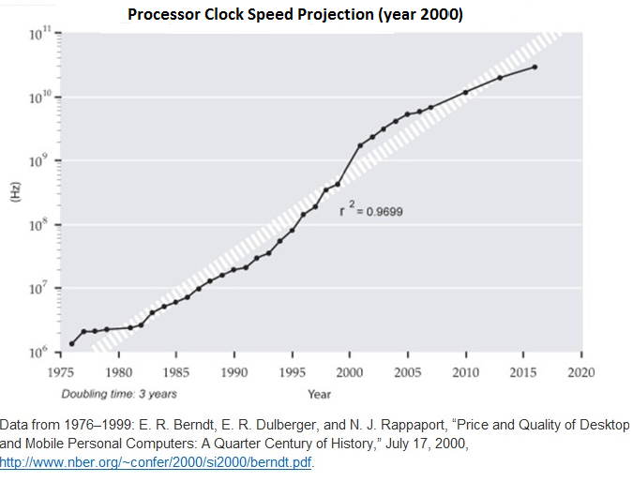
1.<number>

Slide 10
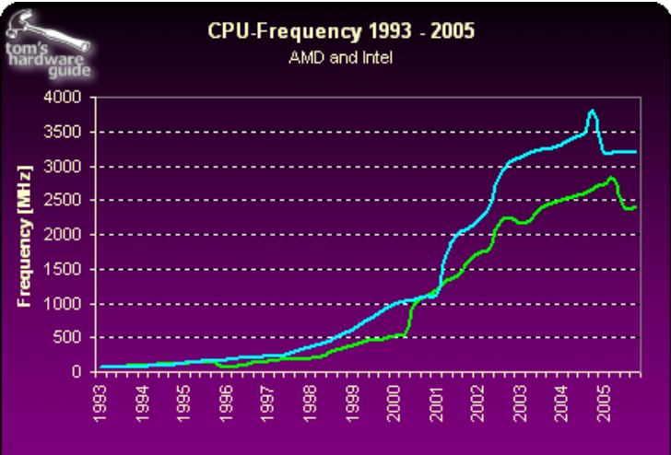
2004 marked the end of clock speed – but the beginning of multi-core
1.<number>

Slide 11
Moore's Law
Stated many ways:
  Sequential Clock Speeds double every 18 months to 3 years.
    No longer true
  Number of transistors that can be placed on a die doubles every 18 months to 3 years.
    Still appears to be true – probably true for another 10 years or so.
1.<number>

Slide 12
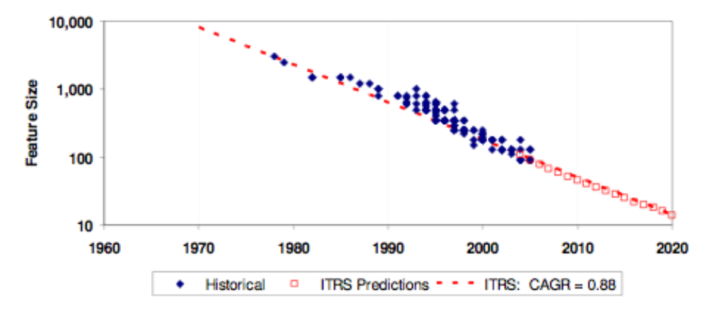
Predicted Feature Size
CAGR: Compound Annual Growth Rate
ITRS: International Technology Roadmap for Semiconductors
1.<number>

Slide 13
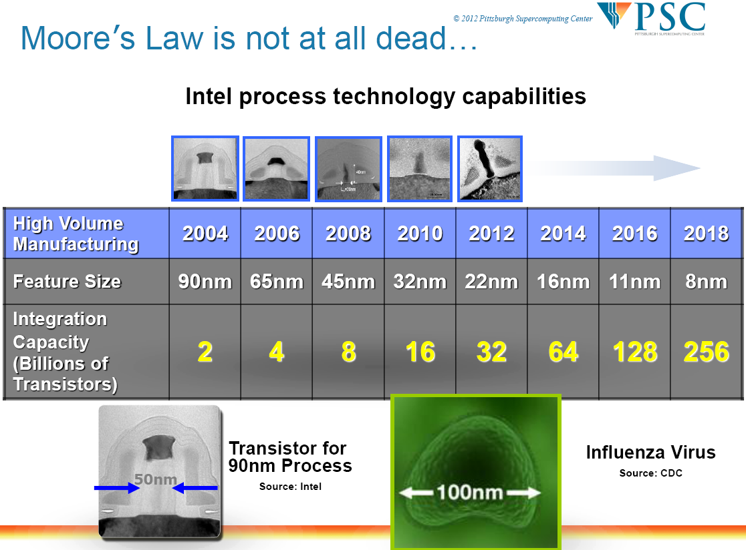

Slide 14
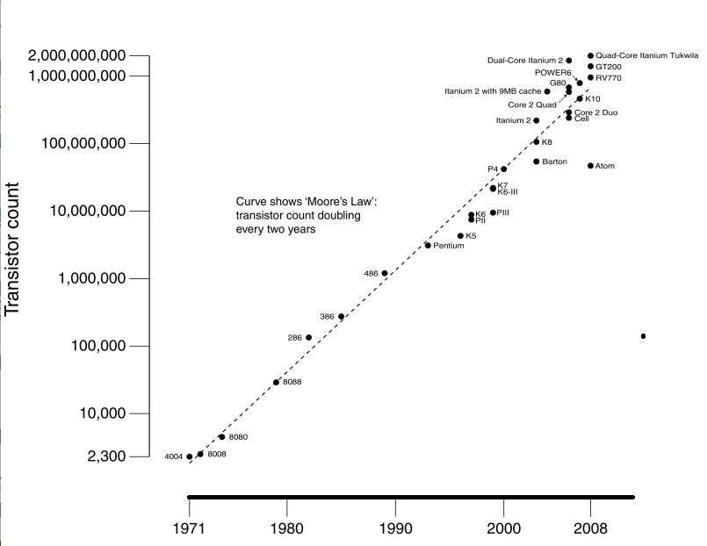
1.<number>

Slide 15
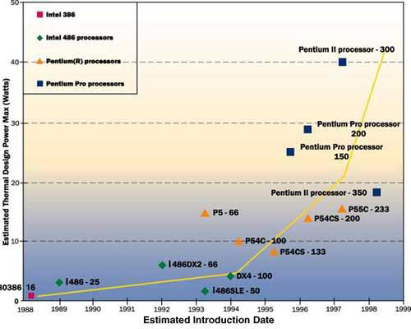
Power Consumption Issues

Slide 16
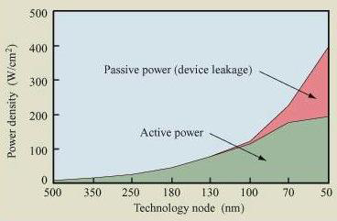
Power Consumption Issues
1.<number>

Slide 17
Resent Trends in Main Memory
Memory bandwidth is projected to increase more slowly than CPU performance
expected compound annual rate 25% vs. 59%
Memory latency is projected to decrease much more slowly than CPU performance increases
expected compound annual rate 5.5% vs. 59%
Source: ITRS

Slide 18
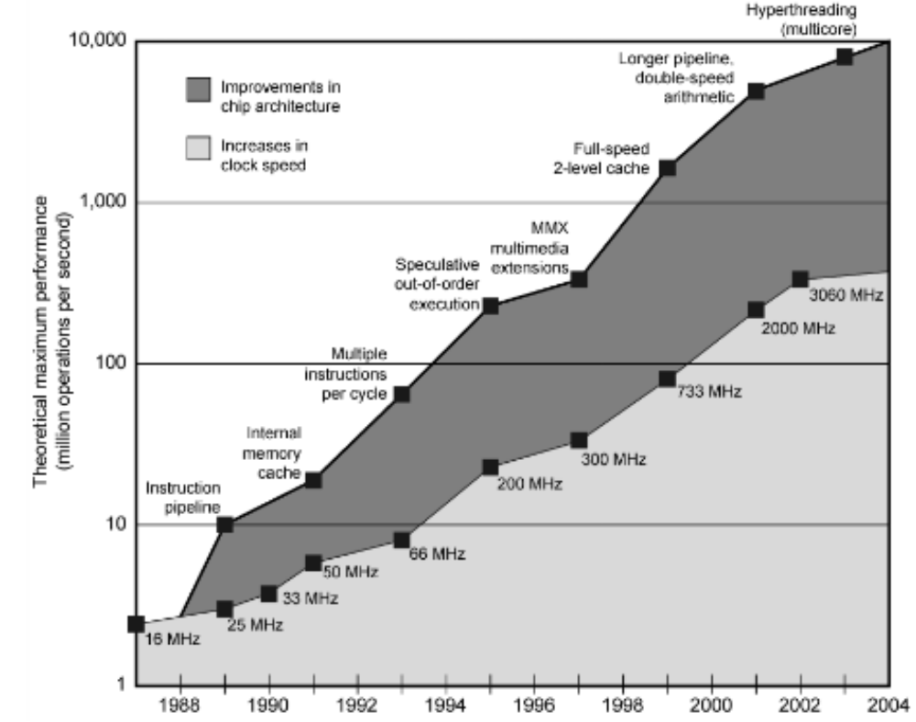
Historic Sources for Performance Gains
~200 x increased clock speeds
~30 x architectural improvements
1.<number>

Slide 19
Summary
We cannot increase clock speeds to improve performance
  faster circuits = higher power consumption (leakage current)
We cannot rely upon speculative methods to increase the effective number of Instructions per clock cycle.
  superscaler, branch prediction, instruction level scheduling are reaching their limits
    Issues:
    Available instruction-level parallelism is often not sufficient to exploit at run time.
    Memory Bandwidth and Latency Gap are resulting in a much larger cost for cache misses.

Slide 20
Sources for Performance Gains
In the future, the major source for performance gains will be the effective utilization of architectural enhancements.
These enhancements will include multi-level caches, and distributed vector and GPU style units.
But the most prevalent enhancement will most likely be the incorporations of multiple cores within the main processing element(s).

Slide 21
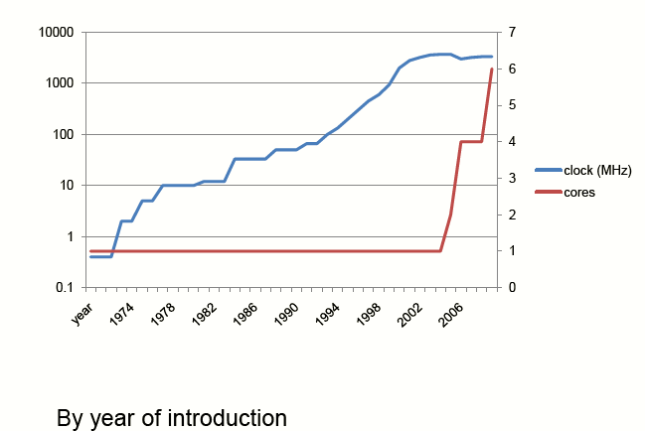
Peak Clock Rate and Number of Cores

Slide 22
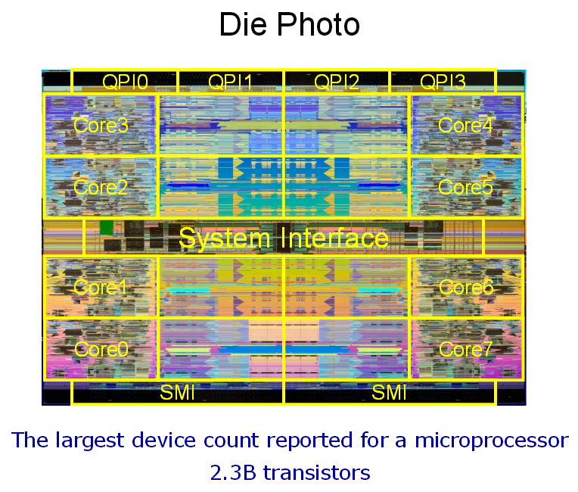
Nehalem-EX: a 45nm,
8-core Enterprise Processor
8 cores
24MB on-die shared L3 cache
Two integrated memory controllers
Four point-to-point links at 6.4GT/s with per-lane compensation
3 primary clock
domains

Slide 23
Software Considerations
Utilizing multi-core/multithread hardware effectively is usually not easy or automatic.
Software environments and tools exist that allow the user to capture the concurrency of the problem and allocate the concurrent entities to the parallel hardware.

Slide 24
Software Considerations
The paradigm that is used here is most often a form of shared memory programming
  Facilitates low latency transfer of data between concurrent entities.
In this course we will focus on the use of pThreads and OpenMP

Slide 25
Clustered Computers
A cluster is two or more independent computers that are combined into a unified system through software and networking.
Clusters are often used to provide greater computational power on a single application than a single computer can provide.

Slide 26
Beowulf Style Clusters
are scalable performance clusters that incorporate commodity hardware, on a private system network, with open source software (Linux) infrastructure.
Applications effectively solved on these clusters include:
  simulations, biotechnology, and petro-clusters; financial market modeling, data mining and stream processing; and Internet servers for audio and games.

Slide 27
Beowulf Style Clusters
Message passing is used to achieve the necessary communication between the segments of the parallel computations.
  Often high bandwidth but also relatively high latency.
  MPI is the predominate message passing environment that is currently in use.
Beowulf systems are usually programmed in languages such as C, C++ and FORTRAN.

Slide 28
Beowulf Style Clusters
Class I clusters are built entirely using commodity hardware and software using standard technology such as SCSI, Ethernet, and IDE
Class II clusters may use specialized hardware to achieve higher performance.

Slide 29
Distributed Local Memory (Clustered) Computing
There are two main avenues to exploit parallelism that is present in clustered computing environments
  Across the computing nodes
  Within the computing node itself
    Multi-core/multi-threading
Hybrid Message Passing and Shared Memory Programming solutions may be required to fully exploit HW capabilities!

Slide 30
General Purpose GPU Accelerated Computing
16 highly threaded SM’s, >128 FPU’s, 367 GFLOPS, 768 MB DRAM, 86.4 GB/S Mem BW, 4GB/S BW to CPU
Host
Input Assembler
Thread Execution Manager
Parallel Data
Cache
Parallel Data
Cache
Parallel Data
Cache
Parallel Data
Cache
Parallel Data
Cache
Parallel Data
Cache
Parallel Data
Cache
Parallel Data
Cache
Texture
Texture
Texture
Texture
Texture
Texture
Texture
Texture
Texture
Load/store
Load/store
Load/store
Load/store
Load/store
Load/store
Global Memory

Slide 31
CPUs and GPU Comparison
Control
ALU
ALU
CPU
GPU
ALU
ALU
Cache
DRAM
DRAM
© David Kirk/NVIDIA and Wen-mei W. Hwu, 2007-2013
ECE 408, University of Illinois, Urbana-Champaign

Slide 32
Parallel Computers
Introduction

Slide 33

General Purpose GPU Accelerated Computing

Slide 34
Task (Functional) Parallelism
(Spatial Parallelism)
Task (Functional) Parallelism may be possible when there are independent processes or threads that apply different operations to different data items

Slide 35
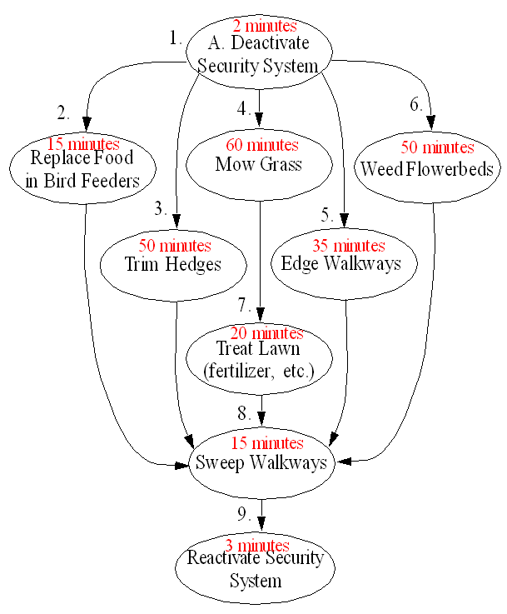
Landscape Management
Example

Slide 36
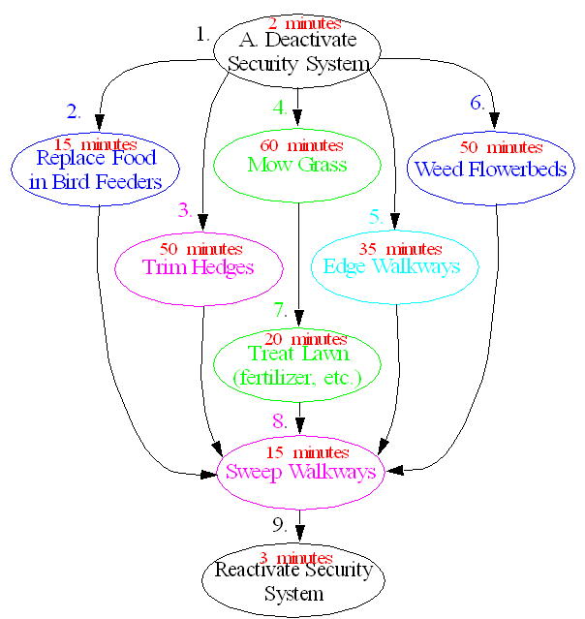
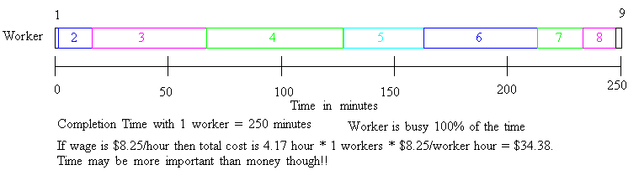

Slide 37
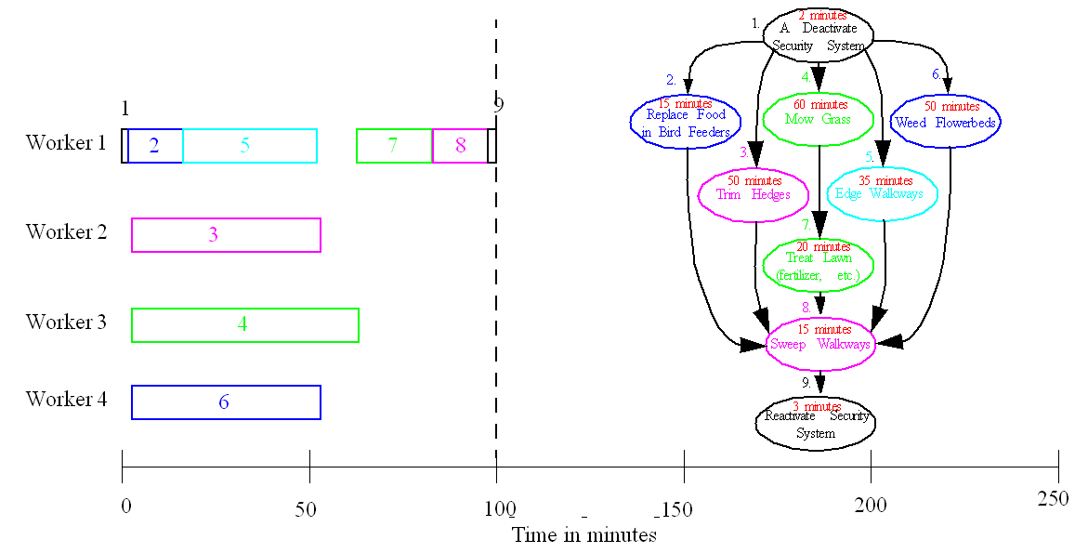

Slide 38
Data Parallelism
(Spatial Parallelism)
Data Parallelism may be possible when there are independent tasks that apply the same operation to different data items

Slide 39
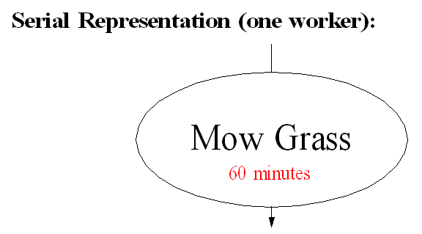
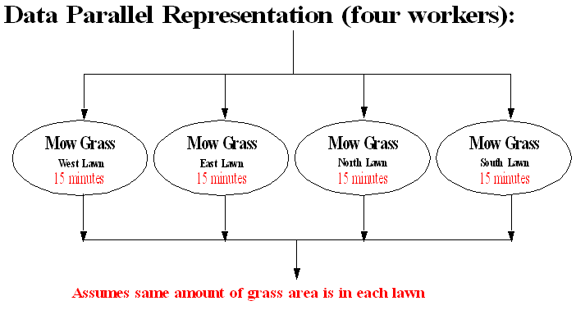

Slide 40
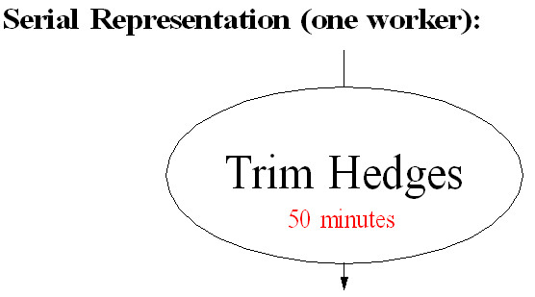
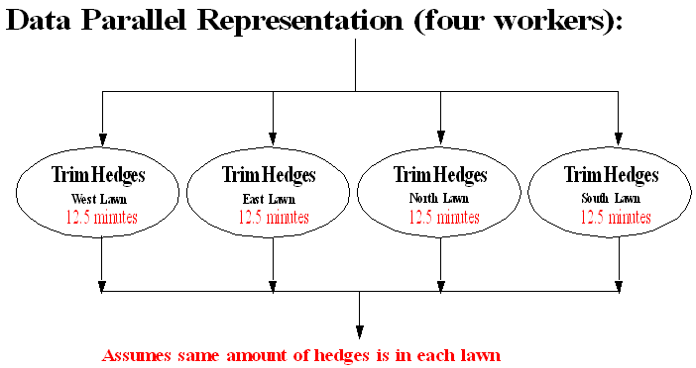

Slide 41
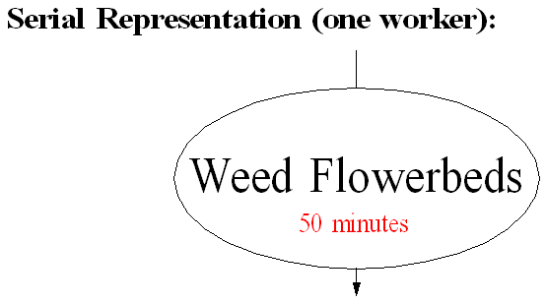
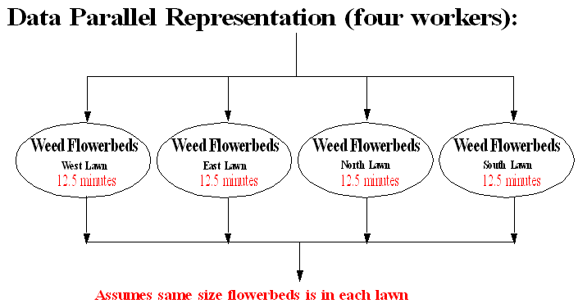

Slide 42
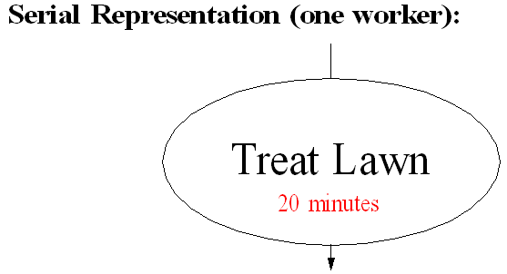
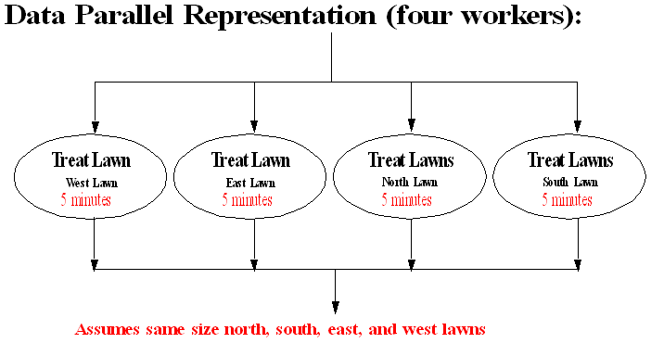

Slide 43
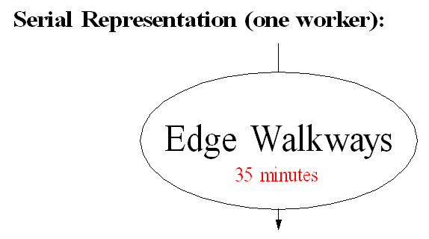
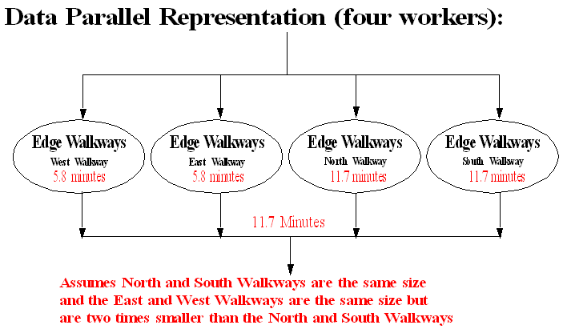

Slide 44
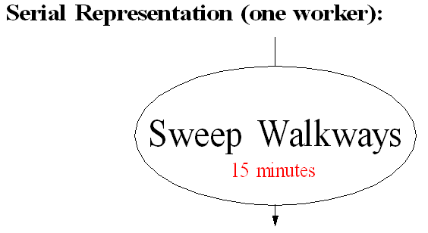
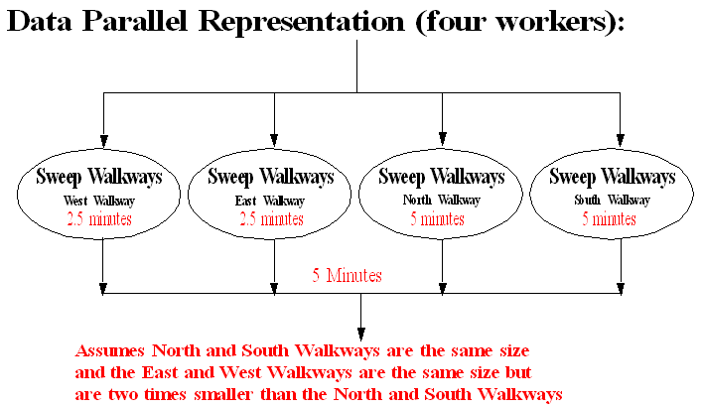

Slide 45
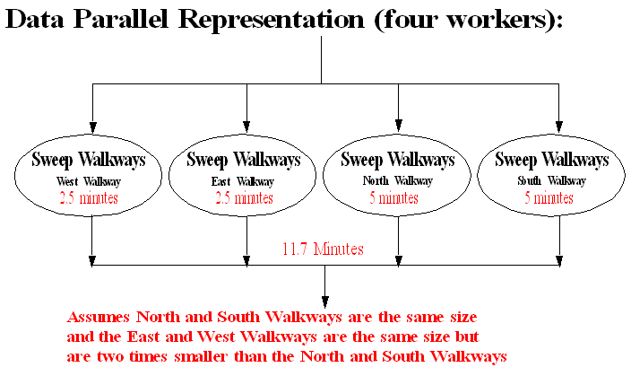
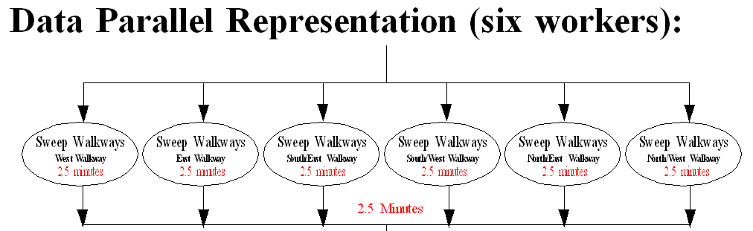

Slide 46
Hybrid Task and Data Parallel Implementations
Often applications can simultaneously exploit both Task and Data Parallelism

Slide 47
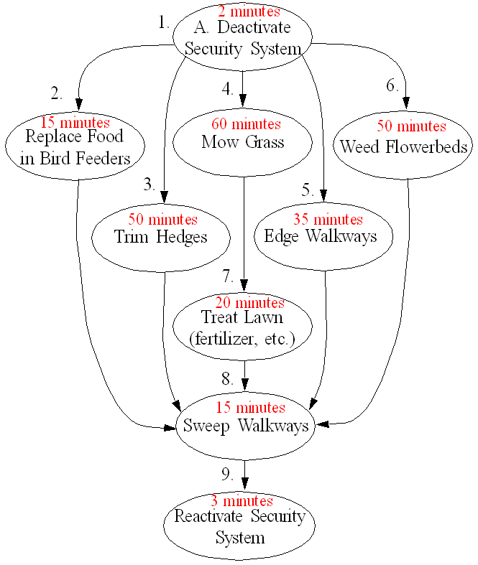
Landscape Management
Example

Slide 48
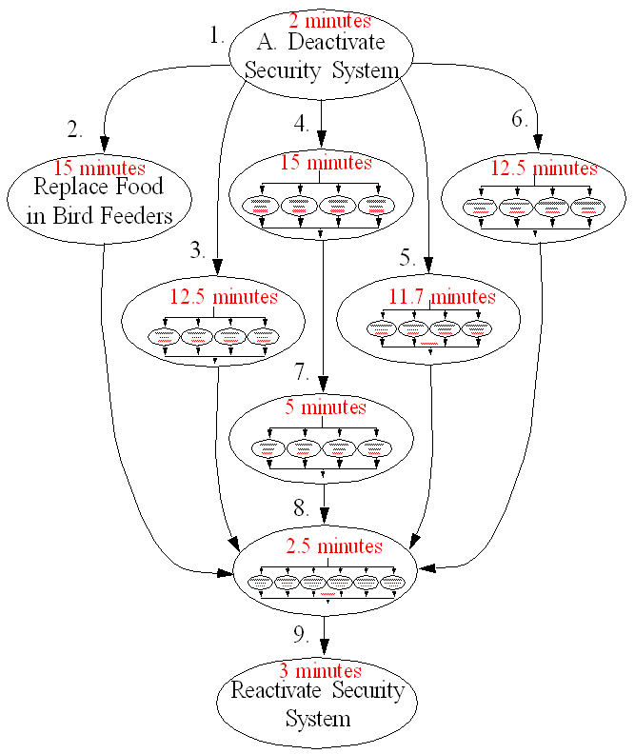
Landscape Management
Example

Slide 49

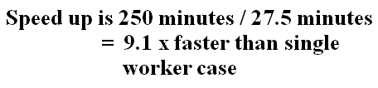
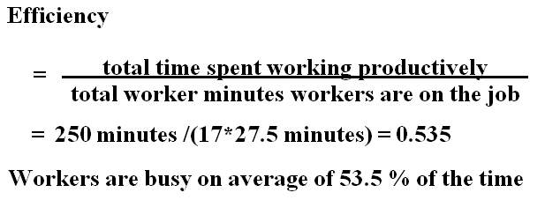

Landscape Management Example

Slide 50
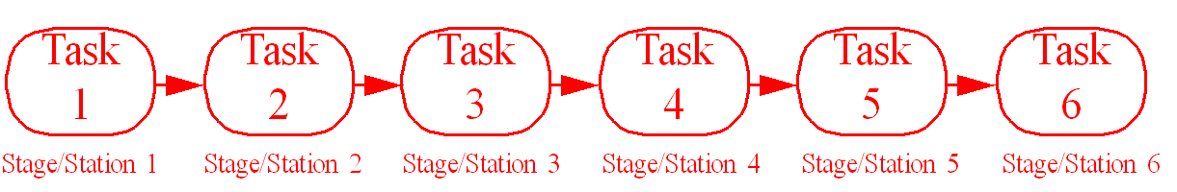
Temporal Parallelism
Pipelined Computations
Problem is divided into a series of tasks that have to be completed one after the other (the basis of sequential programming). Each task executed by a separate process or processor.
5.2

Slide 51

Analogous to the Assembly Line Problem

Slide 52
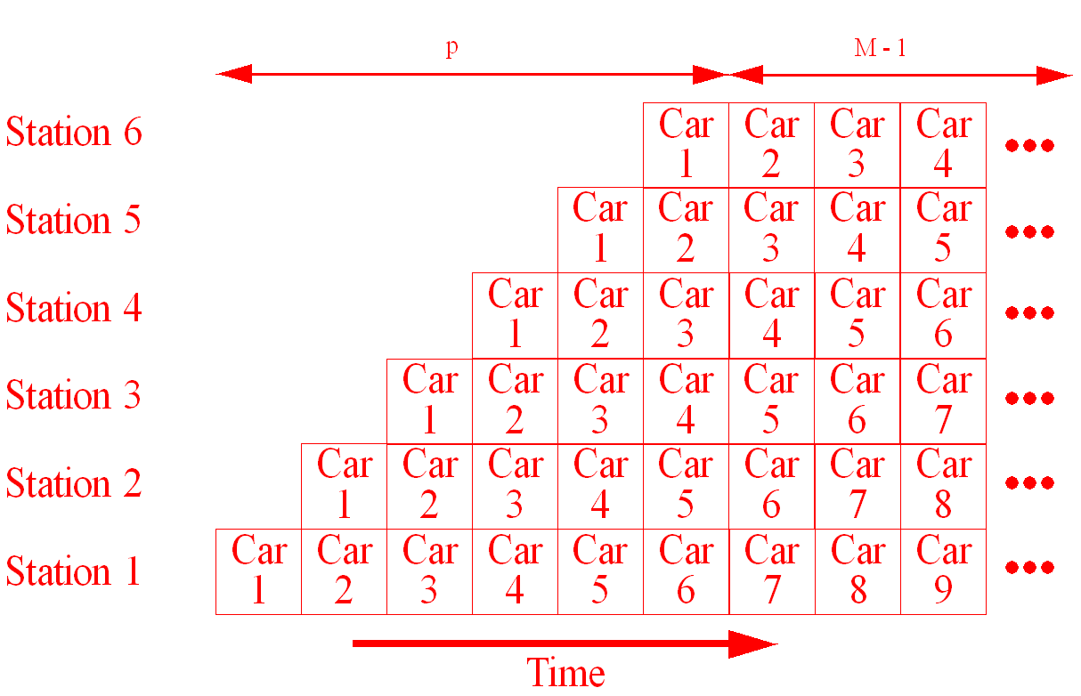
Assembly Line/Pipelining

Slide 53
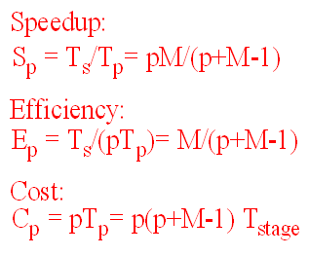
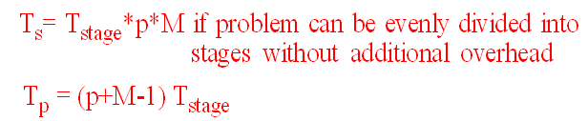
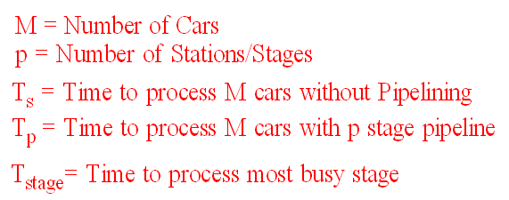

Slide 54
Hybrid Spatial and Temporal Parallel Implementations
Often applications can simultaneously exploit both Task and Data Parallelism and Pipelining!

