Slide 1



Slide 2

Creative Design
  Brand new and innovative products
Variant Design
  Variants to an existing design
  Intent is to improve an existing product – add new features
Routine Design
  Designs for which the theory and practice are well known.

Slide 3

Systems Engineering & Integration
  Large-scale, many people
System Testing
  Does system meet requirements and needs?
Experimental Design
  Develop experimental procedures and apparatus for determining the characteristics of a system
Analysis
  Correct problem, Determining sources of failure, Failure Mode Effect Analysis, FMEA

Slide 4
Discover or create something new
Technology Evaluation
  Evaluates whether a technology can be used for a specific application
  Evaluates if a specific technology can be use to improve an existing system
Research
  Performs experiments with the goal of discovering or creating new technology
  Note: ultimate outcome is not known

Slide 5

Fundamental Research
  Emphasizes the discovery of new scientific principles without having a targeted specific application
Applied Research
  Emphasizes the creation of new technology or systems based on existing technology and theory developed from fundamental research

Slide 6

Industry sponsorship
Organizations such as
  IEEE
  Space Hardware Club
  NSBE
  Engineers without Borders
Campus and local community
Brainstorming

Slide 7

What are your trying to do? Articulate your goals using absolutely no jargon.
How is it done today, and what are the limitations of current practice?
What is new in your approach, and why do you think it will be successful?
Who cares? If you are successful, what difference will it make?
What are the risks and payoffs?
How much will it cost? How long will it take?
What are the midterm and final exams' to check for success?

Slide 8

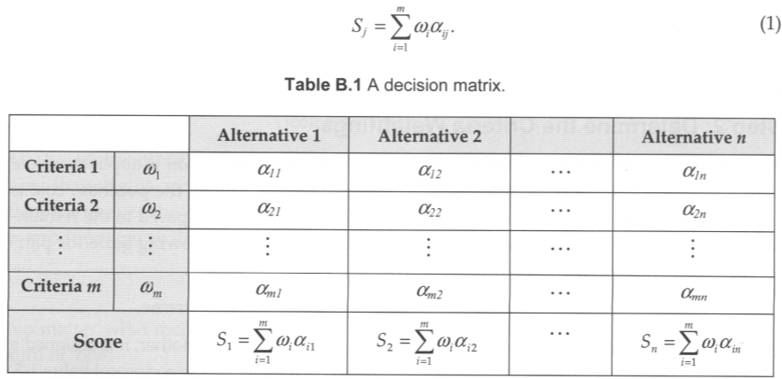
structured method for making complex decisions that involve a list of objectives (criteria) and a set of alternatives.

Slide 9
Determine selection criteria
Determine the criteria weightings
Identify and rate alternatives relative to criteria
Compute scores
Review the decision
See Appendix B – Complete description of AHP
Also can be found on
http://en.wikipedia.org/wiki/Analytic_hierarchy_process

Slide 10

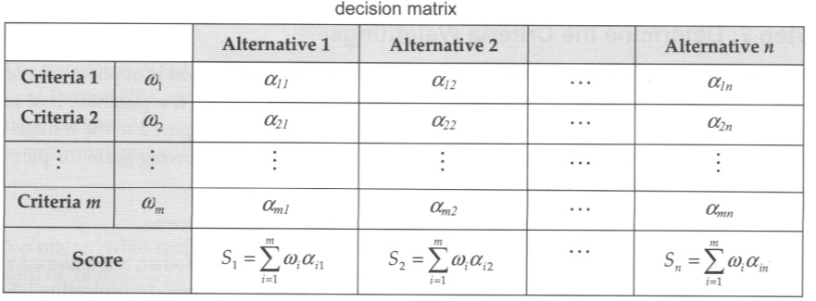
Determine the Selection Criteria
  Identify the criteria against which the decision is to be made
    Best if done before identifying design alternatives to avoid bias toward a particular design solution
  Simple Example
    Purchase cost
    Safety
    Design-styling
    Brand-name recognition

Slide 11
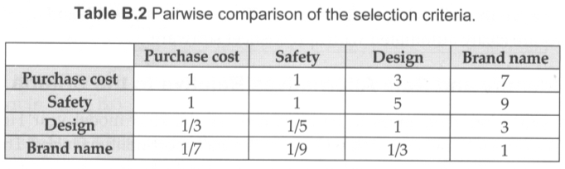
Determine the Criteria Weightings using the Pair-wise Comparison Method
  1=equal, 3=moderate, 5=strong, 7=very strong, 9=extreme
  If one criterion is deemed more strongly or equal to another it is assigned a value that is greater than or equal to 1, else it is assigned a value less than one (but the reciprocal of the value assigned when the two criteria are considered in the opposite order)

Slide 12
Determine the Criteria Weightings
  Note: comparisons are often inconsistent
    First row purchase and safety not same as second row

Slide 13




Determine the Criteria Weightings
  Good way to smooth over inconsistent rating of criteria is to assign weights using a geometric mean.

Slide 14
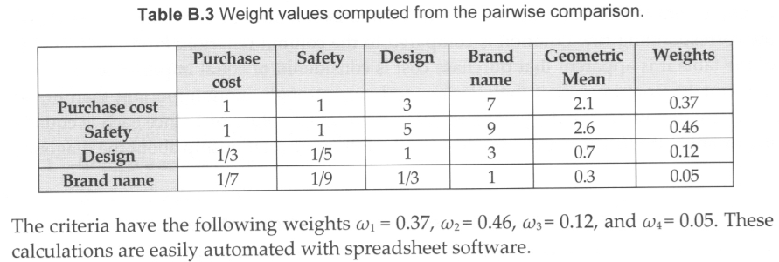
Determine the Criteria Weightings

Slide 15

Identify and Rate Alternatives Relative to the Criteria
  Criterion 1 – Purchase Cost
    Rating should be inversely related to cost
    Assumed Vehicle Costs:
      Honda $21,026, Hyundai $18,183, Toyota $21,989
      Can use the following to rate each alternative to this criterion

Slide 16
Identify and Rate Alternatives Relative to the Criteria
  Criterion 2 – Safety
    Real numbers exist from the U.S. National Highway Transportation Safety Association
    Ratings also go in wrong direction:
      Honda $4.8, Hyundai $4.8, Toyota $4.6
      Can use the following to rate each alternative to this criterion

Slide 17
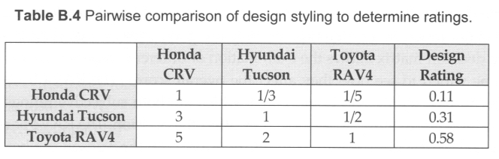
Identify and Rate Alternatives Relative to the Criteria
  Criterion 3 – Design Styling
    Use more subjective criteria weighting
    Same technique suggested as in criteria importance weighting of previous step – use geometric mean to reduce inconsistencies and bias

Slide 18
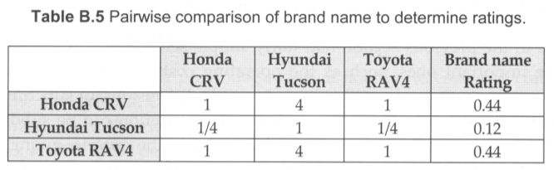
Identify and Rate Alternatives Relative to the Criteria
  Criterion 4 – Brand-Name Recognition
    Also uses subjective criteria weighting
    Same technique suggested as in criteria importance weighting of previous step – use geometric mean to reduce inconsistencies and bias

Slide 19
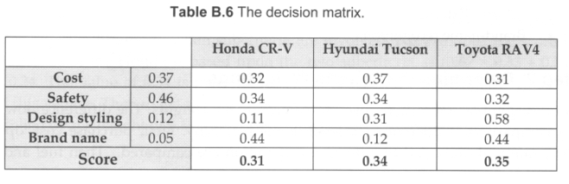
Compute Scores for the Alternatives

Slide 20
Review the Decision
  Make objective and subjective decisions based upon your data

