Slide 1



Slide 2
Understanding the “Voice of the Customer”
Gather raw data
Translate to marketing requirements
Organize the needs into a hierarchy
Rank the Needs
Review the outcomes

Slide 3

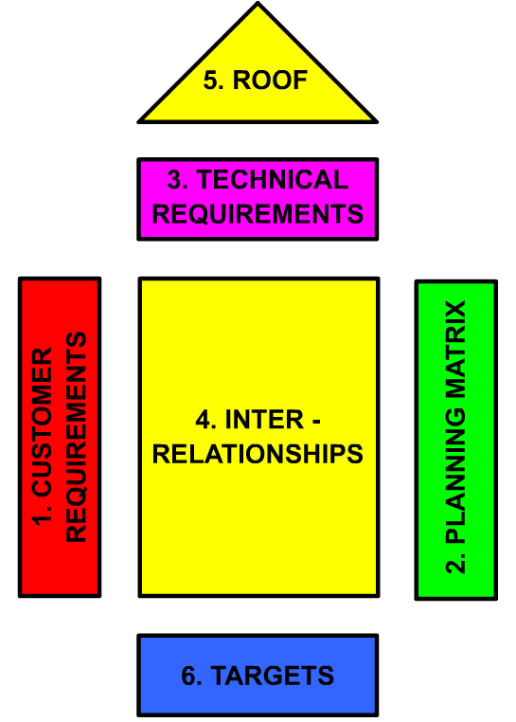


Slide 4

Some methods are:
Interviews
  When and why do you use this type of product (system)?
  Walk us through a typical session using the product.
  What do you like about the existing products?
  What do you dislike about the existing products?
  What issues do you consider when purchasing the product?
  What improvements would you make to the product?

Slide 5
Some methods are:
Focus Groups
Direct Observation (example IDEO heart device)
Trends

Slide 6

Marketing Requirements (specifications)
Statement of Customer Needs in language of customer.
What the product should do, NOT how it should be achieved.
Short, action-oriented phrases
Example - “The system should have high quality audio.”

Slide 7

Example
In Portable Audio Device example in the text the statement “The system should have high-quality audio” is a customer need/marketing requirement
  It does not address how this will be obtained
  It does not state numerical targets
Other marketing requirements could be
  “The system should be easy to use”
  “The system should be able to survive a drop from the runner’s height”

Slide 8

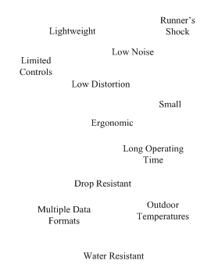

Slide 9

Organize needs by functional similarity, not by importance!
What is functional similarity?

Slide 11
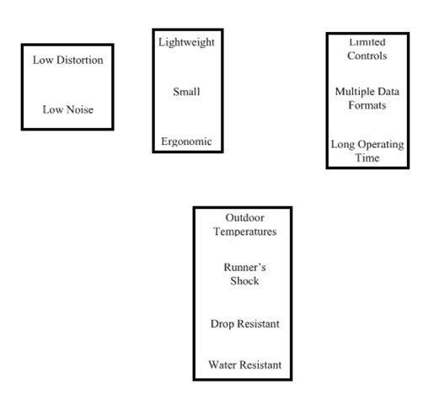

Slide 12
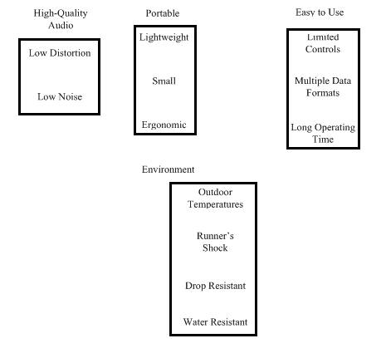

Slide 13
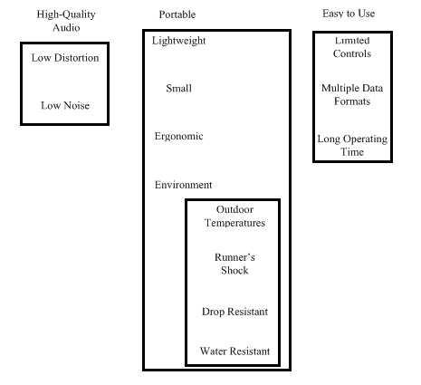

Slide 14

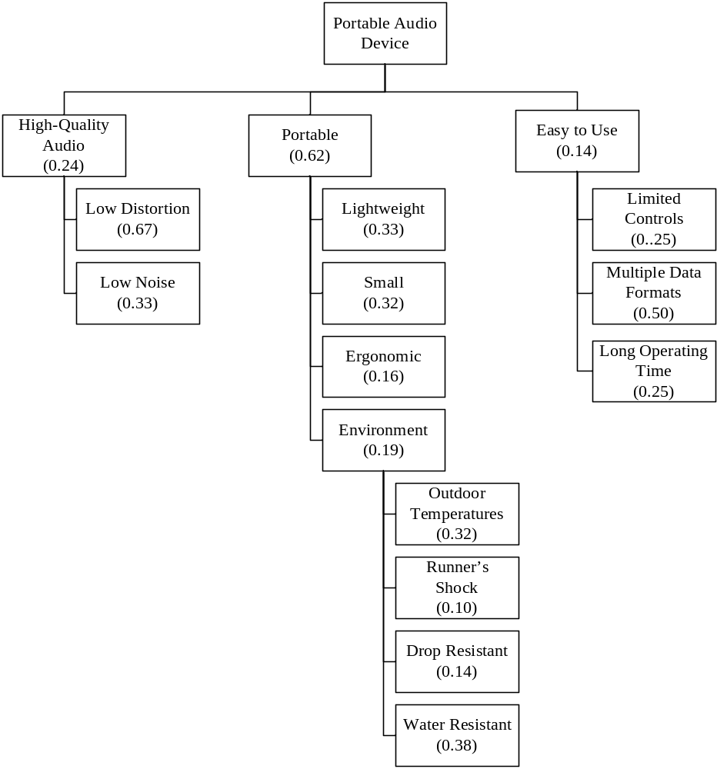

Slide 15

Rank the needs to determine the relative importance of each of the needs.
Systematically compare each need to all other needs.
Who should do this?

Slide 16
 | High-Quality Audio | Portable | Easy-to-Use | Score (Weight)
High-Quality Audio | 1 | 1/3 | 2 | 0.24
Portable | 3 | 1 | 4 | 0.62
Easy-to-Use | 1/2 | 1/4 | 1 | 0.14

Slide 17

This is just a process that embodies a good practice.
It is ultimately for making decisions about what is important to the end-user.
In the end ask yourself – “Does this make sense?” If not, you should make it so that it does or determine why not.

Slide 18

Gather Raw Data (Customers, end-users)
Translate into Marketing Requirements.
Organize need into Hierarchy (Functional Similarity)
Rank Needs (Pairwise comparison – at each level)
Review the outcomes
YES – you will apply this to your design project!

Slide 19

You need to become the experts on the problem and state-of-the-art in this area.
If you don’t, then
  you re-invent the wheel
  you don’t look too smart!

Slide 20

Identify the basic theory behind the concept
Determine how it currently being done
Discover the limitations of the current designs or technology
Highlight the similarities/differences between your concept and current systems
Identify existing or patented systems that are relevant to the design

Slide 21

See the book
  Internet resources
  Electrical and computer engineering type.
  Government resources
  Journal and conference papers.

Slide 22

The need statement should
Briefly and clearly state the need to be met
  Do not provide a solution to the problem
Provide supporting statistics or anecdotes
Describe current limitations
Describe any supporting processes

Slide 23

According to AppleInsider, approximately 10.3 million people owned iPods at the end of 2004 and many of the owners used them while operating their automobiles. The National Highway Traffic Safety Administration estimates that driver distraction is a contributing cause of 20 to 30 percent of all motor vehicle crashes – or 1.2 million accidents per year. One research study has estimated that driver inattention may cause as many as 10,000 deaths each year and approximately $40 billion in damages. iPods can present a distraction to drivers that is similar to cell phones in that the driver’s attention is divided between controlling the steering wheel, watching the road, and navigating controls on the iPod. A system is needed to allow users to navigate among the music selections of their iPod without distracting their attention from the road.
From the iPod Hands-Free Device Design Report by Al-Busaidi, Bellavia, and Roseborough [Alb07].

Slide 24

The objective statement should
Summarize what is being proposed to meet the need
It should also provide some preliminary design objectives & a preliminary description of a possible technical solution
  but not a detailed description of the expected implementation.

Slide 25

The objective of this project is to design and prototype a device that will make the iPod safer to use while driving an automobile, by allowing hands-free control of the iPod. The device will interact with the user using spoken English commands. The user will be able to issue simple voice commands to the device to control the operation of the iPod. In turn, the device will communicate information verbally, such as song titles that are displayed on the iPod screen, to the user.
From the iPod Hands-Free Device Design Report by Al-Busaidi, Bellavia, and Roseborough [Alb07].

Slide 26

Problem Statement Contents
Need
Objective
Background (Research Survey)
Marketing Requirements
Objective Tree

