Slide 1

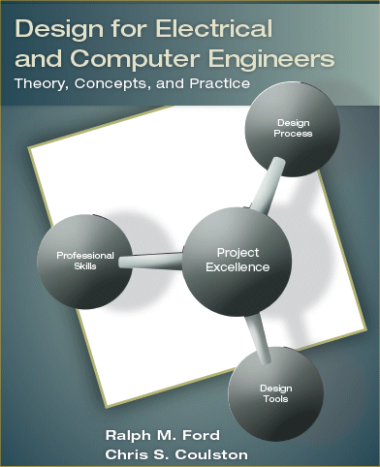

Slide 2

Marketing Requirement
  a customer's want or need for the product or service
Engineering Requirement
  A detailed characteristic that a design must meet in order to be successful.
Requirements Specification

Slide 3
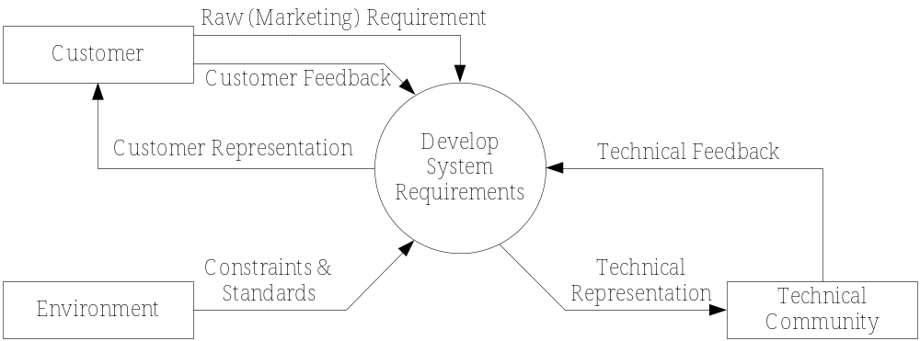
Collection of
  Marketing Requirements
  Engineering Requirements
Stakeholders
  Customers
  Environment
  Technical community
IEEE Guide for Developing System Requirements Specifications: IEEE std. 1233-1998

Slide 4
Engineering Requirements

Slide 5
Types of Design Requirements
Cost target – almost always a requirement!
  Cost to purchase
  Cost to use
  Cost to repair

Slide 6
Types of Design Requirements
Geometry
  Size, overall dimensions
  Curvature
Capacity of the things it will work with
  how many
  how big

Slide 7
Types of Design Requirements
Physical characteristics
  Weight
  Density
  Color
  Transparency
  Reflectance
  Surface texture (polished, rough)
  Elasticity
  Hardness
  Magnetic properties
  Electrical properties (resistance, impedance, etc.)
  Impact resistance

Slide 8
Types of Design Requirements
Performance characteristics
  Accuracy
  Strength
  Reproducibility, repeatability
  Speed
  Acceleration
  Resolution
  Flammability (ability to set on fire)
  Insulation value

Slide 9
Types of Design Requirements
Aesthetics (how it looks)
  Style
  Color
  Fit and finish
  Modern Appeal

Slide 10
Types of Design Requirements
Manufacturing considerations
  Difficulty of making
  Equipment or manufacturing techniques required to build the invention
  Number of component parts
  Labor requirements
  Means of shipping or delivery

Slide 11
Types of Design Requirements
Environmental requirements
  Operating temperature range
  Storage temperature range
  Water resistance
  Resistance to corrosion
  Compatibility
  Radiation Hardness

Slide 12
Types of Design Requirements
User requirements
  Ease of use
  Ease of learning
  Operator training

Slide 13
Types of Design Requirements
Acoustic characteristics
  Pitch
  Sound transmission
  Resonance

Slide 14
Types of Design Requirements
Durability
  Service requirements
  Ease of repair
  Reliability
  Lifespan
  Disposability

Slide 15
Types of Design Requirements
Regulatory & licensing considerations
  Meets government rules
  Meets league rules (a sporting product)
  Patent or license fee Requirements

Slide 16
Types of Design Requirements
Inputs
  Energy consumption
  Fuel consumption
  Labor

Slide 17
Types of Design Requirements
Outputs
  Product produced
  Power
  Pollution
  Undesirable side effect limitations

Slide 18

1) Abstract
Explain what it does not how it does it
Description of capabilities and conditions; Should be numerical.
2) Verifiable
Ways to measure and demonstrate that it meets the needs

Slide 19
3) Unambiguous
Short and clear
A one-sentence description of the requirement.
4) Traceable
It can be traced to the original customer need (i.e. marketing requirement(s))

Slide 20

Does the following requirement meet the four desirable properties? (abstract, verifiable, unambiguous, traceable)
“The robot must have an average forward speed of 0.5 feet/sec, a top speed of at least one foot/sec, and the ability to accelerate from standstill to the average speed in under one second.”

Slide 21
Does the following requirement meet the four desirable properties? (abstract, unambiguous, verifiable, traceable)
“The robot must employ IR sensors to sense its external environment and navigate autonomously with a battery life of one hour.”

Slide 22

IMPORTANT – Your requirements for your project must also be REALISTIC.
=> You need to demonstrate that the target you have selected is technically feasible.

Slide 23

Constraint = design decision imposed by the environment or a stakeholder that impacts or limits the design. (see the original overview diagram).
Example contraint: The system must use a MSP430 microcontroller to implement processing functions.

Slide 24

A standard is what?
Question is, what standards are relevant to your project and how do you use them?
Different levels of usage
  User
  Implementation
  Developer
Types: safety, testing, reliability, communication, data, documentation, design, …

Slide 25

Structured workshops and brainstorming
Interviews and surveys
Observation of processes and devices in use
Benchmarking and market analysis
Prototyping and simulation
Research survey

Slide 26

Need to know what type of requirement to select for a given system.
These are but EXAMPLES – you must determine the correct ones for your system!

Slide 27
Performance
The system should detect 90% of all human faces in an image.
The amplifier will have a total harmonic distortion less than 1%.
Reliability & Availability
The system will have a reliability of 95% in five years.
The system will be operational from 4AM to 10PM, 365 days a year.

Slide 28
Energy
The system will operate for a minimum of three hours without needing
Environmental
The system should be able to operate in the temperature range of 0°C to 75°C.
The system must be waterproof and operate while submersed in water.
to be recharged.
Many more examples in the book.

Slide 29
The Requirements Specification

Slide 30
Verification Versus Validation
Verification
Are we building the product correctly?
Validation
Are we building the correct product to meet the customer requirements?

Slide 31

Ask the customer if the requirements meet their needs.
Usually done in teams.
For each engineering requirement
  Traceable?
  Verifiable?
  Realistic & technical feasible?
For the complete Requirements Specification
  Orthogonal?
  Complete?
  Consistent?

Slide 32

Marketing Requirements | Engineering Requirements | Justification
1, 2, 4 | The total harmonic distortion should be <0.1%. | Based upon competitive benchmarking and existing amplifier technology. Class A, B, and AB amplifiers are able to obtain this level of THD.
1–4 | Should be able to sustain an output power that averages ≥ 35 watts with a peak value of ≥ 70 watts. | This power range provides more than adequate sound throughout the automobile compartment. It is a sustainable output power for projected amplifier complexity.
2, 4 | Should have an efficiency (η) >40 %. | Achievable with several different classes of power amplifiers.
3 | Average installation time for the power and audio connections should not exceed 5 minutes. | Past trials using standard audio and power jacks demonstrate that this is a reasonable installation time.

Slide 33

1–4 | The dimensions should not exceed 6” x 8”x 3”. | Fits under a typical car seat. Prior models and estimates show that all components should fit within this package size.
1–4 | Production cost should not exceed $100. | This is based upon competitive market analysis and previous system designs.
Marketing Requirements 1-1 The system should have excellent sound quality. 1-2 The system should have high output power. 1-3 The system should be easy to install. 1-4 The system should have low cost.

Slide 34
Advanced Requirements Analysis

Slide 35

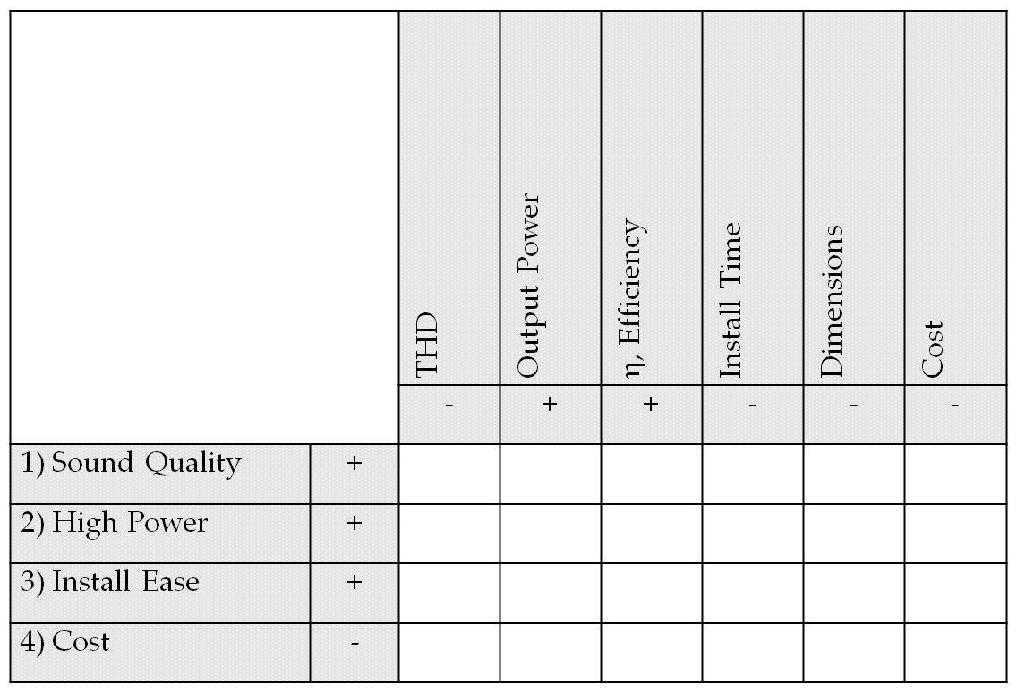

Slide 36
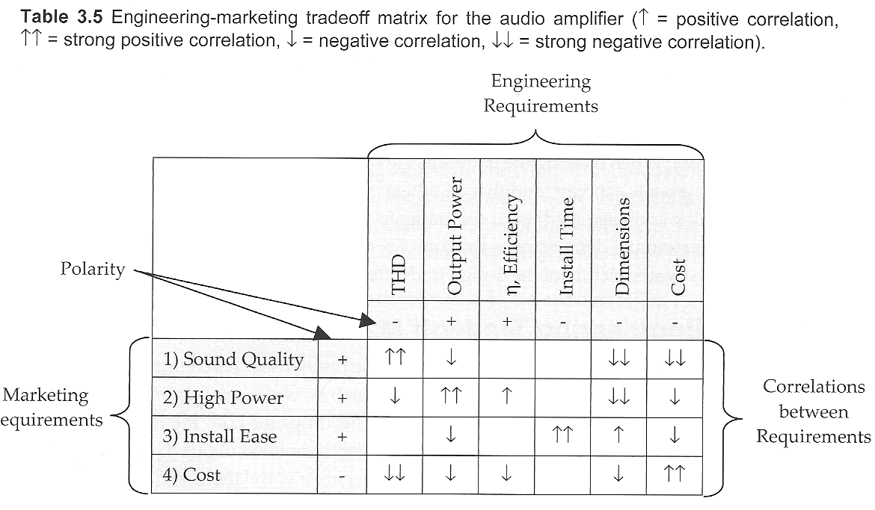

Slide 37

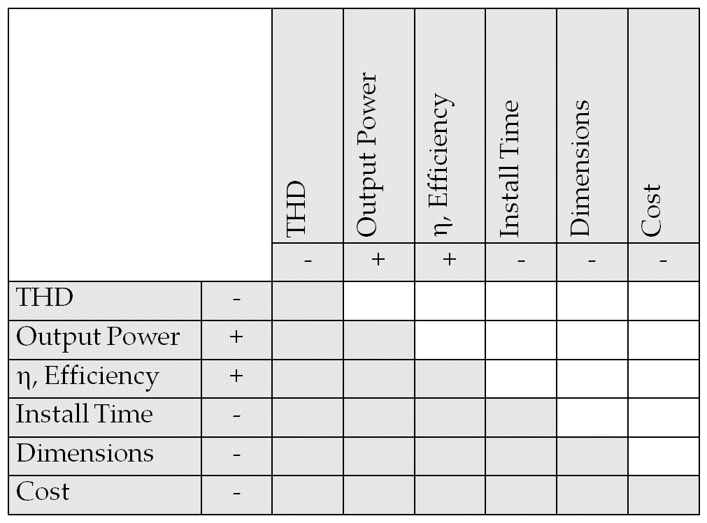

Slide 38
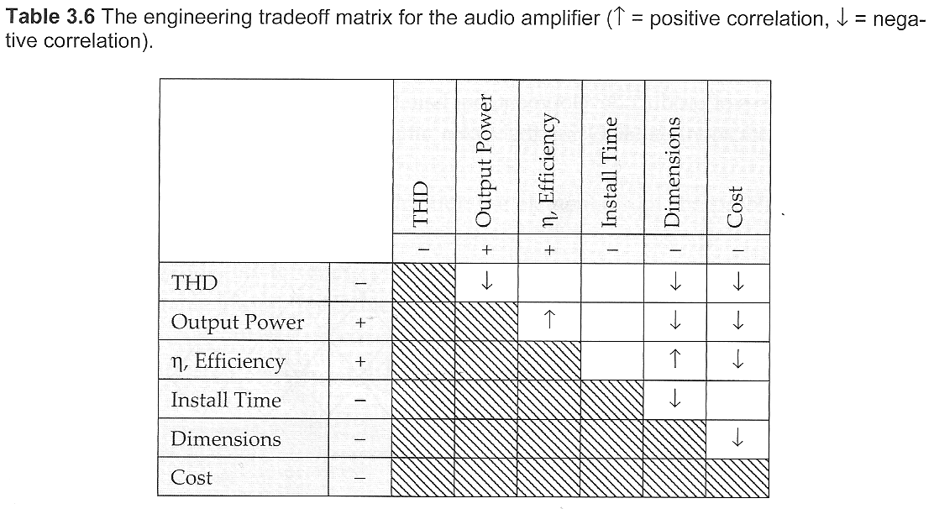

Slide 39
 | Apex Audio | Monster Amps | Our Design
THD | 0.05% | 0.15% | 0.1%
Power | 30W | 50W | 35W
Efficiency | 70% | 30% | 40%
Cost | $250 | $120 | $100

Slide 40

A complete requirements document will contain:
Needs, Objectives, and Background (See Chapter 2).
Requirements.
  marketing requirements
  engineering requirements
    Should be abstract, verifiable, and traceable
    Some maybe constraints
    Some may be standards
  Advanced analysis
    Engineering-marketing tradeoffs
    Engineering-engineering tradeoffs
    Benchmarks

