Slide 1


If you fail to plan, then you plan to fail!!

Slide 2
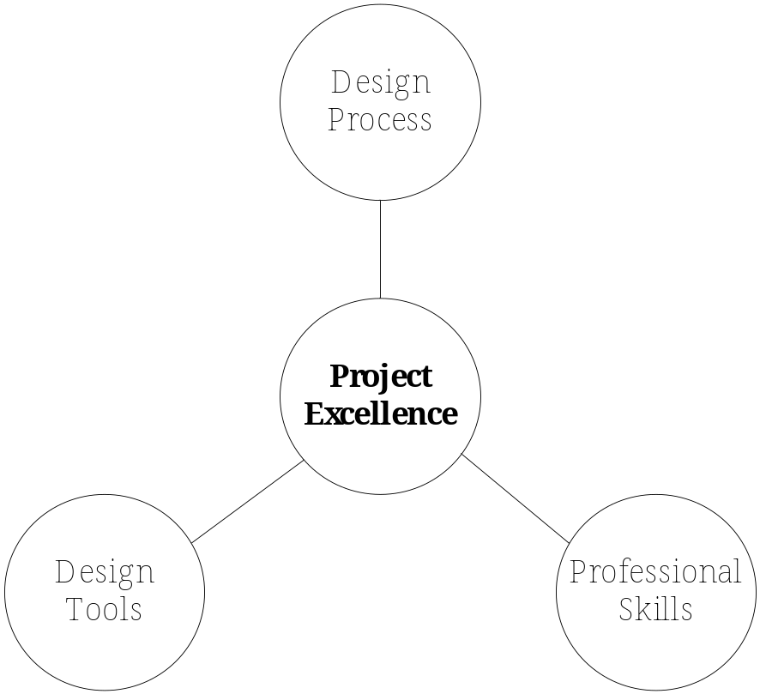
Engineers are regularly engaged in projects in their careers!
Middle management continues to shrink
Industry now organizes more around projects than functions.
Notes:
Middle management is dying, industry continu

Slide 3

Engineers have led the way on project management, it is now “hot and trendy”.
#1 Area of Continuing Education reported by Penn State Behrend ECE alumni.
Penn State Behrend School of Engineering Survey 2003 of Fortune 500 companies- #1 required skill for new engineers = PROJECT MANAGEMENT SKILLS

Slide 4

To complete the project
  On-time
  Within budget
  So that it meets the requirements

Slide 5

By the end of this chapter, you should
Be able to create a work breakdown structure.
Be able to create network diagrams and Gantt charts.
Be able to determine the critical path for completing a project and the float time for each activity in the plan.
Be able to conduct break-even analysis and understand some basic methods of cost estimation.
APPLY THIS TO YOUR PROJECT – YOU MUST LEARN BY DOING!

Slide 6

Work Breakdown Structure (WBS)
  hierarchical breakdown of tasks and deliverables that need to be completed in order to accomplish the project objectives
    first set of project planning!
Activity
  A combination of a task and its associated deliverables

Slide 7

Tasks
  Necessary actions that accomplish a job
  Examples
    Conducting research, writing program
Deliverables
  Entities that are delivered to the project upon completion of a set of tasks
  Examples
    Circuit design, software module, module integration & test, report, presentation, validation, approval

Slide 8

From MIL-HDBK 881
A product-oriented family tree composed of hardware, software, services, data, and facilities. The family tree results from systems engineering efforts.
A WBS displays and defines the product, or products, to be developed and/or produced. It relates the elements of work to be accomplished to each other and to the end product.
A WBS can be expressed down to any level of interest. However the top three levels are as far as any program or contract need go unless … .

Slide 9

Activities
Responsibilities
Timeline
Dependencies
Costs
HINT: THESE THINGS OUGHT TO BE IN YOUR PLAN!

Slide 10

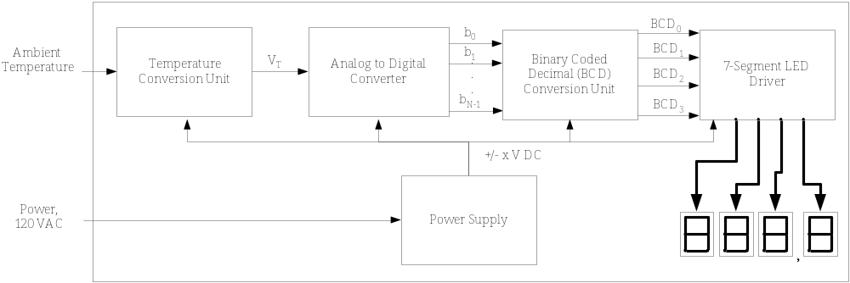
Problem: Create the WBS for a temperature monitoring system design

Slide 11

There are three main tasks
The analog interface circuitry.
The LED & digital circuitry.
Integrate & Test.

Slide 12
Activity: Design Circuitry
Description: Complete the detailed design and verify it.
Deliverables/Checkpoints: 1) Circuit schematic, and 2) Verify in simulation.
Duration: 14 days.
People: Jana (1), Rob (1)
Resources: PC, SPICE Simulator
Predecessors: none

Slide 13
ID | Activity | Description | Deliverables / Checkpoints | Duration (days) | People | Resources | Predecessors
1 | Interface Circuitry
1.1 | Design Circuitry | Complete the detailed design and verify it in simulation. | • Circuit schematic • Simulation verification | 14 | Rob (1) Jana (1) | • PC • SPICE simulator
1.2 | Purchase Components |  | • Identify parts • Place order • Receive parts | 10 | Rob |  | 1.1
1.3 | Construct & Test Circuits | Build and test.
1.3.1 | Current Driver Circuitry | Test of circuit with sensing device. | • Test data • Measurement of linearity | 2 | Jana (1) Rob (2) | • Test bench • Thermo- meter | 1.2
1.3.2 | Level Offset & Gain Circuitry | Test of circuit with voltage inputs. | • Test data • Measurement of linearity | 3 | Rob (1) Jana (2) | • Test bench | 1.2
1.3.3 | Integrate Components | Integrate the current driver and offset circuits. | • Test data verifying functionality and linearity requirement | 5 | Rob (1) Jana (1) | • Test bench • Thermo- meter | 1.3.1 1.3.2

Slide 14


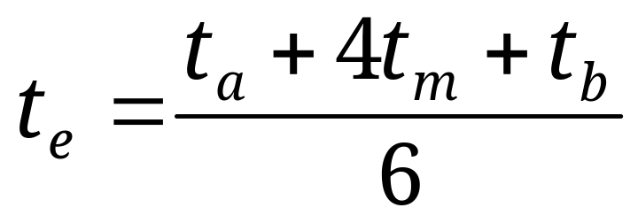

PERT: Project Evaluation and Review Technique
Statistical methods to estimate project completion time.
Based on earlier studies that show that project task completion follows a Beta probability distribution.

Slide 15
Activity/Task = a specific actions that needs to be performed take within each phase
Milestones = a point of achievement that has special significance
  Often modeled as an activity/task of zero duration
  Used to determine the degree to which a project is meeting its schedule

Slide 16
Critical Path Method (CPM) was developed for project management in the private sector at about the same time.
Program Evaluation Review Technique (PERT) a methodology developed by the U.S. Navy in the 1950s to manage the Polaris submarine missile program.

Slide 17
A network diagram is a CPM representation of project activities and dependencies as a directed graph.
  Allows for graphical visualization of the project as well as quantitative analysis
AON (Activity on Node) form of a network diagram
  Activities/tasks and milestones are represented by nodes
  Dependencies by arrows
PERT Chart provides same functionality

Slide 18
The PERT chart/Network Diagram is sometimes preferred over the Gantt chart because it clearly illustrates task dependencies.
It can be much more difficult to interpret, especially on complex projects.
Frequently, project managers use both techniques.

Slide 19

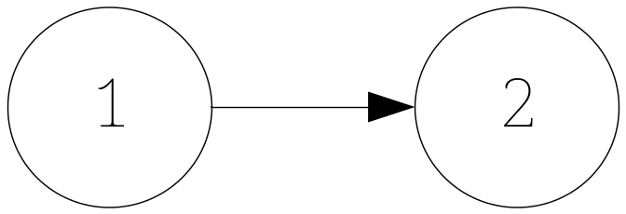
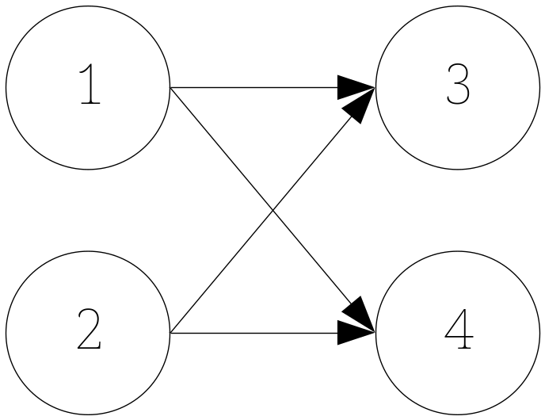
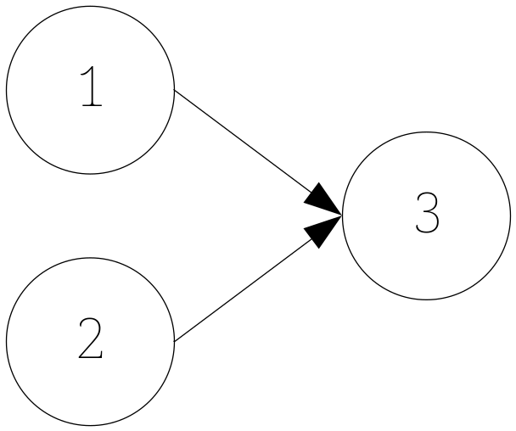

Slide 20

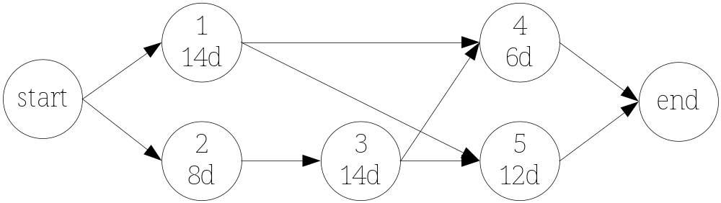
Problem: identify the paths to completion.

Slide 21
Critical Path = Longest sequence of activities/tasks (i.e. path) in a network diagram that must be completed on time for the project to complete on its due date.
Slippage = Amount of time an activity or task falls behind its scheduled completion time.
Float = Amount of time that an activity/task can slip without extending the overall completion time.
– critical path activities/tasks all have zero float times!

Slide 22

Problem: Calculate the float for all activities in network.

Slide 23

A Gantt chart is a horizontal bar chart developed as a production control tool in 1917 by Henry L. Gantt, an American engineer and social scientist.
  provides a graphical illustration of a schedule that helps to plan, coordinate, and track specific tasks in a project.

Slide 24
horizontal axis represents the total time span of the project, broken down into increments (days, weeks, or months).
  i.e. the sequences, timing, and time span for each task.
vertical axis represents the set of tasks that make up the project.
  note bar spans may overlap in time.
  As the project progresses, secondary bars, arrowheads, or darkened bars may be added to indicate completed tasks, or the portions of tasks that have been completed.
  A vertical line is often used to represent the report date.

Slide 25
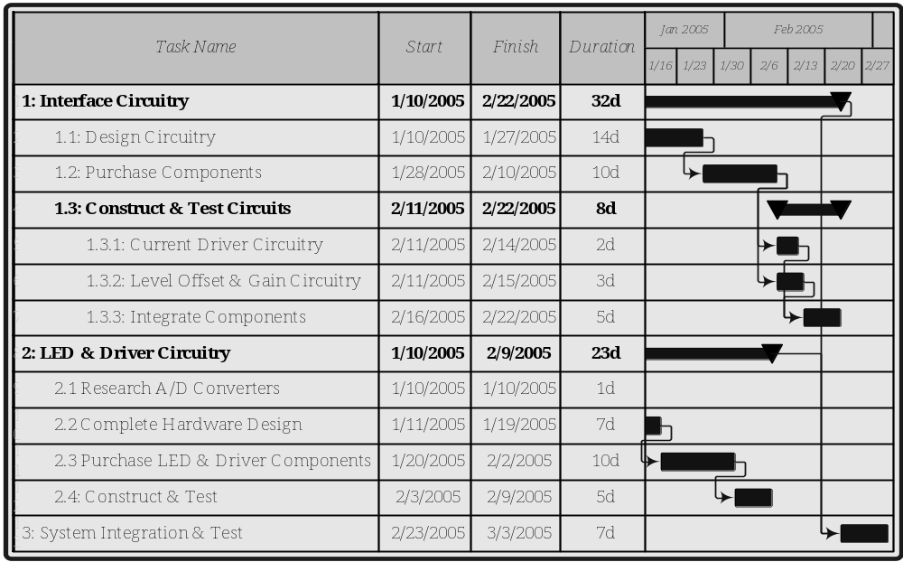

Slide 26
Gantt charts give a clear illustration of project status, but one problem with them is that they don't indicate task dependencies
  you cannot tell how one task falling behind schedule affects other tasks
  PERT Charts can be used for that

Slide 27

How do you complete projects within cost?
Need to be able to estimate costs for
  System design
  Development
  Manufacture
Basics presented here – complex problem that requires experience.

Slide 28

Fixed costs
  costs that are constant regardless of the number of units produced and cannot be directly charged to a process or activity
    examples: development costs, market research, rent overhead, insurance, property taxes
Variable Costs
  Costs that vary depending upon the process or items being produced, and fluctuate directly with the number of units produced.
    examples: raw materials, inventory, energy costs, and labor costs.

Slide 29
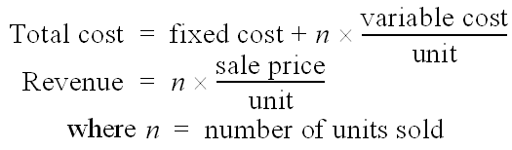
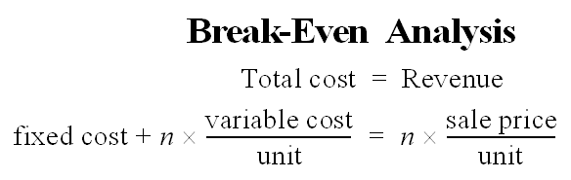
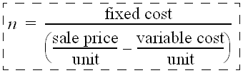
Break-Even Point
  Point where the number of units sold is such that there is no profit or loss

Slide 30
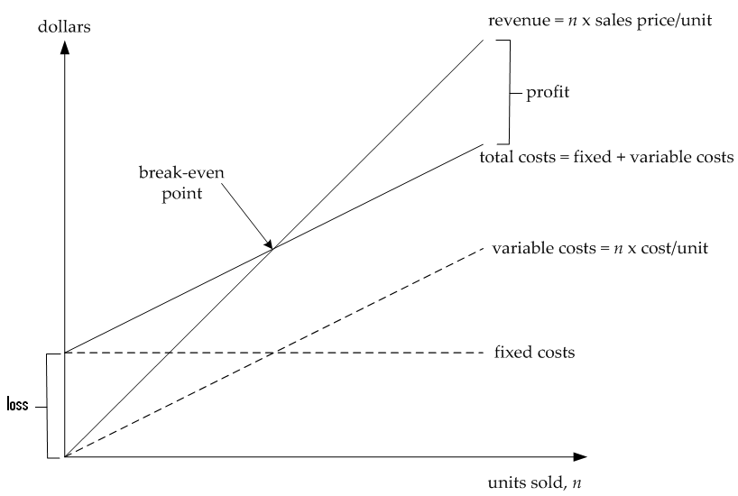

Slide 31

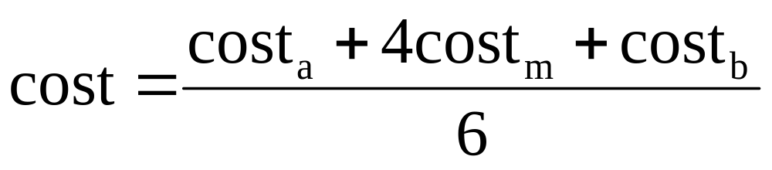

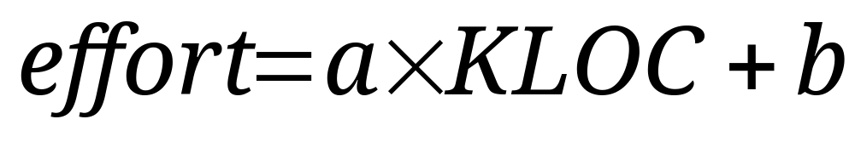
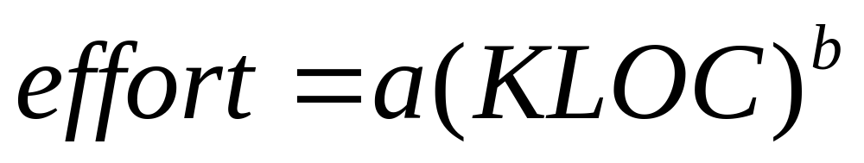

Slide 32

Take the initial time estimates for activities and double them!
Assign a lot of time for testing and integration.
Factor in lead times for part ordering.
Assign a project manager(s).
Do not assign all team members to all tasks.
Track the progress versus the plan.
Don’t become a slave to the plan.
Experience counts.

Slide 33

A Project Plan should contain
Work Breakdown Structure. Identify the activities, deliverables, responsibilities, duration, resources, and dependencies.
Gantt Chart and/or Network Diagram. Provide a graphical representation of the project plan.
Costs. Develop a tabulated list of costs and for the equipment, materials, and labor necessary to carry out the project.

Slide 34

Three important objectives of project management are to complete the project
  On-time
  Within budget
  To meet the needs of the user.
WBS – hierarchical breakdown of activities needed to complete a project.
Network diagram – graphical representation of activities for project – can use for quantitative analysis of project.
Cost estimates
  Break-even analysis
  Cost estimation models

