Slide 1

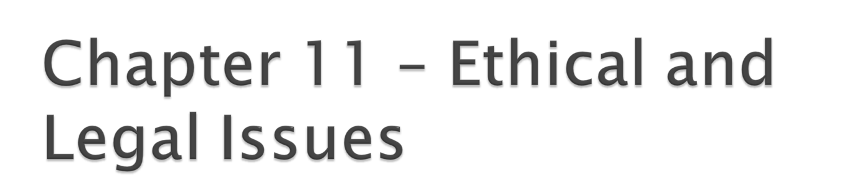
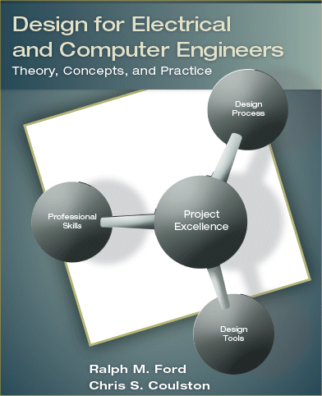

Slide 2

You will face ethical dilemmas in your career – count on it!
Your decisions will affect:
  your professional reputation.
  your employability.
  the welfare of others.
Companies are placing more value on ethics (or at least saying they are – just ask Enron, Worldcom, and Adelphia!).

Slide 3

By the end of this chapter, you should:
Understand what is meant by morals, ethics, and values.
Be familiar with the IEEE Code of Ethics.
Understand what a patent is, the criteria for filing one, and the elements that constitute it.
Understand differences between patents, copyrights, trademarks, and trade secrets.
Understand the concepts of negligence and liability as they apply to product design.
Understand how to incorporate ethical issues throughout the design process.
Be able to analyze ethical case studies and suggest solutions to the dilemmas that they embody.

Slide 4

Ethics
1. Branch of philosophy that deals with the general nature of good and bad and the specific moral obligations of and choices to be made by the individual in her/his relationship to others. 2. Rules or standards governing conduct, especially those of a profession.
Notes:
Key points of the definition are:
Choices => implying decisions that have to be made.
Key is part 2 – which is rules & standards of a profession.

Slide 5

What are
Morals?
  Principles of right and wrong and the decisions that are derived from these principles.
Principles?
  Fundamental laws or rules that govern behavior.
  Example “The Golden Rule”
Values?
  Something that a person believes to be worthwhile
Notes:
Ethics – STUDY or PHILOSOPHY or moral obligations.
Morals: Choices between good and bad.
Principle: Fundamental laws that govern human behavior – i.e. Golden Rule.
Value: Something a group holds to be valuable or worthwhile.

Slide 6
Rule-Based Ethics – Apply a set of rules to make all decisions
  Universality: reasons for action that all people in society could accept.
  Transitivity: you would accept others applying the same decision to you.
What does this remind you of?
What are problems with this?
Notes:
This is basically the Golden Rule. It assumes that we can develop a universal set of ethical rules to govern conduct, and that we would all accept them decision being applied to yourself as well as to others. Examples of this are:
Can’t kill others.
Can’t steal.
Don’t drive while intoxicated.
Problems with this is the difficulty defining a universal set of rules. We can probably agree on the biggies, but beyond that universal agreement can be difficult.

Slide 7
Conditional Rule-Based Ethics – applying a set of rules to make your decisions except under certain conditions.
Examples of this are?
  Speeding to save an injured person
  Killing except in war
What are the problems with this approach?
Notes:
Examples:
Driving over the speed limit when transporting a seriously ill person to the hospital.
How about cheating on exam because you helped bring a sick person to the hospital?
How about cheating on exam because you didn’t have time to cheat?
Problem: Need to determine under which circumstance the moral good of one exceeds the other.

Slide 8

Situational Ethics – The decision that produces the highest good for the individual and situation at hand.
Utilitarian Ethics - The decision that produces the highest good for all people involved.
Expanded definition: Utilitarian Ethics is the study of how human action affects other humans, sentient beings, or the ecosystem.
  seeking to promote “good” when possible.
  at a minimum, choosing actions that do not cause unjustified harm.
Problem?
Notes:
Problem – who decides on the highest good. If I decide that the highest good is “whatever is good for me” then you can justify virtually anything.

Slide 9

Question: Is it ethical to accept a job offer with a company, then change your mind and decline the offer if you subsequently receive a better offer from another company? YES or NO.
How do you avoid being put in this situation?

Slide 10

Question: Is it ethical to go on a job interview with a company that you have no intention working for? YES or NO.

Slide 11

  We, the members of the IEEE, in recognition of the importance of our technologies in affecting the quality of life throughout the world, and in accepting a personal obligation to our profession, its members and the communities we serve, do hereby commit ourselves to the highest ethical and professional conduct and agree:
  to accept responsibility in making decisions consistent with the safety, health, and welfare of the public, and to disclose promptly factors that might endanger the public or the environment;
  to avoid real or perceived conflicts of interest whenever possible, and to disclose them to affected parties when they do exist;
  to be honest and realistic in stating claims or estimates based on available data;
  to reject bribery in all its forms;

Slide 12
  to improve the understanding of technology; its appropriate application, and potential consequences;
  to maintain and improve our technical competence and to undertake technological tasks for others only if qualified by training or experience, or after full disclosure of pertinent limitations;
  to seek, accept, and offer honest criticism of technical work, to acknowledge and correct errors, and to credit properly the contributions of others;
  to treat fairly all persons regardless of such factors as race, religion, gender, disability, age, or national origin;
  to avoid injuring others, their property, reputation, or employment by false or malicious action;
  to assist colleagues and co-workers in their professional development and to support them in following this code of ethics.

Slide 13
Modified Lockheed Martin Corporation Ethics Paradigm
Gather information. What things are know about the situation? What is not know, and what assumptions are bing made?
Identify the stakeholders. Who will be affected by the decision?
  You, your company, supervisors, porofessional colleagues, your profession, the public, etc.
Consider what ethical values are relevant to this situation.
  What elements of the IEEE Code of Ethics and legal issues apply?
Determine a course of action. Identify different alternative decisions and actions. Select the one that you believe best meets the interest of the stakeholders.

Slide 14

The question here is "Who owns it?"
When you show up for the first day of work at a new company they will likely ask you to sign a contract.
  They own all of the intellectual property that you create while on the payroll.
  You may also have to sign a no-compete clause indicating that you will not work for a direct competitor for a given period of time after leaving the company.

Slide 15

Patent – offensive legal rights for a design or invention.
The Patent Quiz (True or False)
If you have a patent on a design and somebody else uses it, the government will find them and penalize them.
The first person to file for a patent at the patent office receives the patent.
If you have a patent on a technology, you have unlimited right to use it.
Filing for a patent is free.
You must reduce the idea to practice in order to receive a patent.
If you unwittingly infringe upon someone else’s patent, you are not liable.
Notes:
Patent: Other’s cannot use design/idea with out permission (compensation) of the owner.
Copyright: Protects published works: books, articles, music, software.
Trademark: Protect registered symbols/design.

Slide 16

To get a utility patent, the idea must be:
Novel
Non-obvious
Useful
Who determines this?
Notes:
Novel = New – nothing like it exists.
Non-obvious = no expectation that another person would be able to develop it based upon current technology.
Useful = must perform something useful and be able to reduce it to practice (current case – the guy who invented e-business).
Transporter example.

Slide 17

Citation of prior art.
Description of the invention.
Claims – legal description of the invention and its uniqueness.
www.uspto.gov

Slide 18
Other Types of Intellectual Property
Trade Secrets: Design ideas that are are only disclosed to trusted individuals
  Trade secrets are usually only given to those that sign a legally-binding non-disclosure agreement.
  Reverse engineering – taking a device or process apart to understand how it works – is a method of discovering trade secrets. Ethical? Legal?
Copyrights: protection for published works such as books, articles, music, and software.
  Is immediate if word “copyright” and date is placed on material
  Can be registered through the U.S. Copyright Office
Trademarks: a word or symbol that is consistently attached to a product or its packaging to identify and distinguish it from others in the market place.
  Can be registered through the U.S. Patent & Trademark Office
Notes:
Patent: Other’s cannot use design/idea with out permission (compensation) of the owner.
Copyright: Protects published works: books, articles, music, software.
Trademark: Protect registered symbols/design.

Slide 19

Liability: 1. something that one owes; an obligation; debt.
Tort: Any wrongful act that does not involve a breach of contract and for which civil suit can be brought.
Negligence: not following reasonable rules and standards that apply and committed a wrongful act.

Slide 20

An act is defined a legally negligent if the following 4 hold true.
  The manufacturer had a duty to follow reasonable standards and rules.
  There was a breach of duty (i.e. failed to include safety devices).
  The plaintiff was harmed.
  The breach caused the harm.

Slide 21

An even less stringent standard, known as strict liability, has been adopted. The person/company suing you does not have to prove negligence. You are liable if the following four things hold true.
  The product was dangerous and/or defective.
  The defect existed when is left your control.
  Defect caused harm.
  The harm is assignable to the defect.

Slide 22
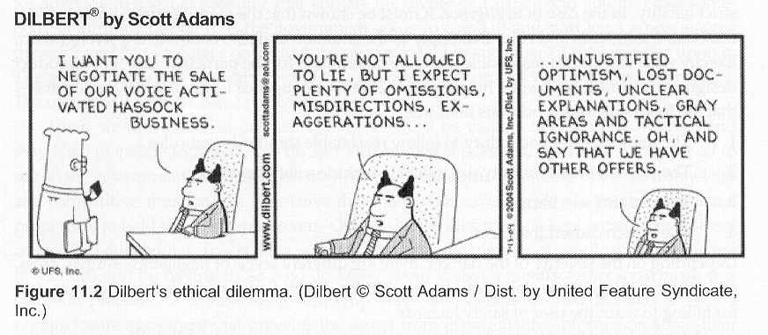
Engineering Ethics

Slide 23
Consider the ethical issues involved in the following statements:
  “We have invested a lot of time and money in the design.”
  “We really need this system to work.”
  “The company's future depends upon this.”
  “Is there any way that we can make adjustments to make it pass the certification?”
  “Is it close enough that we could certify it? It really meets the needs and the standard has a margin of error built in to it.”

Slide 24
Compliance versus Ethics
Compliance -- following the Legal Rules and Laws
Ethics – deals with the general nature of good and bad and the specific moral obligations of and choices to be made by the individual in her/his relationship to others. Rules or standards governing conduct, especially those of a profession.

Slide 25

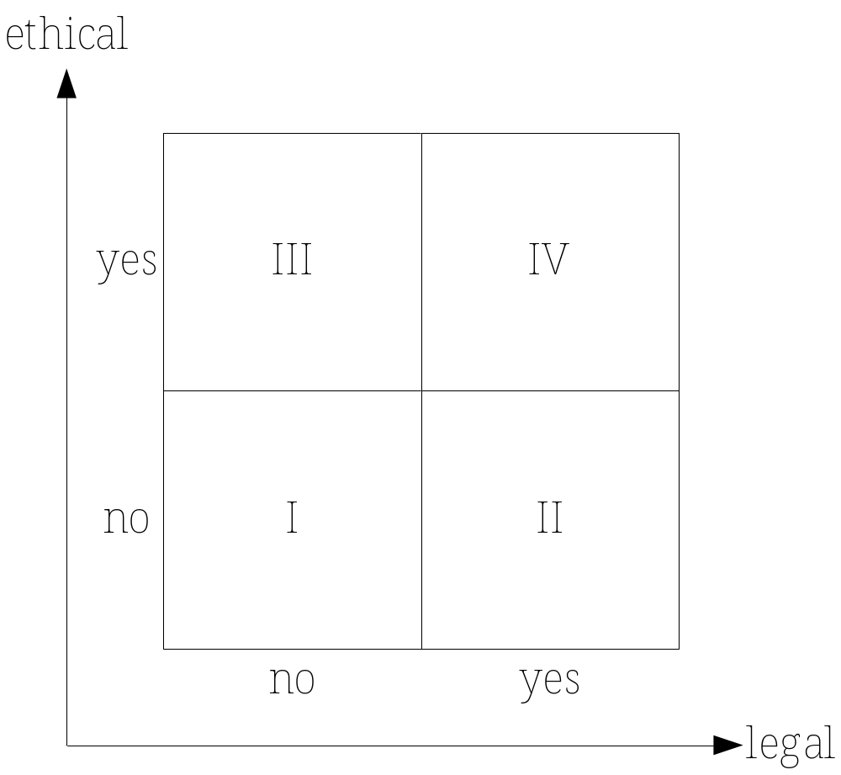

Slide 26

What is a whistleblower?
  Going outside the company or organization to the press or a government agency to report the problem.
What are some well-known examples of “whistleblowing” ?
  Space Shuttle Challenger accident

Slide 27

When it is appropriate to become a whistleblower?
  The harm to the public must be considerable or serious.
  Concerns must have been made to your superiors (up to the CEO) without satisfactory resolution.
  You have documented evidence that would convince an impartial observer that your company is wrong.
  Release of the information outside of the company will prevent the harm.

Slide 28

Gather information.
Identify the stakeholders.
Consider the ethical values are relevant to the situation.
Determine the best course of action.
Apply to Example 11.1 in text and end-of-chapter problems.

Slide 29

Have you conducted adequate research to understand prior art? Are you infringing on patents or copyrights?
Do your requirements specifications meet the needs of the stakeholders?
Did you make the design space as large as possible?
Did you identify and apply relevant safety standards?
Did you consider all possible ways a design can fail?
Did you consider ways the product can be misused?
Did you conduct design reviews?
Have you reversed engineered another’s product?
Are your cost & project schedules fair & realistic?
Did the design pass acceptance tests (verification)?

Slide 30
Other Ethical and Legal Issues
Fabrication: is the act of making up data or results, then recording or reporting them as fact.
Plagiarism: The appropriation of another person's ideas, processes, results, or words without giving appropriate credit.
Self-Plagiarism: Republishing or presenting previous work in a manner that conceals the original authorship in attempts to obtain additional recognition for the same work.
Falsification: Manipulating materials, equipment, or processes, or changing or omitting data or results such that the research or results from an engineering verification test is not accurately represented in the record.
Practical Ethics Center at the University of Montana with Office of Research Integrity: http://resadmin.uah.edu/resadminweb/information/compliance/rcr_montana/

Slide 31
Other Ethical and Legal Issues
Conflicts of Interest: when the performing one of your required duties lead to the disregard of one or more of your other required duties.
  Example: a designer inspecting and certifying his/her own work.
  Often there is a financial incentive for one duty to take precedence over another equally important one.
  Conflicts of interest have the potential to inappropriately influence engineering safety, data collection/analysis, personnel selection, etc.
  Conflicts of interest can be real or apparent. Important to avoid both if possible and to fully disclose all unavoidable apparent conflicts of interest to all affected parties.

Slide 32

Be prepared to encounter ethical dilemmas in your career.
Important to understand basics of intellectual property – who owns it?
Employ good design process activities to include ethical considerations in design..
Apply ethical decision-making paradigm and utilize resources available to you.

