Slide 1
CPE 323 Introduction to
Embedded Computer Systems:
Resets, Interrupts, and Operating Modes
Instructor: Dr Aleksandar Milenkovic
Lecture Notes
Notes:
Alex Milenkovich

Slide 2
Outline
MSP430: System Architecture
System Resets, Interrupts, and
Operating Modes
Basic Clock Module
Watchdog Timer
CPE 323
Notes:
Alex Milenkovich

Slide 3
Resets
Reset – a sequence of operations that put device into a well-defined state (from which the user’s program may start)
Performed when
  Power is first applied and
  Device detects serious fault in hardware or software from which the user’s program cannot be expected to recover
MSP430 supports two types of reset (HW and SW controlled)
  Power-on Reset (POR)
  Power-up Clear (PUC)
CPE 323

Slide 4
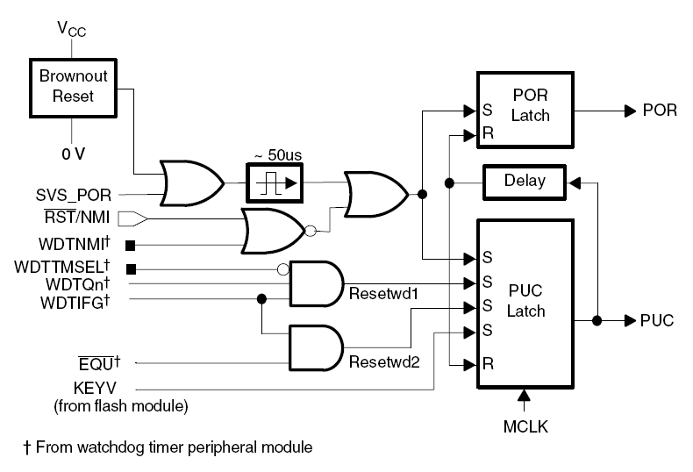
System Reset
Power-on Reset (POR)
  Powering up the device
  A low signal on the RST/NMI pin when configured in the reset mode
  An SVS low condition when PORON=1.
Power-up Clear
  A POR signal
  Watchdog timer expiration when in watchdog mode only
  Watchdog timer security key violation
  A Flash memory security key violation
CPE 323
Notes:
Alex Milenkovich

Slide 5
Power-on Reset (POR)
Generated by the following severe conditions related to hardware
1. Device is powered-up. POR us raised if the supply voltage drops to so low a value that the device may not work correctly. Include brownout detector.
2. A low external signal on the #RST/NMI pin (if the pin is configured for the reset function rather than the nonmaskable interrupt). Active by default.
3. Some MSP430s have a more comprehensive supply voltage supervisor (SVS). It sets the SVSFG flag if the voltage falls below the programmed level and can optionally reset the device.
CPE 323

Slide 6
Power-Up Clear (PUC)
It always follows the POR. It is generated when software appears to be out of control in the following ways:
1. Watchdog time overflows in watchdog mode
2. Write into the watchdog control register (WDTCTL) with incorrect password in the upper byte. Can be triggered even if the WDT is disabled or operates in the interval mode
  Correct password is 0x5A available as symbol WDTPW
3. Write an incorrect password into the flash memory controller registers (FCTLn). FWKEY=0xA5
  Protects the stored program from a runaway software
In newer devices, a PUC is triggered when we try to fetch an instruction from the range of addresses reserved for peripheral I/O or for unimplemented memory
CPE 323

Slide 7
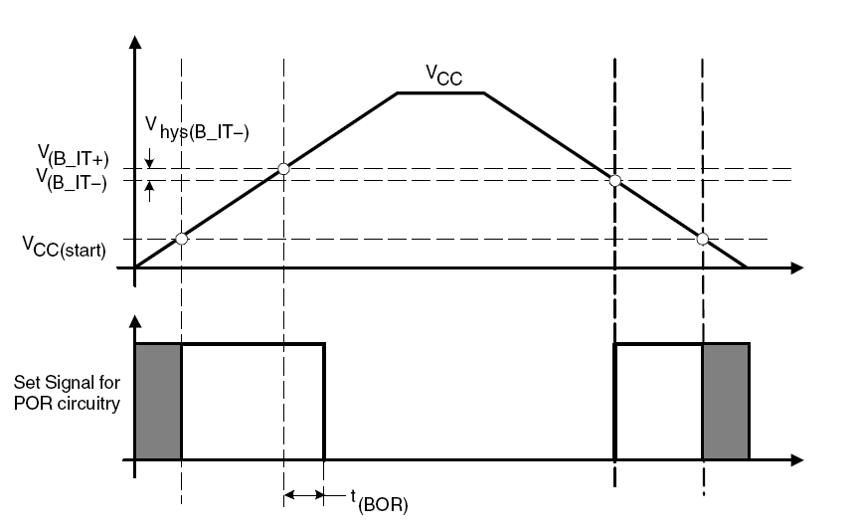
Brownout Reset
Supply Voltage Supervisor (SVS) circuits are used to monitor the supply voltage to embedded and other micro-controller systems for under voltage conditions. If an under voltage condition is detected then the supervisory circuit will reset the controller and keep it in that state as long as the under voltage condition persists. This type of reset is called brown out reset.
CPE 323
Notes:
Alex Milenkovich

Slide 8
Conditions after Reset
Initial conditions for all registers and peripherals after POR and PUC are specified in the family’s user guides; some common effects
#RST/NMI pin is configured for reset
Most I/O pins are configured as digital inputs
For registers see the manual. Notation is as follows
  rw-0: means that a bit can be read and written and is initialized to 0 after a PUC
  rw-(0): means that a bit can be read and written and is initialized to 0 after a POR and retains its value after a PUC
Status register is cleared (R2=0): active mode
WDT starts in watchdog mode
PC is loaded with the reset vector which is @0x0FFFE
CPE 323

Slide 9

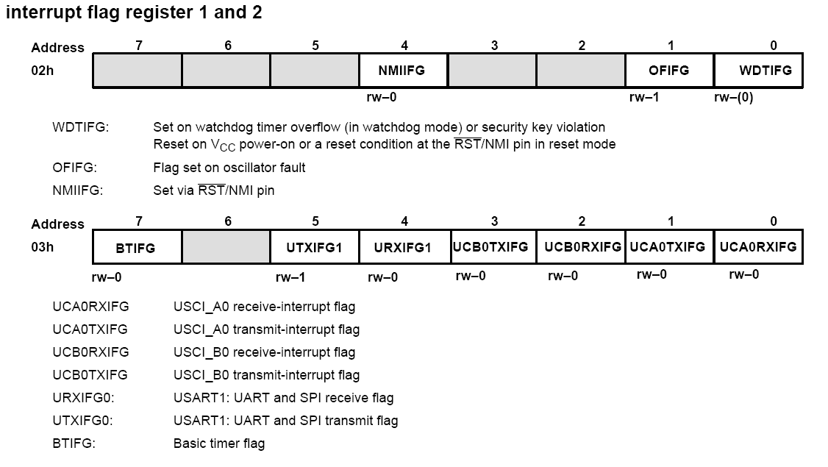
Interrupt Flag Registers
Cleared on POR, retains its value on PUC
Cleared on POC
CPE 323

Slide 10
Reset Related Flags
How to identify a source of the reset when debugging
IFG – Interrupt Flag Register (IFG1, IFG2)
  WDTIFG: shows that the WDT timed out or its security key is violated
  OFIFG: indicates an oscillator fault (causes a nonmaskable interrupt, not reset)
  RSTIFG: indicates a reset caused by a signal on the #RST/NMI pin
  PORIFG: is set on power-on reset
  NMIIFG: flags a non-maskable interrupt caused by a signal on #RST/NMI
These bits are not cleared by a PUC, so they can be tested to identify the source of the PUC
CPE 323

Slide 11
Software configuration
Your SW must configure the MSP430
Initialize the SP, typically to the top of RAM
Configure the watchdog to
the requirements of the application
Setup the clock (clocks)
Configure all ports (unused pins should never be left as floating inputs)
Configure peripheral modules to the requirements of the application (e.g. TimerA, ADC12, ...)
Finally enable interrupts if needed
Note: Additionally, the watchdog timer, oscillator fault, and flash memory flags can be evaluated to determine the source of the reset
CPE 323
Notes:
Alex Milenkovich

Slide 12
Exceptions/Interrupts (CHAPTER 6 in Textbook)
Events caused by hardware or software that require an urgent response
  E.g., a packet of data has been received,
  a new sample from ADC is ready, etc.
What do we need when an interrupt request is raised
  Processor stops its current task
  Stores enough information to be able
  to resume the task later (PC and SR)
  Executes an Interrupt Service Routine (ISR) or Interrupt Handler
    Like a subroutine to handle a specific request. It can be invoked at hardware at UNPREDICTABLE times
Exception processing
  What are possible sources of interrupt requests (HW internal/external, SW)?
  What do we do in presence of multiple requests?
  How do we decide which request to accept (priorities, masking, selective masking)?
  Where do we find the starting address of an ISR (vector table)
CPE 323

Slide 13
When Do We Use Interrupts
Crucial in embedded systems –
tasks are often triggered by external events
Handle urgent tasks that need to be executed at higher priority than the main code
  E.g., a received data packet should be read from a communication devices before it gets overwritten by another one
Handle infrequent tasks
  E.g., reading slow input devices (key pressed). An alternative is I/O polling – CPU waits for an event – would be extremely inefficient
Wake the CPU from sleep
  CPU is in a low-power mode to conserve energy
Calls to an operating system (SW interrupt)
CPE 323

Slide 14
Interrupt Service Routines
Look like a subroutine
Unique characteristics:
  Interrupts arise at unpredictable times and require prompt response =>
  ISR is carried out in such a way to allow the main code to resume without any error (like it has never occurred)
Triggered by events in the CPU, peripherals, busses (hardware) or software (interrupt instruction)
CPE 323

Slide 15
Tracking Interrupts and Masking
Interrupt Flags
  Each interrupt has a flag
    E.g., TAIFG – Timer A Interrupt Flag
  It is set when a the condition for interrupt occur
    Can be read from SW at any time (polling)
  Cleared when an interrupt is accepted
    by HW automatically in case of single-sourced interrupts
    by SW in the ISR in case of multiple-sourced interrupts
Maskable Interrupts
  Each flag has a corresponding enable bit
    E.g, TAIE – Timer A Interrupt Enable
  Allows us to selectively enable/disable interrupts
  GIE – General Interrupt Enable in SR; when cleared all MASKABLE interrupt requests are ignored; non-maskable are not affected (though they may have their own mask bits)
CPE 323

Slide 16
Interrupt Vector Table
Address of an ISR (vector) is stored in a table – interrupt vector table
Starts at defined address in memory
Vector is determined based on the source of the interrupt
  Single sourced interrupts: each vector is associated with a unique interrupt
  Multi-sourced interrupts: multiple sources may share a single vector
Priority: each vector has a distinct priority
  Defines which vector is taken if more than one request exists
CPE 323

Slide 17
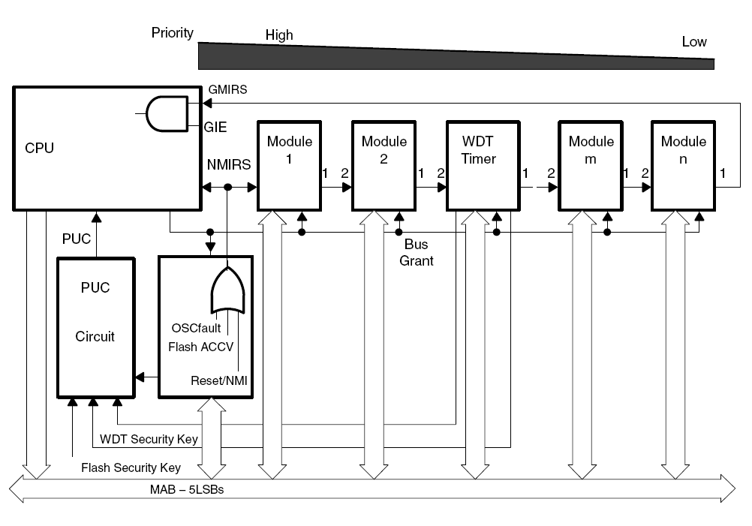
MSP430 Interrupts
3 types
  System reset
  (Non)-maskable NMI
  Maskable
Interrupt priorities are fixed and defined by the arrangement of modules (the nearer a module is to the CPU/NMIRS,
the higher the priority)
CPE 323
Notes:
Alex Milenkovich

Slide 18
What Happens When an Interrupt Is Requested?
1) Any currently executing instruction is completed.
2) The PC, which points to the next instruction, is pushed onto the stack.
3) The SR is pushed onto the stack.
4) The interrupt with the highest priority is selected if multiple interrupts occurred during the last instruction and are pending for service.
5) The interrupt request flag resets automatically on single-source flags. Multiple source flags remain set for servicing by software.
6) The SR is cleared with the exception of SCG0, which is left unchanged. This terminates any low-power mode. Because the GIE bit is cleared, further interrupts are disabled.
7) The content of the interrupt vector is loaded into the PC: the program continues with the interrupt service routine at that address.
Takes 6 cc to execute
CPE 323
Notes:
Alex Milenkovich

Slide 19
What Happens on Return from Interrupt?
RETI - Return from Interrupt Service Routine
  1) The SR with all previous settings pops from the stack. All previous settings of GIE, CPUOFF, etc. are now in effect, regardless of the settings used during the interrupt service routine.
  2) The PC pops from the stack and begins execution at the point where it was interrupted.
Takes 5 cc to execute
CPE 323
Notes:
Alex Milenkovich

Slide 20
Non-Maskable Interrupts (NMI)
Sources
  An edge on the RST/NMI pin
  when configured in NMI mode
  An oscillator fault occurs
  An access violation to the flash memory
Are not masked by GIE (General Interrupt Enable), but are enabled by individual interrupt enable bits (NMIIE, OFIE, ACCVIE)
CPE 323
Notes:
Alex Milenkovich

Slide 21
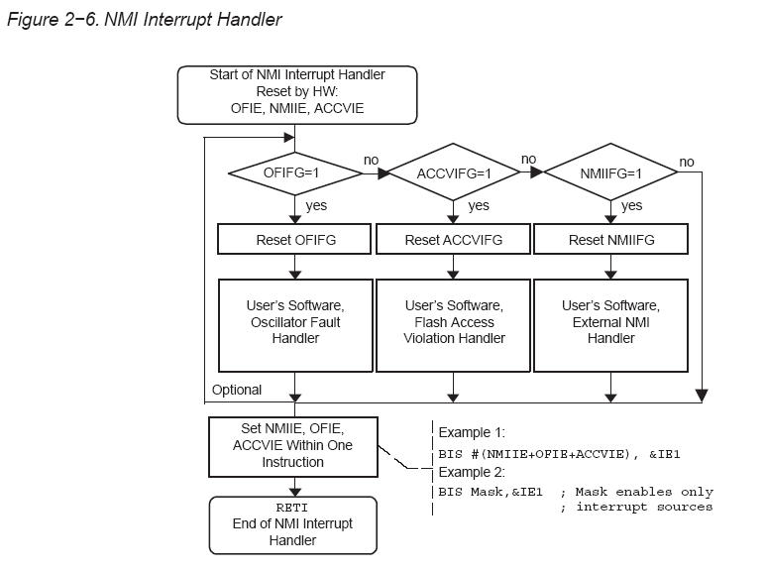
NMI Interrupt Handler
CPE 323
Notes:
Alex Milenkovich

Slide 22
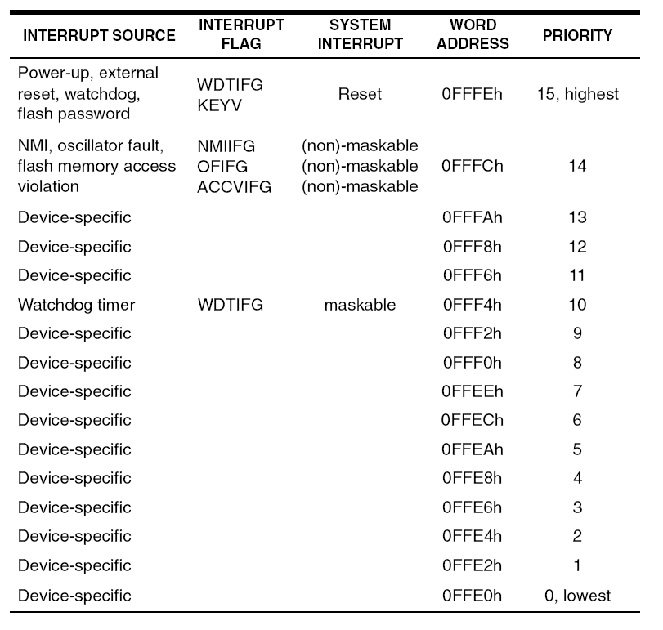
Interrupt Vectors
CPE 323
Notes:
Alex Milenkovich

Slide 23
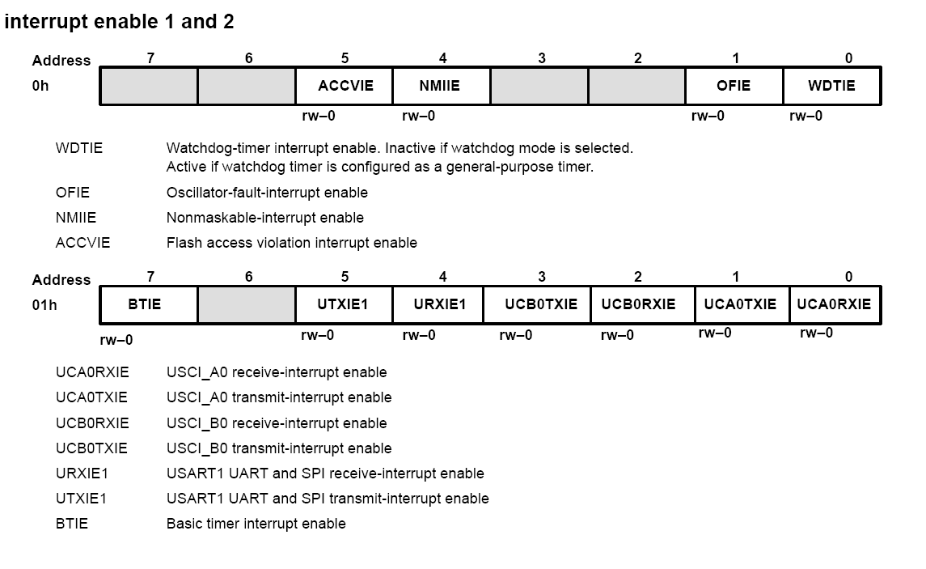
Special Function Registers (MSP430xFG4618)
IE1/IE2 (Interrupt Enable 1,2)
CPE 323

Slide 24
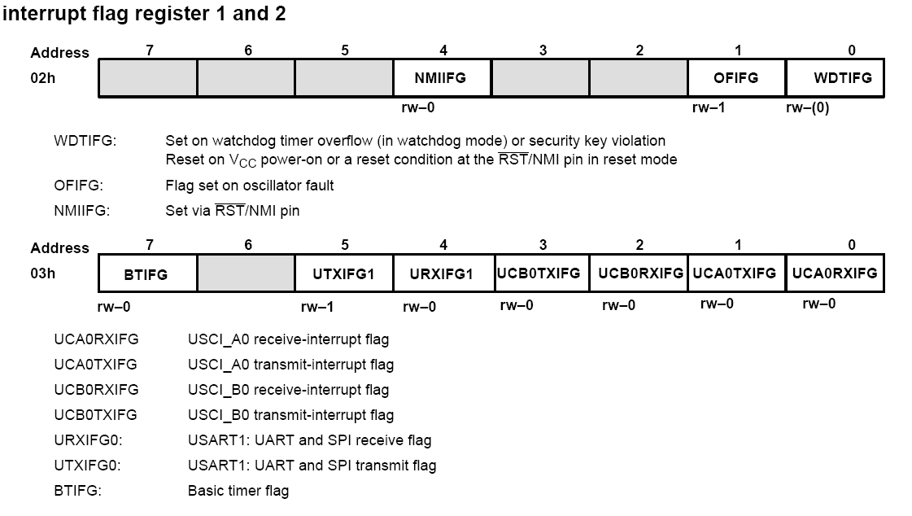
Special Function Registers (MSP430xFG4618)
Cleared on POR, retains its value on PUC
IFG1/IFG2 (Interrupt Flag Register)
CPE 323

Slide 25
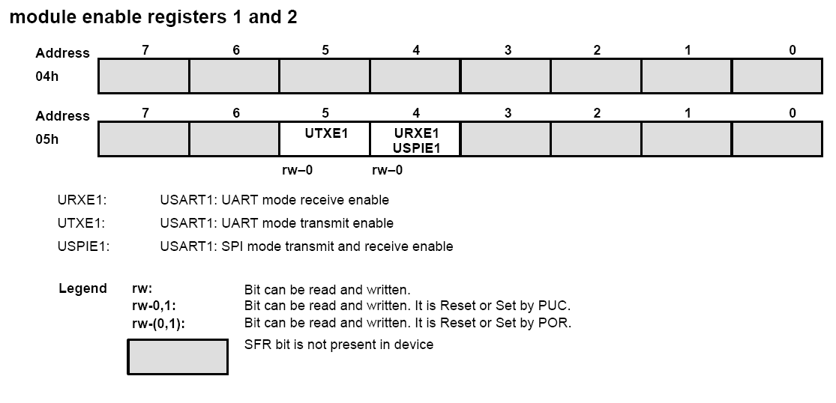
Special Function Registers (MSP430xFG4618)
ME1/ME2 (Module Enable Registers)
CPE 323

Slide 26
Interrupt Vectors (from msp430xG46x.h)
/************************************************************
* Interrupt Vectors (offset from 0xFFC0)
************************************************************/
#define DAC12_VECTOR (14 * 2u) /* 0xFFDC DAC 12 */
#define DMA_VECTOR (15 * 2u) /* 0xFFDE DMA */
#define BASICTIMER_VECTOR (16 * 2u) /* 0xFFE0 Basic Timer / RTC */
#define PORT2_VECTOR (17 * 2u) /* 0xFFE2 Port 2 */
#define USART1TX_VECTOR (18 * 2u) /* 0xFFE4 USART 1 Transmit */
#define USART1RX_VECTOR (19 * 2u) /* 0xFFE6 USART 1 Receive */
#define PORT1_VECTOR (20 * 2u) /* 0xFFE8 Port 1 */
#define TIMERA1_VECTOR (21 * 2u) /* 0xFFEA Timer A CC1-2, TA */
#define TIMERA0_VECTOR (22 * 2u) /* 0xFFEC Timer A CC0 */
#define ADC12_VECTOR (23 * 2u) /* 0xFFEE ADC */
#define USCIAB0TX_VECTOR (24 * 2u) /* 0xFFF0 USCI A0/B0 Transmit */
#define USCIAB0RX_VECTOR (25 * 2u) /* 0xFFF2 USCI A0/B0 Receive */
#define WDT_VECTOR (26 * 2u) /* 0xFFF4 Watchdog Timer */
#define COMPARATORA_VECTOR (27 * 2u) /* 0xFFF6 Comparator A */
#define TIMERB1_VECTOR (28 * 2u) /* 0xFFF8 Timer B CC1-2, TB */
#define TIMERB0_VECTOR (29 * 2u) /* 0xFFFA Timer B CC0 */
#define NMI_VECTOR (30 * 2u) /* 0xFFFC Non-maskable */
#define RESET_VECTOR (31 * 2u) /* 0xFFFE Reset [Highest Priority] */
CPE 323
Notes:
Alex Milenkovich

Slide 27
Interrupt Service Routines
ASM EXAMPLE
Reset: MOV.W #SFE(CSTACK),SP ; main program
....
JMP $ ; loop forever
TA0_ISR: ... ; ISR
RETI ; return from interrupt
;------------------
COMMON INTVEC ; segment for vectors
ORG TIMERA_VECTOR
DW TA0_ISR ; ISR for TimerA
ORG RESET_VECTOR ; address to start ex.
DW Reset
END
C EXAMPLE
#pragma vector = TIMERA0_VECTOR
__interrupt void TA0_ISR (void){
// ISR code
}
CPE 323
Notes:
Alex Milenkovich

Slide 28
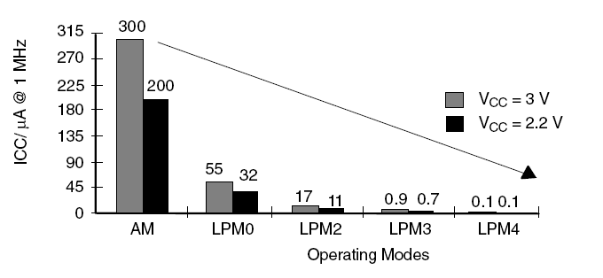
Operating Modes
MSP430 supports several operating modes
  Active – all clocks are up and running
  LPM0-LPM4 – low power modes (some clocks are turned-off)
Save energy – device is typically in a LPM and only ISRs
CPE 323

Slide 29
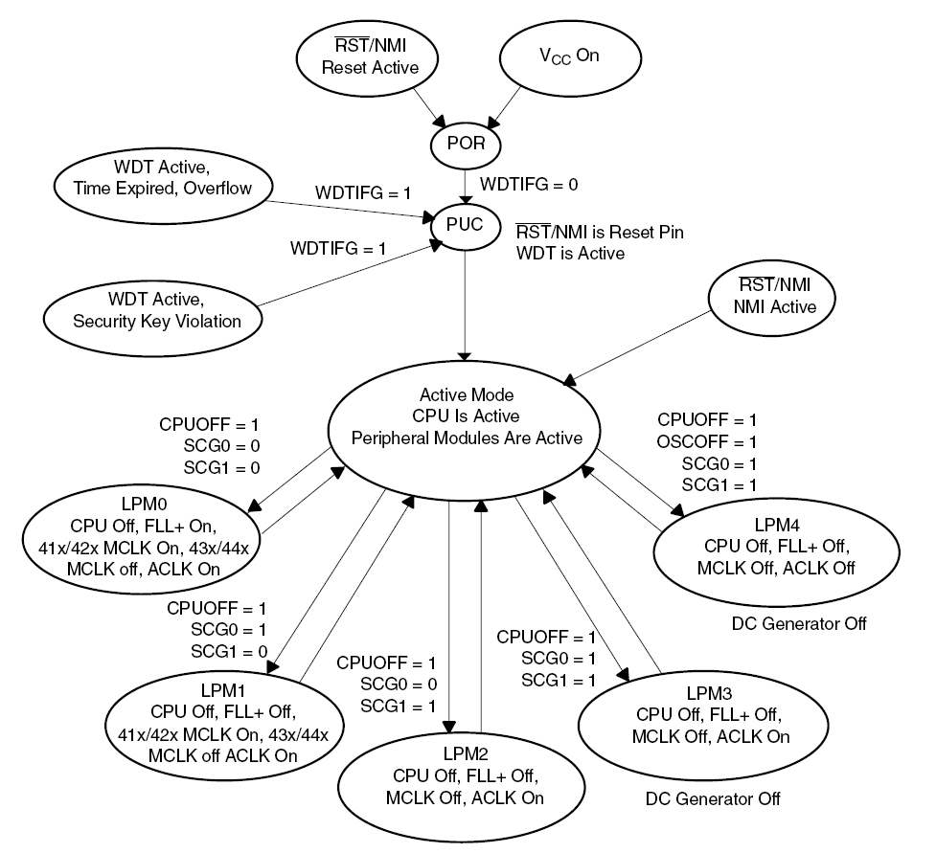
Operating Modes
(to be discussed later)
CPE 323
Notes:
Alex Milenkovich

Slide 30
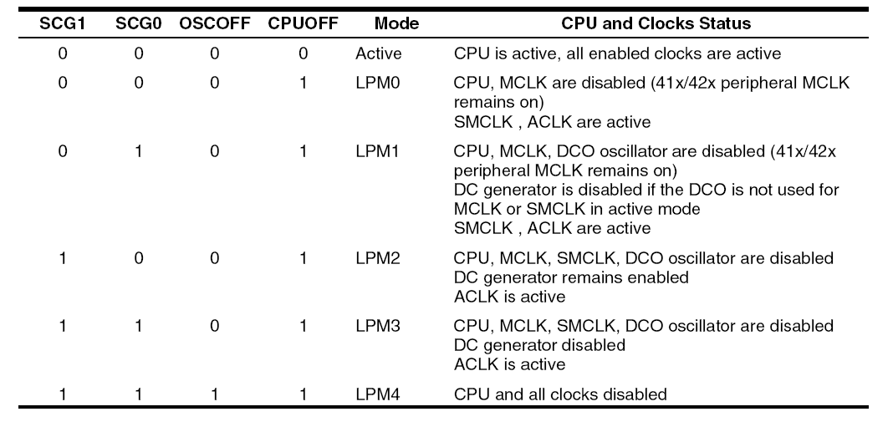
Operating Modes
(to be discussed later)
CPE 323
Notes:
Alex Milenkovich

Slide 31
Toggling a LED: WDT_ISR
// Description: Toggle LED1 on P1.0 using software timed by the WDT ISR.
// In this example the WDT is configured in interval timer mode,
// and it is clocked with fACLK, where fACLK = 32,768 Hz.
// The WDT ISR toggles the LED.
//
// MSP430xG461x
// -----------------
// /|\ | XIN|-
// | | | 32kHz
// ---|RST XOUT|-
// | |
// | |
// | |
// | P1.0|--> LED
// | |
// | |
// | |
//
// @A. Milenkovic, milenkovic@computer.org
// Max Avual, ma0004@uah.edu
//**************************************************************************
#include <msp430xG46x.h>
#define WDT_ADLY_1s (WDTPW+WDTTMSEL+WDTCNTCL+WDTSSEL) /* 1 s interval */
/* WDT_ADLY_1000 is predefined in the header file and can be used here,
instead of our own definition of delay WDT_ADLY_1s*/
void main(void)
{
WDTCTL = WDT_ADLY_1s; // 1 s interval timer
P1DIR |= 0x01; // Set P1.0 to output direction
IE1 |= WDTIE; // Enable WDT interrupt
_BIS_SR(LPM0_bits + GIE); // Enter LPM0 w/ interrupt
}
// Watchdog Timer interrupt service routine
#pragma vector=WDT_VECTOR
__interrupt void watchdog_timer(void)
{
P1OUT ^= 0x01; // Toggle P1.0 using exclusive-OR
}
CPE 323

Slide 32
Toggling a LED: WDT_ISR
// Description: Toggle LED1 on P1.0 using software timed by the WDT ISR.
// In this example the WDT is configured in interval timer mode,
// and it is clocked with fACLK, where fACLK = 32,768 Hz.
// The WDT ISR toggles the LED.
//
// MSP430xG461x
// -----------------
// /|\ | XIN|-
// | | | 32kHz
// ---|RST XOUT|-
// | |
// | |
// | |
// | P1.0|--> LED
// | |
// | |
// | |
//
// @A. Milenkovic, milenkovic@computer.org
// Max Avual, ma0004@uah.edu
//**************************************************************************
#include <msp430xG46x.h>
#define WDT_MDLY_32 (WDTPW+WDTTMSEL+WDTCNTCL) /* 32ms interval (default) */
void main(void)
{
WDTCTL = WDT_MDLY_32; // 32ms interval (default)
P1DIR |= 0x01; // Set P1.0 to output direction
IE1 |= WDTIE; // Enable WDT interrupt
_BIS_SR(LPM0_bits + GIE); // Enter LPM0 w/ interrupt
}
// Watchdog Timer interrupt service routine
#pragma vector=WDT_VECTOR
__interrupt void watchdog_timer(void)
{
static int i = 0;
i++;
if (i == 32) {
// 1 second on, 1 second off 31.25 * 32 ms = 1s
P1OUT ^= 0x01; // Toggle P1.0 using exclusive-OR
i = 0;
}
}
CPE 323

