Slide 1
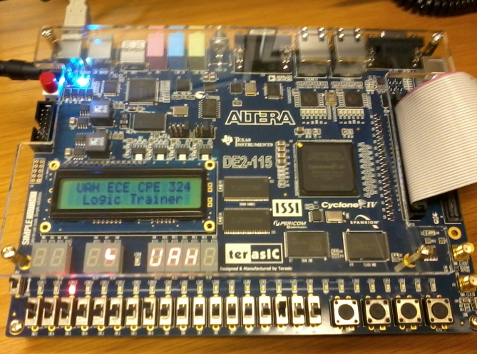
CPE 322
Digital Hardware Design Fundamentals
Electrical and Computer Engineering
UAH
Introduction to Verilog Part II

Slide 2
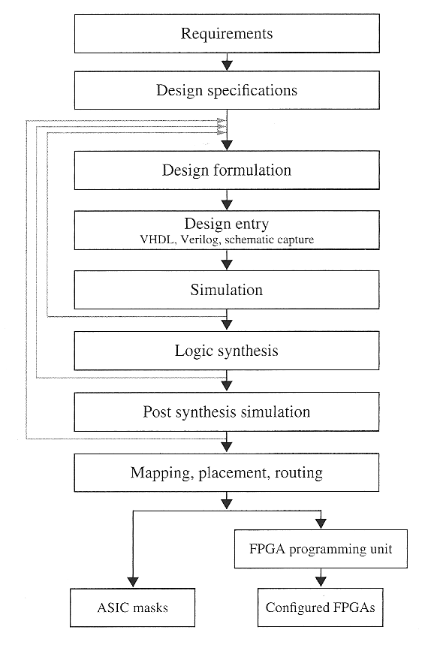
Steps in Modern Digital System Design

Slide 3
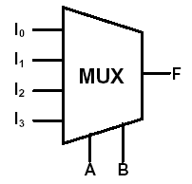
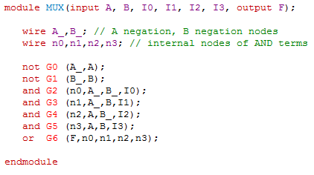
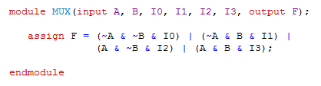
Verilog Models for a MUX
Structural Design using AND, OR, NOT primatives
Data flow design using continuous (concurrent signal) assignment statement

Slide 4

Verilog Models for a MUX
  Conditional continuous (concurrent signal) assignment statement format:
    <condition> ? <if true> : <else>;
      If the Condition is true, the value of <if true> will be taken, otherwise the value of <else> will be taken.
Data flow design of MUX using conditional continuous (concurrent signal) assignment statement

Slide 5
Behavioral Modeling using
Procedural Constructs
Two Procedural Constructs
  initial Statement
  always Statement
initial Statement : Executes only once
always Statement : Executes in a loop
Example:
  …
  always @(A or B)
  begin
  Sum = A ^ B;
  Cout = A & B;
  end
  …
  …
  initial
  begin
  Sum = 0;
  Cout = 0;
  end
  …

Slide 6
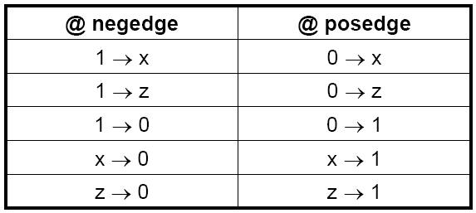
Event Control
Event Control
  Edge Triggered Event Control
  Level Triggered Event Control
Edge Triggered Event Control
  @ (posedge CLK) //Positive Edge of CLK
  Curr_State = Next_state;
Level Triggered Event Control
  @ (A or B) //change in values of A or B
  Out = A & B;

Slide 7
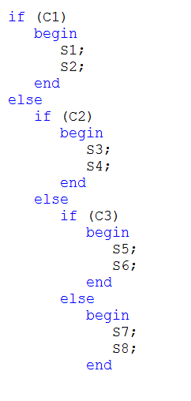
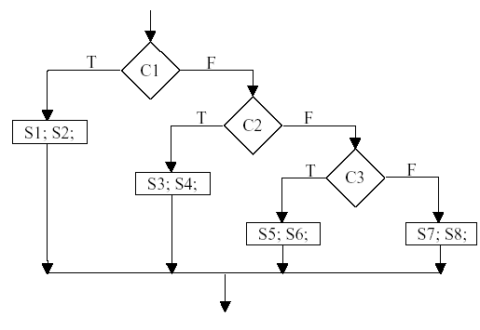
IF Statements in Verilog HDL

Slide 8
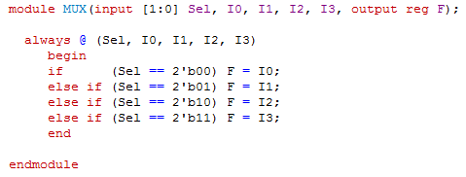
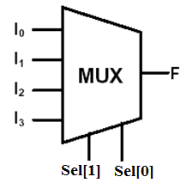
Verilog Models for a MUX
Data flow design of MUX using nested if statement placed inside an always block

Slide 9
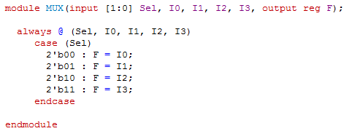
Verilog Models for a MUX
  The case statement has the general form:
    case expression
      choice1 : sequential statements1
      choice2 : sequential statements2
      . . .
      [default : sequential statements]
    endcase
Data flow design of MUX using a case statement placed inside an always block

Slide 10
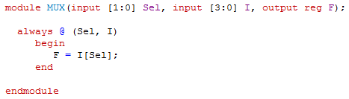
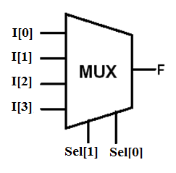
Verilog Models for a MUX
Data flow design of MUX using array declaration of the two sets of inputs
The Sel input is used as the index into the I inputs.

Slide 11
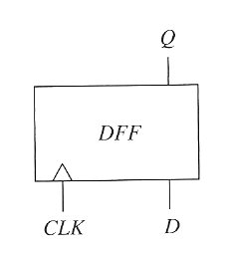
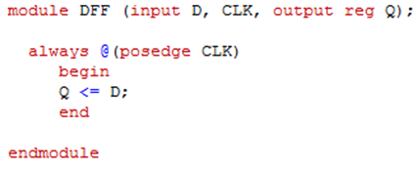
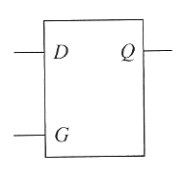
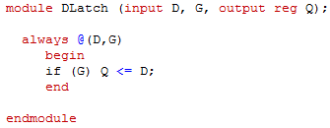
Modeling Simple Sequential Elements
D Flip/Flop
D Latch

Slide 12
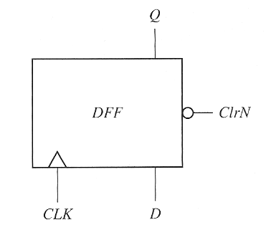
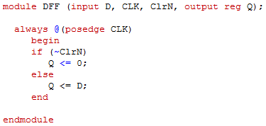
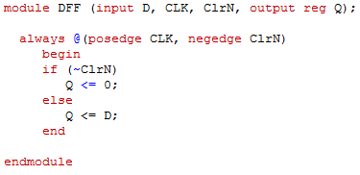
Modeling Simple Sequential Elements
D Flip/Flop
Synchronous ClrN
Note: should not mix level triggered and edge triggered inputs on sensitivity lists
Asynchronous ClrN

Slide 13
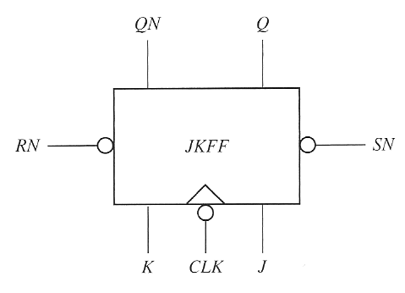
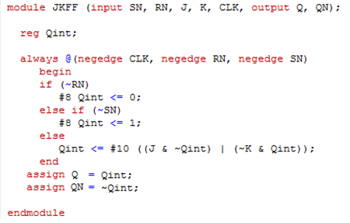
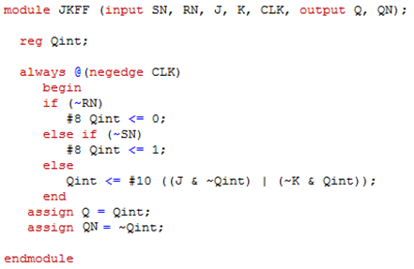
Modeling Simple Sequential Elements
Text incorrectly mixed level triggered and edge triggered inputs on the same sensitivity list which is not recommended practice for asynchronous case
Asynchronous SN and RN
Synchronous SN and RN

Slide 14
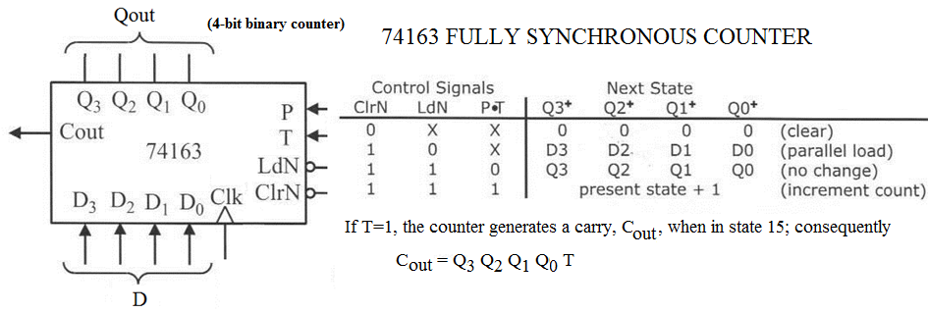
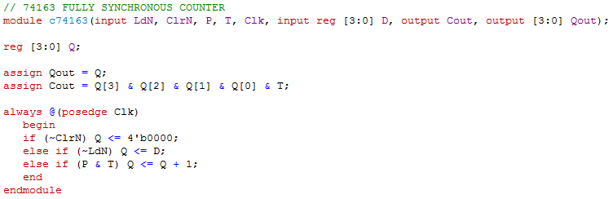
Modeling more Complex Sequential Elements

Slide 15
Modeling more Complex Sequential Elements
Synchronous inputs, such as the ClrN signal on the 74163 take effect after the active edge of the clock.
Asynchronous inputs are level triggered not edge triggered.
To ensure correct simulation properties, an always block should always contain the same type of triggering in the sensitivity list
  If one signal is edge-sensitive, then all signals should be edge sensitive.

Slide 16
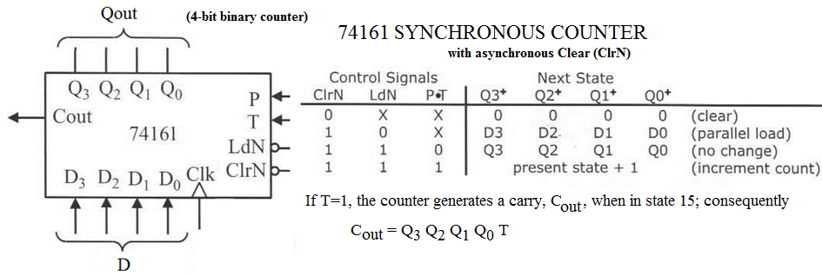
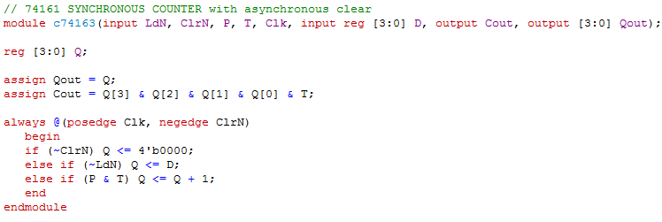
Modeling more Complex Sequential Elements

Slide 17
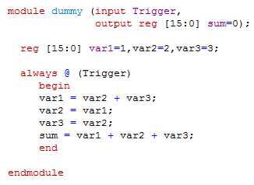
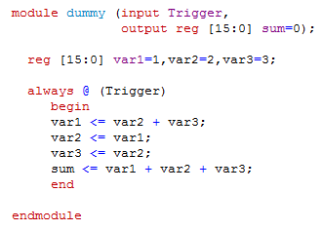
Blocking versus Nonblocking Procedural Assignment Statements
Blocking Assignments
Nonblocking Assignments
Sum = 15 (16’d15)
Sum = 6 (16’d6)
UAH-CPE/EE 422/522 ©AM

Slide 18
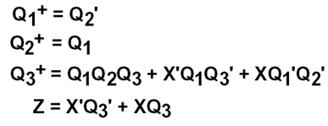
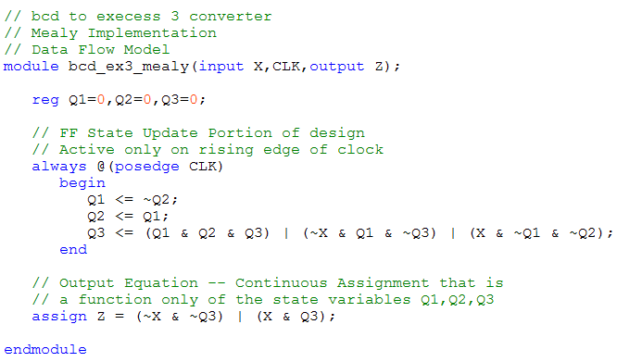
Data Flow Representation Verilog HDL
8421 BCD to Excess3 Code Converter (Mealy FSM)

Slide 19
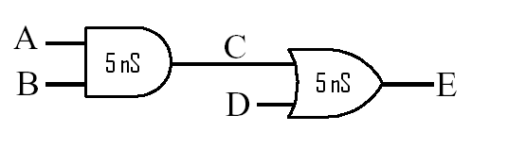
Data Flow Representation
If you are using Verilog HDL for simulation, then you can assign gate and wiring type delays:
  Inertial (delays to operations, i.e. gate type delays)
  Transport (delays between operations, i.e. wire delays)
But user-specified delays are ignored if you are using Verilog HDL for synthesis (i.e. creating circuitry)!

Slide 20
Types of Delay
Transport: Signal will assume its new value
after the specified delay time.
Inertial: Signal will assume its new value
after specified delay time if the signal is in the same state at least as long as the specified propagation delay.

Slide 21
Setting the Timing Scale
Unless set by the `timescale construct units of time in Verilog are generic and measured in ‘time units’
To associate these generic time-units with physical time use the timescale construct
  `timescale time-unit/time-precision
    Example `timescale 1ns/100 ps
      Sets the generic time unit specified in the Verilog file to equal 1 ns
      Sets the precision of time to be 100ps (0.1 ns)
      Thus a time value of 10.52765 ns would be rounded to 10.5 ns

Slide 22

Inertial Delay
(using Continuous Assignment Statements)
Provides for specification of the propagation delay and minimum input pulse width, i.e. ‘inertia’ of output:
  Continuous Assignment statement example
wire <#delay> [net_name];
or
assign <#delay> [net] = Boolean Expression;
  Examples below have the same timing – delaying any change in output C by 5 time units
wire C;
assign #5 C = A & B; //delay in the continuous assignment
wire #5 C = A & B; //delay in the implicit assignment
wire #5 C; //delay in the wire declaration
assign C = A & B;
Notes:
The keyword INERTIAL may be used in the signal assignment statement to specify an inertial delay, or it may be left out because inertial delay is used by default in VHDL signal assignment statements which contain “after” clauses.
If the optional REJECT construct is not used, the specified delay is then used as both the ‘inertia’ (i.e. minimum input pulse width requirement) and the propagation delay for the signal. Note that in the example above, pulses on Input narrower than 10ns are not observed on Output.

Slide 23
Inertial Delay
(using parametrized primitive instantiations)
By default the timing delay for Verilog gate primitives is always zero.
Rising and falling delays can be specified during primitive instantiation using the #(rise, fall) delay operator.
Turn-off delay (transition to high impedance state Z) for tri-state primitives can also be defined by using the #(rise, fall, off) delay operator.
and #(10) G1(C,A,B); //rise=10,fall=10
and #(10,11) G2(C,A,B); //rise=10,fall=11
notif0 #(10,11,25) G3(c,d,en) //rise=10,fall=11,
//off=25 (when en==0)

Slide 24
Inertial Delay
For each rise, fall, and turn-off delay times:
  Minimum, Typical, and Maximum delay values can be entered using a colon to separate the values as shown below:
//min:typ:max values defined for the (rise, fall) delays
and #(6:10:12, 9:11:13) G2(C,A,B);
or
assign #(6:10:12, 9:11:13) C = A & B;
ModelSim™ the Typical delay values are normally used.

Slide 25
Min/Max/Typical Delay Selection in ModelSim™
You can explicitly specify which delays are to be used at the start of the simulation.
To do this utilize the following command line options
  +maxdelays {for utilization of maximum delay values)
  +mindelays {for utilization of minimum delay values)
  +typdelays {for utilization of typical delay values --
  the default}
  These can be placed on the vsim command line or by selecting max, min, or typ under Delay Selection pull down widget of the Verilog tab of the Start Simulation Menu.

Slide 26
Adding Delays to a module
By default the timing inside a module is controlled by the design of the module itself.
Many modules are created that have parameterized delays similar to the #(rise,fall) delay operator used with gate primitives.
This is accomplished using the parameter keyword to create delay variables.
Note that parameters can also be used to change other scalar values in the module.

Slide 27
Parameters
Parameters are run-time constant for storing integers, real numbers, time, delays, or ASCII strings. Parameters may be redefined for each instance of a module.
Syntax parameter declaration
  parameter identifier1 = constant_expression,
    identifier2 = constant_expression, …, ;
Syntax parameter redefinition
  Explicit
defparam heirarchy_path.parameter_name = value;
  Implicit Parameter Redefinition
module_name #(value) instance_name (signals);

Slide 28
Changing Timing Parameters of Modules
for
`timescale 1ns/100 ps;
module comb_logic(input A,B,D, output E);
parameter and_delay = 5, // default rise/fall delays of 5
or_delay = 5; // for both internal gates
assign #or_delay C = A & B;
assign #and_delay E = C & D;
endmodule
When the module is instantiated then you can choose to override the delay values using the #(first_parameter, second_parameter) notation

Slide 29
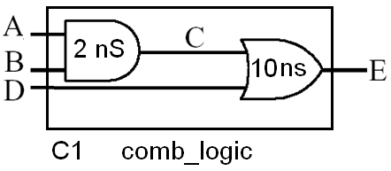
Changing Timing Parameters of Modules
for
`timescale 1ns/100 ps;
For example to specify a 2ns rise/fall for the internal OR gate and a 10ns rise/fall for the internal AND gate you could instantiate the component as follows:
comb_logic #(2,10) C1(A,B,D,E);

Slide 30
Assigning Inertial Delay to Complex Combinational Logic that is Modeled Behaviorally
Best Practices:
When using an always block to model complex combinational logic behaviorally
  Model this logic without assigning delay parameters (i.e. zero delay logic).
  The outputs from this block should then be passed through as inputs to continuous assignment statements.
  Assign the appropriate delays to these statements.
The delay values should then reflect true inertial type delays.

Slide 31
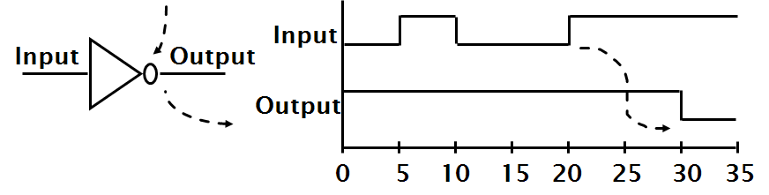
Inertial Delay Example
assign #10 Output = ~Input; // using continuous assignments
or
not #(10) I1(Output,Input); // using primitives
Example of gate with ‘inertia’ smaller than propagation delay
  e.g. Inverter with propagation delay of 10ns which suppresses pulses shorter than 5ns

Slide 32
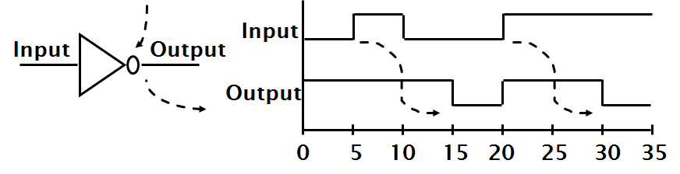
Transport Delay
Best practices for modeling Transport delays in Verilog is to place the delay on the RHS of a non-blocking procedural assignment statement.
// Transport delay example
always @(Input)
Output <= #10 ~Input;
Notes:
The keyword TRANSPORT must be used to specify a transport delay.
Transport delay is the simplest in that when it is specified, any change in an input signal value may result in a new value being assigned to the output signal after the specified propagation delay.
Note that no restrictions are specified on input pulse widths. In this example, Output will be an inverted copy of Input delayed by the 10ns propagation delay regardless of the pulse widths seen on Input .

Slide 33
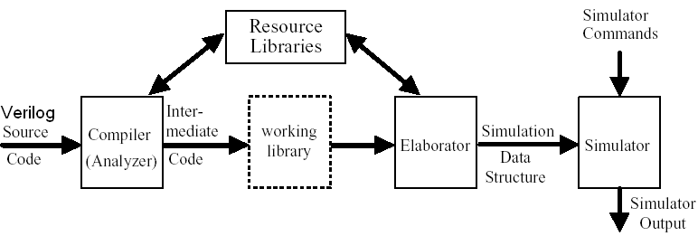
Compilation &Simulation of Verilog HDL Models
Compiler (Semantic Analyzer) – checks the Verilog HDL source model
  does it conforms with Verilog HDL syntax and semantic rules
  are references to libraries correct
Elaboration
  creates an intermediate form used by a simulator or by a synthesizer
  create ports, allocate memory storage, create interconnections, ...
  establish mechanism for executing of Verilog HDL processes

Slide 34
Logic Simulation
Discrete Event Simulation -- where the passage of time is simulated in discrete event driven steps.
  Simulation time – the time value maintained by the simulator to model the actual time it would take for the circuit being simulated
  Event driven
    Update Event – an actual change in value of a net or variable in the circuit being simulated.
    Evaluation Event – evaluation of a possible future change in value of a net or variable.
  All process that are sensitive to the update event are evaluated in an arbitrary order.

Slide 35
Simulation
  Event Queue –list of pending events that is ordered based upon increasing simulation time that the event is to occur.
    The Verilog event queue is segmented into five different regions
  Scheduling an event – the placement of an event on one of the regions of the event queue.
  Simulation Cycle – the processing of all active events.

Slide 36
Verilog Event Queue Regions
Active Event Region: Events that are scheduled to occur at the current simulation time.
  This is the only region that events can be retired.
  Continuous assignment & procedural continuous assignment constructs add events to this region
Inactive Event Region: Events that occur at the current simulation time but are required to wait until all events in the active region have been processed.
  When all active events are processed events in this region are placed in active event region.
  Blocking assignments with zero delay are placed here.

Slide 37
Verilog Event Queue Regions
Non-blocking Assign Update Region: Events that were evaluated at some previous simulation time but are scheduled to occur at the current simulation time.
  Events in this region are processed only after events in the active and inactive regions have been retired.
Monitor Event Region: Events scheduled for the current time step that are continuously reenabled in every successive time step by the $monitor and $strobe system tasks.
  Events in this region are processed only after events in the active, inactive, and non-blocking regions have been retired.

Slide 38
Verilog Event Queue Regions
Future Event Region: Events that occur at some future simulation time.
  Two sub-regions:
  Future Inactive Events:
    Events generate by Blocking assignments with nonzero delay
  Future Non-blocking Assignment Update Events:
    Events generated by Non-blocking assignments with nonzero delay
  Processed after all other regions with events chosen based upon those that have the earliest scheduled simulation time.

Slide 39
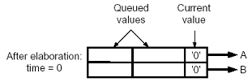
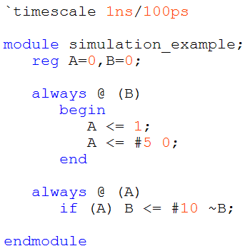






Simulation Example
Signal Drivers

Slide 40
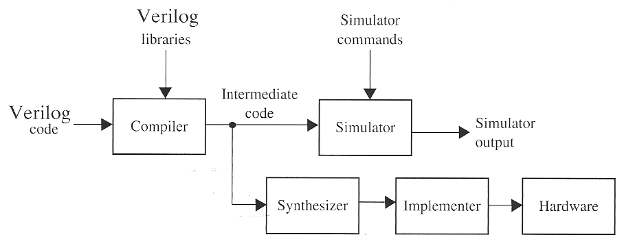
Synthesis of Verilog Code
Synthesis – automatic create hardware from a Verilog Description
  Intermediate code is created through the same steps of analysis and elaboration used in simulation
  Often simulation is performed first to catch errors before hardware is created

Slide 41
Synthesis of Verilog Code
Synthesis
  Produces a netlist that includes a list of required components and their interconnections
  Output of synthesizer is used by the targeted implementer module to create the specific CPLD, FPGA, or ASIC hardware.

Slide 42
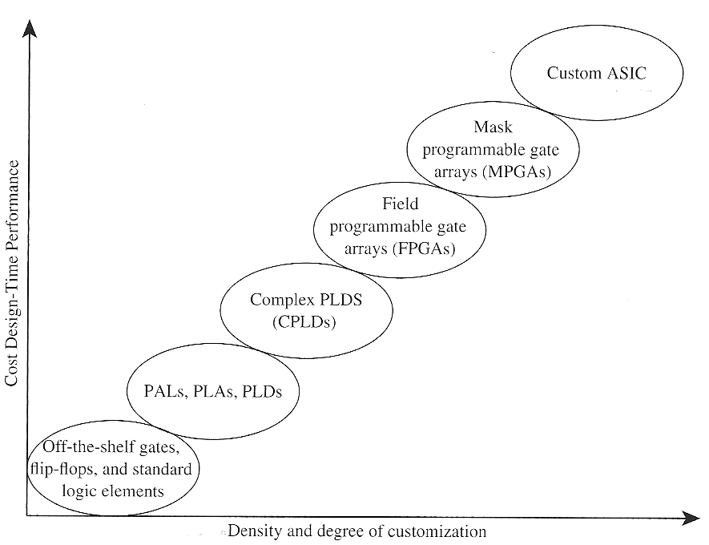
Spectrum of Possible Technologies for Design Synthesis

Slide 43
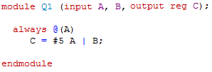
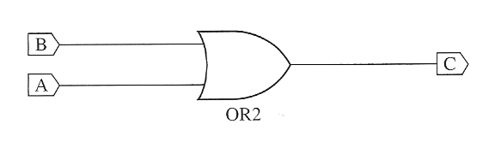
Synthesis Issues and Examples
What logic circuit will be synthesized?
Most synthesizers will give a warning that B is not in sensitivity list but synthesize an OR gate.
In this case the synthesizer “guessed” at what the user wanted.
This means the simulation of the circuit will behave differently from the actual circuit that is synthesized!
  Check the warnings – synthesizer may have helped or it may have hurt you
(The synthesizer will also ignore the #5 delay)

Slide 44
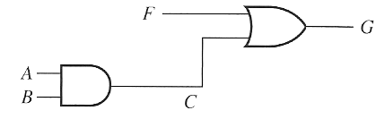
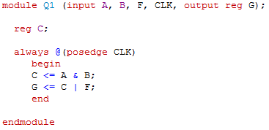
Synthesis Issues and Examples
What logic circuit will be synthesized?
Is it?
An edge-triggered clock is implied (by the posedge or negedge)
This means LHS variables C and G will need to be remembered after the clocks edge.
Non-blocking assignments mean that both statements function concurrently

Slide 45
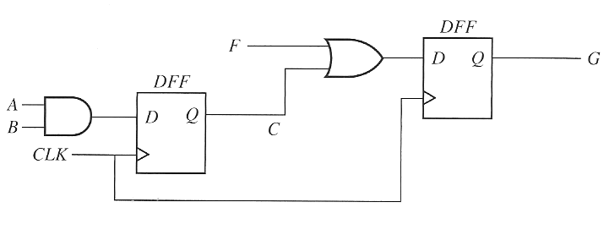
Synthesis Issues and Examples
What logic circuit will be synthesized?
Actual Circuit

Slide 46
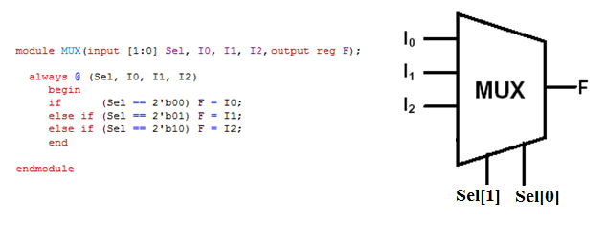
Avoiding Unwanted Latches
Unwanted latch created

Slide 47
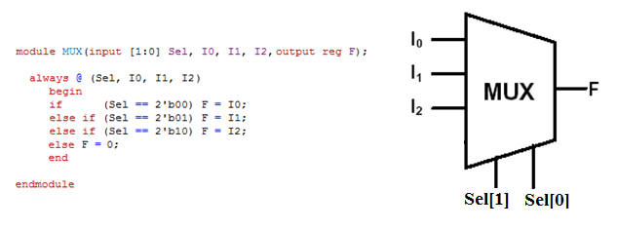
Avoiding Unwanted Latches

Slide 48
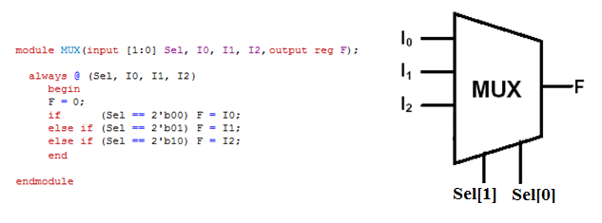
Avoiding Unwanted Latches

