Slide 1
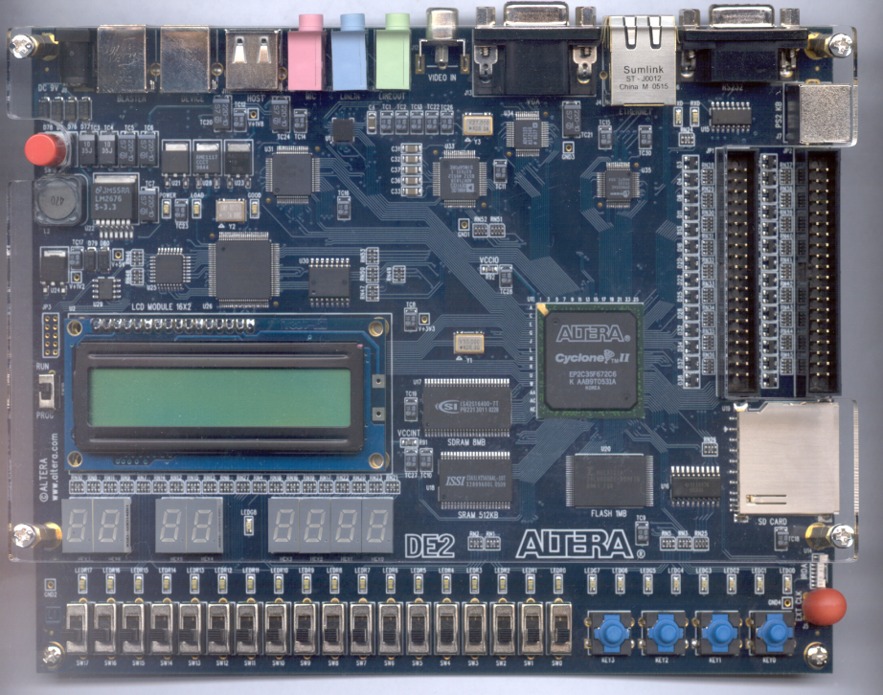
CPE 322
Digital Hardware Design Fundamentals
Electrical and Computer Engineering
Performing Simple Static Timing Analysis in Verilog HDL

Slide 2
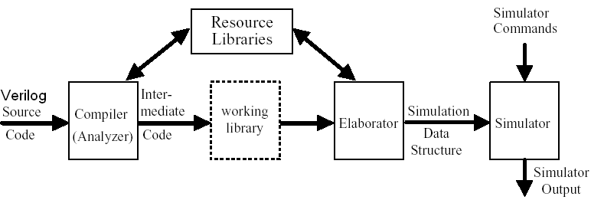
Compilation &Simulation of Verilog HDL Models
Compiler (Semantic Analyzer) – checks the Verilog HDL source model
  does it conforms with Verilog HDL syntax and semantic rules
  are references to libraries correct
Elaboration
  creates an intermediate form used by a simulator or by a synthesizer
  create ports, allocate memory storage, create interconnections, ...
  establish mechanism for executing of Verilog HDL processes

Slide 3
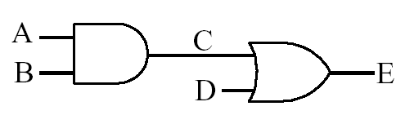
Data Flow Representation
  Continuous Assignment Statements
  assign C = A & B;
  assign E = C | D;
  Order of continuous assignment statements is not important
  assign C = A & B;
  assign E = C | D;
These signal are assumed to be evaluated by the Verilog simulator concurrently in an ideal manner.
  i.e. zero delays

Slide 4
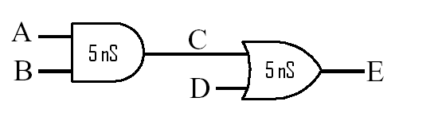
Data Flow Representation
If you are using Verilog HDL for simulation, then you can assign gate and wiring type delays:
  Inertial (delays to operations, i.e. gate type delays)
  Transport (delays between operations, i.e. wire delays)
But user-specified delays are ignored if you are using Verilog HDL for synthesis (i.e. creating circuitry)!

Slide 5
Types of Delay
Transport: Signal will assume its new value
after the specified delay time.
Inertial: Signal will assume its new value
after specified delay time if the signal is in the same state at least as long as the specified propagation delay.

Slide 6
Setting the Timing Scale
Unless set by the `timescale construct units of time in Verilog are generic and measured in ‘time units’
To associate these generic time-units with physical time use the timescale construct
  `timescale time-unit/time-precision
    Example `timescale 1ns/100 ps
      Sets the generic time unit specified in the Verilog file to equal 1 ns
      Sets the precision of time to be 100ps (0.1 ns)
      Thus a time value of 10.52765 ns would be rounded to 10.5 ns

Slide 7

Inertial Delay
(using Continuous Assignment Statements)
Provides for specification of the propagation delay and minimum input pulse width, i.e. ‘inertia’ of output:
  Continuous Assignment statement example
wire <#delay> [net_name];
or
assign <#delay> [net] = Boolean Expression;
  Examples below have the same timing – delaying any change in output C by 5 time units
wire C;
assign #5 C = A & B; //delay in the continuous assignment
wire #5 C = A & B; //delay in the implicit assignment
wire #5 C; //delay in the wire declaration
assign C = A & B;
Notes:
The keyword INERTIAL may be used in the signal assignment statement to specify an inertial delay, or it may be left out because inertial delay is used by default in VHDL signal assignment statements which contain “after” clauses.
If the optional REJECT construct is not used, the specified delay is then used as both the ‘inertia’ (i.e. minimum input pulse width requirement) and the propagation delay for the signal. Note that in the example above, pulses on Input narrower than 10ns are not observed on Output.

Slide 8
Inertial Delay
(using parametrized primitive instantiations)
By default the timing delay for Verilog gate primitives is always zero.
Rising and falling delays can be specified during primitive instantiation using the #(rise, fall) delay operator.
Turn-off delay (transition to high impedance state Z) for tri-state primitives can also be defined by using the #(rise, fall, off) delay operator.
and #(10) G1(C,A,B); //rise=10,fall=10
and #(10,11) G2(C,A,B); //rise=10,fall=11
notif0 #(10,11,25) G3(c,d,en) //rise=10,fall=11,
//off=25 (when en==0)

Slide 9
Inertial Delay
For each rise, fall, and turn-off delay times:
  Minimum, Typical, and Maximum delay values can be entered using a colon to separate the values as shown below:
//min:typ:max values defined for the (rise, fall) delays
and #(6:10:12, 9:11:13) G2(C,A,B);
or
assign #(6:10:12, 9:11:13) C = A & B;
ModelSim™ the Typical delay values are normally used.

Slide 10
Min/Max/Typical Delay Selection in ModelSim™
You can explicitly specify which delays are to be used at the start of the simulation.
To do this utilize the following command line options
  +maxdelays {for utilization of maximum delay values)
  +mindelays {for utilization of minimum delay values)
  +typdelays {for utilization of typical delay values --
  the default}
  These can be placed on the vsim command line or by selecting max, min, or typ under Delay Selection pull down widget of the Verilog tab of the Start Simulation Menu.

Slide 11
Adding Delays to a module
By default the timing inside a module is controlled by the design of the module itself.
Many modules are created that have parameterized delays similar to the #(rise,fall) delay operator used with gate primitives.
This is accomplished using the parameter keyword to create delay variables.
Note that parameters can also be used to change other scalar values in the module.

Slide 12
Parameters
Parameters are run-time constant for storing integers, real numbers, time, delays, or ASCII strings. Parameters may be redefined for each instance of a module.
Syntax parameter declaration
  parameter identifier1 = constant_expression,
    identifier2 = constant_expression, …, ;
Syntax parameter redefinition
  Explicit
defparam heirarchy_path.parameter_name = value;
  Implicit Parameter Redefinition
module_name #(value) instance_name (signals);

Slide 13
Changing Timing Parameters of Modules
for
`timescale 1ns/100 ps;
module comb_logic(input A,B,D, output E);
parameter and_delay = 5, // default rise/fall delays of 5
or_delay = 5; // for both internal gates
assign #or_delay C = A & B;
assign #and_delay E = C & D;
endmodule
When the module is instantiated then you can choose to override the delay values using the #(first_parameter, second_parameter) notation

Slide 14
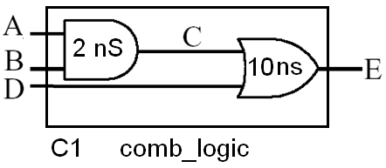
Changing Timing Parameters of Modules
for
`timescale 1ns/100 ps;
For example to specify a 2ns rise/fall for the internal OR gate and a 10ns rise/fall for the internal AND gate you could instantiate the component as follows:
comb_logic #(2,10) C1(A,B,D,E);

Slide 15
Assigning Inertial Delay to Complex Combinational Logic that is Modeled Behaviorally
Best Practices:
When using an always block to model complex combinational logic behaviorally
  Model this logic without assigning delay parameters (i.e. zero delay logic).
  The outputs from this block should then be passed through as inputs to continuous assignment statements.
  Assign the appropriate delays to these statements.
The delay values should then reflect true inertial type delays.

Slide 16
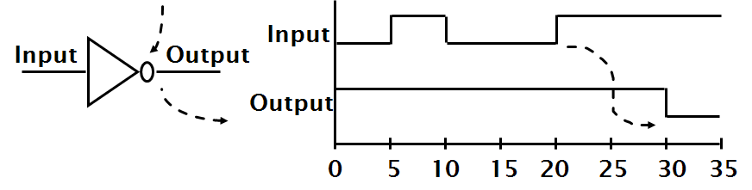
Inertial Delay Example
assign #10 Output = ~Input; // using continuous assignments
or
not #(10) I1(Output,Input); // using primitives
Example of gate with ‘inertia’ smaller than propagation delay
  e.g. Inverter with propagation delay of 10ns which suppresses pulses shorter than 5ns

Slide 17
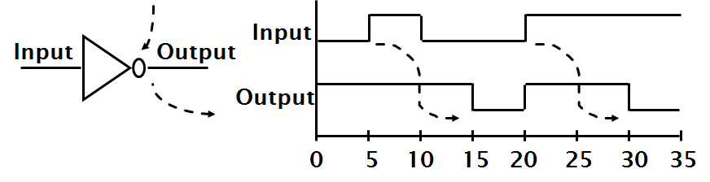
Transport Delay
Best practices for modeling Transport delays in Verilog is to place the delay on the RHS of a non-blocking procedural assignment statement.
// Transport delay example
always @(Input)
Output <= #10 ~Input;
Notes:
The keyword TRANSPORT must be used to specify a transport delay.
Transport delay is the simplest in that when it is specified, any change in an input signal value may result in a new value being assigned to the output signal after the specified propagation delay.
Note that no restrictions are specified on input pulse widths. In this example, Output will be an inverted copy of Input delayed by the 10ns propagation delay regardless of the pulse widths seen on Input .

Slide 18
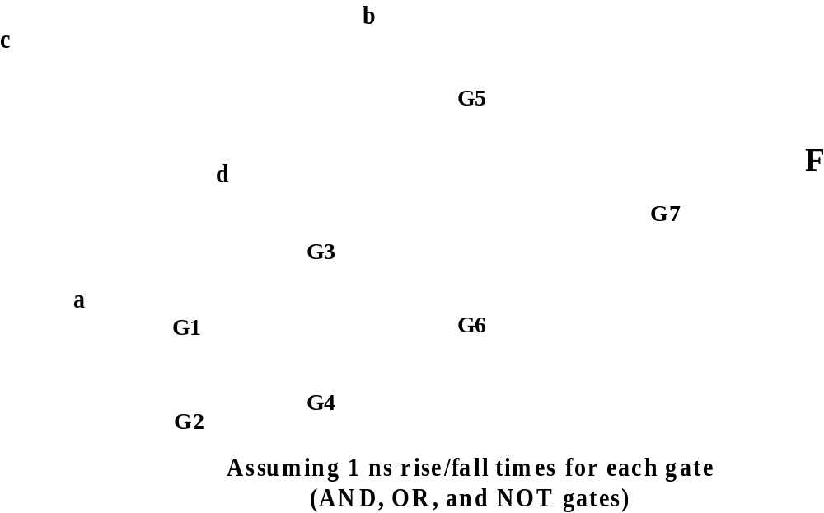
Using Static Timing to Observe the Effect of Hazards

Slide 19
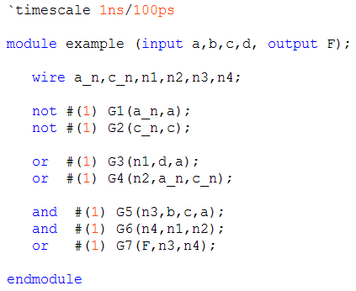
Using Static Timing to Observe the Effect of Hazards

Slide 20
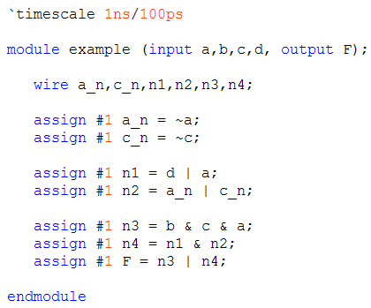
Using Static Timing to Observe the Effect of Hazards

Slide 21
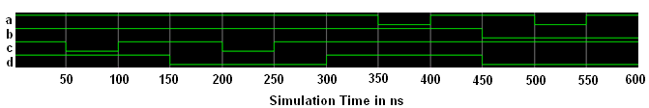
Driving the input to Detect Hazards
1-Hazard exists for case where c changes (from 0 to 1 or 1 to 0) and a=1, b=1, d=1.
1-Hazard exists for case where c changes (from 0 to 1 or 1 to 0) and a=1, b=1, d=0.
1-Hazard exists for case where a changes (from 0 to 1 or 1 to 0) and b=1, c=1, d=1.
0-Hazard exists for case where a changes (from 0 to 1 or 1 to 0) and b=0, c=1, d=0.
force a 1 0 ns, 0 350 ns, 1 400 ns, 0 500 ns, 1 550 ns
force b 1 0 ns, 0 450 ns
force c 1 0 ns, 0 50 ns, 1 100 ns, 0 200 ns, 1 250 ns
force d 1 0 ns, 0 150 ns,1 300 ns, 0 450 ns

Slide 22
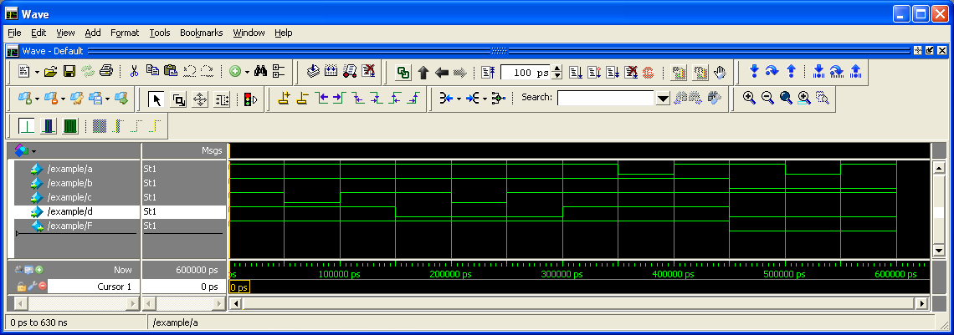
RTL Simulation
(zero delay)
add wave a b c d F
force a 1 0 ns, 0 350 ns, 1 400 ns, 0 500 ns, 1 550 ns
force b 1 0 ns, 0 450 ns
force c 1 0 ns, 0 50 ns, 1 100 ns, 0 200 ns, 1 250 ns
force d 1 0 ns, 0 150 ns,1 300 ns, 0 450 ns
run 600 ns

Slide 23
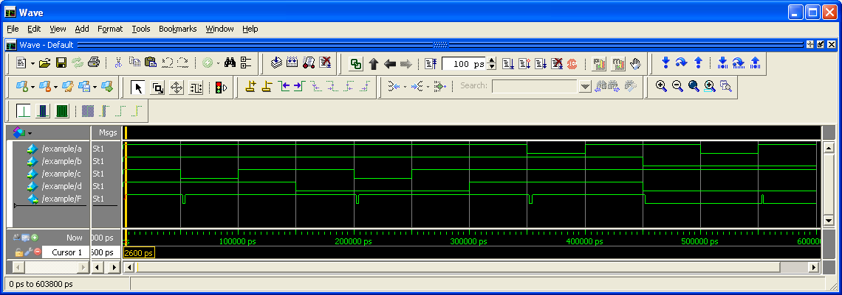
Static Timing Simulation
(1ns Delay each gate)
add wave a b c d F
force a 1 0 ns, 0 350 ns, 1 400 ns, 0 500 ns, 1 550 ns
force b 1 0 ns, 0 450 ns
force c 1 0 ns, 0 50 ns, 1 100 ns, 0 200 ns, 1 250 ns
force d 1 0 ns, 0 150 ns,1 300 ns, 0 450 ns
run 600 ns

Slide 24
Static Timing Simulation
(1ns Delay each gate)
In this case we were able to see the effect of all four hazards!
  Not always the case – hazards may cause a glitch but whether or not one occurs depends upon the actual timing values.
There is automated help in ModelSim™ to allow for hazard checking.

