Slide 1
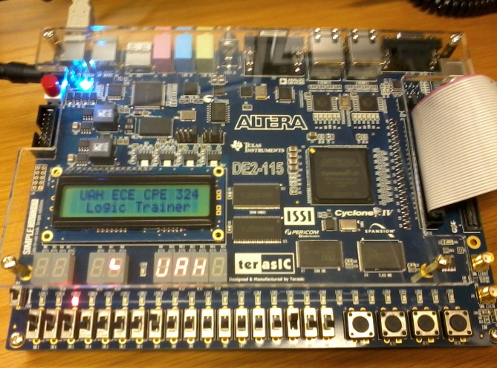
CPE 322
Digital Hardware Design Fundamentals
Timing Considerations in Synchronous Sequential Design

Slide 2
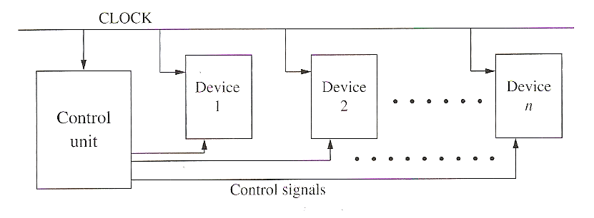
Synchronous Digital Systems
Use a clock to synchronize the operation of all flip-flops, registers, and counters in the system
  all changes occur immediately following the active clock edge
  clock period must be long enough so that all changes flip-flops, registers, counters will have time to stabilize before the next active clock edge
Control section + Data Section
Mealy and Moore Machines typically form the control sections of synchronous designs

Slide 3
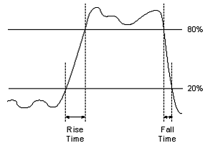
Rise/Fall Times & Pulse Width
The rise time or fall time of a signal is usually defined as the time it takes the signal to change between the 10% to 90% values of the transition.
An ideal timing diagram does not show rise times and fall times and each gate is assumed to have a 0 gate delay.
The pulse width of a positive pulse is usually defined as the time it takes the signal to go from its 50% value on the rising edge of the pulse to its 50% value on the falling edge of the pulse.

Slide 4
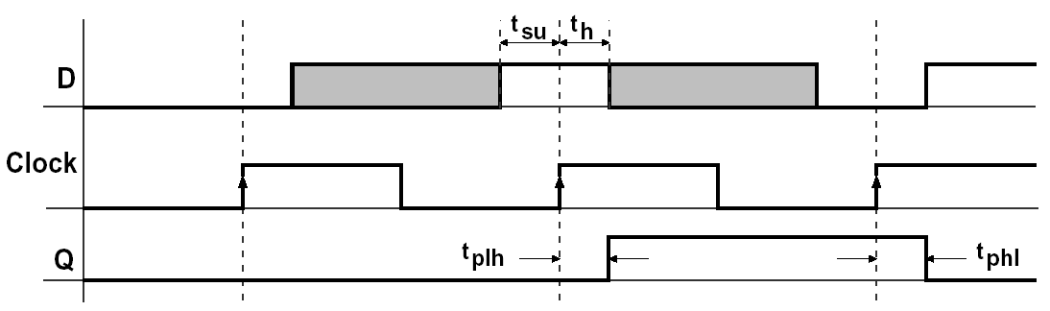
Setup and Hold Times
For a real D-FF
  D input must be stable for a certain amount of time
  before the active edge of clock cycle => Setup time
  D input must be stable for a certain amount of time
  after the active edge of the clock => Hold time
Propagation time: from the time the clock changes to the time the output changes
Manufacturers provide minimum t_{su}, th, and maximum tplh, tphl

Slide 5
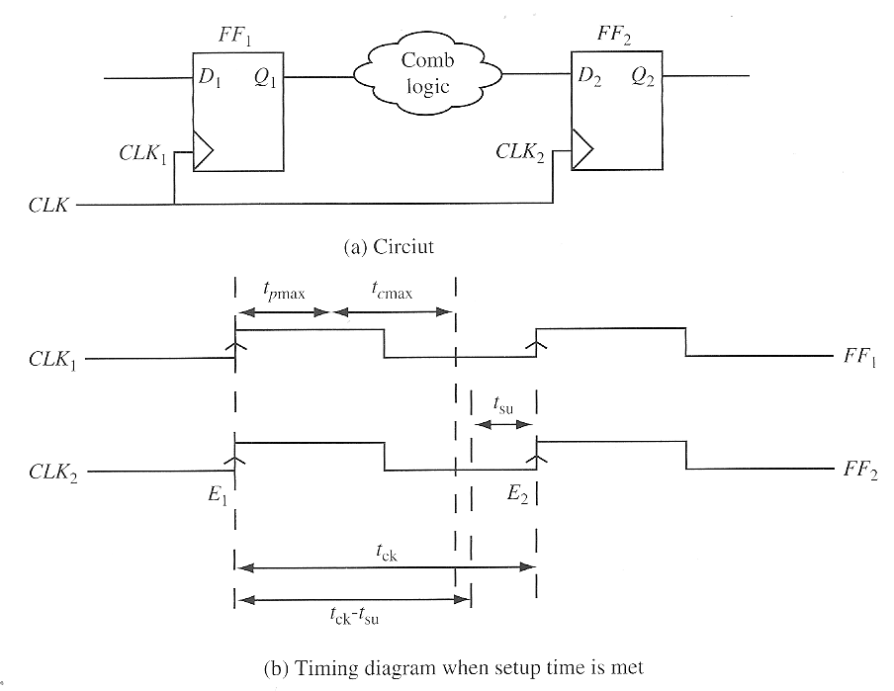
FF to FF Path via Combinational Logic
(when setup time is met)

Slide 6
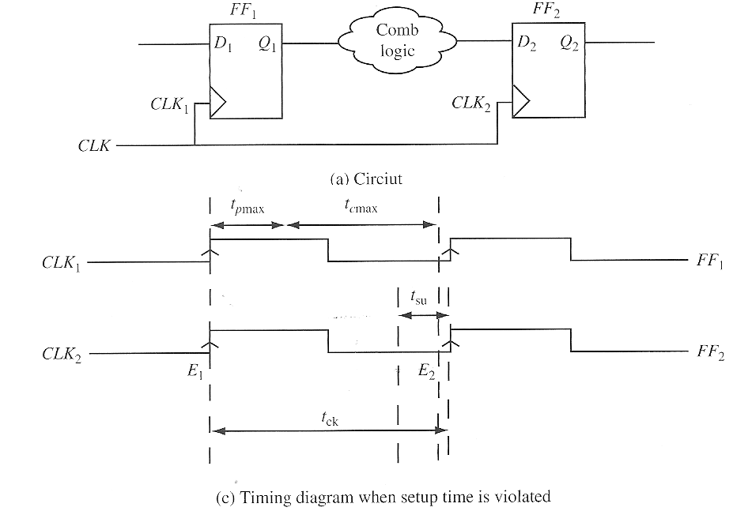
FF to FF Path via Combinational Logic
(when setup time is not met)

Slide 7





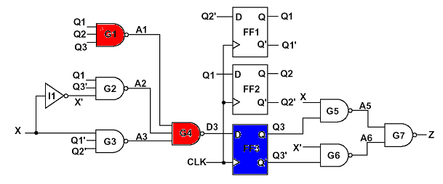

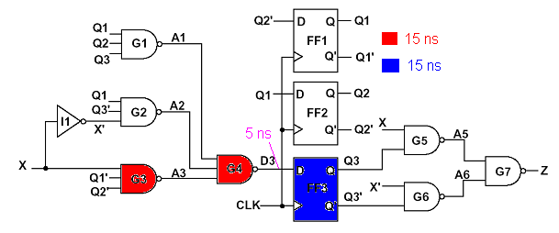
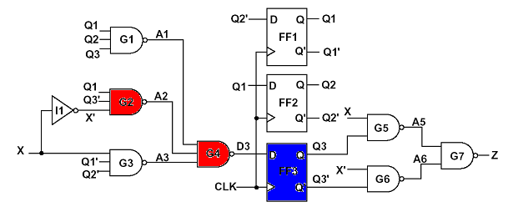
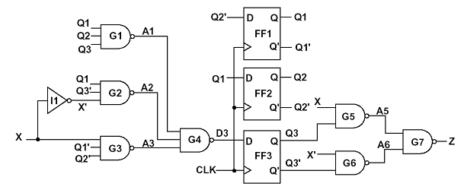



Maximum Clock Frequency
Max propagation delay through the combinational network
(path from register outputs back to register inputs – ignoring inputs)
- Max propagation delay from the time the clock changes to the flip-flop output changes { = max(tplh, tphl)}
- Clock period
Example:

Slide 8
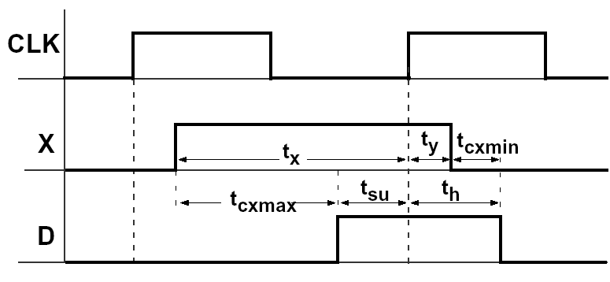
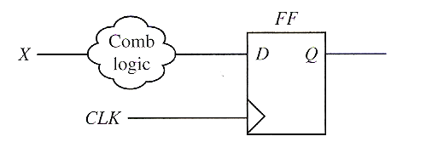


Setup Time Violations, Input X point of view
Occurs if the change in X that is fed back through the combinational network causes input D to change too soon after the clock edge
What about X?
Make sure that input changes propagate to the flip-flops inputs such that setup time is satisfied.
- Max propagation delay through the combinational network from input X (or any other input) to the flip-flop input D

Slide 9

Setup Time Violations, Input X point of view

Slide 10
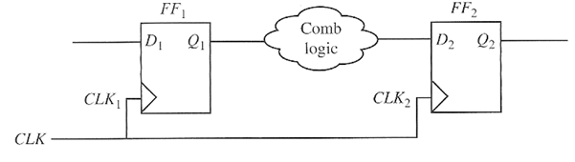
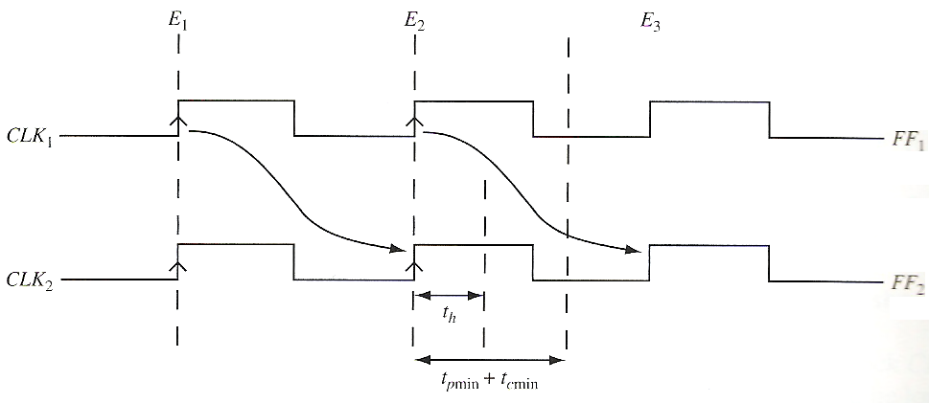

Hold Time Rule for FF
Note: if a circuit has a hold-time violation, it cannot be corrected by changing the clock frequency – must be redesigned by adding combinational delays!

Slide 11
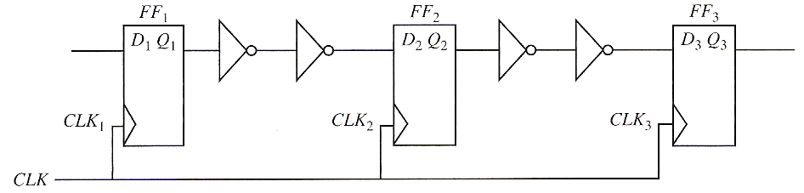
Fixing Hold Time Problems in a Shift Register Design using Buffers

Slide 12
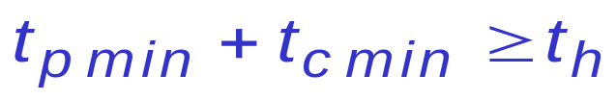
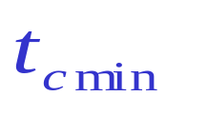
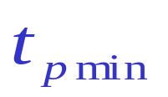
Hold Time Violations
(not considering the Input X)
Occurs if the change in Q that is fed back through the combinational network causes input D to change too soon after the clock edge
Hold time is satisfied if:
- Min propagation delay through the combinational network
- Min propagation delay from the time the clock changes to the flip-flop output changes { = min(tplh, tphl)}

Slide 13
Hold Time Violations
(not considering the Input X)

Slide 14

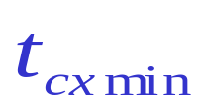
Hold Time Violations, Input X point of view
Occurs if the change in X that is fed back through the combinational network causes input D to change too soon after the clock edge
What about X?
Make sure that X does not change too soon after the clock.
If X changes at time ty after the active edge, hold time is satisfied if
- Min propagation delay through the combinational network from input X (or any other input) to the flip-flop input D

Slide 15
Hold Time Violations, Input X point of view

Slide 16
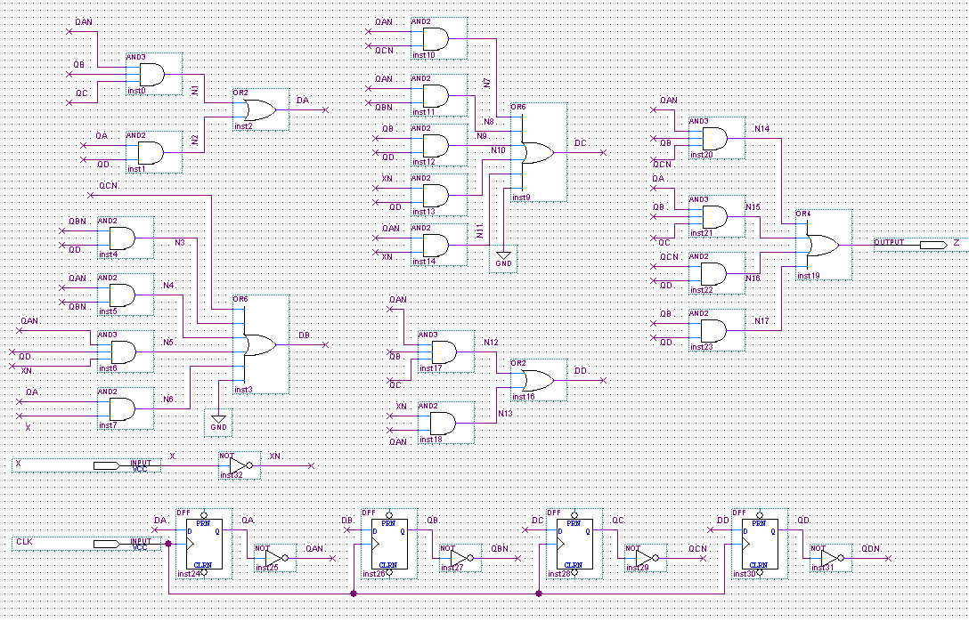
Quartus II Moore Implementation of BCD to Excess 3

Slide 17
Clock Skew in Synchronous Designs
Clock Skew - absolute time difference in clock signal arrival between two points in the clock network.
  Often caused by delays in the interconnect within the clock distribution network.
  Can also be caused by combinational logic used to selectively gate the clock of certain devices
Positive Skew –capturing flip-flop gets the clock delayed with reference to the launching flip-flop
Negative Skew – launching filip-flop get the clock delayed with reference to the capturing flip-flop

Slide 18
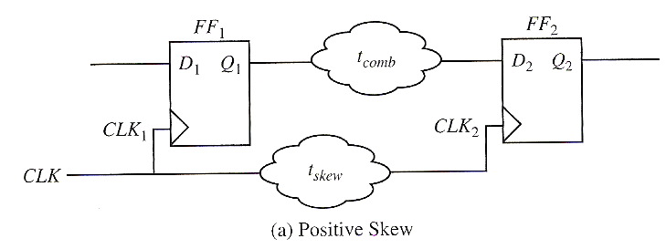
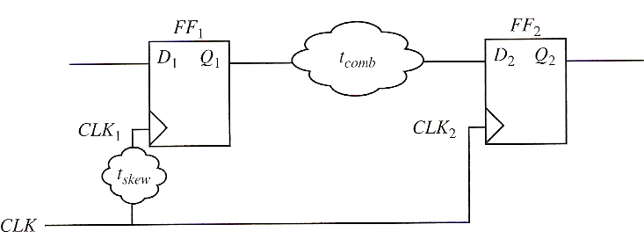






Setup & Hold Equations with Clock Skew
Positive Clock Skew
Negative Clock Skew

Slide 19
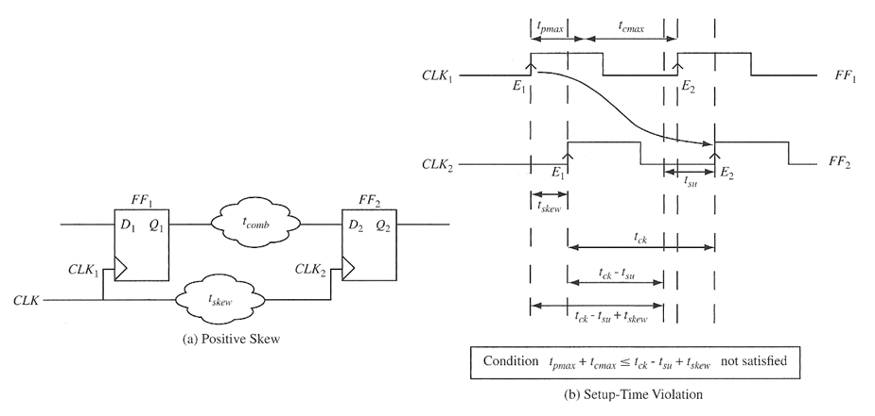
Positive Clock Skew – Setup Time

Slide 20
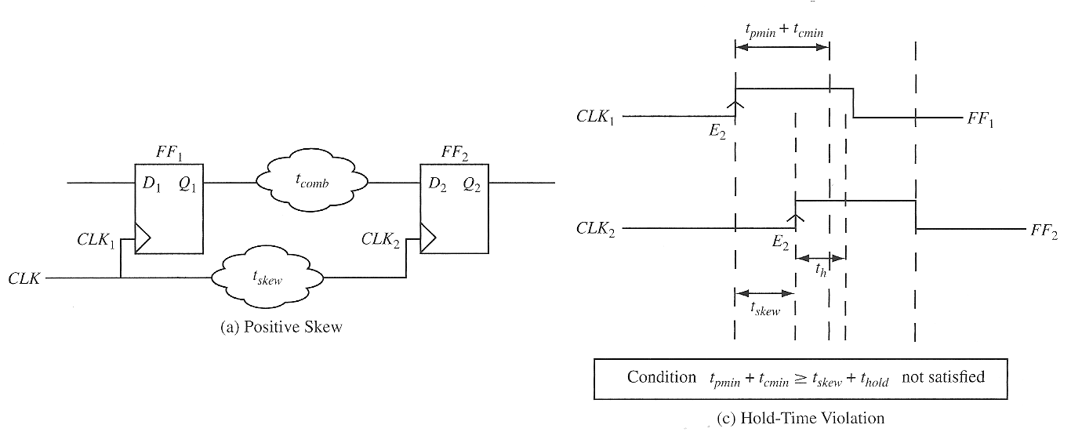
Positive Clock Skew – Hold Time

Slide 21
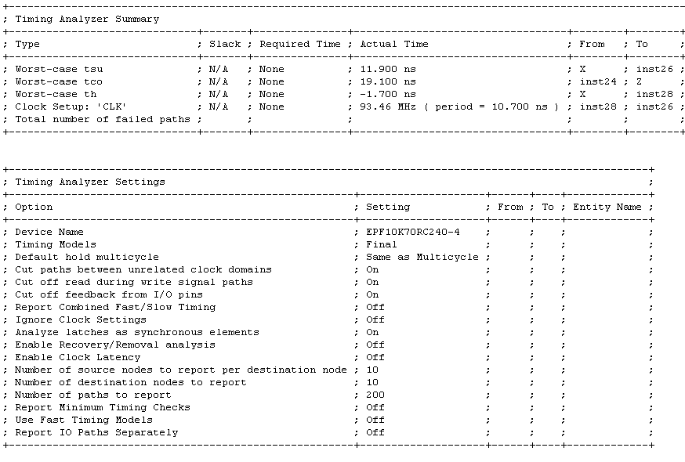
Timing Analysis Example

Slide 22
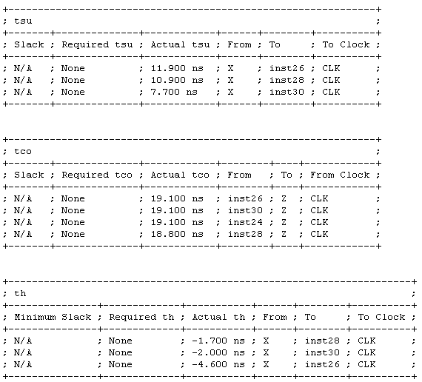
Setup/Combinational/Hold Time Report

Slide 23
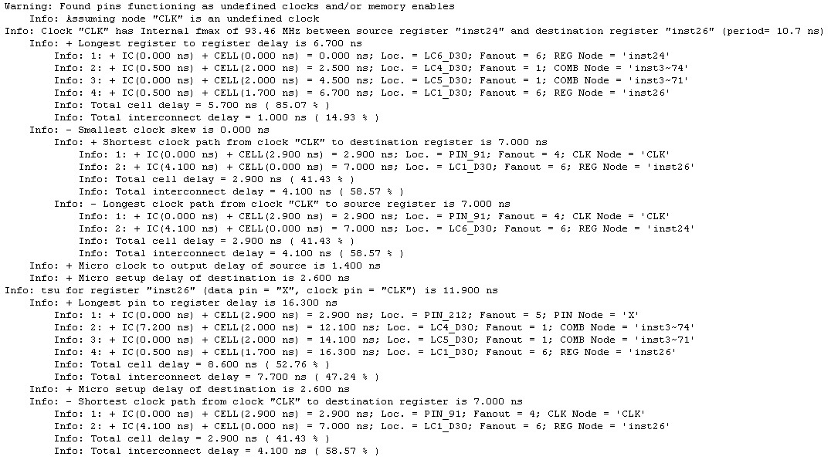

Slide 24
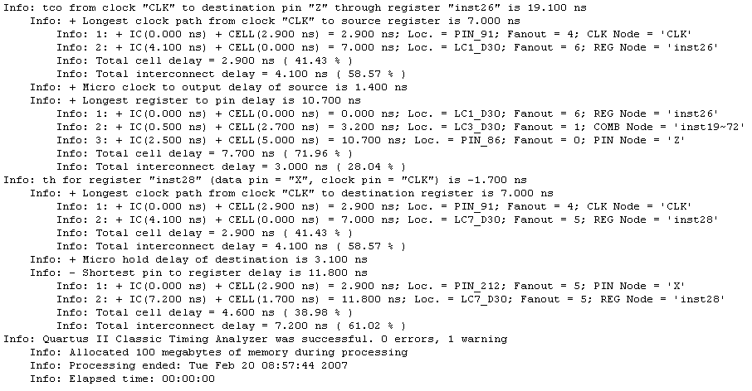

Slide 25
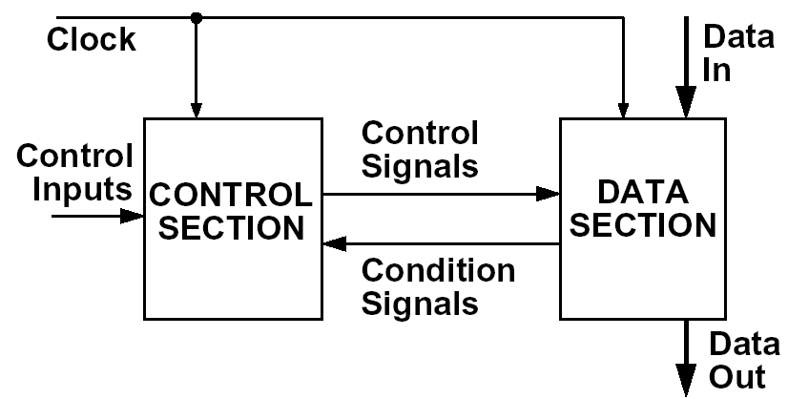
Synchronous Design
Use a clock to synchronize the operation of all flip-flops, registers, and counters in the system
  all changes occur immediately following the active clock edge
  clock period must be long enough so that all changes flip-flops, registers, counters will have time to stabilize before the next active clock edge
Typical design: Control section + Data Section

Slide 26
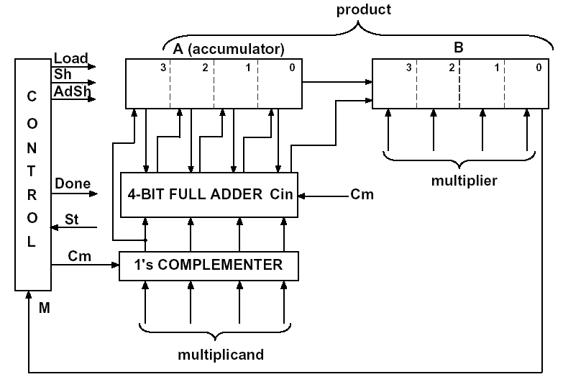
Example: Faster Multiplier
Move wires from the adder outputs one position to the right =>
add and shift can occur at the same clock cycle

Slide 27
Control Signal Timing Issues
Change in state of the flip-flops in control section determined by the propagation delay
Time control signals change depend upon this FF propagation delay and combination network delay
Glitches and spikes may occur in the control signals due to hazards in the network
Noise may be introduced on the control signals by changing signals in another part of the circuit
THIS MEANS THAT THERE IS A TIME INTERVAL AFTER THE ACTIVE EDGE OF THE CLOCK WHERE THE STATE OF THE CONTROL SIGNAL IS NOT KNOWN AND MAY NOT BE STABLE

Slide 28
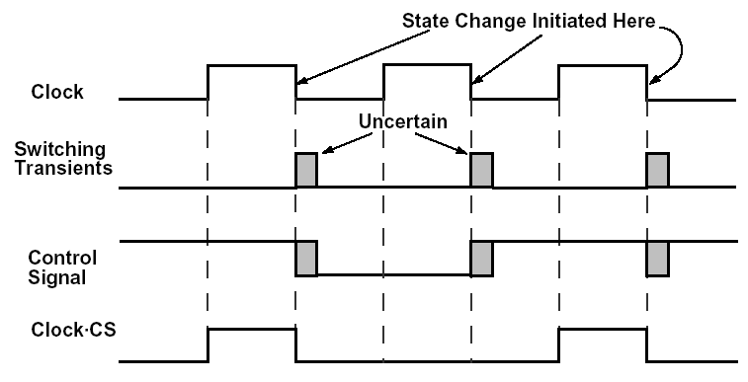
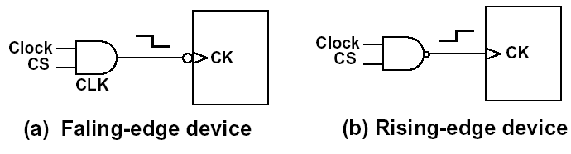
Timing Chart for System with
Falling-edge Devices

Slide 29
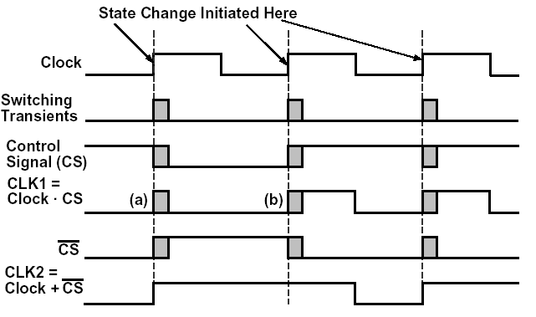
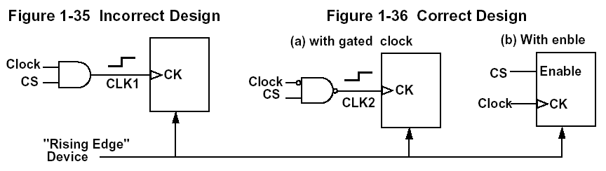
Timing Chart for System with
Rising-edge Devices

Slide 30
Metastability Issues
Metastability in digital systems can occur when the data input to a flip-flop is asynchronous to the clock, which can lead to setup or hold time violations.
  It can cause flip-flops to switch late or not at all.
  It can present a brief pulse at a flip-flop output (called a runt pulse) or cause flip-flop output oscillations.
  This can cause system failures
    Source: Xilinx Application notes: XAPP077 January, 1997

Slide 31
Metastability Issues
To ensure reliable operation, the input to a register must be stable for a minimum time before the clock edge (register setup time or tSU) and for a minimum time after the clock edge (register hold time or tH).
The register output then is available after a specified clock-to-output delay (tCO).
If a data signal transition violates a register’s tSU or tH requirements, the output of the register may go into a metastable state.
In a metastable state, the register output hovers at a value between the high and low states for some arbitrary period of time
This means the output transition to a defined high or low state is delayed beyond the specified tCO.
Source: Altera White paper, “Understanding Metastability FPGAs” http://www.altera.com/literature/wp/wp-01082-quartus-ii-metastability.pdf, 2009

Slide 32
Metastability Issues
Not every signal transition that violates a register’s tSU or tH results in a metastable output.
More often than not, these timing violations result in nondeterministic but stable output from the register.
The likelihood that a register enters a metastable state and the time required to return to a stable state vary depending on the process technology used to manufacture the device and on the operating conditions.

Slide 33
Metastability Issues
Metastability does not always cause a problem.
  If the data output signal resolves to a valid state before the next register captures the data, then the metastable signal does not negatively impact the system operation.
  But if the metastable signal does not resolve to a low or high state before it reaches the next design register, it can cause the system to fail.

Slide 34
Metastability Issues
In properly designed synchronous systems, the input signals must always meet the register timing requirements, so metastability does not occur.
Metastability can occur when
  When the input signal is an asynchronous signal.
  When the clock skew is too large (rise and fall time are more than the tolerable values).
  When interfacing two domains operating at two different frequencies or at the same frequency but with different phase.
  When the combinational delay is such that flip-flop data input changes in the critical window (setup or hold time window)
  Source: ASIC World, “What is Metastability”
  http://www.asic-world.com/tidbits/metastablity.html

Slide 35
Metastability Issues
In safety critical applications it may be necessary to quantify the risks involved.
  Mean Time Between Failures is the accepted metric

Slide 36
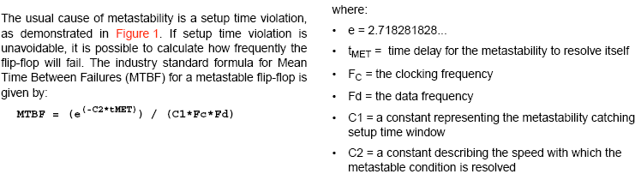
Determining if Metastability is a problem
MTBF Calculation

Slide 37
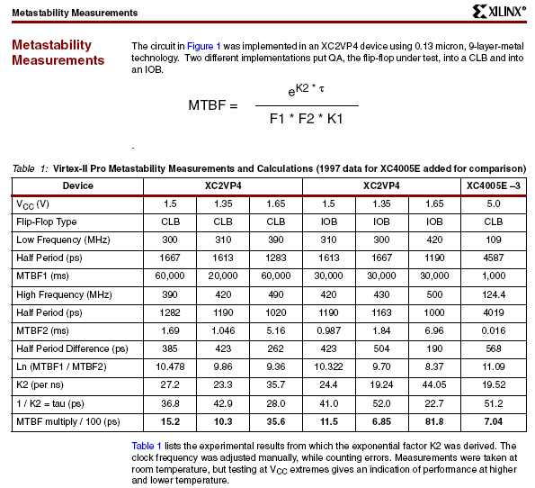

Slide 38
Tolerating Metastability
Method 1: Make sure the clock period is long enough to allow for the resolution of quasi-stable states and for the delay of whatever logic may be in the path to the next flip-flop.
Method 2: Add one or more successive synchronizing flip-flops to the synchronizer.
  This approach allows for an entire clock period (except for the setup time of the second flip-flop) for metastable events in the first synchronizing flip-flop to resolve themselves.
  Disadvantage added latency

Slide 39
Metastability Solutions
Neither of these approaches can guarantee that metastability cannot pass through the synchronizer; they simply reduce the probability to practical levels.

Slide 40
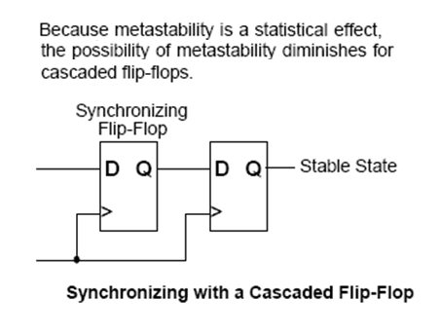
Cascaded Registers to Tolerate
Metastability (from Xilinx Literature)

Slide 41
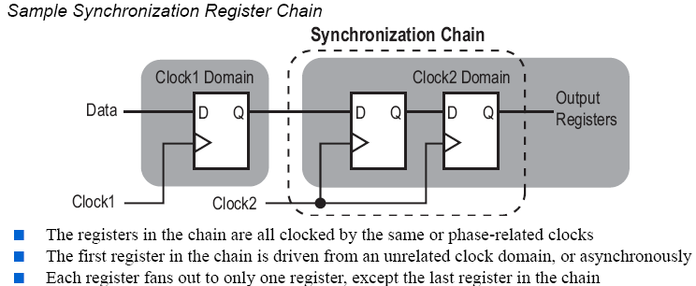
Cascaded Registers to Tolerate
Metastability (from Altera Literature)

Slide 42
Review: Principles of Synchronous Design
Method
  All clock inputs to flip-flops, registers, counters, etc.,
  are driven directly from the system clock or from the clock ANDed with a control signal
Result
  All state changes occur immediately following the active edge of the clock signal
Advantage
  All switching transients, switching noise, etc., occur between the clock pulses and have no effect on system performance

Slide 43
Review: Asynchronous Design
Disadvantage - More difficult
  Problems
    Race conditions: final state depends on the order in which variables change
    Hazards
  Special design techniques are needed to cope with races and hazards
Advantages = Disadvantages of Synchronous Design
  In high-speed synchronous design propagation delay in wiring is significant => clock signal must be carefully routed so that it reaches all devices at essentially same time
  Inputs are not synchronous with the clock –
  no need for synchronizers
  Clock cycle is determined by the worst-case delay

