Slide 1
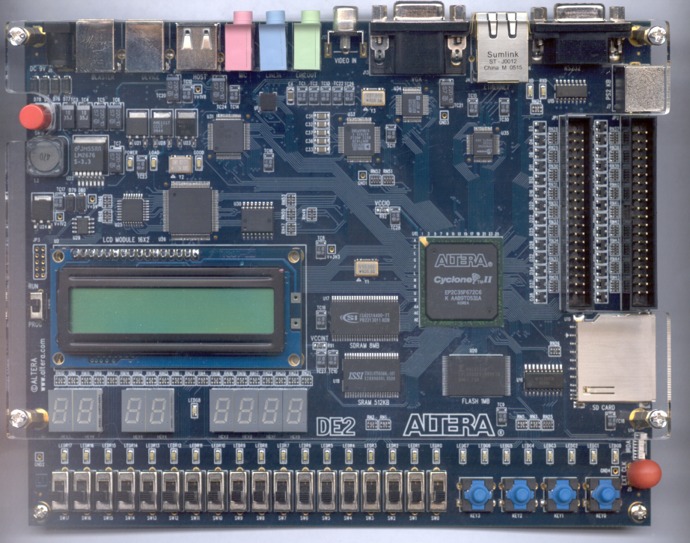
CPE 322
Digital Hardware Design Fundamentals
Electrical and Computer Engineering
UAH
Introduction to Verilog

Slide 2
Hardware Description Languages
Modeling Language that supports
  Design Entry
  Simulation
  Rapid Prototyping of Designs
  Synthesis (design creation)
Promotes top-down design methodologies
Promote the creation of technology independent Intellectual Property

Slide 3
Hardware Description Languages
Support modeling at different levels of abstraction:
  Structural (specifying interconnections of the gates)
  Dataflow (specifying design using Boolean Logic)
    Equations that specify output signals in terms of input signals.
  Behavioral (specifying high-level behavior)

Slide 4
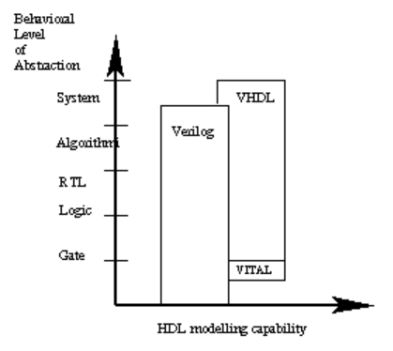
Common Modeling Constructs
http://www.angelfire.com/in/rajesh52/verilogvhdl.html

Slide 5
Verilog HDL Levels of Abstraction
Structural Design (hierarchal design approach)
Data Flow (equation based)
Behavioral Design (modeling using highly abstract language constructs)
Most often Verilog HDL models contain aspects of all three levels of abstraction!

Slide 6
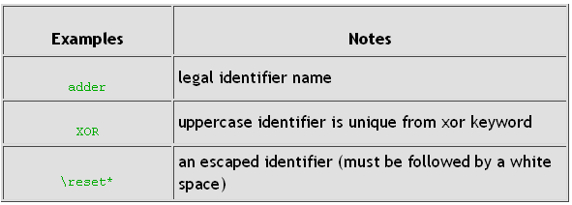
Names (Identifiers)
Must begin with alphabetic or underscore characters a-z A-Z _
May contain the characters a-z A-Z 0-9 _ and $
May use any character by escaping with a backslash ( \ ) at the beginning of the identifier, and terminating with a white space.

Slide 7
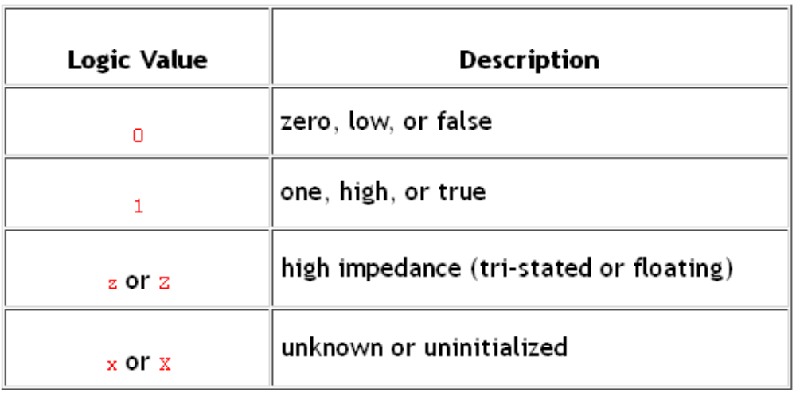
Verilog Logic Values
Verilog HDL support 4 Logic Values

Slide 8
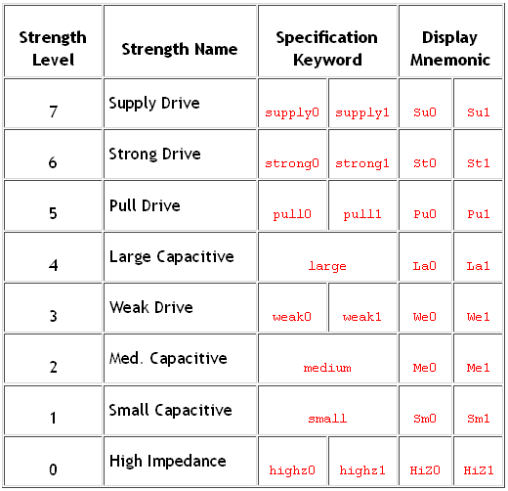
Verilog Logic Strengths
Verilog HLD has 8 strengths: 4 driving, 3 capacitive, and 1 high impedance (no strength)

Slide 9
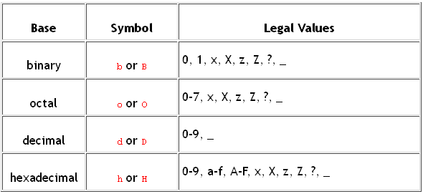
Integer Representation
size'base value – sized integer in the specified base
size -- number of bits in the number (optional)
‘base -- number of bits in the number (optional)
value
Notes: ? Is same as Z or z; _ (underscore) is ignored

Slide 10
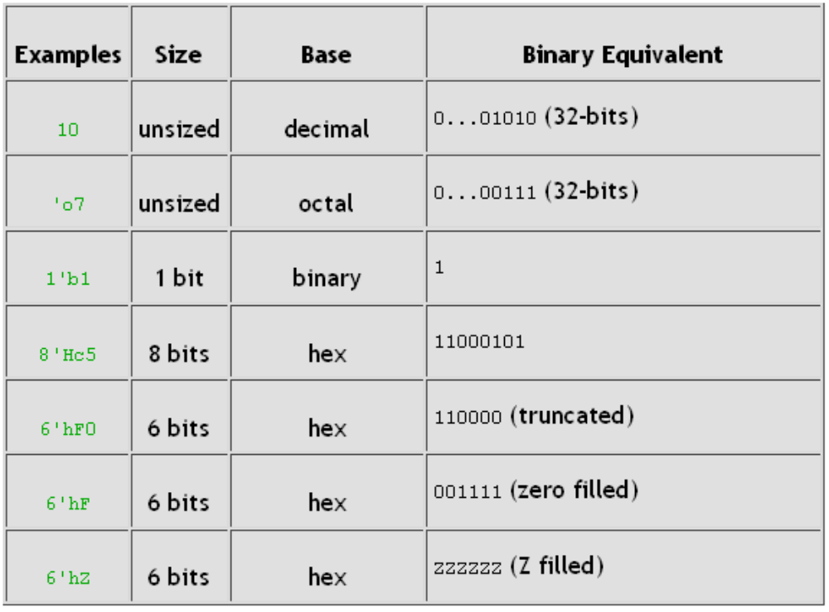
Integer Representation
(Examples)

Slide 11
Verilog Model Structure
module module_name (port list );
port declarations;
…
variable declaration;
…
description of behavior
endmodule
Systems are described as a set of modules
module module_name (port declarations and list);
…
variable declaration;
…
description of behavior
endmodule

Slide 12
Modules
Provides external interface to other modules and/or the outside world
  inputs, outputs, and inouts
Contains internal logic that performs the module’s function
Encapsulates the internal signals, logic, and sub-modules that are referenced by the module.

Slide 13
Verilog Signal Types
Two Main Types of Signals:
  “Wire” is a simple connection between two components
    Should have just one driver
    Value is not retained unless driven – i.e.no persistence
    Wire is the default if not specified in port declarations
      i.e. input x; is the same as input wire x;
  “Reg” stores its value until it is updated again
    Required in behavioral designs that have procedural statements

Slide 14
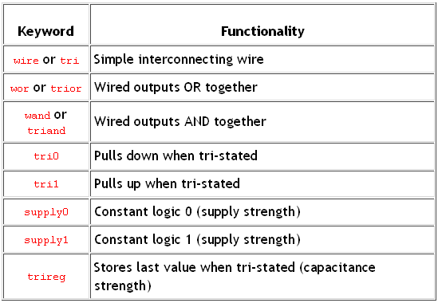
Verilog Net Data Types
The ‘wire’ type is an instance of the allowable net types.
The ‘wire’ type is of primary importance in this course.

Slide 15
Verilog Net Data Types
In general, Net data types are used to connect structural components together.
  They transfer both logic values and logic strengths.
  They must be used when
    A signal is driven by the output of some device.
    A signal is also declared as an input port or an inout port.
    A signal is on the LHS of a continuous assignment statement.

Slide 16
Structural Design
Structural Modeling is a hierarchal design approach that is analogous to schematic capture.
The design is partitioned into manageable hardware blocks that are called components.
Each subcomponent is modeled separately but can reside in the same file with other component modules.
Multiple instances of these subcomponents are then be incorporated into the module and interconnected together to create a more complex design.
The resulting design then becomes a component itself that can be used as one of the building blocks of an even more complex design.

Slide 17
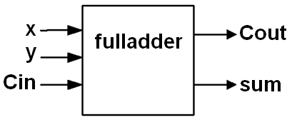
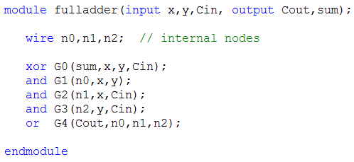
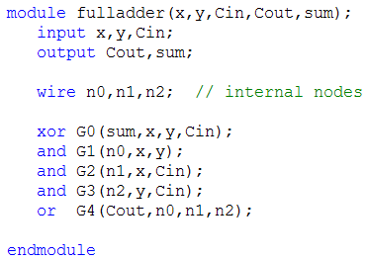
Lower-Level Component Model
(Structural Decomposition)
Full Adder Example

Slide 18

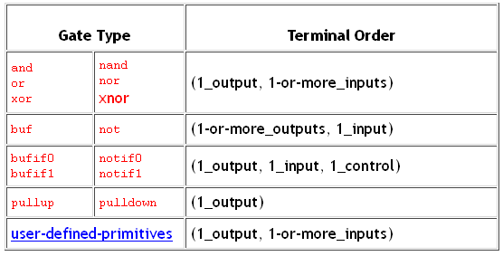
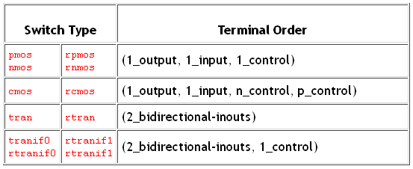
Verilog’s Built-in Primitives

Slide 19
Structural Design
Components are individually modeled as a separate modules
A new module is then created that contains this set of components.
Subcomponent modules are “wired” together by connecting by interconnecting them together using actual signals.
  The input and output signals of the components (component port names) are called formal signals
Instances of a subcomponent module are made by specifying the component type, instance name, and port/signal association paramters.
Either Port Order or Port Name association is used to bind the component I/0 port formal signals to the modules own internal actual signals.

Slide 20
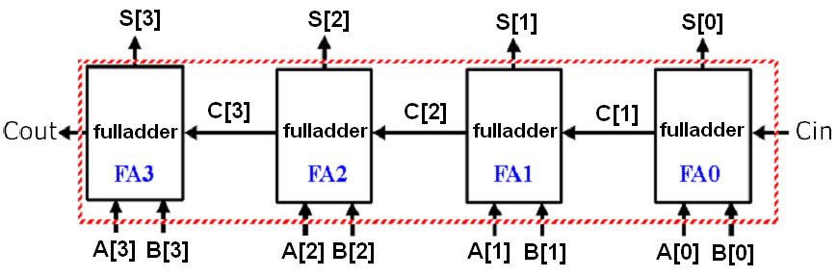
4-bit Adder

Slide 21
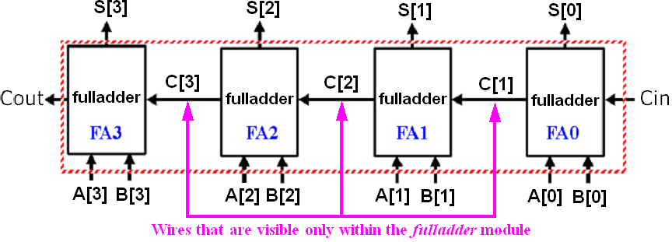
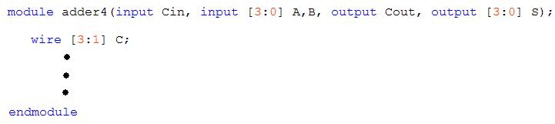
4-bit Adder (cont’d)

Slide 22
Structural Design
Model Instance Port Order Association
The actual signals in the model instance statement must be placed in the same positions as the corresponding formal signals were listed in the component declaration.
  module_name instance_name(signal, signal, ... );
This is the method most often referenced in the textbook.

Slide 23
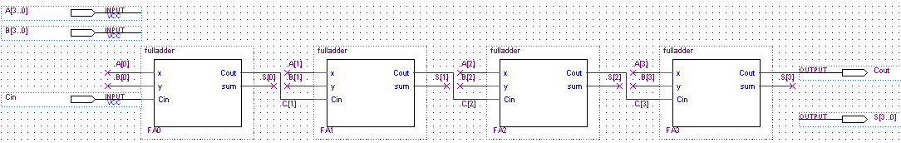
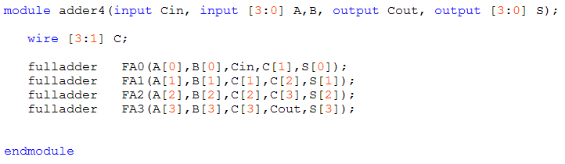
4-bit Adder (cont’d)
(port order association method)
Note: actual signals must be placed in exactly the same positions in the model instance statement as the corresponding formal signals were listed in the component’s model declaration.

Slide 24
Structural Design
Module Instance Port Name Association
The formal signals are those inputs/outputs/or inout signals that are in the port declarations of the given submodule.
These signals must be liked (wired) to the actual signals in the current module.
  This is done during component instantiation using the . operator that proceeds the formal signal name and then encapsulating the actual signal name in parenthesis in the component instantiation,
  module_name instance_name(.port_name(signal), .port_name(signal), ... );

Slide 25
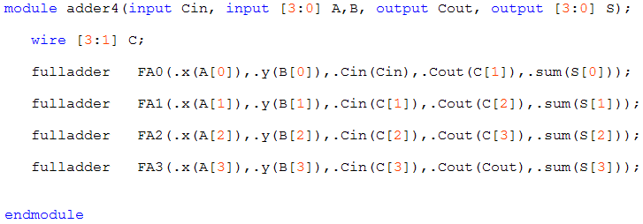
4-bit Adder Structural Design
(port signal name association method)
It does not matter the order that these signals are placed in the port map statement.
More intuitive for many and less error prone.

Slide 26
Data Flow
Method primarily employs RTL (register transfer language) Boolean Equations to describe the functionality of the design
Method is suitable to model both combinational (memory-less) and sequential logic
Represents a relatively low level of abstraction. Complexity is very high for complex designs.
Can be combined with structural methodologies to incorporate a hierarchy that will aid in managing this complexity.

Slide 27
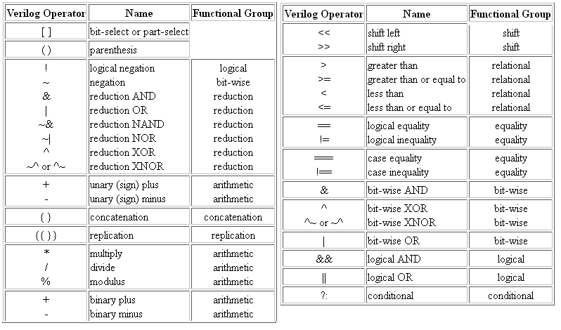
Verilog Operators

Slide 28
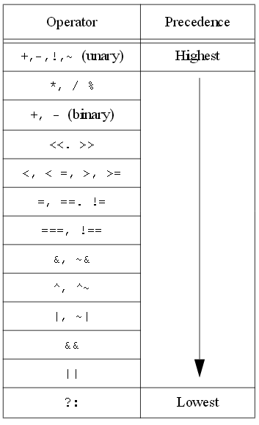
Verilog Operators Order of Precedence

Slide 29
Continuous Assignment Statements
(Implicit form)
net_declaration = expression;
  Example:
    wire sum = x ^ y ^ Cin;

Slide 30
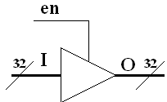
Continuous Assignment Statements
(Explicit form)
  Format: assign net = expression;
  Can use conditional operator ?
    <condition> ? <if true> : <else>;
      If the Condition is true, the value of <if true> will be taken, otherwise the value of <else> will be taken.
      Example:
      assign O = en ? I : 32'bz;

Slide 31
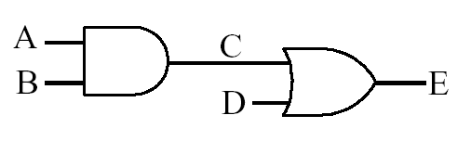
Data Flow Representation
  Continuous Assignment Statements
  assign C = A & B;
  assign E = C | D;
  Order of continuous assignment statements is not important
  assign C = A & B;
  assign E = C | D;
These signal are assumed to be evaluated by the Verilog HDL circuit synthesizer or simulator concurrently.

Slide 32
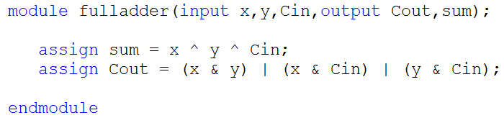
Low-Level Component Model
(Data Flow Example)
Full Adder Example

Slide 33
Behavioral Modeling using
Procedural Constructs
Two Procedural Constructs
  initial Statement
  always Statement
initial Statement : Executes only once
always Statement : Executes in a loop
Example:
  …
  initial begin
  Sum = 0;
  Carry = 0;
  end
  …
  …
  always @(A or B) begin
  Sum = A ^ B;
  Carry = A & B;
  end
  …

Slide 34
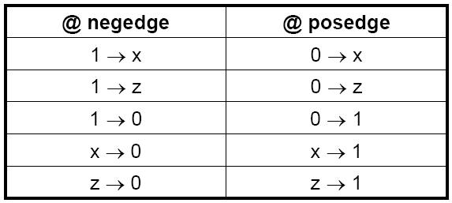
Event Control
Event Control
  Edge Triggered Event Control
  Level Triggered Event Control
Edge Triggered Event Control
  @ (posedge CLK) //Positive Edge of CLK
  Curr_State = Next_state;
Level Triggered Event Control
  @ (A or B) //change in values of A or B
  Out = A & B;

Slide 35
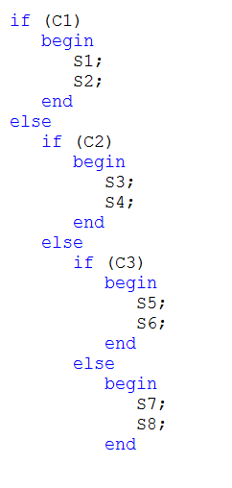
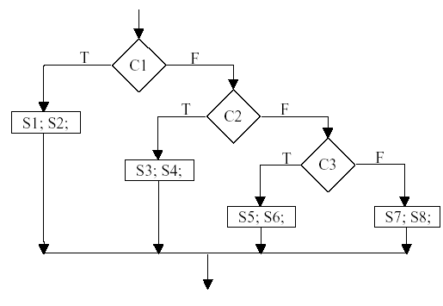
IF Statements in Verilog HDL

Slide 36
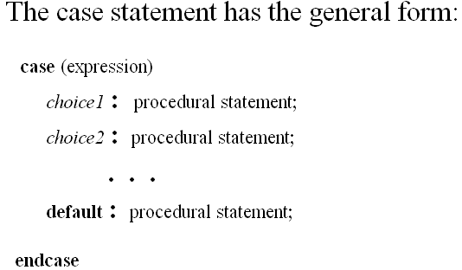
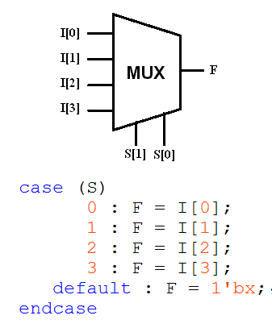
Case Statement in Verilog HDL

Slide 37
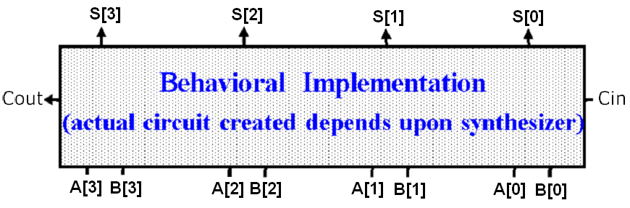
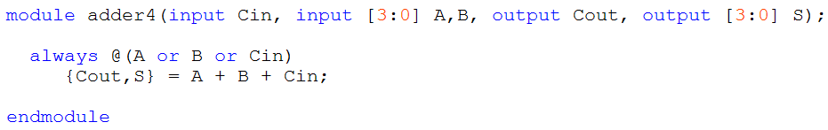
Behavioral Implementation

