Slide 1
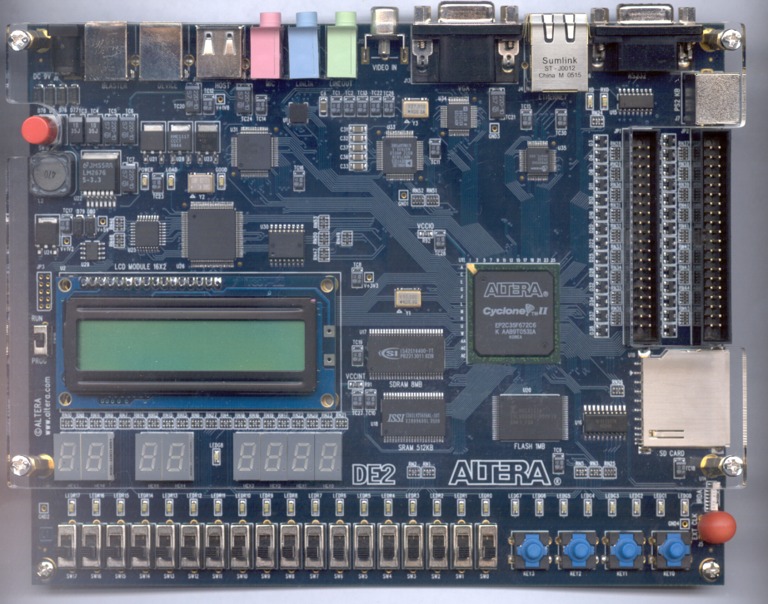
CPE 322 Fundamentals of Hardware Design
Electrical and Computer Engineering
University of Alabama in Huntsville
Hardware Testing and Design For Testability Issues
Hardware/Software Co-Design and General Trade-offs

Slide 2
Hardware Testing and
Design for Testability
Testing during design process
  use Verilog HDL test benches to verify that
  the overall design and algorithms used are correct
  verify timing and logic after the synthesis
Post-fabrication testing
  when a digital system is manufactured,
  test to verify that it is free from manufacturing defects
  today, cost of testing is major component of the manufacturing cost
  efficient techniques are needed to test and
  design digital systems so that they are easy to test

Slide 3
Testing Combinational Logic
Common types of errors
  short circuit
  open circuit
If the input to a gate is shorted to ground,
the input acts as if it is stuck at logic 0
  s-a-0 (stuck-at-0) faults
If the input to a gate is shorted to positive supply voltage, the input acts as if it is stuck at logic 1
  s-a-1 (stuck-at-1) faults

Slide 4
Stuck-at Faults
How many single stuck-at faults —
  2 (n + 1) — where n is the number of inputs
We will assume
  that there is only one stuck-at-fault active at a time
  in the whole circuit
  “SSF” — single stuck-at fault
s-a-1
s-a-0
s-a-1
s-a-1
s-a-0
s-a-0

Slide 5
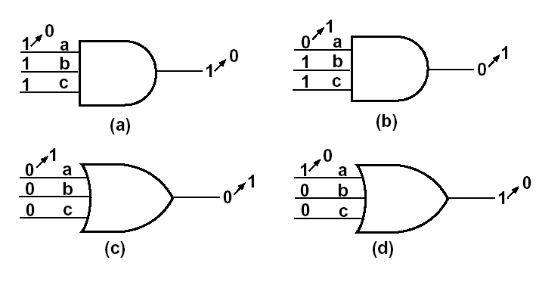
Stuck-at Faults for AND and OR gates
Test a
for s-a-1
Test a
for s-a-0
Test a
for s-a-1
Test a
for s-a-0

Slide 6
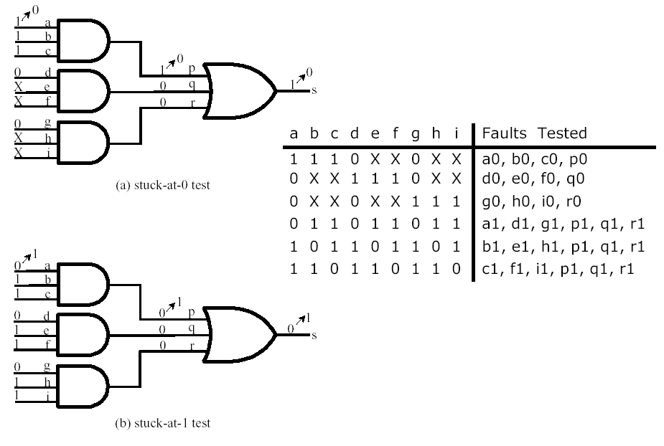
Testing an AND-OR Network
BRUTE-FORCE testing:
apply 2⁹=512 different input combinations and check the output

Slide 7
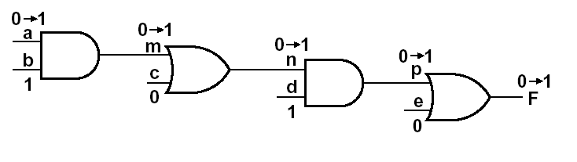
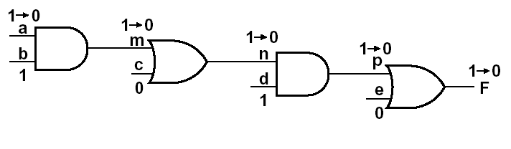
Path Detection & Sensitization: Small Example
Test n to s-a-1
n=0 =>
m=0, c = 0 =>
a=0, b=1, c=0
d=1, e=0
Change a to 1 =>
We can test a, m, n, or p to s-a-0
Testing internal faults:
choose a set of inputs that will excite the fault and
then propagate the fault to the network output

Slide 8
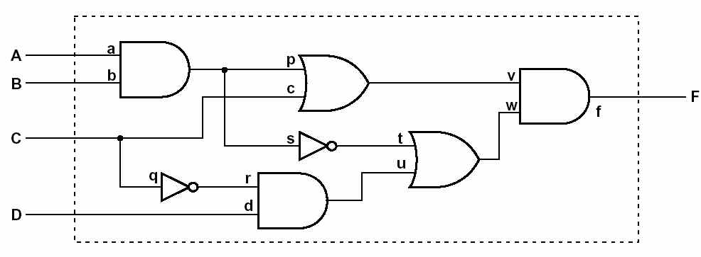
An Example
What is a minimum set of test vectors to test the network below for all stuck-at-1 and stuck-at-0 faults?
E.g., start with A-a-p-v-f-F path, determine the test vector to test s-a-0
determine the list of faults covered
select an untested fault, determine the required ABCD inputs
determine the additional faults tested
repeat the process until all faults are covered

Slide 9
An Example (cont’d)
 | 0 | 1
a | + | &
b | + | *
c | * | &
d | + | %
p | + | *
q | # | +
r | + | #
s | # | *
t | * | #
u | + | #
v | + | &
w | + | #
f | + | #
Step 1: A-a-p-v-f-F, s-a-0
  ABCD: 1101 (+)
Step 2: s-a-0 for c
  C=1, p=0, w=1 => ABCD=1011 (*)
Step 3: s-a-0 for q
  C=1, D=1, t=0, s=1 => ABCD=1111 (#)
Step 4: s-a-1 for a
  A=0, B=1, C=0, D=1 => ABCD=0101 (&)
Step 5: s-a-1 for d (%)
  D=0, C =0, t=1 => ABCD = 1100

Slide 10
Testing Sequential Logic
In general, much more difficult than testing combinational logic since we must use sequences of inputs
  typically we can observe inputs and outputs,
  not the state of flip-flops
  assume the reset input,
  so we can reset the network to the initial state
Test procedure
  reset the network to the initial state
  apply a test sequence and observe the output sequence
  if the output is correct, repeat the test for another sequence
How many test sequences do we have?
  how do we test that the initial state of the network under test is equivalent to the initial state of the correct network?
  what is the sequence length?

Slide 11
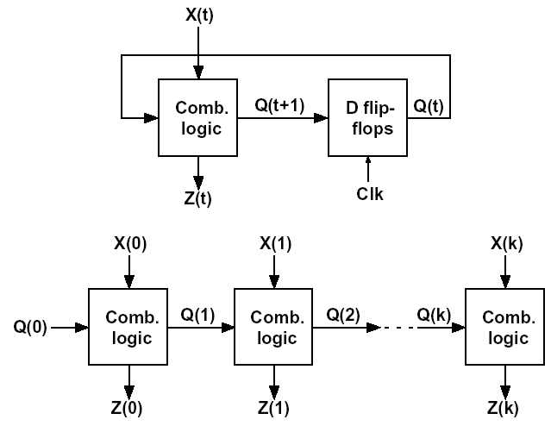
Testing Sequential Logic (cont’d)
In practice, if the network has N or fewer states, then apply only input sequences of length less than or equal 2N-1
Example
  consider a network which includes 5 inputs, 1 output, and 4 states
  total number of test sequences: (2⁵)⁷ = 2³⁵ => infeasible (!)
  derive a small set of test sequences that will adequately test a SN

Slide 12
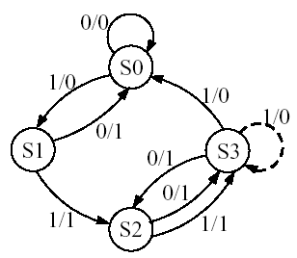
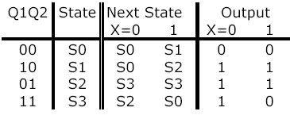
Testing Sequential Logic (cont’d)
Consider input sequence
  X = 0 1 0 1 1 0 0 1 1
  Output sequence
  Z = 0 0 1 0 1 1 1 1 0
  If we change the network
  S3->S0 => S3->S3,
  the output sequence
  will be the same
Find distinguishing sequence
  an input sequence that will distinguish each state from the other states
Input sequence: X=11
S0: Z = 01
S1: Z = 11
S2: Z = 10
S3: Z = 00
UAH-CPE/EE 422/522 ©AM

Slide 13
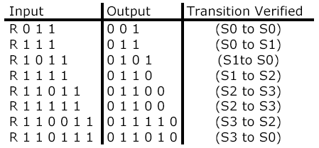
Testing Sequential Logic (cont’d)
Verify each entry in the table using the following sequences:
UAH-CPE/EE 422/522 ©AM

Slide 14
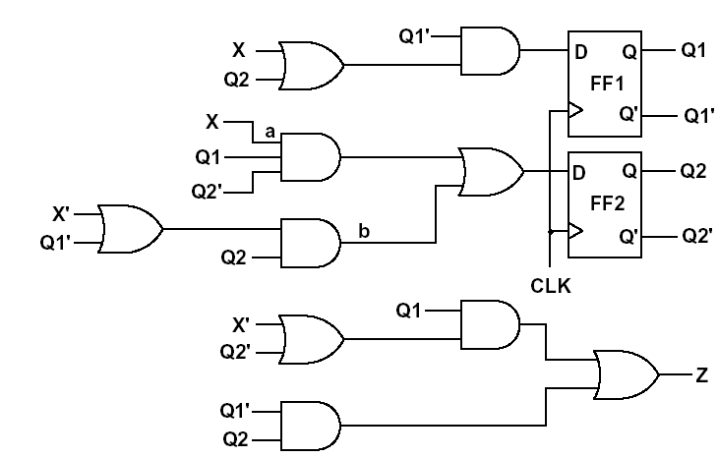
Testing Sequential Logic (cont’d)
Implementation of the FSM
  S0=00, S1=10, S2=01, S3=11
Test a for s-a-1
  to do this Q1Q2 must be 10
  => go to the state S1 and
  then set X to 0 (R10)
  in normal operation,
  the next state will be S0;
  if a is s-a-1 then next state is S2
  distinguish the state (S0 or S2);
  apply sequence 11
  Final sequence: R1011
  Normal output: 0101
  Faulty output: 0110
UAH-CPE/EE 422/522 ©AM

Slide 15
Scan Testing
Testing of sequential networks is greatly simplified if we can observe the state of all the flip-flops instead of just observing the network outputs
  Connect the output of each flip-flop to one of the IC pins?
  Arrange flip-flops to form a shift register =>
  shift out the state of flip-flops bit by bit using
  a single serial output pin => Scan path testing
UAH-CPE/EE 422/522 ©AM

Slide 16
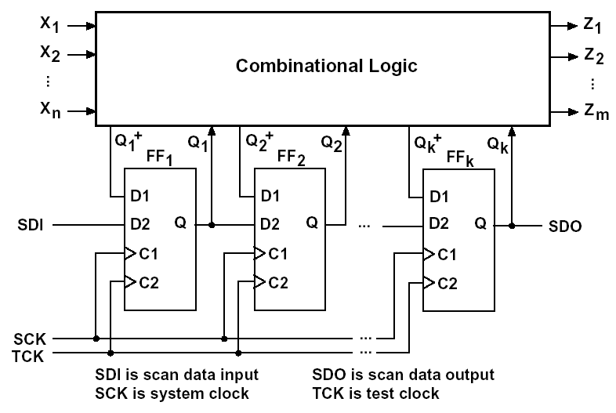
Scan Path Testing
Sequential network is separated into a combinational logic part and a state register composed of flip-flops
Two ports FFs
(2 D inputs and 2 clock inputs)
  D1 is stored in the FF on C1 pulse
  D2 is stored in the FF on C2 pulse
  Q of each FF is connected to D2 of the next FF to form a shift register
UAH-CPE/EE 422/522 ©AM

Slide 17
Scan Path Testing
Normal operation
  system clock SCK = C1
  inputs: X₁X₂...X_{N}
  outputs: Z₁Z₂...Z_{N}
Testing
  FFs are set to a specified state using the SDI and TCK
  test vector is applied X₁X₂...X_{N}
  outputs Z₁Z₂...Z_{N} are verified
  SCK is pulsed to take the network to the next state
  next state is verified by pulsing the TCK to shift the state code out of the scan register via SDO
UAH-CPE/EE 422/522 ©AM

Slide 18
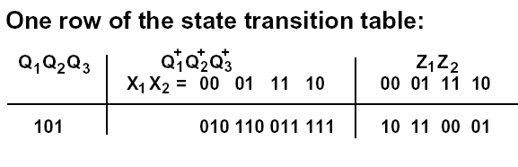
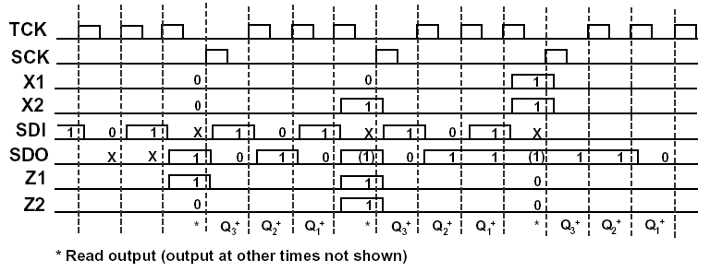
Scan Path Testing: An Example
SQ: X₁X₂, Q₁Q₂Q₃, Z₁Z₂
UAH-CPE/EE 422/522 ©AM

Slide 19
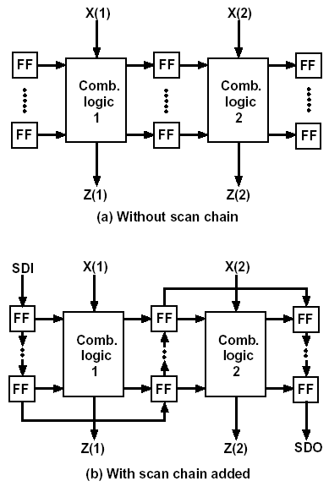
Scan Chain
UAH-CPE/EE 422/522 ©AM

Slide 20
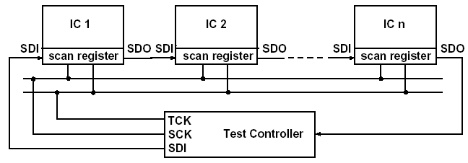
Scan Test with Multiple ICs
UAH-CPE/EE 422/522 ©AM

Slide 21
Boundary Scan
PCB testing has become more difficult
  ICs have become more complex, with more and more pins
  PCBs have become more denser with multiple layers and fine traces
  Bed-of-nails testing
    use sharp probes to contact the traces on the board
    test data are applied to and read from various ICs
    => not practical for high-density PCBs with fine traces and complex ICs
Boundary scan test methodology:
introduced to facilitate the testing of complex PC boards
  developed by JTAG (Joint Task Action Group)
  adopted as ANSI/IEEE Standard 1149.1 –
  “Standard Test Access Port and Boundary Scan Architecture”
  IC manufacturers make ICs that conform the standard
  ICs can be linked together on a PCB, so that they can be tested using only a few pins on the PCB edge connector
UAH-CPE/EE 422/522 ©AM

Slide 22
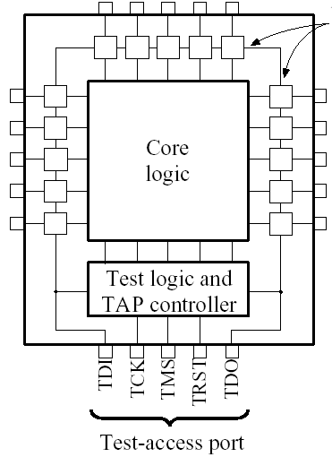
Boundary Scan Register
Boundary Scan Register (BSR) – cells of the BSR are placed between input or output pins and the internal core logic
Four or five pins of the IC are devoted to the test-access-port (TAP)
Boundary scan cells
TAP pins
TDI – Test data input
(data are shifted serially into the BSR)
TCK – Test clock
TMS – Test mode select
TDO – Test data output (serial output from BSR)
TRST – Test reset
(resets the TAP controller and test logic – optional pin)
UAH-CPE/EE 422/522 ©AM

Slide 23
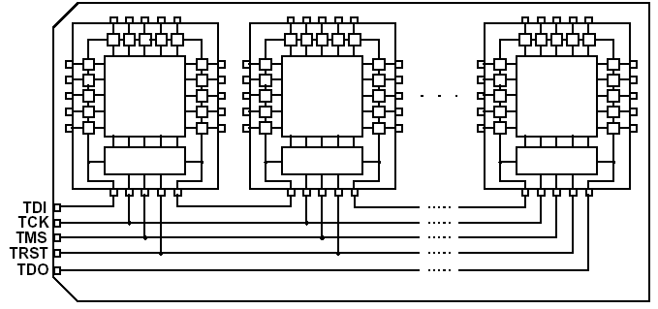
PCB with Boundary Scan ICs
BSRs in the ICs are linked together serially in a single chain with input TDI and output TDO.
TCK, TMS, TRST are connected in parallel to all of the ICs.
UAH-CPE/EE 422/522 ©AM

Slide 24
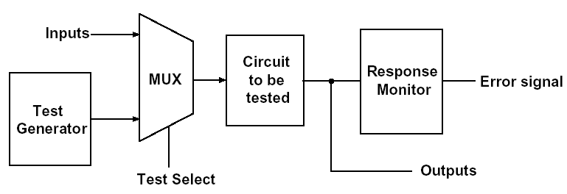
Built-In Self-Test
Add logic to the IC so that it can test itself
  Built-In Self-Test – BIST
Using BIST
  when test mode is selected by the test-select signal,
  an on-chip test generator applies test patterns
  to the circuit under test
  the resulting outputs are observed by the response monitor,
  which produces an error signal if an incorrect output is detected
Generic BIST Scheme
UAH-CPE/EE 422/522 ©AM

Slide 25
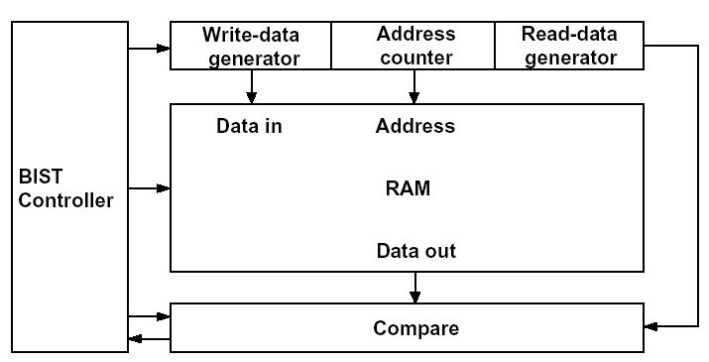
Self-Test Circuit for RAM
UAH-CPE/EE 422/522 ©AM

Slide 26
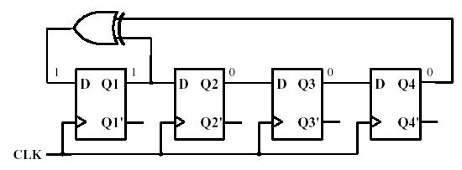
Linear Feedback Shift Registers (LFSR)
UAH-CPE/EE 422/522 ©AM

Slide 27
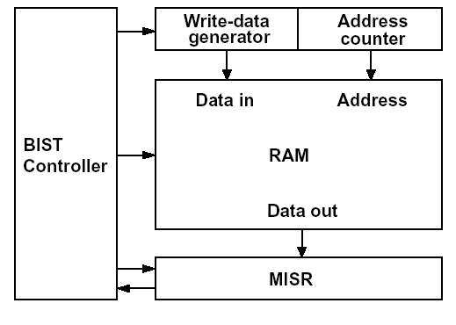
Self-Test Circuit for RAM with Signature Regs
MISR – Multiple Input
Signature Register
E.g. for MISR –form a check-sum by adding up all data bytes stored in the RAM
UAH-CPE/EE 422/522 ©AM

Slide 28
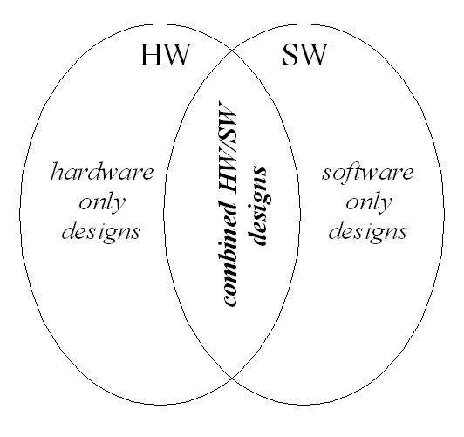
Hardware/Software Design Space Continuum

Slide 29
Hardware/Software Trade-offs
Performance of hardware for a given function can be much faster than a software implementation because
  There is little or no instruction fetch overhead like there is in a traditional instruction set processor
  It can make use of the available fine grain concurrency and execute many operations in parallel
Software is better suited for irregularly-structured control structures
Traditionally software was considered to be more flexible and field upgradable when compared to hardware
  FPGA’s blures this distinction though

Slide 30
Hardware/Software Trade-offs
Cost of implementing a function in hardware is usually much greater than implementing the same function in software
  Requires additional chip area in an Application Specific Integrated Circuit or board area in a PC board or reconfigurable logic area in an FPGA.
  Usually takes more time to create a hardware design than a software one
Both hardware and software resources are limited but hardware resources tend to have tighter limits and should be reserved for elements that have the greatest effect on the performance (or possibly other important constraints such as reliability)

Slide 31
Hardware/Software Trade-offs
Both hardware and software solutions allow for reduced energy consumption
  Dynamic and Static Voltage Frequency Scaling, DVFS
  Dynamic power management
  Power gating with retention modes
  Clock Gating (single and multi-level)
Specific hardware energy consumption strategies can be applied at a finer grain which can result in extremely low power consumption for custom hardware.
These features are also often dynamically controllable by software at a courser grain using commercially available hardware for much less cost.

Slide 32
Differences between ISP Programming and FPGA Reconfiguration
Instruction Set Processors, ISPs, such as microcontrollers, allow you to change the program or programs that execute in one or more thread control units.
FPGAs and other reconfigurable hardware devices allow you to reconfigure both the control units and the data paths of the device.
In both cases this allows one to increase the usability of the devices involved.
The allowable number of configurations is much smaller for an ISP when compared to an FPGA but the size of the program (reconfiguration information) is also much smaller!

Slide 33
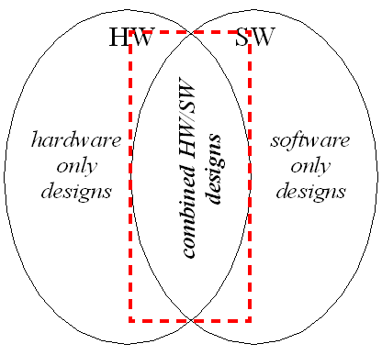
Embedded Systems
  Application-specific systems which contain hardware and software tailored for a particular task
  Generally part of a larger system
  Responds to external inputs and drives external outputs
  Often must respond in real-time
  Must adhere to strict area (footprint), performance, and power consumption constraints

Slide 34
Embedded Systems Examples
  Automotive: Anti-lock breaks, engine control, dynamic ride control, engine diagnostics
  Consumer Electronics: cameras, DVD Controllers, Microwave Ovens, Toasters, Refrigerators, Washers, Smart Card Controllers, RFID systems, Stand Alone GPS systems, TV remote controller, landline telephones, smart scales,
  Industrial Process Controllers: motor control systems , electronic data acquisition and supervisory control, automated laboratory instrument control
  Computer Peripherals: printers, external disk controllers, FAX controllers
  Cell Phones and Peripherals: wireless headsets, wifi bridging devices
  Medical Applications: ECG display and diagnostics, blood cell recorder/ analyzer, patient monitor system
  Network Systems: Routers, network switches, external firewalls

Slide 35
Traditional HW/SW Design Process
  System requirements are developed and then analyzed to determine the “level” of technology required to fulfill these needs.
  Hardware and software teams then independently develop their designs
    combining of design efforts occur late in the development cycle during the first prototype testing.
  Often leads to a generalized hardware platform being selected and all specialization occurring in the software.

Slide 36
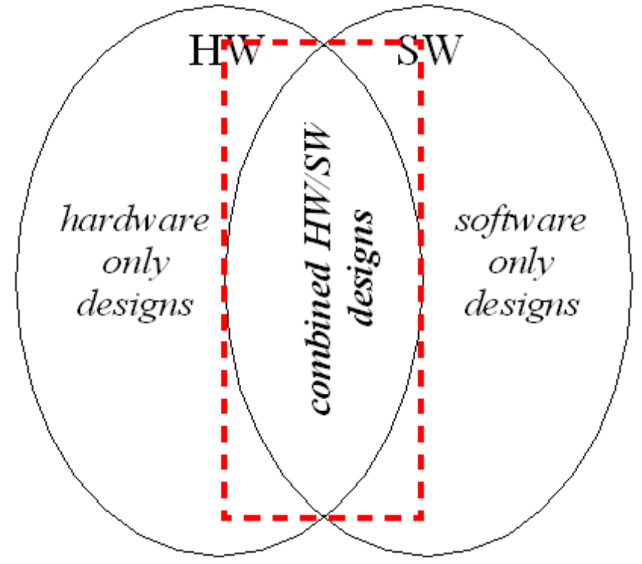
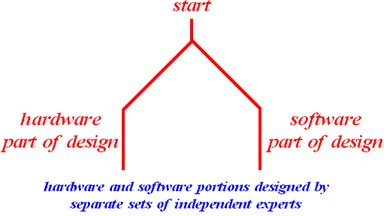
Traditional HW/SW Design Process
UAH-CPE/EE 422/522 ©AM

Slide 37
Hardware/Software Co-Design
Meeting system level objectives by exploiting the synergism of hardware and software through their concurrent design.
"Hardware/Software Co-Design", Giovanni De Micheli, and Rajesh K. Gupta, Readings in Hardware/Software Codesign Academic Press, 2002

Slide 38
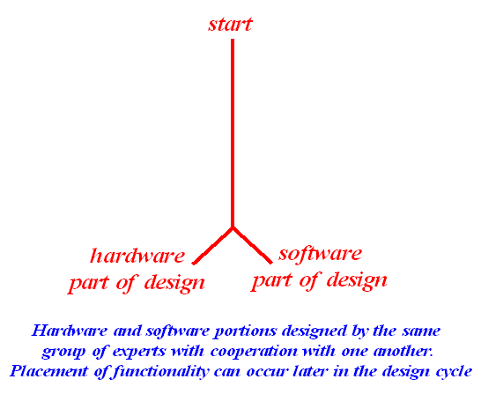
Hardware/Software Codesign

Slide 39
Hardware/Software Co-Design
Meeting system level objectives by exploiting the synergism of hardware and software through their concurrent design.
"Hardware/Software Co-Design", Giovanni De Micheli, and Rajesh K. Gupta, Readings in Hardware/Software Codesign Academic Press, 2002

Slide 40
Hardware/Software Co-Design
Design Flow for HW/SW Co-Design
specification
modeling
design space exploration and partitioning
synthesis and optimization
validation
implementation

Slide 41
Hardware/Software Co-Design
System
Description
Modeling
HW/SW
Partitioning
Unified representation
Software
synthesis
Interface
synthesis
Hardware
synthesis
System
integration
Instruction set level
HW/SW evaluation

