Slide 1
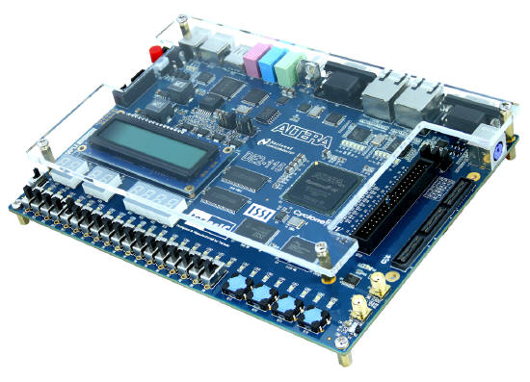
CPE 322
Digital Hardware Design Fundamentals
Electrical and Computer Engineering
Finite State Machine Representation & Verilog

Slide 2

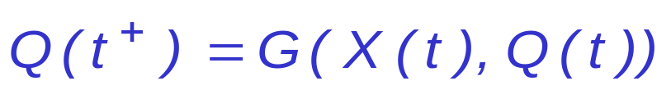
Sequential Networks
Have memory (state)
  Present state depends not only on the current input,
  but also on all previous inputs (history)
  Future state depends on the current input and state
X = x₁ x₂... x_{n}
Q = Q₁ Q₂... Q_{k}
Z = z₁ z₂... z_{m}
x₁
z₁
x₂
z₂
Q
Flip-flops are commonly used as storage devices:
D-FF, JK-FF, T-FF
x_{n}
z_{m}

Slide 3
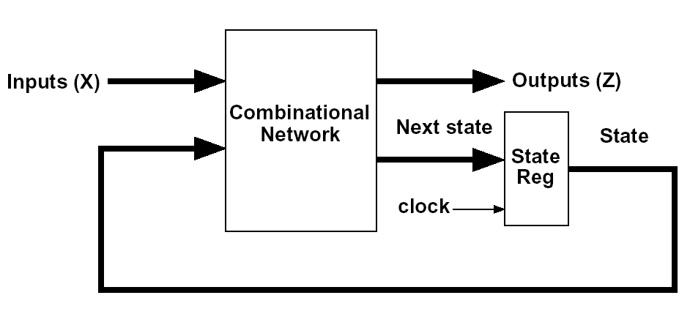
Mealy Sequential Networks
General model of Mealy Sequential Network
(1) X inputs are changed to a new value
After a delay, the Z outputs and next state appear at the output of CM
  (input of State Register)
(3) The next state is clocked into the state register and the state changes

Slide 4
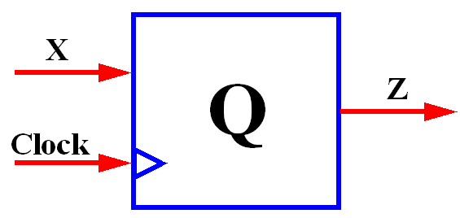
An Example: 8421 BCD to Excess3 BCD Code Converter
X (inputs) |  |  |  | Z (outputs)
t3 | t2 | t1 | t0 | t3 | t2 | t1 | t0
0 | 0 | 0 | 0 | 0 | 0 | 1 | 1
0 | 0 | 0 | 1 | 0 | 1 | 0 | 0
0 | 0 | 1 | 0 | 0 | 1 | 0 | 1
0 | 0 | 1 | 1 | 0 | 1 | 1 | 0
0 | 1 | 0 | 0 | 0 | 1 | 1 | 1
0 | 1 | 0 | 1 | 1 | 0 | 0 | 0
0 | 1 | 1 | 0 | 1 | 0 | 0 | 1
0 | 1 | 1 | 1 | 1 | 0 | 1 | 0
1 | 0 | 0 | 0 | 1 | 0 | 1 | 1
1 | 0 | 0 | 1 | 1 | 1 | 0 | 0

Slide 5
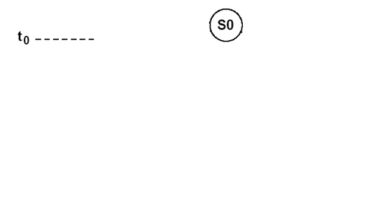
State Graph
BCD to Exess3 Code Converter

Slide 6
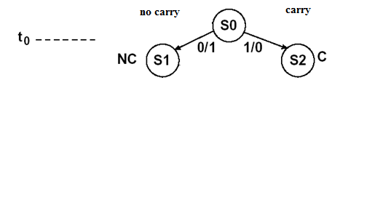
State Graph
BCD to Exess3 Code Converter

Slide 7
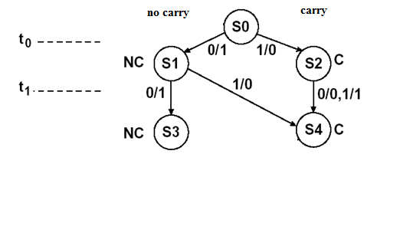
State Graph
BCD to Exess3 Code Converter

Slide 8
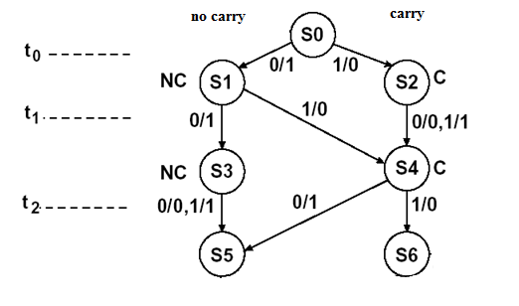
State Graph
BCD to Exess3 Code Converter

Slide 9
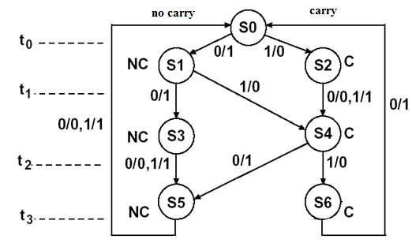
State Graph
BCD to Exess3 Code Converter

Slide 10
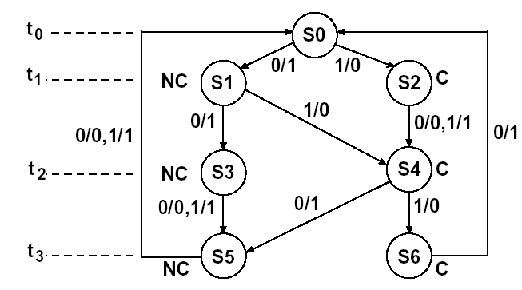
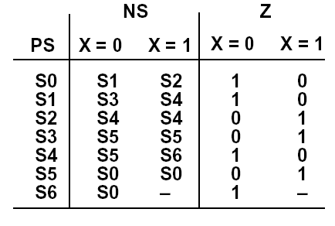
State Graph and Table for
BCD to Exess3 Code Converter

Slide 11
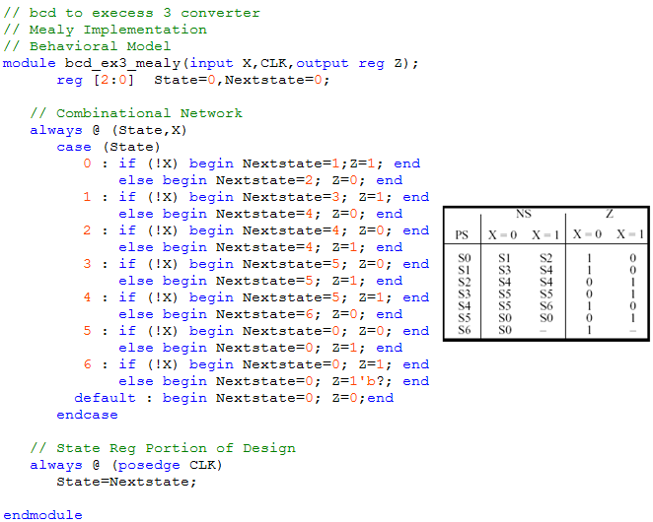
Behavioral Verilog HDL Model
8421 BCD to Excess3 Code Converter (Mealy FSM)
Two always sections:
  the first represents the combinational network;
  the second represents
  the state register

Slide 12
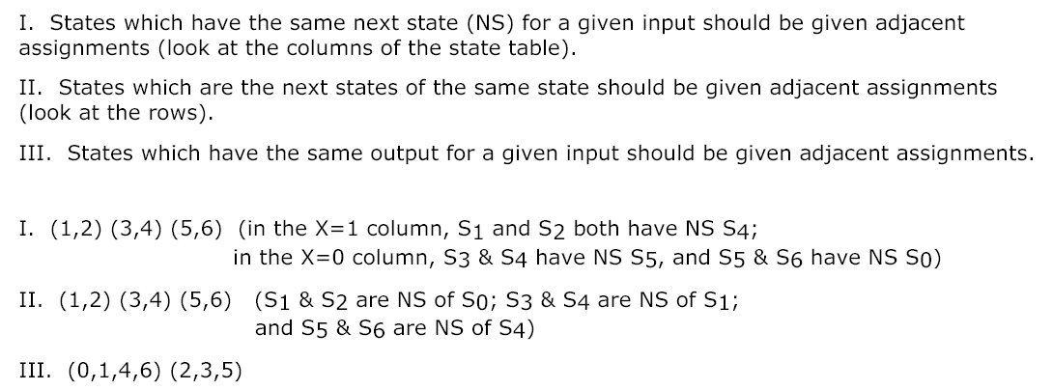
State Assignment Rules

Slide 13
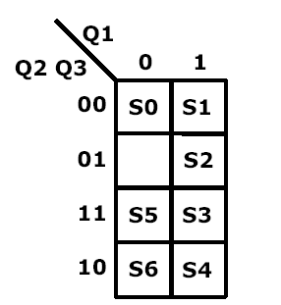
State Assignment Rules

Slide 14
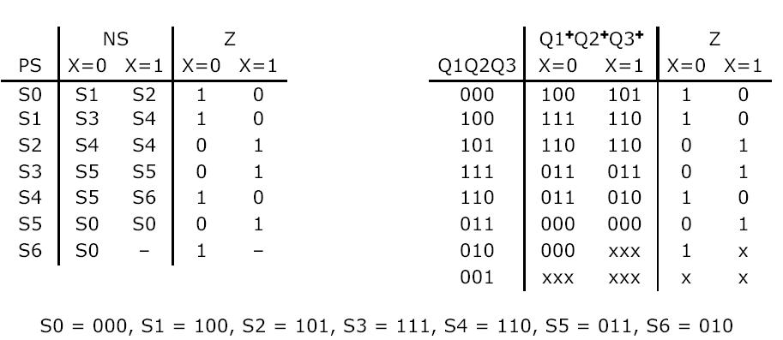
Transition Table

Slide 15
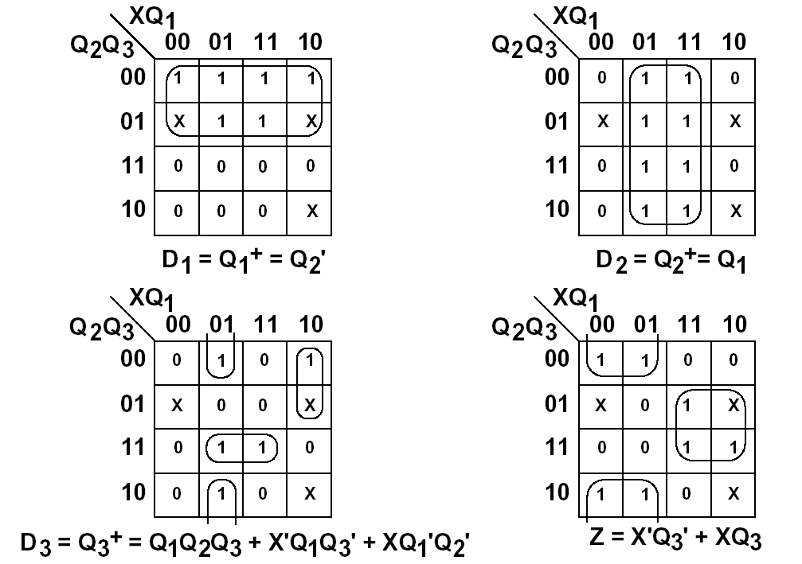
K-maps

Slide 16
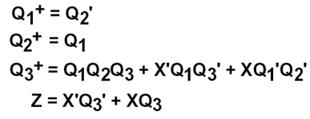
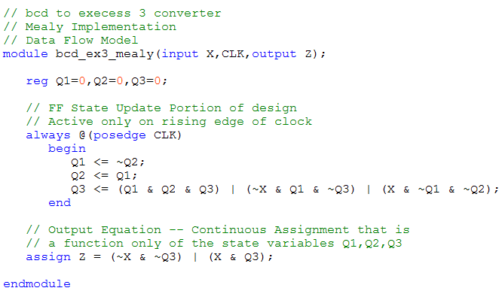
Data Flow Representation Verilog HDL
8421 BCD to Excess3 Code Converter (Mealy FSM)

Slide 17
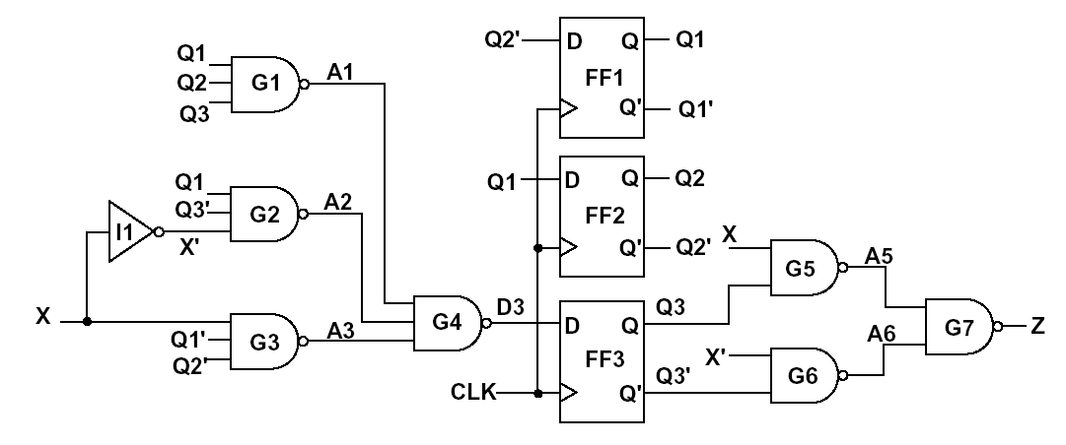
Schematic Realization
8421 BCD to Excess3 Code Converter (Mealy FSM)

Slide 18
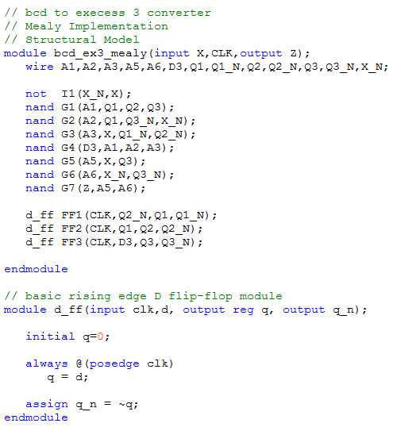
Structural Representation Verilog HDL
8421 BCD to Excess3 Code Converter (Mealy FSM)

Slide 19
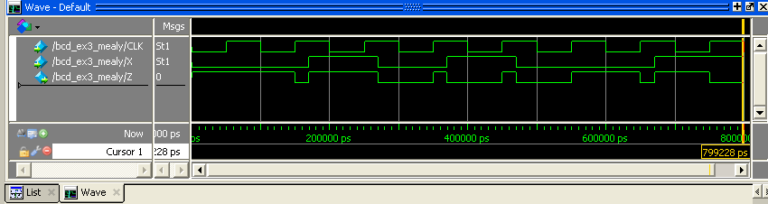
Sequential Network Timing
Code converter
  X = 0010_1001 =>
  Z = 1110_0011
Changes in X are not synchronized with active clock edge =>
glitches (false output), e.g. at tb

Slide 20
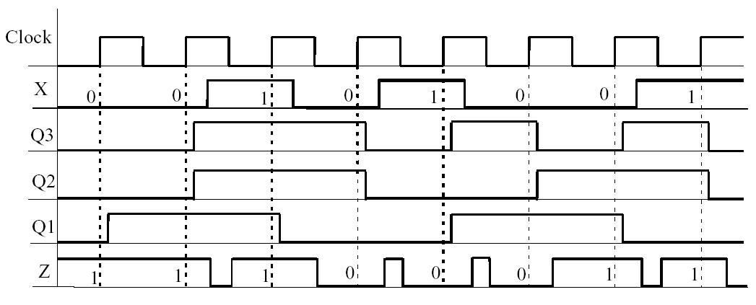
Sequential Network Timing (cont’d)
Timing diagram assuming a propagation delay
of 10 ns for each flip-flop and gate
(State has been replaced with the state of three flip-flops)

Slide 21
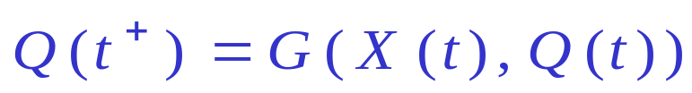
Review: Mealy Sequential Networks
(1) X inputs are changed to a new value
After a delay, the Z outputs and next state appear at the output of CN
(input of state register)
(3) The next state is clocked into the state register and the state changes

Slide 22
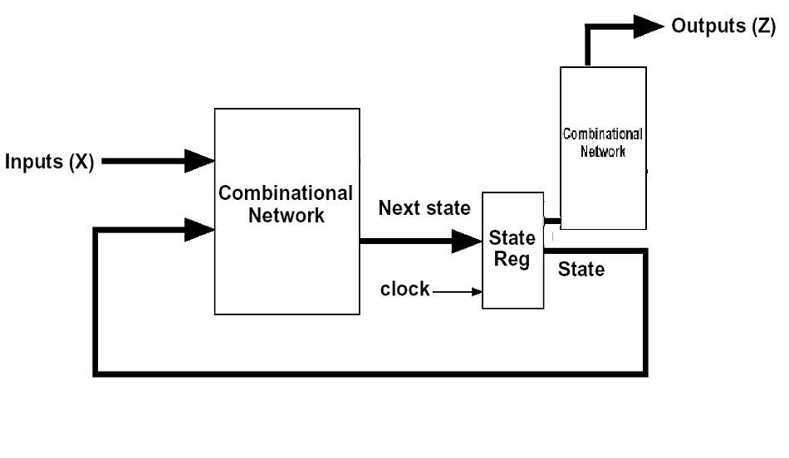
Moore Sequential Networks
General model of Moore Sequential Network
(1) X inputs are changed to a new value
The next state is clocked into the state registers
(3) The outputs appear which are a function of the current state only (not the inputs)

Slide 23

General Model of
Moore Sequential Machine
Outputs depend only on present state!
X = x₁ x₂... x_{n}
Q = Q₁ Q₂... Q_{k}
Combinational Network #2
Z = z₁ z₂... z_{m}
Outputs(Z)
Next State
Inputs(X)
State(Q)
Combinational Network #1
State
Register
Clock
(1) X inputs are changed to a new value
After a delay, the output of CN appears on the inputs of the state register
(3) The next state is clocked into the state register resulting in a possible change in state, and possible new Z outputs appear after a CN delay

Slide 24
An Example: 8421 BCD to Excess3 Code Converter
X (inputs) |  |  |  | Z (outputs)
t3 | t2 | t1 | t0 | t3 | t2 | t1 | t0
0 | 0 | 0 | 0 | 0 | 0 | 1 | 1
0 | 0 | 0 | 1 | 0 | 1 | 0 | 0
0 | 0 | 1 | 0 | 0 | 1 | 0 | 1
0 | 0 | 1 | 1 | 0 | 1 | 1 | 0
0 | 1 | 0 | 0 | 0 | 1 | 1 | 1
0 | 1 | 0 | 1 | 1 | 0 | 0 | 0
0 | 1 | 1 | 0 | 1 | 0 | 0 | 1
0 | 1 | 1 | 1 | 1 | 0 | 1 | 0
1 | 0 | 0 | 0 | 1 | 0 | 1 | 1
1 | 0 | 0 | 1 | 1 | 1 | 0 | 0

Slide 25
Moore Machine
Start
S0
0
0
1
NC
S1
C
S2
1
0
0
1
0
1
NC
S3
C
S4
C
S5
1
0
1
0
1
0
1
0
1
NC
S6
NC
S7
C
S8
0
1
0
1
0
0
0
1
0
NC
S9
S10
1
1
0
0
NC
1
Note: state S0 could be eliminated
(S0 == S9), if S9 was start state!

Slide 26
Moore Machine
Start
S0
0
0
1
PS | NS |  | Z
 | X=0 | X=1
S0 | S1 | S2 | 0
S1 | S3 | S4 | 1
S2 | S4 | S5 | 0
S3 | S6 | S7 | 1
S4 | S7 | S8 | 0
S5 | S7 | S8 | 1
S6 | S9 | S10 | 0
S7 | S9 | S10 | 1
S8 | S10 | - | 0
S9 | S1 | S2 | 0
S10 | S1 | S2 | 1
NC
S1
C
S2
1
0
0
1
0
1
NC
S3
C
S4
C
S5
1
0
1
0
1
0
1
0
1
NC
S6
NC
S7
C
S8
0
1
0
1
0
0
0
1
0
NC
S9
S10
1
1
0
0
NC
1
Note: state S0 could be eliminated
(S0 == S9), if S9 was start state!

Slide 27
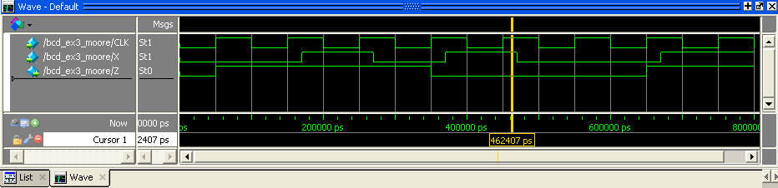
FSM Timings
Differences between Mealy and Moore
X = 0010_1001 => Z = 1110_0011
Mealy
Moore

Slide 28
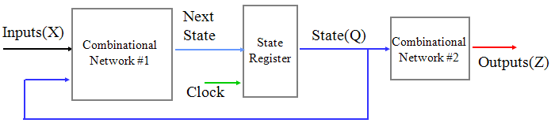
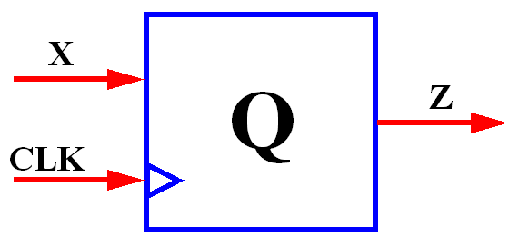
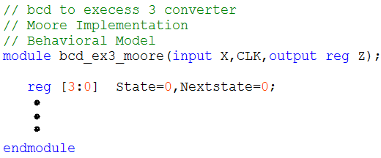
Behavioral Verilog HDL Model
8421 BCD to Excess3 Code Converter (Moore FSM)
PS | NS |  | Z
 | X=0 | X=1
S0 | S1 | S2 | 0
S1 | S3 | S4 | 1
S2 | S4 | S5 | 0
S3 | S6 | S7 | 1
S4 | S7 | S8 | 0
S5 | S7 | S8 | 1
S6 | S9 | S10 | 0
S7 | S9 | S10 | 1
S8 | S10 | - | 0
S9 | S1 | S2 | 0
S10 | S1 | S2 | 1

Slide 29
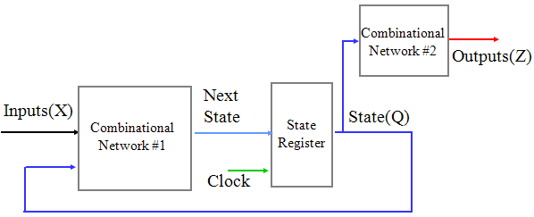
Behavioral Verilog HDL Model
8421 BCD to Excess3 Code Converter (Moore FSM)
PS | NS |  | Z
 | X=0 | X=1
S0 | S1 | S2 | 0
S1 | S3 | S4 | 1
S2 | S4 | S5 | 0
S3 | S6 | S7 | 1
S4 | S7 | S8 | 0
S5 | S7 | S8 | 1
S6 | S9 | S10 | 0
S7 | S9 | S10 | 1
S8 | S10 | - | 0
S9 | S1 | S2 | 0
S10 | S1 | S2 | 1

Slide 30
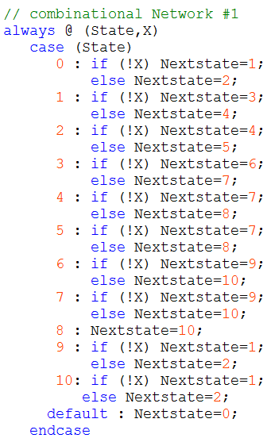
Behavioral Verilog HDL Model
8421 BCD to Excess3 Code Converter (Moore FSM)
PS | NS |  | Z
 | X=0 | X=1
S0 | S1 | S2 | 0
S1 | S3 | S4 | 1
S2 | S4 | S5 | 0
S3 | S6 | S7 | 1
S4 | S7 | S8 | 0
S5 | S7 | S8 | 1
S6 | S9 | S10 | 0
S7 | S9 | S10 | 1
S8 | S10 | - | 0
S9 | S1 | S2 | 0
S10 | S1 | S2 | 1

Slide 31
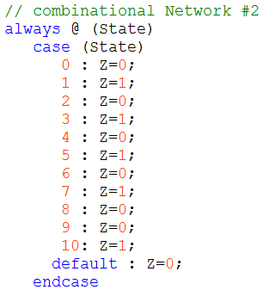
Behavioral Verilog HDL Model
8421 BCD to Excess3 Code Converter (Moore FSM)
PS | NS |  | Z
 | X=0 | X=1
S0 | S1 | S2 | 0
S1 | S3 | S4 | 1
S2 | S4 | S5 | 0
S3 | S6 | S7 | 1
S4 | S7 | S8 | 0
S5 | S7 | S8 | 1
S6 | S9 | S10 | 0
S7 | S9 | S10 | 1
S8 | S10 | - | 0
S9 | S1 | S2 | 0
S10 | S1 | S2 | 1

Slide 32

Behavioral Verilog HDL Model
8421 BCD to Excess3 Code Converter (Moore FSM)
PS | NS |  | Z
 | X=0 | X=1
S0 | S1 | S2 | 0
S1 | S3 | S4 | 1
S2 | S4 | S5 | 0
S3 | S6 | S7 | 1
S4 | S7 | S8 | 0
S5 | S7 | S8 | 1
S6 | S9 | S10 | 0
S7 | S9 | S10 | 1
S8 | S10 | - | 0
S9 | S1 | S2 | 0
S10 | S1 | S2 | 1

Slide 33
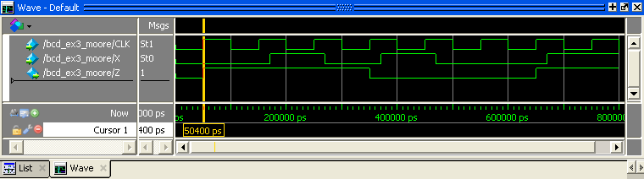
ModelSim™ Waveform
Behavioral 8421 BCD to Excess3 Code Converter (Moore FSM)
X = 0010_1001 => Z = 1110_0011
add wave CLK X Z
force CLK 0 0 ns, 1 50 ns -r 100 ns
force X 0 0 ns, 1 170 ns, 0 270 ns, 1 370 ns, 0 470 ns, 1 670 ns
run 800 ns

Slide 34
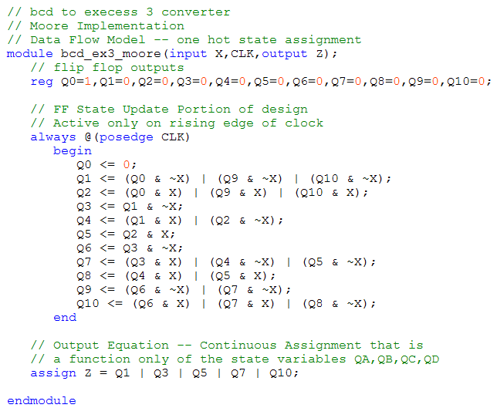
One-hot State Encoding
PS | NS |  | Z
 | X=0 | X=1
S0 | S1 | S2 | 0
S1 | S3 | S4 | 1
S2 | S4 | S5 | 0
S3 | S6 | S7 | 1
S4 | S7 | S8 | 0
S5 | S7 | S8 | 1
S6 | S9 | S10 | 0
S7 | S9 | S10 | 1
S8 | S10 | - | 0
S9 | S1 | S2 | 0
S10 | S1 | S2 | 1

Slide 35
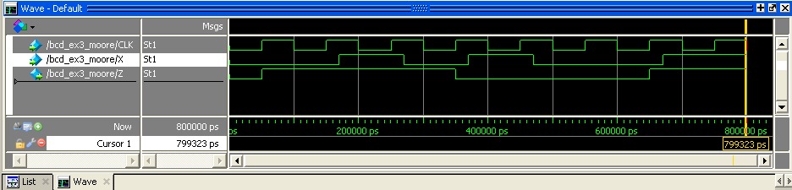
X = 0010_1001 => Z = 1110_0011
add wave CLK X Z
force CLK 0 0 ns, 1 50 ns -r 100 ns
force X 0 0 ns, 1 170 ns, 0 270 ns, 1 370 ns, 0 470 ns, 1 670 ns
run 800 ns

Slide 36
State Assignment Rules

Slide 37
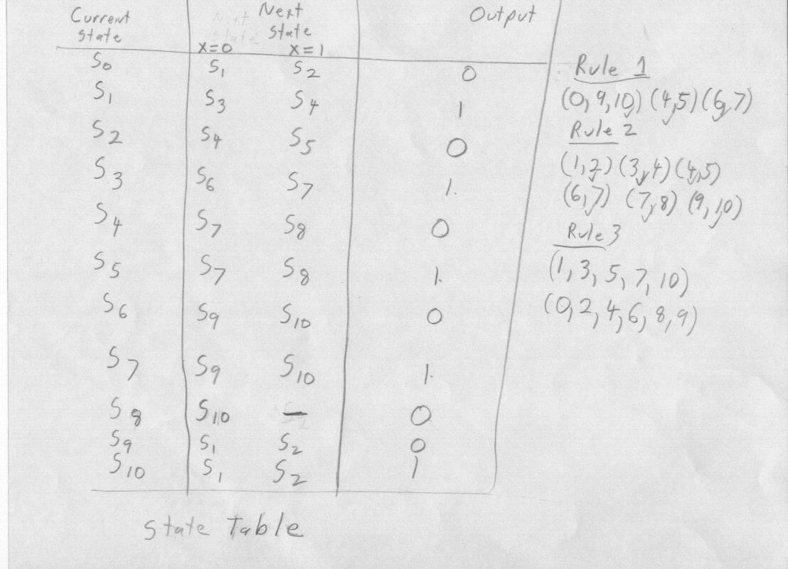
Moore State Table

Slide 38
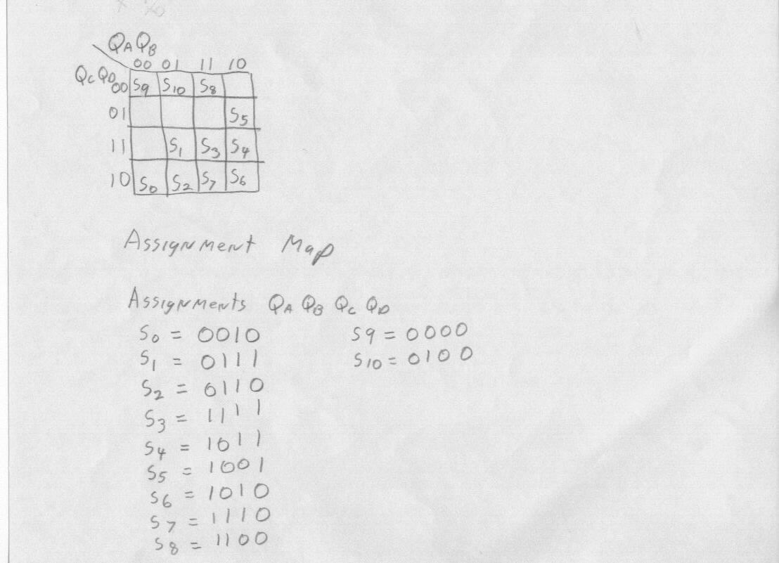
State Assignments

Slide 39
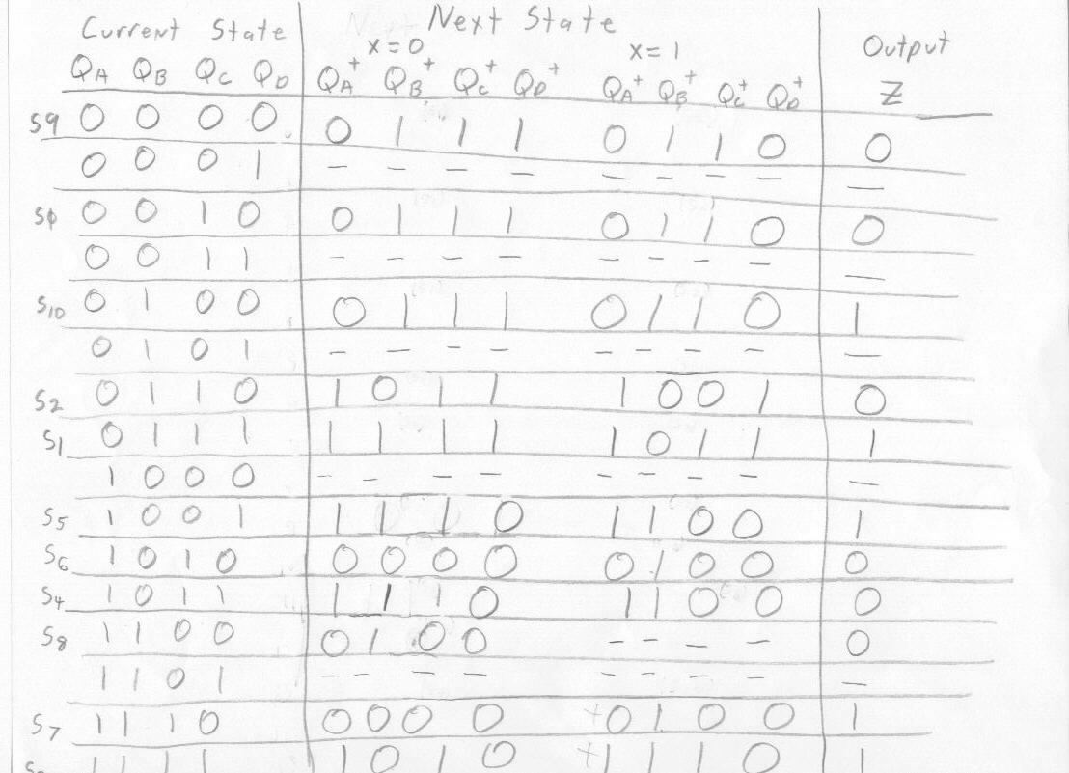
Transition Diagram

Slide 40
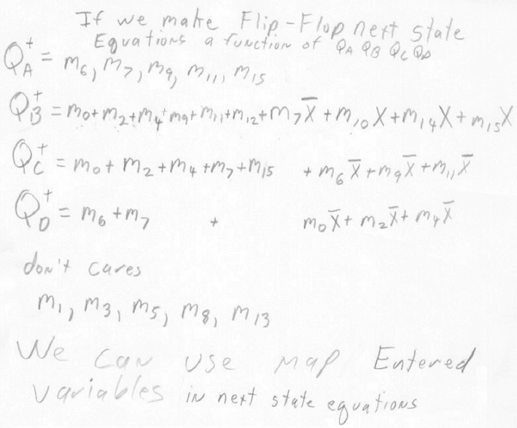
Resulting Boolean Equations

Slide 41
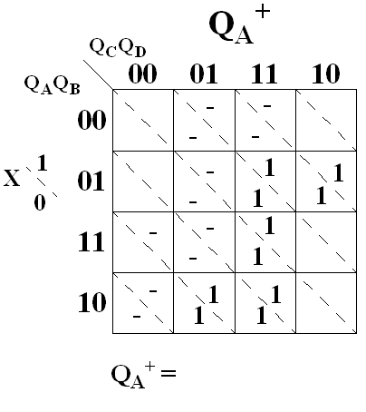
Flip-flop Q_{A}

Slide 42
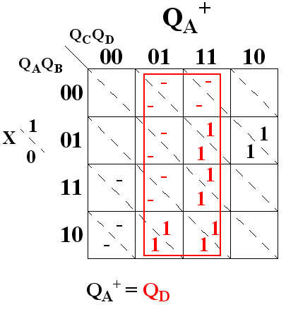
Flip-flop Q_{A}

Slide 43
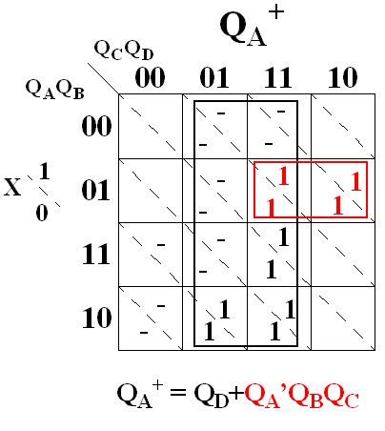
Flip-flop Q_{A}

Slide 44
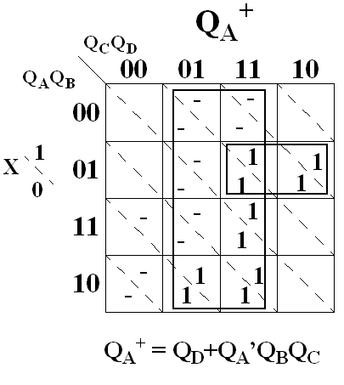
Flip-flop Q_{A}

Slide 45

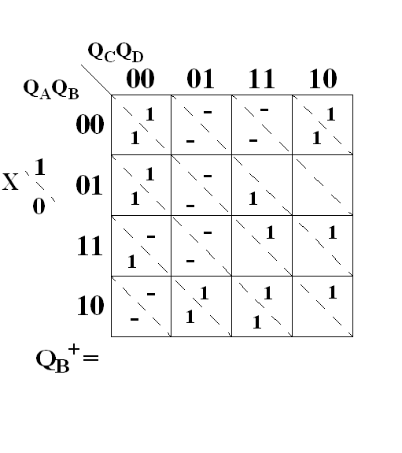
Flip-flop Q_{B}

Slide 46
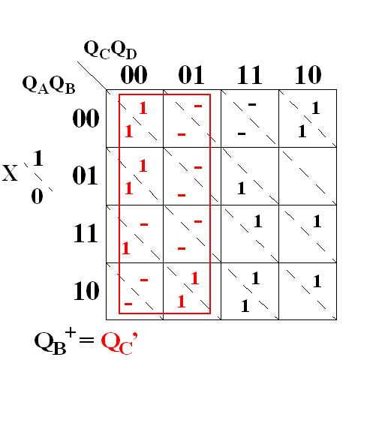
Flip-flop Q_{B}

Slide 47
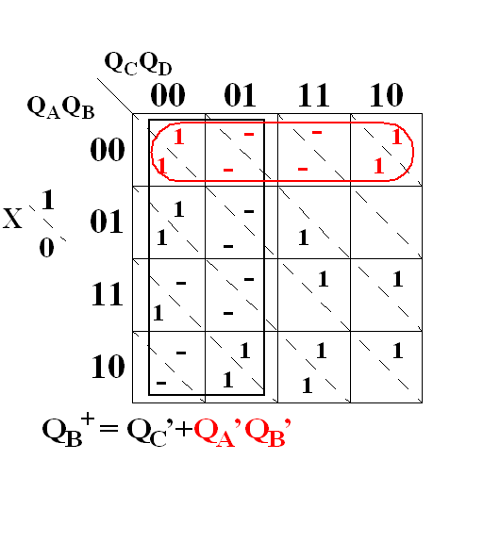
Flip-flop Q_{B}

Slide 48
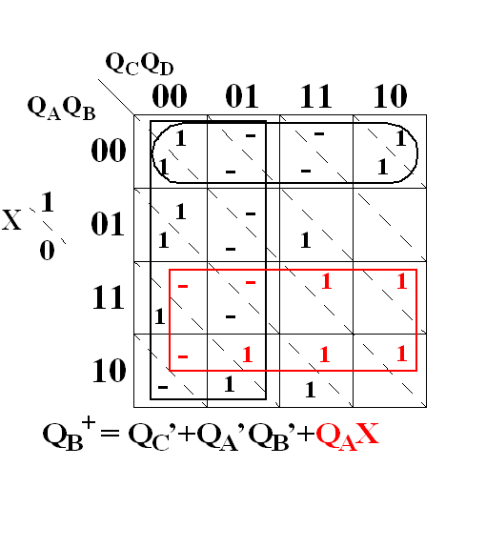
Flip-flop Q_{B}

Slide 49
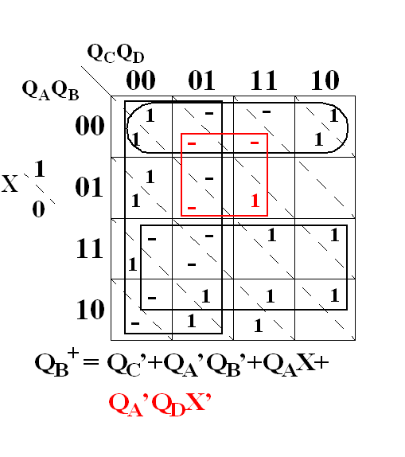
Flip-flop Q_{B}

Slide 50
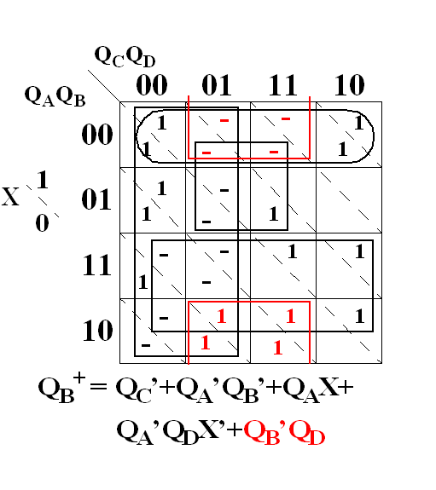
Flip-flop Q_{B}

Slide 51
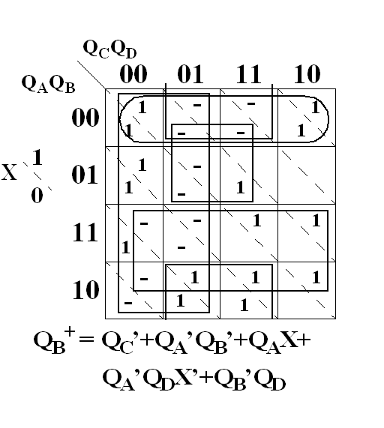
Flip-flop Q_{B}

Slide 52
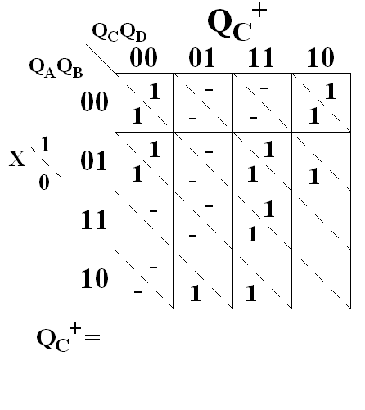
Flip-flop Q_{C}

Slide 53

Flip-flop Q_{C}

Slide 54

Flip-flop Q_{C}

Slide 55

Flip-flop Q_{C}

Slide 56

Flip-flop Q_{C}

Slide 57

Flip-flop Q_{C}

Slide 58

Flip-flop Q_{C}

Slide 59

Flip-flop Q_{D}

Slide 60

Flip-flop Q_{D}

Slide 61

Flip-flop Q_{D}

Slide 62

Flip-flop Q_{D}

Slide 63

Output Z

Slide 64

Output Z

Slide 65

Output Z

Slide 66

Output Z

Slide 67

Output Z

Slide 68

Output Z

Slide 69

Quartus II Schematic Realization
8421 BCD to Excess3 Code Converter (Moore FSM)

Slide 70

Data Flow Representation Verilog HDL
8421 BCD to Excess3 Code Converter (Moore FSM)

Slide 71

ModelSim™ Waveform
Data Flow 8421 BCD to Excess3 Code Converter (Moore FSM)
X = 0010_1001 => Z = 1110_0011
add wave CLK X Z
force CLK 0 0 ns, 1 50 ns -r 100 ns
force X 0 0 ns, 1 170 ns, 0 270 ns, 1 370 ns, 0 470 ns, 1 670 ns
run 800 ns

