Slide 1
Convolution Example
Dr. Emil Jovanov
CPE381 Signals & Systems
for Computer Engineers

Slide 2
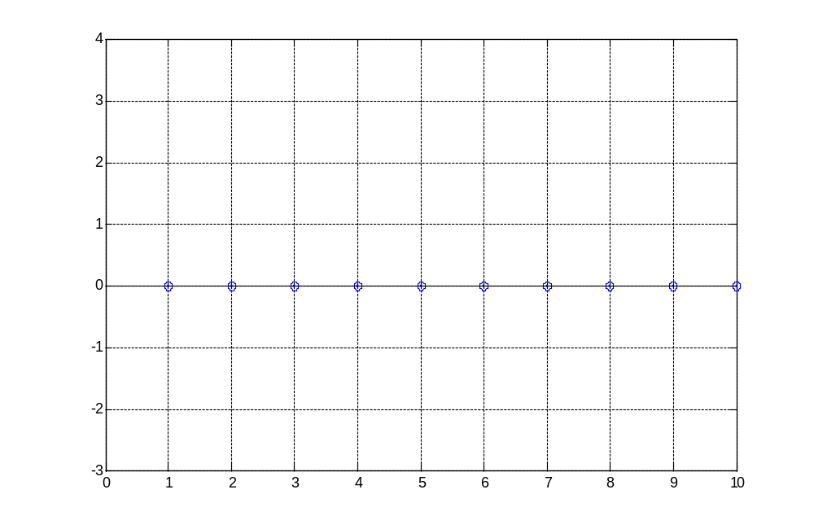

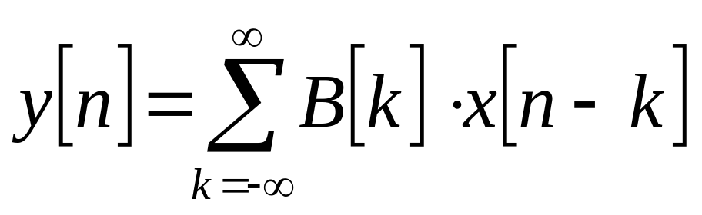
Convolution
X
0
…
n-2
n-1
n

Slide 3
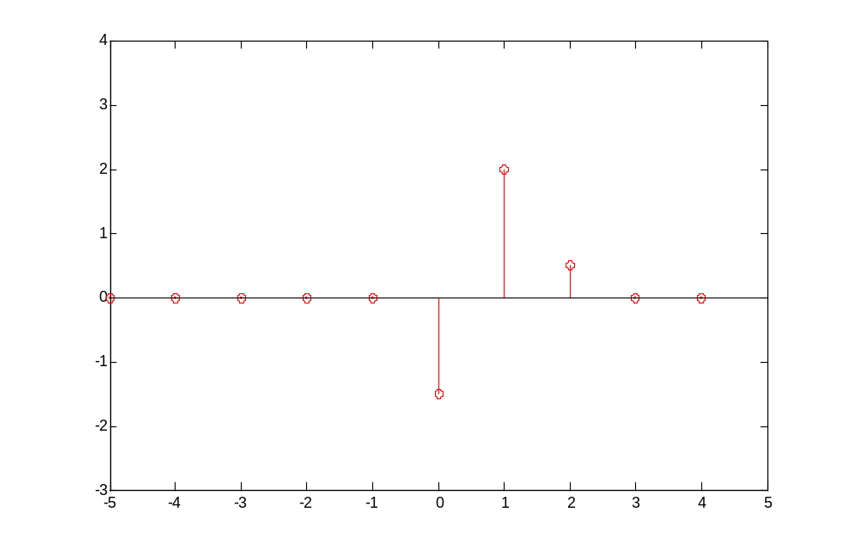
B=[-1.5 2 0.5]
B

Slide 4
Conv:
X
n-4
n-3
n-2
n-1
n
B
0
1
2

Slide 5
Conv:
X
n-4
n-3
n-2
n-1
n
B
2
1
0

Slide 6
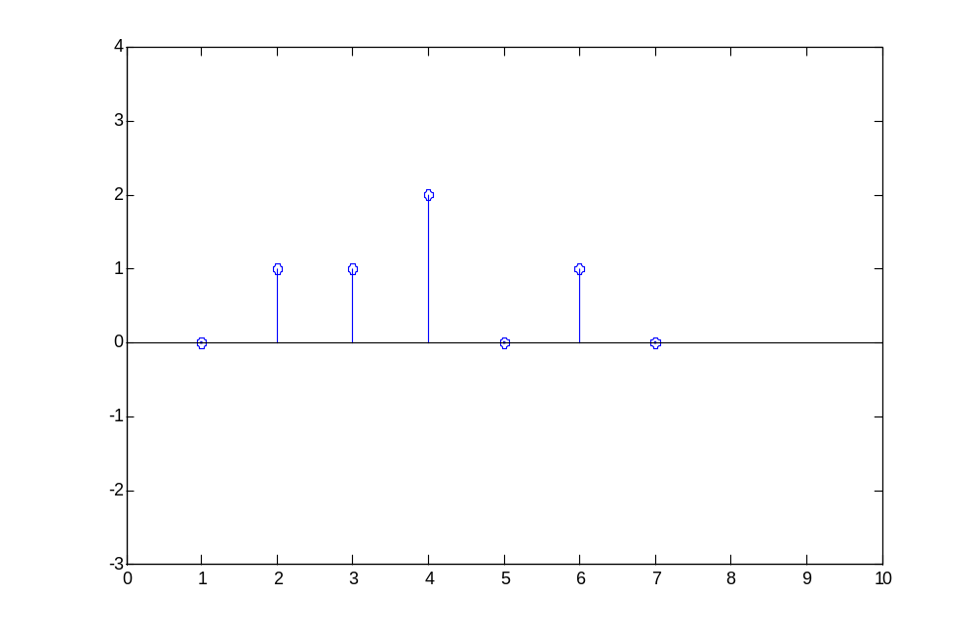
x=[0 1 1 2 0 1 0]
B=[-1.5 2 -0.5]
n=3
X
y[3] = B[0]*x[3]
+B[1]*x[2]
+B[2]*x[1]
y[3] = 2*(-1.5)+1*2+1*(-0.5) = -1.5
B
2
1
0

Slide 7
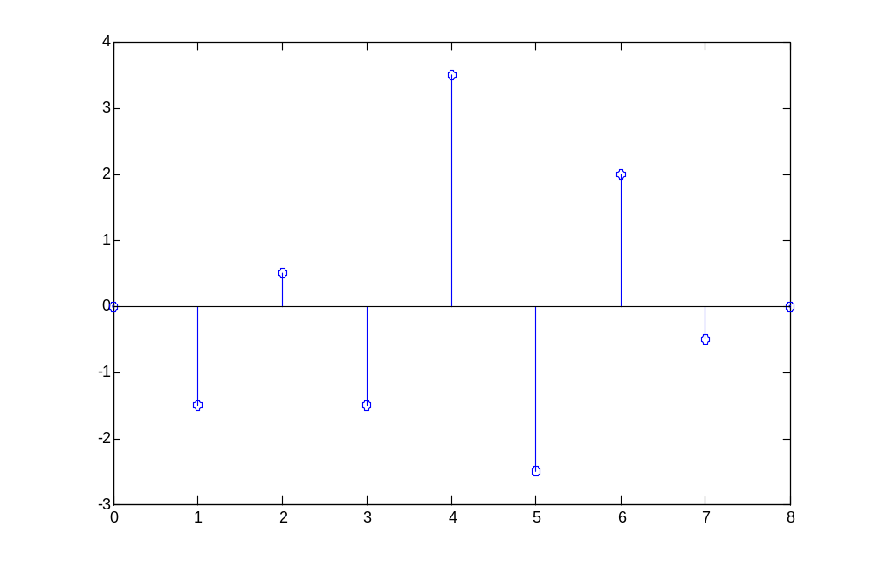
conv([-1.5 2 -0.5],[0 1 1 2 0 1 0])
Y
y[3] = 2*(-1.5)+1*2+1*(-0.5) = -1.5

