Slide 1
Active Listening

Slide 2
What is active listening
Process of attending carefully to whatever you are listening to.
http://en.wiktionary.org/wiki/active_listening

Slide 3
The Active Listening Process
If we can’t hear, we can’t listen
  Noisy environments interfere with our ability to hear
  To remedy problem:
    ask the speaker to speak louder
    move to a quieter location
http://www.ehow.com/how_5171480_actively-listen.html

Slide 4
Interference with listening
Boredom
  reframe outlook by withholding judgment
  think about what can learn from the speaker
Prejudice
(thinking message is unimportant or believing the speaker misguided)
  reframe outlook by withholding judgment
  think about what can learn from the speaker
Emotions (particularly anger)
  Take a break to relax
  Refocus before attempting to listen again
http://www.ehow.com/how_5171480_actively-listen.html

Slide 5
Understanding a speaker's message
Key component in the active-listening process
  If can't make sense of the speaker's statements--ask questions
  Asking questions fosters understanding
  & keeps focus on what's being said
http://www.ehow.com/how_5171480_actively-listen.html

Slide 6
Respond to the speaker
Give observable feedback
Ask questions
Paraphrase what the speaker has said
Respond nonverbally
  eye contact
  body orientation
  posture
http://www.ehow.com/how_5171480_actively-listen.html

Slide 7
Remember what was said
Take notes on the gist of the statement
Not only does the act of writing reinforce memory, but you'll also have a record of what was said.
http://www.ehow.com/how_5171480_actively-listen.html

Slide 8
Barriers to Active Listening
Information overload
  We give too much information in a speech or presentation
Audience Preoccupation
  As speakers we have the duty to know, or at least understand, our audience.
http://ezinearticles.com/?Presentation-Audiences---5-Barriers-To-Active-Listening-And-How-Public-Speakers-Overcome-Them&id=1053385

Slide 9
Barriers to Active Listening Con’t
Think Ahead
  We need to build structure and organization in our speech.
  If the eyes glaze over, then there's something wrong with our presentation.
Noise
  Not all our public speaking will be in a rarefied auditorium with pitch perfect acoustics
  Speak up, tone up and emphasize the key points.
http://ezinearticles.com/?Presentation-Audiences---5-Barriers-To-Active-Listening-And-How-Public-Speakers-Overcome-Them&id=1053385

Slide 10
Barriers to Active Listening Con’t
Audience Exhaustion
  We should be alert to the audience's physical tiredness
  Be ready with some participative exercises, change the pace or use more multimedia
http://ezinearticles.com/?Presentation-Audiences---5-Barriers-To-Active-Listening-And-How-Public-Speakers-Overcome-Them&id=1053385

Slide 11
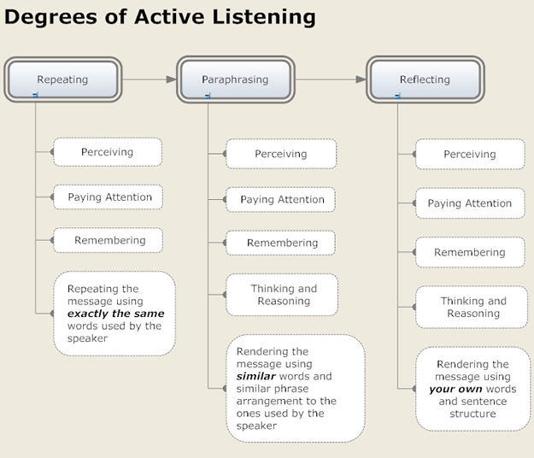
Chart licensed under the terms of the GNU Free Documentation License

