Slide 1
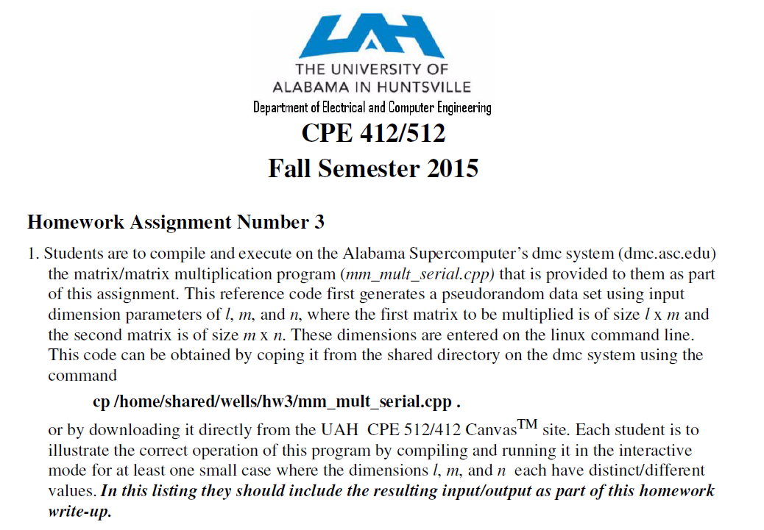
1.<number>

Slide 2
Evaluating Programs Empirically
Measuring Execution Time
To measure the execution time in seconds between points in the code, we can utilize the built in MPI_Wtime() function
.
#include <mpi.h>
double t1,t2, elapsed_time; // declare variables as doubles
t1 = MPI_Wtime(); /* start timer */
.
.
.
t2 = MPI_Wtime(); /* stop timer */
elapsed_time = t2-t1; /* elapsed_time = t2 - t1 */
cout << “Elapsed time = “ << elapsed_time << endl;
1.<number>

Slide 3
Evaluating Programs Empirically
Measuring Execution Time
The resolution of the MPI_Wtime() function is system dependent. To determine its resolution on a particular implementation use the MPI_Wtick() function.
It returns, as a double precision value, the number of seconds between successive clock ticks.
.
double MPI_Wtick(); // declared in mpi.h file
cout << “Timer Resolution = “ << MPI_Wtick() << endl;
1.<number>

Slide 4
Evaluating Programs Empirically
Measuring Execution Time
To measure the execution time in seconds between points in the code, using the gettimeofday() functions
#include <sys/time.h>
#define TIMER_CLEAR (tv1.tv_sec = tv1.tv_usec = tv2.tv_sec = tv2.tv_usec = 0)
#define TIMER_START gettimeofday(&tv1, (struct timezone*)0)
#define TIMER_ELAPSED ((tv2.tv_usec-tv1.tv_usec)+((tv2.tv_sec-tv1.tv_sec)*1000000))
#define TIMER_STOP gettimeofday(&tv2, (struct timezone*)0)
struct timeval tv1,tv2;
TIMER_CLEAR; /* start timer */
TIMER_START;
.
.
.
TIMER_STOP; /* stop timer */
cout << “Elapsed time = “ << TIMER_ELAPSED/1000000.0 << endl;
1.<number>

Slide 5
Matrix Multiplication

Slide 6
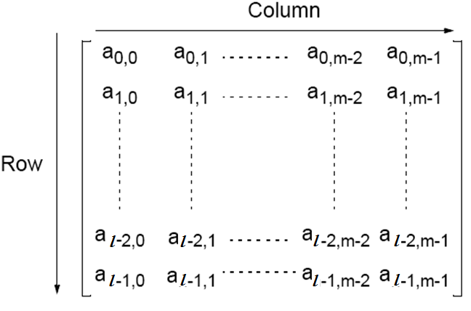
Matrices — A Review
An l x m matrix

Slide 7
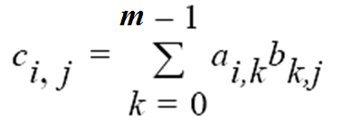
Matrix Multiplication
Multiplication of two matrices, A and B, produces the matrix C
whose elements, c_{i,j} (0 <= i < l, 0 <= j < n), are computed as follows:
where A is an l x m matrix and B is an m x n matrix.

Slide 8
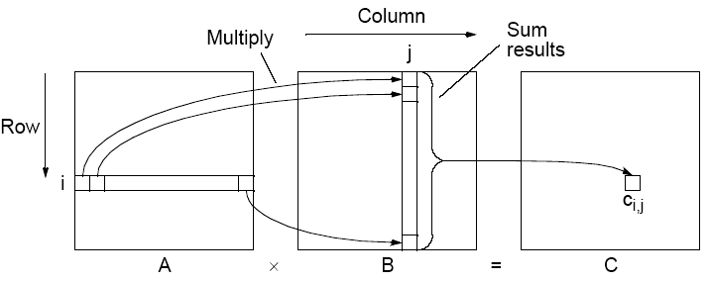
Matrix multiplication, C = A x B
1.<number>

Slide 9
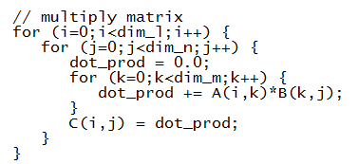
Matrix Multiplication
The sequential code to compute A x B could simply be
In the case where dim_l == dim_m == dim_n then this algorithm requires n³ multiplications and n³ additions, leading to a sequential time complexity of O(n³).

Slide 10
Contiguous/Dynamic Memory Issues
It is often desirable to allocate memory dynamically in C/C++
  cannot use M[num_rows][num_ columns] notation
  C allocation
    float *M;
    M= (int *) malloc(sizeof(float)*num_columns*num_rows);
  C++ allocation
    float *M;
    M= new (nothrow) float[num_columns*num_rows];
In case of multi-dimensional data location memory elements are determined based upon
  where memory begins and
  on how multi-dimensional data is stored in linear memory.

Slide 11
Row-ordered Storage in Dynamic Memory
  C allocation
    float *M;
    M= (int *) malloc(sizeof(float)*num_columns*num_rows);
  C++ allocation
    float *M;
    M= new (nothrow) float[num_columns*num_rows];
In C/C++ it is stored in row-ordered format
  rows are stored one after the other in memory, i.e. row 0 then row 1 etc
M_{0,0}
M_{0,1}
M_{0,2}
M_{0,3}
M_{1,0}
M_{1,1}
M_{1,2}
M_{1,3}
M_{2,0}
M_{2,1}
M_{2,2}
M_{2,3}
M_{3,0}
M_{3,1}
M_{3,2}
M_{3,3}
M
M_{0,0}
M_{0,1}
M_{0,2}
M_{0,3}
M_{1,0}
M_{1,1}
M_{1,2}
M_{1,3}
M_{2,0}
M_{2,1}
M_{2,2}
M_{2,3}
M_{3,0}
M_{3,1}
M_{3,2}
M_{3,3}

Slide 12

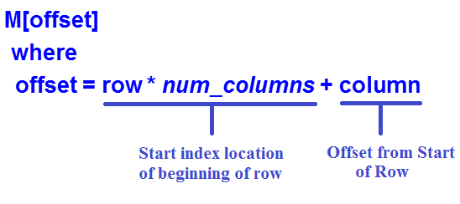


Row-ordered Storage in Dynamic Memory
(representing a 2-D data structure as a 1-D array)
Number of columns,
num_columns
column
0
N-1
0
row
1.<number>

Slide 13
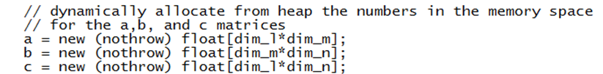
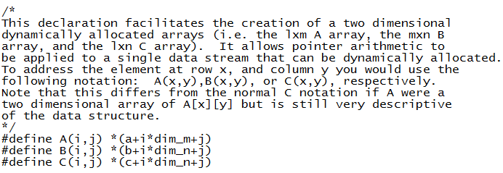
Dynamic 2-D memory allocation and
Usuage in the mm_mult_serial.cpp file
1.<number>

Slide 14
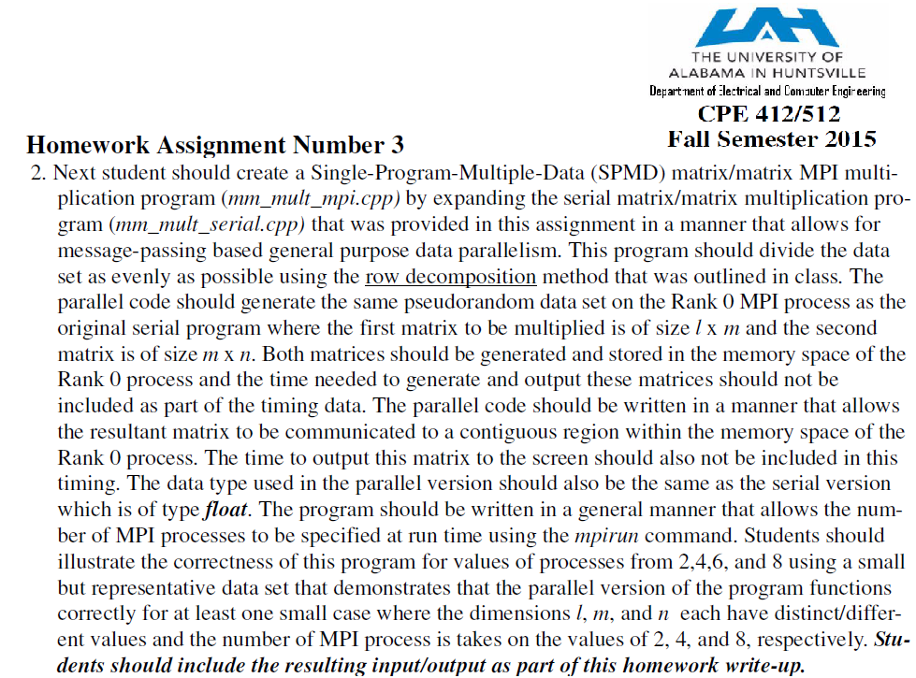
1.<number>

Slide 15
Parallel Code
With n processors (and n x n matrices), can obtain:
• Time complexity of O(n²) with n processors
Each instance of inner loop independent and can be done
by a separate processor
• Time complexity of O(n) with n² processors
One element of A and B assigned to each processor.
Cost optimal since O(n³) = n x O(n²) = n² x O(n)].
• Time complexity of O(log n) with n³ processors
By parallelizing the inner loop. Not cost-optimal since
O(n³) < n³xO(log n)).
O(log n) lower bound for parallel matrix multiplication.
1.<number>

Slide 16
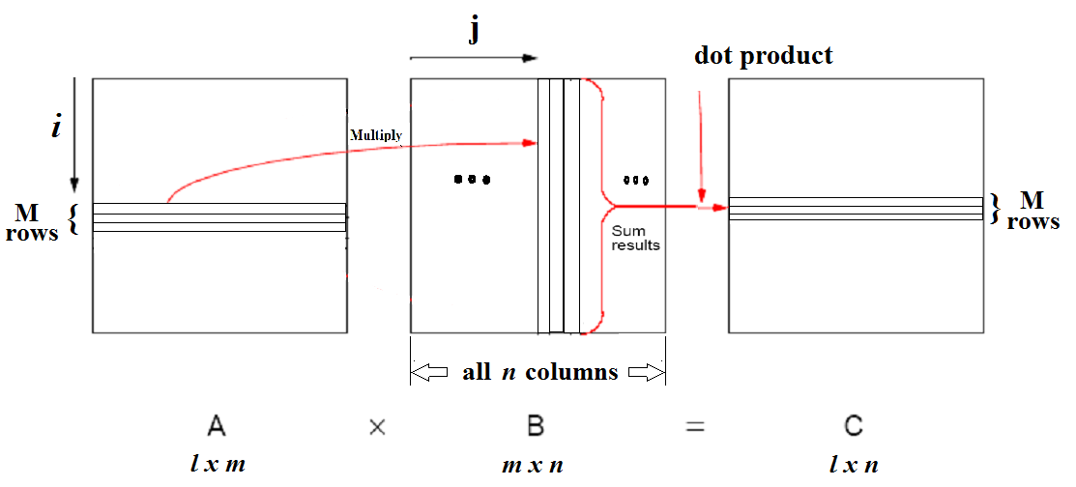
Matrix Multiplication
(row decomposition)

Slide 17
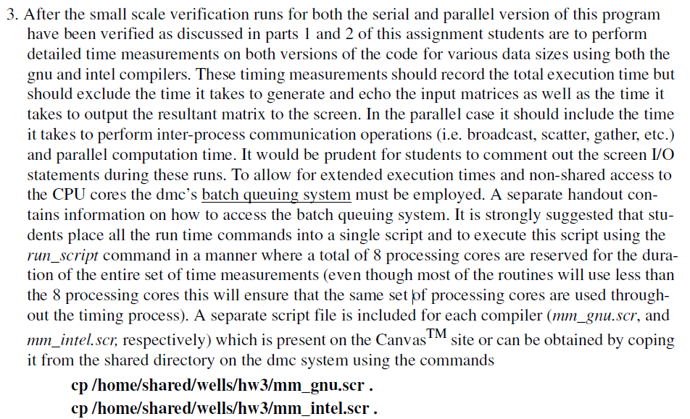

Slide 18
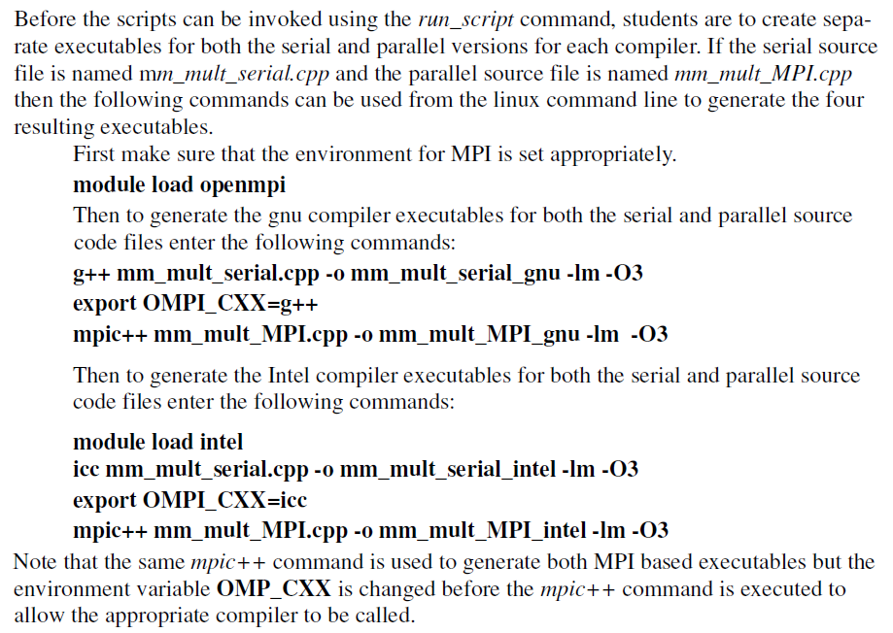

Slide 19
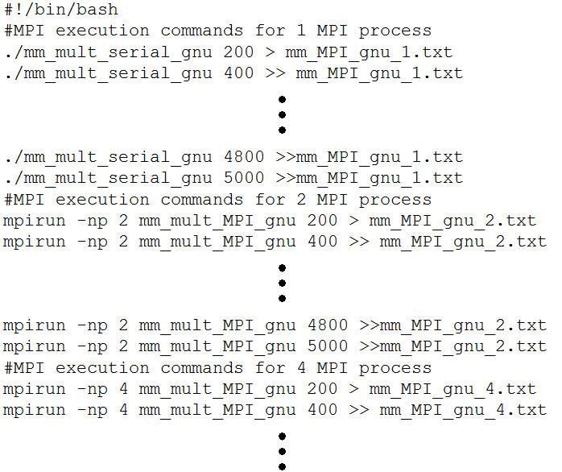
mm_gnu.scr file

Slide 20
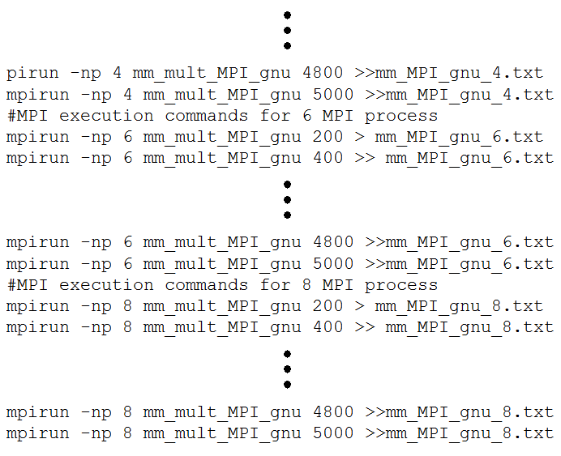
mm_gnu.scr file

Slide 21
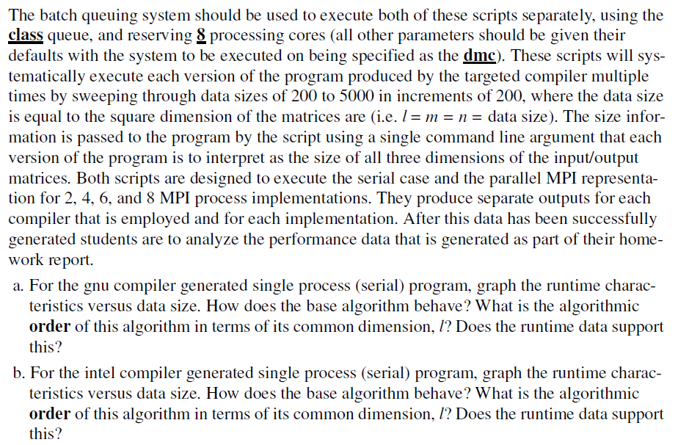

Slide 22
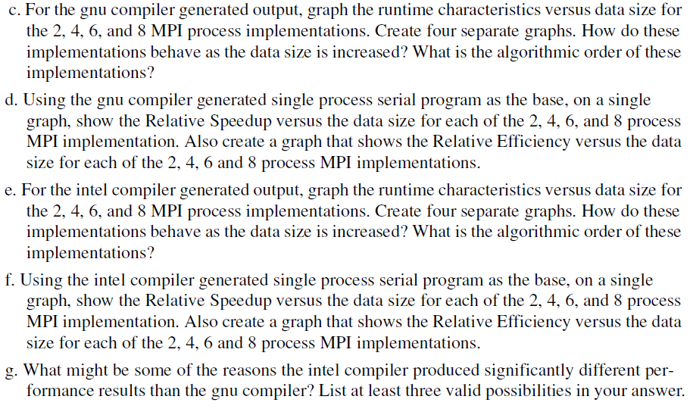

Slide 23
Some Example Data
The following represents some example data that came from similar experiments executed on some legacy systems.
This is to aid in describing the types of results – your experiments were run under different conditions and your results may be significantly different from these!

Slide 24
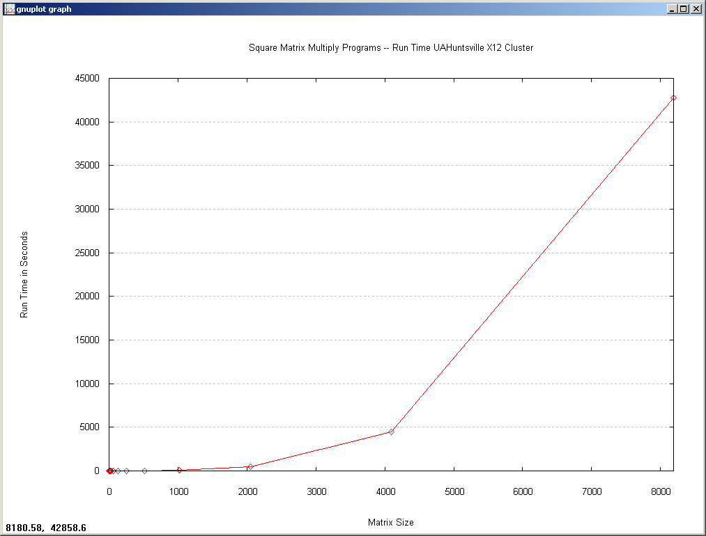

Slide 25
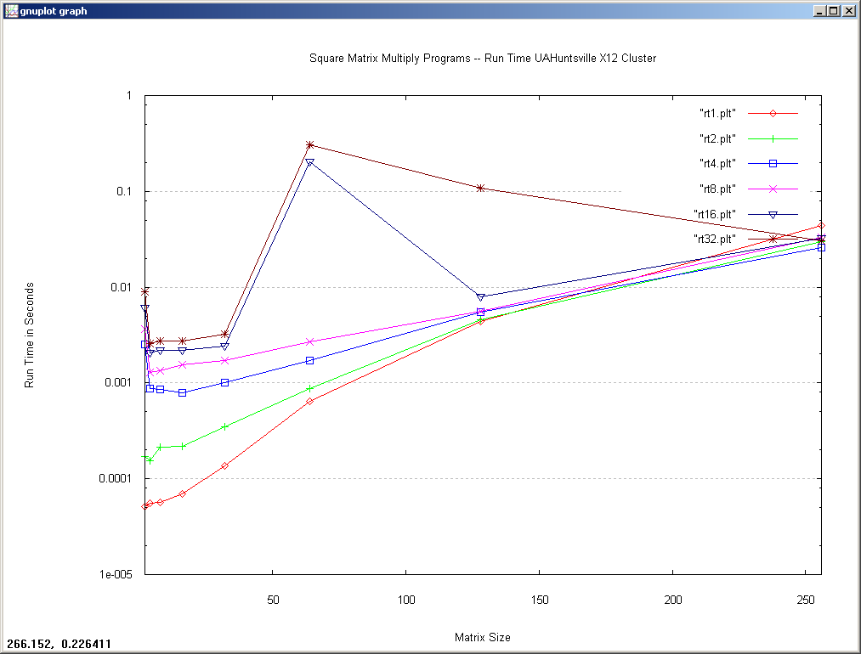

Slide 26
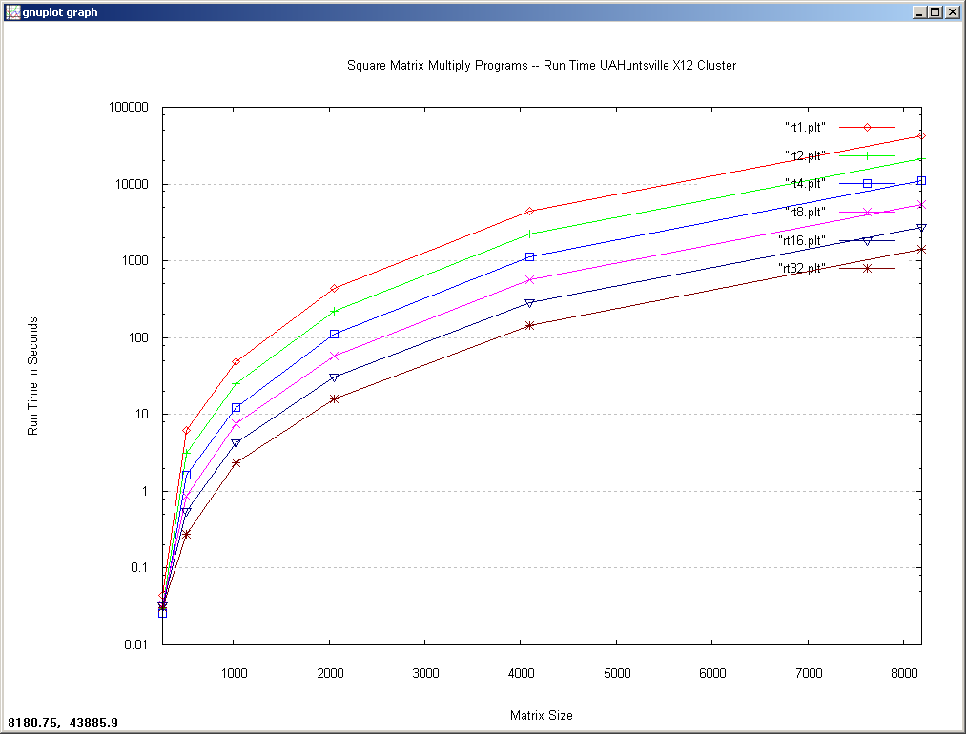

Slide 27
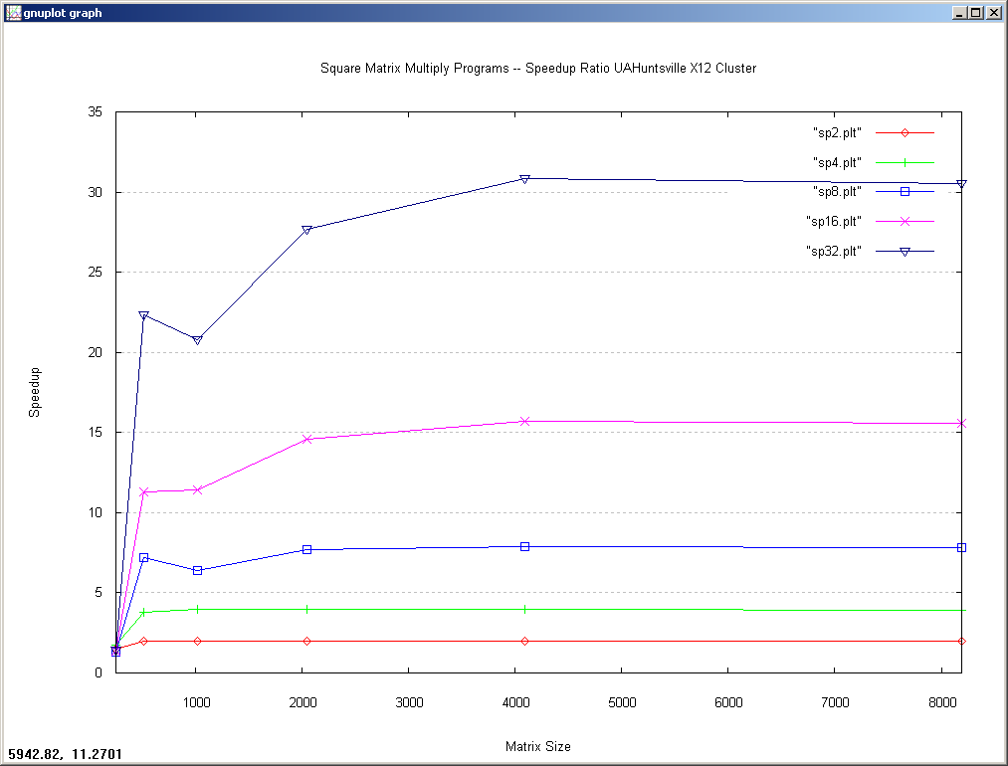

Slide 28
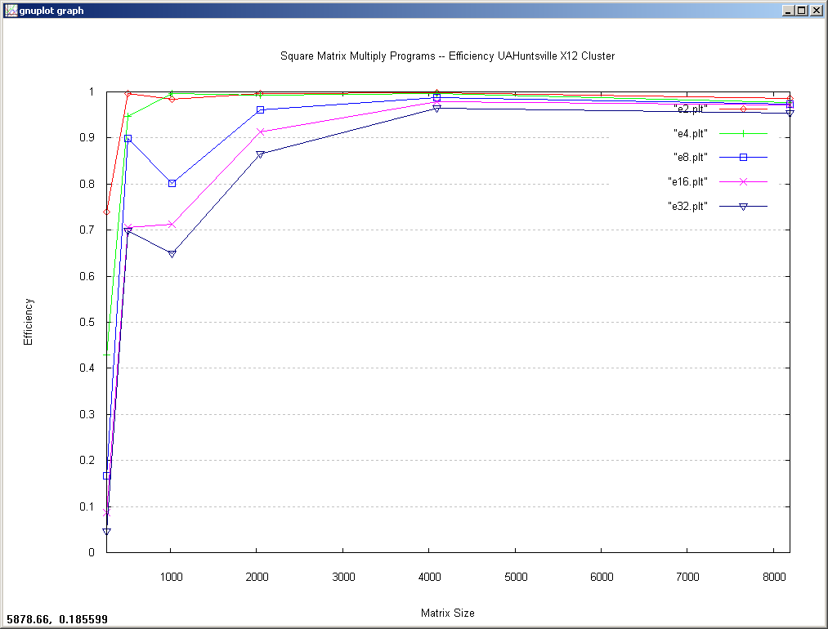

Slide 29
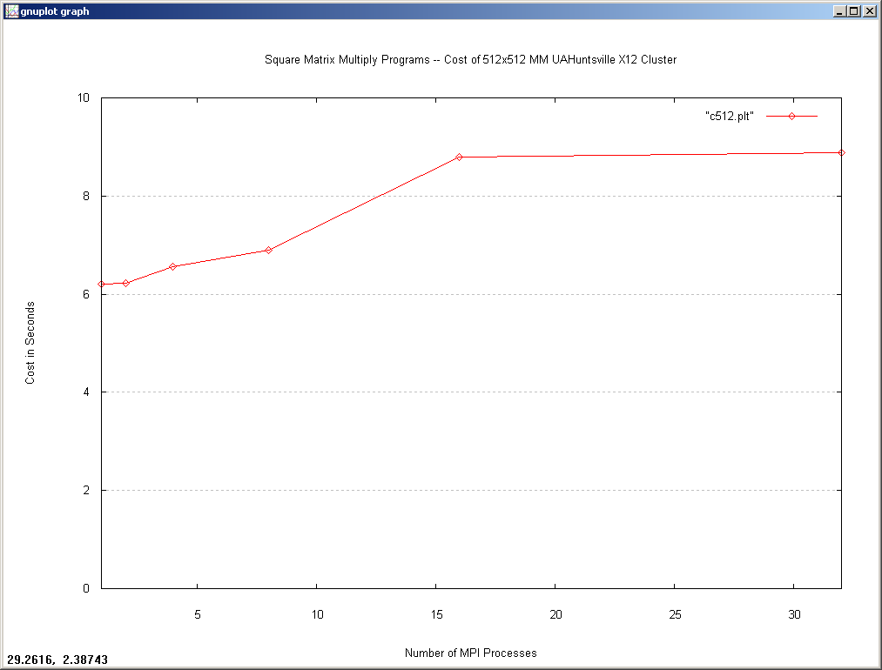

Slide 30
