Slide 1

The Linux “Completely Fair Scheduler”
Ben Nayer – Kalamazoo College
CS430 Operating Systems

Slide 2
Introduction
Starting with release 2.6.23, the Linux kernel has included a new scheduler, replacing the “O(1) Scheduler” which was previously used.
The new, so-called “Completely Fair Scheduler” was a major departure from the previous model, and is much simpler.
Both the O(1) Scheduler and CFS were developed by Ingo Molnar.

Slide 3
O(1) Background
Briefly – the scheduler maintained two runqueues for each CPU, with a priority linked list for each priority level (140 total).
Tasks are enqueued into the corresponding priority list.
The scheduler only needs to look at the highest priority list to schedule the next task.
Assigns timeslices for each task.
Had to track sleep times, process interactivity, etc.

Slide 4
Okay, maybe not briefly...
Two runqueues per CPU, I said...one active, one expired. If a process hasn't used its entire timeslice, it's on the active queue; if it has, it's expired. Tasks are swapped between the two as needed.
Timeslice and priority are recalculated when a task is swapped.
If the active queue is empty, they swap pointers, so the empty one is now the expired queue.

Slide 5
Last one, I promise!
The first 100 priority lists are for real-time tasks, the last 40 are for user tasks.
User tasks can have their priorities dynamically adjusted, based on their dependency. (I/O or CPU)
Better for SMP than previous schedulers; each CPU has its own queue, and its own lock. Previously, if one CPU was picking a task, it locked the queue, and made other CPUs wait.

Slide 6
The Completely Fair Scheduler
CFS cuts out a lot of the things previous versions tracked – no timeslices, no sleep time tracking, no process type identification...
Instead, CFS tries to model an “ideal, precise multitasking CPU” – one that could run multiple processes simultaneously, giving each equal processing power.
Obviously, this is purely theoretical, so how can we model it?

Slide 7
CFS, continued
We may not be able to have one CPU run things simultaneously, but we can measure how much runtime each task has had and try and ensure that everyone gets their fair share of time.
This is held in the vruntime variable for each task, and is recorded at the nanosecond level. A lower vruntime indicates that the task has had less time to compute, and therefore has more need of the processor.
Furthermore, instead of a queue, CFS uses a Red-Black tree to store, sort, and schedule tasks.

Slide 8
RB Trees
A red-black tree is a binary search tree, which means that for each node, the left subtree only contains keys less than the node's key, and the right subtree contains keys greater than or equal to it.
A red-black tree has further restrictions which guarantee that the longest root-leaf path is at most twice as long as the shortest root-leaf path. This bound on the height makes RB Trees more efficient than normal BSTs.
Operations are in O(log n) time.

Slide 9
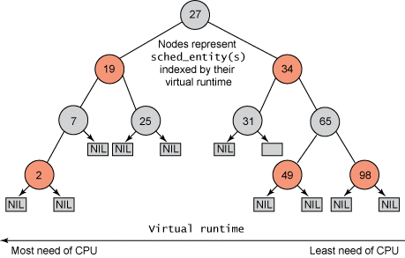
The CFS Tree
The key for each node is the vruntime of the corresponding task.
To pick the next task to run, simply take the leftmost node.
http://www.ibm.com/developerworks/linux/library/l-completely-fair-scheduler/

Slide 10
VRuntime tracking
The primary code modification I made was to have the scheduler printk the vruntime of the next task when it picks a new one.
What do you think we should see?
An aside: Originally, instead of tracking the vruntime, CFS tracked the wait time of a task, when it was not running; it decreased when a task was running. The goal was to keep it as close to 0 for all tasks as possible.

Slide 11
Digging in – CFS Data Structures
CFS has three primary structures – task_struct, sched_entity, and cfs_rq.
task_struct is the top-level entity, containing things such as task priorities, scheduling class, and the sched_entity struct. (sched.h, L1117)
sched_entity includes a node for the RB tree and the vruntime statistic, among others. (sched.h, L1041)
cfs_rq contains the root node, task group (more on this later), etc. (sched.c, L424)
Let's take a look...

Slide 12
Priorities and more
While CFS does not directly use priorities or priority queues, it does use them to modulate vruntime buildup.
In this version, priority is inverse to its effect – a higher priority task will accumulate vruntime more slowly, since it needs more CPU time.
Likewise, a low-priority task will have its vruntime increase more quickly, causing it to be preempted earlier.
“Nice” value – lower value means higher priority.
Relative priority, not absolute...

Slide 13
...that's it?
The CFS algorithm is, as stated, a lot simpler than the previous one, and does not require many of the old variables.
Preemption time is variable, depending on priorities and actual running time. So we don't need assign tasks a given timeslice.

Slide 14
Other additions
CFS introduced group scheduling in release 2.6.24, adding another level of fairness.
Tasks can be grouped together, such as by the user which owns them. CFS can then be applied to the group level as well as the individual task level.
So, for three groups, it would give each about a third of the CPU time, and then divide that time up among the tasks in each group.

Slide 15
Modular scheduling
Alongside the initial CFS release came the notion of “modular scheduling”, and scheduling classes. This allows various scheduling policies to be implemented, independent of the generic scheduler.
sched.c, which we have seen, contains that generic code. When schedule() is called, it will call pick_next_task(), which will look at the task's class and call the class-appropriate method.
Let's look at the sched_class struct...(sched.h L976)

Slide 16
Scheduling classes!
Two scheduling classes are currently implemented: sched_fair, and sched_rt.
sched_fair is CFS, which I've been talking about this whole time.
sched_rt handles real-time processes, and does not use CFS – it's basically the same as the previous scheduler.
CFS is mainly used for non-real-time tasks.

Slide 17
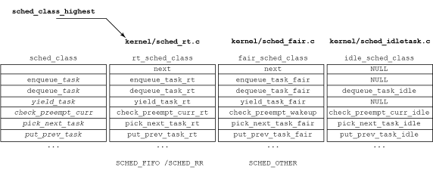
A visual aid is in order...
Classes are connected via linked-list, making it easy to iterate among them.
Each has its own functions corresponding to the core sched_class.
http://www.ibm.com/developerworks/linux/library/l-completely-fair-scheduler/

Slide 18
Kernel Modification
Or: How I spent a weekend trying to cripple the scheduler...
Two main modifications – you've seen the effect of the first already. I inserted a pair of printk statements into sched_fair.c, and specifically in the pick_next_task_fair method.
Every time a new process is selected, it will print out its name, PID, and its current vruntime value.

Slide 19
Modifications – what I DID do
My goal was to mess around with the priorities and how they were utilized in scheduling. Of course, since they're not used as directly in the CFS, even finding them became a bit problematic.
Priorities/weights seem to be used to modify vruntime in the calc_delta_mine function of sched.c (L1305), which is called by a series of functions, leading up to update_curr, which is called by entity_tick, in sched_fair.c.
Modification was a simple as changing a division to a multiplication.

Slide 20
Modifications – what NOT to do
This was not the first thing I attempted to do, however. Since I hadn't yet found the previous code, I first tried changing update_curr. (sched_fair.c, L463)
I set it to subtract the result of (originally) calc_delta_mine from vruntime, instead of adding it.
What do you think happened? Hint: it wasn't pretty.

Slide 21
Modifications – what I learned
The most important lesson? VirtualBox snapshots are there for a reason. Don't forget to use them...
Aside from that, I found that it may be relatively hard to trigger an obvious slowdown or side effect from fiddling with the priorities as I did, or at least doing so without crippling the virtual machine.
While the commenting was decent in this part of the kernel, tracing specific operations was still an involved and convoluted task. Don't overdo it.

Slide 22
Interesting tidbits & questions
One major advantage CFS has is attack resistance. There are methods of attacking the Linux kernel or scheduler that targeted the heuristics for determining what tasks were dependent on.
CFS doesn't even use those heuristics!
Some controversy over CFS' inclusion at the time.
Other questions?

Slide 23
Sources
Images are from Inside the Linux 2.6 Completely Fair Scheduler
Sources used overall include the CFS documentation, Completely Fair Scheduler,
Inside the Linux Scheduler ,Multiprocessing with the Completely Fair Scheduler, A Study on Linux Kernel Scheduler Version 2.6.32(Thang Ming Le), and Completely Fair Scheduler and its tuning (Jacek Kobus and Rafal Szklarski, 2009)

