Slide 1

DTMFE
Dual Tone Multi Frequency – ASCII Extended
Christopher Bero

Slide 2
What & Why
I'm not a HAM operator.
I'm not a lawyer.
I'm definitely not your lawyer.
This demonstration is likely legal.

Slide 3
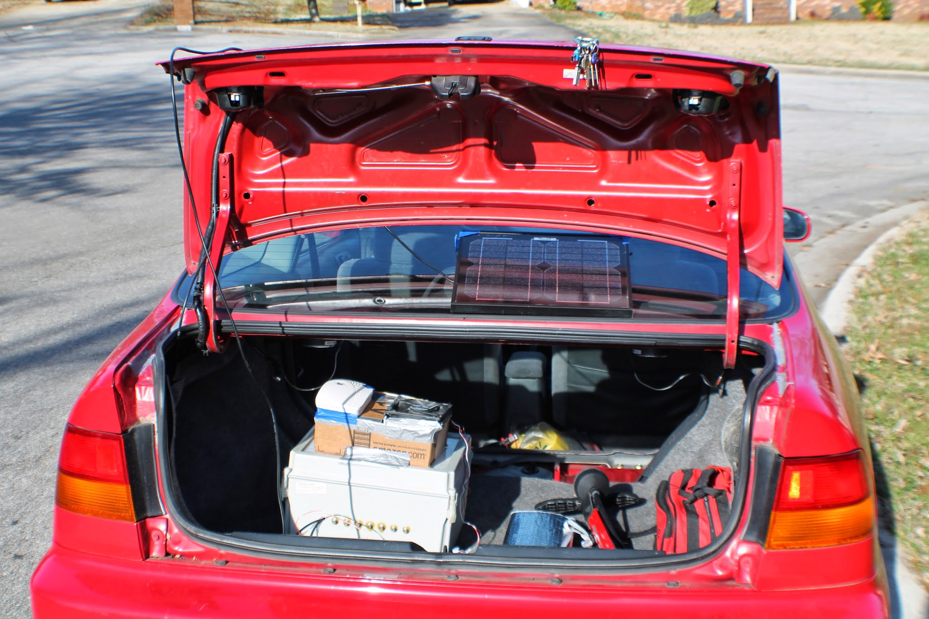
What & Why
I'm building a computer for my car that will listen on the OBD port and relay information to me.
I want it to be wireless.
Solution: MURS [Multi-Use Radio Service]

Slide 4
What & Why
DTMF exists on many HAM services, and can be how you route yourself over repeaters. Excellent stuff!
Numbers are (relatively) lame for this project. Text encoded formats exist, so we're just reinventing the wheel here.
MURS is a citizen band, no HAM license needed!
MURS also allowes encryption of data!
[150-155 MHz] - 5 Channels

Slide 5
Design
ASCII Table: 128 characters…. So we're going to need a 12x11 matrix of frequencies! Oh no!

Slide 6
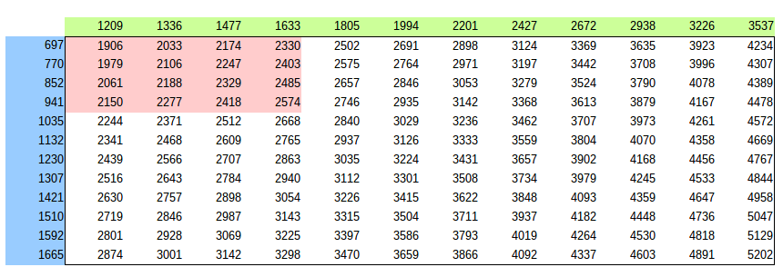
Design

Slide 7
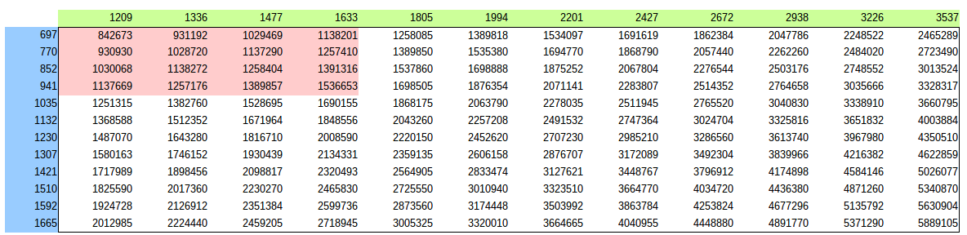
Design

Slide 8
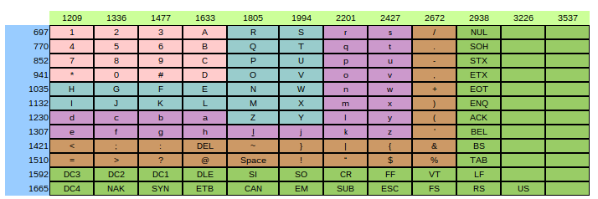
Design

Slide 9
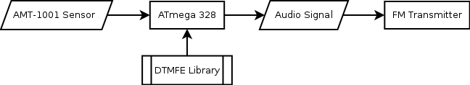
Design
Phew! Now to create our transmitter.

Slide 10
Capture
The signal:
- Can be heard on a radio
- Can be seen with GQRX
- Can be captured with rtl_sdr
- Can be parsed with Matlab/Octave

Slide 11
Matlab
We can create a file of IQ complex signal data.
Matlab has a nice function called decimate.
We can decimate the signal to remove other stations.
Then we can use convolution to demodulate the FM signal.

Slide 12
Matlab
Script Process:
- Parse .dat file to create easily managed signal.
- Filter the signal (2048000 / 16) = 128000Hz
- Separate Real/Img parts, perform convolution, multiply by signal and receive Mono Wideband FM
- Filter the signal down to 8KHz (128000 / 16) = 8000Hz
- Save audio file (auto normalizes for us)
- Parse audio file for ASCII data tones

Slide 13
Matlab
function [ dat ] = loadIQdat( file )
% loadIQdat
fid=fopen(file,'rb');
dat=fread(fid,'uint8=>double');
dat=dat-127.5;
dat=dat(1:2:end) + (1i*dat(2:2:end));
end

Slide 14
Matlab
function [y_FM_demodulated] = FM_IQ_Demod(y)
%This function demodualtes an FM signal. It is assumed that the FM signal
%is complex (i.e. an IQ signal) centered at DC and occupies less than 90%
%of total bandwidth.
b = firls(30,[0 .9],[0 1],'differentiator');
%design differentiater
d=y./abs(y);
%normalize the amplitude (i.e. remove amplitude variations)
rd=real(d);
%real part of normalized siganl.
id=imag(d);
%imaginary part of normalized signal.
y_FM_demodulated=(rd.*conv(id,b,'same')-id.*conv(rd,b,'same'))./(rd.^2+id.^2);
end

