Slide 1
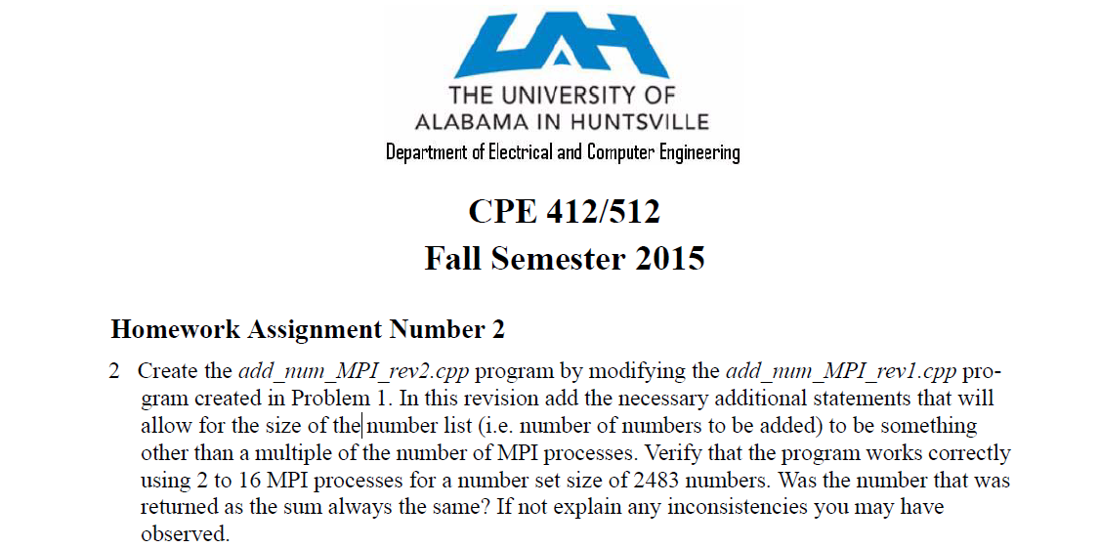
1.<number>

Slide 2
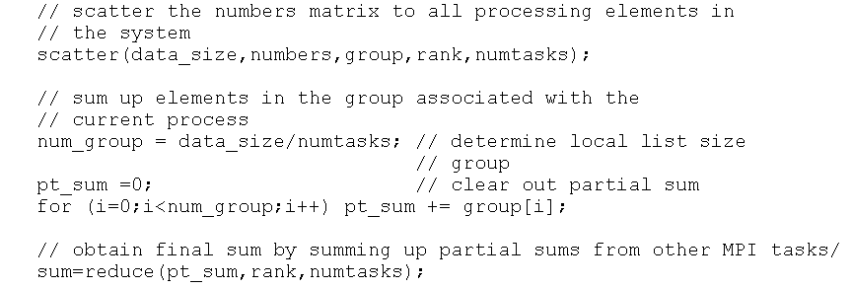
1.<number>

Slide 3
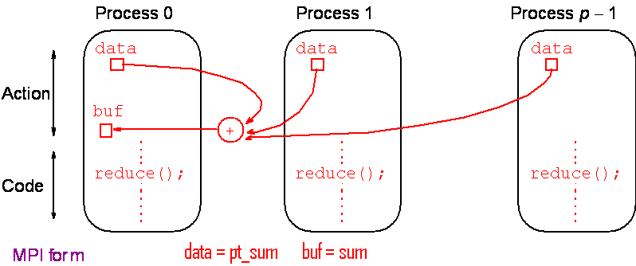
Reduce
Gather operation combined with specified arithmetic/logical operation.
Example: Values could be gathered and then added together by root:
1.<number>

Slide 4
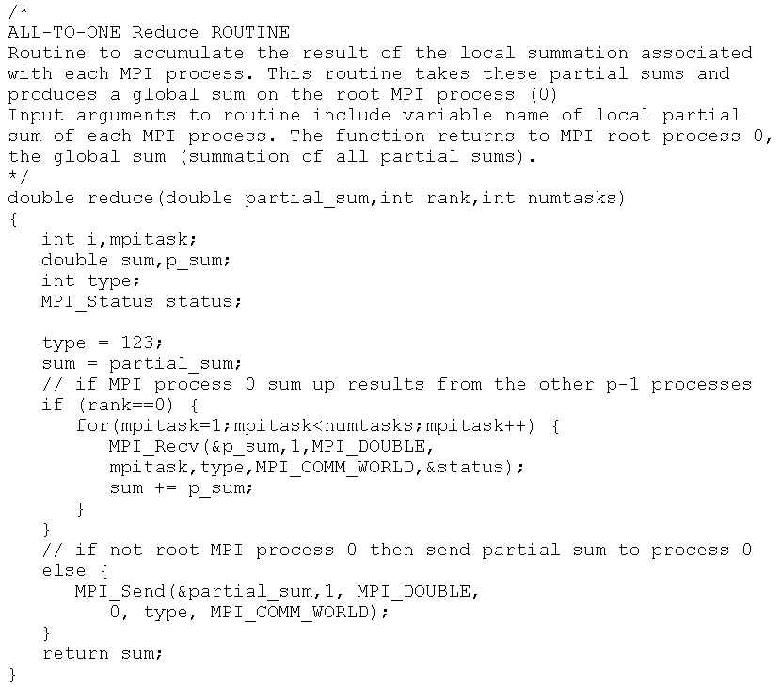
1.<number>

Slide 5
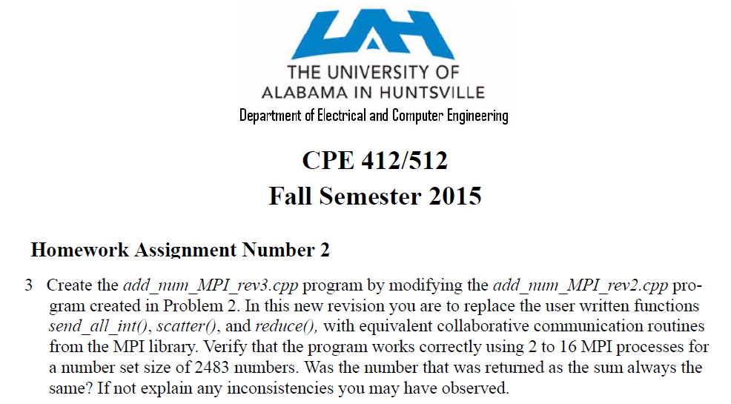
1.<number>

Slide 6
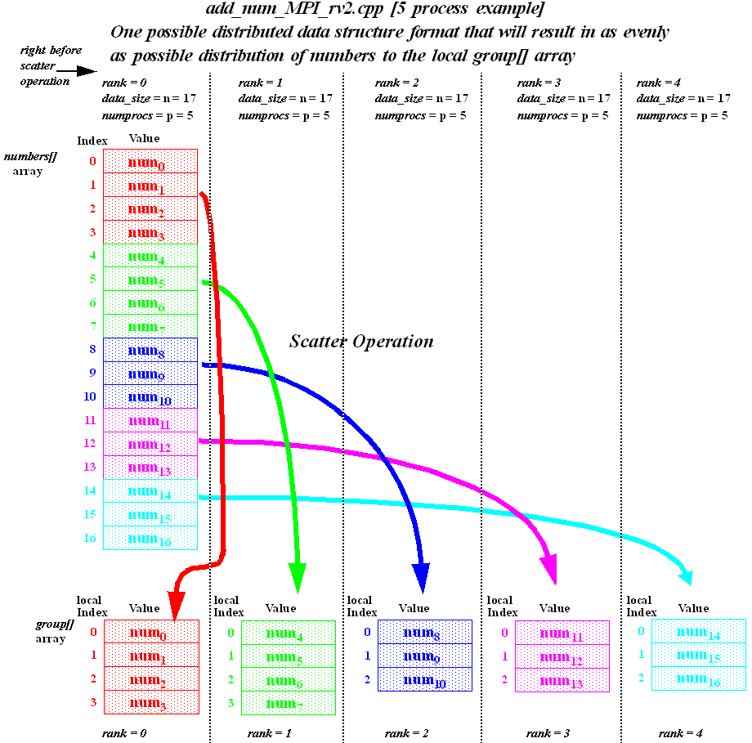
1.<number>

Slide 7
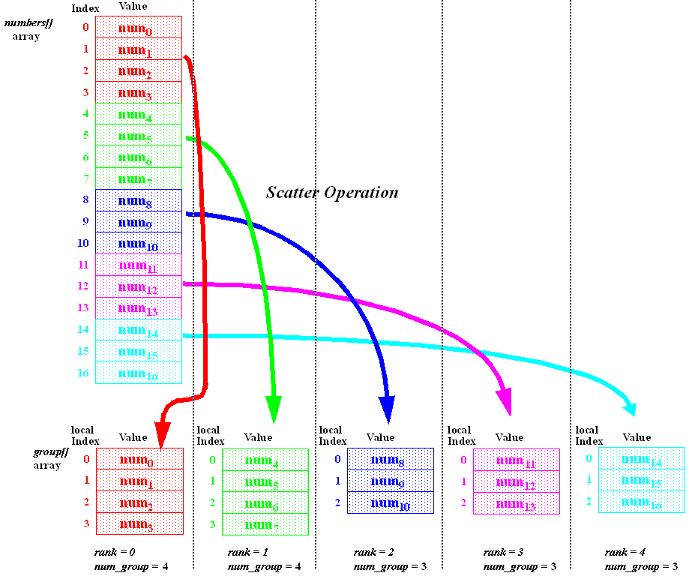
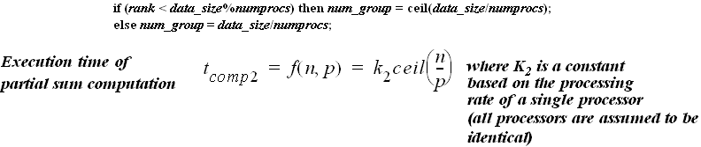
1.<number>

Slide 8
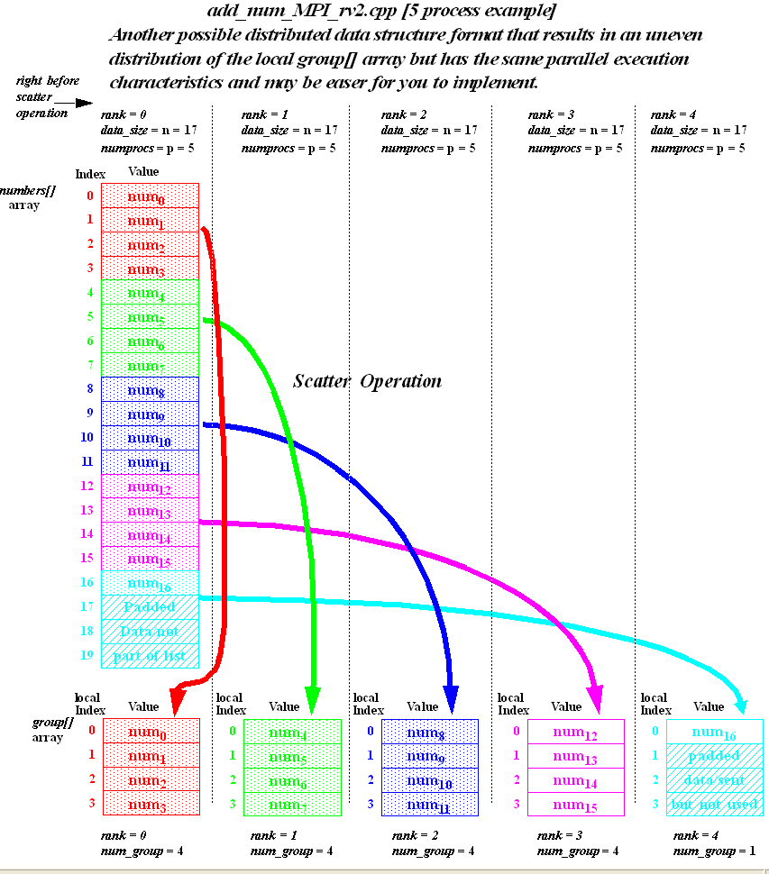
1.<number>

Slide 9
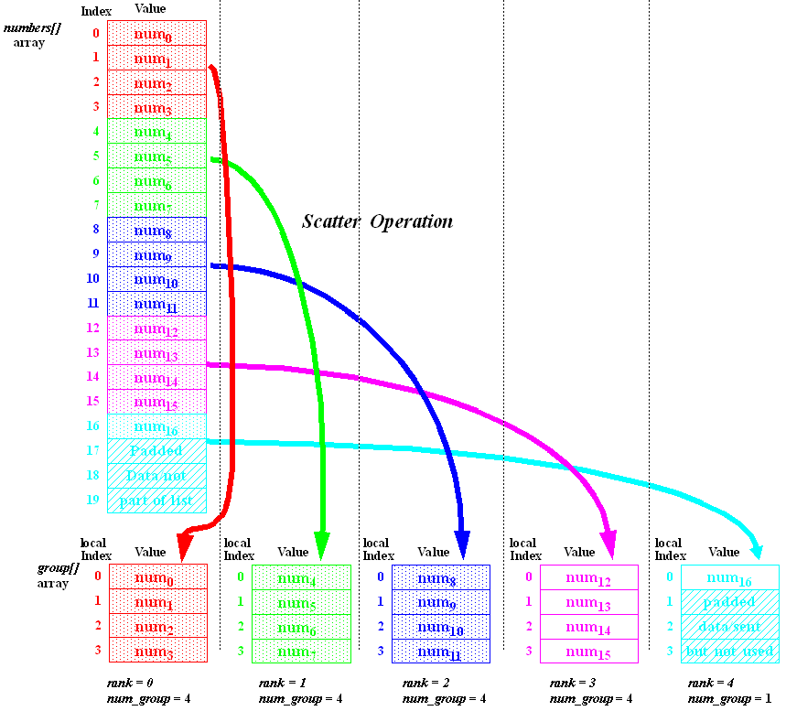
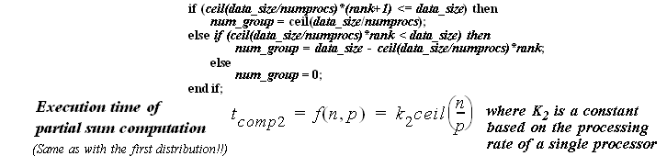
1.<number>

Slide 10
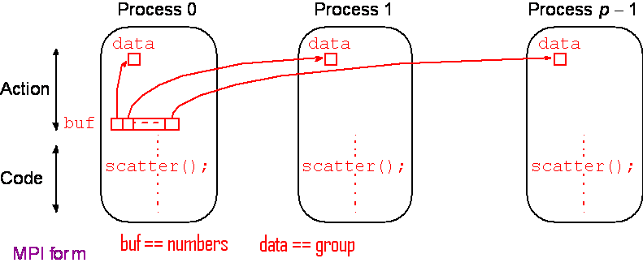
Scatter
Sending each element of an array in root process to a separate process. Contents of ith location of array sent to ith process.
1.<number>

Slide 11
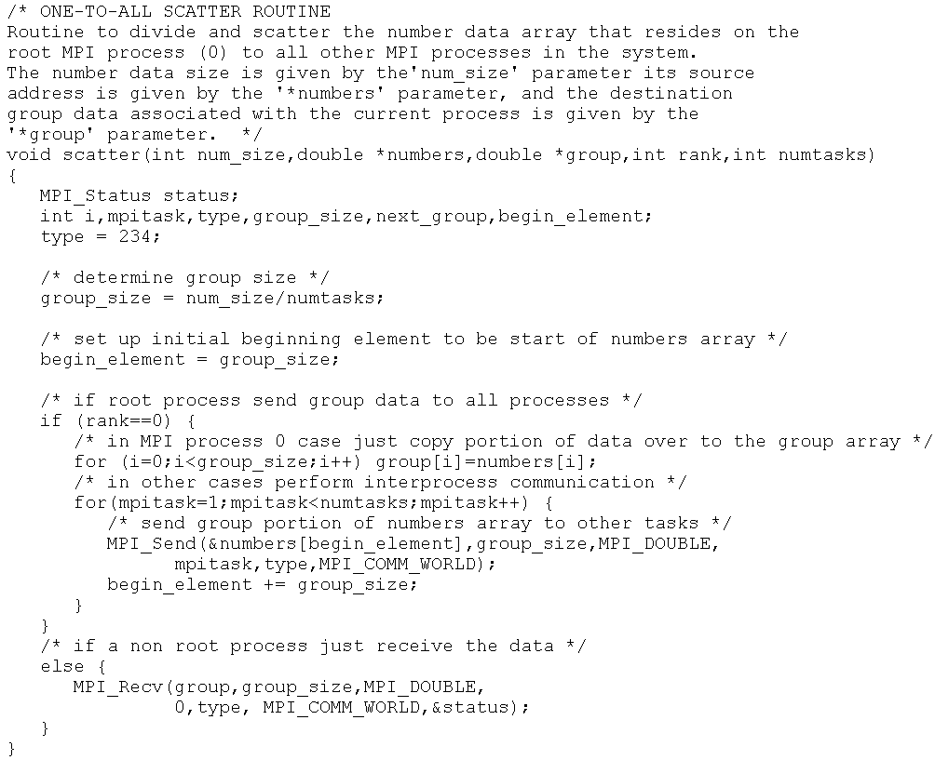
1.<number>

Slide 12
1.<number>

Slide 13
Collective Communication
Involves set of processes, defined by an intra-communicator. Message tags not present. Principal collective operations:
MPI_Bcast() - Broadcast from root to all other processes
MPI_Gather() - Gather values for group of processes
MPI_Scatter() - Scatters buffer in parts to group of processes
MPI_Alltoall() - Sends data from all processes to all processes
MPI_Reduce() - Combine values on all processes to single value
MPI_Reduce_scatter() - Combine values and scatter results
MPI_Scan() - Compute prefix reductions of data on processes
MPI_Barrier() - block all processes until all members have
reached the barrier call
1.<number>

Slide 14
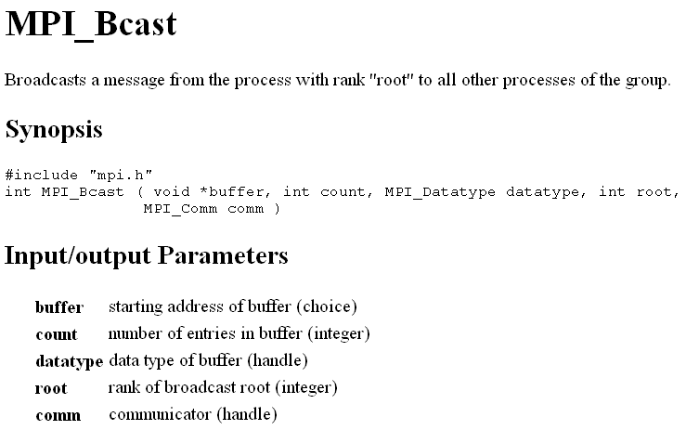
1.<number>

Slide 15
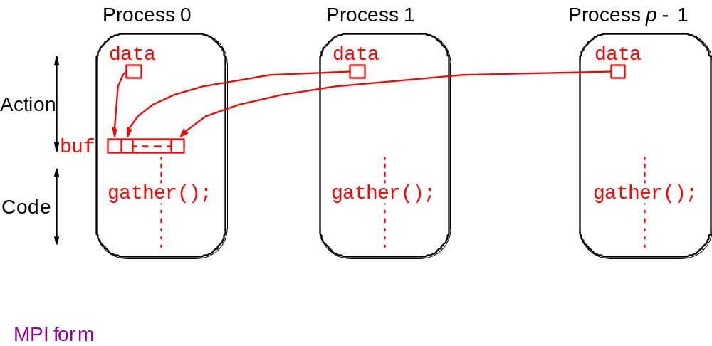
Gather
Having one process collect individual values from set of processes.
1.<number>

Slide 16
Example
To gather items from group of processes into process 0, using dynamically allocated memory in root process:
int data[10]; /*data to be gathered from processes*/
MPI_Comm_rank(MPI_COMM_WORLD, &myrank); /* find rank */
if (myrank == 0) {
MPI_Comm_size(MPI_COMM_WORLD, &grp_size); /*find group size*/
buf = (int *)malloc(grp_size*10*sizeof (int)); /*allocate memory*/
}
MPI_Gather(data,10,MPI_INT,buf,grp_size*10,MPI_INT,0,MPI_COMM_WORLD);
MPI_Gather() gathers from all processes, including root.
1.<number>

Slide 17
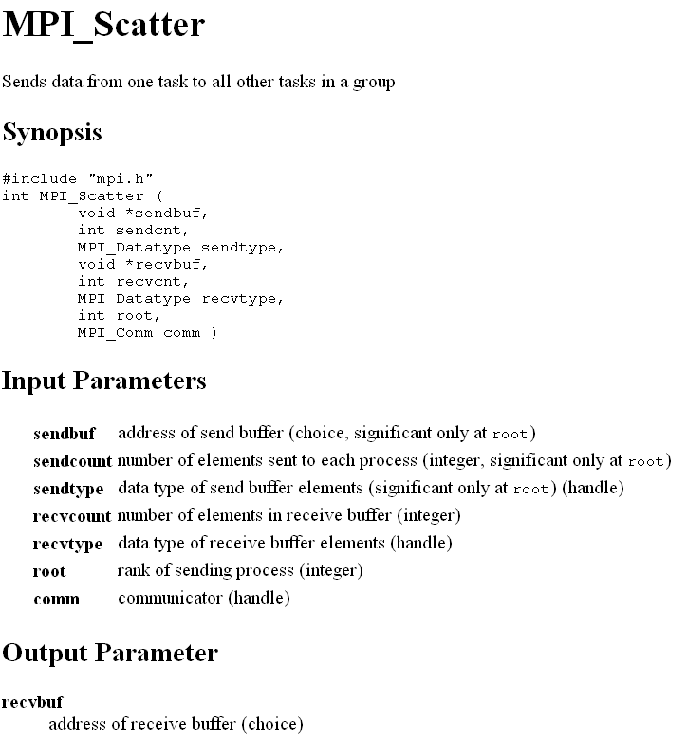
1.<number>

Slide 18
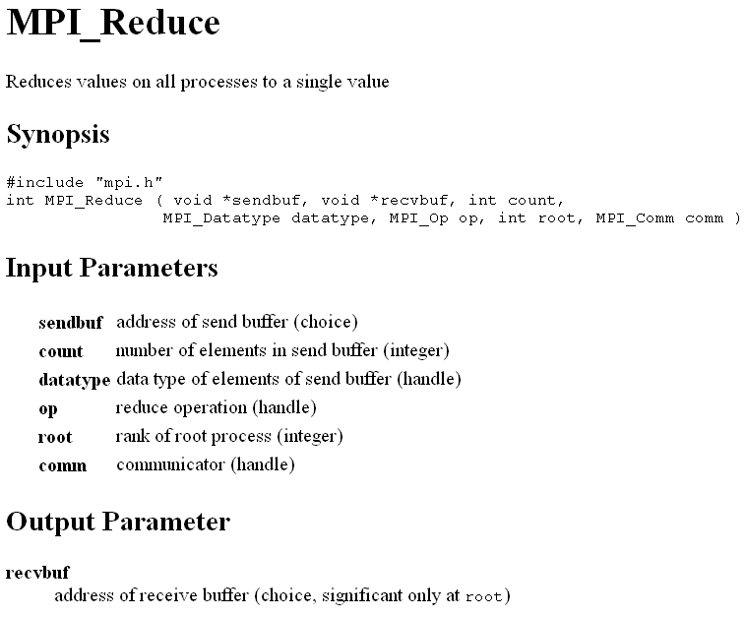
1.<number>

Slide 19
Reduction Operations
#define MPI_MAX (MPI_Op)(100)
#define MPI_MIN (MPI_Op)(101)
#define MPI_SUM (MPI_Op)(102)
#define MPI_PROD (MPI_Op)(103)
#define MPI_LAND (MPI_Op)(104)
#define MPI_BAND (MPI_Op)(105)
#define MPI_LOR (MPI_Op)(106)
#define MPI_BOR (MPI_Op)(107)
#define MPI_LXOR (MPI_Op)(108)
#define MPI_BXOR (MPI_Op)(109)
#define MPI_MINLOC (MPI_Op)(110)
#define MPI_MAXLOC (MPI_Op)(111)
1.<number>

Slide 20
Barrier
As in all message-passing systems, MPI provides a means of synchronizing processes by stopping each one until they all have reached a specific “barrier” call.
1.<number>

Slide 21
Synchronous Computations
In a (fully) synchronous application, all the processes synchronized at regular points.
Barrier
A basic mechanism for synchronizing processes - inserted at the point in each process where it must wait.
All processes can continue from this point when all the processes have reached it (or, in some implementations, when a stated number of processes have reached this point).
1.<number>
6.2

Slide 22
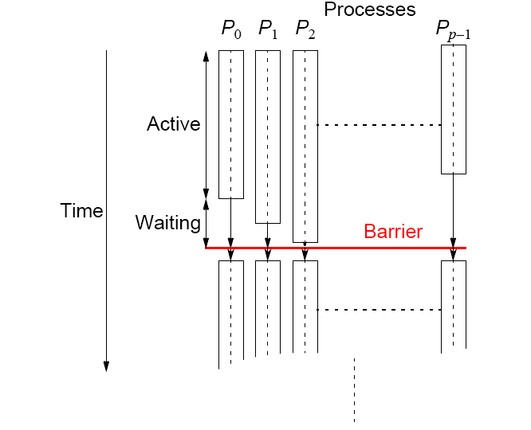
Processes reaching barrier
at different times
1.<number>
6.3

Slide 23
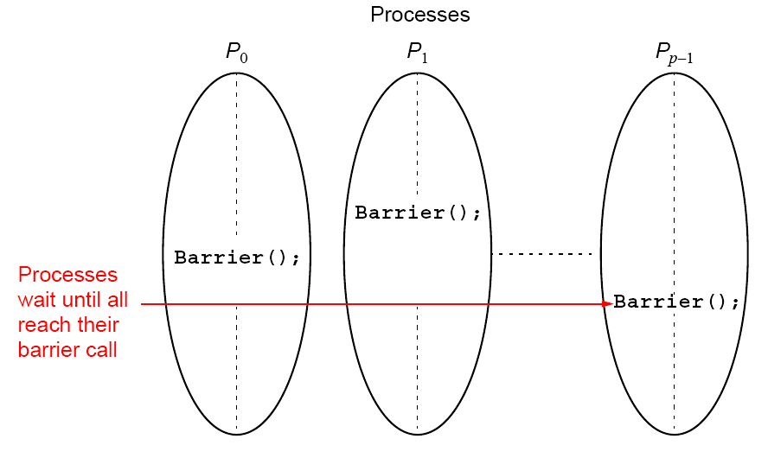
In message-passing systems, barriers provided with library
routines:
1.<number>
6.4

Slide 24
MPI
MPI_Barrier()
Barrier with a named communicator being the only parameter.
Called by each process in the group, blocking until all members of the group have reached the barrier call and only returning then.
1.<number>
6.5

Slide 25
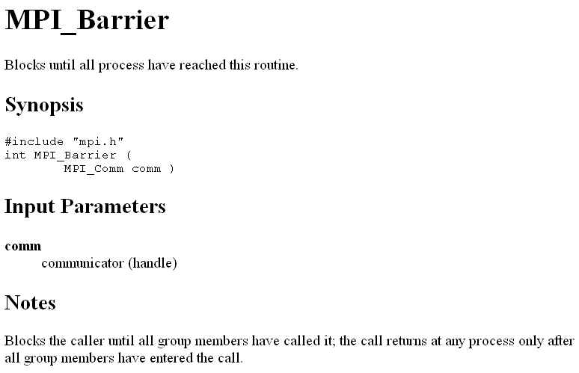
1.<number>

Slide 26
Evaluating Programs Empirically
Measuring Execution Time
To measure the execution time between point L1 and point L2 in the code, we might have a construction such as
.
L1: time(&t1); /* start timer */
.
.
.
L2: time(&t2); /* stop timer */
elapsed_time = difftime(t2, t1); /* elapsed_time = t2 - t1 */
cout << Elapsed time = ” << elapsed_time << endl;
MPI provides the routine MPI_Wtime() for returning time (in seconds).
1.<number>

Slide 27
Evaluating Programs Empirically
Measuring Execution Time
To measure the execution time in seconds between points in the code, we can utilize the built in MPI_Wtime() function
.
double t1,t2, elapsed_time; // declare variables as doubles
t1 = MPI_Wtime(); /* start timer */
.
.
.
t2 = MPI_Wtime(); /* stop timer */
elapsed_time = t2-t1; /* elapsed_time = t2 - t1 */
cout << “Elapsed time = “ << elapsed_time << endl;
1.<number>

Slide 28
Evaluating Programs Empirically
Measuring Execution Time
The resolution of the MPI_Wtime() function is system dependent. To determine its resolution on a particular implementation use the MPI_Wtick() function.
It returns, as a double precision value, the number of seconds between successive clock ticks.
.
double MPI_Wtick(); // declared in mpi.h file
cout << “Timer Resolution = “ << MPI_Wtick() << endl;
1.<number>

Slide 29
MPI Blocking Routines
Return when “locally complete” - when location used to hold message can be used again or altered without affecting message being sent.
Blocking send will send message and return - does not mean that message has been received, just that process free to move on without adversely affecting message.
1.<number>

Slide 30
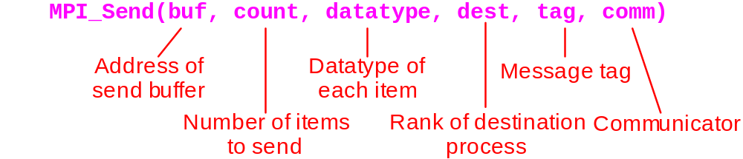
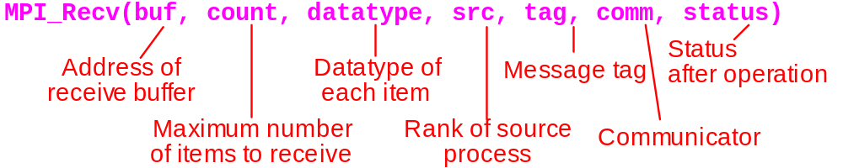
Parameters of MPI blocking point-to-point send & receive functions
1.<number>

Slide 31
MPI Nonblocking Routines
Nonblocking send - MPI_Isend() - will return “immediately” even before source location is safe to be altered.
Nonblocking receive - MPI_Irecv() - will return even if no message to accept.
1.<number>

Slide 32
Nonblocking Routine Formats
MPI_Isend(buf,count,datatype,dest,tag,comm,request)
MPI_Irecv(buf,count,datatype,source,tag,comm, request)
Completion detected by MPI_Wait() and MPI_Test().
MPI_Wait() waits until operation completed and returns then.
MPI_Test() returns with flag set indicating whether operation completed at that time.
Need to know whether particular operation completed.
Determined by accessing request parameter.
1.<number>

Slide 33
Example 1
To send an integer x from process 0 to process 1 and allow process 0 to continue,
MPI_Comm_rank(MPI_COMM_WORLD, &myrank); /* find rank */
if (myrank == 0) {
int x;
MPI_Isend(&x,1,MPI_INT, 1, msgtag, MPI_COMM_WORLD, &req1);
compute();
MPI_Wait(&req1, &status);
} else if (myrank == 1) {
int x;
MPI_Recv(&x,1,MPI_INT,0,msgtag, MPI_COMM_WORLD, &status);
}
1.<number>

Slide 34
Example 2
To send an integer x from process 0 to process 1 and allow process 0 to continue,
MPI_Comm_rank(MPI_COMM_WORLD, &myrank); /* find rank */
if (myrank == 0) {
int x;
x = 1;
MPI_Isend(&x,1,MPI_INT, 1, msgtag, MPI_COMM_WORLD, &req1);
x = 2; // computation that modifies x;
MPI_Wait(&req1, &status);
} else if (myrank == 1) {
int x;
MPI_Recv(&x,1,MPI_INT,0,msgtag, MPI_COMM_WORLD, &status);
}
Cannot know if receiver process variable x will get 1 or 2!
1.<number>

Slide 35
Four Send Communication Modes
Standard Mode Send - Not assumed that corresponding receive routine has started. Amount of buffering not defined by MPI. If buffering provided, send could complete before receive reached.
  Examples MPI_Send, MPI_Isend
1.<number>

Slide 36
Four Send Communication Modes
.
Buffered Mode - Send may start and return before a matching receive. Necessary to specify buffer space via routine MPI_Buffer_attach().
  Example: MPI_Bsend, MPI_Ibsend
    Note: The send will complete as soon as the send buffer is copied to the system buffer
1.<number>

Slide 37
Four Send Communication Modes
Synchronous Mode - Send and receive can start before each other but can only complete together.
  Example: MPI_Ssend, MPI_Issend
    Note: The send does not complete until after a matching receive has been posted
1.<number>

Slide 38
Four Send Communication Modes
Ready Mode - Send can only start if matching receive already reached, otherwise error. Use with care.
  Example: MPI_Rsend, MPI_Irsend
    Note: The send will send its data with the assumption that a matching receive has already been posted (if this is not the case then program will not function correctly!)
1.<number>

Slide 39
Each of the four modes can be applied to both blocking and nonblocking send routines.
Only the standard mode is available for the blocking and nonblocking receive routines.
Any type of send routine can be used with any type of receive routine.
1.<number>

Slide 40
Heat Transfer Example
The following compute_temp function is the heart of a one dimensional heat transfer simulation program that is designed to execute on any multiple of 2 processors (2, 4, 6, 8, etc.). The program computes the temperature at each point along a one dimensional metal strip at a set of points that are evenly distributed among the set of MPI processes. The input parameters are as follows: temp[] represents the even subset of points to be computed by a given MPI process, total_points represents the total number of points that the set of processors are to calculate the temperature (note: there are two additional points on either end of the line that serve as boundary conditions -- these are not included in the value of total_points parameter since the boundary conditions themselves are never computed and thus never change), num_iterations, represents the total number of iterations that are to occur (where each iteration represents a certain increment in time), rank is the process’ MPI rank id, and numprocs represents the total number of MPI processes in the system.
1.<number>

Slide 41
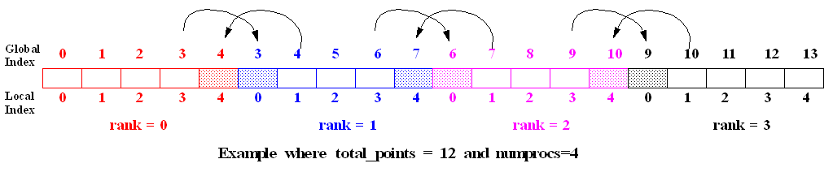
Data Parallelism
(Spatial Parallelism)
Data Parallelism may be possible when there are independent tasks that apply the same operation to different data items
1.<number>

Slide 42
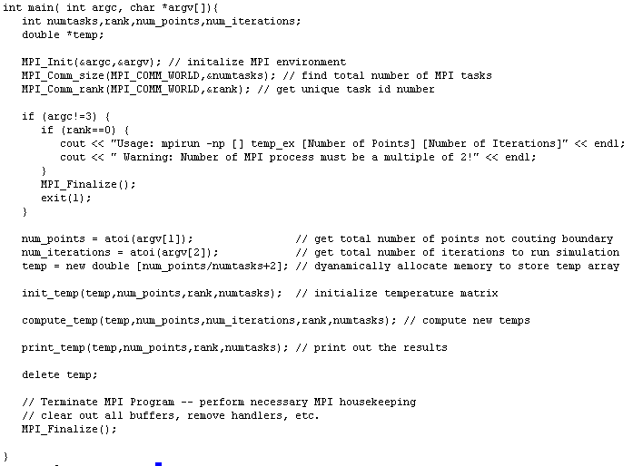
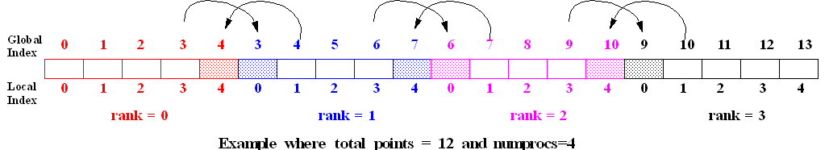
1.<number>

Slide 43
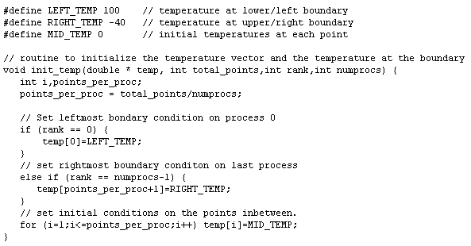
1.<number>

Slide 44
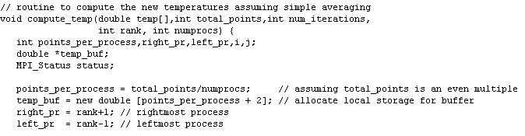
1.<number>

Slide 45
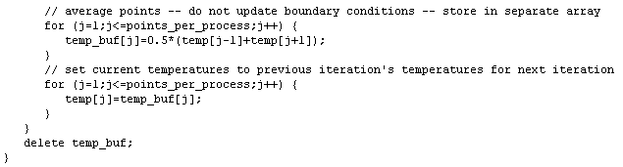
1.<number>

Slide 46
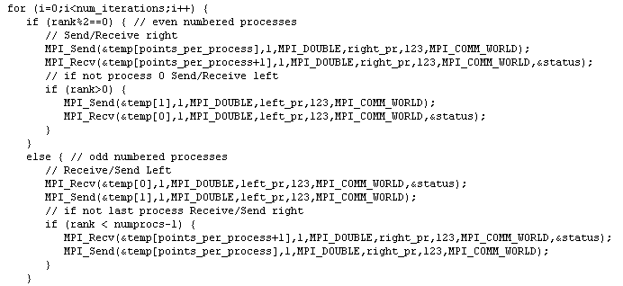
1.<number>

Slide 47
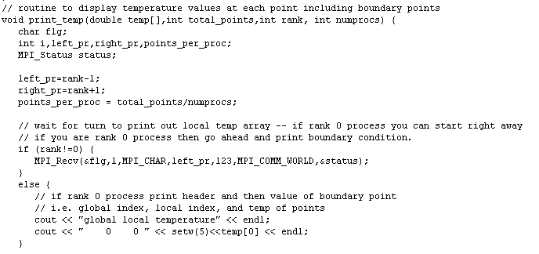
1.<number>

Slide 48
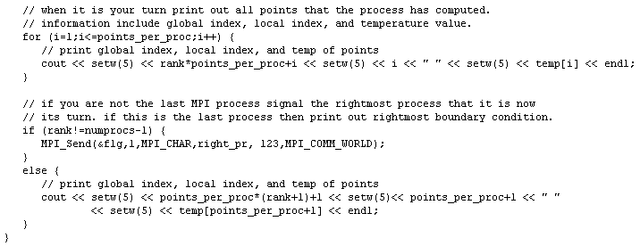
1.<number>

Slide 49
Heat Transfer Example
Timing analysis with Blocking Point-to-point com Routines
If it is assumed that the total_points parameter is an even multiple of numprocs and that all floating point operations are of unit time weight, determine a general expression for the parallel execution time of the compute_temp function. This expression should be an algebraic function of the parameters numprocs, total_points, num_iterations, and the Tstartup, and Tdata components of the MPI point-to-point message passing routines. Assume that the buffer size for this implementation is so small that the both the MPI_Send and the MPI_Recv routines will always block until the entire message has been transferred (i.e. assume they operate synchronously). Also assume that the network that is being used does not block simultaneous point-to-point transfers of data between distinct source and destination processor pairs (the very best case in this regard).
1.<number>

Slide 50
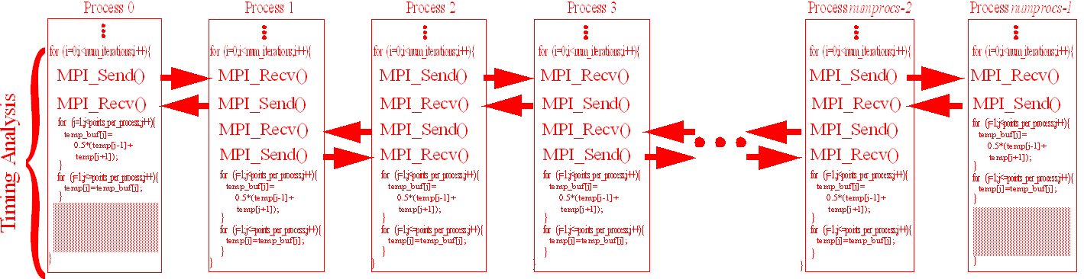
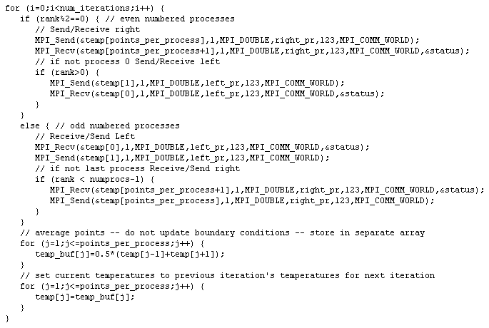
1.<number>

Slide 51
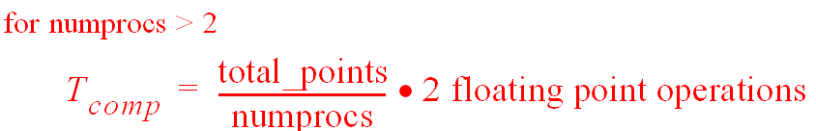
1.<number>

Slide 52
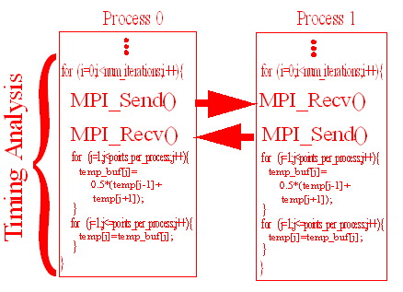



1.<number>

Slide 53
Heat Transfer Problem
Nonblocking Implementation of exchange operation
  Sends have to occur before receives
  Waits need to occur after receives to insure that there is no implementation dependent deadlocks
  Harder to analyze performance of nonblocking primatives
1.<number>

Slide 54
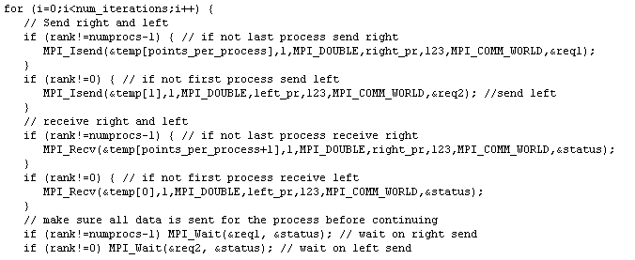
1.<number>

Slide 55
Heat Transfer Problem
Utilizing MPI_Sendrecv
  MPI_Sendrecv is a communication routine that is guaranteed not to deadlock
  Using it produces the most concise implementation of this problem
1.<number>

Slide 56
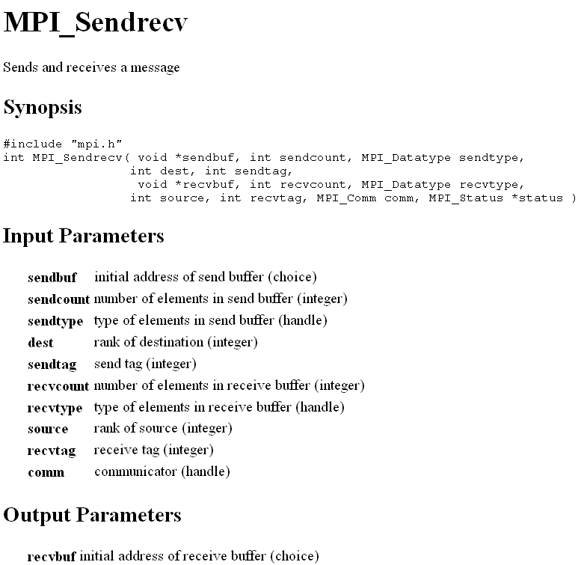
1.<number>

Slide 57
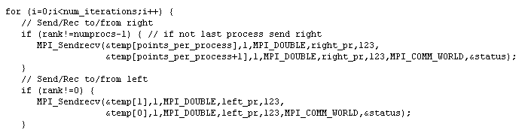
1.<number>

Slide 58
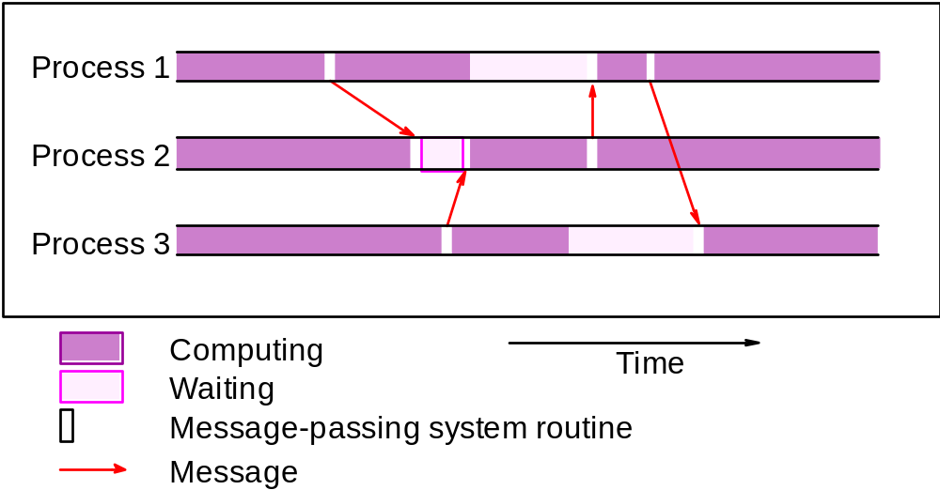
Debugging and Evaluating Parallel Programs Empirically
Profiling Tools
Programs can be watched as they are executed in a space-time diagram (or process-time diagram):
1.<number>

