Slide 1
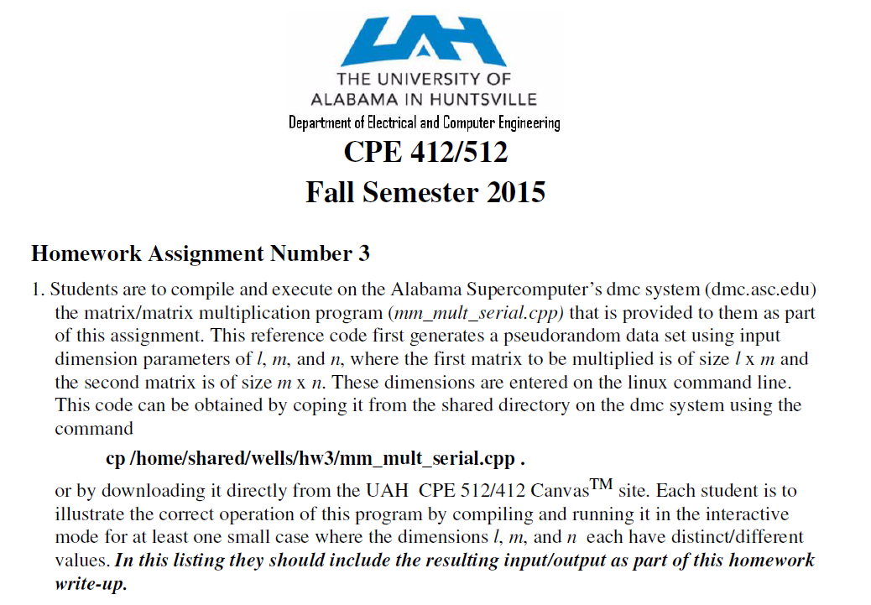
1.<number>

Slide 2
Matrix Multiplication

Slide 3
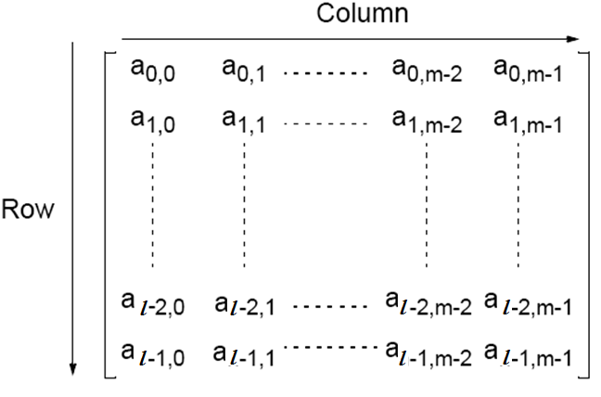
Matrices — A Review
An l x m matrix

Slide 4
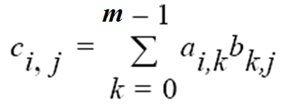
Matrix Multiplication
Multiplication of two matrices, A and B, produces the matrix C
whose elements, c_{i,j} (0 <= i < l, 0 <= j < n), are computed as follows:
where A is an l x m matrix and B is an m x n matrix.

Slide 5
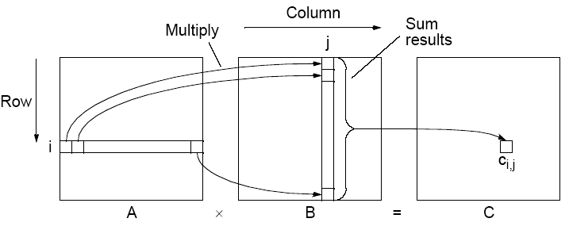
Matrix multiplication, C = A x B
1.<number>

Slide 6
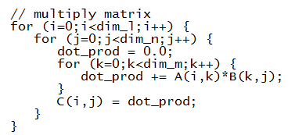
Matrix Multiplication
The sequential code to compute A x B could simply be
In the case where dim_l == dim_m == dim_n then this algorithm requires n³ multiplications and n³ additions, leading to a sequential time complexity of O(n³).

Slide 7
Contiguous/Dynamic Memory Issues
It is often desirable to allocate memory dynamically in C/C++
  cannot use M[num_rows][num_ columns] notation
  C allocation
    float *M;
    M= (int *) malloc(sizeof(float)*num_columns*num_rows);
  C++ allocation
    float *M;
    M= new (nothrow) float[num_columns*num_rows];
In case of multi-dimensional data location memory elements are determined based upon
  where memory begins and
  on how multi-dimensional data is stored in linear memory.

Slide 8
Row-ordered Storage in Dynamic Memory
  C allocation
    float *M;
    M= (int *) malloc(sizeof(float)*num_columns*num_rows);
  C++ allocation
    float *M;
    M= new (nothrow) float[num_columns*num_rows];
In C/C++ it is stored in row-ordered format
  rows are stored one after the other in memory, i.e. row 0 then row 1 etc
M_{0,0}
M_{0,1}
M_{0,2}
M_{0,3}
M_{1,0}
M_{1,1}
M_{1,2}
M_{1,3}
M_{2,0}
M_{2,1}
M_{2,2}
M_{2,3}
M_{3,0}
M_{3,1}
M_{3,2}
M_{3,3}
M
M_{0,0}
M_{0,1}
M_{0,2}
M_{0,3}
M_{1,0}
M_{1,1}
M_{1,2}
M_{1,3}
M_{2,0}
M_{2,1}
M_{2,2}
M_{2,3}
M_{3,0}
M_{3,1}
M_{3,2}
M_{3,3}

Slide 9

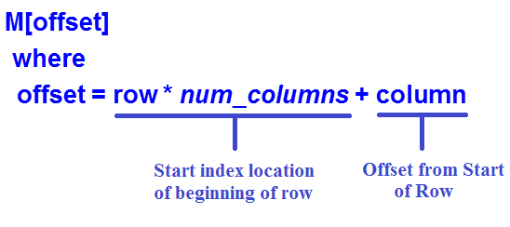


Row-ordered Storage in Dynamic Memory
(representing a 2-D data structure as a 1-D array)
Number of columns,
num_columns
column
0
N-1
0
row
1.<number>

Slide 10
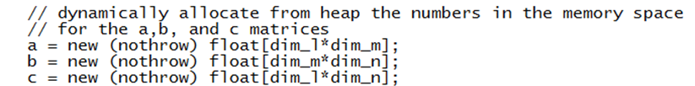
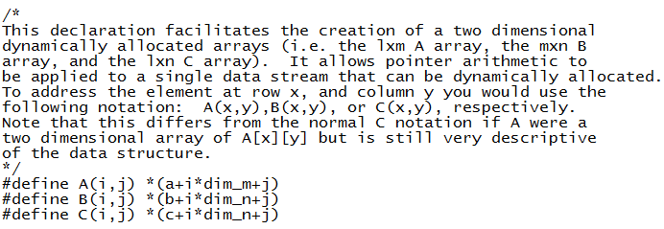
Dynamic 2-D memory allocation and
Usuage in the mm_mult_serial.cpp file
1.<number>

Slide 11
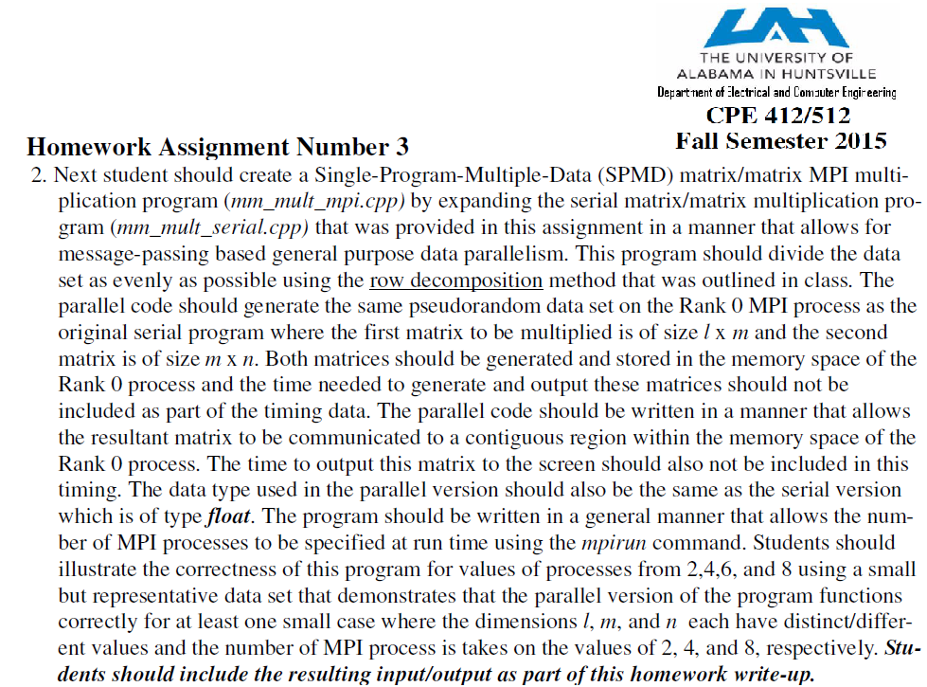
1.<number>

Slide 12
Parallel Code
With n processors (and n x n matrices), can obtain:
• Time complexity of O(n²) with n processors
Each instance of inner loop independent and can be done
by a separate processor
• Time complexity of O(n) with n² processors
One element of A and B assigned to each processor.
Cost optimal since O(n³) = n x O(n²) = n² x O(n)].
• Time complexity of O(log n) with n³ processors
By parallelizing the inner loop. Not cost-optimal since
O(n³) < n³xO(log n)).
O(log n) lower bound for parallel matrix multiplication.
1.<number>

Slide 13
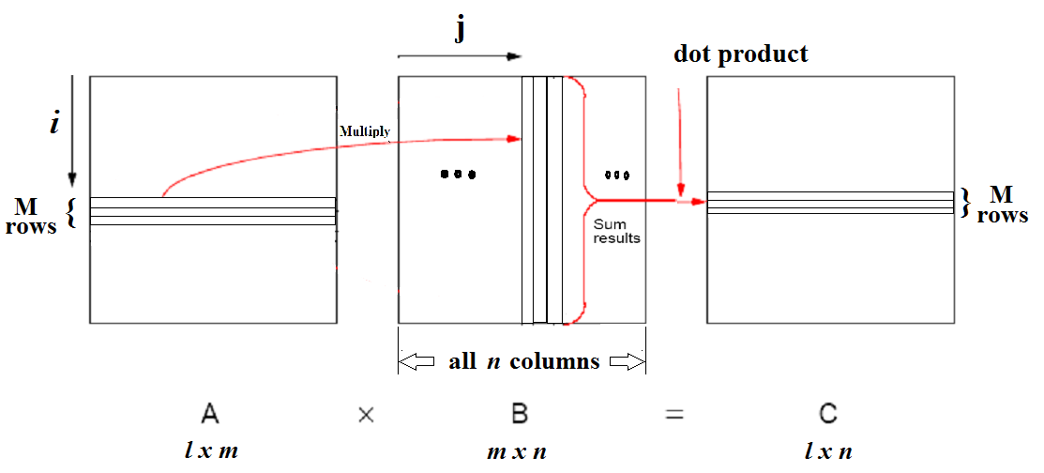
Matrix Multiplication
(row decomposition)

Slide 14
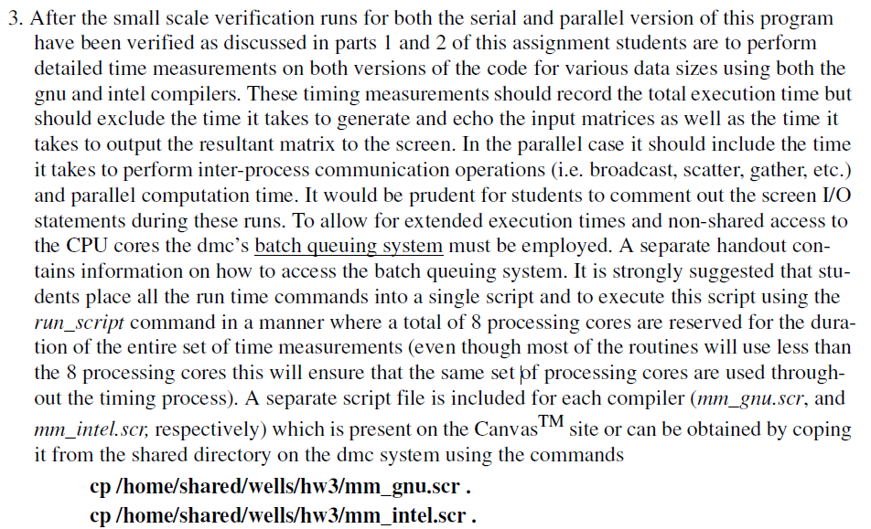

Slide 15
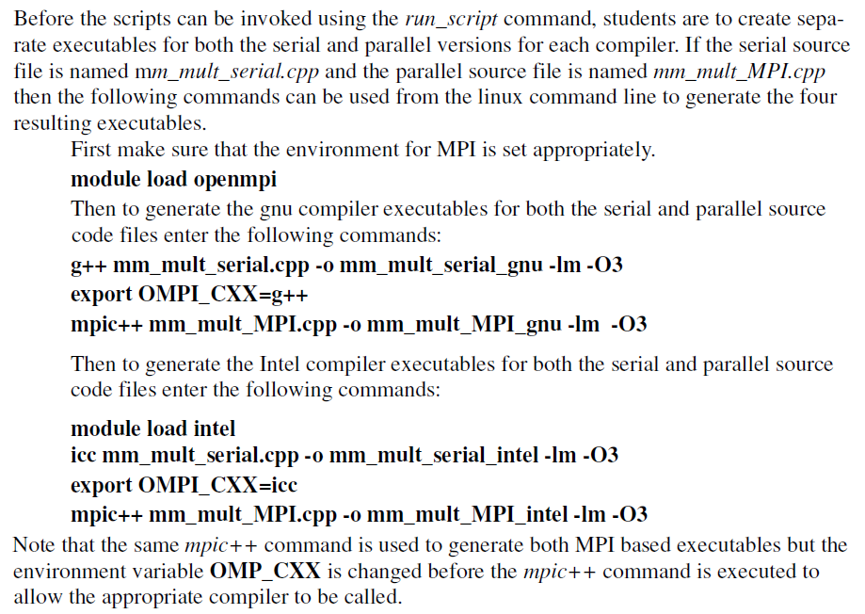

Slide 16
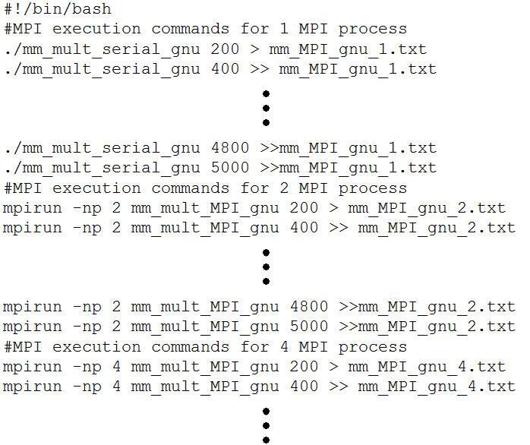
mm_gnu.scr file

Slide 17
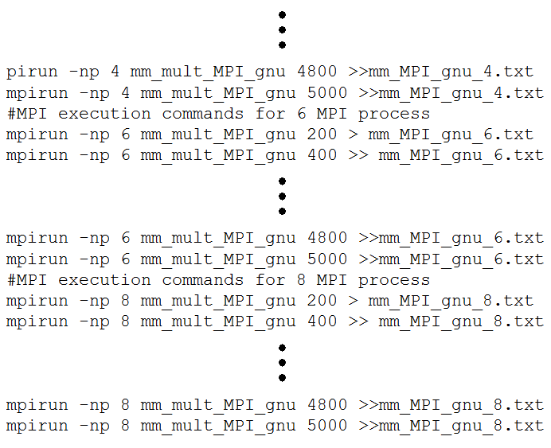
mm_gnu.scr file

Slide 18
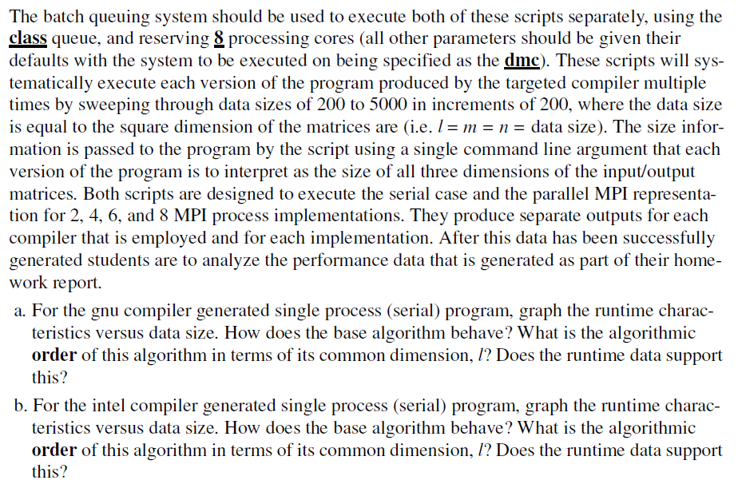

Slide 19
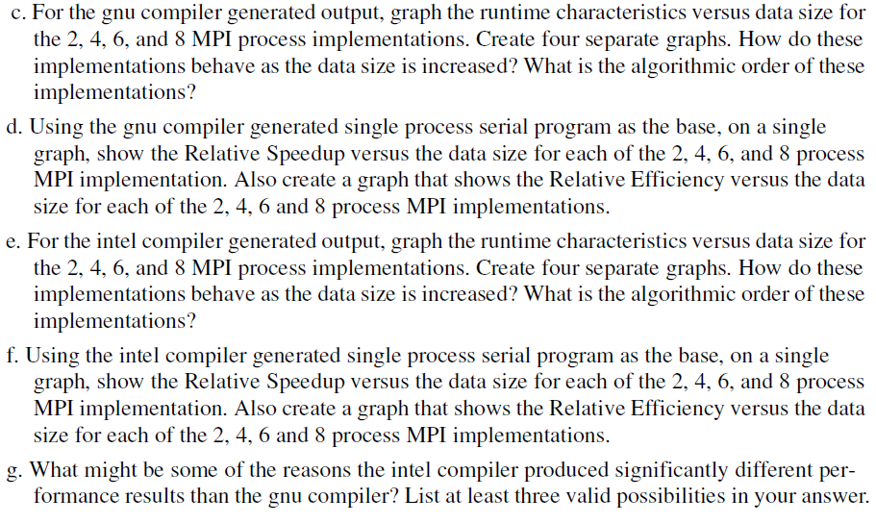

Slide 20
1.<number>

Slide 21
Some Example Data
The following represents some example data that came from similar experiments executed on some legacy systems.
This is to aid in describing the types of results – your experiments were run under different conditions and your results may be significantly different from these!

Slide 22
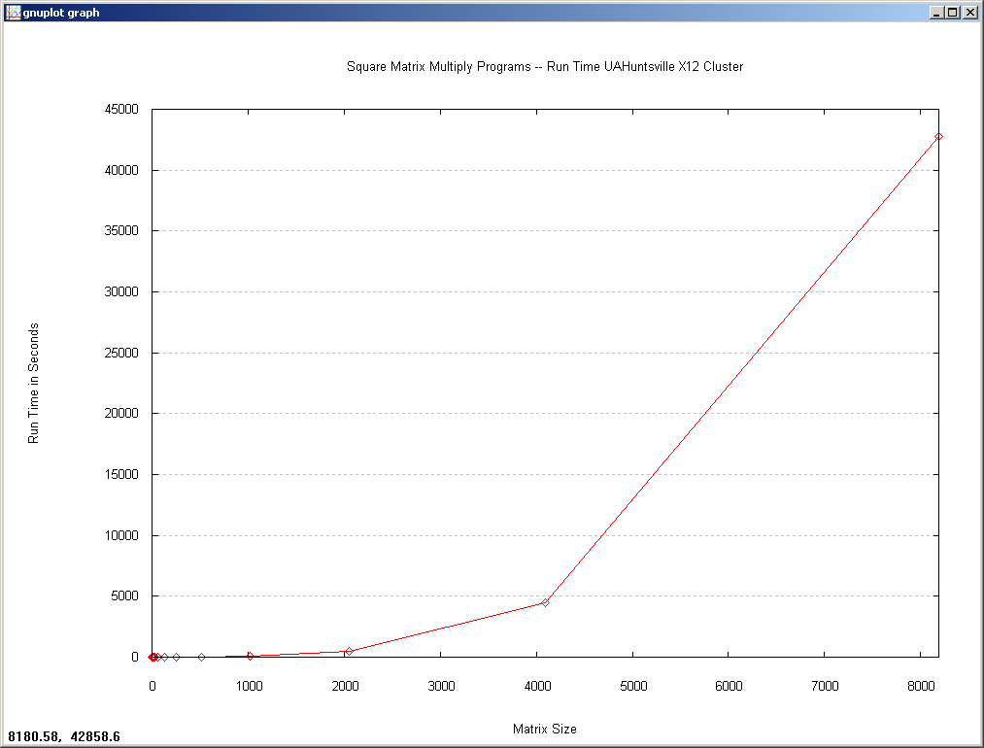

Slide 23
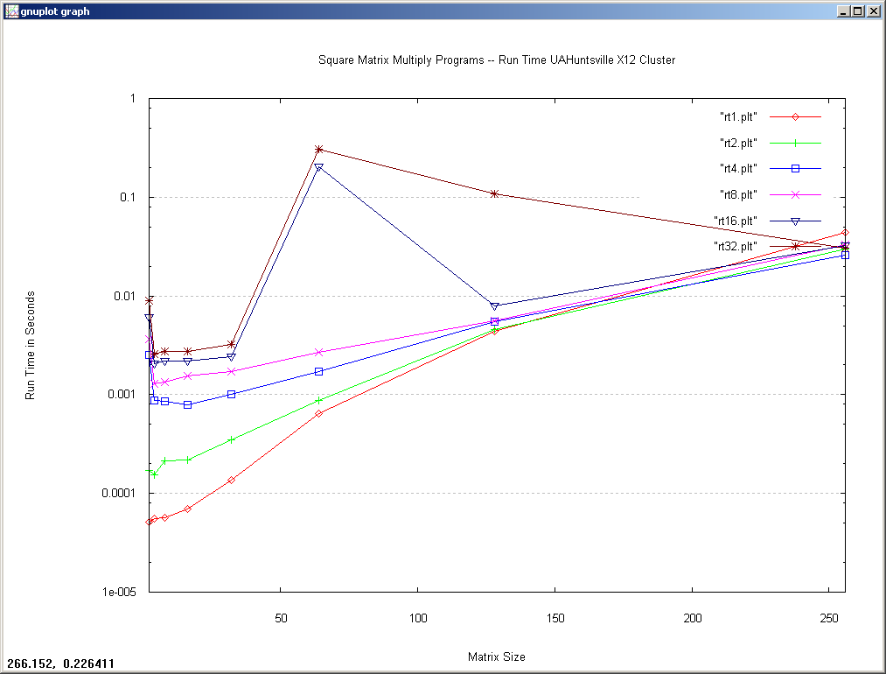

Slide 24
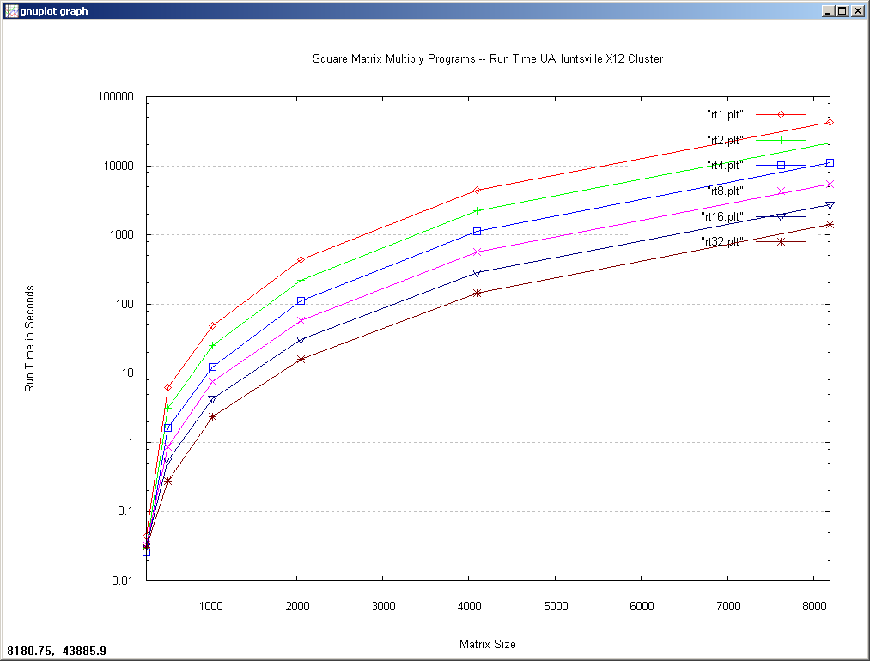

Slide 25
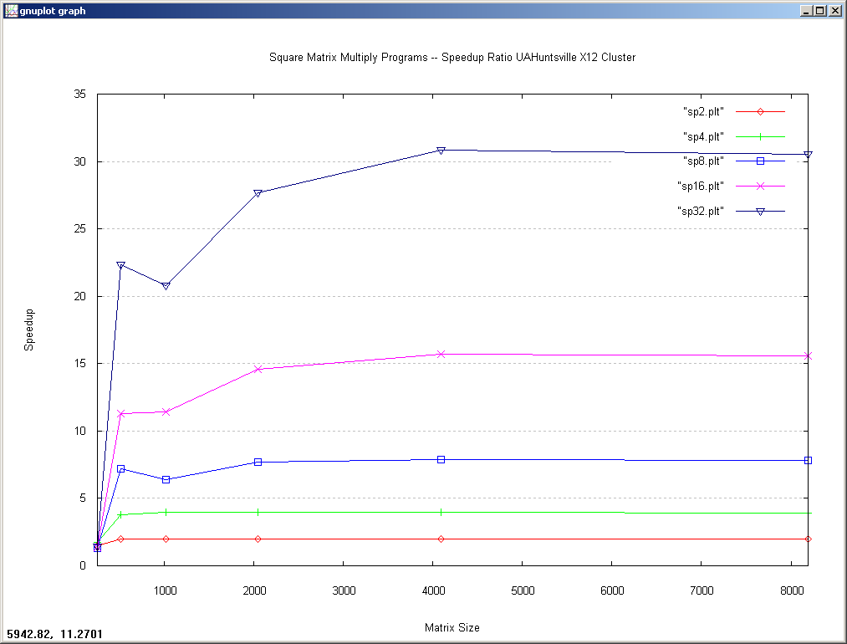

Slide 26
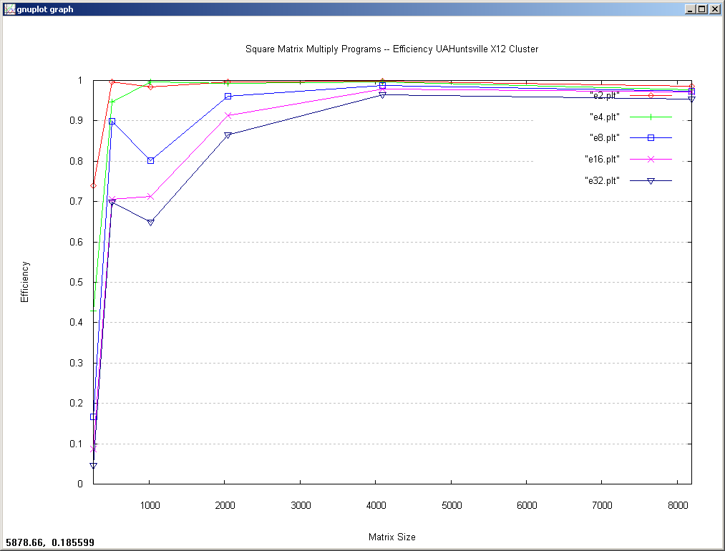

Slide 27
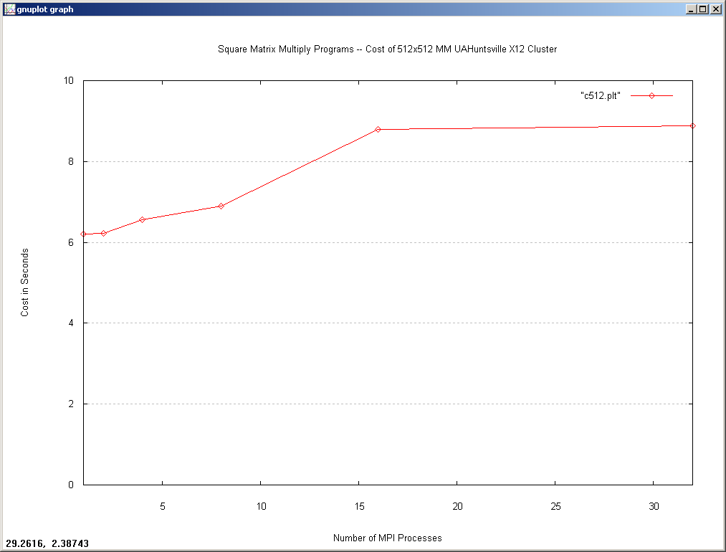

Slide 28
