Slide 1

APC Violation system
Members:
Shogo Roxxy Serra
Elijah Angelo Alcarde

Slide 2
PROBLEM STATEMENT
Students have to inquire to the Disciplinary Officer to keep track of their violations. Thus, their scholarship will be at risk if they failed to appeal the committed violations.
Since students know that most of the violations written in the handbook is not implemented properly, they become conceited and still commit actions that are considered as a violation, e.g., public display of affection, self-bussing, dress code violation.

Slide 3
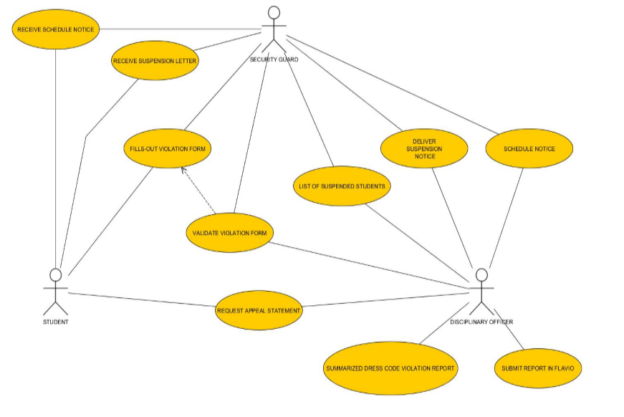

Slide 4
Solution
Provide a web-based violation system which will have an efficient means of communication between the students and the Disciplinary Officer.

Slide 5
objectives
To protect students from losing their scholarship. Thus, keeping track of the violations that the student have committed will be the key.
To deter students from committing violations. Thus, promoting discipline among the student body.
To provide a trend analysis for each term and the corresponding academic school year.

Slide 6
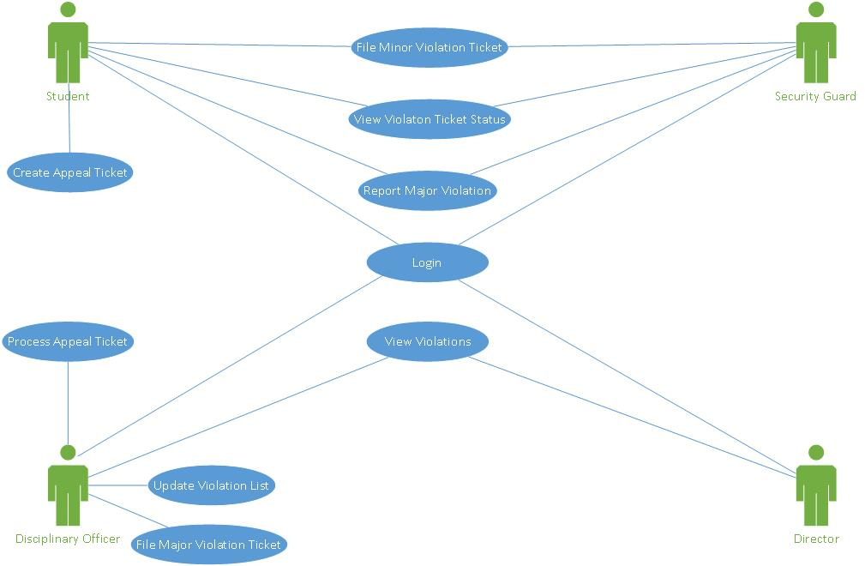

Slide 7
General features
There will be an admin page to create, read, update violation list.
There will be a student page to view violations and create appeal ticket.
There will be notifications in the student page, wherein they will know if they committed a violation, or if they are required to have a meeting with the Disciplinary Officer.

Slide 8
Dress code violation Module
There will be an admin page to create, read, update violation list.
There will be a student page to view violations and create appeal ticket.
There will be notifications in the student page, wherein they will know if they committed a violation, or if they are required to have a meeting with the Disciplinary Officer.

Slide 9
Major and minor offense filing module
The Disciplinary Officer can update the list of violations if there is any revisions in the student hand book.
Final decision for sanctions will be on the discretion of the Disciplinary Officer.

Slide 10
Major and Minor Offense Reporting module
Security guards and students can create a narrative report to report an incident within or outside the school premises.
Reports created by students shall not be anonymous.

Slide 11
Benefits
Seamless reporting and filing of violations.
Students will be aware of the violations they have committed; thus, it will promote discipline to the student body.
Students who have committed a violation, but for a valid reason will be able to easily appeal to the Disciplinary Officer through the Student Page.
If there will be any future revisions in the student hand book, the Disciplinary Officer could change the violation list and its details.

Slide 12
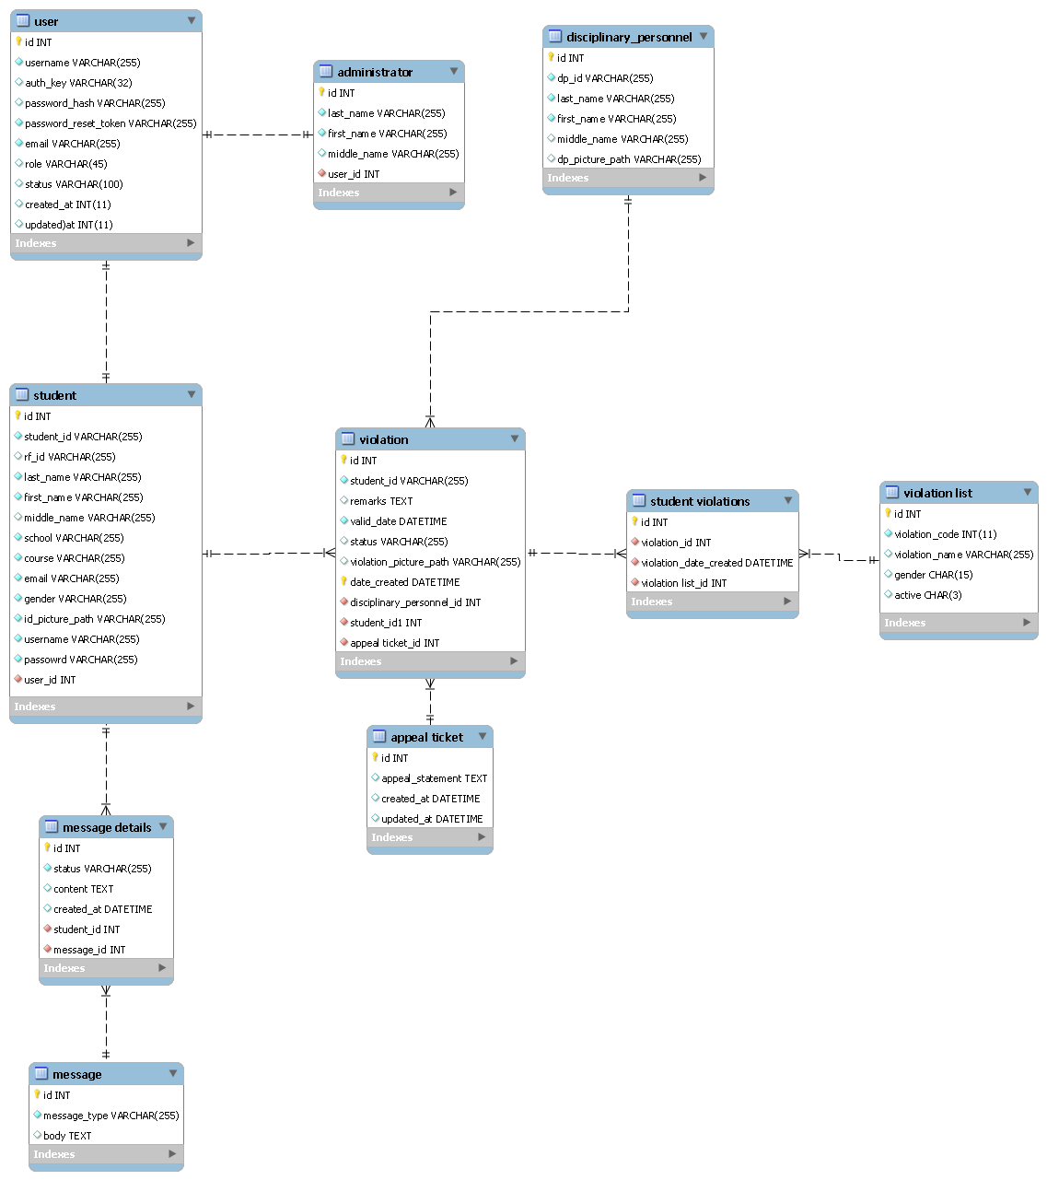

Slide 13
