Slide 1

Student discipline monitoring system
Members:
Serra, Shogo Roxy
Alcarde, Elijah Angelo

Slide 2
objectives
To protect students from losing their scholarship. Thus, keeping track of the violations that the student have committed will be the key.
To deter students from committing violations. Thus, promoting discipline among the student body.
To provide an adaptive violation system where the Disciplinary Officer can manage offenses according to the changes in the student handbook.
To provide a system which promotes ease of communication between a student and the Disciplinary Officer.

Slide 3
PROBLEM STATEMENT
Students have to inquire to the Disciplinary Officer to keep track of their violations. Thus, their scholarship will be at risk if they failed to appeal the committed violations.
Since students know that most of the violations written in the handbook is not implemented properly, they become conceited and still commit actions that are considered as a violation, e.g., public display of affection, self-bussing, dress code violation.

Slide 4
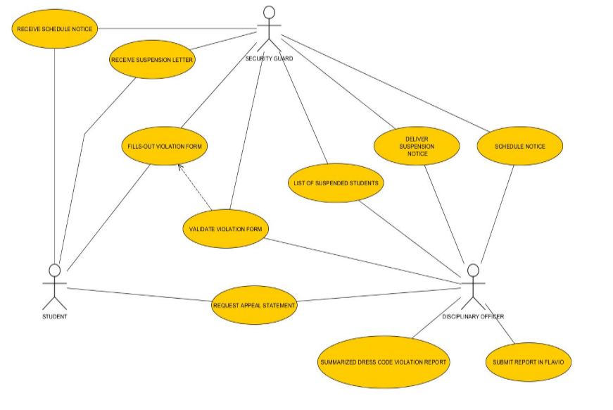
Business Use case

Slide 5
Solution
Provide a web-based violation system which will have an efficient means of communication between the students and the Disciplinary Officer.

Slide 6
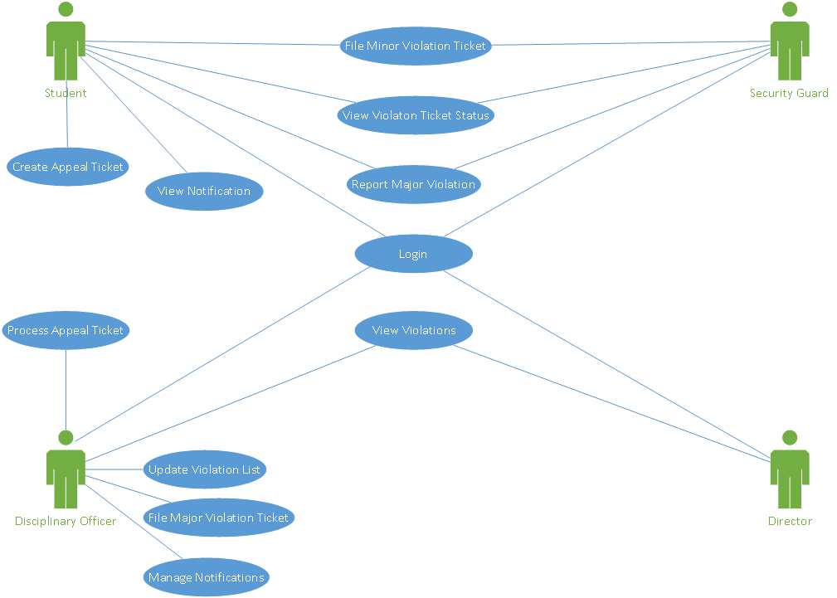
System Use case

Slide 7
General features
There will be an admin page to create, read, update violation list.
There will be a student page to view violations and create appeal ticket.
The web application will be usable in desktop and mobile browsers.

Slide 8
Dress code violation Module
The student either taps his id or type his student id number if a violation will be issued.
The security guard must takes a picture of the student, and saves it in the violation form.
The security guard must confirm the violation form by tapping his id to the scanner, before submitting it.

Slide 9
Major and minor offense filing module
The Disciplinary Officer can update the list of violations if there is any revisions in the student hand book.
Final decision for sanctions will be on the discretion of the Disciplinary Officer.

Slide 10
Notifications module
There will be notifications in the student page, wherein they will know if they committed a violation, or if they are required to have a meeting with the Disciplinary Officer.
The Disciplinary Officer can schedule a meeting with a student.

Slide 11
Summarized Violation reports
The administrator can view the violations of student, and sort them according to terms and school year.

Slide 12
Benefits
Seamless reporting and filing of violations.
Students will be aware of the violations they have committed; thus, it will promote discipline to the student body.
Students who have committed a violation, but for a valid reason will be able to easily appeal to the Disciplinary Officer through the Student Page.
If there will be any future revisions in the student hand book, the Disciplinary Officer could change the violation list and its details.

Slide 13
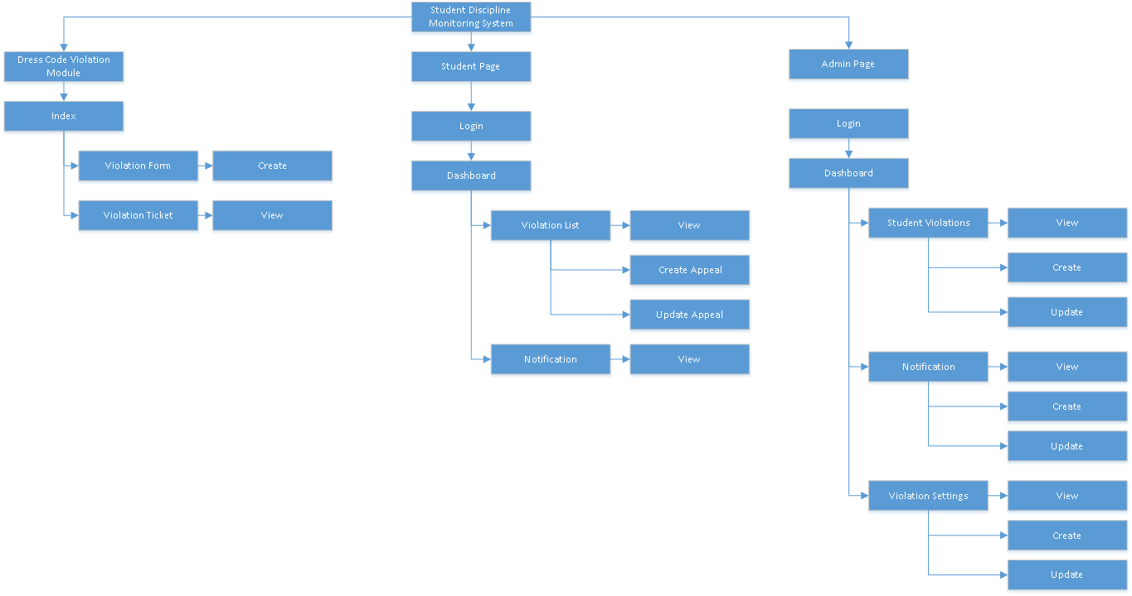
Sitemap

Slide 14
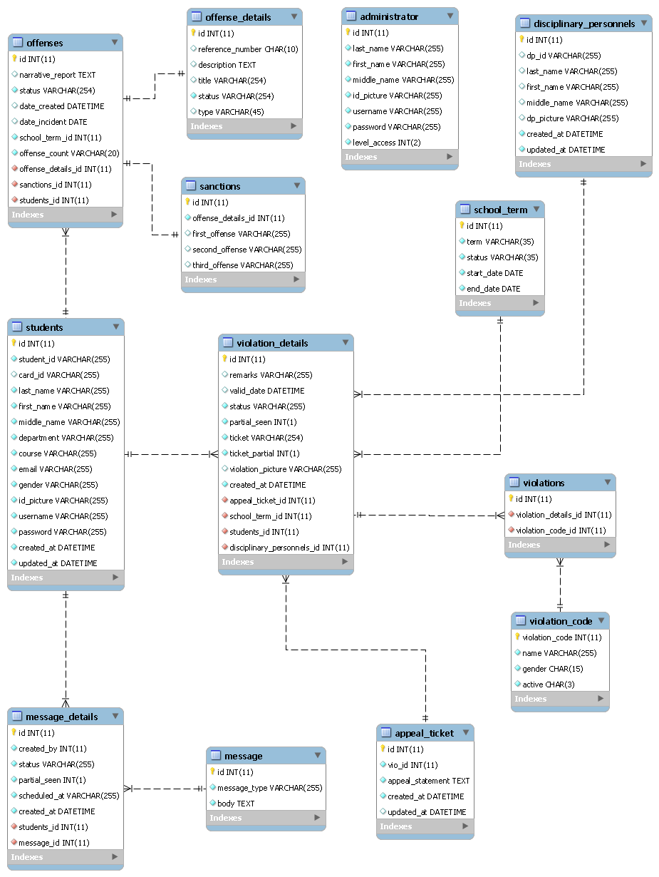

Slide 15
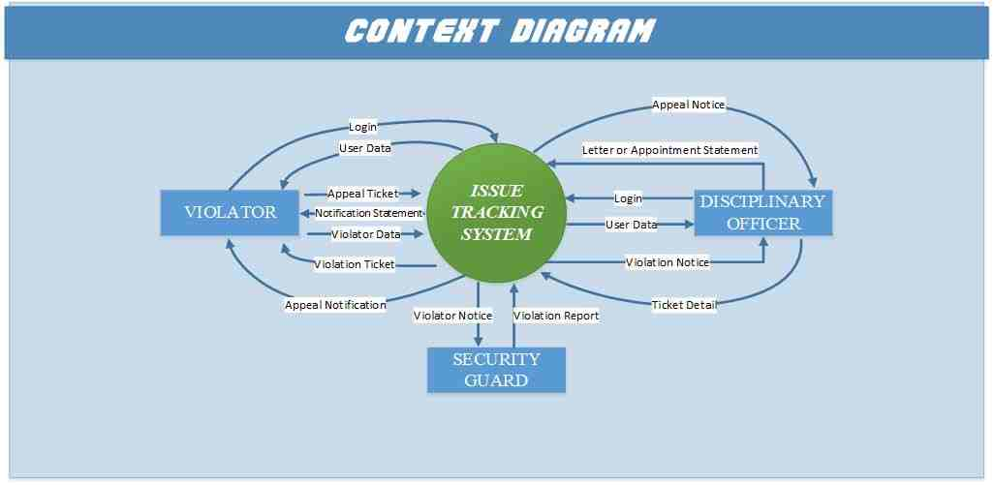

Slide 16
