Slide 1

CPSC 2350 Project
Feb 19, 2022
Instructor: Parsa, Rajabi
Group 4: Joon, Hahn. Christopher, Tan. Hector, Onato

Slide 2
Overview
A web application that tells a city’s weather in 3 ways: Minute, hourly and daily. It will also include a media section that shows weather related news and a map displaying the city and its surrounding weather information that is color coded for air temperature.

Slide 3
SDLC
Model: Prototyping
We chose to use the prototyping model because our research deemed it very beginner friendly. We prefer having a clear representation of our project before starting the development so that we can discuss any features we may want to add/remove prior.

Slide 4
User stories
1) Weather API
-As Max, I want to play outdoor basketball, so we don’t have to reserve an indoor court.
-As Julia, I want to invite my friends, so we can enjoy brunch in our backyard.

Slide 5
User stories
2) News API
-As kevin, I want to know the most interesting news in the town, so I have something to say at dinner table.
-As Fred, I want to know more about the city, so I can write more in my travel diary.

Slide 6
Technology stack
HTML: to create web page
CSS: to beautify the web page
JAVASCRIPT: To interact between client-side and server side
REACTJS: to make the web page fast and simple.

Slide 7
APIs
1_ One call api:
A)Minute forecast
B)Hourly forecast
C)Daily forecast
2_News api:
A)Displays the name of the city from the weather api
B)Displays recent news from the city
C)Displays news from the past 7 days
3_Weather map api:
A) Displays the current weather map
B) Forecast weather maps for 4 days (96 measurements)
C) Historical weather map archive since 14 September, 2020
4_Weather Statistic api:
Displays the statistical data for:
A) Temperature and Pressure
B) Humidity and Wind
C) Precipitation and Clouds

Slide 8
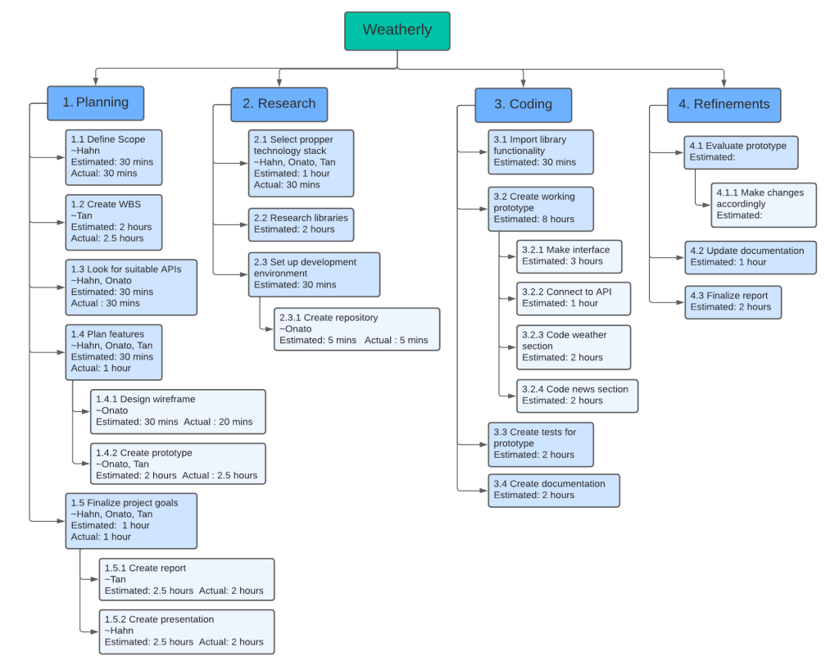
WBS

Slide 9
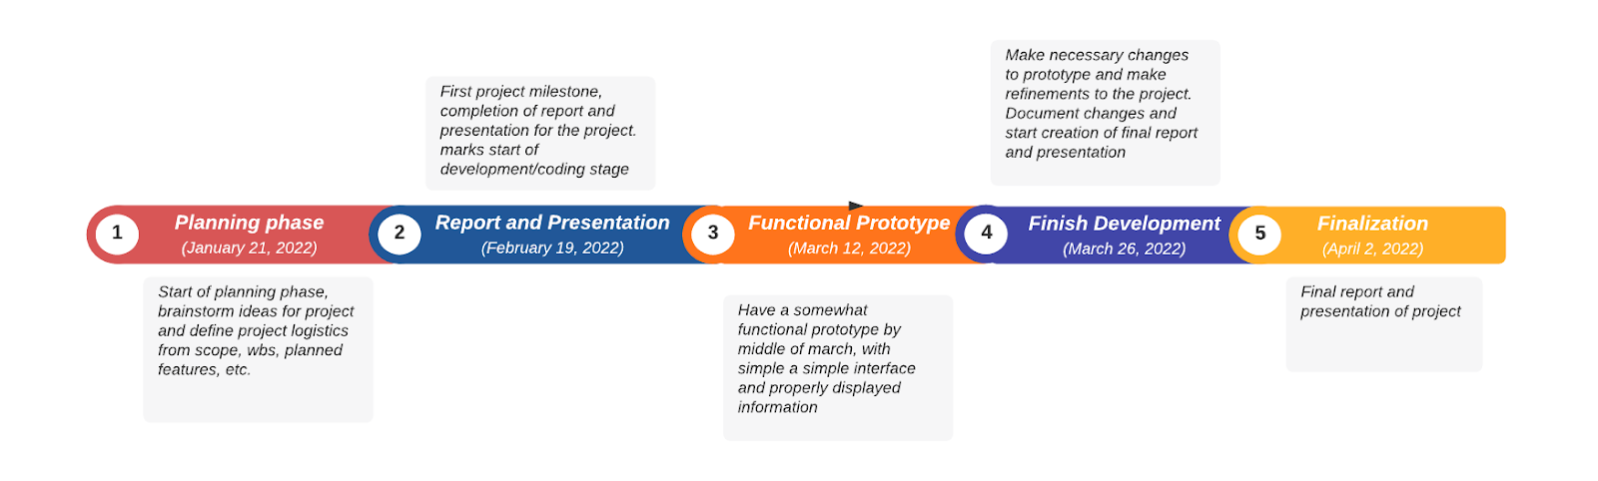
Project schedule

Slide 10
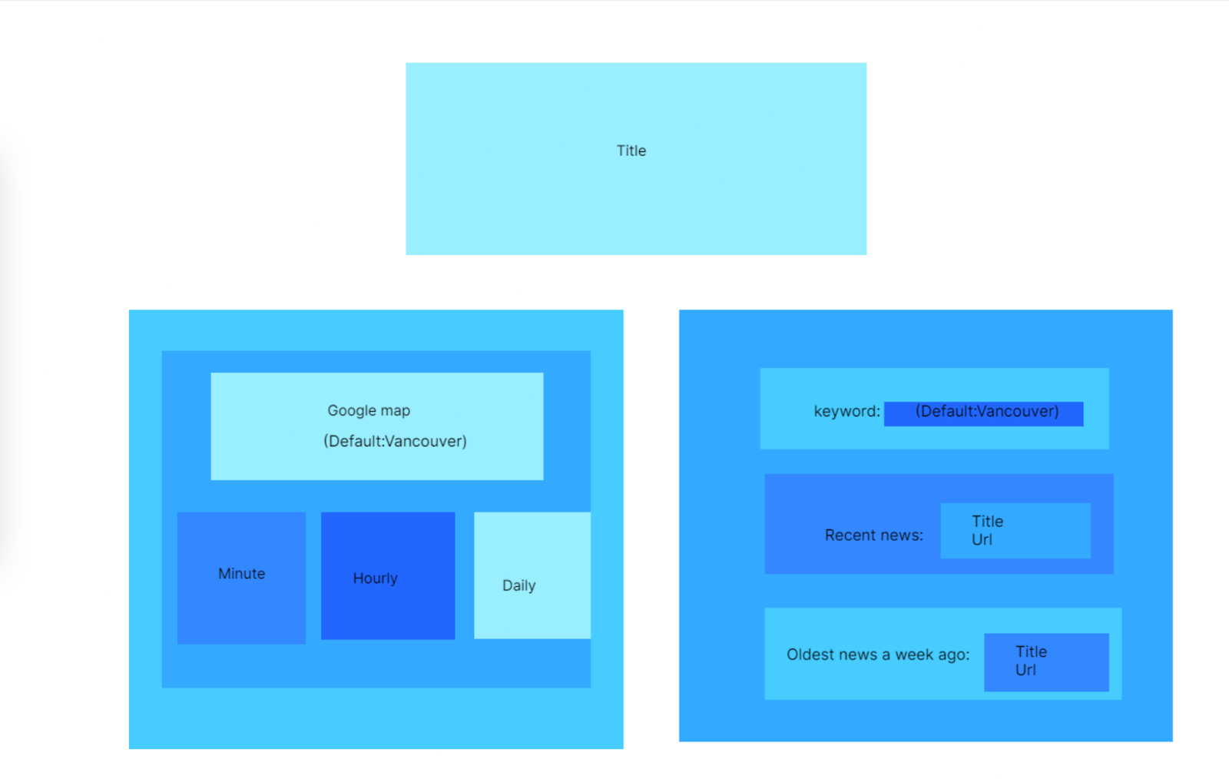
Wireframe

Slide 11
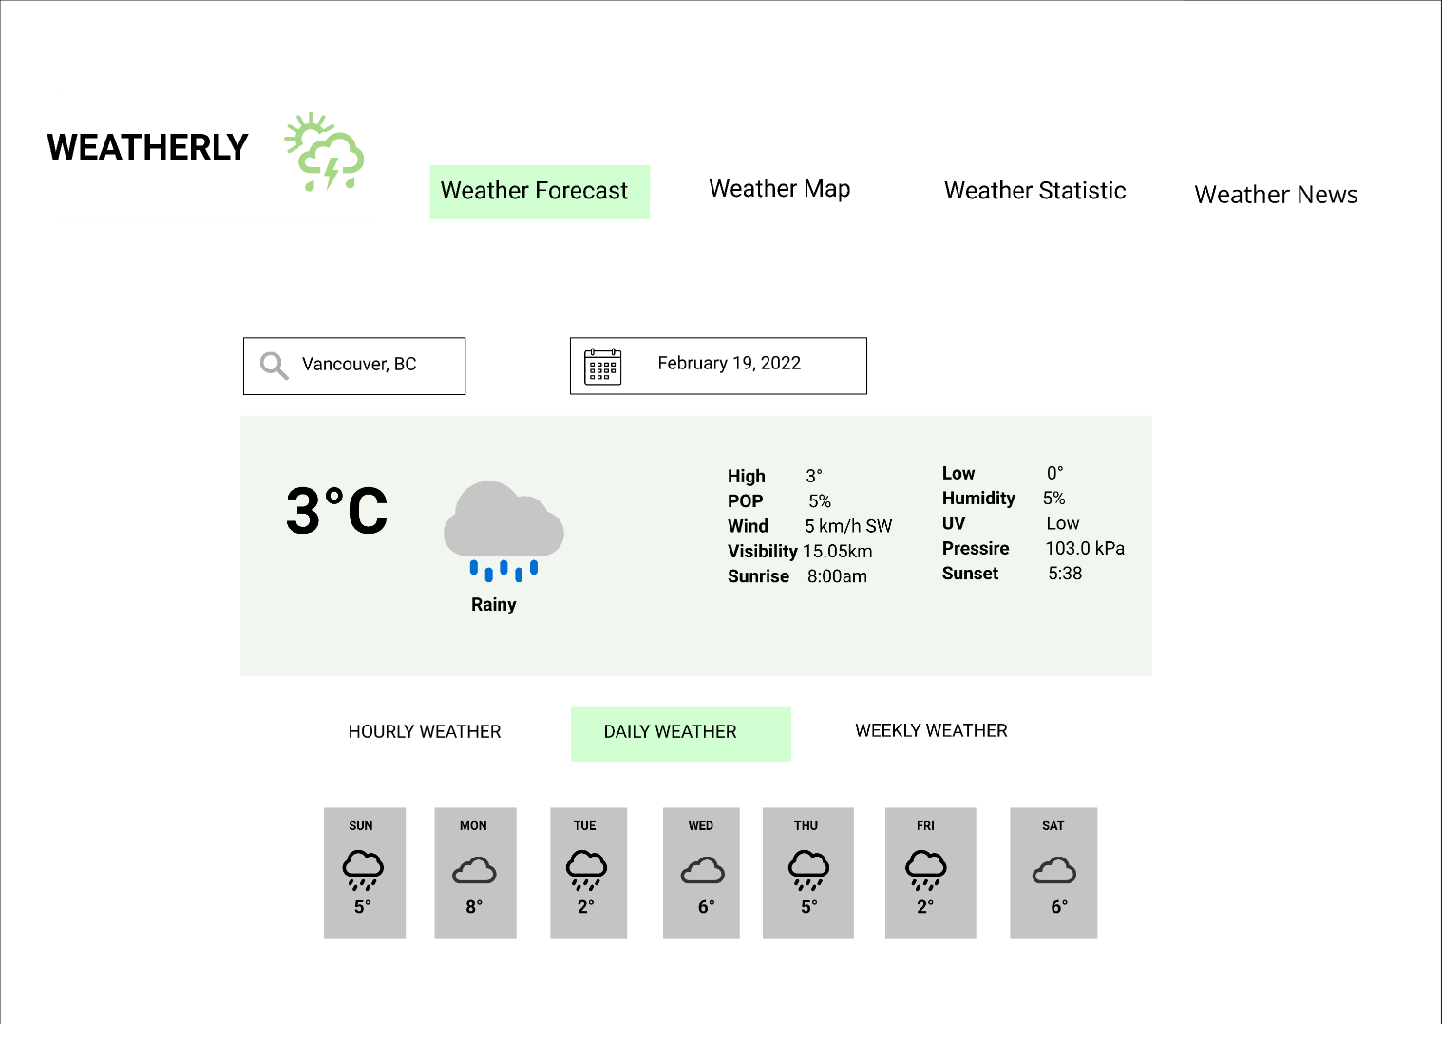
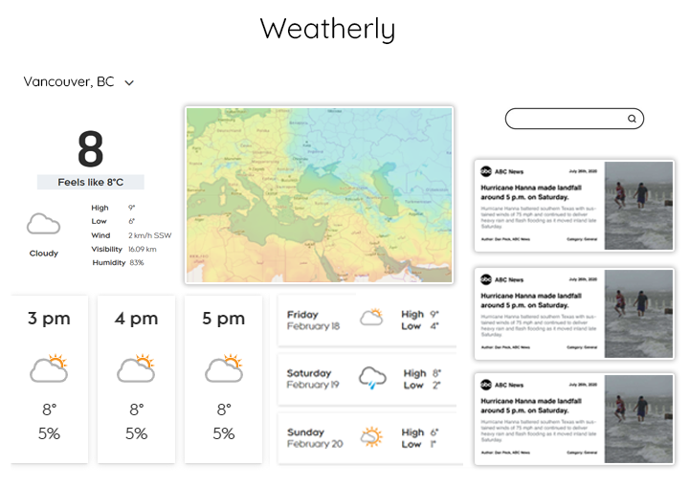
Prototype

Slide 12
Prototype

Slide 13
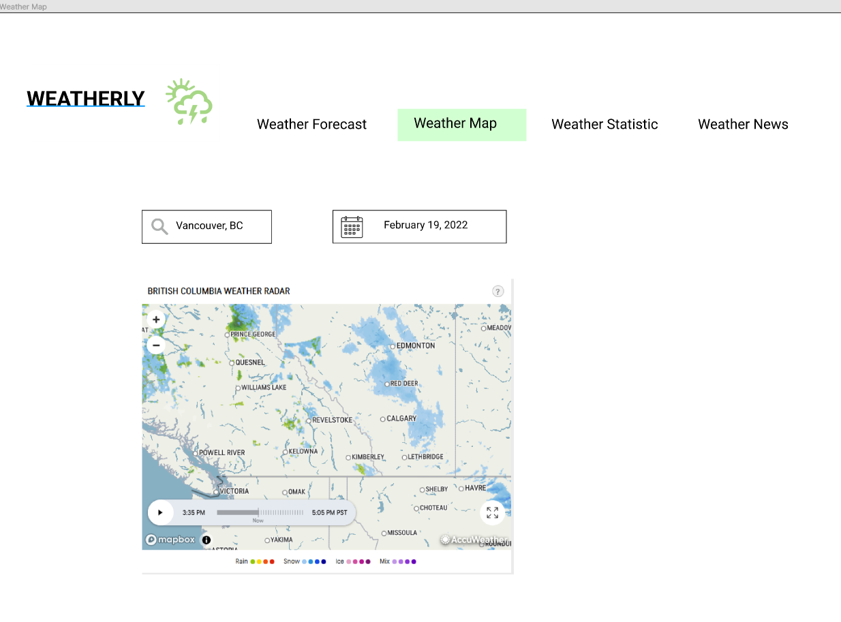

Slide 14
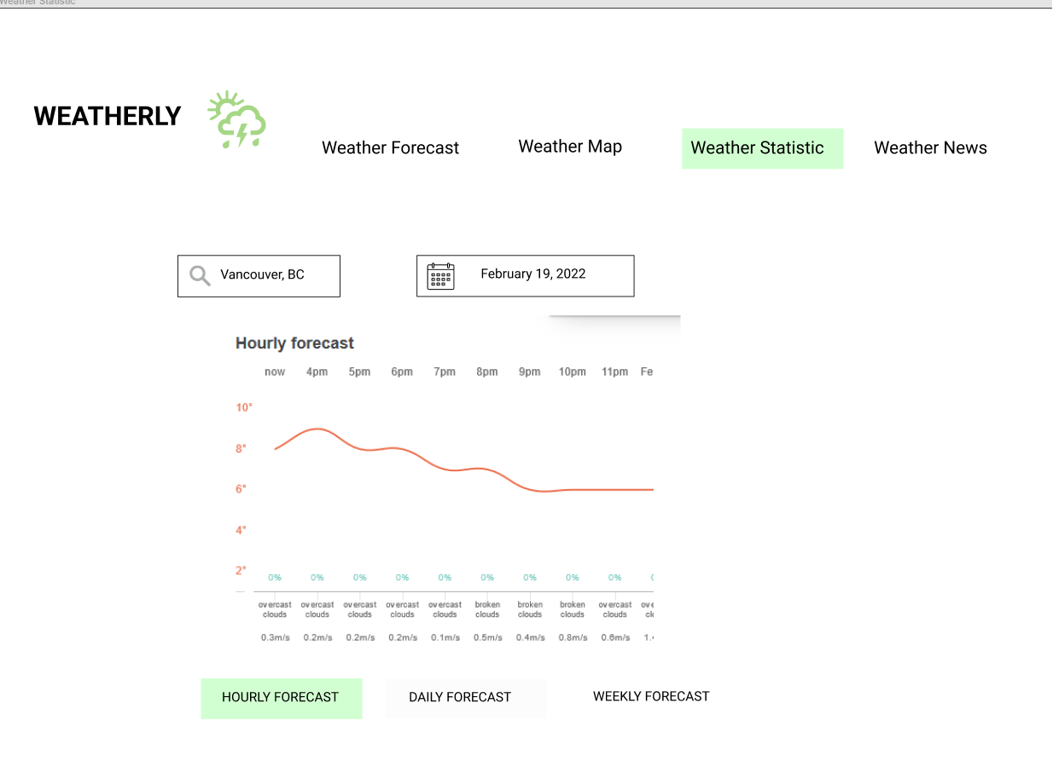

Slide 15
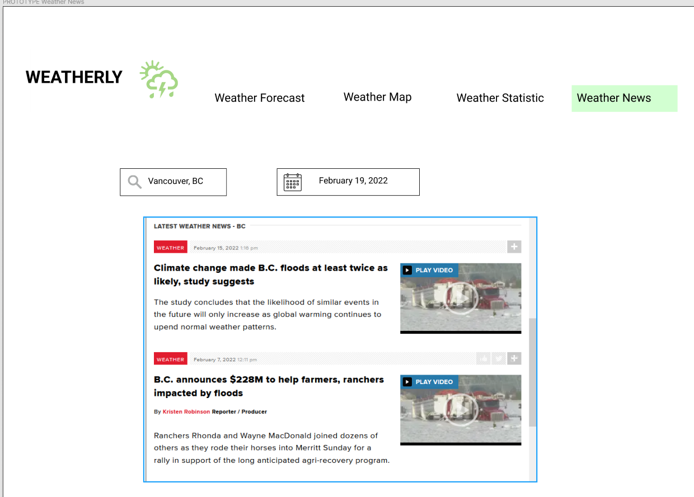

Slide 16
Prototype

Slide 17
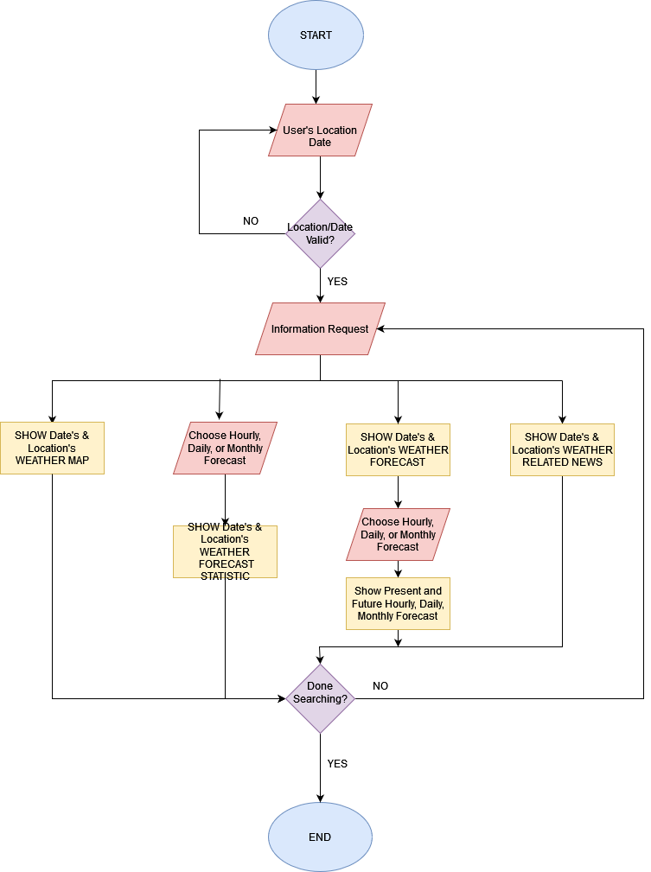
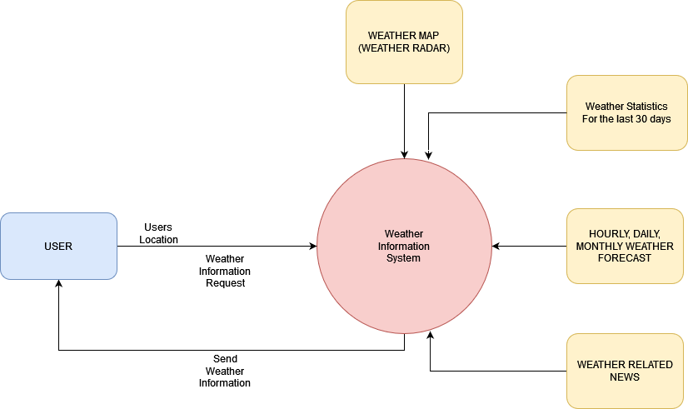
Data Flow Diagram

