Slide 1

Basic Details of the Team and Problem Statement
Ministry/Organization Name/Student Innovation: Ministry of Railways PS Code: SIH-1349 Problem Statement Title: Using existing CCTV network for crowd management, crime prevention, and work monitoring using AIML Team Name: EXPRESS - EYE Team Leader Name: Mansi Parag Shardul Institute Code (AISHE): C-41256 Institute Name: K. K. Wagh Institute of Engineering Education and Research ,Nashik Theme Name: Smart Automation

Slide 2
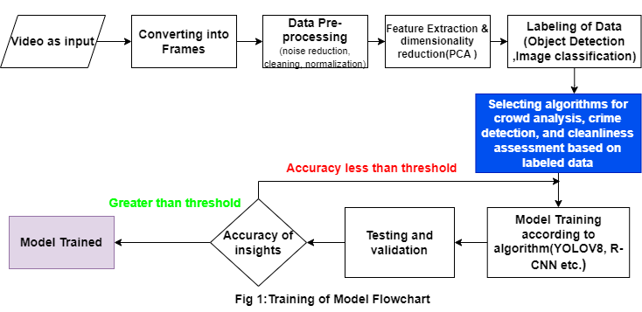
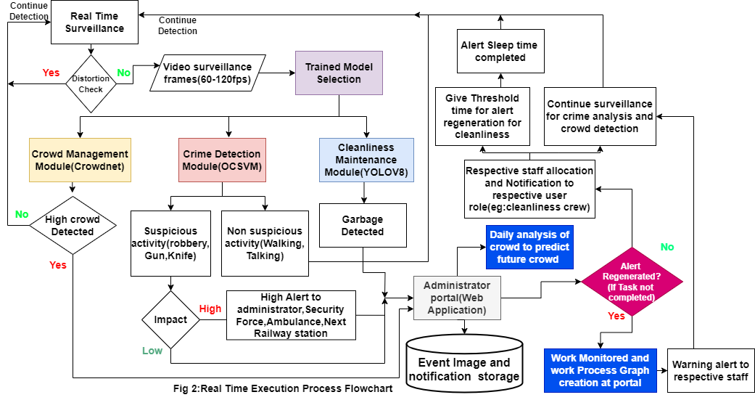
Idea/Approach Details
Idea/Solution/Prototype here:
A CCTV network mechanism to be coupled with proposed system using AI/ML and neural network technique and algorithm to resolve potential event such as robbery, Fighting ,over crowd, weapon detection and excessive garbage on platforms.
During real time surveillance, model using efficient algorithm (YOLOV8,LSTM,FASTER R-CNN) and provide low-alert and high alert based on impact of events.
Sending alerts to an administrator portal managed by trained personnel.
ML model to predict over crowd based on historical data and create graph for work monitoring and daily analysis report.
Alert will be re-generated when staff fail to complete assigned work such as staff and resource allocation, as well as cleanliness work within specified parameters.
CCTV network is managed by portal(Web application) to handle camera tamper and emergency alert to next railway station, ambulance, police station and fire fighter.
Network Security is managed against SQL injection attack, data leakage, unauthorized access to web portal, alerts alteration.
Technology stack:
Development Framework and languages:CPP,QT,Django, PostgreSQL.
Algorithm required:YOLOV8,Faster R-CNN, one-Class Support
Vector Machines (OCSVMs),LSTM,Crowdnet.
Libraries: OpenCV,C++ with TensorFlow-C, Gstreamer.

Slide 3
Idea/Approach Details
Use Cases:
Crowd Density Monitoring : System can analyze CCTV footage to assess crowd density at different times and locations within railway stations. AI will help to avoid Human stampede with better crowd control at emergency situation
Real-time Alerts: The system can send alerts to station staff when crowd density exceeds safe limits, enabling them to take immediate action, such as redirecting passengers or deploying extra personnel.
Anomaly Detection: AI algorithms can detect unusual activities, such as suspicious behavior or unattended bags, and alert security personnel in real-time.
Predictive Policing: System can analyze historical data and CCTV footage to predict potential crime hotspots ,overcrowd area.
Work Monitoring: Railway employees, such as security staff or cleaning crews, can be monitored by system to ensure they are performing their duties efficiently.
Dependencies / Show stopper:
CCTV network configuration : There should be distributed network access for avoiding video data tampering.
The camera devices should have at least 24 hrs battery backup along with continuous power supply.
Data Clarity: A high-resolution camera for superior video quality.
Panoramic Perspective: A 360-degree field of view.
Enhanced Night Vision: Cameras equipped with motion sensors and surveillance capabilities for Night-time monitoring.
Continuous Internet network connectivity requirement for proper functionality.
Unique Selling Point:
Memory and Time Complexity Optimization: Implementing solution in CPP for faster alert and improve accuracy of solution.
Emergency Contact Integration: Direct integration of emergency services to ambulance, nearby police station, next station and fire fighter,etc.
Daily Analysis and Reporting: Work monitoring graph will be created based on performance of railway staff.
Reduced Service Loss Due to Maintenance: System ability to reduce service loss during maintenance downtime in any CCTV tamper in network.
Dynamic Alert Levels: Customizable alert levels based on activity intensity to prevent alert overload and prioritize high-priority notifications.
https://drive.google.com/drive/folders/1KBg6kv9UwpFMJBr3GiGLM3m3a_adnyBg?usp=sharing
Video Link :
3

Slide 4
Team Member Details
Team Leader Name: Mansi Parag Shardul
Branch :BE | Stream :Computer | Year :IV
Team Member 1 Name: Shreyas Ramesh Shelke
Branch :BE | Stream :Computer | Year :IV
Team Member 2 Name: Sakshi Vinayaksing Pardeshi
Branch :BE | Stream :Computer | Year :IV
Team Member 3 Name: Kunal Ravindra Wani
Branch :BE | Stream :Computer | Year :IV
Team Member 4 Name: Yash Kirankumar Jadhav
Branch :BE | Stream :AIDS | Year :IV
Team Member 5 Name: Chetan Kaniram Hatkar
Branch :BE | Stream :AIDS | Year :IV
Team Mentor 1 Name: Dr.Mangesh Ghonge
Category :Industry Expert Team Mentor 2 Name: Prof.Priya Rakibe Category :Academic Expert | Expertise :AI/ML Expertise :Networking | Domain Experience : 10+years Domain Experience : 10+years

