Slide 1
Data and Computer Communications
Chapter 18 – Internet Protocols
Eighth Edition
by William Stallings
Notes:
Lecture slides prepared by Dr Lawrie Brown (UNSW@ADFA) for “Data and Computer Communications”, 8/e, by William Stallings, Chapter 18 “Internet Protocols”.

Slide 2
网络层提供的两种服务
在计算机网络领域，网络层应该向运输层提供怎样的服务（“面向连接”还是“无连接”）曾引起了长期的争论。
争论焦点的实质就是：在计算机通信中，可靠交付应当由谁来负责？是网络还是端系统？

Slide 3
电信网的成功经验
让网络负责可靠交付
面向连接的通信方式
建立虚电路(Virtual Circuit)，以保证双方通信所需的一切网络资源。
如果再使用可靠传输的网络协议，就可使所发送的分组无差错按序到达终点。

Slide 4


虚电路服务
应用层
运输层
网络层
数据链路层
物理层
应用层
运输层
网络层
数据链路层
物理层
H₁
H₂
虚电路

Slide 5
虚电路是逻辑连接
虚电路表示这只是一条逻辑上的连接，分组都沿着这条逻辑连接按照存储转发方式传送，而并不是真正建立了一条物理连接。
请注意，电路交换的电话通信是先建立了一条真正的连接。因此分组交换的虚连接和电路交换的连接只是类似，但并不完全一样。

Slide 6
因特网采用的设计思路
网络层向上只提供简单灵活的、无连接的、尽最大努力交付的数据报服务。
网络在发送分组时不需要先建立连接。每一个分组（即 IP 数据报）独立发送，与其前后的分组无关（不进行编号）。
网络层不提供服务质量的承诺。即所传送的分组可能出错、丢失、重复和失序（不按序到达终点），当然也不保证分组传送的时限。

Slide 7
尽最大努力交付的好处
由于传输网络不提供端到端的可靠传输服务，这就使网络中的路由器可以做得比较简单，而且价格低廉（与电信网的交换机相比较）。
如果主机（即端系统）中的进程之间的通信需要是可靠的，那么就由网络的主机中的运输层负责（包括差错处理、流量控制等）。
采用这种设计思路的好处是：网络的造价大大降低，运行方式灵活，能够适应多种应用。
因特网能够发展到今日的规模，充分证明了当初采用这种设计思路的正确性。

Slide 8
数据报服务
应用层
运输层
网络层
数据链路层
物理层
应用层
运输层
网络层
数据链路层
物理层
H₁
IP 数据报
H₂
丢失
H₁ 发送给 H₂ 的分组可能沿着不同路径传送

Slide 9
虚电路服务与数据报服务的对比
对比的方面 | 虚电路服务 | 数据报服务
思路 | 可靠通信应当由网络来保证 | 可靠通信应当由用户主机来保证
连接的建立 | 必须有 | 不需要
终点地址 | 仅在连接建立阶段使用，每个分组使用短的虚电路号 | 每个分组都有终点的完整地址
分组的转发 | 属于同一条虚电路的分组均按照同一路由进行转发 | 每个分组独立选择路由进行转发
当结点出故障时 | 所有通过出故障的结点的虚电路均不能工作 | 出故障的结点可能会丢失分组，一些路由可能会发生变化
分组的顺序 | 总是按发送顺序到达终点 | 到达终点时不一定按发送顺序
端到端的差错处理和流量控制 | 可以由网络负责，也可以由用户主机负责 | 由用户主机负责

Slide 10
网际协议IP
网际协议 IP 是 TCP/IP 体系中两个最主要的协议之一。与 IP 协议配套使用的还有三个协议：
地址解析协议 ARP
(Address Resolution Protocol)
网际控制报文协议 ICMP
(Internet Control Message Protocol)
网际组管理协议 IGMP
(Internet Group Management Protocol)

Slide 11
网际层的 IP 协议及配套协议
各种应用层协议
应用层
(HTTP, FTP, SMTP 等)
运输层
TCP, UDP
ICMP
IGMP
网络层
（网际层）
IP
ARP
网络接口层
与各种网络接口
物理硬件

Slide 12
虚拟互连网络
互连在一起的网络要进行通信，会遇到许多问题需要解决，如：
  不同的寻址方案
  不同的最大分组长度
  不同的网络接入机制
  不同的超时控制
  不同的差错恢复方法
  不同的状态报告方法
  不同的路由选择技术
  不同的用户接入控制
  不同的服务（面向连接服务和无连接服务）
  不同的管理与控制方式

Slide 13
网络互相连接起来
要使用一些中间设备
中间设备又称为中间系统或中继(relay)系统。
  物理层中继系统：转发器(repeater)。
  数据链路层中继系统：网桥或桥接器(bridge)。
  网络层中继系统：路由器(router)。
  网桥和路由器的混合物：桥路器(brouter)。
  网络层以上的中继系统：网关(gateway)。用网关连接两个不兼容的系统需要在高层进行协议转换。

Slide 14
网络互连使用路由器
当中继系统是转发器或网桥时，一般并不称之为网络互连，因为这仅仅是把一个网络扩大了，而这仍然是一个网络。
网关由于比较复杂，目前使用得较少。
互联网都是指用路由器进行互连的网络。
由于历史的原因，许多有关 TCP/IP 的文献将网络层使用的路由器称为网关。

Slide 15
互连网络与虚拟互连网络
TCP/IP体系在网络互连上采用的做法是在网络层（即IP层）采用了标准化协议，但相互连接的网络则可以是异构的。

Slide 16
互连网络与虚拟互连网络
路由器
网络
网络
虚拟互连网络
（互联网）
网络
网络
网络
(a) 实际互连网络
(b) 虚拟互连网络

Slide 17
虚拟互连网络的意义
所谓虚拟互连网络也就是逻辑互连网络，它的意思就是互连起来的各种物理网络的异构性本来是客观存在的，但是我们利用 IP 协议就可以使这些性能各异的网络从用户看起来好像是一个统一的网络。
使用 IP 协议的虚拟互连网络可简称为 IP 网。
使用虚拟互连网络的好处是：当互联网上的主机进行通信时，就好像在一个网络上通信一样，而看不见互连的各具体的网络异构细节。

Slide 18




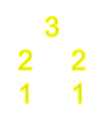
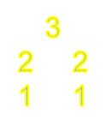
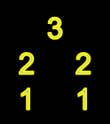

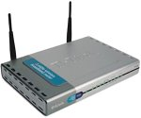


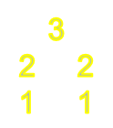

分组在互联网中的传送
H₁
主机
H₁
R₁
R₂
R₃
间接交付
间接交付
间接交付
间接交付
R₅
R₄
间接交付
R₅
R₄
直接交付
H₂
主机 H₂

Slide 19


从网络层看 IP 数据报的传送
如果我们只从网络层考虑问题，那么 IP 数据报就可以想象是在网络层中传送。
IP 数据报
网络层
网络层
网络层
网络层
网络层
网络层
网络层
H₁
R₁
R₂
R₃
R₄
R₅
H₂

Slide 20
Protocol Functions
have a small set of functions that form basis of all protocols
  encapsulation
  fragmentation and reassembly
  connection control
  ordered delivery
  flow control
  error control
  addressing
  multiplexing
  transmission services
Notes:
Key functions typically performed by a protocol include encapsulation, fragmentation and reassembly, connection control, ordered delivery, flow control, error control, addressing, and multiplexing. Not all protocols have all functions. But there are many instances of the same type of function being present in protocols at different levels.

Slide 21
Advantages of Connectionless
Flexible
Highly robust
Best for connectionless transport protocols

Slide 22
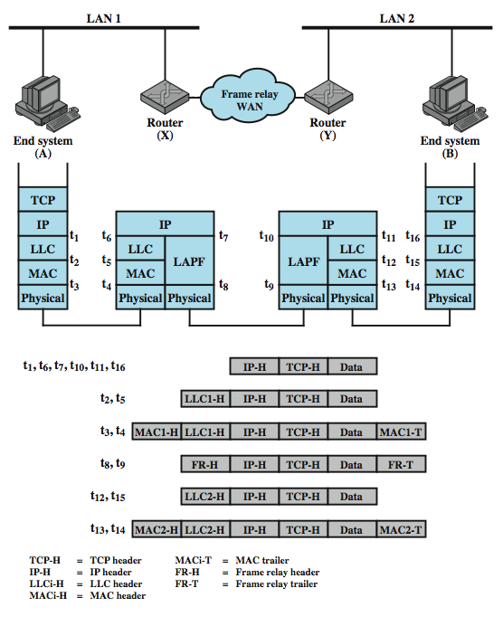
IP Operation
Notes:
Stallings DCC8e Figure 18.3 depicts a typical example using IP, in which two LANs are interconnected by a frame relay WAN. The figure depicts the operation of the Internet Protocol for data exchange between host A on one LAN (network 1) and host B on another LAN (network 2) through the WAN. The figure shows the protocol architecture and format of the data unit at each stage. The IP at A receives blocks of data to be sent to B from a higher layers of software in A (e.g., TCP or UDP). IP attaches a header (at time t₁) specifying, among other things, the global internet address of B. That address is logically in two parts: network identifier and end system identifier. The combination of IP header and upper-level data is called an Internet Protocol data unit (PDU), or simply a datagram. The datagram is then encapsulated with the LAN protocol (LLC header at t₂; MAC header and trailer at t₃).and sent to the router, which strips off the LAN fields to read the IP header (t₆). The router then encapsulates the datagram with the frame relay protocol fields (t₈) and transmits it across the WAN to another router. This router strips off the frame relay fields and recovers the datagram, which it then wraps in LAN fields appropriate to LAN 2 and sends it to B.

Slide 23
Design Issues
routing
datagram lifetime
fragmentation and re-assembly
error control
flow control
Notes:
With that brief sketch of the operation of an IP-controlled internet, we now examine the above design issues in greater detail.

Slide 24
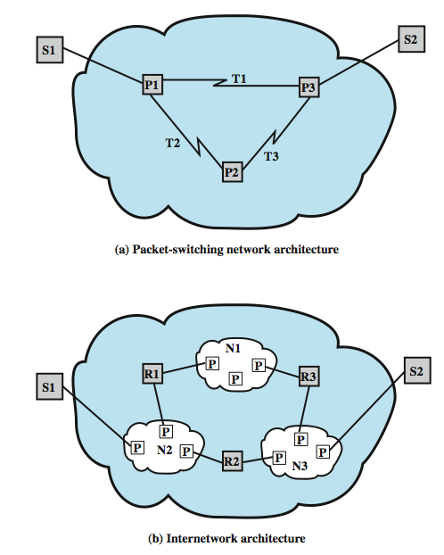
The Internet as a Network
Notes:
As we proceed with this discussion, note the many similarities with design issues and techniques relevant to packet-switching networks. To see the reason for this, consider Stallings DCC8e Figure 18.4, which compares an internet architecture with a packet-switching network architecture. The routers (R1, R2, R3) in the internet correspond to the packet-switching nodes (P1, P2, P3) in the network, and the networks (N1, N2, N3) in the internet correspond to the transmission links (T1, T2, T3) in the networks. The routers perform essentially the same functions as packet-switching nodes and use the intervening networks in a manner analogous to transmission links.

Slide 25
Routing
ES / routers maintain routing tables
  indicate next router to which datagram is sent
  static
  dynamic
source routing
  source specifies route to be followed
  can be useful for security & priority
route recording
Notes:
For the purpose of routing, each end system and router maintains a routing table that lists, for each possible destination network, the next router to which the internet datagram should be sent.The routing table may be static or dynamic. A static table, however, could contain alternate routes if a particular router is unavailable. A dynamic table is more flexible in responding to both error and congestion conditions. In the Internet, for example, when a router goes down, all of its neighbors will send out a status report, allowing other routers and stations to update their routing tables. A similar scheme can be used to control congestion. Congestion control is particularly important because of the mismatch in capacity between local and wide area networks. Routing tables may also be used to support other internetworking services, such as security and priority.
Another routing technique is source routing. The source station specifies the route by including a sequential list of routers in the datagram. This, again, could be useful for security or priority requirements.
Finally, we mention a service related to routing: route recording. To record a route, each router appends its internet address to a list of addresses in the datagram. This feature is useful for testing and debugging purposes.

Slide 26
Datagram Lifetime
datagrams could loop indefinitely
  consumes resources
  transport protocol may need upper bound on lifetime of a datagram
can mark datagram with lifetime
  Time To Live field in IP
  when lifetime expires, datagram discarded
  simplest is hop count
  or time count
Notes:
If dynamic or alternate routing is used, the potential exists for a datagram to loop indefinitely through the internet. This is undesirable for two reasons. First, an endlessly circulating datagram consumes resources. Second, we will see in Chapter 20 that a transport protocol may depend on the existence of an upper bound on datagram lifetime. To avoid these problems, each datagram can be marked with a lifetime. Once the lifetime expires, the datagram is discarded.
A simple way to implement lifetime is to use a hop count. Each time that a datagram passes through a router, the count is decremented. Alternatively, the lifetime could be a true measure of time. This requires that the routers must somehow know how long it has been since the datagram or fragment last crossed a router, to know by how much to decrement the lifetime field. This would seem to require some global clocking mechanism. The advantage of using a true time measure is that it can be used in the reassembly algorithm, described next.

Slide 27

Fragmentation and
Re-assembly
fragmentation:
in: one large datagram
out: 3 smaller datagrams
网络链路具有 MTU (最大传输单位)属性 – 是由链路层最大帧的限制决定的.
  不同类型的链路, 不同的 MTU
较大的IP分组在网络中会被分割(“fragmented”)
  一个分组就被分成了若干分组
  分组只是在最终的信宿站点被重新“组装-reassembled”
  在IP 分组的首部有些位标记用来确认和排序相关的组“片”
reassembly

Slide 28
Fragmentation and
Re-assembly
may have different packet sizes
  on networks along path used by datagram
issue of when to re-assemble
  at destination
    packets get smaller as data traverses internet
  intermediate re-assembly
    need large buffers at routers
    buffers may fill with fragments
    all fragments must go through same router
Notes:
Individual networks within an internet may specify different maximum packet sizes. It would be inefficient and unwieldy to try to dictate uniform packet size across networks. Thus, routers may need to fragment incoming datagrams into smaller pieces, called segments or fragments, before transmitting on to the next network.
If datagrams can be fragmented (perhaps more than once) in the course of their travels, the question arises as to where they should be reassembled. The easiest solution is to have reassembly performed at the destination only. The principal disadvantage of this approach is that fragments can only get smaller as data move through the internet. This may impair the efficiency of some networks. However, if intermediate router reassembly is allowed, the following disadvantages result:
1. Large buffers are required at routers, and there is the risk that all of the buffer space will be used up storing partial datagrams.
2. All fragments of a datagram must pass through the same router. This inhibits the use of dynamic routing.

Slide 29
IP Fragmentation
IP re-assembles at destination only
uses fields in header
  Data Unit Identifier (ID)
    identifies end system originated datagram
  Data length
    length of user data in octets
  Offset
    position of fragment of user data in original datagram
    in multiples of 64 bits (8 octets)
  More flag
    indicates that this is not the last fragment
Notes:
In IP, datagram fragments are reassembled at the destination end system. The IP fragmentation technique uses the following information in the IP header: Data Unit Identifier (ID), Data Length, Offset, & More Flag.
The ID is a means of uniquely identifying an end-system-originated datagram. In IP, it consists of the source and destination addresses, a number that corresponds to the protocol layer that generated the data (e.g., TCP), and an identification supplied by that protocol layer. The Data Length is the length of the user data field in octets, and the Offset is the position of a fragment of user data in the data field of the original datagram, in multiples of 64 bits.
The source end system creates a datagram with a Data Length equal to the entire length of the data field, with Offset = 0, and a More Flag set to 0 (false). To fragment a long datagram into two pieces, an IP module in a router performs the following tasks:
Create two new datagrams and copy the header fields of the incoming datagram into both.
Divide the incoming user data field into two portions along a 64-bit boundary placing one portion in each new datagram
Set the Data Length of the first new datagram to the length of the inserted data, and set More Flag to 1 (true). The Offset field is unchanged.
Set the Data Length of the second new datagram to the length of the inserted data, and add the length of the first data portion divided by 8 to the Offset field. The More Flag remains the same.

Slide 30
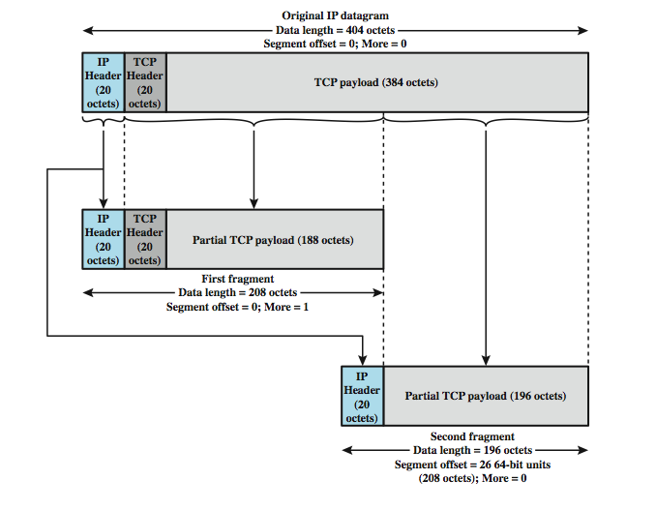
Fragmentation Example
Notes:
Stallings DCC8e Figure 18.5 gives an example in which two fragments are created from an original IP datagram. The procedure is easily generalized to an n-way split. In this example, the payload of the original IP datagram is a TCP segment, consisting of a TCP header and application data. The IP header from the original datagram is used in both fragments, with the appropriate changes to the fragmentation-related fields. Note that the first fragment contains the TCP header; this header is not replicated in the second fragment, because all of the IP payload, including the TCP header is transparent to IP. That is, IP is not concerned with the contents of the payload of the datagram. To reassemble a datagram, there must be sufficient buffer space at the reassembly point. As fragments with the same ID arrive, their data fields are inserted in the proper position in the buffer until the entire data field is reassembled, which is achieved when a contiguous set of data exists starting with an Offset of zero and ending with data from a fragment with a false More Flag.

Slide 31
Dealing with Failure
re-assembly may fail if some fragments get lost
need to detect failure
re-assembly time out
  assigned to first fragment to arrive
  if timeout expires before all fragments arrive, discard partial data
use packet lifetime (time to live in IP)
  if time to live runs out, kill partial data
Notes:
One eventuality that must be dealt with is that one or more of the fragments may not get through: the IP service does not guarantee delivery. Some method is needed to decide when to abandon a reassembly effort to free up buffer space. Two approaches are commonly used. First, assign a reassembly lifetime to the first fragment to arrive. This is a local, real-time clock assigned by the reassembly function and decremented while the fragments of the original datagram are being buffered. If the time expires prior to complete reassembly, the received fragments are discarded. A second approach is to make use of the datagram lifetime, which is part of the header of each incoming fragment. The lifetime field continues to be decremented by the reassembly function; as with the first approach, if the lifetime expires prior to complete reassembly, the received fragments are discarded.

Slide 32
Error Control
no guaranteed delivery
router should attempt to inform source if packet discarded
source may modify transmission strategy
may inform high layer protocol
need datagram identification
see ICMP in next section
Notes:
The internetwork facility does not guarantee successful delivery of every datagram. When a datagram is discarded by a router, the router should attempt to return some information to the source, if possible. The source Internet Protocol entity may use this information to modify its transmission strategy and may notify higher layers. To report that a specific datagram has been discarded, some means of datagram identification is needed. Such identification is discussed in the next section. Datagrams may be discarded for a number of reasons, including lifetime expiration, congestion, and FCS error. In the latter case, notification is not possible because the source address field may have been damaged.

Slide 33
Flow Control
allows routers and/or stations to limit rate of incoming data
limited in connectionless systems
send flow control packets to request reduced flow
see ICMP in next section
Notes:
Internet flow control allows routers and/or receiving stations to limit the rate at which they receive data. For the connectionless type of service we are describing, flow control mechanisms are limited. The best approach would seem to be to send flow control packets, requesting reduced data flow, to other routers and source stations. We will see one example of this with ICMP, discussed in the next section.
第一次课结束

