Slide 1
1 Peter 5
Withstanding the Lion
Notes:
Intro: Covid story – March 11
Caitlin – we are experiencing history being made
Immediately – are we ready?
Always talked about pandemic
Now: Not enough room in hospitals

Slide 2
Spiritual Warfare
1 Peter 5:8-9
8 Be alert and of sober mind. Your enemy the devil prowls around like a roaring lion looking for someone to devour. 9 Resist him, standing firm in the faith, because you know that the family of believers throughout the world is undergoing the same kind of sufferings.
Notes:
On spiritual warfare – engaged in battle w Satan
Can’t see it – but happening all around
War btw G and Satan – which ideology is going to win
Last week… (slide)

Slide 3
Spiritual Warfare
1 Peter 5:8-9
8 Be alert and of sober mind. Your enemy the devil prowls around like a roaring lion looking for someone to devour. 9 Resist him, standing firm in the faith, because you know that the family of believers throughout the world is undergoing the same kind of sufferings.
Notes:
Last week – who satan is
Subtle and sneaky
The father of lies
Wages a war of deception and accusation
Must be awre of him
Many xians not ready for this – evth feels safe
Satan wants to keep ppl from kingdom
He will avoid ppl not doing anything – no threat
Xians on mission – be aware
This week… (slide)

Slide 4
Spiritual Warfare
1 Peter 5:8-9
8 Be alert and of sober mind. Your enemy the devil prowls around like a roaring lion looking for someone to devour. 9 Resist him, standing firm in the faith, because you know that the family of believers throughout the world is undergoing the same kind of sufferings.
Notes:
About resisting him
How to we wage battle effectively?
First – understand nature of this war

Slide 5
Spiritual Warfare – on the offensive
Matthew 16:18
And I tell you that you are Peter, and on this rock I will build my church, and the gates of Hades will not overcome it.
Notes:
It’s an OFFENSIVE war
Not a defensive one
Read verse – gates overcome?
Not an offensive weapon
Translation issue – (blue X)
Should be this (slide)

Slide 6
Spiritual Warfare – on the offensive
Matthew 16:18
And I tell you that you are Peter, and on this rock I will build my church, and the gates of Hades will not WITHSTAND it.
2 Corinthians 10:4
The weapons we fight with are not the weapons of the world. On the contrary, they have divine power to demolish strongholds.
Notes:
WITHSTAND
We are called to go OUT as Xians- take the battle to the front lines
2 Cor verse (show verse)
Proves we conquer
Must boldly go out and fight
- Anti – the fortress church (slide)

Slide 7
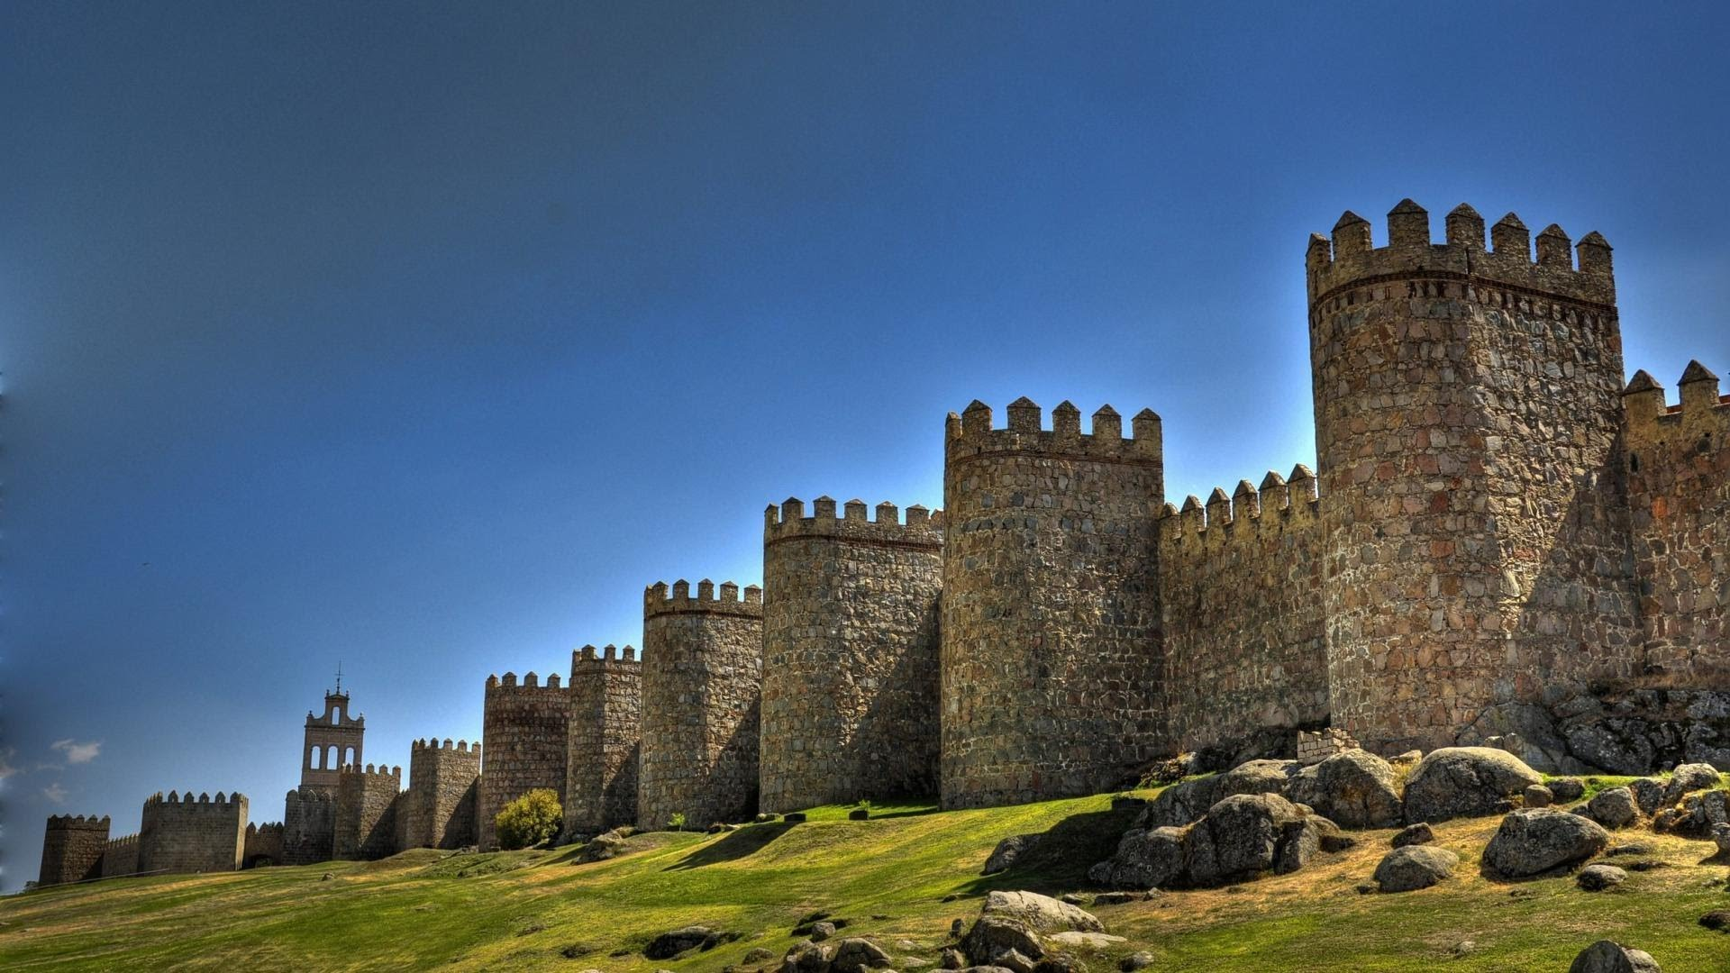
Notes:
Fortress – we will hide from evil world here
Safe behind these walls
We can sing our songs here
Enjoy our amenities and programs
Satan cant get us here!
On 1 hand – Satan isn’t as threatened
On 2nd hand, he will come and destroy – dwindle away
Especially among the young
That’s where the fortress churches are LOSING
Rome example (slide)

Slide 8
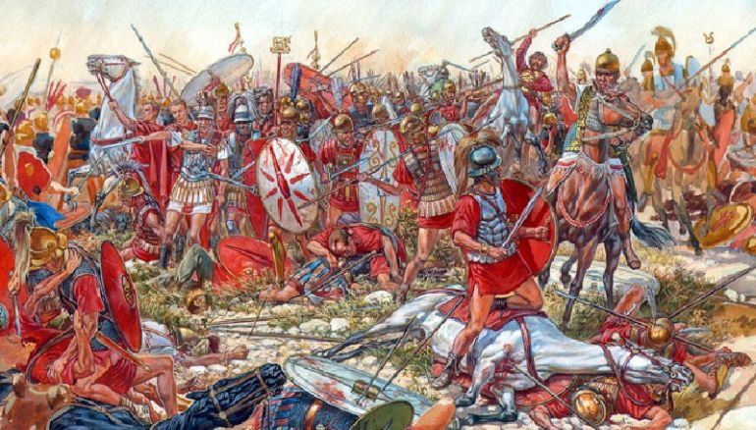
Notes:
Battle of cannae 216 BC
Hannible vs. Rome
Brought huge army over alps – ELEPHANTS!
Cornered the Roman army – total slaughter
Over the day, romans bunched up, cant move
Just hearthe dying screams around them
Know they are next
Many Xians bury head in sand
Must take war TO SATAN
This is how we do it… (slide)

Slide 9
Spiritual Warfare – on the offensive
Matthew 18:18-20
18 Then Jesus came to them and said, “All authority in heaven and on earth has been given to me. 19 Therefore go and make disciples of all nations, baptizing them in the name of the Father and of the Son and of the Holy Spirit, 20 and teaching them to obey everything I have commanded you. And surely I am with you always, to the very end of the age.”
Colossians 2:13-15
13 When you were dead in your sins and in the uncircumcision of your flesh, God made you alive with Christ. He forgave us all our sins, 14 having canceled the charge of our legal indebtedness, which stood against us and condemned us; he has taken it away, nailing it to the cross. 15 And having disarmed the powers and authorities, he made a public spectacle of them, triumphing over them by the cross
Notes:
War = winning ppl, making disciples
Warfare mentality – this is what I live for
Develop consensus as Xians – we gonna go out and conquer LIKE THIS
Good fact to remember- JC already won on the cross
Bridged gap btw us and G – no longer slaves to Satan’s kingdom (Col Verse)
But Satan isn’t done fighting… (slide)

Slide 10
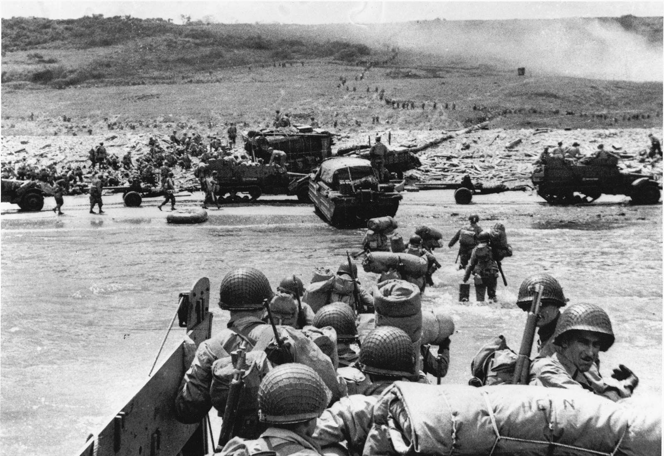
Notes:
D-day – Nazis lost

Slide 11
Spiritual Warfare
1 Peter 5:8-9
9 Resist him, standing firm in the faith, because you know that the family of believers throughout the world is undergoing the same kind of sufferings.
Notes:
So we must resist him
Starts with FAITH (slide)

Slide 12
Spiritual Warfare
1 Peter 5:8-9
9 Resist him, standing firm in the faith, because you know that the family of believers throughout the world is undergoing the same kind of sufferings.
Notes:
Faith – not magical thinking
Active trust in Biblical facts
It’s an issue of truth – I take God’s truth
I believe his promises
IMP – Satan will get you off convictions
U forget what G promised
Now Another passage – readying self to hold to truth (Eph)

Slide 13
The Armor of God
Ephesians 6:10-17
10 Finally, be strong in the Lord and in his mighty power. 11 Put on the full armor of God, so that you can take your stand against the devil’s schemes. 12 For our struggle is not against flesh and blood, but against the rulers, against the authorities, against the powers of this dark world and against the spiritual forces of evil in the heavenly realms. 13 Therefore put on the full armor of God, so that when the day of evil comes, you may be able to stand your ground, and after you have done everything, to stand.
Notes:
This a truth battle, not physical battle
Truth vs. lies
As Xian – u have truth on your side
Armor – Paul tie to Roman soldier

Slide 14
The Armor of God
Ephesians 6:10-17
14 Stand firm then, with the belt of truth buckled around your waist, with the breastplate of righteousness in place, 15 and with your feet fitted with the readiness that comes from the gospel of peace. 16 In addition to all this, take up the shield of faith, with which you can extinguish all the flaming arrows of the evil one. 17 Take the helmet of salvation and the sword of the Spirit, which is the word of God.
Notes:
Belt = Lock in other pieces
Truth holds it all together
Taking on father of lies

Slide 15
The Armor of God
Ephesians 6:10-17
14 Stand firm then, with the belt of truth buckled around your waist, with the breastplate of righteousness in place, 15 and with your feet fitted with the readiness that comes from the gospel of peace. 16 In addition to all this, take up the shield of faith, with which you can extinguish all the flaming arrows of the evil one. 17 Take the helmet of salvation and the sword of the Spirit, which is the word of God.
Notes:
Feet = gospel
Knowing good news of gospel – saved
U ready to go OUT and declare

Slide 16
The Armor of God
Ephesians 6:10-17
14 Stand firm then, with the belt of truth buckled around your waist, with the breastplate of righteousness in place, 15 and with your feet fitted with the readiness that comes from the gospel of peace. 16 In addition to all this, take up the shield of faith, with which you can extinguish all the flaming arrows of the evil one. 17 Take the helmet of salvation and the sword of the Spirit, which is the word of God.
Notes:
Sword – The word
Striking down the enemy
Ex: JC in wilderness – IT is written
Satan could do nothing
Don’t know scripture = ineffective
3 of the 6 so far – all related…

Slide 17
The Armor of God
Truth!
Ephesians 6:10-17
14 Stand firm then, with the belt of truth buckled around your waist, with the breastplate of righteousness in place, 15 and with your feet fitted with the readiness that comes from the gospel of peace. 16 In addition to all this, take up the shield of faith, with which you can extinguish all the flaming arrows of the evil one. 17 Take the helmet of salvation and the sword of the Spirit, which is the word of God.
Notes:
Truth binds these all together
Peter says “resist with faith” = grounded in biblical truth
App: Equipping!
App: Memorization!

Slide 18
The Armor of God
Ephesians 6:10-17
14 Stand firm then, with the belt of truth buckled around your waist, with the breastplate of righteousness in place, 15 and with your feet fitted with the readiness that comes from the gospel of peace. 16 In addition to all this, take up the shield of faith, with which you can extinguish all the flaming arrows of the evil one. 17 Take the helmet of salvation and the sword of the Spirit, which is the word of God.
Hebrews 2:14-15
14 Since the children have flesh and blood, he too shared in their humanity so that by his death he might break the power of him who holds the power of death—that is, the devil—15 and free those who all their lives were held in slavery by their fear of death.
Romans 8:1
Therefore, there is now no condemnation for those who are in Christ Jesus
Notes:
Breastplate of righteousness
Our standing before God – Can’t be harmed
NOT my self righteousness
Guts are all there – kill shot
No more fearing death… (verse)
Fear death
Satan’s power – distraction – frantic lives
Fear for what comes next – G is ok with me?
Breastplate – no fear
No condemnation now… (verse)

Slide 19
The Armor of God
Ephesians 6:10-17
14 Stand firm then, with the belt of truth buckled around your waist, with the breastplate of righteousness in place, 15 and with your feet fitted with the readiness that comes from the gospel of peace. 16 In addition to all this, take up the shield of faith, with which you can extinguish all the flaming arrows of the evil one. 17 Take the helmet of salvation and the sword of the Spirit, which is the word of God.
Notes:
Shielf of faith – fiery arrows
Last week: Arrows = accustionsm deceit, lies, false thoughts
Satan is a liar and manipulator
I don’t trust what YOU say, I trust God
Ex: Guy who got all flipped out stepping into leadership
Can’t REASON w Satan – he is better at that
Can only rely on G word

Slide 20
The Armor of God
Ephesians 6:10-17
14 Stand firm then, with the belt of truth buckled around your waist, with the breastplate of righteousness in place, 15 and with your feet fitted with the readiness that comes from the gospel of peace. 16 In addition to all this, take up the shield of faith, with which you can extinguish all the flaming arrows of the evil one. 17 Take the helmet of salvation and the sword of the Spirit, which is the word of God.
2 Corinthians 5:18-19
18 All this is from God, who reconciled us to himself through Christ and gave us the ministry of reconciliation: 19 that God was reconciling the world to himself in Christ, not counting people’s sins against them. And he has committed to us the message of reconciliation.
Notes:
Salvation – cant ever me removed
Wont lose salvation
Know I have eternal life
Gospel: Have you received?
Many Xians never get here
Imagine running out wout helmet
Anyway, this is how we withstand
Many casualties in a spirit war
Ppl giving up – live for self
Turn inwrd
Satan loves this!
Notice: None of these are about conquering his system
Not about ushering in new political Christian right
God will destroy these systems
We are saving people
Ministry of reconciliation (verse)

Slide 21
Spiritual Warfare
1 Peter 5:8-9
8 Be alert and of sober mind. Your enemy the devil prowls around like a roaring lion looking for someone to devour. 9 Resist him, standing firm in the faith, because you know that the family of believers throughout the world is undergoing the same kind of sufferings.
Notes:
Remember – we are not alone!
- Most persecuted group in the world
He says look forward towards the hope… (slide)

Slide 22
Spiritual Warfare
1 Peter 5:10-11
10 And the God of all grace, who called you to his eternal glory in Christ, after you have suffered a little while, will himself restore you and make you strong, firm and steadfast. 11 To him be the power for ever and ever. Amen
Notes:
These sufferings wont last forever
Every battle is about getting to the victory
At last we can have peace
DON’T DROP YOUR GUARD
App: Accountability, community, band of brothers

Slide 23
Wrapping up
We are engaged in an offensive against Satan
This is a war for the lives of people
The greatest weapon we have is truth
Satan does not give up ground easily, so be ready
Notes:
Read points
- Battle of the bulge

