Slide 1
STUDY CENTER PALETTES
August 1, 2020

Slide 2
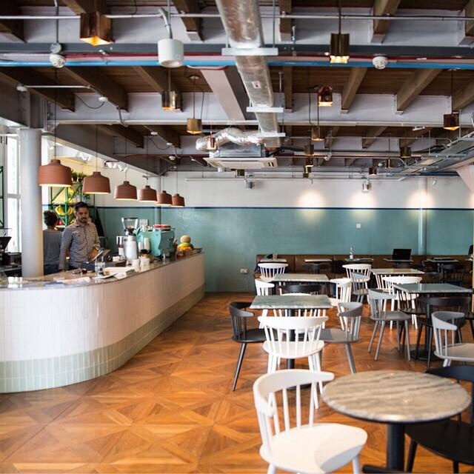
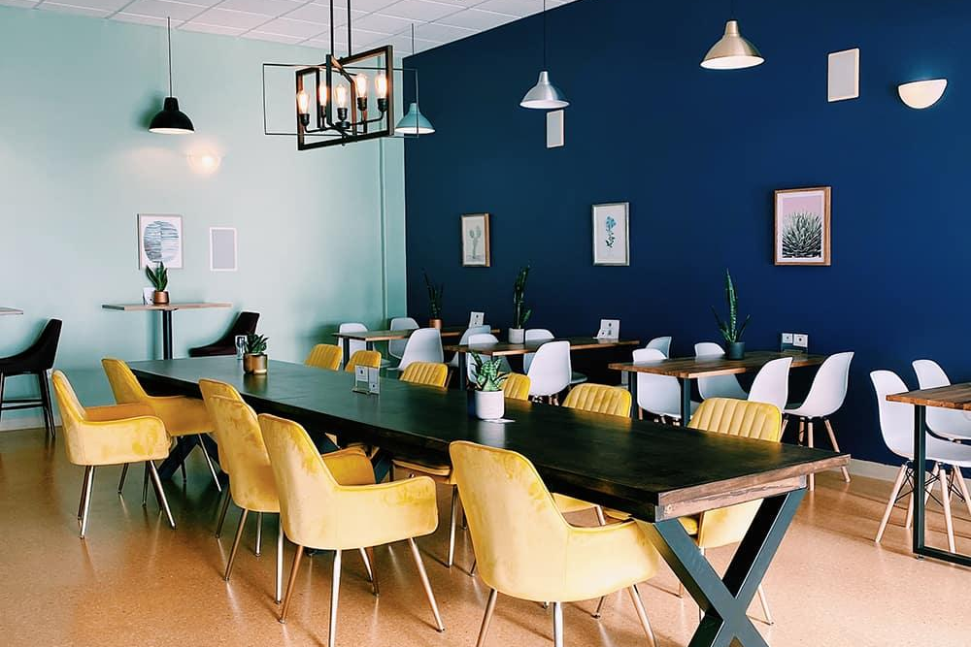
INSPIRATION

Slide 3
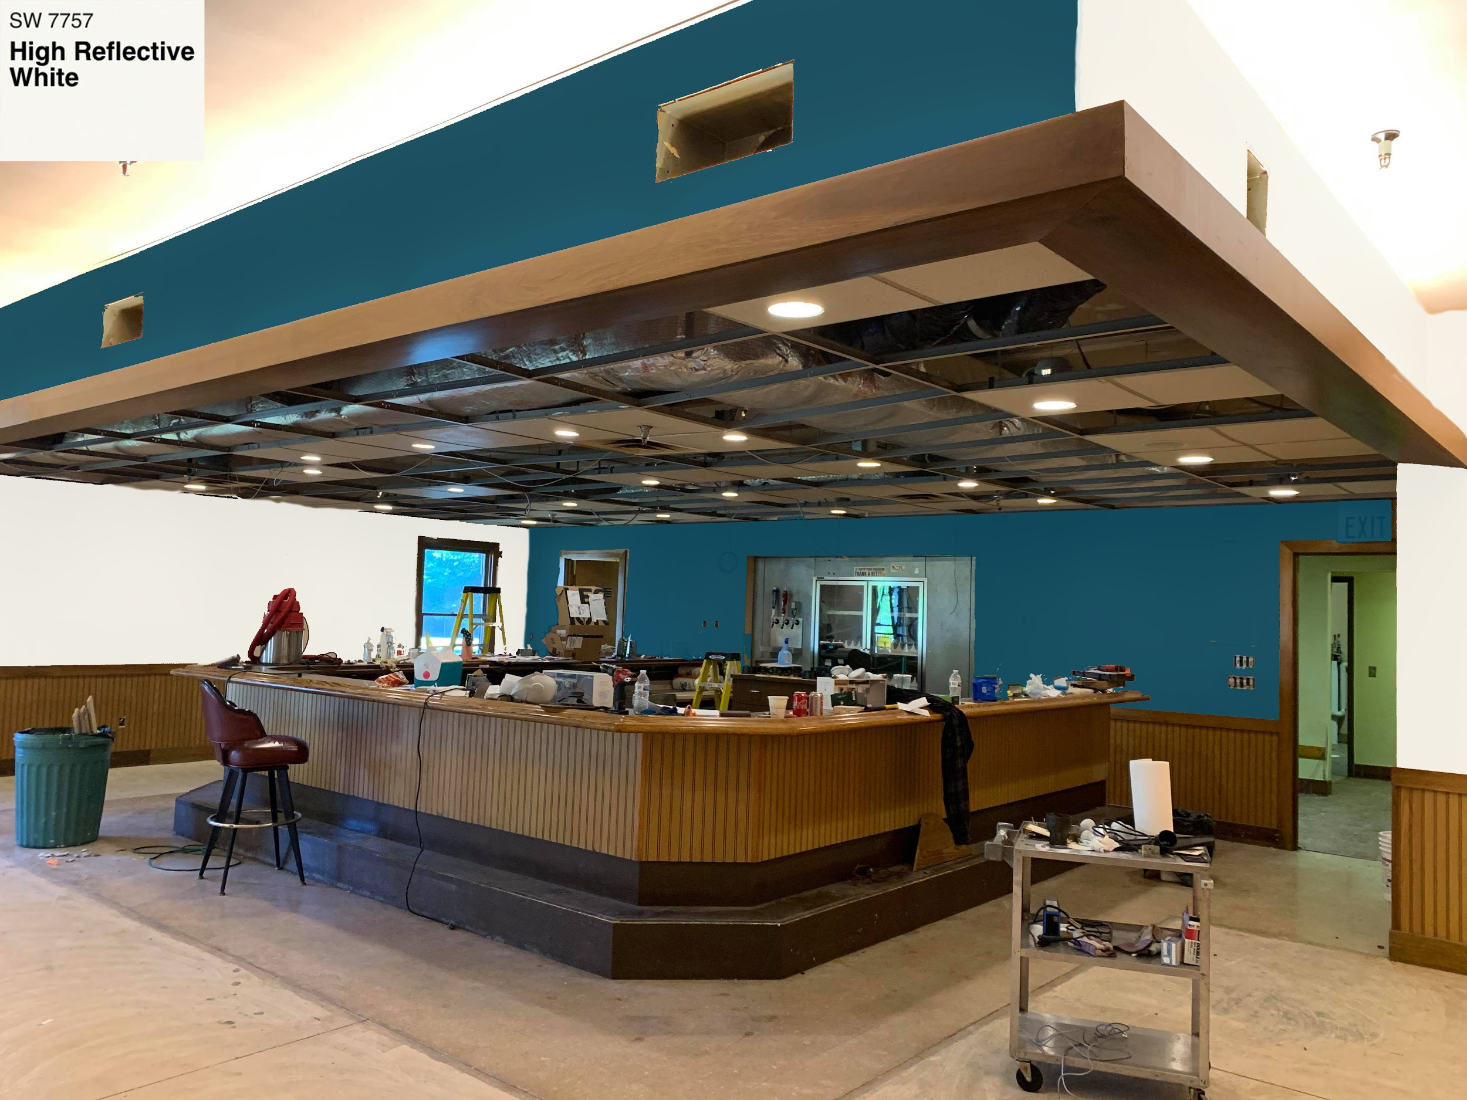

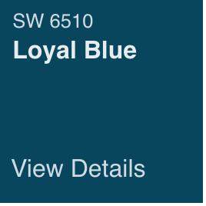
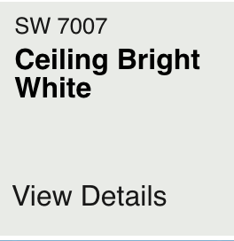
PALETTE 1
Walls
Accent Wall
Ceiling (not drop tiles)

Slide 4
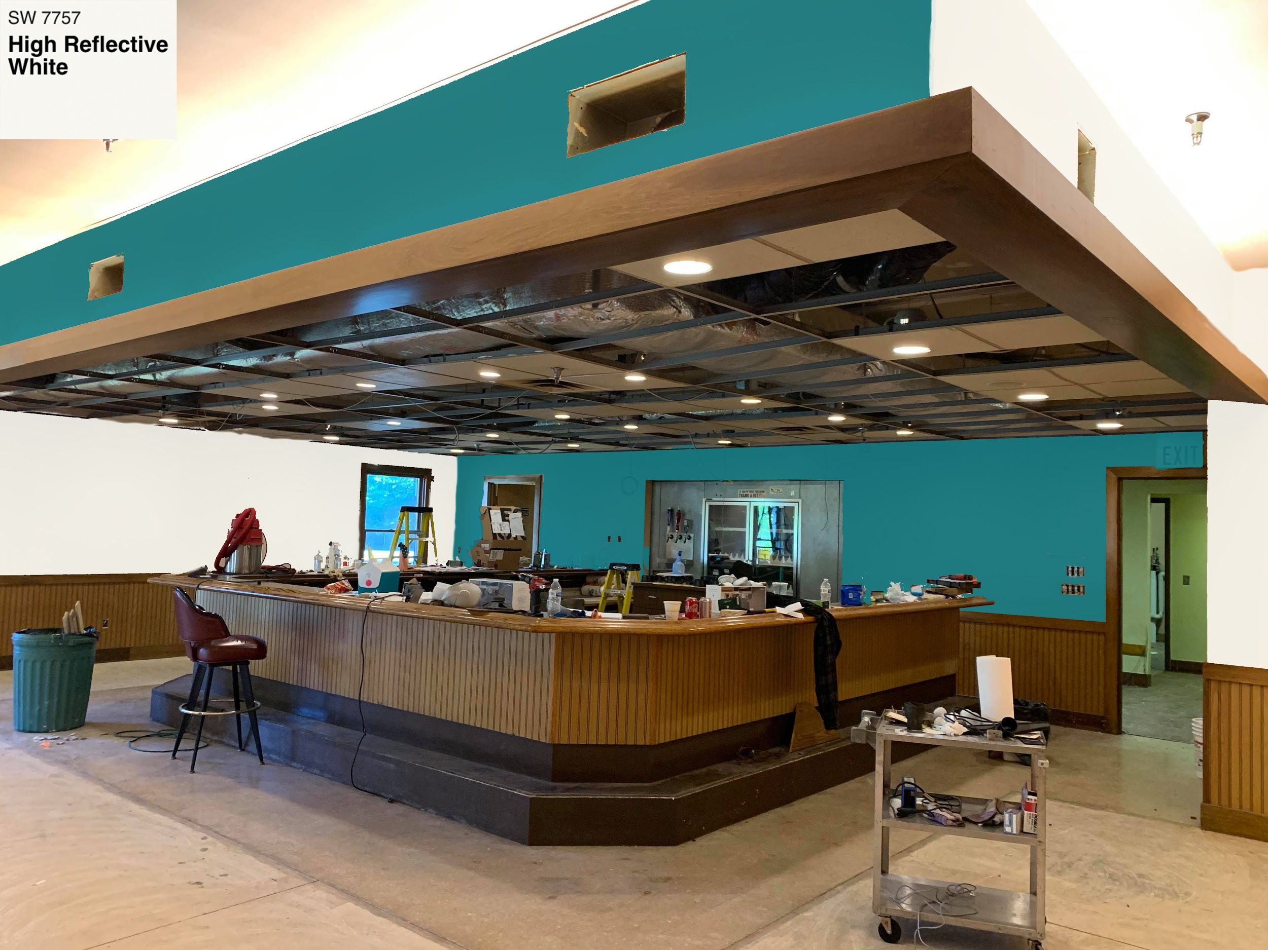
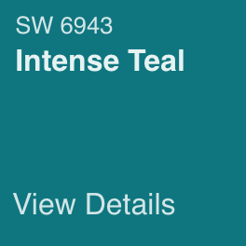
PALETTE 2:
Walls
Accent Wall
Ceiling (not drop tiles)

Slide 5
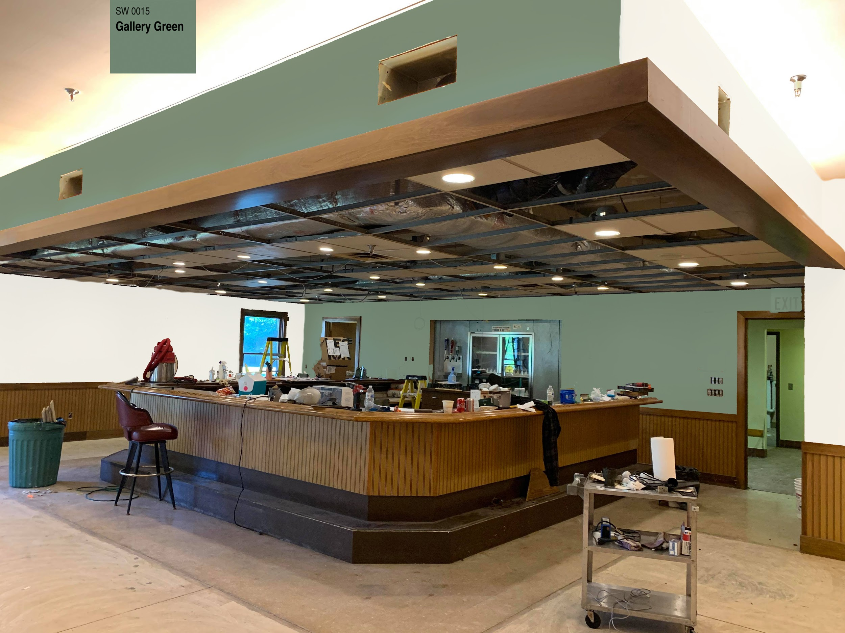

PALETTE 3:
Walls
Accent Wall
Ceiling (not drop tiles)

Slide 6
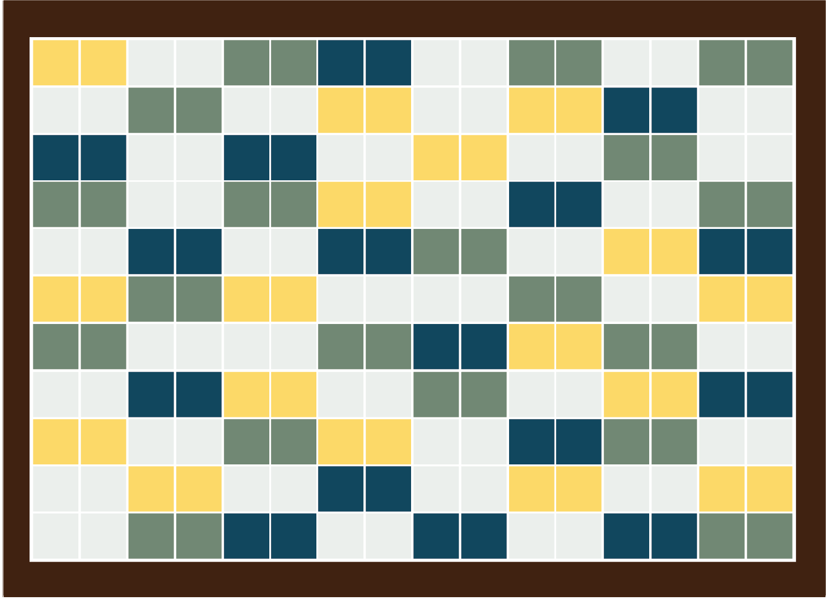
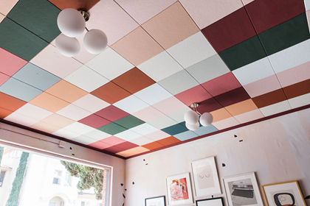
PAINTING CEILING TILES
Inspiration:
Use bright colors here that we can repeat in other design elements throughout the room.

Slide 7
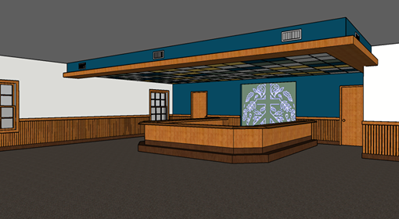
TIM’S MOCKUP: LOYAL BLUE & CEILING TILES
REASONING
- Accent wall: highlight bar area - going with blues and greens to go with the wood paneling instead
- Keep the bar: elders like functionality - coffee/work/ reserving special materials - Keep the paneling and trim, looks OK with new paint - Ceiling tile colors = fun accent for the room & introduce new colors for wall art & furniture to work with.

