Slide 1
Walking in Freedom
Galatians 5:13-21

Slide 2
Jesus Christ Delights in Freedom!
“It was for freedom that Christ set us free!” Galatians 5:1

Slide 3
Jesus Christ Delights in Freedom!
“It was for freedom that Christ set us free!” Galatians 5:1
He throws gates open.
Matthew 28:19 (NLT) Therefore, go! Make disciples of all the nations, baptizing them in the name of the Father and the Son and the Holy Spirit.

Slide 4
Jesus Christ Delights in Freedom!
“It was for freedom that Christ set us free!” Galatians 5:1
He throws gates open.
Other freedoms, too…
Financial Freedom
Freedom from the Past
Free to love & be loved!

Slide 5
Jesus Christ Delights in Freedom!
“It was for freedom that Christ set us free!” Galatians 5:1
Two Great Freedoms:
Freedom from Religion (the Law)
A terrible burden: you’ll never find life.
Jesus Christ died to pay for our sins.
Now: a love-based relationship with God.
Relax! Rest! Enjoy your Creator!
Notes:
FREEDOM of RELIG!

Slide 6
Jesus Christ Delights in Freedom!
“It was for freedom that Christ set us free!” Galatians 5:1
Two Great Freedoms:
Freedom from Religion (the Law)
Freedom from Slavery to SELF.
How will you deal with this beast?
Go back under the Law (self-effort)
Not really “wired” for this…
Give in to it…
Notes:
SLAVERY..Self→Self-ISM, Self-LOVE, Self-WORSHIP, Self-CONSUMED

Slide 7
Freedom From ‘the Beast Within’
The biggest threat to freedom is anarchy.
There is a lighthearted, fun-loving aspect to freedom
For you were called to freedom, brethren; only do not turn your freedom into an opportunity for the flesh… Gal. 5:13
Notes:
Opport.4 Flesh=>YEEEHA!
* Thus 5:13

Slide 8
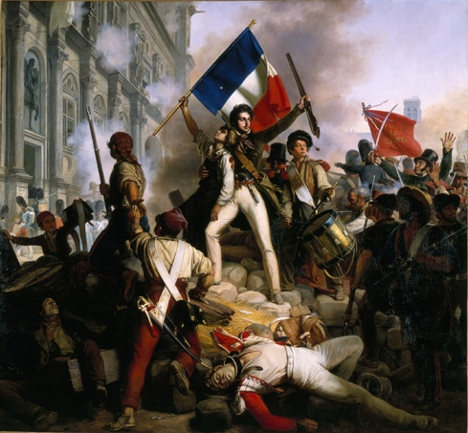
Freedom From ‘the Beast Within’
The biggest threat to freedom is anarchy.
There is a lighthearted, fun-loving aspect to freedom
For you were called to freedom, brethren; only do not turn your freedom into an opportunity for the flesh… Gal. 5:13
Notes:
French Revol: “Let them eat cake!”
> Carried out the Royal Family…beheaded!

Slide 9
Freedom From ‘the Beast Within’
The biggest threat to freedom is anarchy.
There is a lighthearted, fun-loving aspect to freedom
…Resulting in chaos and open warfare!
But if you bite and devour one another, take care that you are not consumed by one another. Gal. 5:15
Notes:
Bite & Devour:
> in BOC=Cut Each Other DOWN

Slide 10
Freedom From ‘the Beast Within’
The biggest threat to freedom is anarchy.
Real freedom is the ability to love others.
…do not turn your freedom into an opportunity for the flesh, but through love serve one another. For the whole Law is fulfilled in one word, in the statement, "You shall love your neighbor as yourself." Gal. 5:13-14
Notes:
Love Others==NOT WIRED this way
> Normally OBSESSED with:
How can I get OTHERS 2 Srv Me?
How can I ELEVATE Myself?

Slide 11
Freedom From ‘the Beast Within’
The biggest threat to freedom is anarchy.
Real freedom is the ability to love others.
Love is the structure in Christian ‘Freedom’
For the whole Law is fulfilled in one word, in the statement, “You shall love your neighbor as yourself.” Gal. 5:14
Notes:
“Whole law..fulfilled”
→NOT under LAW
→IS: New Way of LIFE
i.e., New VIEWPOINT

Slide 12
Freedom From ‘the Beast Within’
The biggest threat to freedom is anarchy.
Real freedom is the ability to love others.
Real bondage lies within!
…do not turn your freedom into an opportunity for the flesh… Gal. 5:13-14
Notes:
Love Others==NOT WIRED this way
> Normally OBSESSED with:
How can I get OTHERS 2 Srv Me?
How can I ELEVATE Myself?

Slide 13
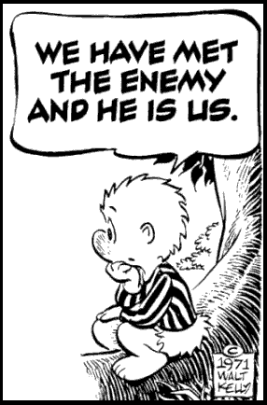
Freedom From ‘the Beast Within’
The biggest threat to freedom is anarchy.
Real freedom is the ability to love others.
Real bondage lies within!
…do not turn your freedom into an opportunity for the flesh… Gal. 5:13-14
Notes:
POGO=4 REAL!

Slide 14
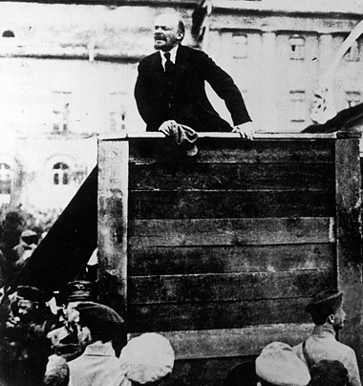
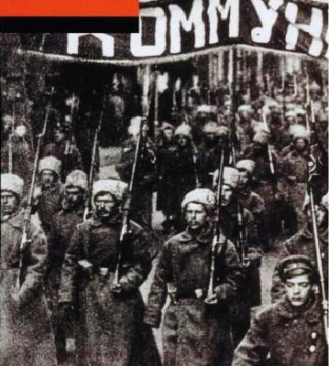
Freedom From ‘the Beast Within’
From here
To there
The biggest threat to freedom is anarchy.
Real freedom is the ability to love others.
Real bondage lies within!
…do not turn your freedom into an opportunity for the flesh… Gal. 5:13-14
Notes:
THUS: Communism=FARCE
> From: UTOPIAN DREAMS
“Let’s all just get along…”
* To: BLOODY DICTATORSHIP

Slide 15
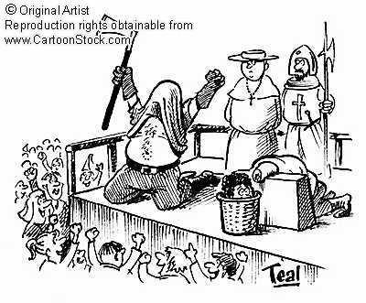
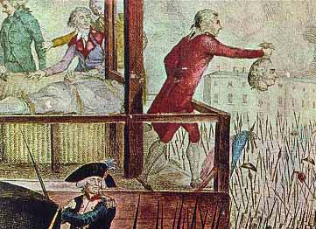
Freedom From ‘the Beast Within’
From here
To there
The biggest threat to freedom is anarchy.
Real freedom is the ability to love others.
Real bondage lies within!
…do not turn your freedom into an opportunity for the flesh… Gal. 5:13-14
Notes:
THUS: French Revolution
> From: UTOPIAN DREAMS
“Man is basically GOOD…”
> To: BLOODY DECAPITAT.
(With some humor)

Slide 16
Freedom From ‘the Beast Within’
The biggest threat to freedom is anarchy.
Real freedom is the ability to love others.
Real bondage lies within!
It’s the war-like “flesh” (“sinful nature”)
Galatians 5:17 The sinful nature wants to do evil, which is just the opposite of what the Spirit wants. And the Spirit gives us desires that are the opposite of what the sinful nature desires. These two forces are constantly fighting each other, so you are not free to carry out your good intentions.

Slide 17
Freedom From ‘the Beast Within’
The biggest threat to freedom is anarchy.
Real freedom is the ability to love others.
Real bondage lies within!
It’s the war-like “flesh” (“sinful nature”)
Not a ‘philosophical’ or ‘religious’ issue
Galatians 5:19-21 When you follow the desires of your sinful nature, the results are very clear…

Slide 18
Freedom From ‘the Beast Within’
…results are very clear: sexual immorality, impurity, lustful pleasures, idolatry, sorcery, hostility, quarreling, jealousy, outbursts of anger, selfish ambition, dissension, division, envy, drunkenness, wild parties, and other sins like these… Gal. 5:19-21
The biggest threat to freedom is anarchy.
Real freedom is the ability to love others.
Real bondage lies within!
It’s the war-like “flesh” (“sinful nature”)
Not a ‘philosophical’ or ‘religious’ problem
A poisonous mind-set.

Slide 19
Freedom From ‘the Beast Within’
Self
You
You
You
You
The biggest threat to freedom is anarchy.
Real freedom is the ability to love others.
Real bondage lies within!
It’s the war-like “flesh” (“sinful nature”)
Not a ‘philosophical’ or ‘religious’ problem
A poisonous mind-set.
Notes:
This is what the SELF-LIFE looks like…
> Supposedly “Friends”, but NOT REALLY
> Always looking @ how YOU affect ME!
WHEN You’re INCONVENIENT, then GOODBYE!

Slide 20
Freedom From ‘the Beast Within’
The biggest threat to freedom is anarchy.
Real freedom is the ability to love others.
Real bondage lies within!
It’s the war-like “flesh” (“sinful nature”)
Greed
“Sexual Immorality, impurity, (‘pornea’), orgies”
Notes:
You PAY a HEAVY PRICE to USE people…
> Sexuality=DEEP Expression of LOVE
I.e., “I’m COMMITTED to YOU!”
TEARS APART the FABRIC of our SOULS
→DEEP-set DAMAGE..4 LIFETIME
→INABILITY 2 Form COMMITTED Luv relationships…
PORN==HUGE INDUSTRY
→Creating GREEDY APPETITES …
→ORIGIES==Xtreme PERVERTS

Slide 21


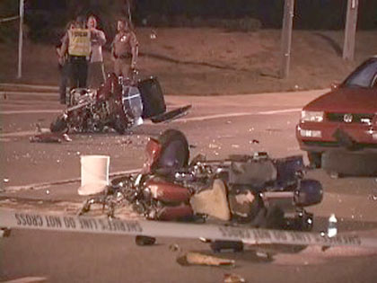
Freedom From ‘the Beast Within’
The biggest threat to freedom is anarchy.
Real freedom is the ability to love others.
Real bondage lies within!
It’s the war-like “flesh” (“sinful nature”)
Greed
“Sexual Immorality, impurity, (‘pornea’), orgies”
Notes:
“Flesh”..Sounds so LUXURIOUS idyllic, FANTASTIC, alluring.
* IL: Billy Idol→Handsome
* But then he wrecked his motorcycle,
* And now his whole life was wrecked!
→BIGGEST WRECKER OF LIVES!!

Slide 22
Freedom From ‘the Beast Within’
The biggest threat to freedom is anarchy.
Real freedom is the ability to love others.
Real bondage lies within!
It’s the war-like “flesh” (“sinful nature”)
Greed
“Sexual Immorality, impurity, (‘pornea’), orgies”
“Sensuality, drunkenness, carousing, debauchery”
Notes:
INSATIABLE “Feel Good” appetites
→“I Feel DEPRESSED..Get STONED”
→1 PROBLEM: “Tomorrow”
GOD Wants U 2 FEEL GOOD!
→It’s AVAILABLE..Diff. Way

Slide 23
Freedom From ‘the Beast Within’
My Interests
Your Interests
The biggest threat to freedom is anarchy.
Real freedom is the ability to love others.
Real bondage lies within!
It’s the war-like “flesh” (“sinful nature”)
Greed
War
“Enmities, strife, jealousy, fits of rage, disputes, dissensions, factions…”
Notes:
Serv Self=Bad BASIS 4 RELAT.
** Inevit: DIVERGENT Interests (“Scratch U, Scratch Me” ~Enuff)
Who’ll GIVE In?
→ “Fits..RAGE” = SOLUTION
→ Wars/INHUMANE Treatment
→ ?DIVORCE? (Prob=ME?)
GOSP: U==LIFETIME of War 2 Luk Forward 2…
→G. Has Someth. BETTER…

Slide 24
Freedom From ‘the Beast Within’
The biggest threat to freedom is anarchy.
Real freedom is the ability to love others.
Real bondage lies within!
It’s the war-like “flesh” (“sinful nature”)
Greed
War
Idols
“Idolatry, Sorcery”
Notes:
WEIRD Relig: Pwr,Future=ME
> Idols=“Theol. of BRIBERY”
> Ppl INVENTING GOD
“Pharmacea”
==REAL SPIRIT’L CONTACT

Slide 25
Freedom From ‘the Beast Within’
The biggest threat to freedom is anarchy.
Real freedom is the ability to love others.
Real bondage lies within!
It’s the war-like “flesh” (“sinful nature”)
Greed
War
Idols
After a lifetime?
Slavery, Death
Notes:
Lifetime? →DEATH
Worn OUT, BITTER
WARN YOUNG:
> Big MARKETING Targets

Slide 26
Freedom From ‘the Beast Within’
People who love it?
“Let me tell you again, as I have before, that anyone living that sort of life will not inherit the Kingdom of God.”
Living far, far away from God’s world...alienated.
The biggest threat to freedom is anarchy.
Real freedom is the ability to love others.
Real bondage lies within!
It’s the war-like “flesh” (“sinful nature”)
Greed
War
Idols
Notes:
Love This? =v.21
* ==ALIENATED Frm.G.
GOSP: “I’ll receive LATER”
> MAYBE NOT!

Slide 27
Freedom From ‘the Beast Within’
The biggest threat to freedom is anarchy.
Real freedom is the ability to love others.
Real bondage lies within!
It’s the war-like “flesh” (“sinful nature”)
Greed
War
Idols
Galatians 5:17 For the flesh sets its desire against the Spirit, and the Spirit against the flesh; for these are in opposition to one another, so that you may not do the things that you please.
Christians in Turmoil
Notes:
==Xians Living in TURMOIL
> Spiritual MOLASIS
* Gal. 5:17= @War WITHIN!

Slide 28
OR: “Through Love, Serve…”
Beast Within
Others-Centered
Notes:
OR…
* 2 Ways 2 Enter the ROOM…
> With the SELFISH BEAST Within
> As a REFRESHING BLAST of God’s Presence!

Slide 29
OR: “Through Love, Serve…”
A Carefree Heart On the Move!
Growing, not degrading…
Beast Within
Others-Centered
Notes:
==CARE-FREE Heart On the MOVE
** I.e., GROWING, not DEGRADING
==PERPETUAL YOUTH
This==God’s WILL 4 U!!

Slide 30
OR: “Through Love, Serve…”
A Carefree Heart On the Move!
Means Following God’s Leadership
Galatians 5:16 So I say, let the Holy Spirit guide your lives. Then you won’t be doing what your sinful nature craves.
Notes:
==NATURAL CHANGE

Slide 31
OR: “Through Love, Serve…”
A Carefree Heart On the Move!
Means Following God’s Leadership
NOT an issue of “being good”
Galatians 5:18 (NLT) But when you are directed by the Spirit, you are not under obligation to the law of Moses.
Sin-focused life
Notes:
~ “Being GOOD” / UPTIGHT
* Law=SIN-FOCUSED LIFE
=How MANY try to live the Xian life,
=FATE Worse Than DEATH!
=Guaranteed FAILURE!

Slide 32
OR: “Through Love, Serve…”
A Carefree Heart On the Move!
Means Following God’s Leadership
God-Driven Growth
But the fruit of the Spirit is love, joy, peace, patience, kindness, goodness, faithfulness, gentleness, self-control; against such things there is no law. Gal. 5:22-23
Notes:
God-DRIVEN
==REAL FREEDOM!

Slide 33
OR: “Through Love, Serve…”
A Carefree Heart On the Move!
Means Following God’s Leadership
God-Driven Growth
But the fruit of the Spirit…against such things there is no law. Gal. 5:22-23
Notes:
God-DRIVEN / ~SELF-Driven
AP: You Want CHANGE?
> U Need. Relat. w/ God!
IL: ASK: ‘How..Doin’ w/JC?’

Slide 34
OR: “Through Love, Serve…”
John 15:4-5 (NASB) "Abide in Me, and I in you. As the branch cannot bear fruit of itself unless it abides in the vine, so neither can you unless you abide in Me. "I am the vine, you are the branches; he who abides in Me and I in him, he bears much fruit, for apart from Me you can do nothing.
A Carefree Heart On the Move!
Means Following God’s Leadership
God-Driven Growth
But the fruit of the Spirit…against such things there is no law. Gal. 5:22-23
Notes:
Jn.15=Same=MUCH FRUIT!
AP: Luk @2008→ “Wow! Much Fruit!”

Slide 35
OR: “Through Love, Serve…”
A Carefree Heart On the Move!
Means Following God’s Leadership
God-Driven Growth
Developing The Maturity to Love
But the fruit of the Spirit is love… Gal. 5:22-23
THE Fruit is…
Notes:
THE Fruit…
* Singular=SEMI-COLON…
AP: =1 Big BET: U=Able 2 LUV

Slide 36
OR: “Through Love, Serve…”
A Carefree Heart On the Move!
Means Following God’s Leadership
God-Driven Growth
Developing The Maturity to Love
A Different Mind-Set
Those who live according to the sinful nature have their minds set on what that nature desires; but those who live in accordance with the Spirit have their minds set on what the Spirit desires. Romans 8:5
Notes:
Much Like Ro.8:5

Slide 37
OR: “Through Love, Serve…”
A Carefree Heart On the Move!
Means Following God’s Leadership
God-Driven Growth
Developing The Maturity to Love
A Different Mind-Set
Life vs. Death
The mind of sinful man is death, but the mind controlled by the Spirit is life and peace; Romans 8:6
Notes:
Life & PEACE
→ Ap:VALUABLE COMMODITY!!

Slide 38
The Freedom of Choice
Life (Jas.4:8)
“Draw near to God, and He will draw near to you”
Death (Ro.8:6)
“The mind set on the flesh is death”
Notes:
Freedom==
Before: all you could do is think about yourself;
after all, nobody else was thinking about you!
* Life vs. DEATH

Slide 39
The Freedom of Choice
Death (5:19f)
sexual immorality, impurity, lustful pleasures, idolatry, sorcery, hostility, quarreling, jealousy, outbursts of anger, selfish ambition, dissension, division, envy, drunkenness, wild parties
Life (Jas.4:8)
love, joy, peace, patience, kindness, goodness, faithfulness, gentleness, self-control;
Notes:
Death=INFINITE POSSIBILITIES!
Life=Sweet & SIMPLE

Slide 40
The Freedom of Choice
Death (5:19f)
“The WORKS of the Flesh…”
Life (Jas.4:8)
“The FRUIT of the Spirit”
God wants to bless you right now!
Notes:
WORK=Desperate THRASHING
FRUIT=NATURAL, Growth
AP: R.U. Thrashing?
or FRUITFUL?
* G=Wants to BLESS U

