Slide 1
Investing Talents
Matthew 25:14-30
Notes:
Intro - Parables this summer
This one the parab of talents
Part of three parables about staying awake…. (slide)

Slide 2
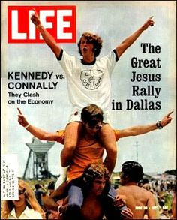
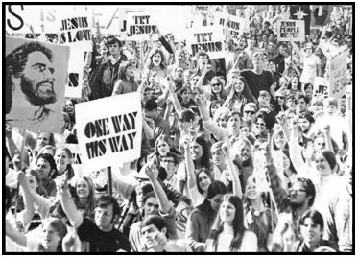
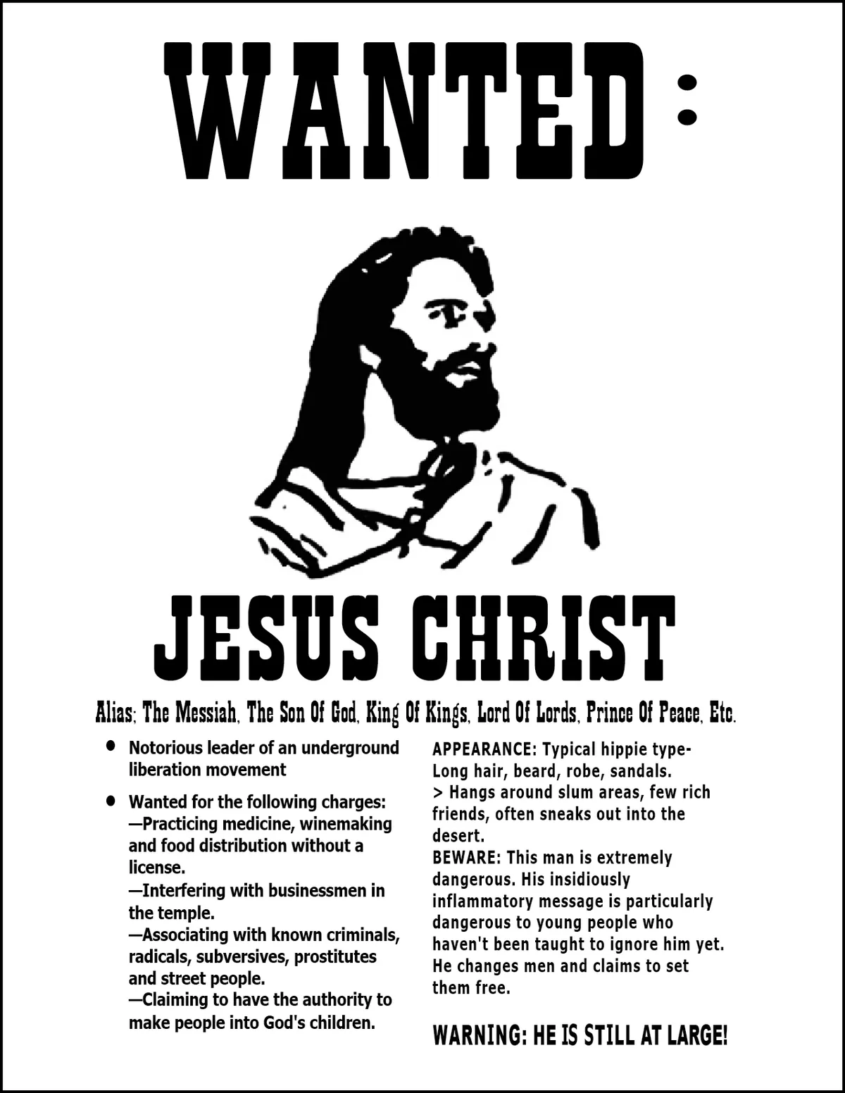
Notes:
Jesus Freak movement - 3rd great awakening - 1972ff
What made it work?
Disenfranchised with hippie movement
CHRIST’S IMMINENCE
What happened to it?
Fizzled out - got jobs made money
Lost revolutionary fervour
Fell ASLEEP!
Scripture is all about being awake
Use time wisely
INVEST! (slide)

Slide 3
Matthew 25
14 “For it is just like a man about to go on a journey, who called his own slaves and entrusted his possessions to them. 15 To one he gave five talents, to another, two, and to another, one, each according to his own ability; and he went on his journey.
Notes:
Taking care of someone else’s stuff.
This is called… (slide)

Slide 4
Matthew 25
14 “For it is just like a man about to go on a journey, who called his own slaves and entrusted his possessions to them. 15 To one he gave five talents, to another, two, and to another, one, each according to his own ability; and he went on his journey.
Stewardship
Notes:
Stewardship - taking care, and doing WELL
Ex: Denethor (slide)

Slide 5
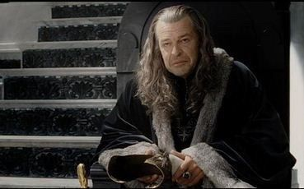
Matthew 25
14 “For it is just like a man about to go on a journey, who called his own slaves and entrusted his possessions to them. 15 To one he gave five talents, to another, two, and to another, one, each according to his own ability; and he went on his journey.
Stewardship
Notes:
Josh spoiled for me
Take care of the kingdom
Make it fluerish until King
A good steward gets rewarded
Are we stewards? Yes!
How? Good looks, mental capacity, country born into
Evth. GOOD
This COMES FROM GOD
Some have less, some more - UNFAIR
But NOT for pleasure!
FOR God
Those of us with more… More is expected
App: We get jealous b/c we think blessings are for us

Slide 6
Matthew 25
16 Immediately the one who had received the five talents went and traded with them, and gained five more talents. 17 In the same manner the one who had received the two talents gained two more.
Notes:
Immediately - got to work right away
Had an immediacy to them - remember Jesus freak!
App: Sometimes we say “Maybe later”
Now is the time!
The reality is we have freedom w talents
Can do WHATEVER WHENEVER
Can use for God or selves
BUT means we 100% accountable for our decisions
Will you invest or not?
App: What does it mean to invest?
Ministry! Service!
(slide)

Slide 7
Matthew 25
Matthew 25
35 For I was hungry, and you gave Me something to eat; I was thirsty, and you gave Me something to drink; I was a stranger, and you invited Me in; 36 naked, and you clothed Me; I was sick, and you visited Me; I was in prison, and you came to Me.’
16 Immediately the one who had received the five talents went and traded with them, and gained five more talents. 17 In the same manner the one who had received the two talents gained two more.
Notes:
The sheep and the goats judgment
Love! Building up!
Paul also says… (slide)

Slide 8
Matthew 25
Matthew 25
35 For I was hungry, and you gave Me something to eat; I was thirsty, and you gave Me something to drink; I was a stranger, and you invited Me in; 36 naked, and you clothed Me; I was sick, and you visited Me; I was in prison, and you came to Me.’
16 Immediately the one who had received the five talents went and traded with them, and gained five more talents. 17 In the same manner the one who had received the two talents gained two more.
Ephesians 4:11-12
11 And He gave some as apostles, and some as prophets, and some as evangelists, and some as pastors and teachers, 12 for the equipping of the saints for the work of service, to the building up of the body of Christ;
Notes:
Service/investing to build up Body
Being a soul winner
Healing/encouraging
Teaching
It is NOT shallow relating
Sometimes we think “fellowship” and “ministry” is hanging out
But to INVEST takes hard work
What about the last guy… (slide)

Slide 9
Matthew 25
18 But he who received the one talent went away, and dug a hole in the ground and hid his master’s money.
Notes:
Doesnt sound too bad, but imagine doing this
It’s not what you did, what you DIDN’T do
The sin of OMISSION
Easy to judge the out there sinners
What’s so bad? Taking wonderful things from God and doing NOTHING
Need to recognize a sobering fact… (slide)

Slide 10
Matthew 25
19 “Now after a long time the master of those slaves came and settled accounts with them. 20 The one who had received the five talents came up and brought five more talents, saying, ‘Master, you entrusted five talents to me. See, I have gained five more talents.’ 21 His master said to him, ‘Well done, good and faithful slave. You were faithful with a few things, I will put you in charge of many things; enter into the joy of your master.’
Notes:
V. 19 - settle accounts
U will face G someday
More gifted = more accountable
What we do here echoes into eternity, good or bad
V. 20-22
Rewarded!
Calls it a “few” but a LOT of money!
The good things G has prepared beyond comprehension
Even the other guy… (slide)

Slide 11
Matthew 25
22 “Also the one who had received the two talents came up and said, ‘Master, you entrusted two talents to me. See, I have gained two more talents.’ 23 His master said to him, ‘Well done, good and faithful slave. You were faithful with a few things, I will put you in charge of many things; enter into the joy of your master.’
Notes:
Maybe you’re not Billy Graham…
But it’s what you do with what you got
Enter into joy - sharing glory
Ex: rock concert - filling in as drummer
We do all to glory of G - but he shares
Paralell passage… (slide)

Slide 12
Matthew 25
22 “Also the one who had received the two talents came up and said, ‘Master, you entrusted two talents to me. See, I have gained two more talents.’ 23 His master said to him, ‘Well done, good and faithful slave. You were faithful with a few things, I will put you in charge of many things; enter into the joy of your master.’
Luke 19:17
“‘Well done, my good servant!’ his master replied. ‘Because you have been trustworthy in a very small matter, take charge of ten cities.’
Notes:
That’s what we want to hear!
In charge of 10 cities? What’s that mean in heaven?
Not sure… but glorious
We destined for glory… (slide)

Slide 13
Matthew 25
22 “Also the one who had received the two talents came up and said, ‘Master, you entrusted two talents to me. See, I have gained two more talents.’ 23 His master said to him, ‘Well done, good and faithful slave. You were faithful with a few things, I will put you in charge of many things; enter into the joy of your master.’
Luke 19:17
“‘Well done, my good servant!’ his master replied. ‘Because you have been trustworthy in a very small matter, take charge of ten cities.’
1 Cor 2:7
No, we declare God’s wisdom, a mystery that has been hidden and that God destined for our glory before time began.
Notes:
Mystery = the gospel
God working towards our glory
Now back to bad steward.. (slide)

Slide 14
Matthew 25
24 “And the one also who had received the one talent came up and said, ‘Master, I knew you to be a hard man, reaping where you did not sow and gathering where you scattered no seed. 25 And I was afraid, and went away and hid your talent in the ground. See, you have what is yours...’
Notes:
I hid it - b/c you are harsh?
How will master respond?

Slide 15
Matthew 25
26 “But his master answered and said to him, ‘You wicked, lazy slave, you knew that I reap where I did not sow and gather where I scattered no seed. 27 Then you ought to have put my money in the bank, and on my arrival I would have received my money back with interest.
Notes:
Agreeing? No.
Saying… OK you wanna play it that way?
Verse backs this up.. (slide)

Slide 16
Matthew 25
26 “But his master answered and said to him, ‘You wicked, lazy slave, you knew that I reap where I did not sow and gather where I scattered no seed. 27 Then you ought to have put my money in the bank, and on my arrival I would have received my money back with interest.
Luke 19:22
“His master replied, ‘I will judge you by your own words, you wicked servant! You knew, did you, that I am a hard man, taking out what I did not put in, and reaping what I did not sow?
Notes:
Judge by own words!
Problem = This servant doesn’t KNOW God!
Well ok… wanna play it that way should have done this… (slide)

Slide 17
Matthew 25
26 “But his master answered and said to him, ‘You wicked, lazy slave, you knew that I reap where I did not sow and gather where I scattered no seed. 27 Then you ought to have put my money in the bank, and on my arrival I would have received my money back with interest.
Notes:
At least should have invested!
App: A lot of ppl think this way - god should accept me
What will u say when you meet G?
G will say - you KNEW and never bothered to check me out?
Why ppl do this?
Some scared
Some too distracted
Biggest sin of ommission - never to accept
So he continues… (slide)

Slide 18
Matthew 25
28 Therefore take away the talent from him, and give it to the one who has the ten talents.’
29 “For to everyone who has, more shall be given, and he will have an abundance; but from the one who does not have, even what he does have shall be taken away. 30 Throw out the worthless slave into the outer darkness; in that place there will be weeping and gnashing of teeth.
Notes:
That what you have taken away
Ppl have sense of G there…
Interested… but over time it dies away
Must use it or lose it
Ppl reject god - Hell
Romans - those who suppress truth of God
Imp. distinction.. Not investing doesnt mean hell (slide)

Slide 19
Matthew 25
28 Therefore take away the talent from him, and give it to the one who has the ten talents.’
29 “For to everyone who has, more shall be given, and he will have an abundance; but from the one who does not have, even what he does have shall be taken away. 30 Throw out the worthless slave into the outer darkness; in that place there will be weeping and gnashing of teeth.
1 Cor 3:15
15 If it is burned up, the builder will suffer loss but yet will be saved—even though only as one escaping through the flames.
Notes:
Those who receive Christ, but live for self
Just escaping flames
Reality = not everyone will hear “well done”
Receiving Christ is putting in bank
It’s the least you can do
But I urge you to do more!

Slide 20
Conclusions
Recognize that you are a steward

Slide 21
Conclusions
Recognize that you are a steward
Use your freedom responsibly

