Slide 1
The Apex of Human Greatness
Revelation 17

Slide 2
Where Are We In Revelation?
Israel regathered in Israel
God’s “Restraint” is removed
Israel flourishes, enemies decay
Great “church” denial of JC
End of the “Church Age”
Global unity
Global leader
Global religion
Global Media
European 10-nation union
Global, no-currency economy
Humans destroying the planet
HUGE armies gathering
W.M.D. unleashed

Slide 3
Already fulfilled prophecies…
Israel regathered in Israel
God’s “Restraint” is removed
Israel flourishes, enemies decay
Great “church” denial of JC
End of the “Church Age”
Global unity
Global leader
Global religion
Global Media
European 10-nation union
Global, no-currency economy
1967
Luke 21:24 and they will fall by the edge of the sword, and will be led captive into all the nations; and Jerusalem will be trampled under foot by the Gentiles until the times of the Gentiles are fulfilled.
Humans destroying the planet
HUGE armies gathering
W.M.D. unleashed

Slide 4
Easily-fulfilled prophecies…
Israel regathered in Israel
God’s “Restraint” is removed
Israel flourishes, enemies decay
Great “church” denial of JC
End of the “Church Age”
Global unity
Global leader
Global religion
Global Media
European 10-nation union
Global, no-currency economy
Humans destroying the planet
HUGE armies gathering
W.M.D. unleashed
“Too hard to under-stand”
Not today
Notes:
10-Nation→ Pressure=ON!
GLOBAL→ Pressure=ON!!

Slide 5
What Was “Impossible” Last Century?
Israel regathered in Israel
God’s “Restraint” is removed
Israel flourishes, enemies decay
Great “church” denial of JC
End of the “Church Age”
Global unity
Global leader
Global religion
Global Media
European 10-nation union
Global, no-currency economy
Mark 13:32 "But of that day or hour no one knows, not even the angels in heaven, nor the Son, but the Father alone.
Humans destroying the planet
HUGE armies gathering
W.M.D. unleashed

Slide 6
Thus Armageddon Begins
Revelation 16:2 loathsome and malignant sores on the people…
Revelation 16:3 the sea became blood like that of a dead man; and every living thing in the sea died.
Revelation 16:4 Then the third angel poured out his bowl into the rivers and the springs of waters; and they became blood.
Revelation 16:8 …the sun scorched men with fire. Men were scorched with fierce heat; and they blasphemed the name of God who has the power over these plagues…
Revelation 16:12-16 The sixth angel poured out his bowl on the great river, the Euphrates; and its water was dried up, so that the way would be prepared for the kings from the east…And they gathered them together to the place which in Hebrew is called Har-Magedon.
Revelation 9:14-16 "Release the four angels who are bound at the great river Euphrates." And the four angels, who had been prepared for the hour and day and month and year, were released, so that they would kill a third of mankind. The number of the armies of the horsemen was two hundred million; I heard the number of them.

Slide 7
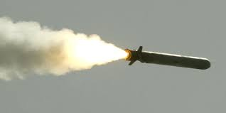
Thus Armageddon Begins
Revelation 16:17-21 Then the seventh angel poured out his bowl upon the air, and a loud voice came out of the temple from the throne, saying, "It is done."
And there were flashes of lightning and sounds and peals of thunder; and there was a great earthquake, such as there had not been since man came to be upon the earth, so great an earthquake was it, and so mighty. The great city was split into three parts, and the cities of the nations fell.
Babylon the great was remembered before God, to give her the cup of the wine of His fierce wrath. And every island fled away, and the mountains were not found.
And huge hailstones, about one hundred pounds each, *came down from heaven upon men; and men blasphemed God because of the plague of the hail, because its plague *was extremely severe.
Notes:
Drones?? More Compact Weapons??

Slide 8
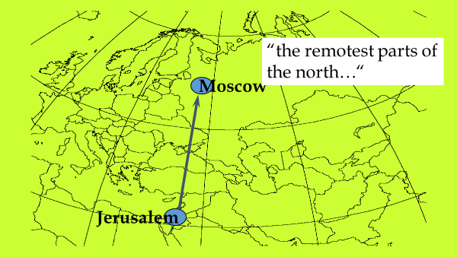
BEFORE Armageddon Begins
“King of the North” Ezek.38; Dan.11
Ez. 38:2 "Son of man, set your face toward Gog of the land of Magog, the prince of Rosh, Meshech and Tubal, and prophesy against him…”
Ez. 38:15 “You will come from your place in the remotest parts of the north…”
Notes:
?? COUNTRY?? → Josephus, etc. identify as “Scythians”

Slide 9
BEFORE Armageddon Begins
“King of the North” Ezek.38; Dan.11
Israel Re-gathered Ezek.37,38
38:8 “After many days you will be summoned; in the latter years you will come into the land that is restored from the sword, whose inhabitants have been gathered from many nations to the mountains of Israel which had been a continual waste; but its people were brought out from the nations, and they are living securely, all of them.”
38:11 and you will say, 'I will go up against the land of unwalled villages. I will go against those who are at rest, that live securely, all of them living without walls and having no bars or gates,
38:16 You will advance against my people Israel like a cloud that covers the land…
Notes:
**LIVING SECURELY = BEGINNING OF SCENARIO
**UNWALLED VILLAGES=Unheard Of Until 2Day

Slide 10
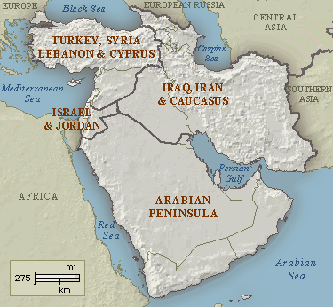
BEFORE Armageddon Begins
“King of the North” Ezek.38; Dan.11
Israel Re-gathered Ezek.37,38
“Kings of the South” Ezek.38; Dan.11
Ez.38:5 Persia, Cush and Put will be with them, [the king of the North] all with shields and helmets
Persia
“Cush”
“Put”

Slide 11
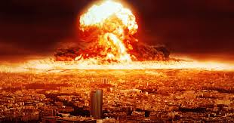
BEFORE Armageddon Begins
“King of the North” Ezek.38; Dan.11
Israel Re-gathered Ezek.37,38
“Kings of the South” Ezek.38; Dan.11
Catastrophe Ezek.38-39
Ezekiel 38:22 "With pestilence and with blood I will enter into judgment with him; and I will rain on him and on his troops, and on the many peoples who are with him, a torrential rain, with hailstones, fire and brimstone.
Ezekiel 39:3-4 "I will strike your bow from your left hand and dash down your arrows from your right hand. "You will fall on the mountains of Israel, you and all your troops and the peoples who are with you; I will give you as food to every kind of predatory bird and beast of the field.
Ezekiel 39:11-12 It will take seven months for the people of Israel to bury the bodies and cleanse the land.
Ezekiel 39:15 Whenever bones are found, a marker will be set up so the burial crews will take them to be buried in the Valley of Gog’s Hordes.
Ezekiel 39:6 "And I will send fire upon Magog and those who inhabit the coastlands in safety; and they will know that I am the LORD.
Notes:
Ez.38 = **W.M.D. ** → describe

Slide 12
Why the Catastrophe?
“The whole earth was amazed and followed after the beast.” -Rev.13:3
“Authority over every tribe and people and tongue and nation was given to him…” -Rev. 13:17
Violation of international order Rev. 13; Dan. 9:27
Daniel 9:27 The ruler will make a treaty with the people for a period of one set of seven, but after half this time, he will put an end to the sacrifices and offerings. And as a climax to all his terrible deeds, he will set up the Abomination of Desolation…
‘Abom’
Notes:
UNITY → ** Peace=3.5 Yrs → UNTIL ** ABOM

Slide 13
Why the Catastrophe?
Violation of international order Rev. 13; Dan. 9:27
“The Beast” is attacked (Dan.11)
Daniel 11:40-43 "And at the end time the king of the South will collide with him, and the king of the North will storm against him with chariots, with horsemen, and with many ships…"
North
North
North
South
South
South
Notes:
“Him” = The Anti-Christ, World-Ruler in Daniel
@ “END TIME” → **Mideast Invasion
ISRAEL=INEXORABLE PULL → ~Stop Hating

Slide 14
Why the Catastrophe?
Violation of international order Rev. 13; Dan. 9:27
“The Beast” is attacked (Dan.11)
“The Beast” responds (Dan.11)
Daniel 11:40-43 "…and he will enter countries, overflow them, and pass through. ⁴¹"He will also enter the Beautiful Land, and many countries will fall…
North
The Beast
North
North
South
South
South
Notes:
Ie., STOPS INSURRECTION → **From Europe

Slide 15
The Apex of Human Achievement
Violation of international order Rev. 13; Dan. 9:27
“The Beast” is attacked (Dan.11)
“The Beast” responds (Dan.11)
The East gets involved (Dan. 11; Rev. 9; 16)
DA 12:1 “At that time Michael, the great prince who protects your people, will arise. There will be a time of distress such as has not happened from the beginning of nations until then…”
Daniel 11:44 "But rumors from the East and from the North will disturb him, and he will go forth with great wrath to destroy and annihilate many.”
Matt.24: 22 If those days had not been cut short, no one would survive, but for the sake of the elect those days will be shortened.
The East
The Beast
Notes:
Rumors=BAD!! → ** ??Happening Over There??
** Arises 2 Meet Threat=BOOM!!
** Mt.24 =Nxt Wk JC Returns

Slide 16
The Apex of Human Achievement
Revelation 17:1-2 One of the seven angels who had poured out the seven bowls came over and spoke to me. “Come with me,” he said, “and I will show you the judgment that is going to come on the great prostitute, who rules over many waters. The kings of the world have committed adultery with her, and the people who belong to this world have been made drunk by the wine of her immorality.”
Revelation 17:3-5 And he carried me away in the Spirit into a wilderness; and I saw a woman sitting on a scarlet beast, full of blasphemous names, having seven heads and ten horns. The woman was clothed in purple and scarlet, and adorned with gold and precious stones and pearls, having in her hand a gold cup full of abominations and of the unclean things of her immorality, and on her forehead a name was written, a mystery, "BABYLON THE GREAT, THE MOTHER OF HARLOTS AND OF THE ABOMINATIONS OF THE EARTH."
Notes:
Rev.17 “Ppl. Of this WORLD” = Kosmos → Pwr Behind Pwrs
** “Harlot” = COUNTERFEIT LOVE = W.S. → Replace G’s Love
DESTROYS Love→ IL: “What Happens Las Vegas….”=LIES!!
Abominations=POISONS=Counterfeits

Slide 17
The Apex of Human Achievement
Every Kingdom Falls
Everyone Blames God
Blame the Demonic Realm
We Have to Fight
Notes:
Babs <100 yrs → Persians < 200 → Greeks < 300
Rome = 11 C → The Epitome
USA=260+ → Time is UP →FRAGILE: Twin Towers=11 Guys
China=Lender → Enemies=Russ, Iran, China, Terrorists
9/11 Celebrations→ THIS WK: Netflix/Facebook Cyber Attack

Slide 18
The Apex of Human Achievement
Every Kingdom Falls
Everyone Blames God
Blame the Demonic Realm
We Have to Fight
2 Corinthians 5:20 Therefore, we are ambassadors for Christ, as though God were making an appeal through us; we beg you on behalf of Christ, be reconciled to God.
Revelation 16:9 Men were scorched with fierce heat; and they blasphemed the name of God who has the power over these plagues, and they did not repent so as to give Him glory.
Revelation 16:11 and they blasphemed the God of heaven because of their pains and their sores; and they did not repent of their deeds.
USELESS!!
Notes:
Fascinating=**16:9/11 → Every1=“Personal/Nice” God UNTIL…
Ppl Get Bitter @CREATOR G. → STEVE Carlisle: “??G Allow…?”
** =USELESS!! → ~RUN from G! ??Cuss Out Ur Judge??

Slide 19
The Apex of Human Achievement
Every Kingdom Falls
Everyone Blames God
Blame the Demonic Realm
We Have to Fight
Revelation 16:13-14 And I saw coming out of the mouth of the dragon and out of the mouth of the beast and out of the mouth of the false prophet, three unclean spirits like frogs; for they are spirits of demons, performing signs, which go out to the kings of the whole world, to gather them together for the war of the great day of God, the Almighty.
Revelation 17:3 And he carried me away in the Spirit into a wilderness; and I saw a woman sitting on a scarlet beast, full of blasphemous names, having seven heads and ten horns.
Notes:
** Rev. 16 Satan=LOVES DEATH → “Murderer from the beginning”
Terrorists ~Insane → DEMONIZED → Kill Women/Children →CHAOS
** Rev.17:32 → UNRESTRAINED Satanic Evil

Slide 20
The Apex of Human Achievement
Every Kingdom Falls
Everyone Blames God
Blame the Demonic Realm
We Have to LOVE
Notes:
~Afford 2 Straddle 2 Worlds → ~Cruise Blissfully
“PROCLAIM 2 THE ENDS OF THE WORLD”
FIGHT=Reject COUNTERFEIT LOVE → Embrace G’s Love
=SO POISONOUS / Pervasive / Deceitful / GRAVITY
“They will know you are Christians by your love”

Slide 21
Immediately Beforehand

