Slide 1
The Blind Faith religion

Slide 2
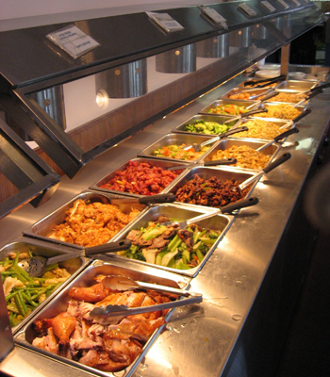
Religious Buffet
Choose a little of everything!
Become a “religious mutt”
Evidence screams against this!

Slide 3
World Religions
 | WHAT IS GOD? | SPIRITUAL DILEMMA | WHAT IS SALVATION | WAY TO SALVATION
CHRISTIANITY | Personal & Trinitarian | Separation from God because of moral guilt | Conscious, personal fellowship with God | Grace, faith in Jesus
JUDAISM | Personal & Unitarian | Separation from God because of moral guilt | Conscious, personal fellowship with God | Turn to God & live a moral life
ISLAM | Personal & Unitarian | Separation from God because of moral guilt | Sensual paradise | Perform the 5 Pillars of Faith
HINDUISM | Pantheistic or Polytheistic | Ignorance that all is one | Freedom from individual existence ("moksha") | Better reincarnation by improving karma
BUDDHISM | Pantheistic or Atheistic | Ignorance that all is one | Freedom from individual existence ("nirvana") | Escape reincarnation

Slide 4
Other religions…
 | WHAT IS GOD | SPIRITUAL DILEMMA | WHAT IS SALVATION | WAY TO SALVATION
Pastafarianism | Flying Spaghetti Monster | World messed up because Spaghetti Monster was intoxicated | Heaven is a beer volcano and stripper factory | Observance of Ramendan, Pastover, Yeaster
Scientology | Aliens | We are Immortal spirits who have lost “true nature” | Crossing the “Bridge to Total Freedom” | Pay money to take “auditing” courses to purge bad memories

Slide 5
Tolerance
Definition:
a fair, objective, and permissive attitude toward opinions and practices that differ from one's own.
FREE CHOICE!
Today’s definition:
Acknowledging that everyone’s beliefs are equally valid and correct. Not disagreeing.
CENSORSHIP!

Slide 6
Conclusion
Blind Faith Religion
Confusion
No answers
Christianity
Solid answers
Solid evidence
No evidence
Can be confident!

