Slide 1
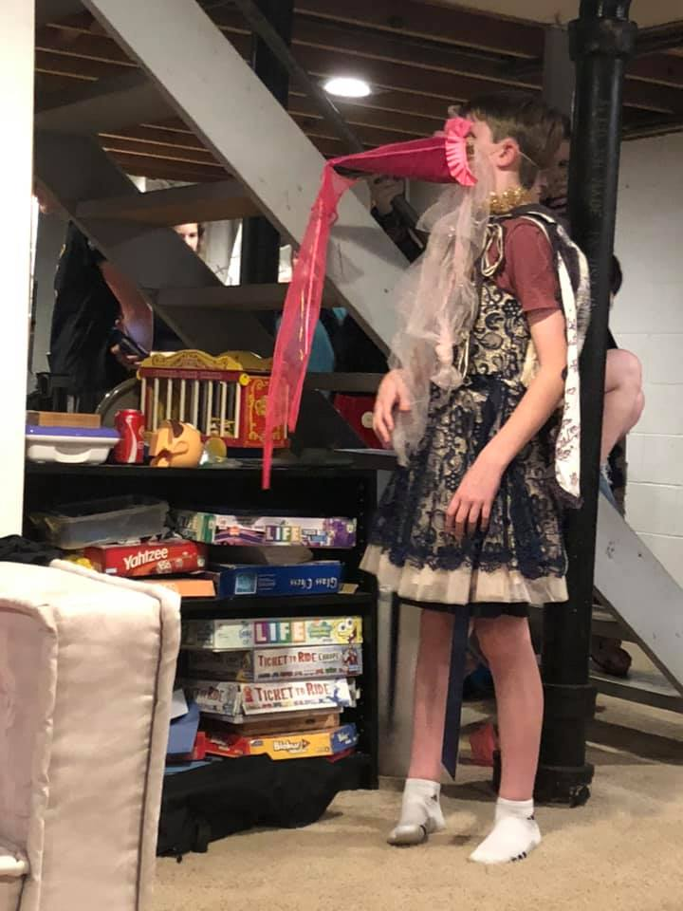
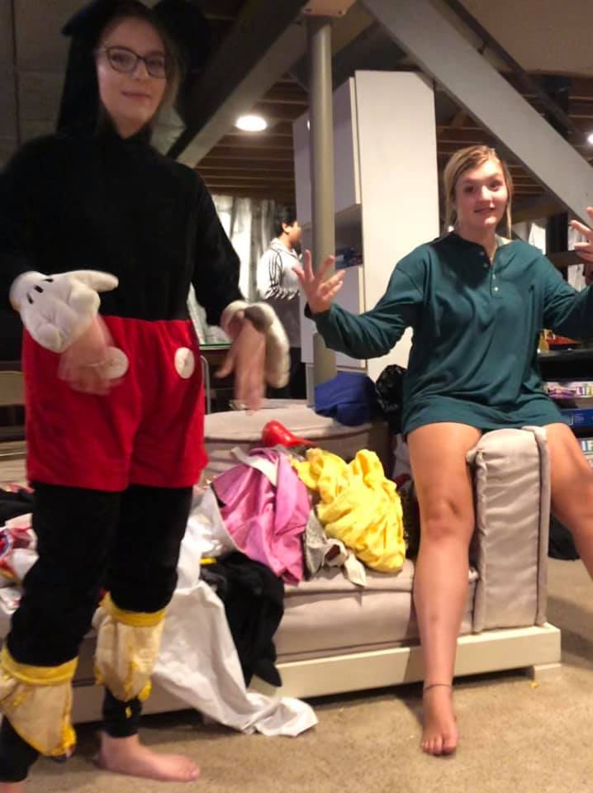
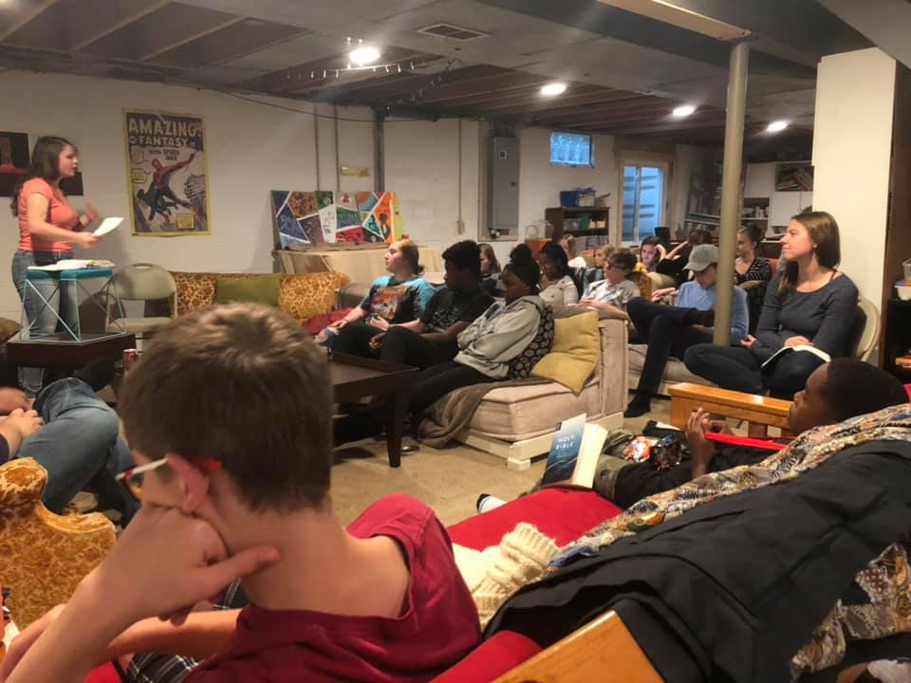
Cubed 2019
DMT

Slide 2
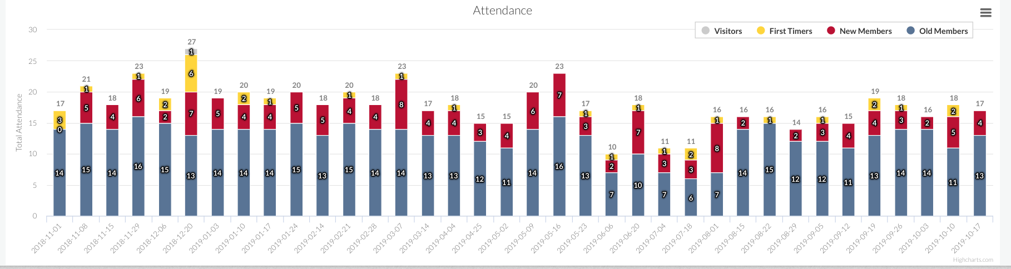
Since last DMT

Slide 3
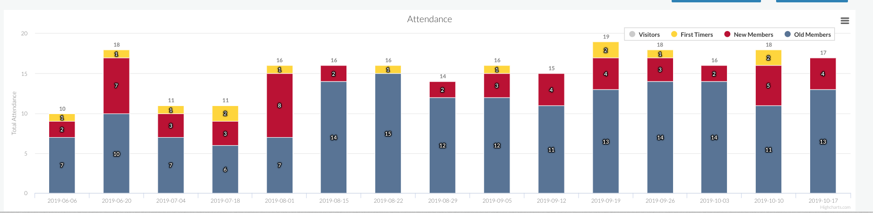
Since the seniors graduated

Slide 4
Explanation of Statistics
Some growth since seniors left! More consistency lately.
For the newer guys there are some competing factors (band, baseball, boxing, ping pong...)
We have (coming consistently)…
Five 8th graders
Two 9th graders
Six 10th graders
One 11th grader
Five 12th graders
Leadership Team
Guys: Max Miller (new!), Joe Prillaman, Scott Pfeiffer, Zak Rozler
Girls: Jordan Jarc, Frankie Cook, Katie Morscher, Erin Tyrell, Elli Rozler

Slide 5
Past Year’s Wins & Losses
WINS
Rebounded after graduating another bigger class (8 consistent seniors graduated)
Avalanche boys have gotten incorporated
Some Non-Christian Outreach
Spiritual conversations happening at Cubed
LOSSES (or weaknesses)
Ownership of outreach
Compartmentalized Christian lives
Leadership losses
Some guy leaders have stepped out
Leadership changes
Kyle/Caitlin had a baby

Slide 6
Upcoming challenges
Xenos Freedom Fellowship kids unifying the group and reaching out to others
Coaching younger leaders on discipleship
Creative discipleship needed
iGen forgetfulness
Popularity desires
Unity between the different high schools, ages & social groups
Cliques, etc. Being friends outside of “Cubed events”
Getting guys into discipleship

Slide 7
Hope!
PRAY
We are trending younger for the first time in a while!
Struggling with outreach but there is time & some is already happening!
We can envision this young core rallying together and reaching people as they grow
For salvations!
Rosteen so close!
Heaven having spiritual conversations
Possible new dships
Seniors leave unified legacy
(Amia, Olivia, Alexis)
Meagan, Meghan, Nate & Miles to own it as the year goes

Slide 8
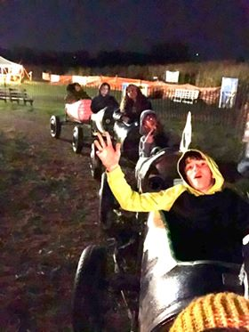
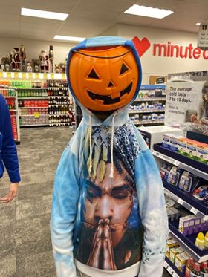

Slide 9
New Horizons...

Slide 10
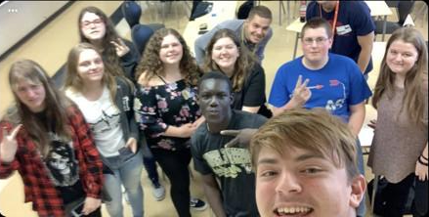
Warren High School
“Deeper Identity” - After school Bible Study with Ben - Around 12 people
The Hub - During lunch periods - Outreach meetings - 60-70 kids over the 3 lunches (2 weeks so far)
Working with Believers Church in Warren

Slide 11
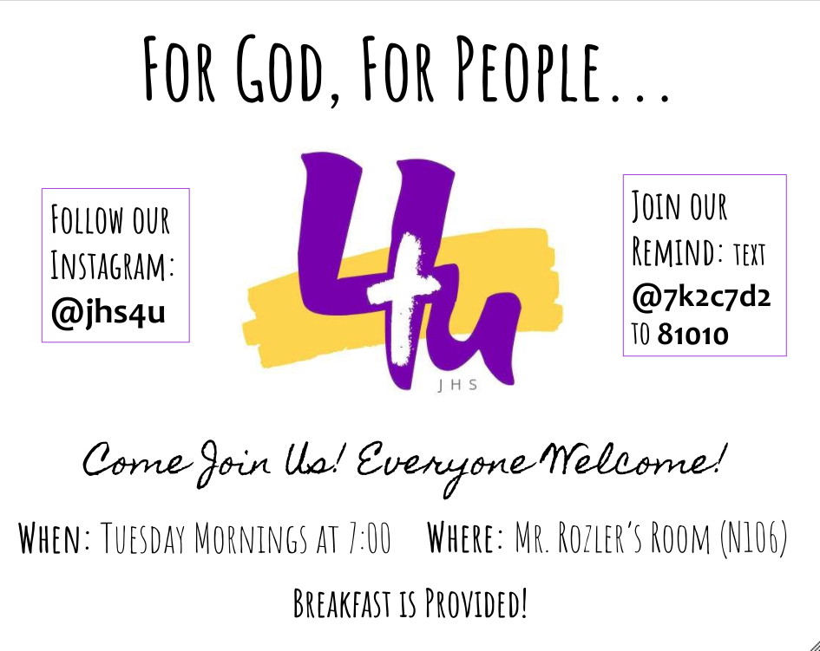
Jackson High School
4 meetings so far
Around 25 kids each time
Working with RiverTree Jackson

