Slide 1
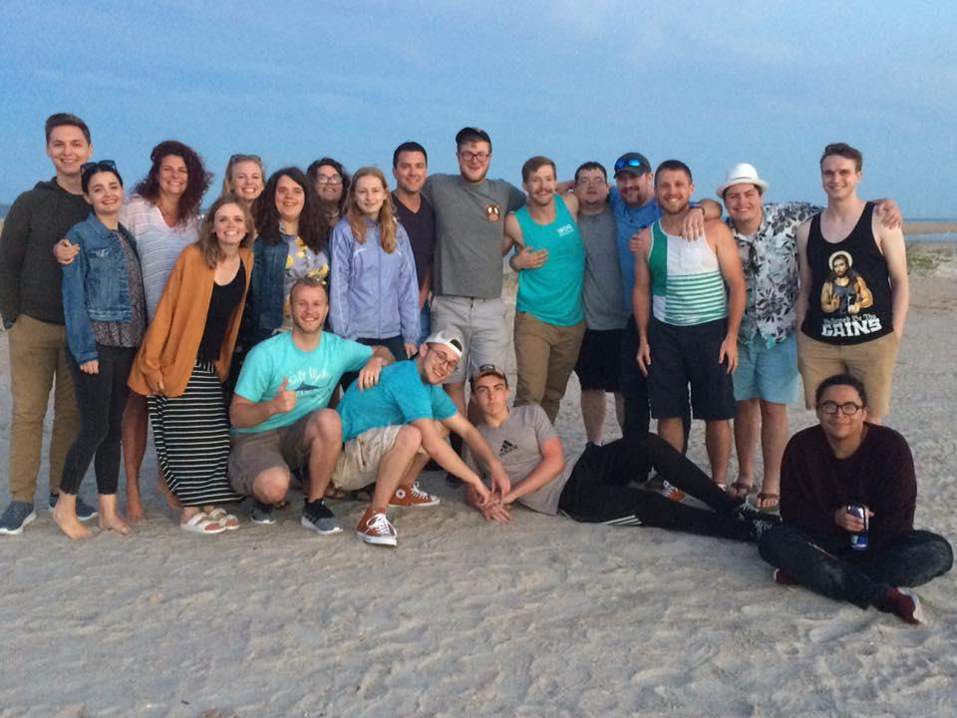
NOVA
DMT 2019

Slide 2
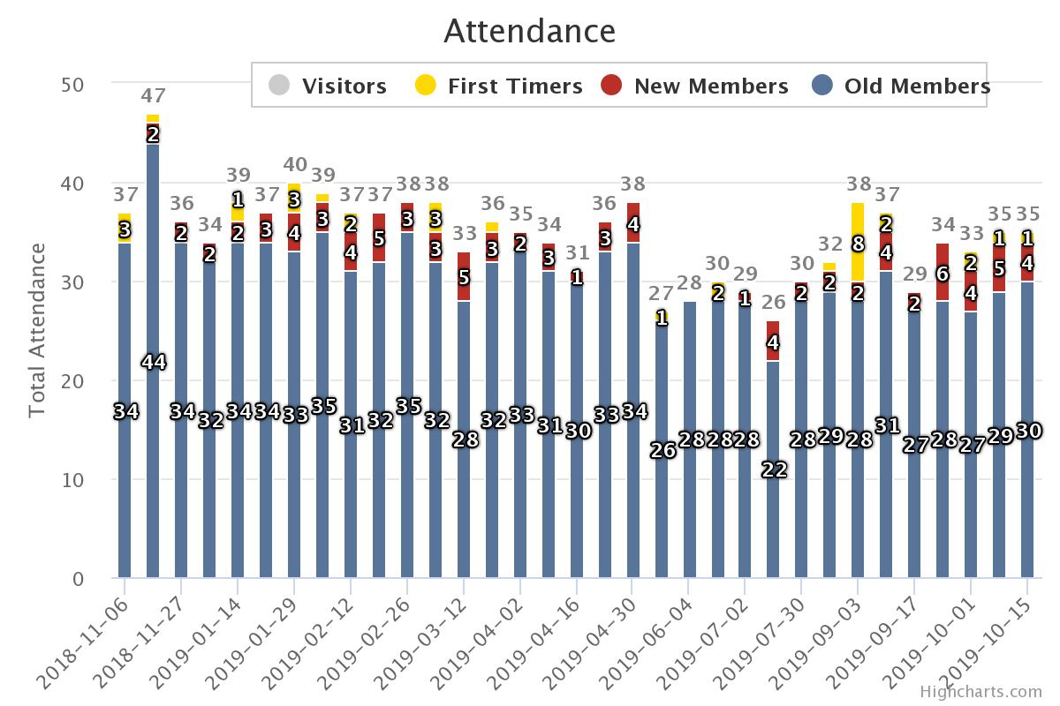
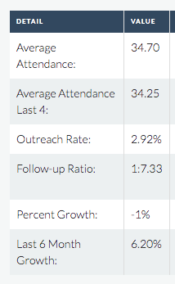
STATS
NOVA

Slide 3
STATE OF THE UNION
NOVA
WINS
10 Salvations
Service ministries (11 ppl)
Ministry Apt Move-ins! (4x)
Gabbi, Tyler, Mason, Michael
Deacon-team unity
Tarter Marriage
Theologian / Scholar (Adam)
We got 3 puppers
LOSES
Spiritual attack!
Kicked out of / leaving apts
Thinking of leaving
Entire cell group nearly wiped out
Deacons under attack
New converts leaving (4/10)
“2nd decision” difficulties
Moved Joe to help other cell
People moving to other HCs (2x)
Notes:
The lord gave a shot in the arm to start, but then said “time to start growing up” → salvations came to a halt and people started struggling or just flat out failing/leaving

Slide 4
CHALLENGES
NOVA
Reluctance to suffer / mature
Salvations stalled
Reproductive discipleships
Raising next gen leaders
Nick Rajcsak
Corey & Alyssa
Teaching competency
Familial struggles
Notes:
The lord gave a shot in the arm to start, but then said “time to start growing up” → salvations came to a halt and people started struggling or just flat out failing/leaving

