Slide 1
Thriving Communities
1 Thessalonians 5b

Slide 2
They Enjoyed a Revolution!
Therefore encourage one another and build up one another, just as you also are doing. 1 Thess. 5:11
But we don’t need to write to you about the importance of loving each other, for God himself has taught you to love one another. 1 Thessalonians 4:9
Indeed, you already show your love for all the believers throughout Macedonia. Even so, dear brothers and sisters, we urge you to love them even more. 1 Thessalonians 4:10
For this is the will of God: your sanctification; 1 Thess. 4:3

Slide 3
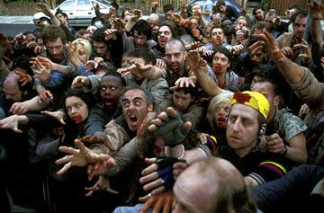
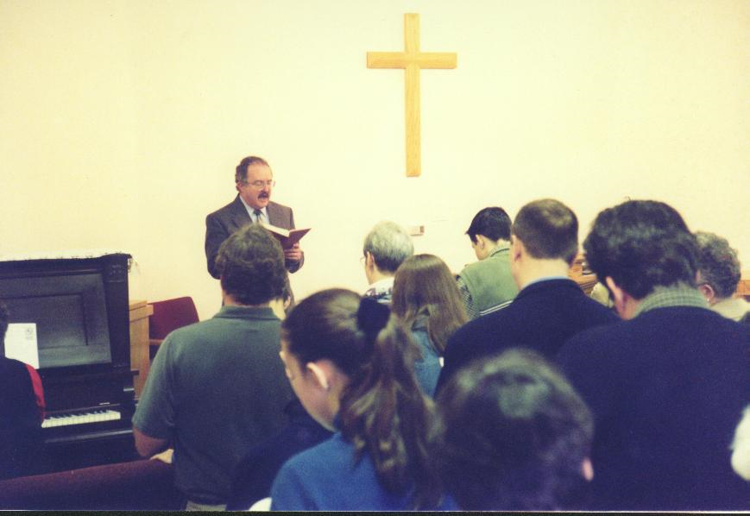
They Enjoyed a Revolution!
Modern Contagion:
Therefore encourage one another and build up one another, just as you also are doing. 1 Thess. 5:11
But we don’t need to write to you about the importance of loving each other, for God himself has taught you to love one another. 1 Thessalonians 4:9
Indeed, you already show your love for all the believers throughout Macedonia. Even so, dear brothers and sisters, we urge you to love them even more. 1 Thessalonians 4:10
For this is the will of God: your sanctification; 1 Thess. 4:3
Christian Answer
Rage Virus

Slide 4
They Enjoyed a Revolution!
Therefore encourage one another and build up one another, just as you also are doing. 1 Thess. 5:11
But we don’t need to write to you about the importance of loving each other, for God himself has taught you to love one another. 1 Thessalonians 4:9
Indeed, you already show your love for all the believers throughout Macedonia. Even so, dear brothers and sisters, we urge you to love them even more. 1 Thessalonians 4:10
For this is the will of God: your sanctification; 1 Thess. 4:3
In Community

Slide 5
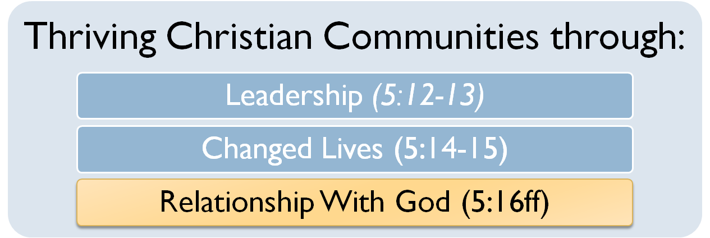
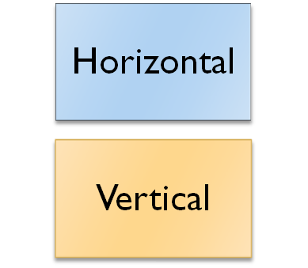
They Enjoyed a Revolution!
Therefore encourage one another and build up one another, just as you also are doing. 1 Thess. 5:11

Slide 6
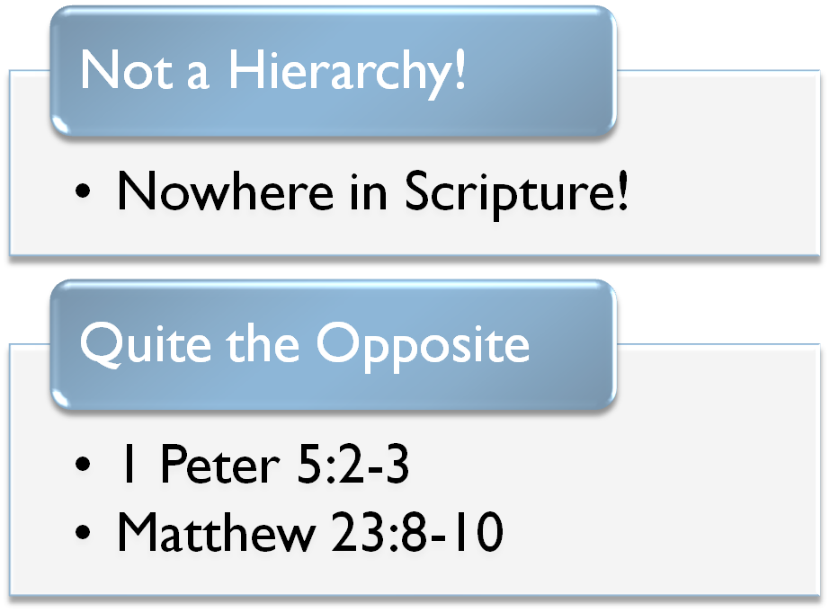
They Enjoyed a Revolution!
Therefore encourage one another and build up one another, just as you also are doing. 1 Thess. 5:11
But we request of you, brethren, that you appreciate those who diligently labor among you, and have charge over you in the Lord and give you instruction, 1 Thessalonians 5:12

Slide 7
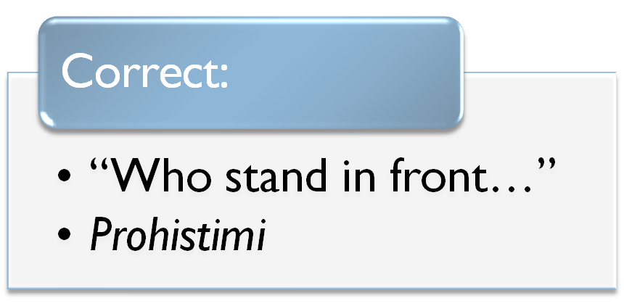
They Enjoyed a Revolution!
Therefore encourage one another and build up one another, just as you also are doing. 1 Thess. 5:11
But we request of you, brethren, that you appreciate those who diligently labor among you, and have charge over you in the Lord and give you instruction, 1 Thessalonians 5:12

Slide 8

They Enjoyed a Revolution!
Therefore encourage one another and build up one another, just as you also are doing. 1 Thess. 5:11
But we request of you, brethren, that you appreciate those who diligently labor among you, and have charge over you in the Lord and give you instruction, 1 Thessalonians 5:12

Slide 9
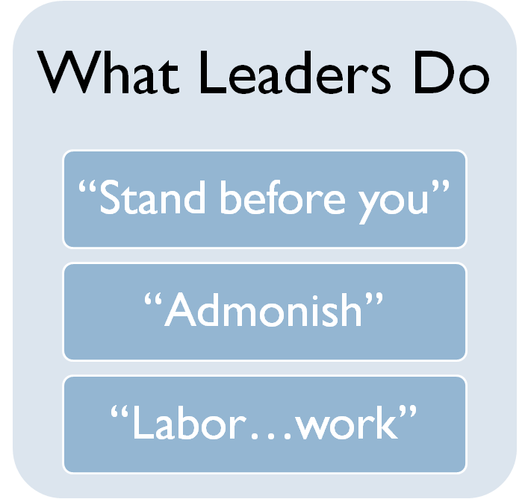
They Enjoyed a Revolution!
Therefore encourage one another and build up one another, just as you also are doing. 1 Thess. 5:11
But we request of you, brethren, that you appreciate those who diligently labor among you, and have charge over you in the Lord and give you instruction,
and that you esteem them very highly in love because of their work. Live in peace with one another. 1 Thessalonians 5:13

Slide 10
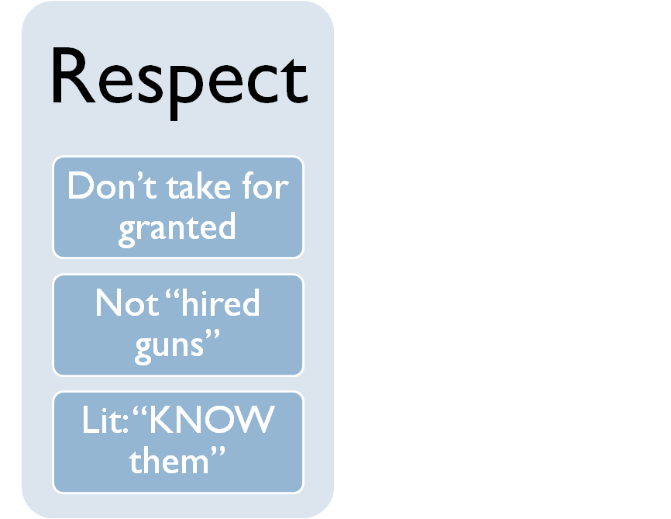
They Enjoyed a Revolution!
Therefore encourage one another and build up one another, just as you also are doing. 1 Thess. 5:11
But we request of you, brethren, that you appreciate those who diligently labor among you, and have charge over you in the Lord and give you instruction,
and that you esteem them very highly in love because of their work. Live in peace with one another. 1 Thessalonians 5:13
Hebrews 13:17 (NASB) Obey your leaders and submit to them, for they keep watch over your souls as those who will give an account. Let them do this with joy and not with grief, for this would be unprofitable for you.

Slide 11
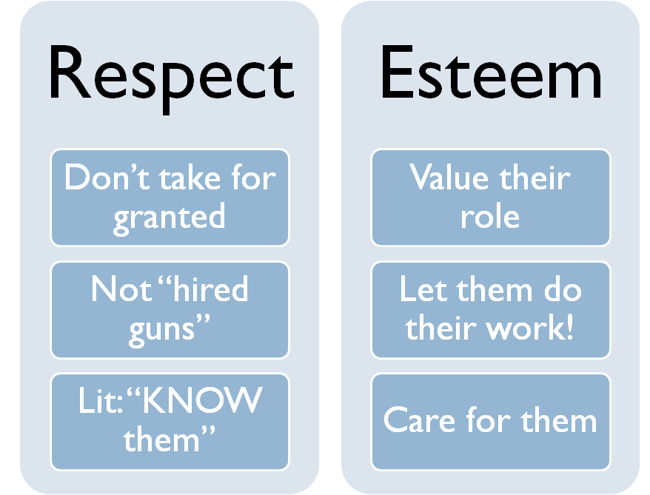
They Enjoyed a Revolution!
Therefore encourage one another and build up one another, just as you also are doing. 1 Thess. 5:11
But we request of you, brethren, that you appreciate those who diligently labor among you, and have charge over you in the Lord and give you instruction,
and that you esteem them very highly in love because of their work. Live in peace with one another. 1 Thessalonians 5:13
“esteem them very highly in love”

Slide 12
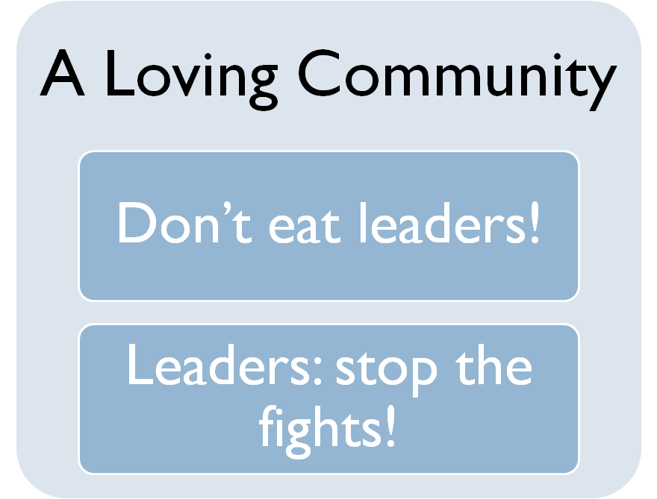
They Enjoyed a Revolution!
Therefore encourage one another and build up one another, just as you also are doing. 1 Thess. 5:11
But we request of you, brethren, that you appreciate those who diligently labor among you, and have charge over you in the Lord and give you instruction,
and that you esteem them very highly in love because of their work. Live in peace with one another. 1 Thessalonians 5:13
Live in peace with one another.

Slide 13
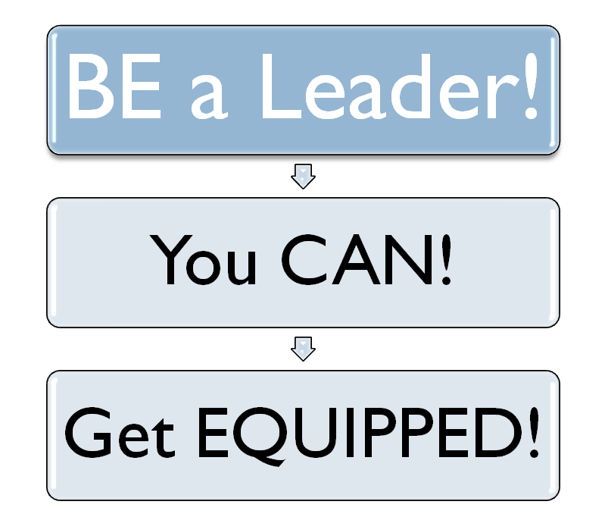
They Enjoyed a Revolution!
Therefore encourage one another and build up one another, just as you also are doing. 1 Thess. 5:11
But we request of you, brethren, that you appreciate those who diligently labor among you, and have charge over you in the Lord and give you instruction,
and that you esteem them very highly in love because of their work. Live in peace with one another. 1 Thessalonians 5:13

