Slide 1
A Radical Nation
Revelation 1
Notes:
“For our citizenship is not of this world…”
“My Kingdom is not of this world…”

Slide 2
Why Bother With “Revelation” ?
After the 4 Gospels, it explains “Christianity” more than any other book in the Bible.
Strong continuity with the “Old Testament”, including Isaiah.
Biblical prophecy is more intelligible today than ever before.
A great source of happiness, hope, confidence, instruction, direction and God’s love.
Because I want to! (And you will too!)
Notes:
Did U Know?
** Over 300 OT References \ OT=Key 2 Interp. \ =Integration of ALL Scripture
** Israel→1948, 1945, 1967, ISIS \ Shoulders of Ch.Hist \ REALISTIC: # for $$, WMD
** ~Dystopian Future → UTOPIAN \ v.3 “U=Blessed” \ PLEASE RETURN
Nearly 300 references to the Old Testament are found in Revelation! This means that we must anchor our interpretations to what God has already revealed, lest we misinterpret this important prophetic book…Bible Exposition Commentary (BE Series) - New Testament - The Bible Exposition Commentary – New Testament, Volume 2.
…with the exception of the Gospels, this book is the most profound and moving teaching on Christian doctrine and discipleship found anywhere in Scripture Expositor's Bible Commentary Abridged, The - – The Expositor's Commentary - Abridged Edition: New Testament.

Slide 3
The Foundation for “Revelation”
Revelation 1:1 The Revelation of Jesus Christ, which God gave Him to show to His bond-servants, the things which must soon take place; and He sent and communicated it by His angel to His bond-servant John,
ἀποκάλυψις
Radical “Uncovering” or “Breakthrough” *
*Preacher's Commentary – Volume 35: 1, 2, 3 John; Revelation.
Notes:
“Foundation”=Authoritative, ~Opinions, ~Speculation
**Apokalupsis=“THE Rev…” ~Plural!

Slide 4
The Foundation for “Revelation”
Revelation 1:1 The Revelation of Jesus Christ, which God gave Him to show to His bond-servants, the things which must soon take place; and He sent and communicated it by His angel to His bond-servant John,
NOT
Apocalyptic
Copy-Cat Fiction
Notes:
~ “Apocalyptic”=Common (=Cultural Impact of Rev)
“Scary” to Ppl Who ~Know JC \ ~Knw God
AP: Ur Future=Scary If ~Knw JC
~ “Apocalyptic Lit.” = Qumran Cult \ Pseudapigrapha
Symbols/Pictures=DANIEL/Is./Ez., 700 bc=WOG

Slide 5
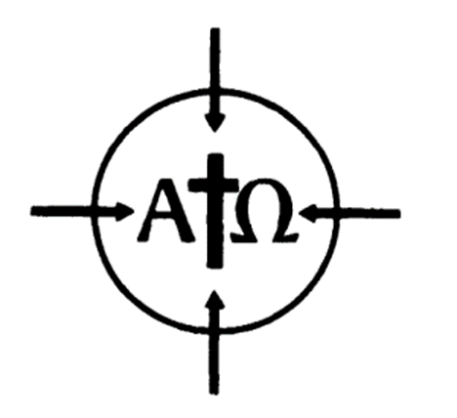
The Foundation for “Revelation”
Revelation 1:1 The Revelation of Jesus Christ, which God gave Him to show to His bond-servants, the things which must soon take place; and He sent and communicated it by His angel to His bond-servant John,
IS
From God
To You & Me
For a Δοῦλος
“Servant for Hire”
Notes:
JC=God! \ **@Centr of ALL G’s Rev: OT/NT
U/Me=Vital/Imp. Info G.Says WE NEED
THUS: Rev = Intelligible (^ It’s a LIE)
** U&I=Doulos=Willing \ IL: Repay Debt
AP: Every1=Serves Somebody: Devil ^ Lord?

Slide 6
The Foundation for “Revelation”
Revelation 1:1 The Revelation of Jesus Christ, which God gave Him to show to His bond-servants, the things which must soon take place; and He sent and communicated it by His angel to His bond-servant John,
“Suddenly”
“Soon” in God’s View

Slide 7
The Foundation for “Revelation”
1:2 (NLT) …John, who faithfully reported everything he saw. This is his report of the word of God and the testimony of Jesus Christ.
Disciple of Jesus
In his 80s (90s) ?
Last surviving disciple
John 21:19-22 Jesus said this to let Peter know by what kind of death he would glorify God… Peter turned around and saw behind them the disciple Jesus… Peter asked Jesus, “What about him, Lord?”
Jesus replied, “If I want him to remain alive until I return, what is that to you? As for you, follow me.”
1 John 1:3 what we have seen and heard we proclaim to you also
Notes:
**Disciple=Known/Acknowledged Universally 1st/2nd C
Iraeneus → Polycarp → John
**Jn.21=Interesting=Gud News! Jealousy ~Uniq!
**1Jn.1=Rev.1:2=Gud Time 2 Say “Kidding!”

Slide 8
The Foundation for “Revelation”
1:2 (NLT) …John, who faithfully reported everything he saw. This is his report of the word of God and the testimony of Jesus Christ.
Why So Pictographic?
Self-Interpreting
Confusion? Israel / KOG
Face-Value, not Allegorical
Notes:
“SAW” ~Jst “Heard” → **Pictogrph=Symbols/Pics → Misinterp??
**SYMB=Self-Interp (7 Lamps) ^ OT (7 Spirits/Beast=Dan.8)
**Interp @FaceValue, ~Allegor = **Confused Interp.

Slide 9
The Foundation for “Revelation”
1:2 (NLT) …John, who faithfully reported everything he saw. This is his report of the word of God and the testimony of Jesus Christ.
Why So Pictographic?
A Spiritual Code-book *
Conveys Values & Emotions
Timeless
* Bible Exposition Commentary (BE Series) - New Testament - The Bible Exposition Commentary – New Testament, Volume 2.
Notes:
Gud Reasons…
**Code-BooK: this kind of "spiritual code" is understood only by those who know Christ personally. If any Roman officers had tried to use Revelation as evidence against Christians, the book would have been a puzzle and an enigma to them. –BEC
**Timeless: “Dictator” vs “Beast”
**Complex: Heaven, Values, Emotions
“World System” ^ “Harlot..Blood Saints”

Slide 10
The Foundation for “Revelation”
1:3 [Happy/Fulfilled] is the one who reads and those who hear the words of the prophecy, and heed the things which are written in it; for the time is near.
Or:
(NLT) God blesses the one who reads the words of this prophecy
IF:
We “Heed” – i.e., do something about it!
Notes:
** NLT=KMcC Blessed! ** IF→DO ^ BORING CT!!

Slide 11
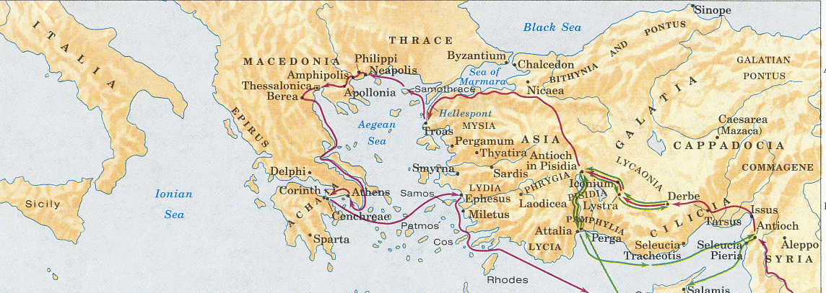
Revelation of a “New Nation”
1:4 (NLT) This letter is from John to the seven churches in the province of Asia.
Notes:
=SURPRISE! **=Paul’s Churches! Jerus.=Destroyed 70 ad
P=Bummed ~Jewish Success → G=Said “NO!”
Jn & 12=S-L-O-W→ ~Listen=Alwys an Option
AP: G’s Will=GUD! \ IL: “Goto India”=Saved frm Nukes

Slide 12
Revelation of a “New Nation”
1:4 (NLT) This letter is from John to the seven churches in the province of Asia.
Notes:
“7”= # of Completion: 7 Days Creation,
7 ^ 7 Million=Same Audience = NeoXenos

Slide 13
Revelation of a “New Nation”
Revelation 1:4-5 (NASB) John to the seven churches that are in Asia: Grace to you and peace, from Him who is and who was and who is to come, and from the seven Spirits who are before His throne, and from Jesus Christ, the faithful witness, the firstborn of the dead, and the ruler of the kings of the earth. To Him who loves us and released us from our sins by His blood—
Notes:
G=Wants 2 GIVE & PEACE & LUV U & RELEASE frm Bondage
= “Fulfilled/Happy” Promise

Slide 14
Revelation of a “New Nation”
Revelation 1:4-5 (NASB) John to the seven churches that are in Asia: Grace to you and peace, from Him who is and who was and who is to come, and from the seven Spirits who are before His throne, and from Jesus Christ, the faithful witness, the firstborn of the dead, and the ruler of the kings of the earth. To Him who loves us and released us from our sins by His blood—
Notes:
G=OWNS TIME=Able 2 Deliver Promises
AP: G=Working Around U, Behind U, In FRONT U, IN U
2 GIVE & PEACE & LUV & RELEASE frm Bondage

Slide 15
Revelation of a “New Nation”
Revelation 1:4-5 (NASB) John to the seven churches that are in Asia: Grace to you and peace, from Him who is and who was and who is to come, and from the seven Spirits who are before His throne, and from Jesus Christ, the faithful witness, the firstborn of the dead, and the ruler of the kings of the earth. To Him who loves us and released us from our sins by His blood—
Isaiah 11:1-2 Then a shoot will spring from the stem of Jesse,
And a branch from his roots will bear fruit.
The Spirit of the LORD will rest on Him, T
he spirit of wisdom and understanding,
The spirit of counsel and strength,
The spirit of knowledge and the fear of the LORD.
Notes:
7 Spirits=Proph. Re: JC **Is. 11

Slide 16
Revelation of a “New Nation”
Revelation 1:4-5 (NASB) John to the seven churches that are in Asia: Grace to you and peace, from Him who is and who was and who is to come, and from the seven Spirits who are before His throne, and from Jesus Christ, the faithful witness, the firstborn of the dead, and the ruler of the kings of the earth. To Him who loves us and released us from our sins by His blood—
Notes:
JC=G.on Earth \ Jn.1 “Nobody..seen G…WE DID!”
=WITNESS “G. Exists & Looks Like This…”=JC’s Ministry=R Min.
“1st Born..Dead” → “I=Resurrection & Life” = OWNS It
“Ruler..Kings” ~Directing → OWNS Them → Incl.Ur Boss

Slide 17
Revelation of a “New Nation”
Revelation 1:6 (NASB) and He has made us to be a kingdom, priests to His God and Father—to Him be the glory and the dominion forever and ever. Amen.
Notes:
*Priests=ALL Saints=Priviledged/Honored
=1st Thing HIJACKED When Gov’t Took Over
AP: If U=Raised w/Elite Priests, U=Ripped Off
= #1 Rsn “Church” SUCKS

Slide 18
Revelation of a “New Nation”
Revelation 1:6 (NASB) and He has made us to be a kingdom, priests to His God and Father—to Him be the glory and the dominion forever and ever. Amen.
Nation of Priests
God’s Status
God’s Gifts, Love, Freedom
Notes:
v.6=THE Point of All B4: **U=Priviledged/Honored
AP: U=Know G! ~Live In Dark/Fear/Confus
** Stand on G’s Status=Backs U, Approves /Loves U
** Stand on G’s Riches: Gifts/Grace/Luv/Freedom=Urs

Slide 19
Revelation of a “New Nation”
Revelation 1:7 (NLT) Look! He comes with the clouds of heaven. And everyone will see him— even those who pierced him. And all the nations of the world will mourn for him. Yes! [It is TRUE]!
Notes:
AP: As Priests=Testify “He Is ALIVE!”
& “TODAY = Day of Salvat!”
“Mourn” → “He IS so GOOD! ??Did I Run??”
“?? Crucify Him??” = Known Even Today!

Slide 20
Revelation of a “New Nation”
Revelation 1:7 (NLT) Look! He comes with the clouds of heaven. And everyone will see him— even those who pierced him. And all the nations of the world will mourn for him. Yes! [It is TRUE]!
Daniel 7:13-14 (NASB) "I kept looking in the night visions,
And behold, with the clouds of heaven
One like a Son of Man was coming…
And to Him was given dominion,
Glory and a kingdom,
That all the peoples, nations and men of every language
Might serve Him.
His dominion is an everlasting dominion
Which will not pass away;
And His kingdom is one
Which will not be destroyed.
Zechariah 12:10 (NASB) “… they will look on Me whom they have pierced; and they will mourn for Him, as one mourns for an only son”
Notes:
“Pierced” = 500 bc Prophecy → 1 of 100s
“Clouds” = Dan.7 → Why They Crucified JC
U=Testify=Persecuted 2! → Ain’t No Thang

Slide 21
Revelation of a “New Nation”
1:8 (NASB) "I am the Alpha and the Omega," says the Lord God, "who is and who was and who is to come, the Almighty."
Isaiah 41:4 "I, the LORD, am the first, and the last. I am He.”
Isaiah 41:1 "Coastlands, listen to Me in silence, And let the peoples gain new strength;
[OR] Let them come forward, then let them speak; Let us come together for judgment.
Notes:
=Same Credits as GOD → PRECISELY, Word-4-Wrd
**Alpha/Omega=All Goes Back 2 JC: Started→End It ALL
Every Atom / Evry Breath / All History / All Future
** =Is.41 **=Challnge 2 “Coastlands”=Gentiles

Slide 22
Revelation of a “New Nation”
1:9-11 I, John, your brother and fellow partaker in the tribulation and kingdom and perseverance which are in Jesus, was on the island called Patmos because of the word of God and the testimony of Jesus. I was in the Spirit on the Lord's day, and I heard behind me a loud voice like the sound of a trumpet, saying, "Write in a book what you see, and send it to the seven churches: to Ephesus and to Smyrna and to Pergamum and to Thyatira and to Sardis and to Philadelphia and to Laodicea."

Slide 23
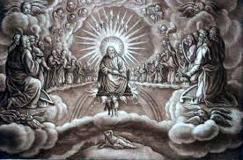
Revelation of a “New Nation”
Isaiah 49:2 He has made My mouth like a sharp sword, In the shadow of His hand He has concealed Me…
1:12-16 (NLT) When I turned to see who was speaking to me, I saw seven gold lampstands. And standing in the middle of the lampstands was someone like the Son of Man. He was wearing a long robe with a gold sash across his chest. His head and his hair were white like wool, as white as snow. And his eyes were like flames of fire. His feet were like polished bronze refined in a furnace, and his voice thundered like mighty ocean waves. He held seven stars in his right hand, and a sharp two-edged sword came from his mouth. And his face was like the sun in all its brilliance.
1:17 (NLT) When I saw him, I fell at his feet as if I were dead.
Notes:
** Sword=Is.49:2=Suffering Servant→Glorified
JC : “~Yet Glorified” → REV= Resurrected&Glorified JC
→ BLINDING! POWER!
** “Dead…” ??Else U Gonna Do?? ARGUE w/ HIM??
** =Surrounded by Terrifying Creatures & Etc.

Slide 24
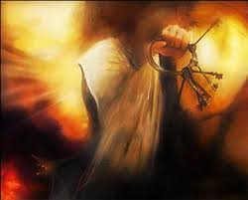
Revelation of a “New Nation”
1:17-18 (NLT) …But he laid his right hand on me and said, “Don’t be afraid! I am the First and the Last. I am the living one. I died, but look—I am alive forever and ever! And I hold the keys of death and the grave.
Notes:
JC=Not Only ALIVE, He’s UR FRIEND!
“Keys..death” = Most Terror → JC=Peace → No 1 Else!
Rev=Dispells Terror / ~Fear “Unknown”
JC ~Want U Wallowing in Confusion/Anxiety

Slide 25

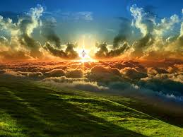
Revelation of a “New Nation”
1 John 3:2 Beloved, now we are children of God, and it has not appeared as yet what we will be. We know that when He appears, we will be like Him, because we will see Him just as He is.
Notes:
JC=SCARY? ** 1Jn.3 ~B Scared of JC → U’ll Lk LIKE Him!!!!
AP: ?? U Gonna TESTIFY?? → ur New Citizenship!? Job?? Browns??
REV==Reveal, TESTIFY = JC =John = Priests
?? They Gonna DO 2 U? Patmos=Jn’s Study Library
IL: Keith ^ **Keith??

Slide 26

The Foundation for “Revelation”
Revelation 1:1 The Revelation of Jesus Christ, which God gave Him to show to His bond-servants, the things which must soon take place; and He sent and communicated it by His angel to His bond-servant John,
Notes:
“Foundation”=Authoritative, ~Opinions, ~Speculation

Slide 27
“Young John”
Matthew 20:20-24 Then the mother of the sons of Zebedee came to Jesus with her sons, bowing down and making a request of Him.
And He said to her, "What do you wish?"
She *said to Him, "Command that in Your kingdom these two sons of mine may sit one on Your right and one on Your left."
But Jesus answered, "You do not know what you are asking. Are you able to drink the cup that I am about to drink?" They *said to Him, "We are able."
He said to them, "My cup you shall drink; but to sit on My right and on My left, this is not Mine to give, but it is for those for whom it has been prepared by My Father."
Upon hearing this, the ten became indignant with the two brothers.

