Slide 1
God’s Promise of a Victorious Life
Romans 5:3-11

Slide 2

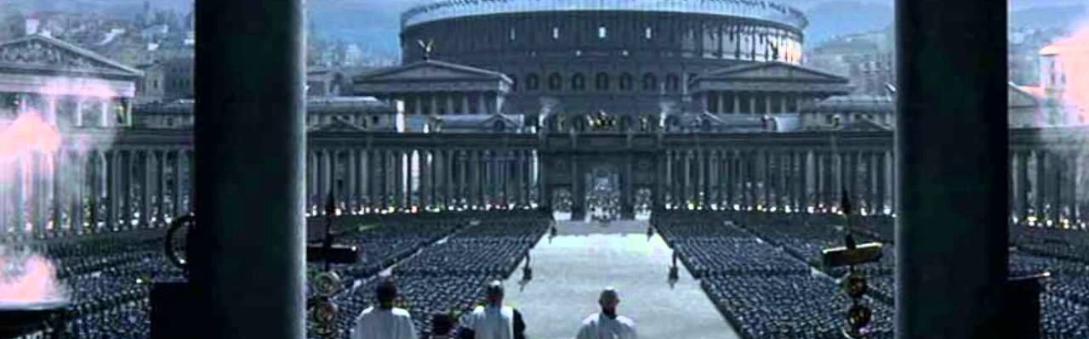
Romans
Anti-Legalism Treatise
Romans 3:28 For we maintain that a man is justified by faith apart from works of the Law.
Notes:
Rom = Written 2 the Hrt of the GLORIOUS Roman Empire
** Anti-Legalism = Attacks the “Glue” of Rome
“Roman Law” = Held Together the Empire
=R Justice System Today
** Ro.3:28 = “APART From…Works” = OFFENSIVE!
=#1 Rsn. Ppl ~Like WOG = P. Hated/Hounded
= Bible “Re-Writes” = Islam/Mormons/JWs

Slide 3
Anarchy!
Romans 3:31 Do we then nullify the Law through faith? May it never be! On the contrary, we establish the Law.

Slide 4
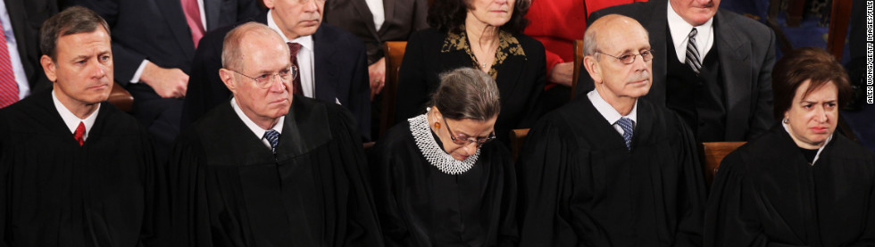
1. A Rule-Lover
What Does a Legalist Look Like?
Notes:
=Uptight / Self-Righteous, Demanding
A Judger = Love RULES 2 Bash Ppl on the Head.
Smug = “I’m Better Than You “
Self-Assured = “At Least I’m ~Like HIM!”

Slide 5
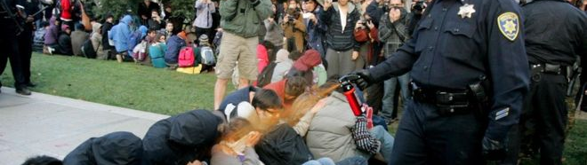
What Does a Legalist Look Like?
2. Cold-Hearted
Notes:
Unmerciful, Inflexible, ANGRY! MEAN (i.e., COPS)
Self-Willed, Unempathetic,
“I’m SO STRONG! What’s the Matter w/ YOU?”
Vengeful, Bitter, Writes People Off,
LONELY, ~FUN, Un-Happy
Criminals = Legalists: Self-Justification

Slide 6

What Does a Legalist Look Like?
3. Self-Obsessed
Notes:
VERY Defensive, Irrational, Self-Dependent,
Unreasonable: UNWILLING 2 BEND
IL: West Branch Cop…”I Hv Receipts!” → State Prosecutor
~Vulnerable: ~Soft → ~Like 2 Spend Time w/ Them

Slide 7

What Does a Legalist Look Like?
4. Hypocrites
Notes:
SECRET Lives → IL: #1 Pedophiles = Policemen
Full of ANXIETY → Arbitrary Rightness → AFRAID of Intimacy
Criminals = Legalists → Use Your Rules Against U,
STUDY How 2 Break the Law
Justify Themselves: “He’s Got Plenty & I Don’t…~FAIR”

Slide 8
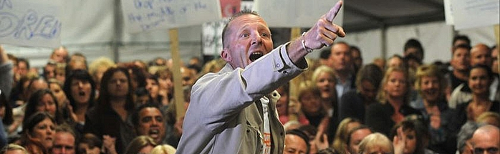
What Does a Legalist Look Like?
5. Alienated From God
Notes:
G=a THREAT, Grace=REPUGNANT
BUILDS a System of RULES 2 EXCLUDE G,
~Worry About G,: “I Got it ALL Figured Out!”

Slide 9
What Does a Legalist Look Like?
Rule-Lovers
Cold-Hearted
Self-Obsessed
Hypocrites
Alienated From God
Notes:
& These R Their GOOD POINTS

Slide 10
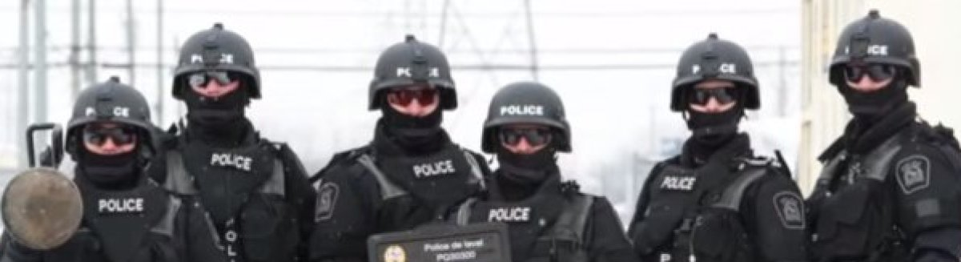
What Does a Legalist Look Like?
YOU and I
Notes:
Popular MYTH =Religion Produces LEGALISTS: Uptight Moralists
** All of Us R → IL: Divided States of America=INTOLERANCE
Rules = Build R Lives & Culture == Success!!
Even ATHEISTS = Legalists

Slide 11
Two Different Approaches to Life
God’s Approach
Legalist’s Approach
Three things will last forever—faith, hope, and love—and the greatest of these is love.
1 Corinthians 13:13
DELIVERABLES: Living in the “Real World”
Faith in ME & MY Strength
Hope in Nothing / Nobody Else
Love is for Useless Teenagers
Notes:
G’s Approach =ROMANS, Esp.Ro. 5
** Legalists = ANYTHING BUT Faith/Hope/Luv

Slide 12
God’s Promise of a Victorious Life
Phase #1: Our Introduction
Romans 5:1-2 Therefore, having been justified by faith, we have peace with God through our Lord Jesus Christ, through whom also we have obtained our introduction by faith into this grace in which we stand; and we exult in hope of the glory of God.
Notes:
Introduction =
PEACE w/G = Reference Pt. Of Where You’re STANDING
Standing in GRACE = PEACE = Totally Accepted
EXULT = Bravado / Courage / Strength / Rejoicing
“God’s On My Side” =Makes a DIFF

Slide 13
God’s Promise of a Victorious Life
Phase #2: Our Transformation
Romans 5:3-5 And not only this, but we also…
exult in our tribulations, knowing that
tribulation brings about perseverance;
and perseverance, proven character;
and proven character, hope;
and hope does not disappoint, because the love of God has been poured out within our hearts through the Holy Spirit who was given to us.
Notes:
“not only this” → BEYOND Introduction

Slide 14
God’s Promise of a Victorious Life
Phase #2: Our Transformation
“we also exult in our tribulations, knowing that tribulation brings about perseverance”
Tribulations
“Troubles of all kinds” – big or small.
Perseverance
Patience, able to take it, steady & stable.
Real World, not escapism
“This too will soon pass!”
1 Corinthians 10:13 No temptation has overtaken you that is not common to man. God is faithful, and he will not let you be tempted beyond your ability, but with the temptation he will also provide the way of escape, that you may be able to endure it.
Notes:
Exult ~ in TRIB Alone → “Knowing…”
IL: James Bond: “I’ve Got a Secret!”
**TRIB=All/Any→Big/Small/Hassles/Irritations/Tragedies
?? Happening? My SIN? G=TORTURING??
Legalist = “?? ME ?? ~DESERVE!!” → Why ~MATTER!!
What U Do=MATTERS
**Pers=Able 2 Take It = REAL WORLD: ~Escapism
Legalists ~the Only Realists! → ~RUN b/c
WILL PASS: ** G=Faithful → Spiritual Escape, ~Ur Escape

Slide 15

God’s Promise of a Victorious Life
Phase #2: Our Transformation
“we also exult in our tribulations…”
1 Peter 4:12 Beloved, do not be surprised at the fiery ordeal among you, which comes upon you for your testing, as though some strange thing were happening to you;
Notes:
Exult = BAFFLES Ppl = Observers: U=Stronger/Stirred, ~Shaken
& Baffles SNOWFLAKE Xians: Ben Shapiro “Melt…Heat”
** Pet: “~B Surprised…Esp. If U=BIG-Mouth Peter”
AP: Princelings & Princesses = “I ~Deserve! I’m ~a PEASANT!”
UNREAL Expectations = ~Take Suffr/Opposit./ “Unfair!”
=Naïve & Narcissistic → IL: **Research = USA ^Narcissistic

Slide 16
God’s Promise of a Victorious Life
Phase #2: Our Transformation
“we also exult in our tribulations…”
Proverbs 13:24 Those who spare the rod of discipline hate their children. Those who love their children care enough to discipline them.
1 Peter 4:12 Beloved, do not be surprised at the fiery ordeal among you, which comes upon you for your testing, as though some strange thing were happening to you;
News Flash
It’s war zone
Not a palace
Can’t get what you want
Notes:
NEWS… AP: PARENTS! ~Protect/Coddle Ur Child=**POISON
World’s Wisdom =FOLLY → IL Corporeal Punishment
IL: “Disapproving Look is all it takes”

Slide 17
God’s Promise of a Victorious Life
“Exult” is NOT:
Lashing Out
Running Away
“Exult” IS:
Not Intimidated
TRUSTING
Control-Freakism
The Terminator
Gratitude
Vulnerable
Phase #2: Our Transformation
“we also exult in our tribulations…”
Philippians 4:8 Finally, brethren, whatever is true, whatever is honorable, whatever is right, whatever is pure, whatever is lovely, whatever is of good repute, if there is any excellence and if anything worthy of praise, dwell on these things.
Notes:
** Terminator=Kosmos→ ~Feel/Tuff Guy→TRUMP
**~Lashing: Every1 PAYS/Slam Doors → Midnight Basketball
** Run away → Ice Cream, Chocolates, Cry @Girlfriend
=Perpetual H.S. : Video Games / Playboy
** Control-Frk: Worry/Fret/DWELL: “So BAD!” → BITTER
** ~Intim: “Please Explain” → TURN CHEEK
** Vuln → “Can U Help Me” ~Scares U
** TRUST → “I Know My Redeemer Lives”
** Gratit → “We R of Gud Cheer” → **Ph.4:8

Slide 18
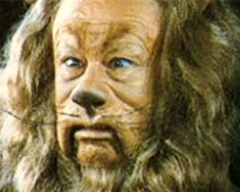

God’s Promise of a Victorious Life
Phase #2: Our Transformation
“and perseverance, proven character …”
Notes:
Ur Character =Most PRICELESS Possess
=U Can Handle G’s RICHES
UNPROVEN Character= “I’M DEFECTIVE”
~1 UNDERSTANDS Me! → & ~1 Wants 2!!
PROVEN =Got Something 2 Say/OFFER/Give
~Passing Emotion → VETERAN, Tuff-Minded
Ap: G=Transform. U Frm **COWARD in2 a **LION
GIRLS: ??U rather Date??

Slide 19
God’s Promise of a Victorious Life
Phase #2: Our Transformation
“and proven character, hope…”
NOT: Romans 5:2 we exult in hope of the glory of God.
IS: Hope in the HERE & NOW
You’re Getting PROMOTED
2 Corinthians 5:8 we are of good courage, I say…
Notes:
**2 Co. 5:8 = HOPE Unleashed

Slide 20
God’s Promise of a Victorious Life
Phase #2: Our Transformation
“and hope does not disappoint, because the love of God has been poured out within our hearts through the Holy Spirit who was given to us.”
Reveals God’s Love
Shatters Old, Defective View of Love
New Capacity to Love: Mature Love
Notes:
Suffering = **REVEALS G’s Luv: ~Abandoned, ~Alone,
G=KINDER than POSSIBLY Imagined
**Shatters Old→ Luv ~Feeling GUD / IL: “Luv ME PLEASE!!”
=KILLS Infantile Luv→ by Slow TORTURE
** New Capactiy = “POURS OUT” = Mature Love
i.e., THRU YOU into OTHERS → Luv ~Private Experience
Luv ~Ur THIRST-Quencher → Pwr 2 Chng Lives

Slide 21
A Victorious Life Means Mature Love
Romans 5:6-11 For while we were still helpless, at the right time Christ died for the ungodly. (For one will hardly die for a righteous man; though perhaps for the good man someone would dare even to die.)
Loving Helpless, Dirty Scumbags
NOT “My Friends”

Slide 22
A Victorious Life Means Mature Love
Romans 5:8 But God demonstrates His own love toward us, in that while we were yet sinners, Christ died for us.
God’s Love Pays a Price
Without Expecting a Return
Notes:
**“Christ Died” = PAYS…PRICE
** “while..SINNERS” = ~Expecting

Slide 23
A Victorious Life Means Mature Love
Romans 5:10 For if while we were enemies we were reconciled to God through the death of His Son, much more, having been reconciled, we shall be saved by His life.
Loving “Enemies” Means Expecting Backlash
“Reconciled” Means Calling for Their Change
2 Corinthians 5:20 Therefore, we are ambassadors for Christ, as though God were making an appeal through us; we beg you on behalf of Christ, be reconciled to God.
Notes:
** ~Expecting Backlash = Planning VICTORIOUS LOVE
** “Reconciled” = US, ~God → i.e., Calling 4 Chng
IL: Dad @Xmas → “Inappropriate” → SERVED Him/Luved/etc.
“Reconciled” = “B SAVED” → GOSP → G’s ~Ur Enemy … ??B Alienated??
** BEG YOU → B Reconciled = ACCEPT GRACE → ~B a Legalist

